Slide 1
Expert Guidance for Use of Videoconferencing: Best Practices for Safe and Effective Service Delivery
Sandnes S. Boulanger, LCSW, MCAP, CET

Slide 2
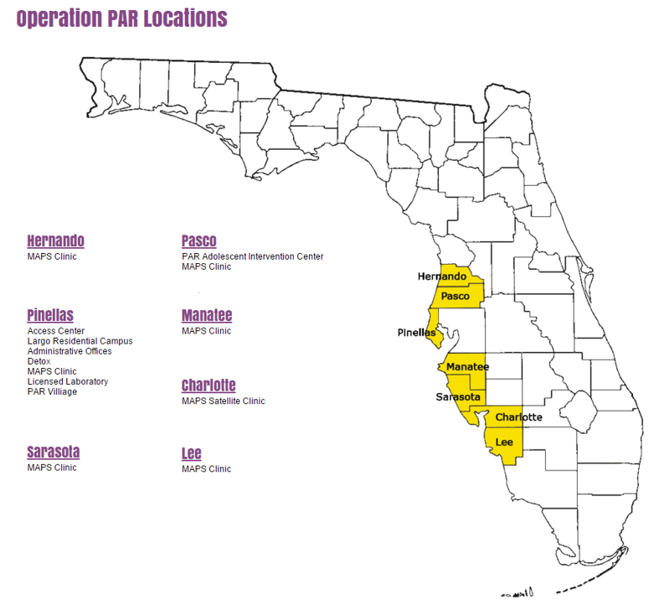
Operation PAR Programs
Operation PAR offers a full continuum of services along the West Coast of Florida
Prevention
Intervention
Detoxification
Opioid Use Disorder Treatment-MAPS
Adolescent and Adult Outpatient and Residential Treatment

Slide 3
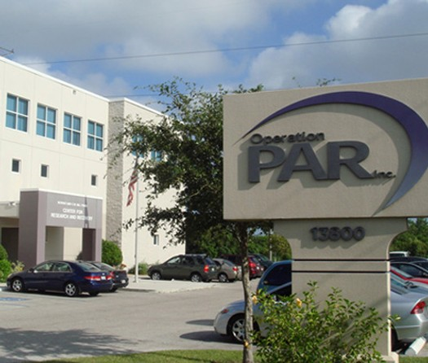
Outpatient Services
Telebehavioral Health
How we began
TCE TAC Federal Grant
1 Counselor and 1 Case
Manager
Started with a video conferencing platform
Created a manual
Safety Checklist
Created Telebehavioral health 2-day training
Started serving within all of outpatient

Slide 4
Project Successes
Using Fed Ex and couriers to enroll clients without physically being in front of them
Open Fridays have given clients added schedule flexibility to meet with counselors
Expanded counseling services to include couples and family as an adjunct to Substance Abuse Counseling
Ability to coordinate services across the state in a cost-effective manner
Contract with local homeless provider to provide Behavioral Tele-Health to their clients
Increased Infrastructure, i.e., agency Wi-Fi
Qualified Behavioral Tele-Health Counselors Across the Agency
Expand technology to all programs across the agency including Adolescent Services
Trained Community Mental Provider therapists for co-occurring client treatment across organizations

Slide 5
Required 20 hours of training for Florida CET with a
Focus on Real World Experiences
In depth Coverage:
Ethics in Behavioral Tele-Health
Clinical Principles/Treatment Modalities
Legal and Jurisdictional Issues
Communication specific to Behavioral Tele-Health
Technology Practice

Slide 6
Session Checklist
Orientation
Technology check
Phone number
Location
ICE

Slide 7
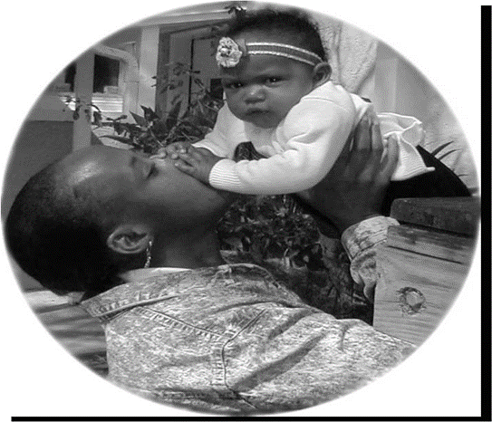
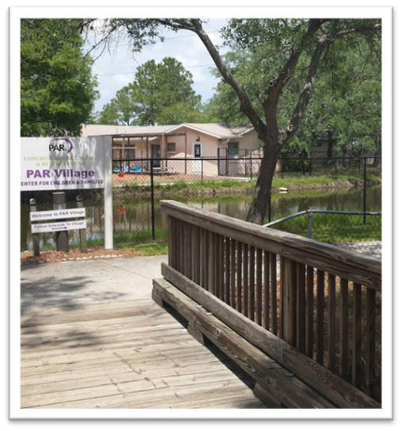
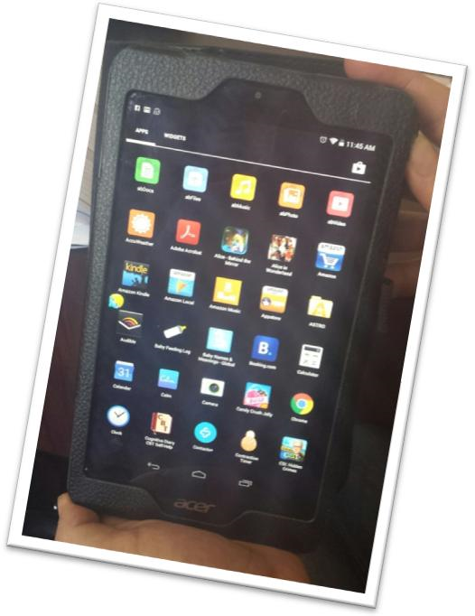
Adult Residential Services Behavioral Tele-Health Innovation

Slide 8
Paradigm Shifts in Treatment Programs
From
Protect them at all costs
They need time away from the world to heal
To
We can’t keep clients in a bubble
Safe failures
No distractions from working on self
No contact with bad influences
Bringing positive out of negative
Teaching Moments

Slide 9
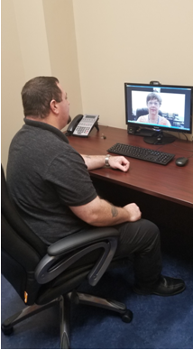
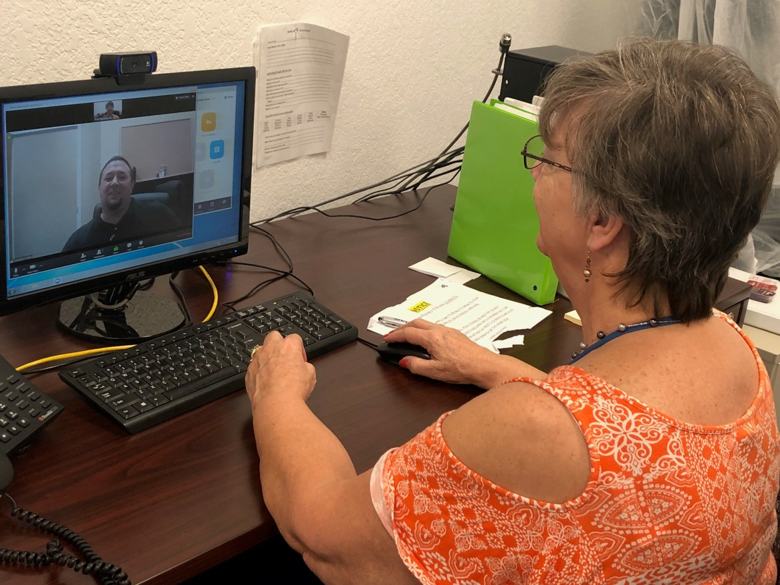
Opioid Treatment Program Satellites / Medication Units
In order to accommodate the counseling requirements for patients who are unable or unwilling to routinely drive long distances to reach the primary OTP, we utilize behavioral telehealth (via Zoom.us software).
N. Ft. Myers
(primary OTP)
Pt. Charlotte
(satellite)

Slide 10
Opioid Treatment Program Satellites / Medication Units
Patients coordinate their counseling schedule with their assigned Primary Counselor at the primary OTP.
When the patients check-in at the satellite on the day of their scheduled counseling session, the satellite staff contacts the patient’s counselor and sets up the secure video conferencing session with the counselor in one of the designated telehealth offices.
The Zoom platform allows the counselor to share their screen to be able to show the patient any relevant documents or educational materials.
If the patient has to sign any treatment documents (e.g., treatment plans, releases of information, or consent forms), the counselor coordinates with the satellite staff so they can either print documents for the patient to physically sign (which are then scanned & emailed back to the counselor) or set them up to electronically sign a document on an electronic signature pad.
Drawbacks / Challenges
Accommodating unscheduled counseling sessions .
Potential for loss of connection mid-session (or spotty connection).
Limited ability to detect signs/symptoms of impairment

Slide 11
Assessing Appropriateness
The Clinician
Foundation of Clinical Skills
Experience
Supervision
Clinicians will be called on for skills and information typically not asked in F2F treatment

Slide 12
Assessing Appropriateness
The Client
Their feelings about Behavioral Tele-Health
Computer
High-Speed Internet Access
Motivation to participate in Behavioral Tele-Health
Safety of self and others
Ability to participate

Slide 13
The Client:
When is it not ok?
Actively suicidal/homicidal?
Psychotic?
Under the influence/intoxicated?
Active thought Disorder?
Not stabilized on medication?
Inconsistent attendance/consistent cancellations?

Slide 14
Expect the Unexpected

Slide 15
Post COVID
Within a matter of 2 weeks, all programs moved to various levels of Telebehavioral Health
Counselors began working from home-new process and new safety procedures

Slide 16
Post COVID
We needed to develop virtual groups-new safety
checklist
How would we conduct drug screens?
Social distancing in the residential programs led
to 10 or less in a room and the rest of the group
participating via telehealth
All visitation via video conferencing
Needed more tablets

Slide 17
What we have learned
MAPS clinics have used far more phone sessions than video-data collection from all programs
Outpatient services had a 33% no show rate Jan-Feb and a 15% no show rate March-May
Zoom channels for on-going virtual communication and safety
Survey to staff regarding working from home and the use of telehealth-we are in a new virtual world

Slide 18
Presenter Contact Information
Sandnes Boulanger, LCSW, MCAP, CET
sboulanger@operpar.org

Slide 19
Expert Guidance for Use of Videoconferencing: Best Practices for Safe and Effective Service Delivery
CoE-PHI Presentation to NASADAD
Thursday June 4th, 2020
3:00 – 4:30PM EST
Notes:
MG

Slide 20
Center of Excellence for Protected Health Information
Funded by SAMHSA, the CoE-PHI develops and disseminates resources, training, and TA for states, healthcare providers, school administrators and individuals and families to improve understanding and application of federal privacy laws and regulations, including FERPA, HIPAA, and 42 CFR Part 2, when providing and receiving treatment for SUD and mental illness.
Resources, training, technical assistance, and any other information provided through the CoE-PHI do not constitute legal advice.
Notes:
MG- COE PHI is funded by SAMHSA to assist people and organizations in understanding and applying current federal privacy laws and regulations on the job, specific to their task or role, and assist patients and families in knowing what their rights are when seeking and receiving treatment.

Slide 21
Presenters
Name | Title
Christine Khaikin, JD | CoE-PHI Health Privacy Associate
Caroline Waterman, MA, LRC, CRC | CoE-PHI SUD Project Lead
Jacqueline Seitz, JD | CoE-PHI Health Privacy Lead
Michael Graziano, MPA | CoE-PHI Project Director
Notes:
MG

Slide 22
Presentation Objectives
Identify basic requirements of
42 CFR Part 2 and HIPAA
Explore recent changes to federal privacy laws outlined in the CARES Act
Explore privacy law application to telehealth in accordance with recently released SAMHSA and OCR guidance
Describe how to access resources and TA provided by the CoE-PHI
Notes:
MG
Identify basic requirements of 42 CFR Part 2 and HIPAA
Explore recent changes to federal privacy laws outlined within the CARES Act
Explore privacy law application to telehealth in accordance with recently released SAMHSA and OCR guidance
Describe how to access resources and TA provided by the Center of Excellence for Protected Health Information (CoE-PHI)

Slide 23
Federal Privacy laws
OVERVIEW
Notes:
LAC

Slide 24
HIPAA
42 CFR Part 2
Applies to covered entities (healthcare providers, health plans, healthcare clearinghouses) and BAs
Protects privacy and security of general health information
Purpose: to protect health data integrity, confidentiality, and accessibility
Permits disclosures without patient consent for treatment, payment, and healthcare operations
Applies to SUD patient records from federally-assisted “Part 2 programs”
Protects privacy and security of records identifying individual as seeking/receiving SUD treatment
Purpose: to encourage people to enter and remain in SUD treatment by guaranteeing confidentiality
Requires patient consent for treatment, payment, and healthcare operations, with limited exceptions
Notes:
LAC
See also: state laws, state licensing requirements, ethical requirements
Both HIPAA and Part 2 apply to information shared via telehealth
But no specific rules in HIPAA or Part 2 regarding telehealth

Slide 25
Changes to Part 2 in CARES ACT
OVERVIEW
Notes:
LAC

Slide 26
Changes to the Law and Regulations
Statute 42 USC § 290dd-2 | Regulations 42 CFR Part 2
March 27, 2020 – Congress amended statute | August 26, 2019 – SAMHSA proposed changes to regulations; CARES Act requires new regulations
Effective: March 27, 2021 | Effective: pending
Notes:
LAC
Explain Statute is the law, and then regulations clarify and explain the law.

Slide 27
Changes in the CARES Act
Still requires initial patient consent to disclose protected SUD records
After initial consent, some re-disclosures permitted:
For treatment/payment/healthcare operations (“TPO”) by HIPAA covered entities, business associates, and Part 2 programs
Patient still has right to revoke initial consent
Notes:
LAC

Slide 28
Poll Question #1
True or False: The CARES ACT repealed 42 CFR Part 2.
True
False
Not Sure
Notes:
LAC

Slide 29
Poll Question #1 Answer
False: The CARES Act makes some changes to the SUD privacy law, and will require future changes to the Part 2 regulations.
The CARES Act goes into effect March 27, 2021.
The CARES Act does not repeal the SUD privacy law or regulations.
Notes:
LAC

Slide 30
COVID-19 and Telehealth
PHI regulations protect patient privacy, give you flexibility to provide the best possible treatment, and help clarify the boundaries in protecting and sharing patient information.
Notes:
LAC

Slide 31
Poll Question #2
What methods are you currently (or considering) using to provide telehealth services?
*please check all that apply
HIPAA-compliant video communications (e.g.; Skype for Business, Updox, Zoom Health, WebEx, GoTo Meeting)
Other video communications (e.g.; Apple FaceTime, Facebook Messenger video, Google Hangouts, Zoom, Skype)
Encrypted text messaging
Phone calls
other
Notes:
Caroline

Slide 32
Privacy Considerations for Telehealth During COVID-19
How do privacy laws apply?
How to protect privacy and security at:
Provider’s location
Patient’s location
Notes:
LAC

Slide 33
HIPAA
42 CFR Part 2
Applies to covered entities (healthcare providers, health plans, healthcare clearinghouses) and BAs
Protects privacy and security of general health information
Purpose: to protect health data integrity, confidentiality, and accessibility
Permits disclosures without patient consent for treatment, payment, and healthcare operations
Applies to SUD patient records from federally-assisted “Part 2 programs”
Protects privacy and security of records identifying individual as seeking/receiving SUD treatment
Purpose: to encourage people to enter and remain in SUD treatment by guaranteeing confidentiality
Requires patient consent for treatment, payment, and healthcare operations, with limited exceptions
Notes:
LAC
See also: state laws, state licensing requirements, ethical requirements
Both HIPAA and Part 2 apply to information shared via telehealth
But no specific rules in HIPAA or Part 2 regarding telehealth

Slide 34
OCR Bulletin: COVID-19
OCR announced it will waive potential penalties for HIPAA violations arising out of good-faith use of telehealth:
Providers may use popular video chats, like FaceTime, Messenger, Google Hangouts, Zoom, or Skype
Providers do not need to have a BAA in place
Does not matter whether telehealth service is directly related to COVID-19
If possible, still best practice to use secure, HIPAA compliant services and have BAA in place
Notes:
LAC
Orally- bad faith would include fraud, using public facing apps such as tiktok or twitch, or using or disclosing data obtained through telehealth visit in impermissible ways.
- Good practice to use HIPAA compliant apps and have BAA in place- but no penalties if not.

Slide 35
SAMHSA guidance and Part 2
Notes:
LAC

Slide 36
Quick Review: 42 CFR § 2.51 Medical Emergencies
Part 2 permits disclosures w/o written consent to medical personnel in order to treat a bona fide medical emergency
Information may be re-disclosed for treatment purposes
Cannot use this provision to “override” patient’s objection to a disclosure
Part 2 program must make note in patient file regarding disclosure
Notes:
LAC

Slide 37
SAMHSA Guidance: COVID-19
SAMHSA’s COVID-19 Part 2 Guidance emphasizes that providers have discretion to determine whether bona fide medical emergency exists
Notes:
LAC
emphasize the main points of the ME exception - only to medical emergency personnel
with SAMHSA guidance, consent may not be able to be obtained due to COVID-19 emergency

Slide 38
Key Points
SAMHSA has not eliminated Part 2’s requirements for written consent to share information
As before - no consent is required in a medical emergency, but SAMHSA has emphasized that providers may determine COVID-19 may meet the requirements
E-signatures and photocopied signatures are okay!
Notes:
LAC

Slide 39
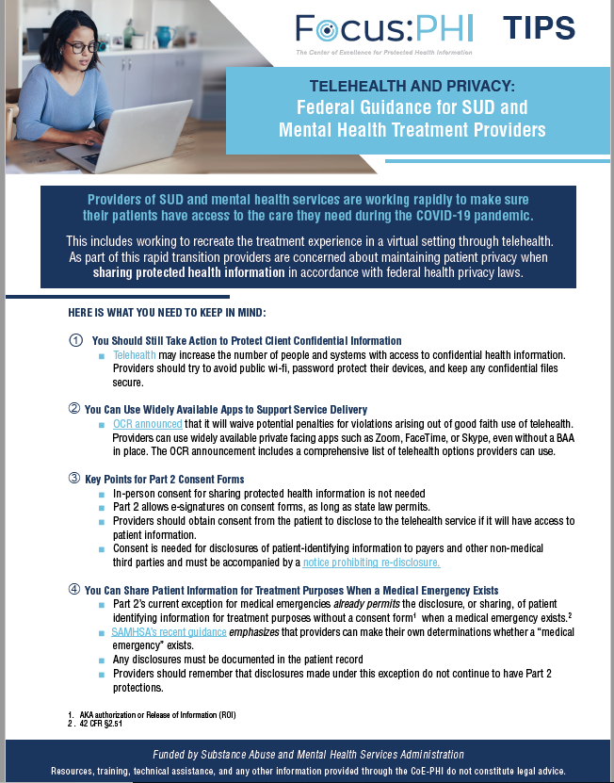
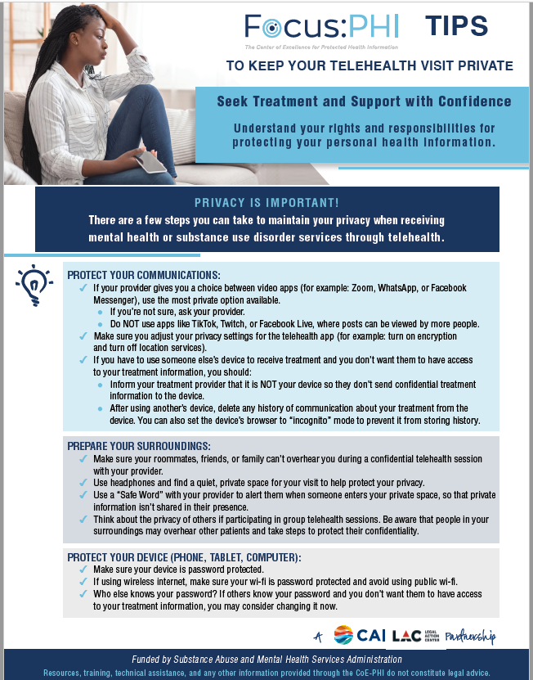
CoE-PHI Telehealth Resources
Link to Provider TH Tips
Link to Client TH Tips
Video - Tips to Keep Your Telehealth Visit Private
Notes:
CAROLINE
The CoE-PHI has recently developed three key telehealth and privacy related resources-- including 2 InFocus Tips Resources to assist in keeping telehealth visits private, one for providers and one for patients.
The Focus PHI Patient Tips resource includes guidance for clients on how to protect their communications, prepare their surroundings in preparation for a TH visit, and protect their devices
The Focus PHI Provider TH Resource includes guidance for SUD and MH Providers on protecting confidential client information, key points for Part 2 consent forms, and information that providers can share with their clients to help them protect their protected health information
Additionally, the CoE-PHI has developed a 2-minute video titled Focus- PHI - Tips for Patients to Keep Their Telehealth Visits Private- which describes three key strategies that clients can use to keep conversations with healthcare providers confidential and we’d like for you to be able to view it here on screen.

Slide 40
Q&A and Discussion
Notes:
Caroline Facilitates, LAC answers questions

Slide 41
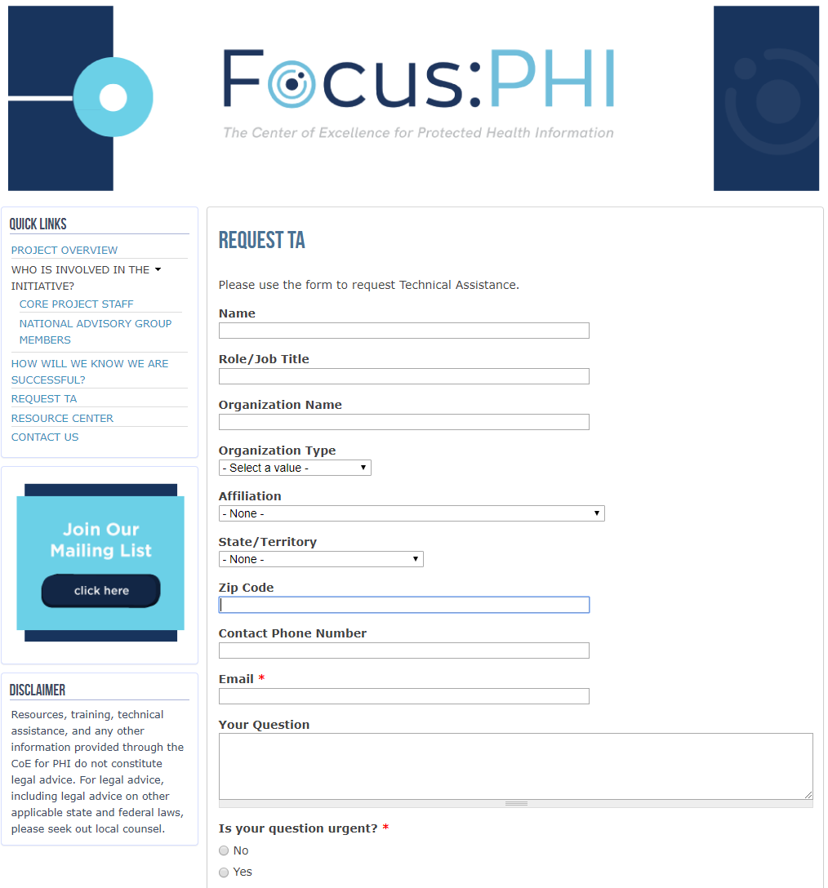
Accessing the CoE-PHI
Request TA
coephi.org/technical-assistance
Resource Library
coephi.org/resource-center
Discussing privacy protections helps the care team to provide the best possible care.
Notes:
MG- we realize that due to the volume of participants, we were likely not able to address all of your questions.
We’re going to be looking through all of your chats and sending answers to all participants of this presentation
We’ll be sharing these slides with all who attended today
We’re here to help you- here’s how you can reach out to us and access our resources…

Slide 42
Webinar Evaluation
Following the conclusion of this webinar, you will be sent a link to complete a brief evaluation.
We value your opinion- please take the time to complete our evaluation!
Notes:
MG

Slide 43
THANK YOU!
Notes:
MG

