Slide 1
Integrated Solid Waste Management Plan Update: Tire Waste
State of Hawaiʻi Solid and Hazardous Waste Branch (SHWB) Office of Solid Waste Management (OSWM): Lane Otsu and Michael Burke
Tetra Tech: Cesar Leon and Christian Ferguson
PBR HAWAII: Catie Cullison, Sunny Rosario, and Ramsay Taum
May 25, 2023

Slide 2
Agenda
Introductions
DOH & Consultant Team
Taskforce
Members of the Public
Purpose of Taskforce and Plan Update
Review current plan and intention for updates
Taskforce’s role in plan updates
Preface schedule and purpose of meetings
Ground rules for productive meetings
Ice Breaker
Please note, this meeting will be recorded

Slide 3
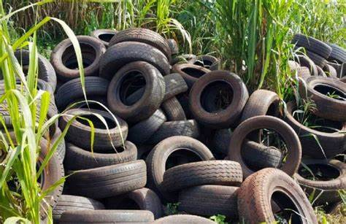
Agenda, cont'd.
Introduction
Solid Waste Stream Topic: Tires
State and County Existing Conditions
Tire Waste Generation
Regulations and Programs
Industry Representative
Potential Solutions Evaluation
States Evaluated
Waste-to-Energy (WTE)
Comparative Analysis
Extended Producer Responsibility (EPR)
Government Programs and Subsidies
Free Market Solutions
Outreach and Education Opportunities
Resource Reduction Alternatives
Feedback Activity

Slide 4
Introductions
State of Hawaiʻi, Department of Health
Project Team Consultants
Taskforce members – roll call
Members of the public
Notes:
Taskforce Intros – this will also serve as our roll call to satisfy sunshine law today, so I will call roll. Taskforce members, please turn your camera on to be counted as present

Slide 5
Purpose of Taskforce and Plan Update
State law mandates an Integrated Solid Waste Management Plan with regular updates and convening this Taskforce (HRS Chapter 342G)
Revise and update material contained in previous plan
With comment from the Taskforce, address other issues of statewide concern regarding integrated solid waste management
Expectation of the Taskforce regarding potential solid waste solutions
Recommendations from the Taskforce

Slide 6
Sunshine Law
The Sunshine Law is Hawaiʻi's open meeting law
The purpose is to help ensure the public can meaningfully participate in the government processes, such as this plan revision
All ISWMP Taskforce meetings are open to the public, and will follow the State's Sunshine Law
NOTE to Taskforce: Discussion on Taskforce business outside the public meeting is prohibited. This includes in-person communications as well as phone, email, and social media communications

Slide 7
Meeting Ground Rules
Acknowledge the contributions of others
Raise hand to speak
Mic off, unless speaking
Engage with an open mind
Listen, then respond
Respect others and their ideas

Slide 8
Icebreaker – Headliner Exercise
Imagine you are reading the Star Advertiser 20 years from now. What would the front page say about how we manage tire waste?

Slide 9
Existing Conditions
State & County

Slide 10
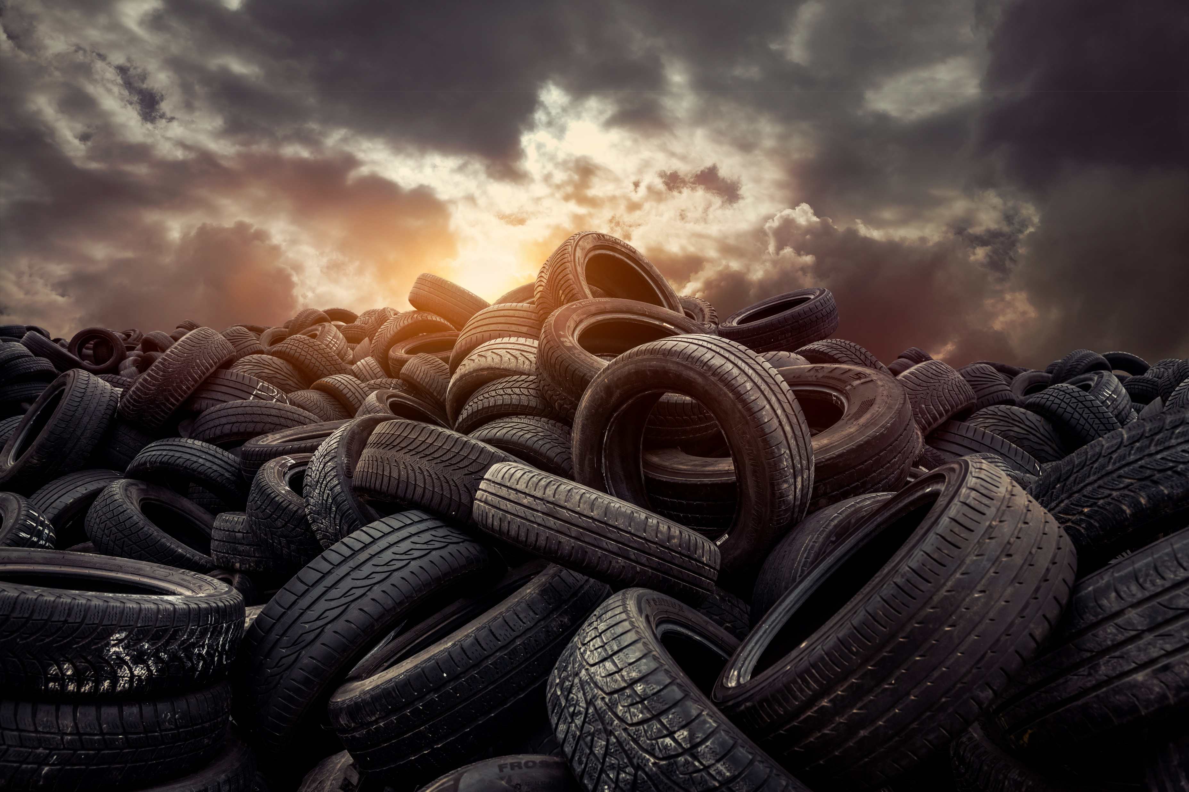
Solid Waste Stream Topic: Tires
More than one million (1,000,000) motor vehicle tires are imported into the State of Hawaiʻi annually, and the disposal of used motor vehicle tires poses a waste management challenge for the State. Motor vehicle tires can create potential health risks when illegally dumped, harboring rodents and vectors (i.e., mosquitoes), or catching on fire. State law bans the landfill disposal or incineration of whole tires and requires retailers to accept old tires and recycle them. However, illegal dumping persists.
Notes:
Their hollow, rounded shape takes up valuable shape in landfills. Additionally, tires often don't stay buried. They can trap gases like methane and then bubble up through landfills, ripping through landfill liners in the process. Also hard to properly compact with dozers and other equipment.

Slide 11
Frustration grows, along with eyesore, as walls of dumped tires fill a private road in Nanakuli (hawaiinewsnow.com)
Motor vehicle tires can create potential health risks when illegally dumped.
Notes:
Example: Nanakuli - There’s about 1,000 or more illegally dumped tires that have been there for quite some time ever since an illegal junkyard got closed down. Tires line a private road. if they take the them to the H-POWER plant or a recycling company, she said the disposal fees will cost thousands of dollars. Some lawmakers are trying to get the city to cover the cost. “I think the waiver would need to be at least $100,000,”

Slide 12
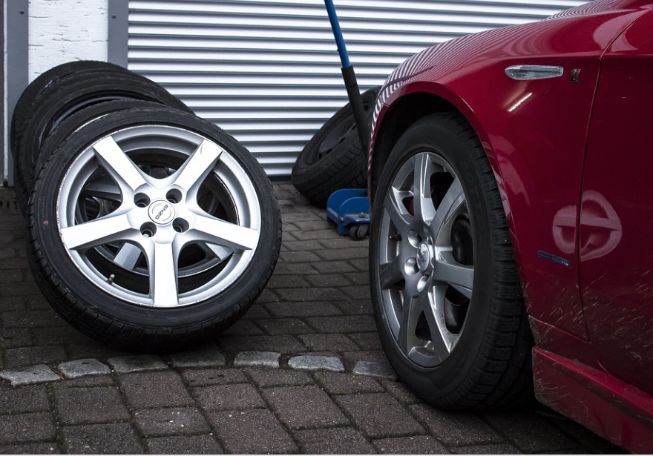
Tires – Overview
The majority of tires imported replace damaged or worn-out tires on existing motor vehicles. Remainder are tires already on new motor vehicles imported into the state.
Customers pay an upfront non-refundable disposal fee and leave their used tires with the retailer/wholesaler.
Permitted recyclers or county establishments (i.e., convenience centers) can also accept used tires (sometimes for a fee) from residents/commercial businesses not purchasing new tires.
Notes:
DOH does not consider incineration as a recycling activity Estimation. User fee helps track metrics.

Slide 13
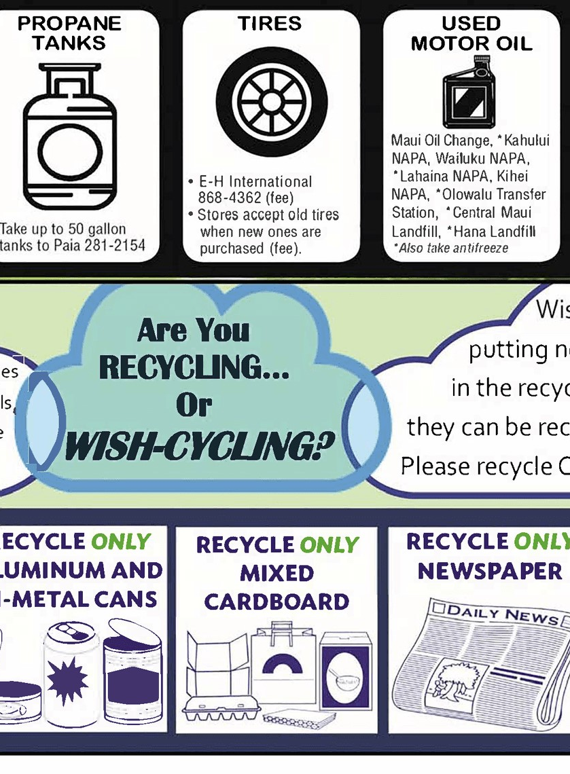
Tires – Overview, cont’d.
Previous State Funding /Revenue Mechanisms
$1.00 motor vehicle tire surcharge on all imported/replacement tires
Implemented in 2000. Purpose was to remove illegal tire dump sites, monitoring and enforcement.
Capped the total amount department able to collect - $3M. Reached in June of 2003.
The department’s authority to collect the surcharge sunset on January 1, 2006.
As of April 2023, the fund balance was $308,786.
January 25, 2023, [HB] 921 was introduced in the Legislature to re-establish the $1.00 surcharge. Bill Status: Deferred in Committee – Not passed into law.
The department is only aware of illegal dumping activity if someone files a complaint with the Solid and Hazardous Waste Branch (SHWB) or by calling 911
Notes:
User Fees help track metrics and prove the effectiveness of programs (see CA, CO, WA)

Slide 14
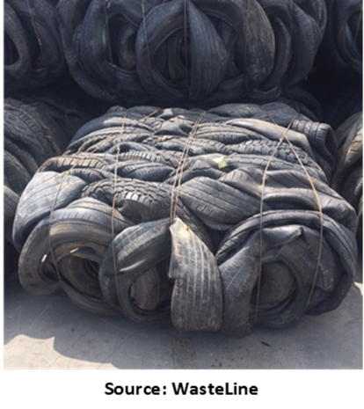
Tires – Disposal/Recycling Data
The DOH tracks some components of the waste tire recycling stream, including tires dropped off at permitted recyclers and convenience centers.
For FY 22, the Hawaiʻi DOH reported that 2,528 tons of tires were recycled statewide (from residential use) in DOH permitted SWM Facilities.
These tonnages do not include:
tires collected by private retailers not sent to a permitted SWM facility for recycling (i.e., were shipped off-island for recycling);
And tires incinerated for energy at H-POWER.

Slide 15
Tires – Estimated Number of Tires Managed
The table below provides an estimated annual number of scrap tires to be managed every year. Estimate developed based on the number of passenger vehicles registered statewide in 2022.
 | Passenger Vehicles | Percent of Tires to be Replaced | Estimated Number of Tires to be Managed Annually | Estimated Tons
State of Hawaiʻi | 1,056,699 | 17% | 718,555 | 7,200
Notes:
Assumptions: Assuming that most tires typically last six years, and the average age of vehicles on the roads in Hawaiʻi is 11.7 years, it is estimated that the State could expect that on average, 17 percent of passenger vehicles will replace one or more tires annually. For purposes of the table, it is assumed that vehicles would replace all four tires at the same time. 20lbs/tire.

Slide 16
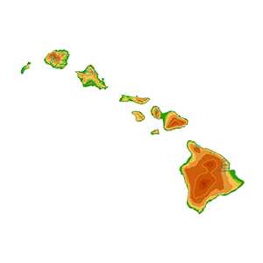
State of Hawaiʻi
Population: 1.44 million
Last Update to ISWMP: 2000
Waste Diversion Data: 7,054 tons/year [2000]
Estimated Number of Registered Passenger Vehicles in 2022: 1,056,699 registered passenger vehicles
Estimated # of Tires to be Managed Annually: 718,555
Notes:
Tires may be a relatively small component of the overall waste stream but is none the less a very difficult item to properly manage given its unique characteristics.

Slide 17
State of Hawaiʻi
Laws & Regulations:
HRS 342I, Part II
HAR Chapter 11-58.1 Solid Waste Management Control
Solid Waste Management Control
Number of Permitted Collectors and Recyclers/Processors: 10
Tire Management Complaints: 25 total, 2 significant (2018 – 2023)
Former Tire Surcharge: Section 342I-27, HRS, previously allowed for the collection of a $1 surcharge per imported tire until the state collected $3M, which occurred by 2003. The fund was primarily used to remove tire piles.
Notes:
HRS Section 342I-22 prohibits the disposal of whole tires at any landfill, incinerator, and all island-wide transfer stations, as well as the illegal dumping of tires on public and private property and bodies of water. The law requires dealers to accept old tires and recycle them or use them in landscaping, or as tire-derived aggregate (TDA) for use in construction projects. Customers are required to pay for tire disposal upon point of purchase even if they decide to keep their old tires.
HAR 11-58.1: Scrap automobiles, .white goods, and tires. Scrap automobiles may not be accepted at disposal facilities permitted under these rules. White goods and motor vehicle tires may not be accepted at disposal facilities permitted under these rules after June 30, 1994. A plan must be developed by the operator of solid waste disposal facility and included in the facility operations plan to implement this ban.

Slide 18
County of Hawaiʻi
Population: 201,000
Last Update to ISWMP: 2019
Waste Characterization Data: 1,124 tons disposed (0.5% of total waste composition) 2008 data
Waste Diversion Data: In FY 2022 – 2023, 57 tons of tires were diverted by the DEM. No data on other gov agencies or private tire recyclers ​
Estimated Number of Registered Passenger Vehicles in 2022:: 186,259
Estimated # of Tires to be Managed Annually: 127,000
Notes:
Per the County’s 2019 ISWMP, scrap tires generated in the County are used as energy feedstock and processed at O‘ahu’s H-Power and AES Hawai‘i Inc. WtE facilities. However, the County has not shipped tires to H-Power in several years and the AES facility closed on September 1, 2022 as part of the State’s goal to reduce greenhouse gas emissions

Slide 19
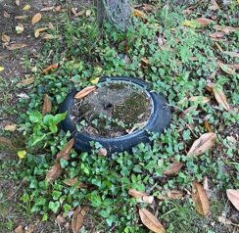
County of Hawaiʻi
County Ordinances: Admin Rules §2-1-3 Prohibits the disposal of whole tires at the sanitary landfill reload facility and island wide recycling and TS's.
County Programs and Funding: The County has established a tire recycling educational program that targets both businesses and the general public. Radio/newspaper ads along with signs are used to inform businesses and the public of the program.
Permitted Collectors/Retailers and Recyclers/Processors:
Big Island Scrap Metal (Keaʻau & Kona)
Goodyear Auto Service Centers, Hilo
Leo’s Rubbish Service (Hilo)
R & G Tire Center, Inc. (Kona)
Notes:
Ordinance Prohibits the disposal of whole, cut, sliced, chipped, or shredded tires at both sanitary landfills and island wide recycling and transfer stations.

Slide 20
City and County of Honolulu
Population: 1.02 million
Last Update to ISWMP: 2019
Waste Characterization Data: Estimated 828 tons of tires between Sep 2016 and Aug 2017 (approximately 0.1% of the overall waste stream)
Waste Diversion Data: In FY 22, 34,539 tires were accepted at the City’s refuse disposal sites (i.e., transfer stations and convenience centers)
Estimated Number of Registered Passenger Vehicles in 2022:: 631,568
Estimated # of Tires to be Managed Annually: 430,000

Slide 21
City and County of Honolulu
City/County Ordinances: City Ordinance, Chapter 9-1.7 (Collection and Disposal of Refuse – Acceptable and Non-acceptable Refuse at Disposal Facilities) - tires are banned from all Citywide disposal facilities.
County Programs and Funding: Disposal Clearance Waiver -exemption from disposal charges for 1-day solid waste cleanup events.
Permitted Collectors/Retailers and Recyclers/Processors:
H-Power WtE Facility (conditional variance)
Unitek Solvent Services
Kapaʻa TS
Kawailoa TS
Island Recycling
Retired Tires
Notes:
Tires are banned from all Citywide disposal facilities.
H-Power has a conditional variance from the DOH to accept used auto tires delivered from refuse and convenience centers/bulky collection crews/illegal tire clean up events. This variance allows H-POWER to receive and process up to 400 tires per day (or 65,000 annually) at the Waste to Energy (WtE) facility. Covanta shall not process commercially-accepted or commercially-generated tires. Variance ends in Feb 2026.

Slide 22
County of Kauaʻi
Population: 73,200
Last Update to ISWMP: 2021
Waste Characterization Data: In FY 2016, approximately 9 tons of tires were disposed (>0.1% of total waste composition)
Waste Diversion Data: In FY 22, the County tracked 16,734 tires collected via recycling contract with Unitek
Estimated Number of Registered Passenger Vehicles in 2022:: 75,765
Estimated # of Tires to be Managed Annually: 51,500

Slide 23
County of Kauaʻi
County Ordinances: Kauaʻi County Code (KCC) Sec. 21-3.2, 3.3 and 7.3
Under certain conditions, the Department of Public Works may accept used passenger car and light truck tires from residential self-haulers only at RTS.
Under certain conditions, the County Engineer may approve the use of county-owned tires whether chipped, chopped or shredded for daily landfill cover.
County Programs and Funding: Program cost approximately $155,000/year. Anticipate higher costs in the future due to increased shipping costs and other costs of doing business. Funding for this program comes from the County’s general fund.
Permitted Collectors/Retailers and Recyclers/Processors:
Four Refuse Transfer Stations
Kekaha Landfill
Unitek Solvent Services
Notes:
Refuse Transfer Stations (RTS) and County landfills may not accept used motor vehicle and heavy equipment whole, cut, sliced, chipped, or shredded motor vehicle and heavy equipment tires, except for whole automobile and passenger truck tires from residential self-haulers for recycling for consolidation and further processing.

Slide 24
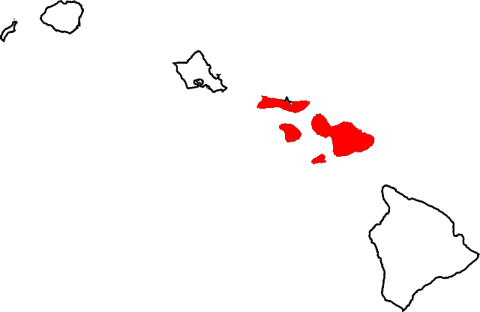
County of Maui
Population: 165,000
Last Update to ISWMP: 2023 {not released}
Waste Characterization Data: (1994) 685 tons of commercial and residential tires combined - 0.4% of total MSW
Waste Diversion Data: FY 2009 – 2014: 8,011 tons of tires diverted
Estimated Number of Registered Passenger Vehicles in 2022: 163,110
Estimated # of Tires to be Managed Annually: 111,000

Slide 25
County of Maui
County Ordinances: None Identified
County Programs and Funding: The County currently bans disposal of tires at landfill facilities. Tires can be taken to permitted facilities for a fee.
Permitted Collectors/Retailers and Recyclers/Processors:
1. E-H International; 2. Unitek – Kahului; 3. Olowalu Recycling and Refuse CC; 4. Molokaʻi Metals; 5. Maui Tire Recycling, LLC.
Planning Issues:
Recycling practices for tires are generally adequate.
Areas of concern include large tire stockpiles, tires illegally dumped on public/private property, and small quantities of tires stored by residents and businesses for disposal or recycling at an indeterminate date.
State funding for implementation of residential tire disposal programs should be considered.

Slide 26
Challenge Identification Activity
What gaps in our existing plans do you observe?

Slide 27
Industry Representative
Joaquin Wright
Tire Derived Aggregate Specialist

Slide 28
Industry Representative
Pathways for End of Life Tires (ELTs)
Speaker: Joaquin Wright
Bio: Joaquin Wright is a Technical Director, Sustainable Resource Engineer, and a Tire Derived Aggregate (TDA) specialist for GHD Inc.

Slide 29
Potential Solutions Evaluation
Out-of-State

Slide 30
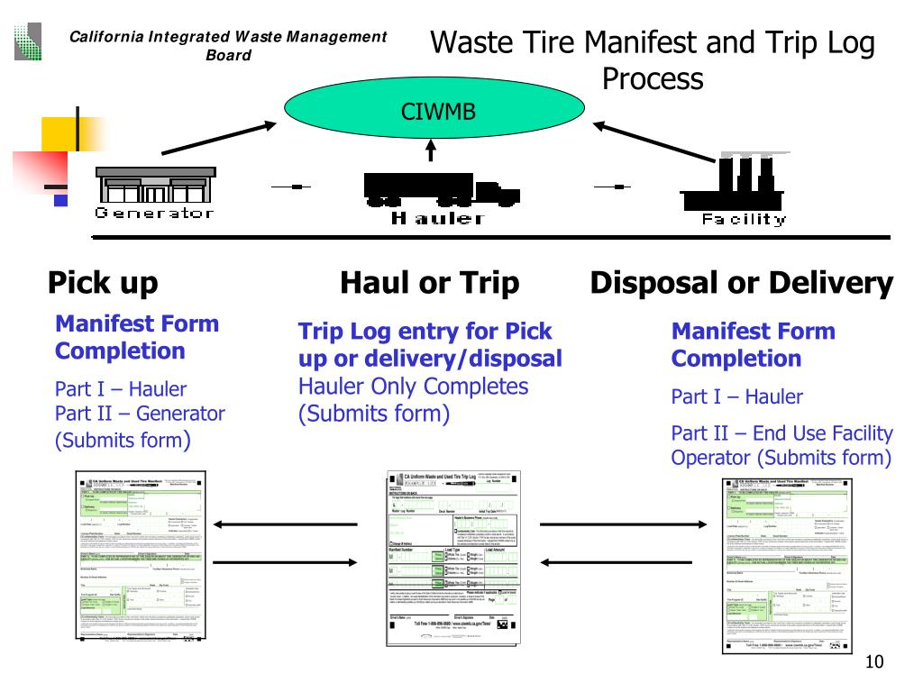
State of California
Statutory Regulations
AB 1843 (1989) California Tire Recycling Act
SB 744 (1993) Waste Tire Hauler and Manifest Program
SB 876 (2000) Five-Year Plan for Waste Tire Management and Recycling

Slide 31
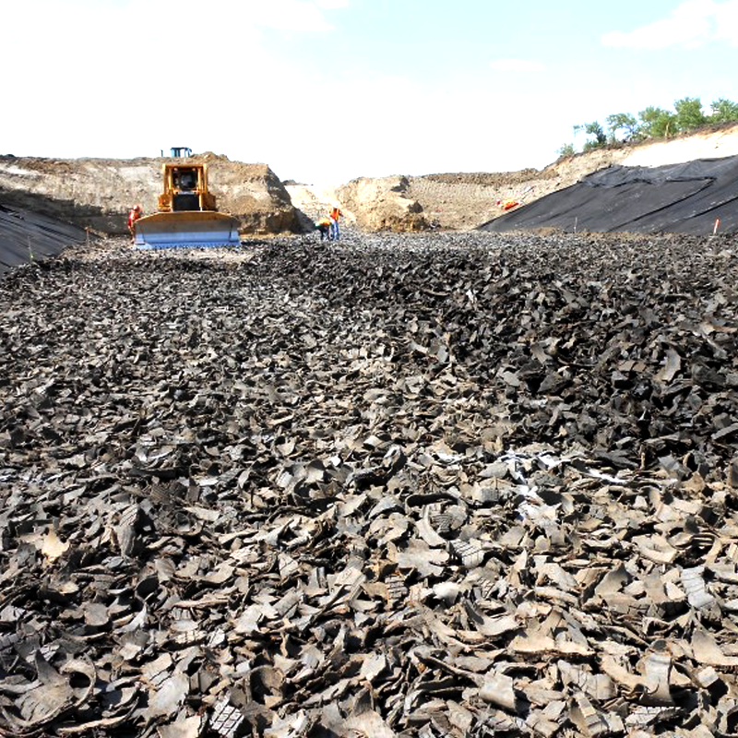
State of California
Programs
California Uniform Waste and Used Tire Manifest
Storage Requirements
Inspection/Enforcement (generators, haulers, and processing facilities)
Outreach and Education (Tire Conference)
Grants/Subsidies
Tire-Derived Products (TPD) Studies
Funding Structure
$1.75 California Tire Fee Program (includes new vehicles and replacement tires)

Slide 32
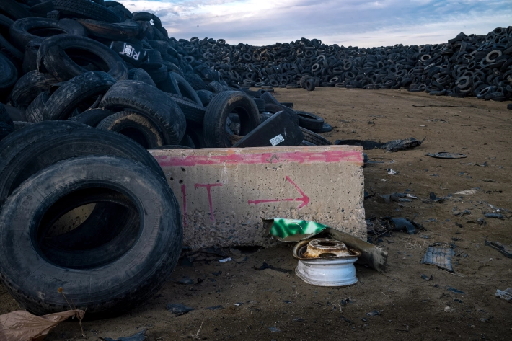
State of Colorado
Statutory Regulations
HB 05-1126 (2005) Waste Motor Vehicle Tire Hauler Act
SB 09-289 (2009) Point of Sale Fee Collection
HB 10-1018 (2011) New Manifest Requirements for Haulers and Retailers
HB 1352 (2014) Tire Monofills Phase Out
SB 19-198 (2019) Continued Management of Waste Tires

Slide 33
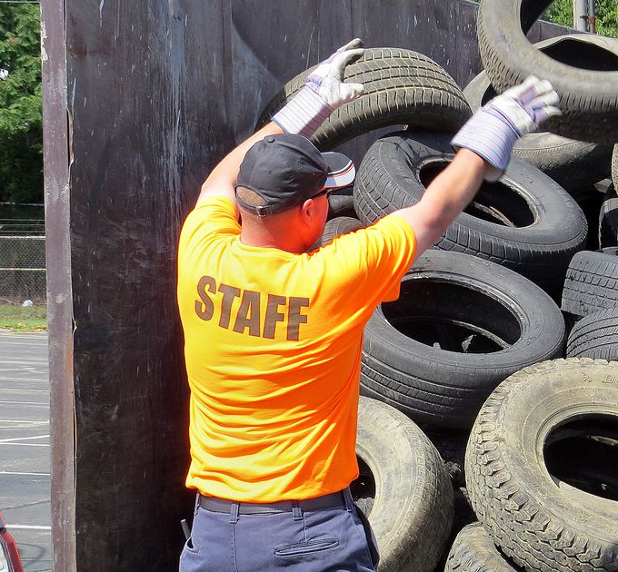
State of Colorado
Programs
Colorado Waste Tire Fee Program
Waste Tire Administration
Regulation Enforcement
Waste Tire Removal Services
Market Development
Grants/Subsidies
Waste Tire Inspection Grant Program
Illegal Waste Tire Cleanup Grant Program
Collection Events
Funding Structure
$0.55 Waste Tire Administration Fund
$1.25 Waste Tire End User Fund

Slide 34
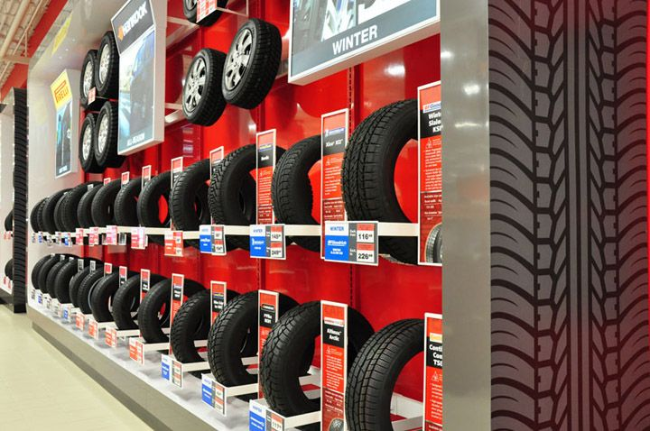
State of Washington
Statutory Regulations
HB 1671 (1989) “Waste not Washington” Act – Established $1 Fee on Retail Sales of New Tires
HB 2085 (2005) Reinstated the Tire Fee Program
Washington Administrative Code (WAC) 458-20-272 Tire Fee, Studded Tire Fee, and Fee on Core (Title 70A, Chapter 205)

Slide 35
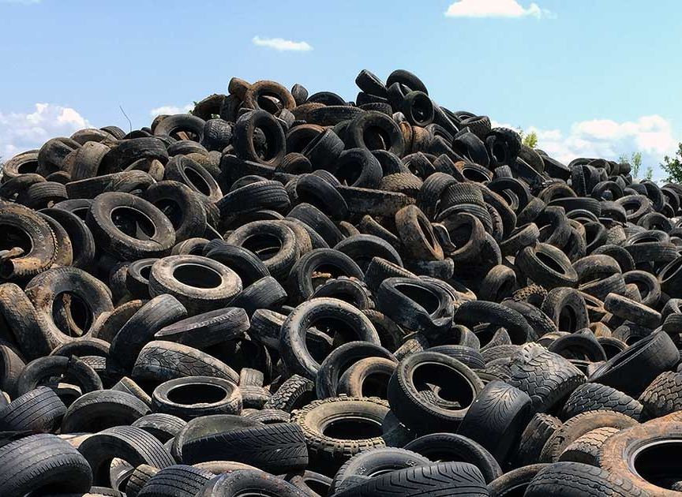
State of Washington
Programs
Washington Waste Tire Fee Program
Waste Tire Removal Services
Waste Tire Pile Prevention Assistance
Outreach and Education
Grants/Subsidies
Funding Structure
$1.00 Washington Tire Fee Program
$5.00 Studded Tire Fee

Slide 36
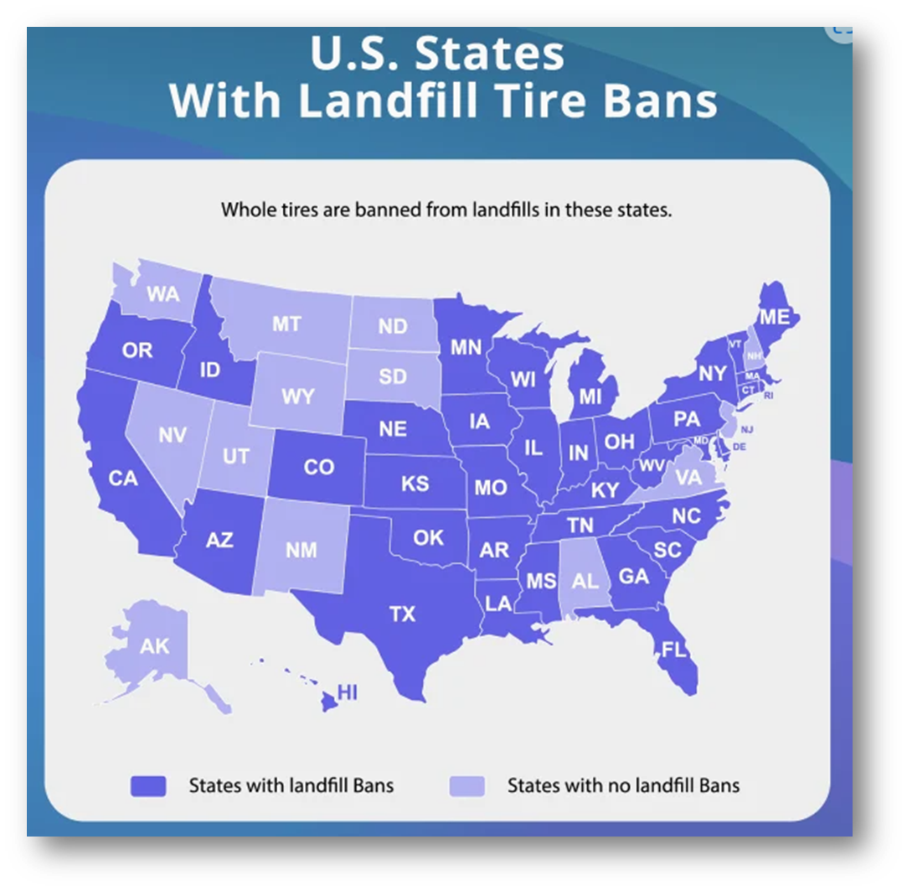
Notes:
Map source: Where To Recycle Tires + State-by-State Disposal Fees - Tire Reviews, Buying Guide & Interesting Facts - Utires.com
See for additional stats: https://archive.epa.gov/epawaste/conserve/materials/tires/web/html/basic.html (last updated 2016)
https://www.ustires.org/sites/default/files/2019%20USTMA%20Scrap%20Tire%20Management%20Summary%20Report.pdf (last updated 2020)

Slide 37
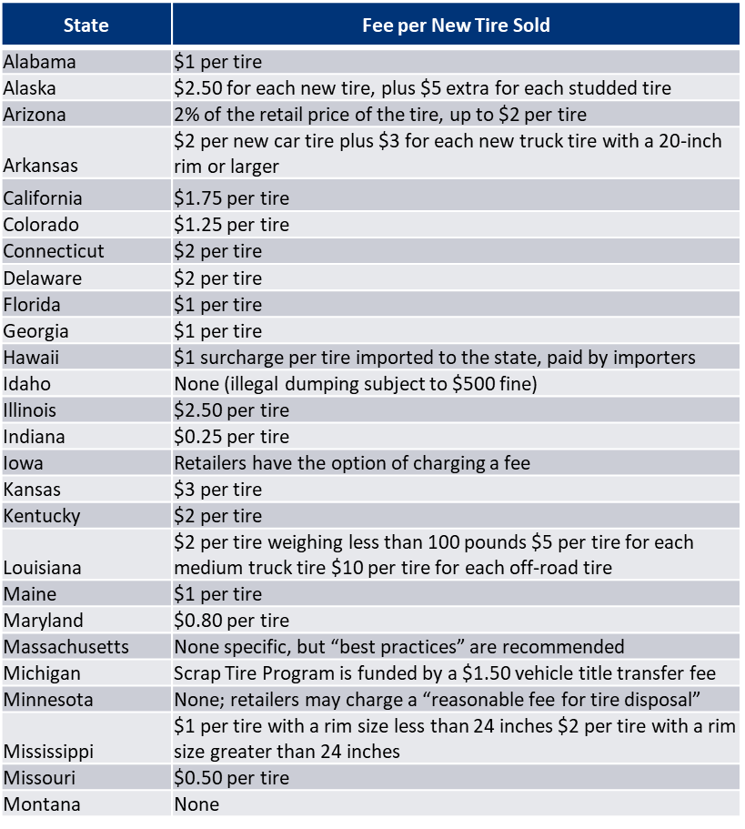
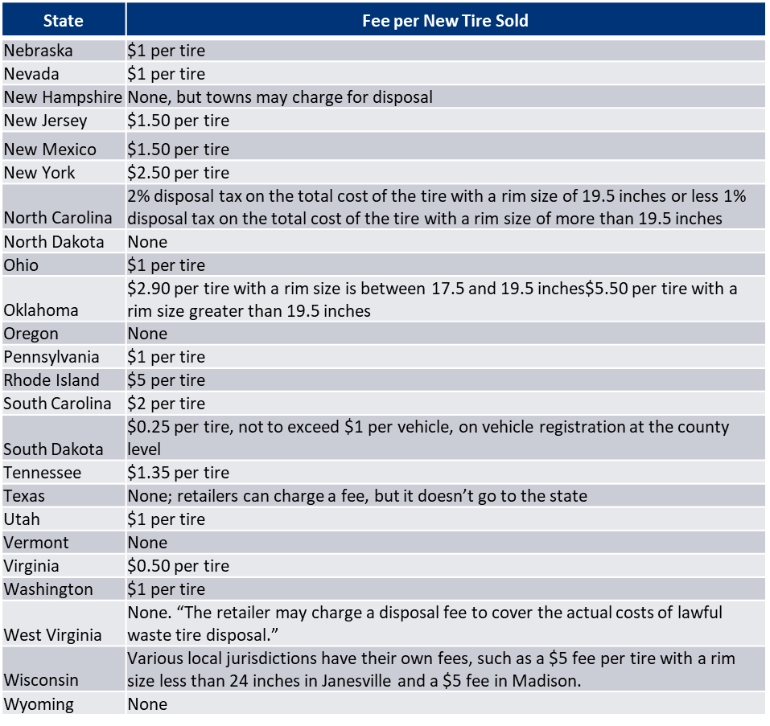
List of State Tire Fees (as of Jan. 2020)
Notes:
Source: Where To Recycle Tires + State-by-State Disposal Fees - Tire Reviews, Buying Guide & Interesting Facts - Utires.com

Slide 38
What Happens to Used Tires in the U.S. (2022)?
Tire-Derived Fuel (TDF) = 37%
Source: U.S. Tire Manufacturers Association
Notes:
According to the U.S. Tire Manufacturers Association, used tires that don’t end up in a landfill are most often used for tire-derived fuel, ground rubber or civil engineering projects.

Slide 39
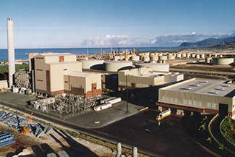
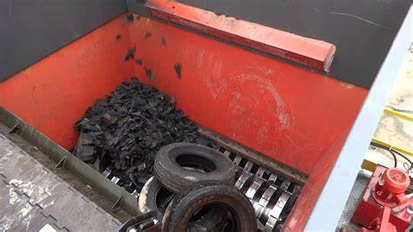
Tire Derived Fuel (TDF) and Waste-to-Energy (WtE)
AES Coal Fired Plant shut down in Sept 2022 (TDF was used occasionally in small amounts)
H-POWER Honolulu (Tires from Honolulu County – Existing Variance)
Tires to TDF (cut/shredded tires)
H-POWER Honolulu
Notes:
(State): AES TDF was utilized in small percentage at certain times during operation. They were not accepting TDF during the entire life of operation. AES could only accept up to 2% coal alternative and TDF was not always available. Sometimes was cheaper to bale and ship

Slide 40
Potential Solutions
Comparative Analysis
Notes:
Hawaiʻi has rules and regulations currently in place to manage tire waste on the various islands. However, more can be done to manage this specific waste stream, and the underlying problems involved with illegal dumping, improper record keeping, and the program direct and indirect costs. This section will explore potential solutions relating to the management of tire waste across the state, including potential EPR legislation, government programs and subsidies, free market solutions, public education components, and resource reduction alternatives.

Slide 41
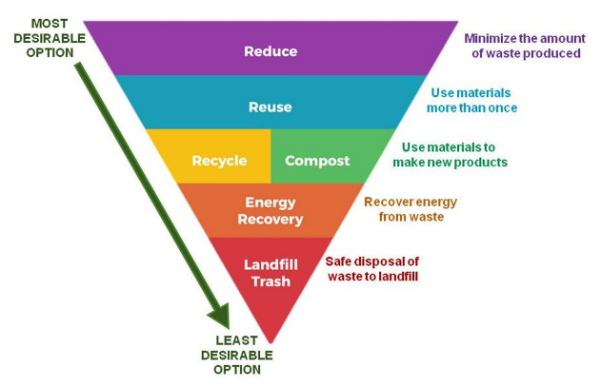
EPA Waste Hierarchy
Sustainable Materials Management
Notes:
EPA Waste Hierarchy since 1970s
There are many strategies to reduce waste. The EPA has categorized and prioritized these strategies by most effective to least effective. Starting with the most effective:
Reducing waste means taking less and therefore disposing of less. There are many ways to reduce but we can start by learning how to not need something because we came prepared or by asking ourselves if we can go without.
Reusing items slows the process of taking and disposing. We can reuse materials that were meant to be disposed of, giving them a second life, or we can choose materials that were meant to be reused and make sure we take good care of them so they can be used many more times.
Recycling the materials of items keeps valuable materials in the materials economy and lets us skip that environmentally disastrous extraction process of raw materials, which benefits the economy and the planet.
_____________________________________________________________________________
A circular economy keeps materials, products, and services in circulation for as long possible. The Save Our Seas 2.0 Act refers to it as an economy that uses a systems-focused approach and involves industrial processes and economic activities that are restorative or regenerative by design, enables resources used in such processes and activities to maintain their highest value for as long as possible, and aims for the elimination of waste through the superior design of materials, products, and systems (including business models).
Circular Economy Hierarchy: Source – Zero Waste International Alliance, Zero Waste Hierarchy of Highest and Best Use 8.0
Guiding Questions:
Rethink/Redesign – What has led us to our present linear use of materials and thus, what needs to evolve to move towards a closed loop model? How do we re-design systems to avoid needless and/or wasteful consumption?
Reduce – What supports the use of less material and less toxic material?
Reuse – What supports the better use of those products we already have in ways that retain the value, usefulness and function?
Recycle/Compost - How do we ensure materials are put back in the materials cycle?
Material Recovery – What was salvaged from mixed waste?
Residuals Management – What is still left and why? What do we need to take out of the system that should not have been circulated in the first place? How do we manage what is left in a flexible manner that continues to encourage movement towards Zero Waste?
Unacceptable/Regulation - What systems and policies encourage wasting and should not occur?

Slide 42
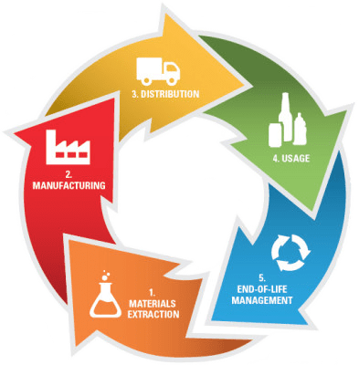
Solid Waste Management Stream: Solution Categories
Extended Producer Responsibility (EPR)
Manufacturers and/or distributors are compelled to address impacts of their own products on the waste stream.
Government Programs and Subsidies
Includes revisions to existing statutes and adjustment to existing State programs and personnel.
Free Market Solutions
Includes identification of new or expanded local market opportunities for recycling.
Considers Hawai’I’s remote geography and related logistic and infrastructure challenges.
Outreach and Education
Identification of potential outreach opportunities.
Less Wasteful
Identification of less wasteful alternatives.
EPR also extends to retailers, consumers, and a state or local government’s existing infrastructure to find cost-effective solutions.
Implementing new government regulations and/or prohibitions.
Examples: Advance Disposal Fee, Deposit Program, and Expanded Government Services.
Identification of potential education opportunities.

Slide 43
Extended Producer Responsibility (EPR)
EPR is “an environmental protection strategy aimed at decreasing total environmental impact from a product and its packaging, by ensuring that the producers of the product take responsibility for the entire lifecycle of their products through the take-back, recycling, and final disposal of their products, including its packaging.”
Notes:
According to the US EPA, EPR, or product stewardship, recognizes that product manufacturers must take responsibility to reduce both the short and long term environmental footprint of their products. This product stewardship also extends to retailers, consumers, and a state or local government’s existing solid waste infrastructure to find cost-effective solutions.

Slide 44
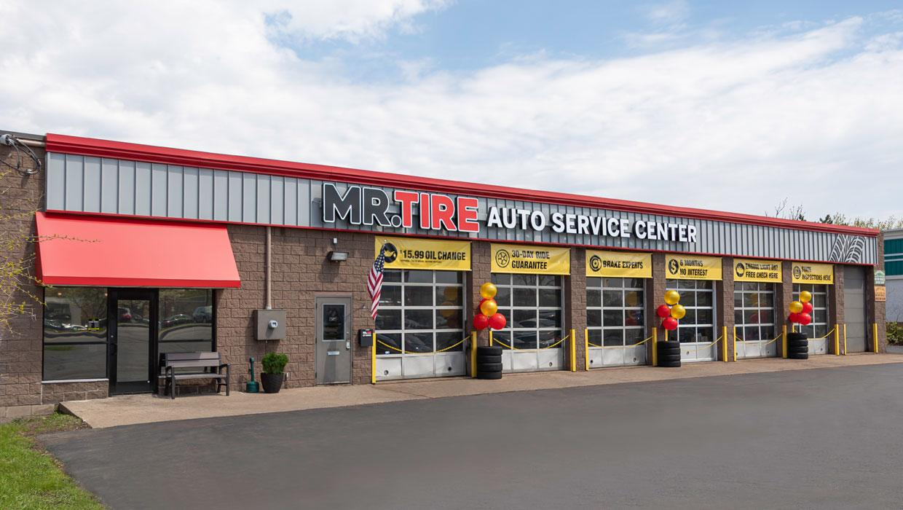
Extended Producer Responsibility (EPR)
State of Hawaiʻi:
Revised Statutes Section 342I-23, Part II
Hawaiʻi Counties:
Defer to State legislation
Automotive Service Center Take Back
State of California:
California Tire Fee
State of Colorado:
Colorado Waste Tire Fee Program
State of Washington:
Waste Tire Removal Fee

Slide 45
Government Programs and Subsidies
State will explore updates or improvements to:
Existing infrastructure;
Policies and regulations;
grants
Outreach and education opportunities.

Slide 46
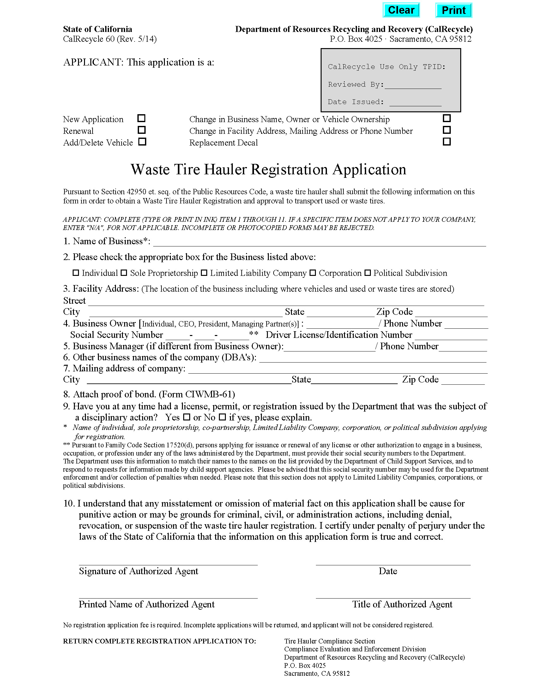
Government Programs and Subsidies
State of Hawaiʻi:
Retailers to Take Back Old Tires (342I Part II)
Hawaiʻi Counties:
Tires collected at:
Local DOH permitted businesses
Automotive Service Centers
Convenience Centers
State of California:
California Tire Fee
State of Colorado:
Colorado Waste Tire Fee Program
State of Washington:
Waste Tire Removal Fee

Slide 47
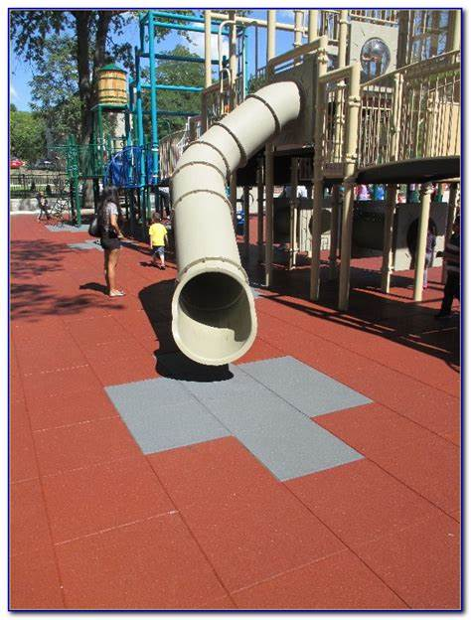
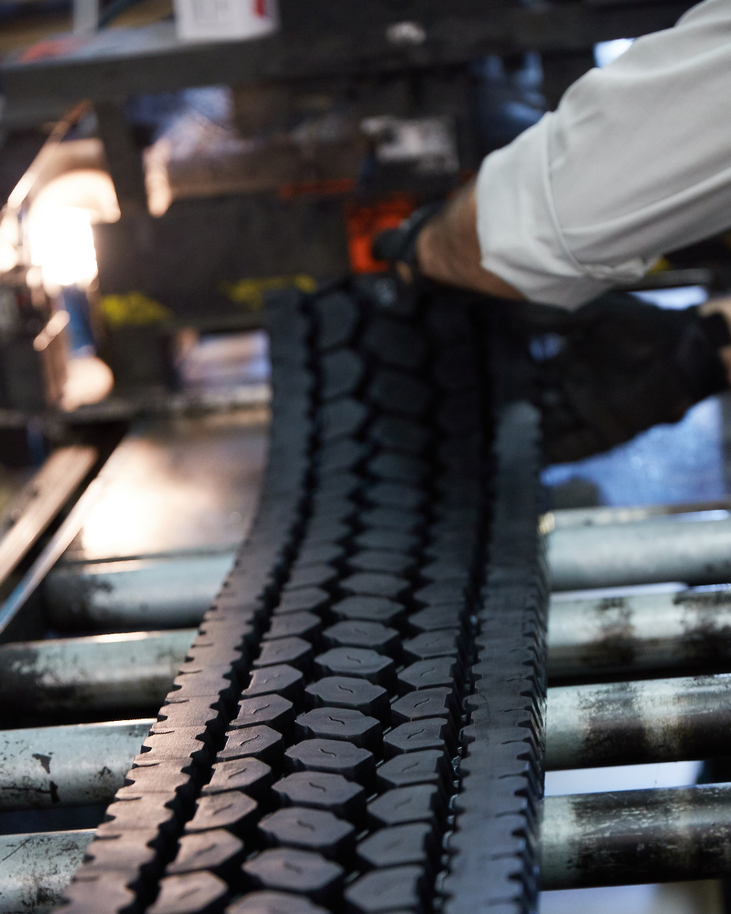
Free Market Solutions
According to the U.S. Tire Manufactures Association (USTMA), roughly 76 percent of scrap tires in the United States enters end-use markets, with the largest market being from TDF.

Slide 48
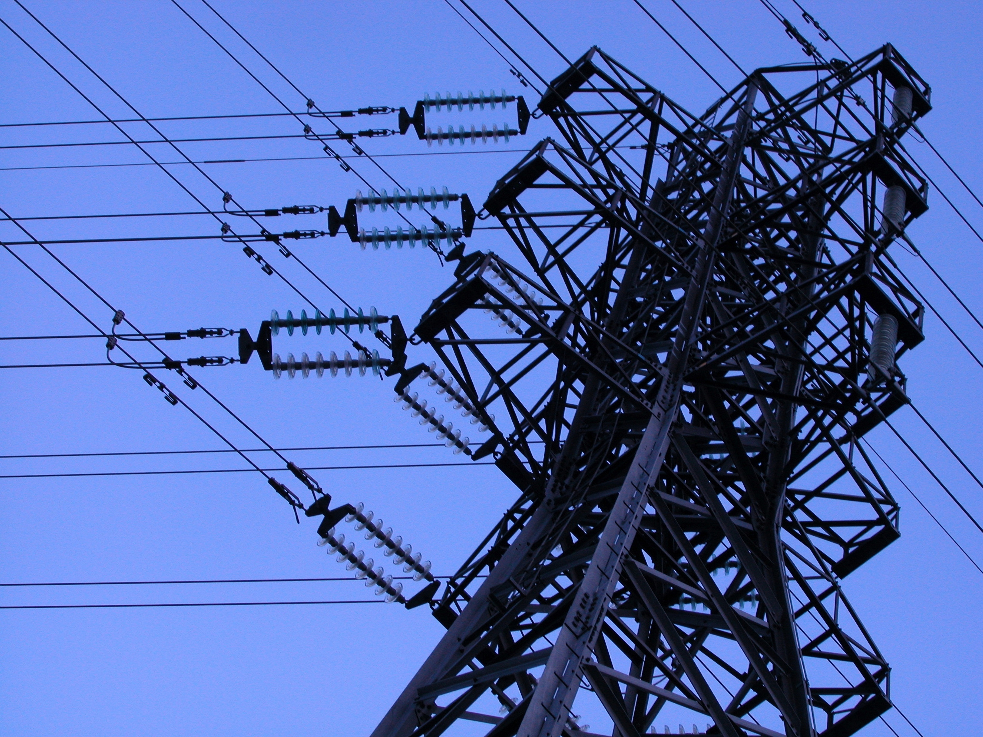
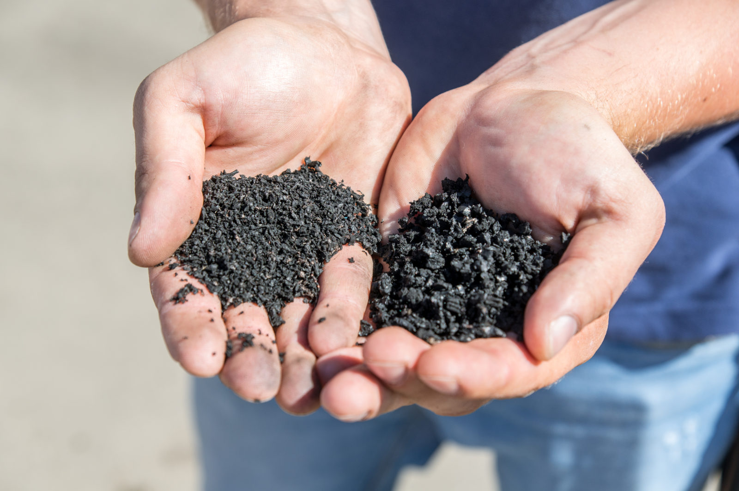
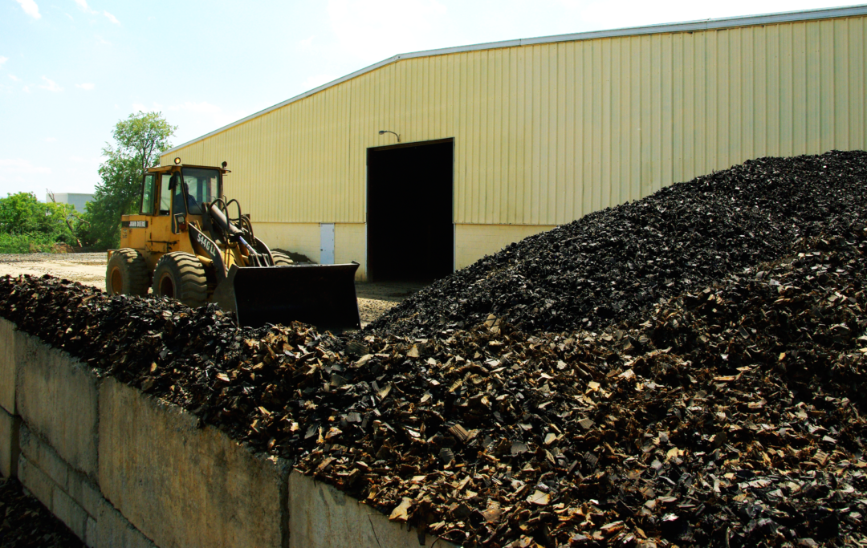
Free Market Solutions
Potential Options
Tire Derived Fuel (TDF)
Tire Derived Products (TDP)
Tire Derived Aggregate (TDA)
Tire Retreading

Slide 49
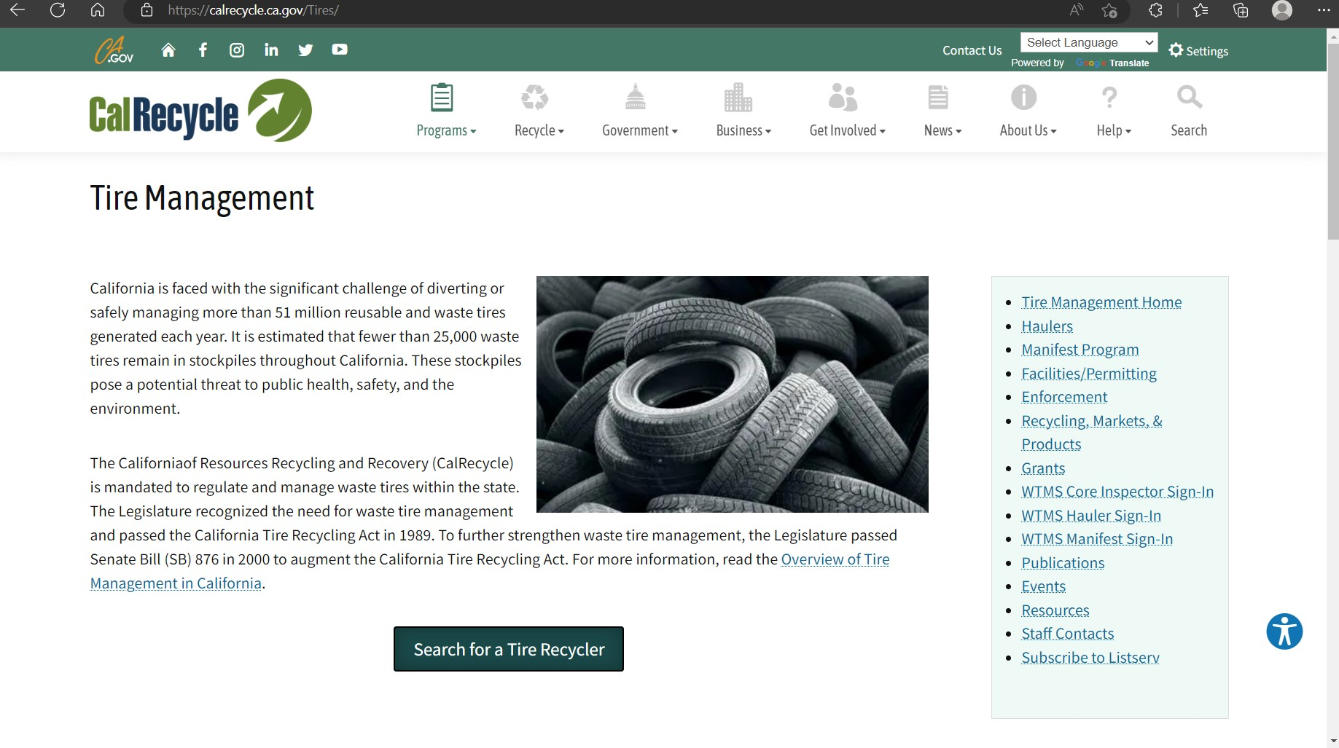
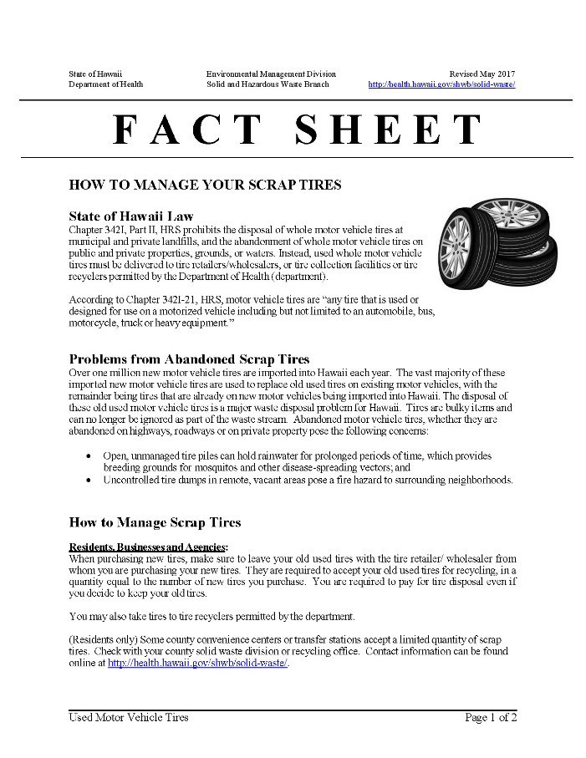
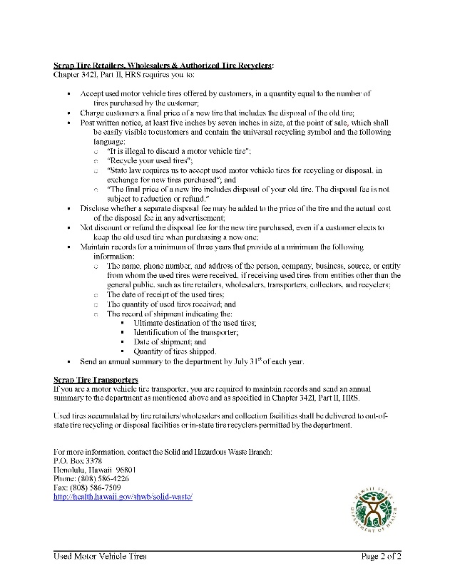
Education and Outreach Opportunities
Due to the potential environmental impacts of improper end-of-life tire management, it is important to have a dedicated education and outreach program that targets both tire retailers as well as the customers who purchase or replace them.

Slide 50
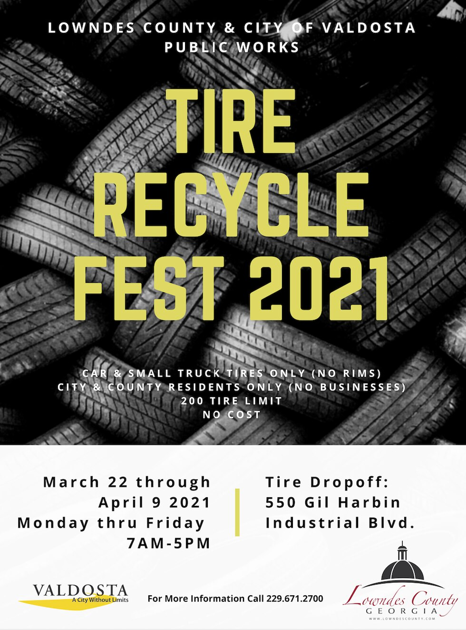
Education and Outreach Opportunities
State of Hawaiʻi:
Used Tires Recycling Signage for Retailers
Illegal Dumping Posters
Fact Sheet (How to Manager Your Scrap Tires)
Hawaiʻi Counties:
Tire Recycling Educational Program
Solid Waste Management Education and Awareness Program
Tire Recycling Web Page
State of California:
Tire Recycling Amnesty Events
Dedicated Tire Waste Management websites
State of Colorado:
Waste Tire drop off events
State of Washington:
Dedicated Tire Waste Management websites

Slide 51
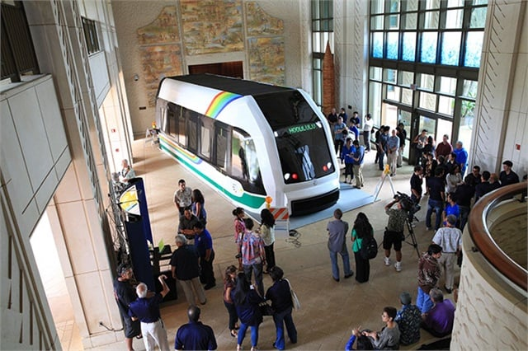
Resource Reduction Alternatives
In Hawaiʻi, most transportation occurs through private and commercial passenger vehicles

Slide 52
Resource Reduction Alternatives
State of Hawaiʻi:
Support public transportation options that reduce the use of personal vehicles for travel
Hawaiʻi Counties:
Honolulu Authority for Rapid Transportation Light-Rail
Other
Use of Alternative Transportation Options
Use of Carbon Black
Rubber Alternatives

Slide 53
Feedback activity
Share your thoughts on solutions presented. In your opinion, which show most promise?

Slide 54
Public Comment
Share your thoughts on materials presented. What solutions would you like to encourage?

Slide 55
State of Hawaiʻi Integrated Solid Waste Management Plan Update
Questions

