Slide 1
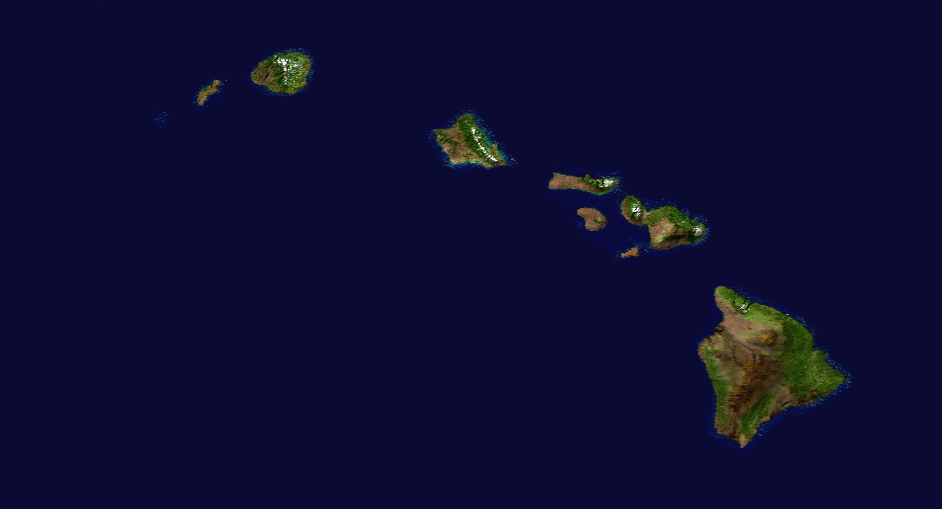
Hawaii –
Big Island Grown Dispensaries
750 Kanoelehua Avenue, Suite 104
Hilo, HI., 96720
64-1040 Mamalahoa Hwy., Suite 101
Kamuela, HI., 96743
74-5617 Pawai Place
Kailua-Kona, HI., 96740
Hawaiian Ethos
73-5613 Olowalu Street, Suite 7
Kailua-Kona, HI., 96740
64-1035 Mamalahoa Hwy., Suite J
Kamuela, HI., 96743
578 Kanoelehua Avenue
Hilo, HI., 96720
Oahu –
Cure Oahu
727 Kapahulu Avenue
Honolulu, HI., 96716
Noa Botanicals
1308 Young Street
Honolulu, HI., 96813
46-028 Kawa Street
Kaneohe, HI., 96744
98-302 Kamehameha Hwy.
Aiea, HI., 96701
Aloha Green Apothecary
1314 S. King Street
Honolulu, HI., 96814
2113 Kalakaua Avenue
Honolulu, Hi., 96815
Kauai –
Green Aloha
4-1565 Kuhio Hwy., #3
Kapaa, HI., 96746
Maui –
Maui Grown Therapies
44 Paa Street
Kahului, HI., 96732
Pono Life Sciences Maui
415 Dairy Road, Suite A
Kahului, HI., 96732
HAWAII MEDICAL CANNABIS
RETAIL FACILITIES

Slide 2
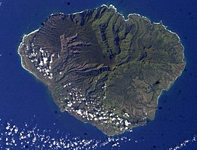
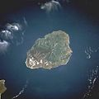
Green Aloha +Dispensary
4-1565 Kuhio Hwy., #3
Kapaa, HI., 96746
Phone: (808) 320-3187
Email: patients@GreenAloha.com
Open Daily (Mon - Sun) 9 am - 6 pm
This Photo by Unknown Author is licensed under CC BY-SA
This Photo by Unknown Author is licensed under CC BY-SA

Slide 3
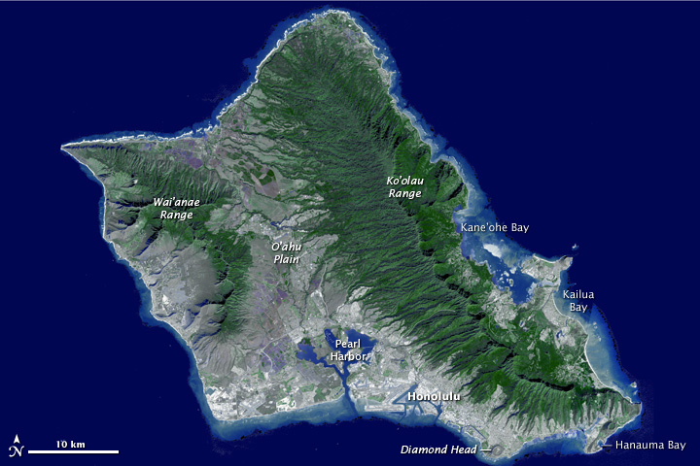
Cure Oahu
727 Kapahulu Avenue
Honolulu, HI., 96716
Phone: (808) 208-8770
Email: info@CureOahu.com
Mon - Sat 10:00am - 7:00pm Sun - 10:00am - 4:00pm
Noa Botanicals
1308 Young Street
Honolulu, HI., 96813
Phone: (808) 800-2126
Monday - Saturday 11am - 7pm
Sunday 10am - 3pm
46-028 Kawa Street
Kāne'ohe, HI., 96744
Phone: (808) 550-9860
Monday - Saturday 11am - 7pm
Closed Sundays
98-302 Kamehameha Hwy
Aiea, HI., 96701
Phone: (808) 900-3320
Monday – Saturday 10am – 7pm
Sunday 10am – 3pm
Aloha Green Apothecary
1324 S. King Street 2113 Kalakaua Avenue
Honolulu, HI. 96814 Honolulu, HI. 96815
Phone: (808) 369-2888 Phone: (808) 369-2888
Email: info@AGApoth.com Email: info@AGApoth.com
Open Daily 10:30am to 7:00pm Open Daily 10:30am to 7:00pm

Slide 4
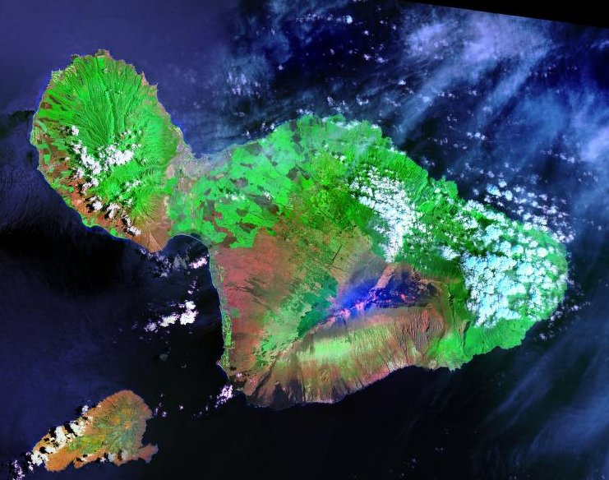
Maui Grown Therapies
44 Paa Street
Kahului, HI., 96732
Phone: (808) 866-7576
Email: info@MauiGrownTherapies.com
Monday-Friday 10am – 6pm
Saturday & Sunday 10am – 4pm
Pono Life Sciences Maui
415 Dairy Road, Suite A
Kahului, HI., 96732
Phone: (808) 489-9454
Email: info@PonoLifeMaui.com
Monday-Saturday 9am – 5pm
Sunday 10am – 4pm

Slide 5
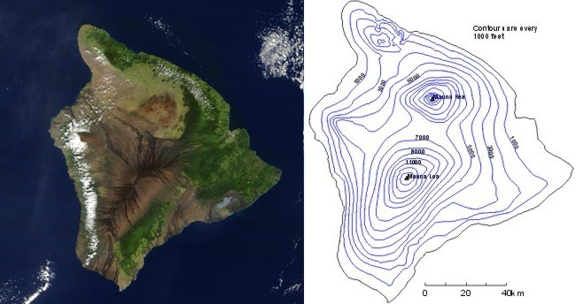
Big Island Grown Dispensaries
750 Kanoelehua Avenue, Suite 104
Hilo, HI., 96720
Phone: (808) 818-7974
Email: info@BigIslandGrown.co
Monday to Saturday: 9AM-7PM
Sunday: 9AM-2PM
64-1040 Mamalahoa Hwy., Suite 101
Kamuela, HI., 96743
Phone: (808) 818-7959
Email: info@BigIslandGrown.co
Monday to Saturday: 9AM-7PM
Sunday: 9AM-2PM
74-5617 Pawai Place
Kailua-Kona, HI., 96740
Phone: (808) 818-8134
Email: info@BigIslandGrown.co
Monday to Saturday: 9AM-7PM
Sunday: 9AM-2PM
Hawaiian Ethos
73-5613 Olowalu Street, Suite 7 64-1035 Mamalahoa Hwy., Suite J 578 Kanoelehua Avenue
Kailua-Kona, HI., 96740 Kamuela, HI., 96743 Hilo, HI., 96720
Phone: (808) 339-3205 Phone: (808) 731-5082 Phone: (808) 731-5559
Open 10am-7pm Every Day Open 10am-6pm Monday thru Saturday Open 10am-7pm Every Day

