Slide 1
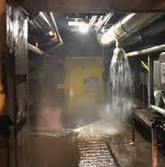
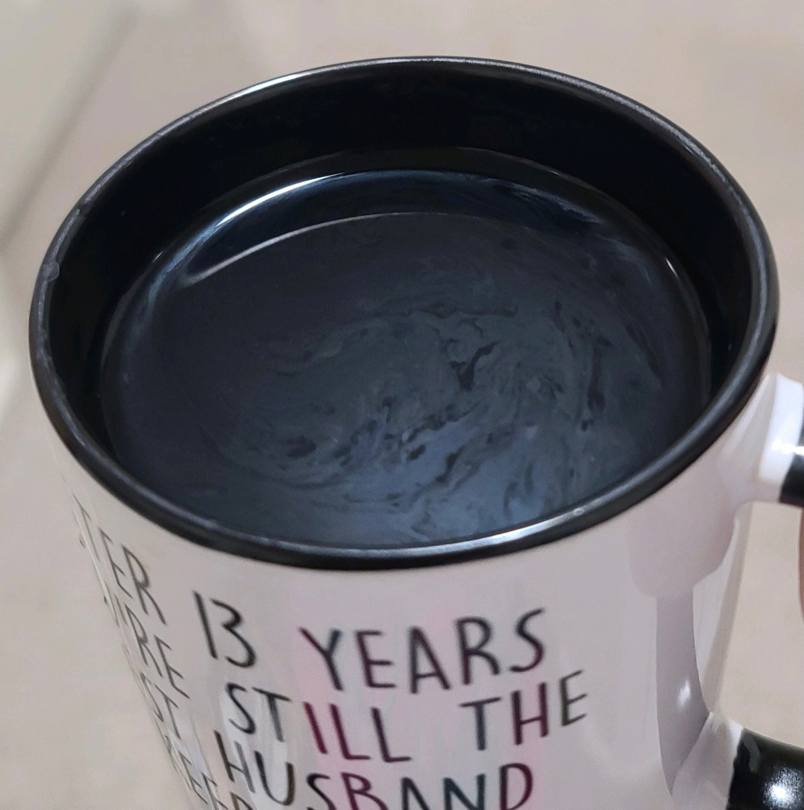
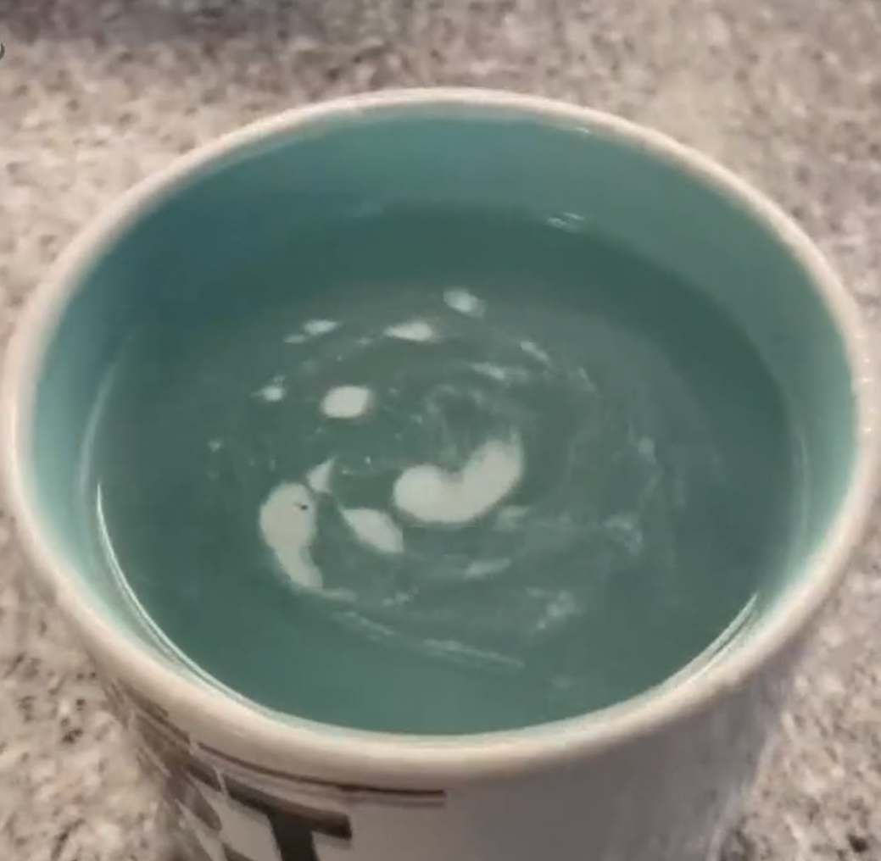
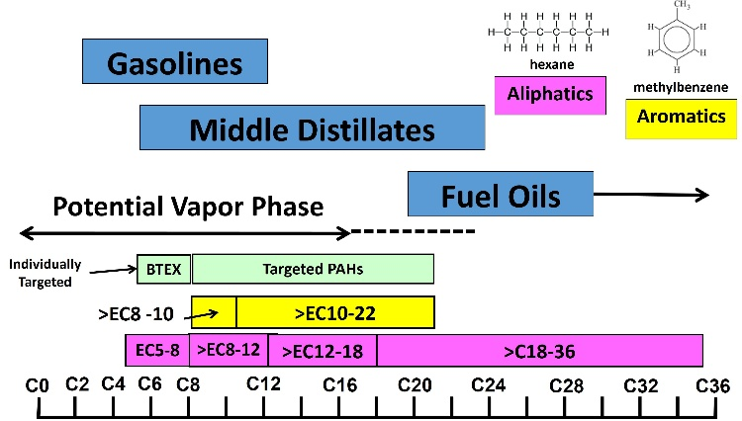
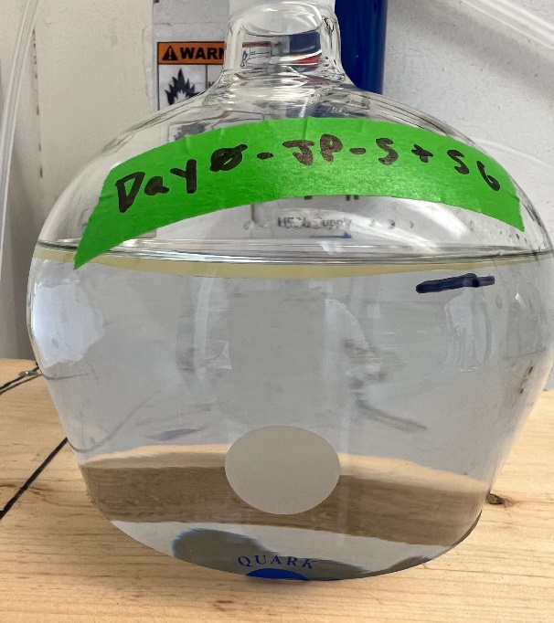
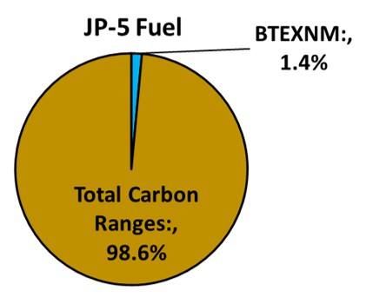
JBPHH JP-5 Exposure Assessment and Technical Basis of Hawaii Department of Health TPH Tapwater Action Levels
Roger Brewer, PhD
Hawai´i Department of Health (retired)
National Academies of Sciences, Engineering and Medicine (NASEM)
Clinical Follow-Up and Care for Those Impacted by the JP-5 Releases at Red Hill
September 8, 2025

Slide 2
Outline
Terminology;
Migration of JP-5 into and through the JBPHH drinking water system;
Categories of tapwater contamination;
Chemistry and toxicity of contaminated tapwater;
Estimates of “Reasonable Maximum Exposure (RME)”;
Use of Total Petroleum Hydrocarbons data to assess health risk.
References:
USDN, 2022, Command Investigation into the 6 May 2021 and 20 November 2021 Incidents at Red Hill Bulk Fuel Storage Facility: United States Department of the Navy, memorandum from Vice Chief of Naval Operations to File, June 13, 2022, Ser N09/22U100552.
HIDOH, 2023, Exposure Assessment: November 2021 Release of JP-5 Jet Fuel into the Joint Base Pearl Harbor Hickam Drinking Water System: Hawaii Department of Health, Hazard Evaluation and Emergency Response, June 2023 (recorded presentation posted June 28, 2023).
HIDOH, 2024, Evaluation of Environmental Hazards at Sites with Contaminated Soil and Groundwater (and updates): Hawai’i Department of Health, Office of Hazard Evaluation and Emergency Response.
HIDOH, 2024, Comparison of HIDOH Total Petroleum Hydrocarbon (TPH) Action Levels to Data for Water Samples (June 2024): Hawai’i Department of Health, Office of Hazard Evaluation and Emergency Response.
HDOH Recorded Webinars: https://health.hawaii.gov/heer/guidance/heer-webinars/

Slide 3
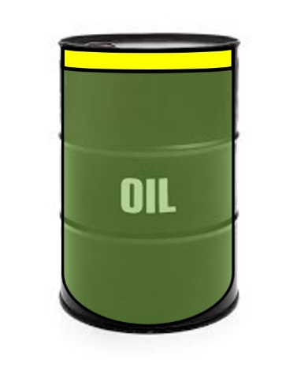
Terminology
TPH: | Total Petroleum Hydrocarbon Complex mixture of hundreds of hydrocarbon compounds; and degradation compounds (“metabolites”); Comprises the dominant fraction of petroleum fuels; Normally drives health and environmental risk over BTEXMN.
BTEXNM: | Benzene, Toluene, Ethylbenzene, Xylenes, Naphthalene, Methylnaphthalenes (individual compounds found in fuels).
FSII: | Fuel System Icing Inhibitor (prevents ice from forming in fuel at high altitudes).
DiEGME: | Diethylene Glycol Monomethyl Ether (FSII; aka: 2-(2-Methoxyethoxy) ethanol, Methyl Carbitol).
BTEXMN+
TPH

Slide 4

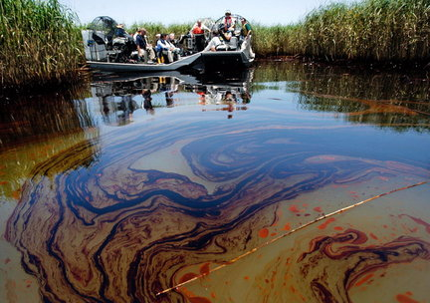
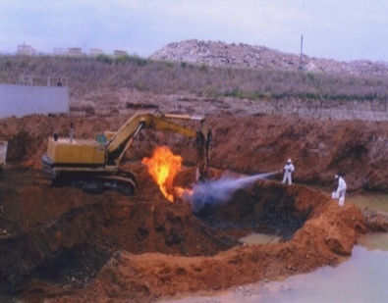
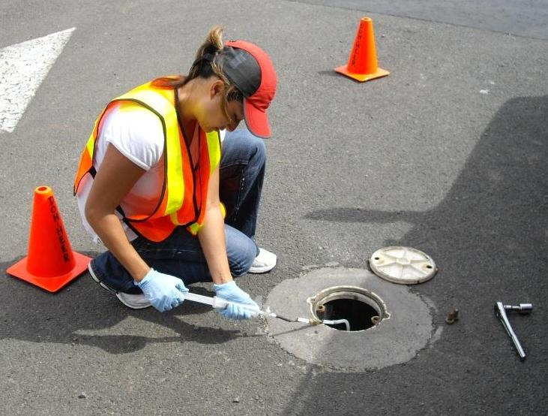
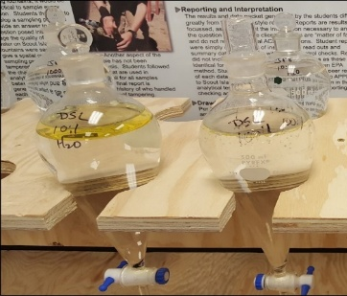
Assessment of Petroleum Exposure Health-Risk
Pre-Mid 1990s:
Focus on short list of individual chemicals (e.g., BTEX & PAHs) but obvious heavy contamination still present when screening levels met.
Mid 1990s:
Total Petroleum Hydrocarbon Criteria Working Group
Air Force (lead), Navy, States, industry, consultants;
Use of “Carbon Ranges” to assess TPH risk (fuel carbon range makeup, toxicity factors).
ATSDR (toxicity factors).
Massachusetts, Washington, Texas (toxicity factors, simplification).
2000-2020s:
USEPA (toxicity factors);
California (toxicity factors, metabolite chemistry & toxicity);
Hawaii (use of “TPH” data; fuel, vapor & metabolite chemistry and toxicity, case studies, forensics);
ITRC (use of TPH to assess risk, case studies).

Slide 5
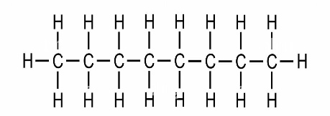
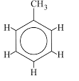
“Carbon Range” Grouping of TPH to Assess Health Risk
(6 groups of chemically similar compounds; toxicity factors assigned to each group)
Gasolines
octane
methylbenzene
Aliphatics
Aromatics
Middle Distillates
Fuel Oils
Individually
Targeted
BTEX
PAHs
Aromatics
>C8-10
>C10-22
Aliphatics
C5-8
>C8-12
>C12-18
>C18-36
TPH = Sum of Aromatics + Aliphatics + Metabolites
(excluding BTEX & PAHs)
Notes:
Benzene (6): EC 6.5
Toluene (7): EC 7.6
Ethylbenzene (8): EC 8.5
Xylenes (8): EC 8.6
Naphthalene (10): EC 11.7
2-Methylnaphthalene (11): EC12.84
1-Methylnaphthalene (11): EC 12.99

Slide 6
Carbon Range Chronic Toxicity Factors
(USEPA 2022; no adverse health effects predicted after years of exposure)
Chemical/ Carbon Range | Oral/Dermal Reference Dose (µg/kg BW per day) | Inhalation Reference Concentration (µg/m³)
C5-C8 Aliphatics | 5 | 400
>C8-C18 Aliphatics | 10 | 100
>C18 Aliphatics | 3,000 | (not volatile)
>C8 Aromatics | 10 | 60
Default physiochemical constants also published (e.g., average volatility and solubility);
Allows for risk-based action levels to be calculated in the same manner as done for BTEXMN (assuming exposure of 15 kg child);
Subchronic toxicity factors also provided (potential effects after days to months of exposure)
Problem: Limited laboratory capability, difficult testing procedure;
Solution: Develop carbon-range weighted TPH toxicity factors based on typical carbon range makeup of neat-, dissolved- and vapor-phase fuel.

Slide 7
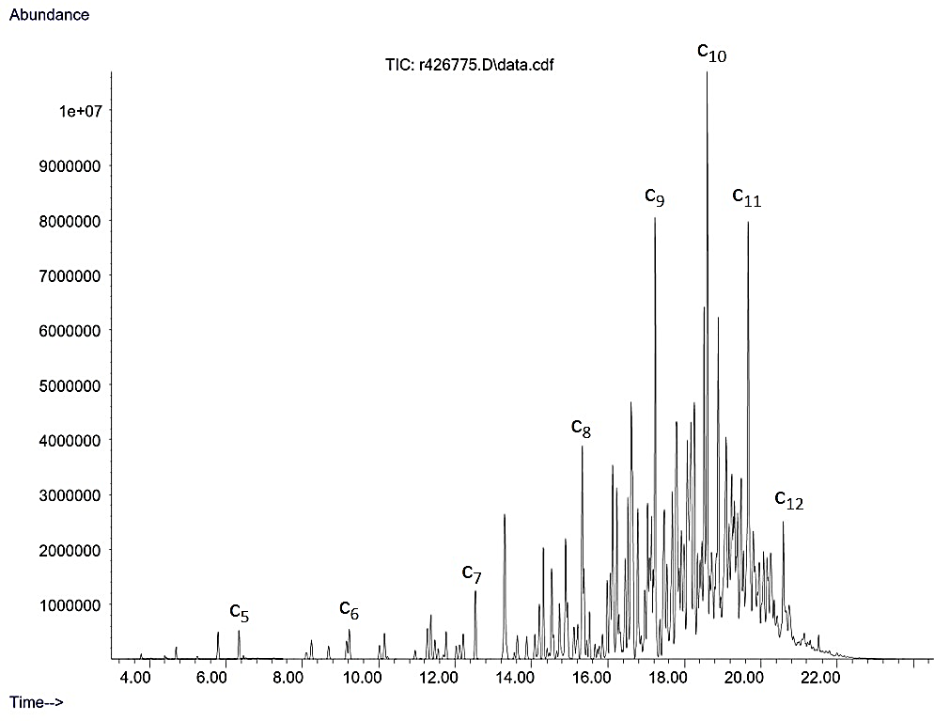
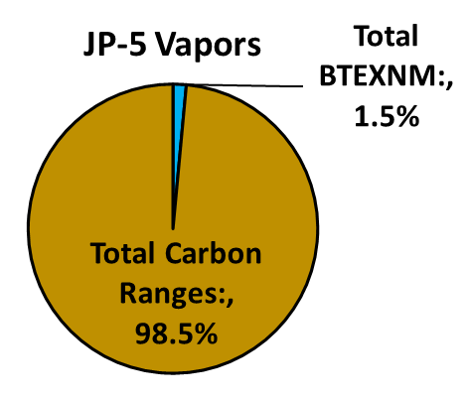
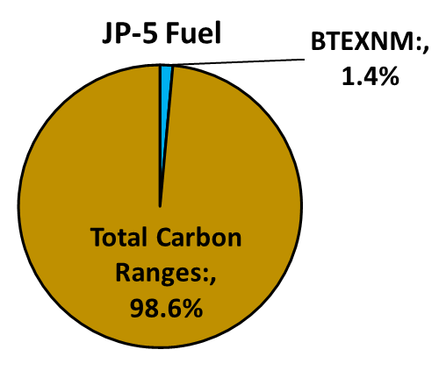
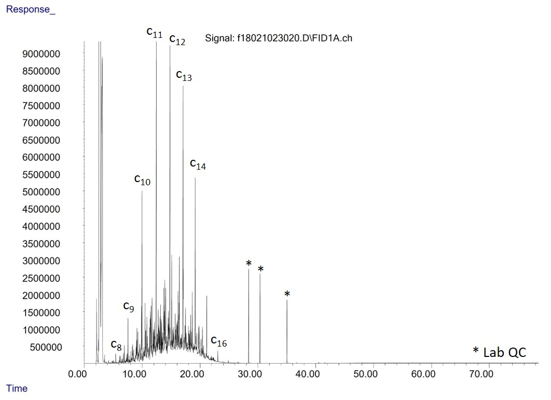
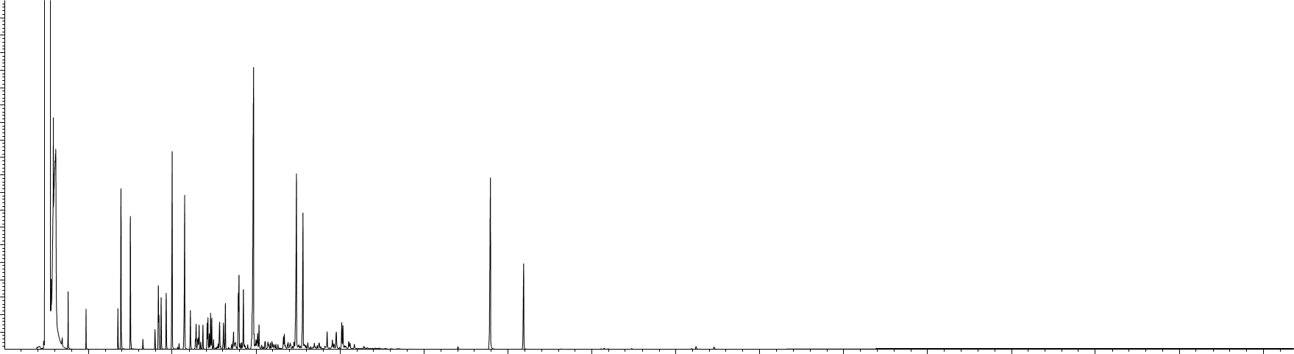
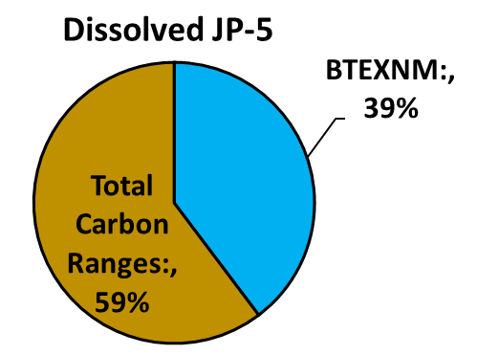
Carbon Range Makeup of JP-5 Jet Fuel (laboratory study)
C8
C12
JP-5
Vapors
TPH
TPH Carbon Range Makeup
C5-C8 Aliphatics | 19%
>C8-C18 Aliphatics | 78%
>C18 Aliphatcs | 0%
>C8 Aromatics | 3.2%
C6
C16
+Additives (e.g., FSII/DiEGME)
TPH
TPH Carbon Range Makeup
C5-C8 Aliphatics | 0.16%
>C8-C18 Aliphatics | 82%
>C18 Aliphatcs | 0.00%
>C8 Aromatics | 18%
JP-5
Neat Fuel
Partially oxidizes to complex metabolites and reported with TPH
JP-5
Dissolved
TPH
TPH Carbon Range Makeup
C5-C8 Aliphatics | 0.17%
>C8-C18 Aliphatics | 0.00%
>C18 Aliphatcs | 0.00%
>C8 Aromatics | 99.8%

Slide 8

Carbon Range-Weighted TPH Toxicity Factors for JP-5
(acute toxicity factors (effects with seconds to days) not available)
Tapwater Contamination Category | Chronic JP-5 TPH Toxicity Factors (potential health effects after many years of continuous exposure if exceeded)
 | Oral RfD (µg/kg BW per day) | Dermal RfD (µg/kg BW-day) | Inhalation RfC (µg/m³)
Dissolved Only | 10 | 10 | 60
Dissolved + Sheen | 10 | 10 | 115
Tapwater Contamination Category | Chronic JP-5 TPH Toxicity Upper Limit for 15 Kg Child (potential health effects after many years of continuous exposure if exceeded)
 | Oral RfD (µg per day) | Dermal RfD (µg per day) | Inhalation RfC (µg/m³)
Dissolved Only | 150 | 150 | 60
Dissolved + Sheen | 150 | 150 | 115
1 Drop of JP-5
Risk Assessment: Assume average 15 kg child.
Target Organs And Health Effects: Alimentary Tract, Developmental, Hematologic, Kidney, Nervous System, Respiratory;
40 mg

Slide 9
Carbon Range-Weighted TPH Toxicity Factors for JP-5
(acute toxicity factors (effects with seconds to days) not available)
Tapwater Contamination Category | Subchronic JP-5 TPH Toxicity Factors (potential health effects after days to months of continuous exposure if exceeded)
 | Oral RfD (µg/kg BW per day) | Dermal RfD (µg/kg BW-day) | Inhalation RfC (µg/m³)
Dissolved Only | 40 | 40 | 200
Dissolved + Sheen | 79 | 79 | 126
Tapwater Contamination Category | Subchronic JP-5 TPH Toxicity Upper Limit for 15 Kg Child (potential health effects after days to months of continuous exposure if exceeded)
 | Oral RfD (µg per day) | Dermal RfD (µg per day) | Inhalation RfC (µg/m³)
Dissolved Only | 600 | 600 | 200
Dissolved + Sheen | 1,185 | 1,185 | 126
1 Drop of JP-5
Risk Assessment: Assume average 15 kg child.
Target Organs And Health Effects: Alimentary Tract, Developmental, Hematologic, Kidney, Nervous System, Respiratory;
40 mg

Slide 10
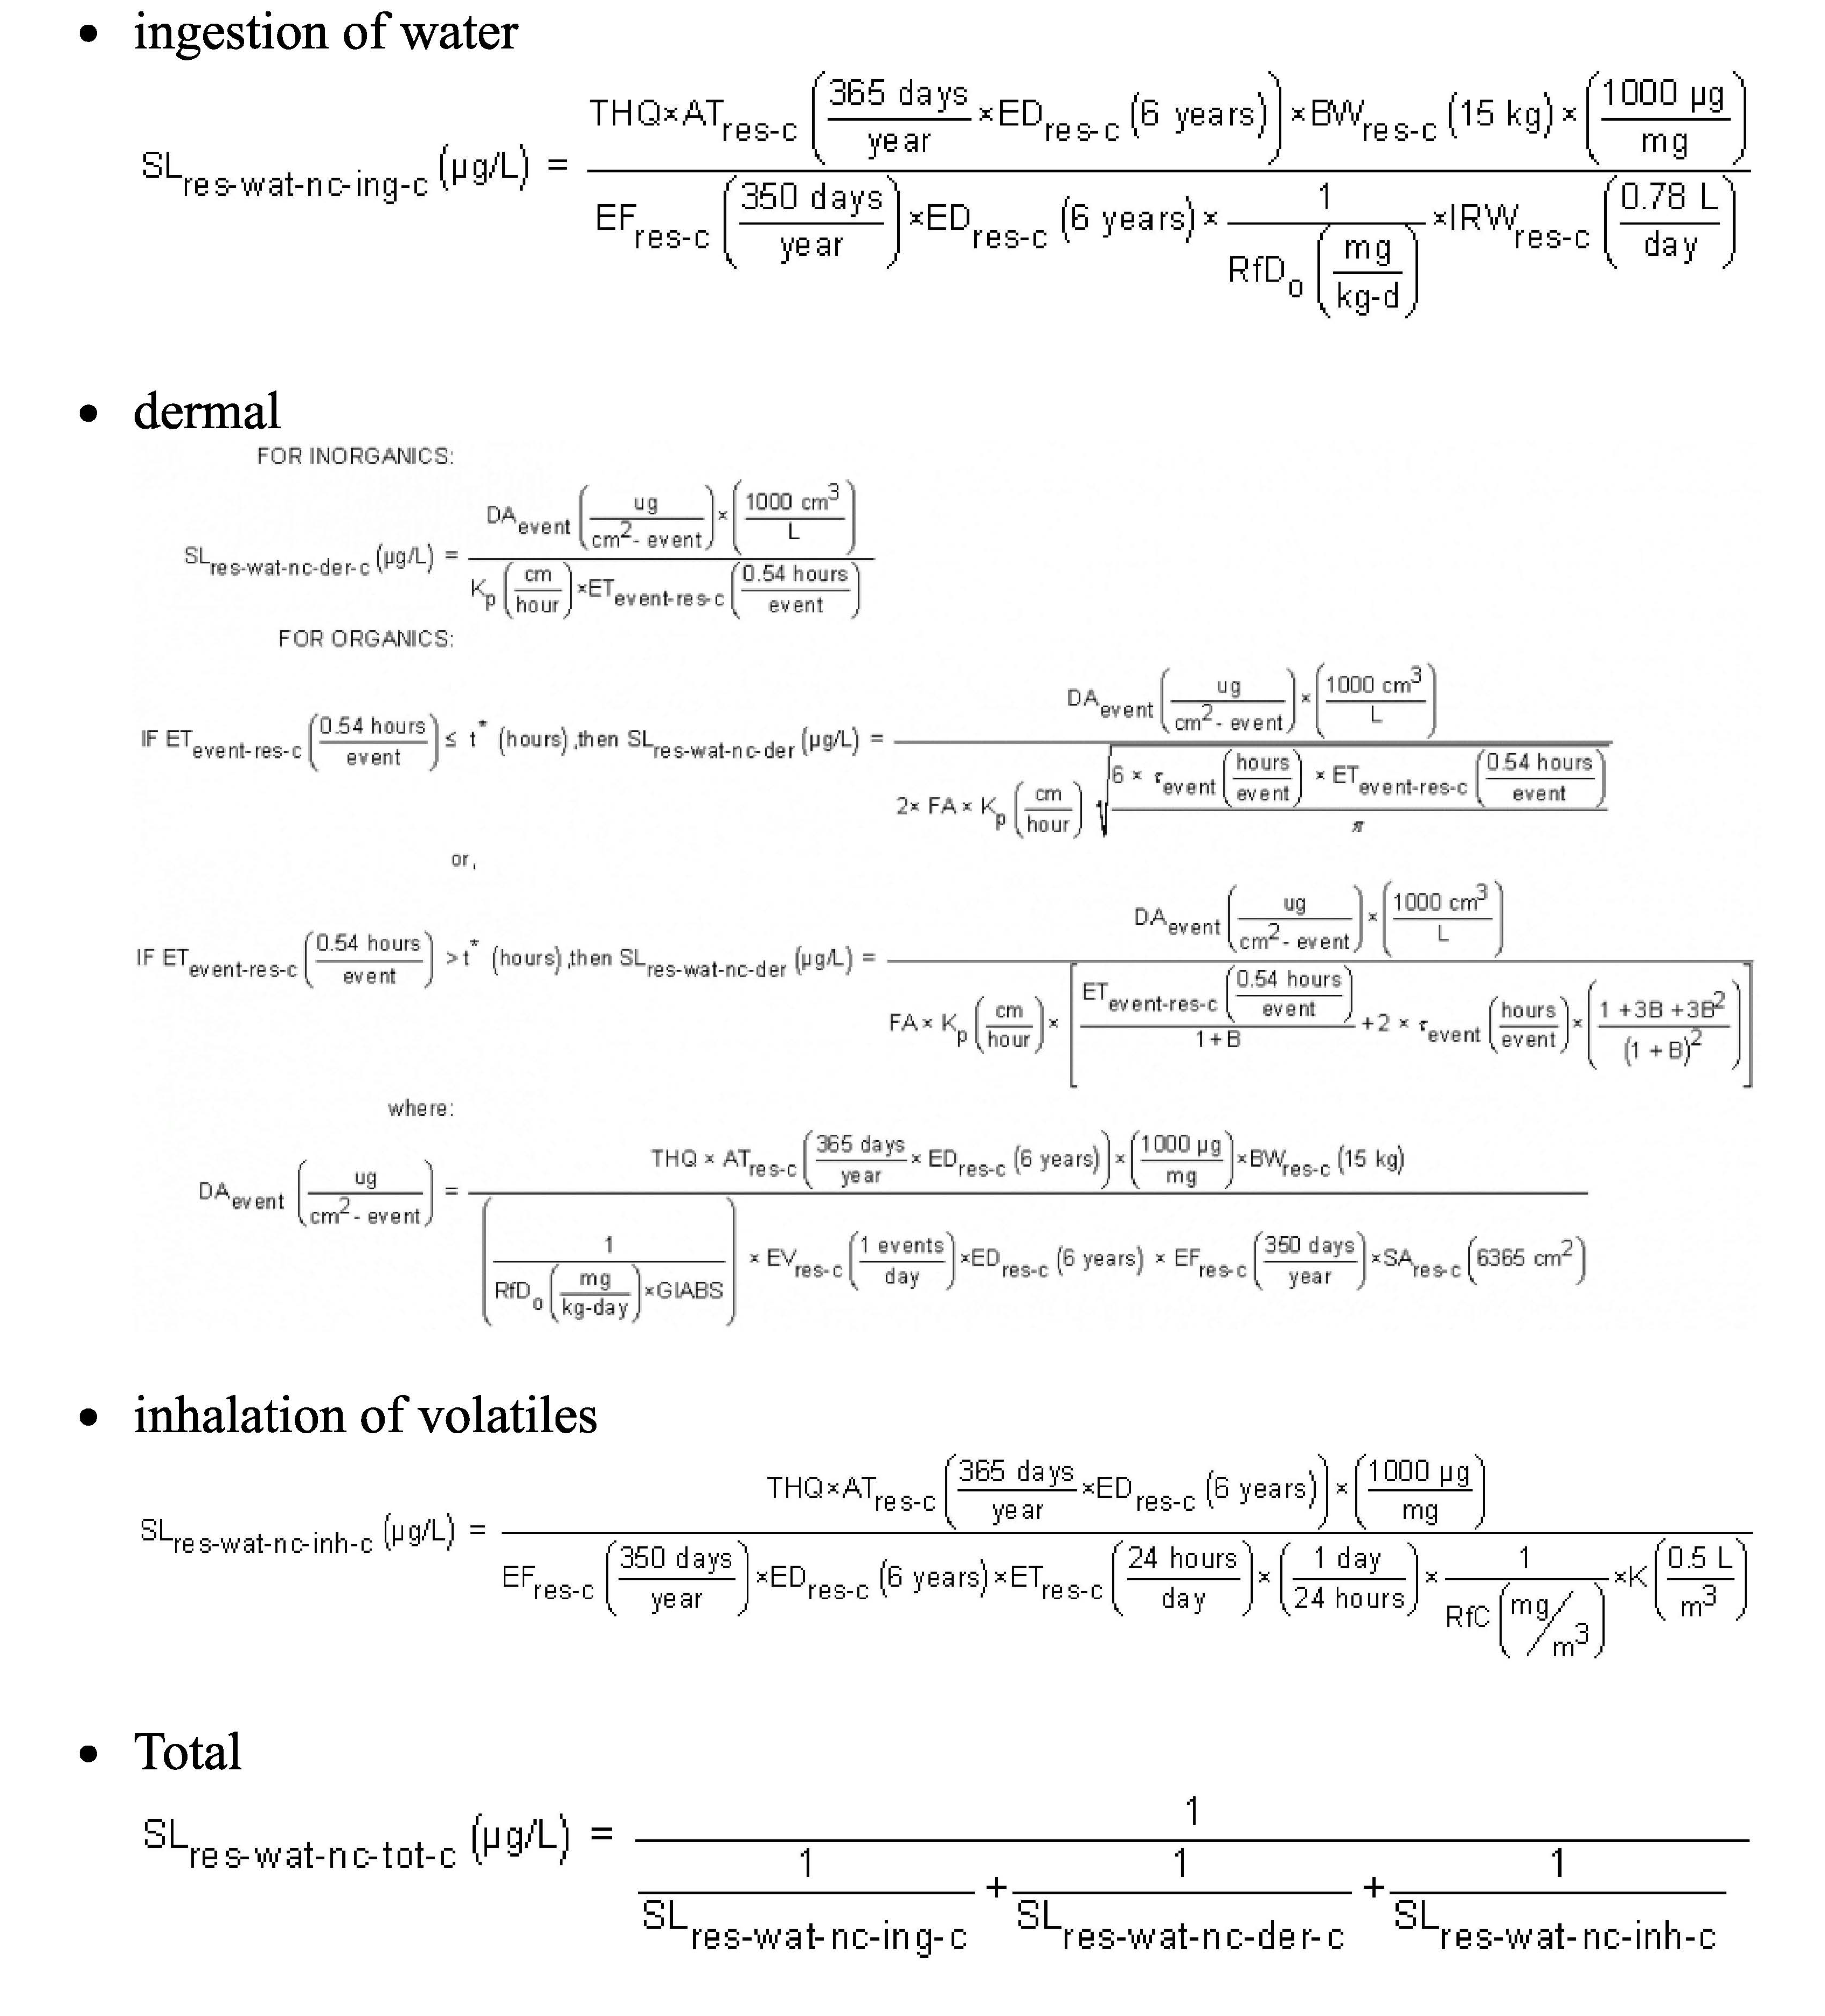
USEPA Tapwater Screening Level Equation
(USEPA Default: Daily use of water by average 15 kg child for 6 years)
Ingestion
Dermal
Absorption
Inhalation

Slide 11
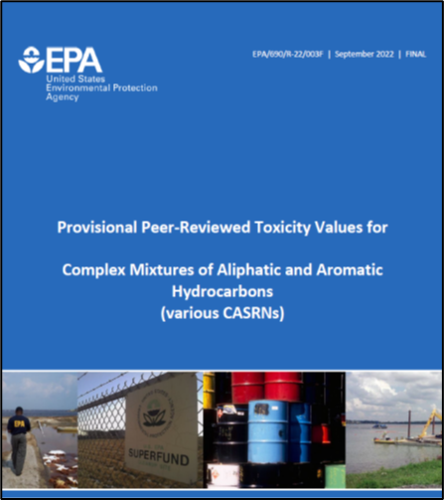
HIDOH TPH Drinking Water Action Levels
for Middle Distillate Fuels (including JP-5)
(concentration at which no adverse chronic health effects expected)
Year | Toxicity | Taste & Odor | Final TPH Action Level | Basis
¹2005 | 400 µg/L | 100 µg/L | 100 µg/L | Taste & Odors
²2017 | 400 µg/L | 500 µg/L | 400 µg/L | Toxicity
³2021/2022 (Red Hill) | 266 µg/L | 500 µg/L | 266 µg/L | Toxicity
⁴2024 | 91 µg/L | 500 µg/L | 91 µg/L | Toxicity
Early toxicity-based TPH action level assumed degraded, non-volatile petroleum (inhalation of vapors not considered).
TPH Taste & Odor threshold updated in 2017.
Toxicity-based action level for JP-5 in JBPHH drinking water system adjusted to reflect volatility and inhalation exposure pathway.
Toxicity-based action level revised to reflect updated USEPA carbon range toxicity factors.
Subchronic Action Levels: Dissolved (340 µg/L), Sheen (270 µg/L).
USEPA Carbon Range Toxicity Factors (2022)

Slide 12
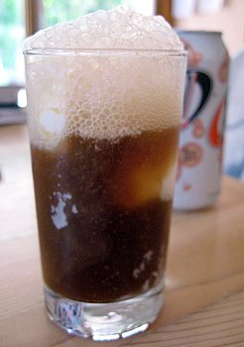
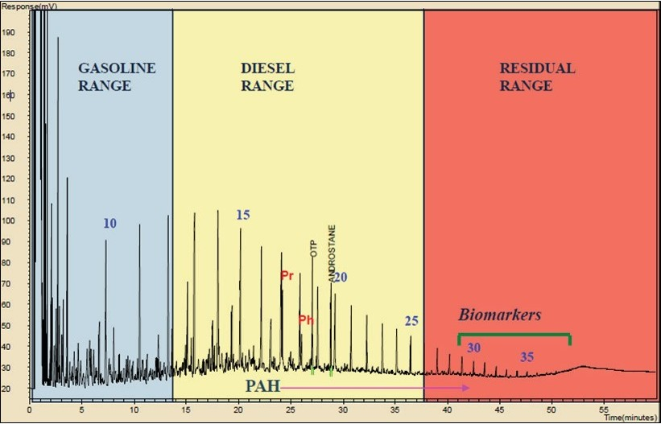
Laboratory Measurement of TPH in Water Samples
Two different tests necessary to quantify the concentration of TPH in a sample:
Purge and Trap: Volatile Organics;
Solvent Extraction: Semi-Volatile and Nonvolatile Organics;
Compare measured TPH to the TPH action level specific to the fuel type best matching the chromatogram (Gasolines, Middle Distillates, Residual Fuels);
Individually targeted compounds subtracted and assessed separately;
Misreported as separate “TPHg”, “TPHd” and “TPHo” in Red Hill groundwater reports.
TPH = (Volatile Organics + Extractable Organics) - BTEXMN
OR
TPH = (“GRO” + “DRO” + “RRO”) - BTEXMN
1. Purge & Trap
2. Solvent Extraction
Volatile Organics
Extractable
Organics
Extractable
Organics
“Gasoline Range”
“Diesel Range”
“Residual Range”
Response
C5-C12
C12-C24
C24-C40+
after ITRC 2018
Retention Time (boiling point, molecular weight, etc.)

Slide 13
*Fuel Fingerprint Chromatograms
(used to identify fuel released and appropriate TPH Action Level for sample data)
Gasoline
JP-4
Stoddard
Motor Oil
0
10
20
30
40
0
10
20
30
40
0
10
20
30
40
0
10
20
30
40
JP-5
Diesel
JP-5
Transformer Oil
Bunker C
0
10
20
30
40
0
10
20
30
40
0
10
20
30
40
0
10
20
30
40
AVGAS is used to power piston engines; jet fuel is used to power jet engines;
JP-4 is a mixture of gasoline and kerosene;
JP-5 is similar to kerosene-based fuels, but with a higher flash point;
JP-8 is a kerosene-based jet fuel (Europe);
Jet A is similar to JP 8 but does not require corrosion or icing inhibitors.
#2 Heating Fuel
Jet-A (JP-8)
Hydraulic Fluid
0
10
20
30
40
0
10
20
30
40
0
10
20
30
40
Analytical Technologies Fuels Reference Library
*Chromatograms inadequate to identify fuel vs naturally occurring organic matter at concentrations <200 µg/L;
More detailed forensics testing and review of sample required (HIDOH 2024).

Slide 14
Exposure Assessment Questions
How did JP-5 jet fuel get into the JBPHH drinking water system?
What was my patient exposed to and for how long?
Which specific chemicals were in the tapwater and at what concentrations?
How did exposure change over time?
Was it high enough to pose a risk to my patient’s health?
Were they exposed to contaminants in the tapwater prior to the November 20, 2021, release?

Slide 15
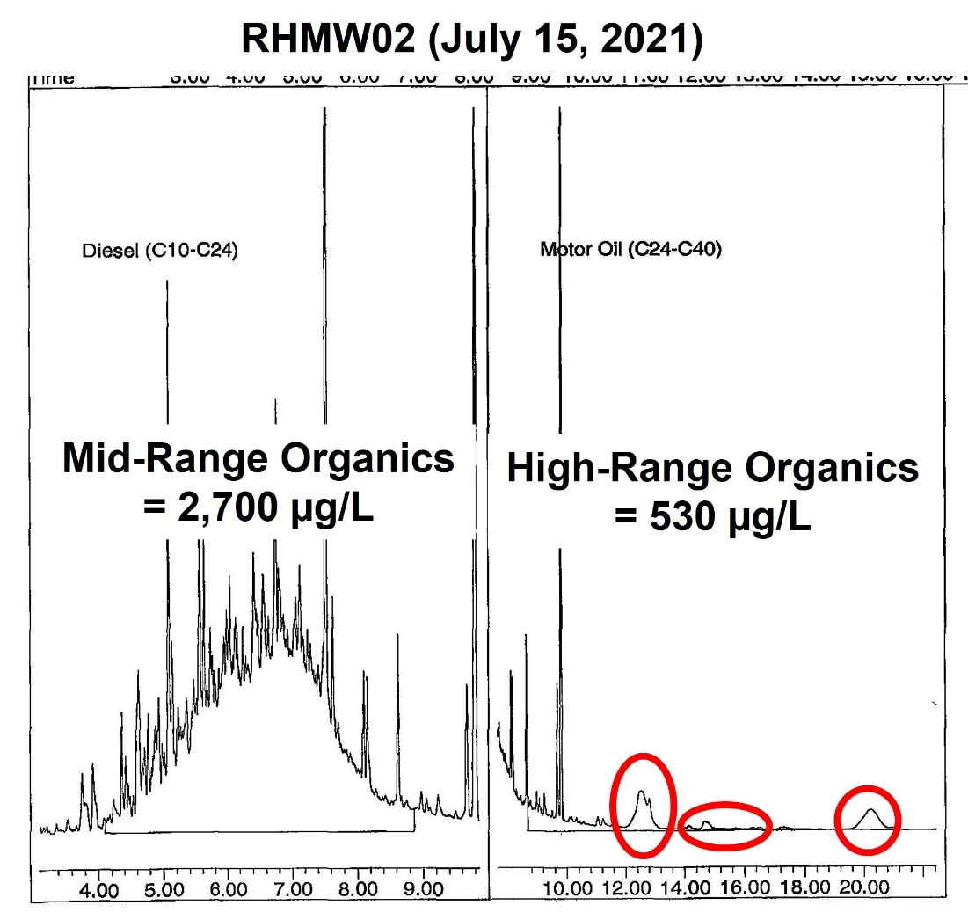
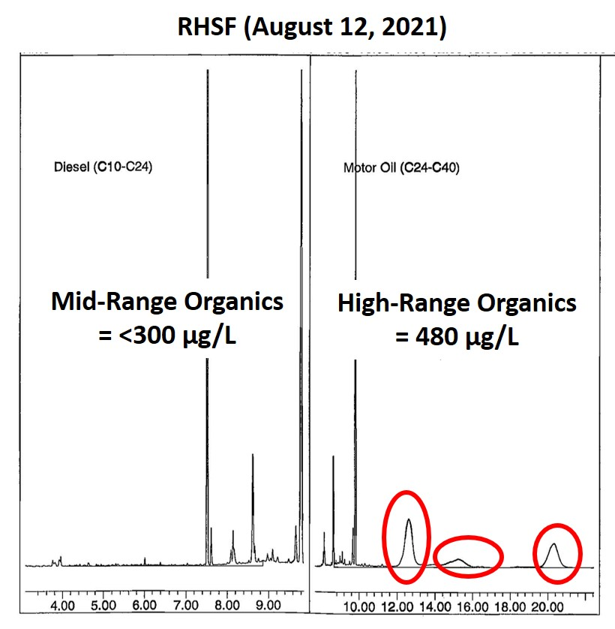
Example: “High Retention Time” (Boiling Point) Compounds
in Chromatograms of Samples of Red Hill Groundwater and Water System Intake July through November 2021
Red Hill Monitoring Well #2
(RHMW02)
July 15, 2021
Red Hill Shaft Faucet
(RHSF: Intake to JBPHH Water System)
July 15, 2021
High Boiling Point compounds reported as “TPH Oil” in Navy reports;
Samples not tested to identify specific compounds presents;
Potential Sources: Degraded Fuel (chemists: “Probably not”), Surfactants, Artifact of Laboratory Sample Processing, Algae, Something Else?

Slide 16
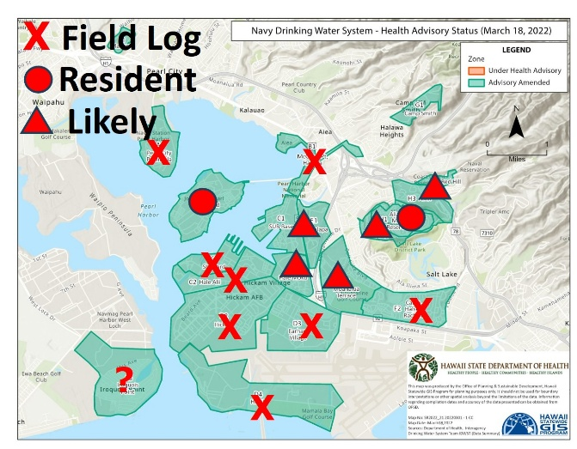
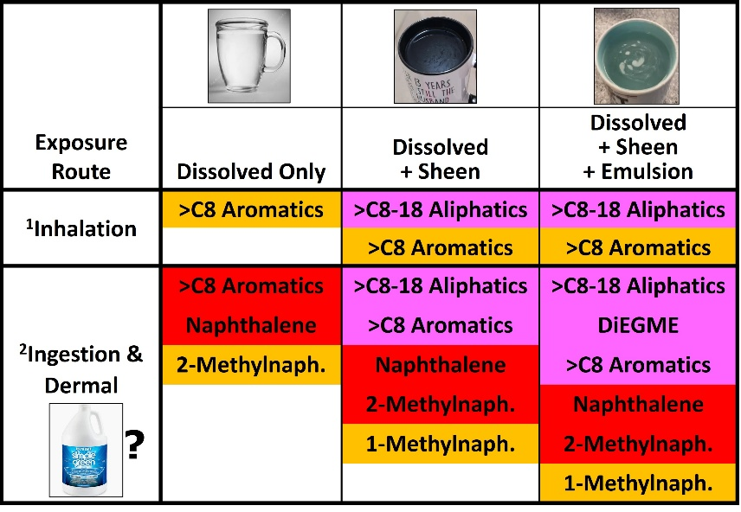

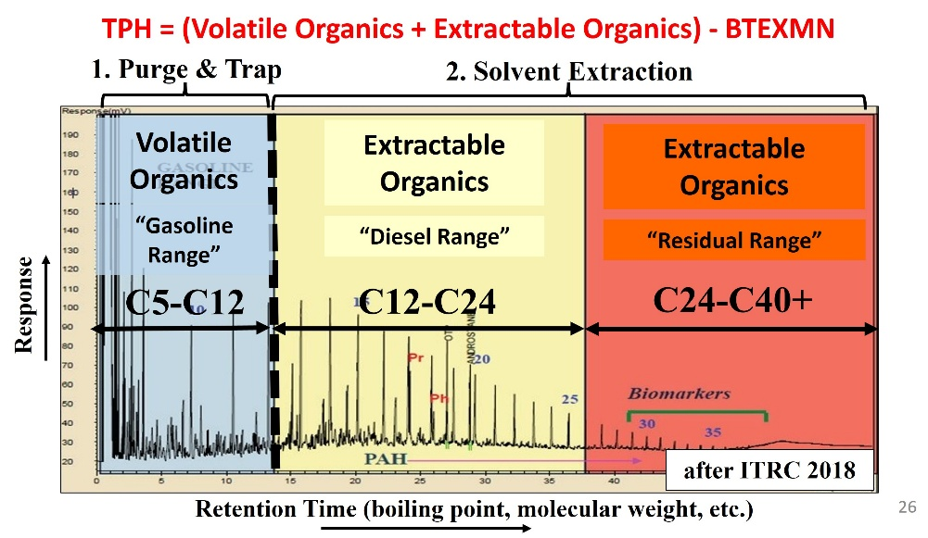
Questions? Ideas?

