Slide 1

Aloha,
The Overview of the EAL Updates and PFAS Field Study Webinar on Wednesday, November 20th, 2024.
Presented by Roger Brewer Hawaii Department of Health (HDOH) HEER Office.
Will start at 10:00 am, Hawaii Standard Time.
REMINDER: Everyone will be muted during the webinar except the presentation team. Please do not unmute your microphone if you join online or your phone if you call in. Background noise from unmuted mics and phones can disrupt the presentation.
There will be a Question & Answer session via Instant Messaging (Chat) at the end of the presentation. There will not be an option to directly ask questions over the phone lines.
Questions posted during a presentation will be read by the moderator
and discussed by the presenter.
Mahalo!

Slide 2
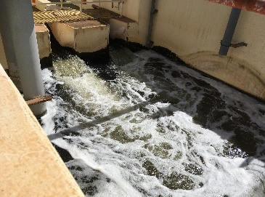
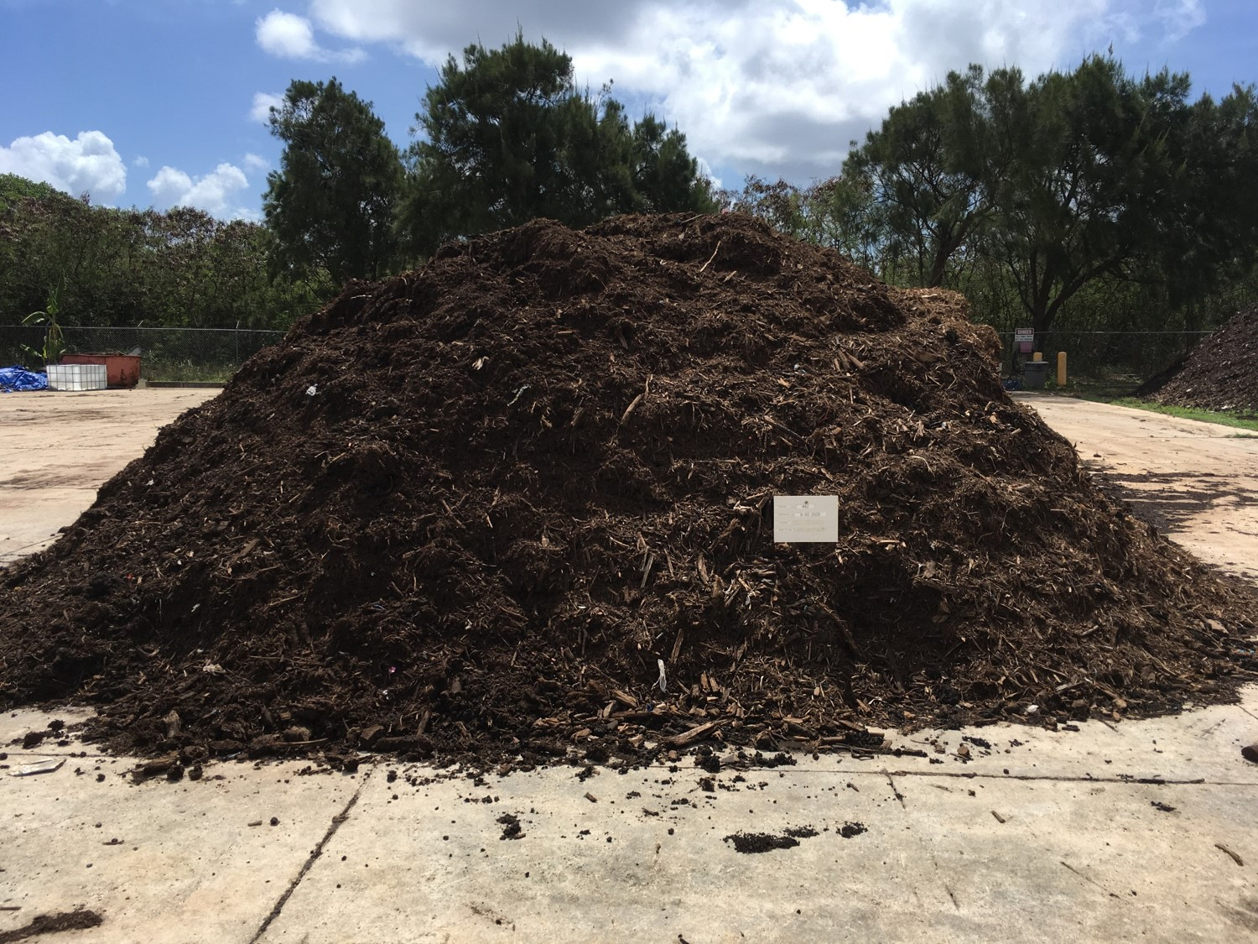
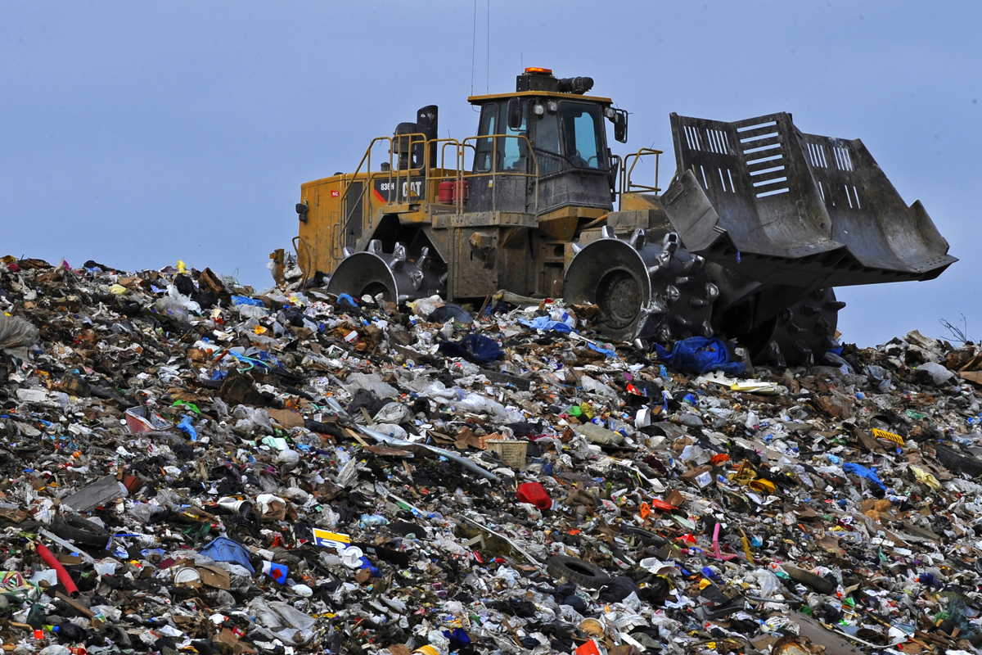

Field Study of PFASs Associated with WWTPs,
Landfills and AFFF-Release Sites in Hawai‘i
Roger Brewer, PhD
Senior Environmental Scientist
Hawaii Department of Health
November 20, 2024
WWTP
Effluent?
WWTP
Biosolids?
Landfill
Leachate?
Fire Training
Areas?
Investigation Questions
Multiple Sample Collection Phases
“Total PFAS Risk”
Sample Collection
Direct
Exposure
Crop
Uptake
?
Aquatic
Habitats
PFAS
Groups
Analytical
Methods
Leaching
Groundwater Impacts

Slide 3
Outline
PFAS Basics
Risk-Based Groupings of PFASs
Estimation of “Total PFAS Risk”
Field Study Results
Comparison of “Relative Source Strengths”
Study Takeaway Points

Slide 4
References
Hawaii Dept of Health Guidance:
Field Study of PFASs Associated with WWTPs, Landfill Leachate and AFFF-Release Sites in Hawaii (November 2024).
Interim Soil and Water Environmental Action Levels (EALs) for Perfluoroalkyl and Polyfluoroalkyl Substances (PFASs), November 2024 (and updates): https://health.hawaii.gov/heer/guidance/additional-guidance-documents/
Toxicity review of FTOHs and PFEtA (aka trifluoroacetate): EAL webpage
Technical Guidance Manual (site investigation design): https://health.hawaii.gov/heer/guidance/specific-topics/decision-unit-and-multi-increment-sampling-methods/
PFAS Basics:
ITRC 2020: Per- and Polyfluoroalkyl Substances (PFASs)
TOPs Methods:
Ateia et al., 2023, Total Oxidizable Precursor (TOP) Assay Best Practices, Capabilities and Limitations for PFAS Site Investigation and Remediation: Environmental Science and Technology Letters. Vol. 10, pp 292−301.
Other HIDOH PFAS Webpage:
https://health.hawaii.gov/heer/environmental-health/highlighted-projects/per-and-polyfluoroalkyl-substances-pfass/
HIDOH Recorded Webinars:
https://health.hawaii.gov/heer/guidance/heer-webinars/

Slide 5
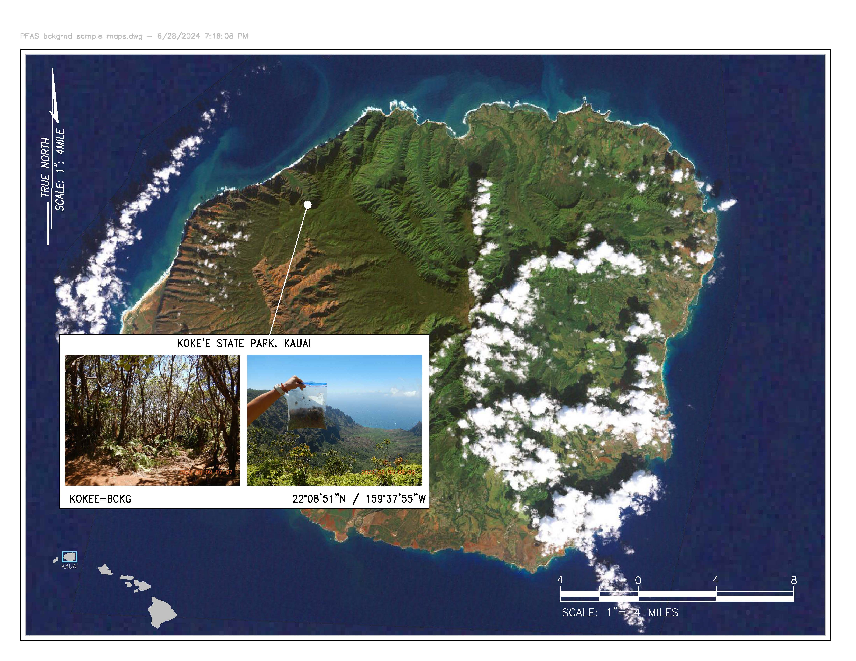

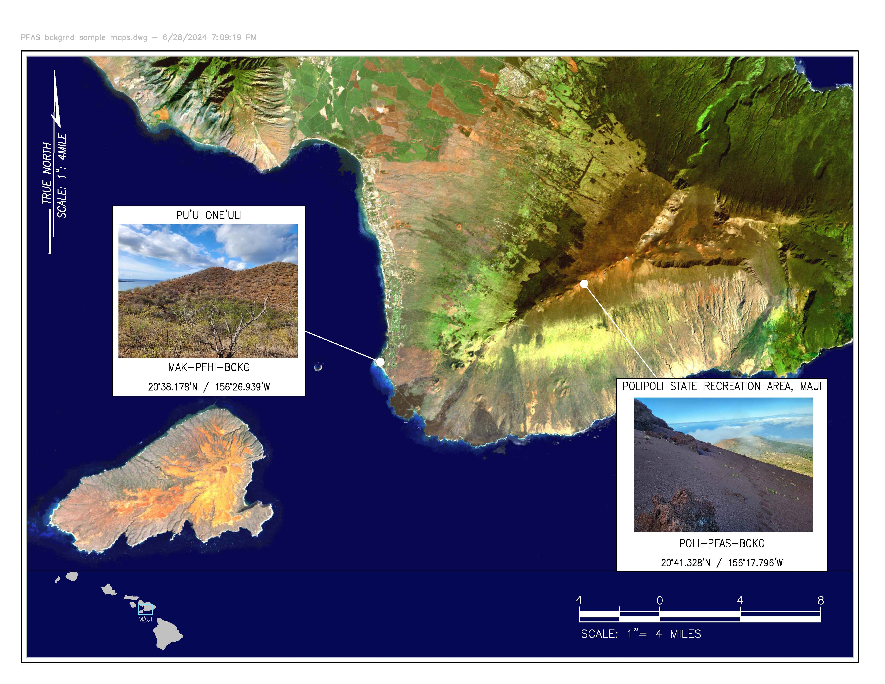
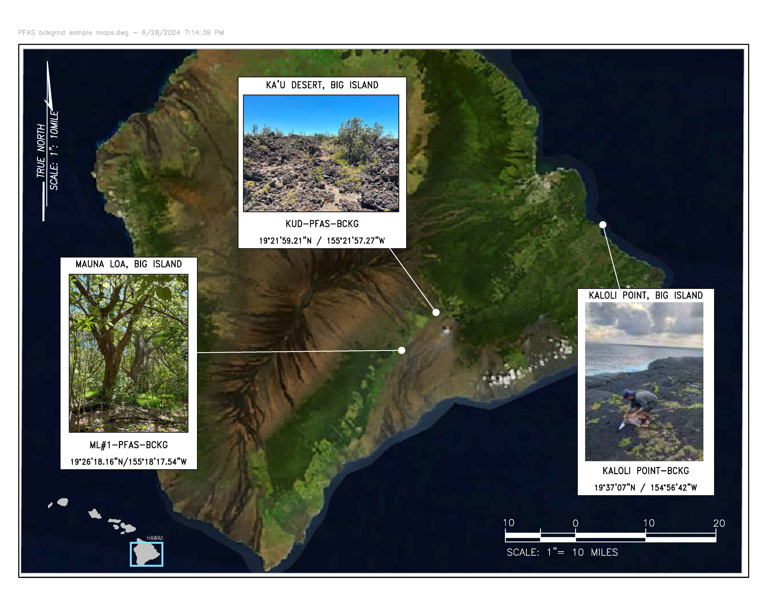
Background PFASs in Hawai‘i Soil – Mostly “Non-Detect”
(trace of PFBA- downwind of a town; trace EOF suspect – samples being retested)
Anthropogenic
Background?

Slide 6

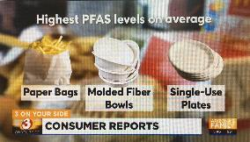
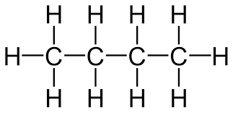
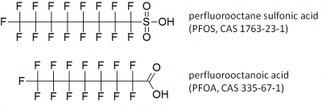
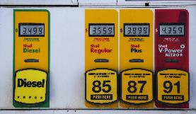
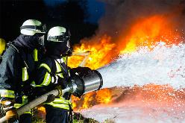
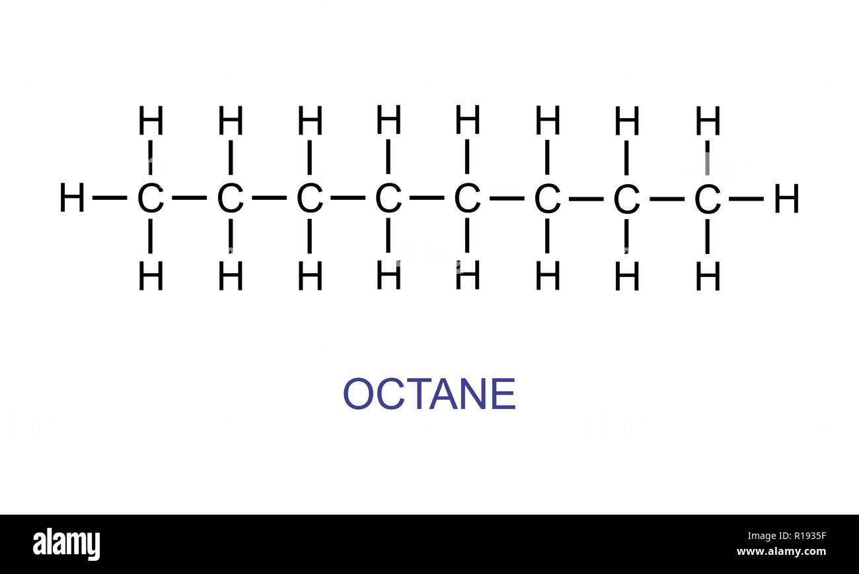
PFASs Chemistry Basics: Carboxylates & Sulfonates
“Terminal PFASs” (“Forever chemicals”)
PFBA/PFBS
(textiles, paper, etc.)
Butane (C₄H₁₀)
Perfluoro Butanoic Acid (perfluoro butanoate)
O⁻
Anionic forms most common in soil and water
PFOA/PFOS
(older AFFF, etc.)
Octane (C₈H₁₈)
Perfluoro Octanoic Acid (perfluoro octanoate)
O⁻

Slide 7
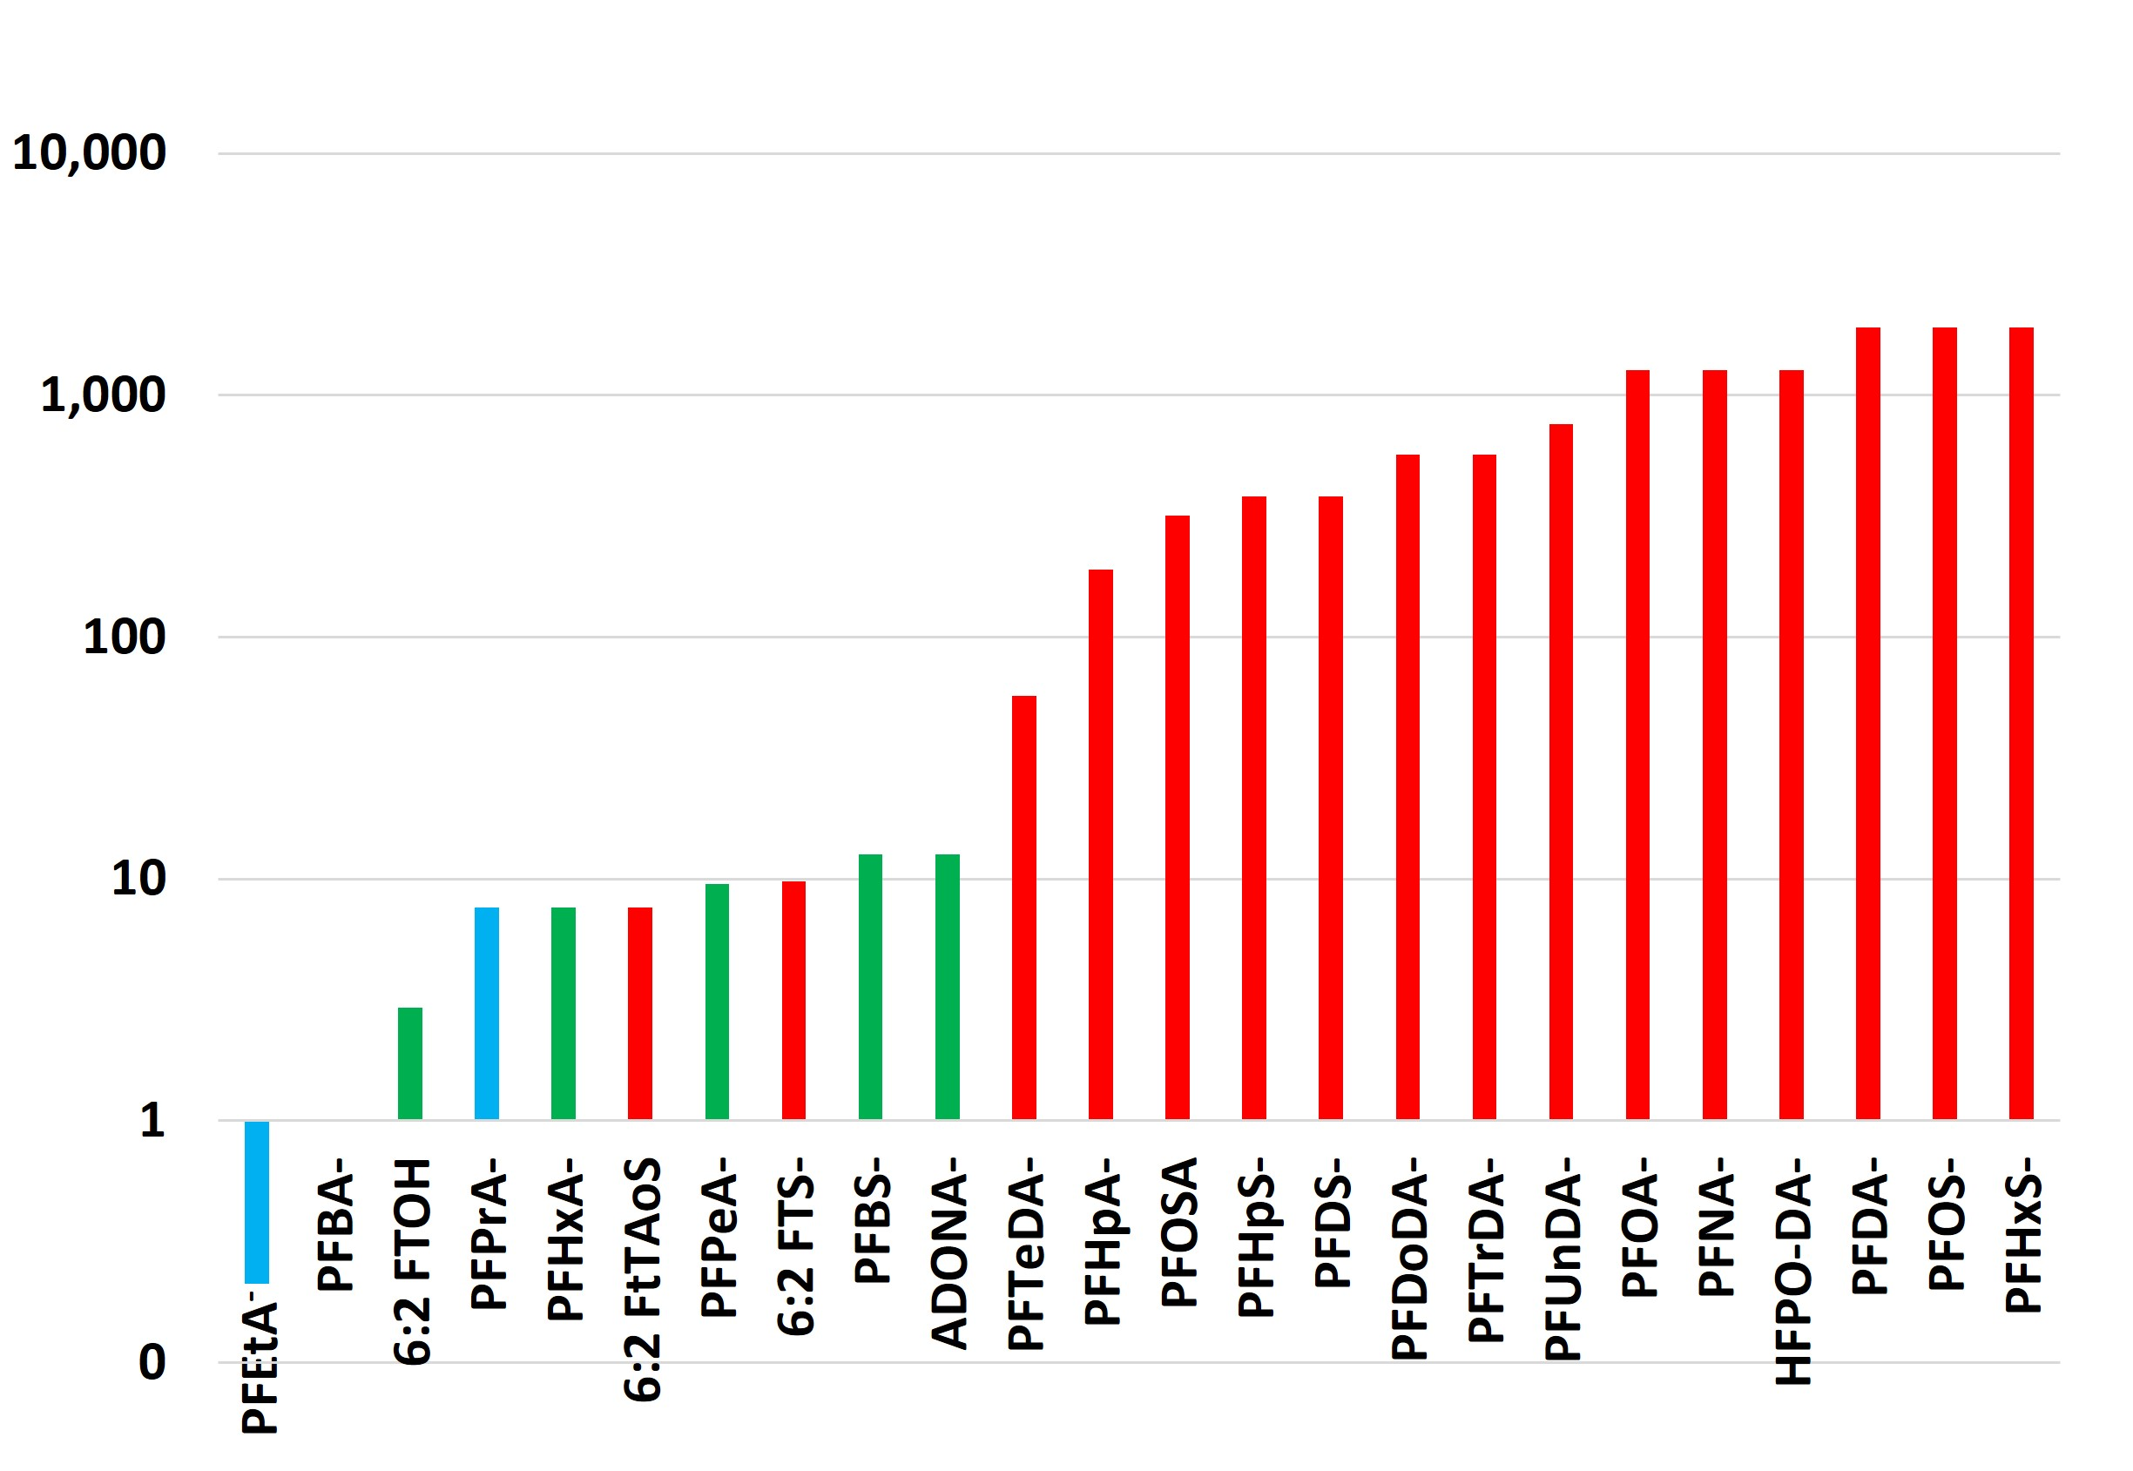
Relative PFAS Toxicity (19 Terminal PFASs & 5 Precursors)
(noncancer Reference Dose; PFBA⁻ = 1)
Ultrashort Chain
Short Chain (lower toxicity)
Long Chain (lower toxicity)
Precursors (mostly lower toxicity)
Increasing Toxicity
PFBA⁻
CrVI
PCE
Benzene
Dioxins = 1,000X PFOS
Naphthalene
DDT
TCE
Arsenic
PCBs

Slide 8
19 “Terminal PFAS” Compounds With Toxicity Factors
2024 Hawaii Dept of Health Toxicity-Based Action Levels (HQ=1) (MCLs & MCLGs)
Terminal PFAS Compound | # Carbons | Soil-res (µg/kg) | Tapwater (ng/L)
Perfluoro butane sulfonate (PFBS⁻) | 4 | 3,800 | 1,700 (2,000)
Perfluoro pentane sulfonate (PFPeS⁻) | 5 | 2,000 | 650
Perfluoro hexane sulfonate (PFHxS⁻) | 6 | 25 | 7.7 (10)
Perfluoro heptane sulfonate (PFHpS⁻) | 7 | 126 | 38
Perfluoro octane sulfonate (PFOS⁻) | 8 | 25 | 7.7 (*4)
Perfluoro decane sulfonate (PFDS⁻) | 10 | 126 | 38
Perfluoro ethanoate (PFPrA⁻, trifluoroacetate) | 2 | 29,000 | 18,000
Perfluoro propanoate (PFPrA⁻) | 3 | 5,000 | 510
Perfluoro butanoate (PFBA⁻) | 4 | 48,000 | 15,000
Perfluoro pentanoate (PFPeA⁻) | 5 | 5,100 | 1,500
Perfluoro hexanoate (PFHxA⁻) | 6 | 6,300 | 1,900
Perfluoro heptanoate (PFHpA⁻) | 7 | 250 | 77
Perfluoro octanoate (PFOA⁻) | 8 | 38 | 12 (*4)
Perfluoro nonanoate (PFNA⁻) | 9 | 38 | 12 (10)
Perfluoro decanoate (PFDA⁻) | 10 | 25 | 7.7
Perfluoro undecanoate (PFUnDA⁻) | 11 | 63 | 19
Perfluoro dodecanoate (PFDoDA⁻) | 12 | 84 | 26
Perfluoro tridecanoate (PFTrDA⁻) | 13 | 84 | 26
Perfluoro tetradecanoate (PFTeDA⁻) | 14 | 840 | 260
Ultrashort
Short
Sulfonates
Long
Carboxylates

Slide 9
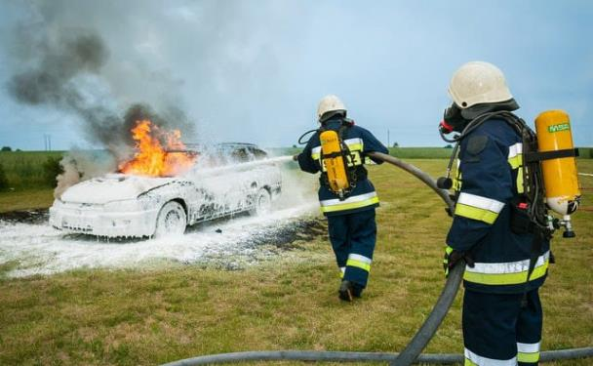


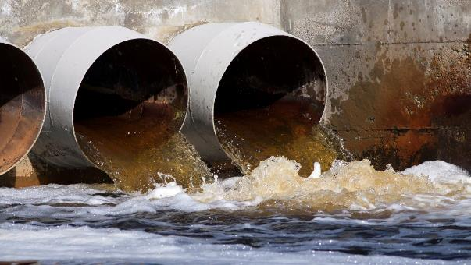
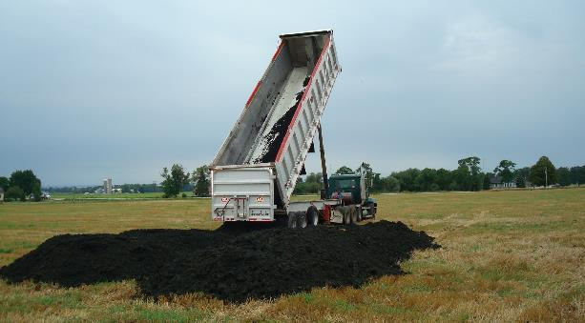
“Precursors”: Terminal PFAS + Functional Group
(most not reported by laboratory and/or lack toxicity factors)
AFFF (6:2 FtTAoS)
Textiles, Carpet.
Food Containers, etc.
(e.g., 6:2 FTOH)
Biosolids
(metabolites)
Wastewater
(metabolites)

Slide 10
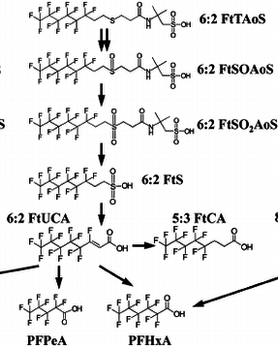
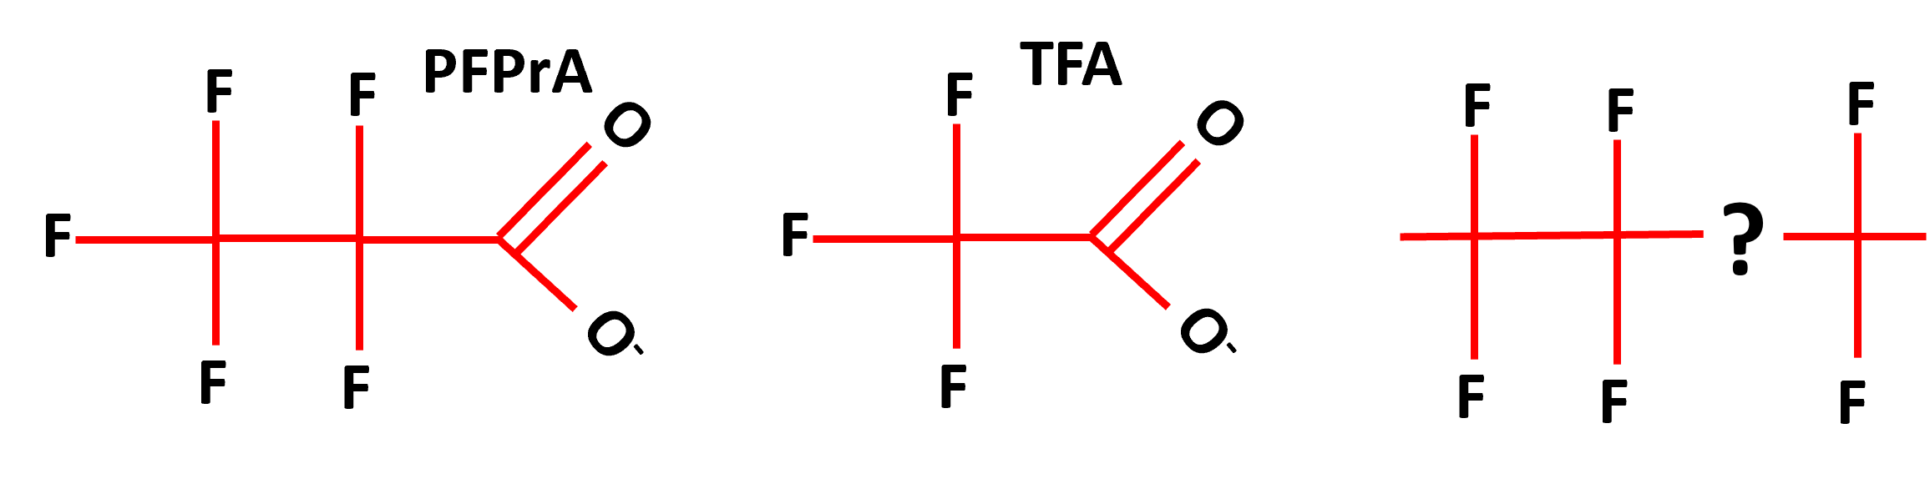
Natural Oxidation and Breakdown of 6:2 FtTAoS
(after Marjanoic et al. 2015)
6 Carbons Fluorinated
PFEtA⁻ (TFA)
?
PFPrA⁻
Metabolites
(partial oxidation)
?
6 Carbons Fluorinated
“PFAS Debris”
(C-F & C-C bonds broken)
5:3 FTCA
5 Carbons Fluorinated
?
F⁻
Secondary Terminal PFAS
4 & 5 Carbons Fluorinated
F⁻
?

Slide 11
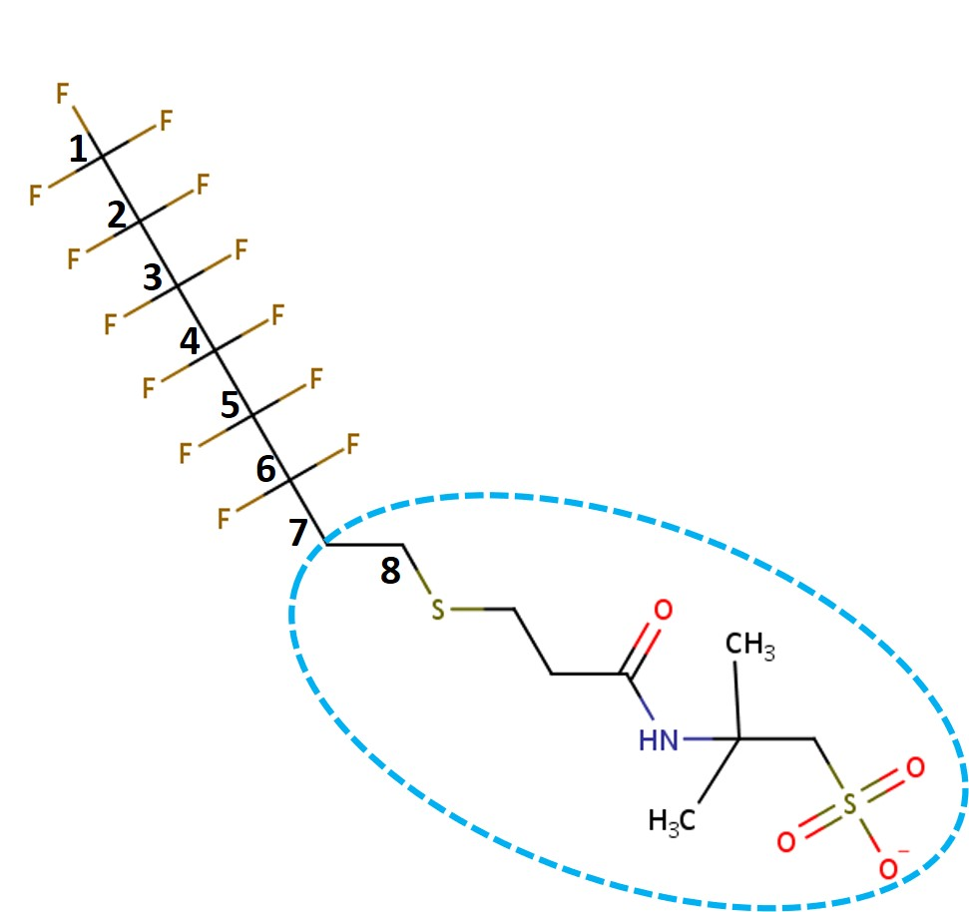
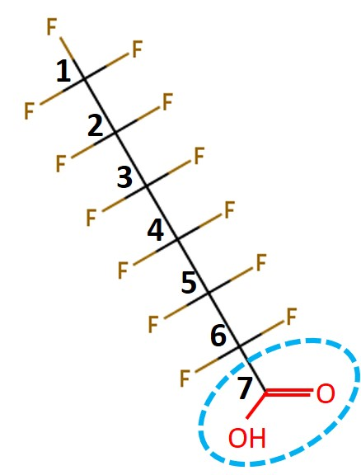

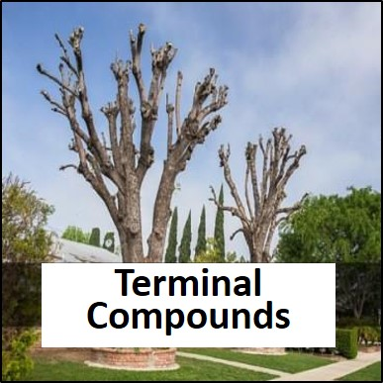
Total Oxidizable Precursors (TOPs) Processing
(breaks precursors down to Terminal PFASs)
Primary
Terminal PFASs
Precursor PFASs
6:2 FtTAoS
(PFHpA + Functional Group)
PFHpA
Removed by TOPs
Originally Present in Sample
TOPs
Used to Assess Risk
Primary
Terminal PFASs
Secondary
Terminal PFASs
PFPeA⁻
PFHxA⁻
+ ultrashorts

Slide 12

PFAS Groups and Assessment of Total PFAS Risk
(cumulative health risk)
3. Excess
Fluorine
PFAS
PFAS Groups:
Primary Terminal PFASs: Originally present in sample (direct comparison to action levels).
Secondary Terminal PFASs: Generated by TOPs breakdown of precursors (direct comparison to action levels).
Excess Fluorine PFASs: Additional PFASs identified by Total Organic Fluorine (TOF)
2. Secondary
PFAS
+TOF
?
1. Primary
PFAS
$Excess Organic Fluorine =Measured TOF−Predicted TOF$
+TOPs
+TOPs
NTA data and degradation pathway of precursors suggests Excess Organic Fluorine at least in part associated with ultrashort PFASs.
Sample Analysis

Slide 13

Assessment of Excess Organic Fluorine PFASs Health Risk
$Excess Organic Fluorine =Measured TOF−Predicted TOF$
3. Excess
Fluorine
PFAS
Estimation of Health Risk:
Assume All Excess Fluorine = PFPrA⁻ (C₃HF₅O₂).
Convert Excess Fluorine Concentration to equivalent concentration of PFPrA⁻.
Compare to PFPrA⁻ Action Levels.
Calculate Hazard Quotient.
2. Secondary
PFAS
+TOF
Excess Organic Fluorine PFASs Concentration:
= Excess Organic Fluorine x
PFPrA⁻ Molecular Weight (164)
F Atomic Mass (19) x # Fs (5)
1. Primary
PFAS
+TOPs
+TOPs
= Excess Organic Fluorine Conc. X 1.73
HIDOH 2024 PFPrA⁻ Action Levels:
Soil Direct Exposure = 5,100 µg/kg
Drinking Water/Tapwater AL = 510 ng/L
Sample Analysis

Slide 14
Total PFAS Risk
- WWTP Biosolids Example -
3. Excess
Fluorine
PFAS
Total PFASs Risk =
Primary Terminal PFASs Risk +
Secondary Terminal PFASs Risk +
Excess Fluorine PFASs Risk
2. Secondary
PFAS
+TOF
Laboratory Methods
*Primary Terminal PFASs:
SGS MLA110 or USEPA 1633 or 537M (before TOPs processing)
*Secondary Terminal PFASs:
SGS MLA111 or USEPA 1633 or 537M (after TOPs processing)
Excess Fluorine PFASs:
MLA 119 (TOF: Liquids = AOF; Solids = EOF)
1. Primary
PFAS
+TOPs
+TOPs
Sample Analysis
*Ultrashorts: MLA120 (or request with USEPA Method)

Slide 15
Primary Terminal PFAS Noncancer Risk
- Example WWTP Biosolids -
Potential Health Risk if Hazard Index >1 (rounded to single significant digit)

Slide 16
Calculation of Secondary Terminal PFASs (precursors)
- Example WWTP Biosolids -
Pre-TOPs missed 90% of PFASs in sample
Concentration of Secondary PFAS = Post-Tops minus Primary Terminal PFAS data

Slide 17
Secondary Terminal PFASs Noncancer Risk (precursors)
- Example WWTP Biosolids -
Primary PFASs + Secondary PFAS HI = 1.5

Slide 18
Excess Fluorine PFAS Noncancer Risk
- Example WWTP Biosolids -
Excess Fluorine PFASs:
1. PRPrA⁻_{equiv} = 577 µg/Kg x 1.73
2. PRPrA⁻_{equiv} = 998 µg/Kg
3. EF PFASs = 998 µg/Kg
HQ =
Excess Fluorine PFASs
PFPrA⁻ Soil Action Level
HQ =
1,015 µg/Kg
5,100 µg/Kg
EF PFASs HQ = 0.2

Slide 19
Total PFAS Risk
- Example WWTP Biosolids -
3. Excess
Fluorine
PFAS
Total PFASs Risk =
Pre-TOPs PFASs Risk +
Post-TOPs PFASs Risk +
Excess Fluorine PFASs Risk
2. Secondary
PFAS
+TOF
Total PFASs Risk
= 0.5 + 1.0 + 0.2
= 1.7
= 2 (*noncancer Hazard Index)
1. Primary
PFAS
+TOPs
+TOPs
*Rounded to single digit
Hazard Index (very simplified interpretation):
<1: No anticipated adverse health risk
>1: Review actual exposure, risk model assumptions, toxicity studies, etc.
Sample Analysis

Slide 20
Hawai’i DOH Total PFAS Risk Calculator:
Example: WWTP Biosolids (residential soil exposure)
Step 1:
Input Sample Information
Step 2:
Select Media Type
(solid or liquid)
Step 3:
Select Exposure Scenario
Step 4 (optional):
Input Alternative Excess Fluorine PFASs Action Levels

Slide 21
Hawai’i Total PFAS Risk Calculator:
Example: WWTP Biosolids (residential soil exposure)
Step 5:

Slide 22
Hawai’i DOH Total PFAS Risk Calculator:
Example: WWTP Biosolids (residential soil exposure)

Slide 23
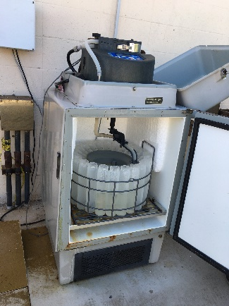

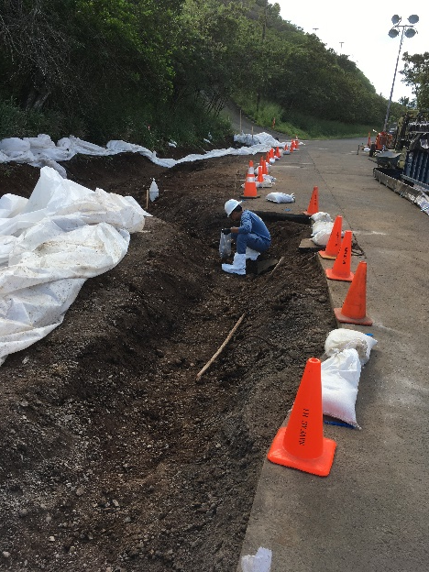
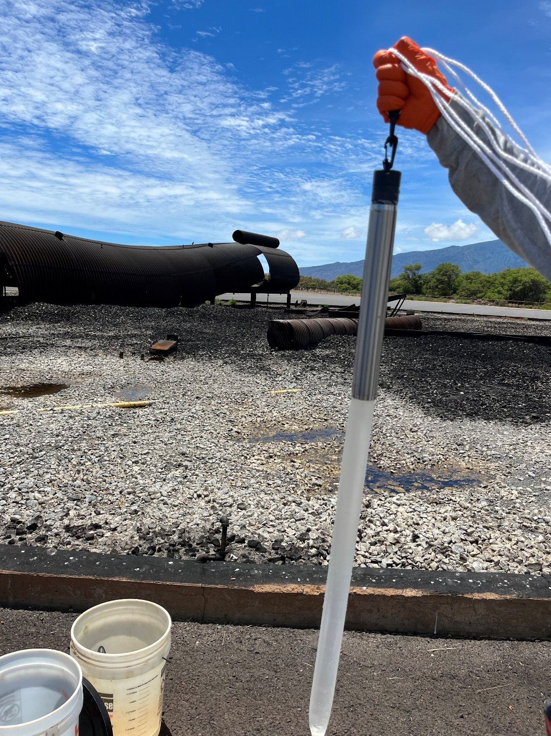
Field Study: WWTPs, Landfills, AFFF-Release Sites
- Sample Collection and Laboratory Analyses -
Sample Collection:
WWTP Influent and Effluent:
24-Hour “Composite” Samplers
WWTP Biosolids and AFFF-Site Soils:
30- to 50-Increment Multi Increment Samples
Landfill Leachate and AFFF-Site Groundwater:
Grab samples (bailer, HydraSleeve)
Sample Analyses
Pre-TOPs: MLA110 (Method 537M )
Post-TOPs: MLA111 (Method 537M+TOPs)
Ultrashorts: MLA120 (+ added to 537M)
Total Organic fluorine: MLA119 (Method 1621)
Liquids: “Absorbable Organic Fluorine”
Solids: “Extractable Organic Fluorine”
Non-Target Analysis (optional)
Six Wastewater Treatment Plants
Five Landfills
Two AFFF Release Sites

Slide 24
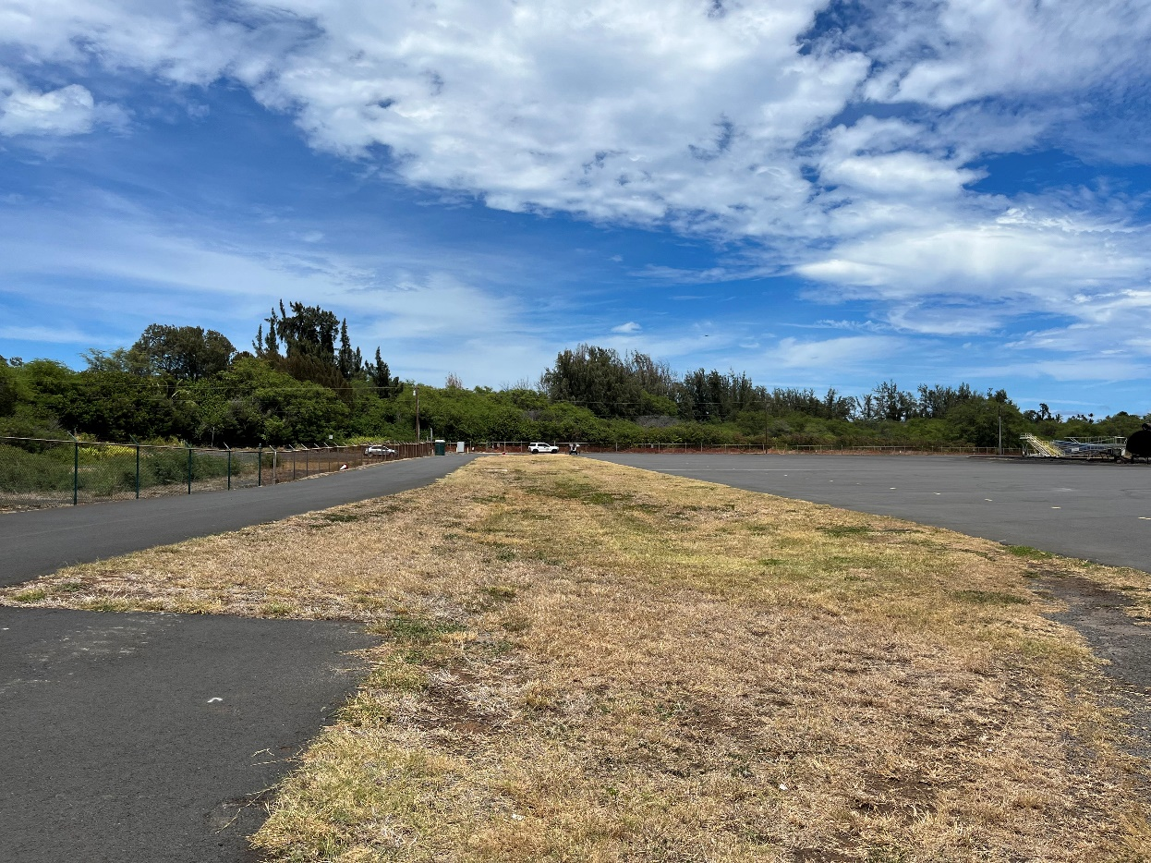

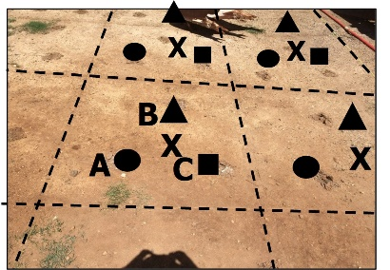
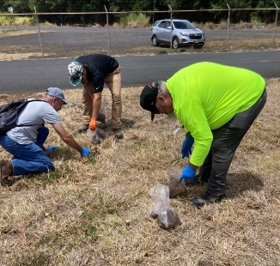
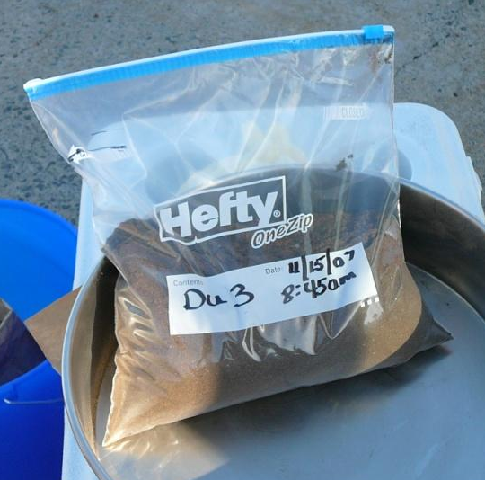

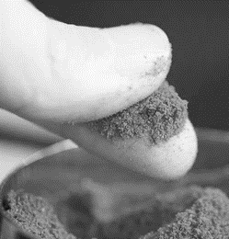
Collection of Multi Increment Soil & Biosolids Samples
Decision Unit area & volume of soil/biosolids designated for collection of a sample (worker exposure area);
Two kilogram, 45-increment sample collected;
Triplicate samples collected to test sampling method precision (not for a 95% UCL);
Sample air-dried & sieved to target particle size (methanol used for VOCs);
Minimum 10-gram MI subsample collected for analysis.
DU-5
X
X
X
X
X
X
X
X
X
X
X
X
B
A
C
Stop the Grab!
X
X
Field Study of Grab/Discrete Sample Reliability
https://health.hawaii.gov/heer/guidance/specific-topics/decision-unit-and-multi-increment-sampling-methods/

Slide 25
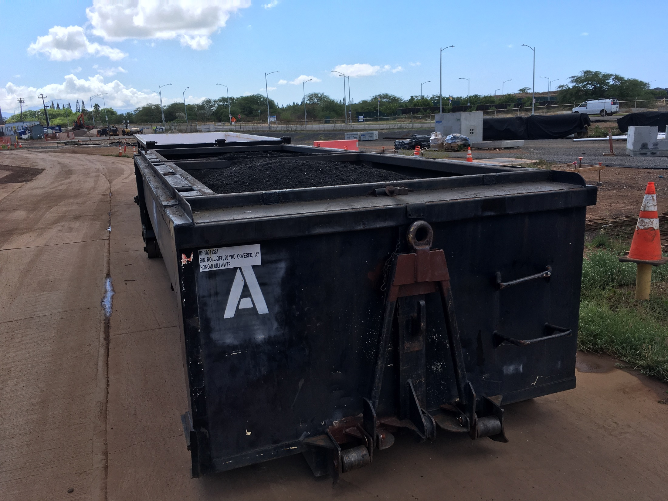
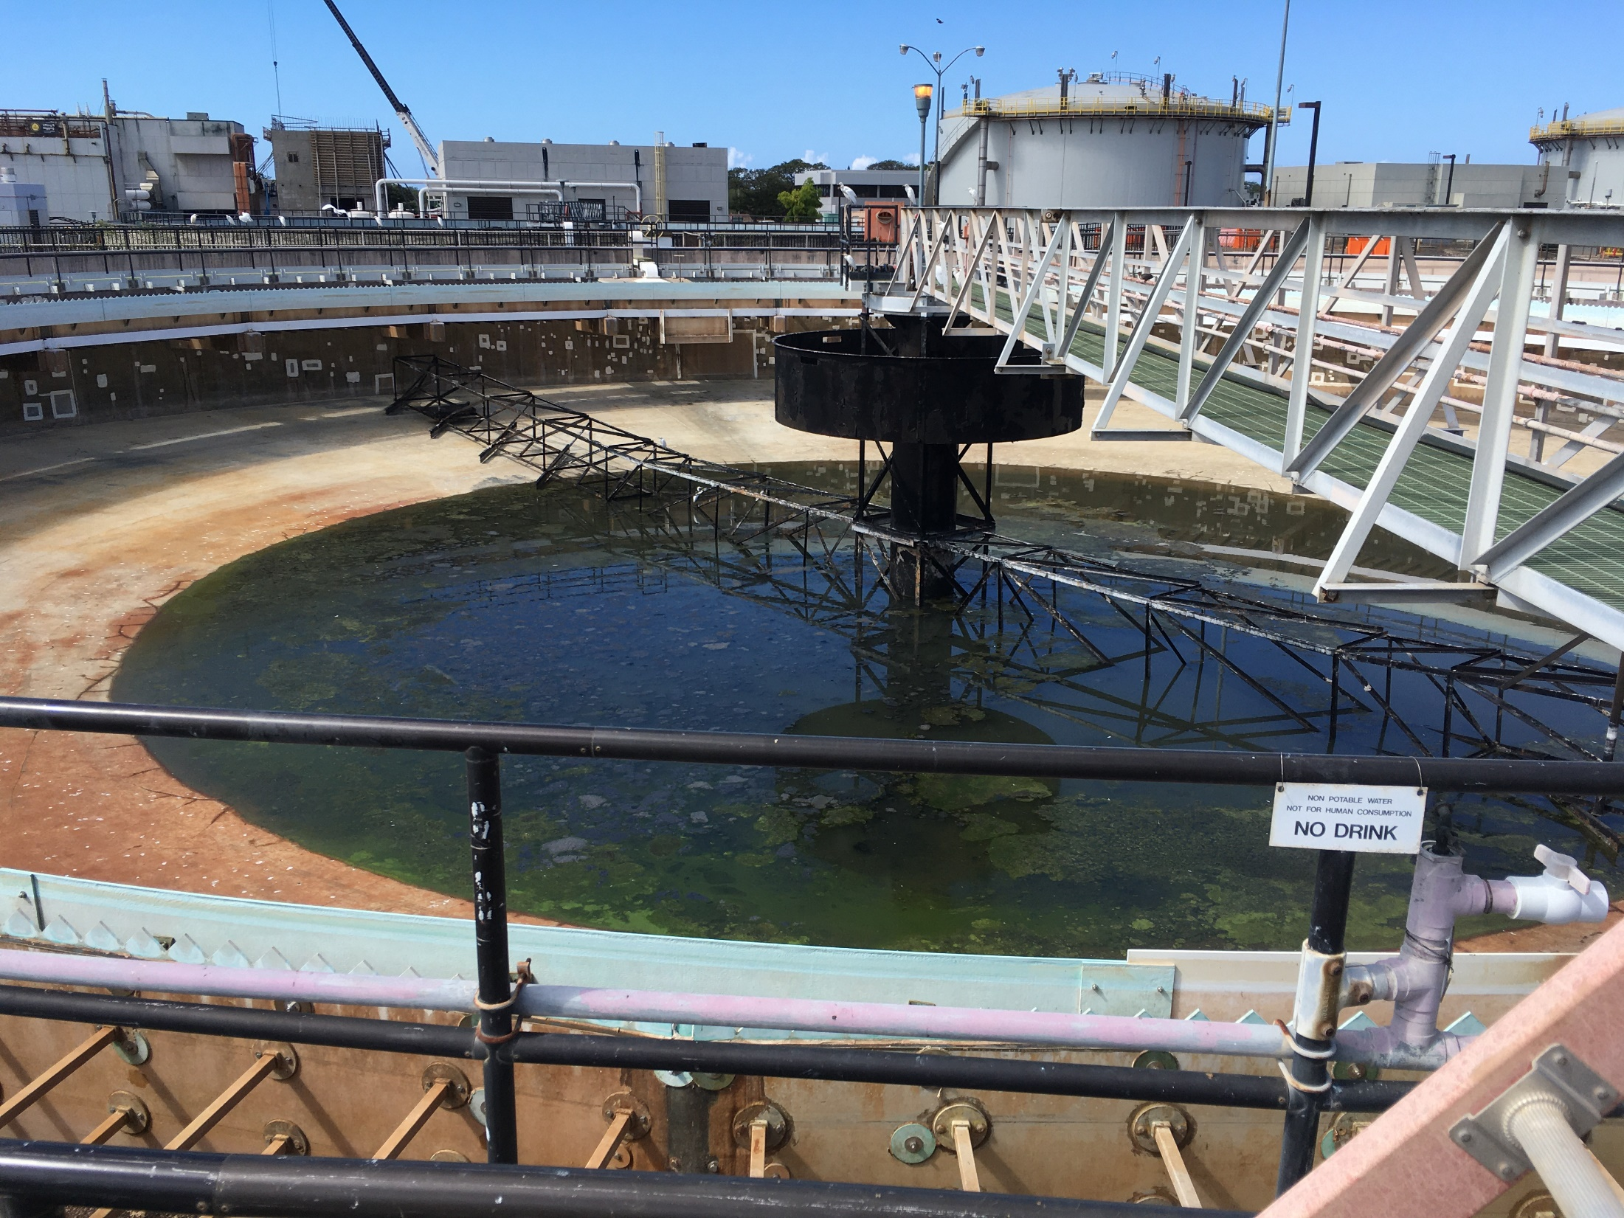

Wastewater Treatment Plants (WWTP #5)
AOF = ?
Not from landfill leachate
Total Post-TOPs PFASs less than Total Pre-TOPs
Post-TOPs decrease in total PFASs due to removal of Functional Group from 5:3 FTCA and lack of other precursors
Significant increase in Total Post-TOPs PFASs;
No EOF
No NTA
AOF = ?

Slide 26
Wastewater Treatment Plants (WWTP #6)
AOF =
2,000 ng/L
EOF =
892 µg/Kg
Total Post-TOPs PFASs similar to Total Pre-TOPs
AOF >10X higher than predicted;
NTA: Excess AOF = Ultrashorts?
Significant increase in Total Post-TOPs PFASs;
EOF 2X higher than predicted;
NTA: Excess EOF = Ultrashorts?
AOF =
1,600 ng/L
EOF =
892 µg/Kg

Slide 27
Landfill Leachate
(specifically reported PFASs)
AOF =
83,000 ng/L
AOF =
13,000 ng/L
100X increase in reported Total PFASs;
Significant concentration of 5:3 FTCA⁻ in municipal waste cell leachate;
Reduced 5:3 FTCA⁻ in cell storing incinerated municipal waste ash;
Total Post-TOPs PFASs similar to Total Pre-TOPs PFASs (minimal additional precursors);
AOF 2X higher than predicted based on identified PFASs (additional PFASs);
Ultrashort & NTA data: Pending.
AOF =
51,000 ng/L

Slide 28
AFFF Release Site #1 (Fuel Storage): Impacted Soil
Release of AFFF concentrate in 2022 (“Modern” AFFF);
45-Increment Multi Increment samples collected;
Pre-TOPs missed 99.9% of PFASs in soil (NTA = 6:2 FtTAoS);
TOF (EOF) not analyzed.
Indicator of post-2005 AFFF and likely presence of 6:2 FtTAoS
High concentration of 6:2 FtTAoS oxidized to PFBA⁻, PFPeA⁻ and PFHxA⁻

Slide 29
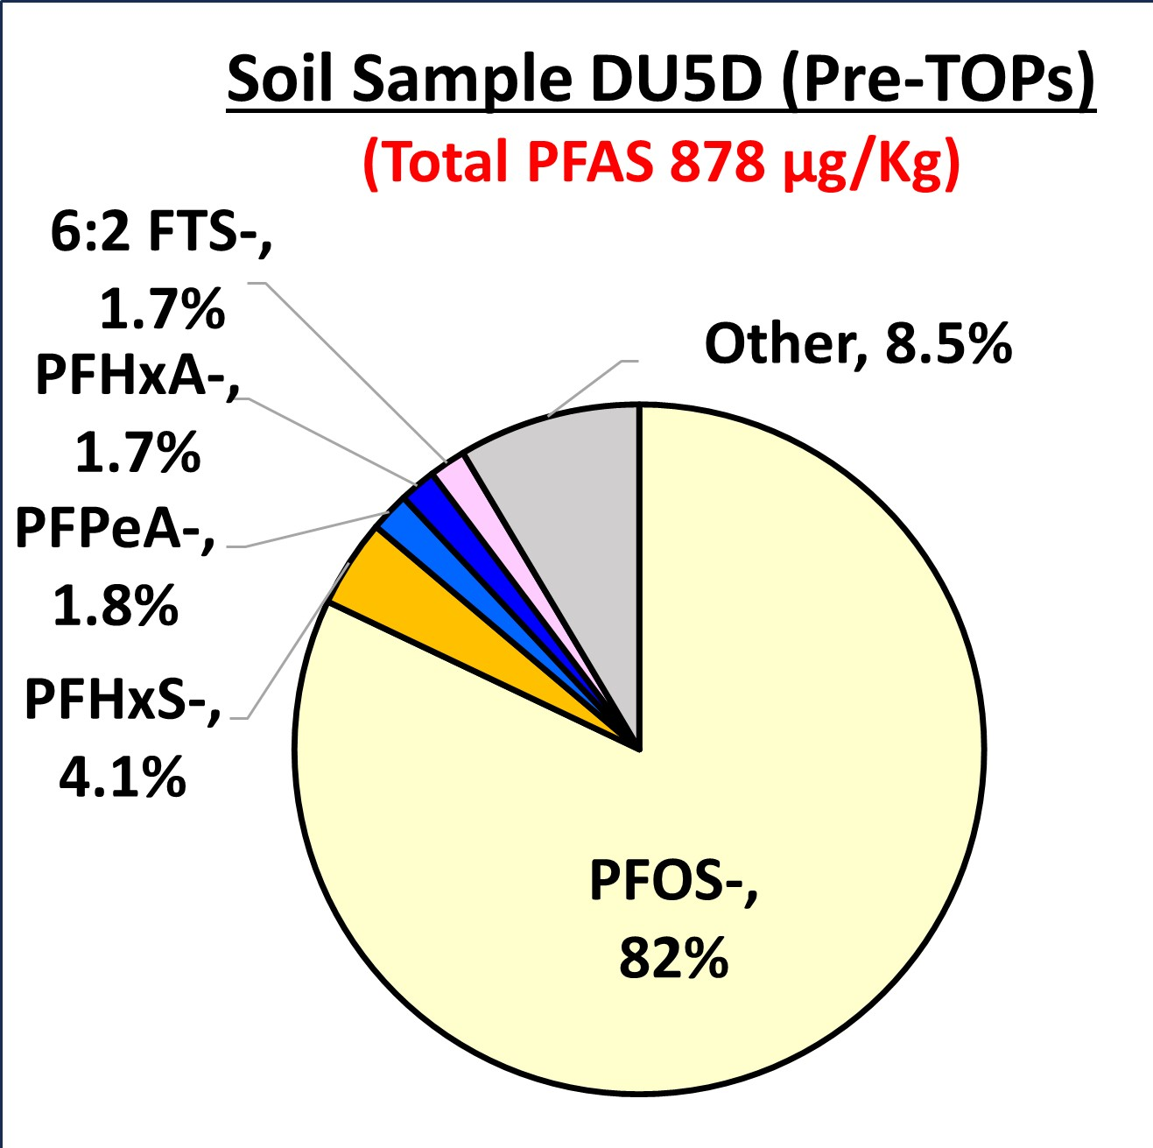
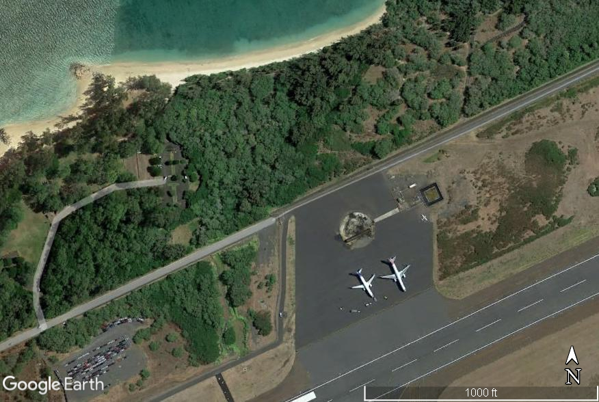
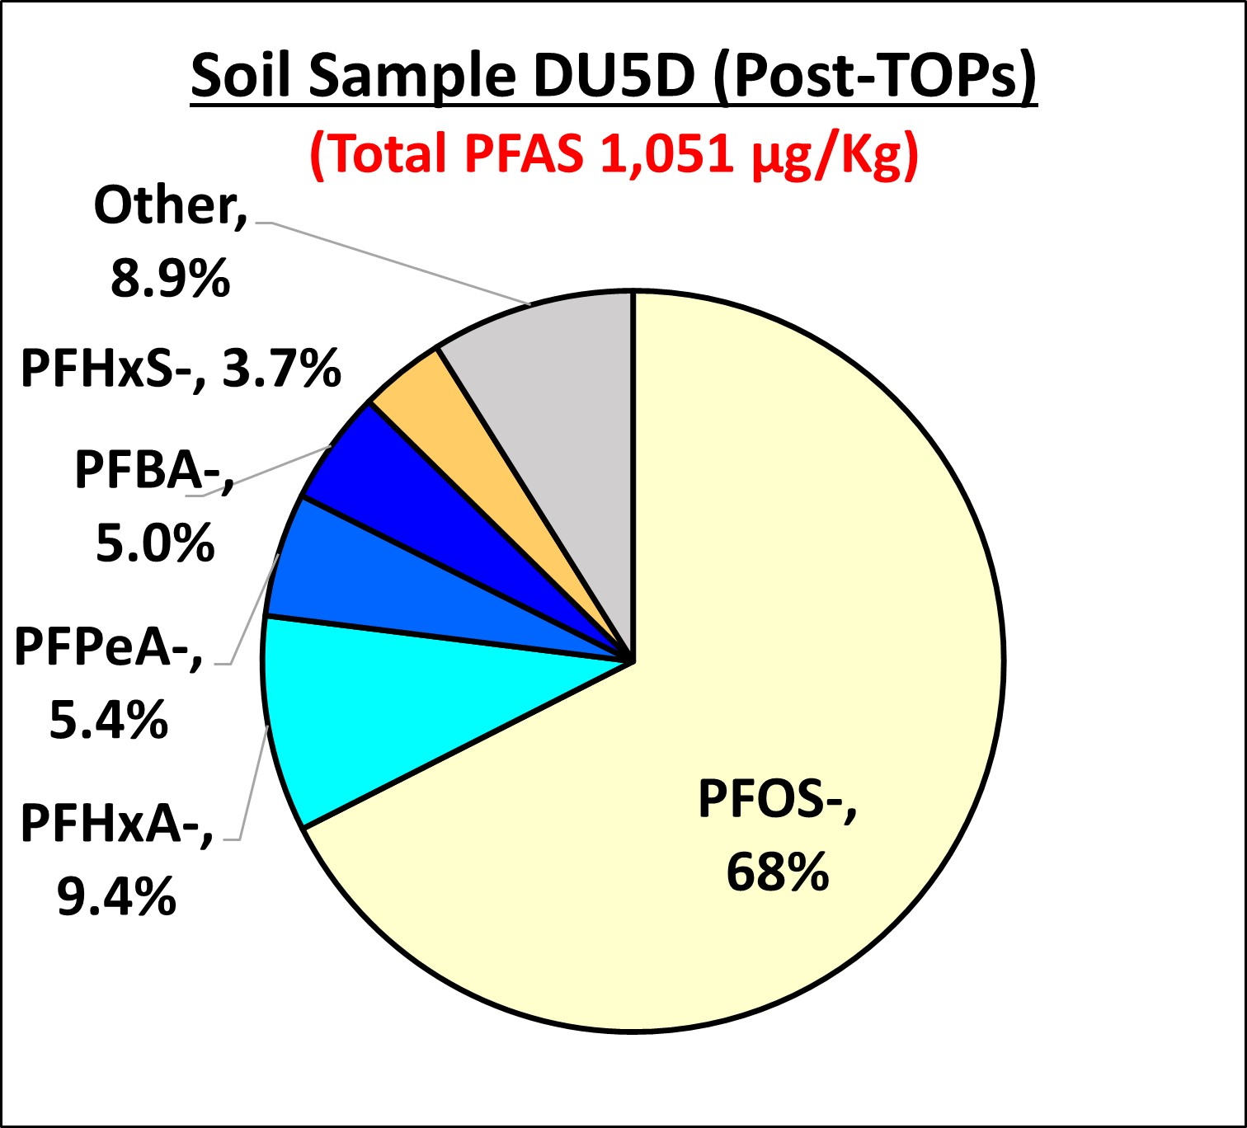
AFFF Release Site #2 (Fire Training Area): Impacted Soil
Pre-TOPs: 878 µg/Kg
800 ft
1977-1997: Unlined
Post 1997: Lined
Post-TOPs: 1,051 µg/Kg
paved
Post-TOPs Total PFASs slightly higher than Pre-TOPs Total PFASs (low concentration of additional precursors);
Likely related to past releases of PFOS-based AFFF.

Slide 30
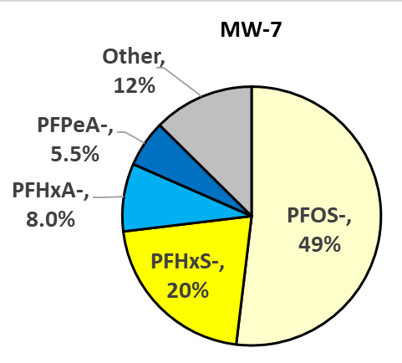
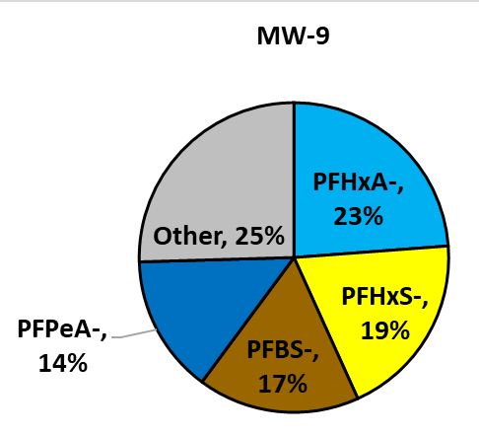
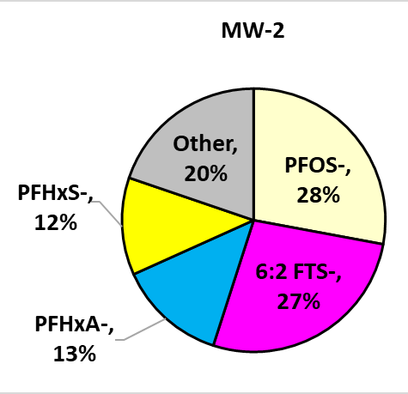
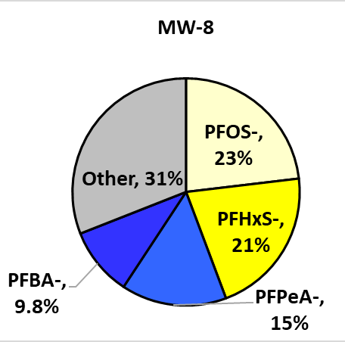
AFFF Release Site #2 (Fire Training Area): Impacted Groundwater (µg/L)
Total PFAS: 49 µg/L
AOF: 190 µg/L
Total PFAS: 8.0 µg/L
AOF: 18 µg/L
5% PFOS⁻
Total PFAS: 1,200 µg/L
AOF: 2,400 µg/L
Total: 0.16 µg/L
AOF: <2.0 µg/L
Very high concentration of Total PFASs;
Total Post-TOPs PFASs similar to Total Pre-TOPs PFASs (minimal additional precursors);
AOF 3-6X higher than predicted based on identified PFASs (Excess Fluorine PFASs);
No NTA data (ultrashorts?).
Notes:
6:2 FTS⁻ remained in source area;
PFOS⁻ stays with plume in migration directions
More mobile PFASs diffuse laterally (e.g., PFHxA⁻, PFBS⁻, PFHxS⁻).

Slide 31
Relative PFAS Makeup and Hypothetical Risk
WWTP
Effluent?
WWTP
Biosolids?
Landfill
Leachate?
Fire Training
Areas?
Direct
Exposure
Crop
Uptake
?
Aquatic
Habitats
Leaching
Groundwater Impacts

Slide 32
Comparison of Relative PFAS Group Makeup
- Effluent vs Leachate vs AFFF-Impacted Groundwater -
Only in Source Area
Primary
PFASs
Secondary
PFASs

Slide 33
Comparison of Relative PFAS Group Risk
- Effluent vs Leachate vs AFFF-Impacted Groundwater -
Primary
PFASs
Secondary
PFASs

Slide 34
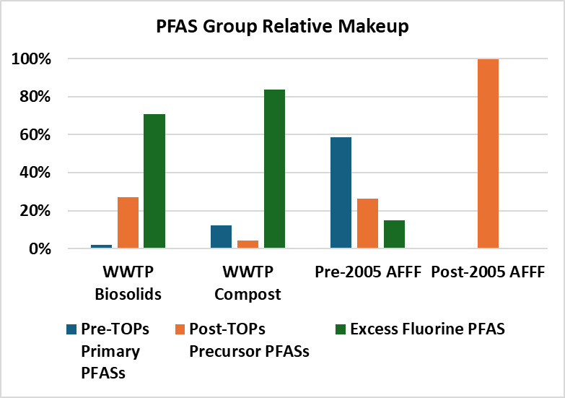
Comparison of Relative PFAS Group Makeup
- Biosolids vs Compost vs AFFF-Impacted Soil -
Example
Pre-TOPs
PFAS 0.1%
EOF Not Tested
Primary
PFASs
Secondary
PFASs

Slide 35
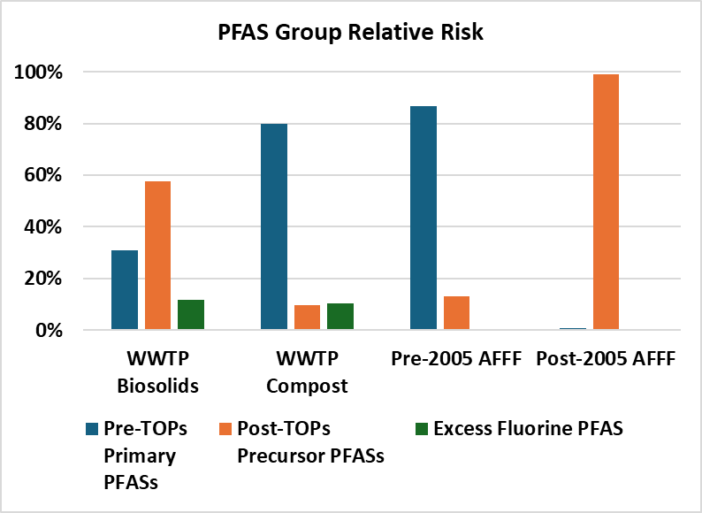
Comparison of Relative PFAS Group Risk
- Biosolids vs Compost vs AFFF-Impacted Soil -
Example
Pre-TOPs
PFAS 1.0%
EOF Not Tested
Primary
PFASs
Secondary
PFASs

Slide 36
Relative “Source Strength” in Terms of Risk (noncancer Hazard)
-WWTP Effluent vs Landfill Leachate vs AFFF-Impacted Groundwater-
Effluent
Landfills
AFFF-Impacted Groundwater
Hazard Index
Study Site

Slide 37
Relative Source Strength in Terms of Risk (noncancer Hazard)
-Biosolids vs Compost vs AFFF-Impacted Soil-
Biosolids/Compost
AFFF-Impacted Soil
(Hazard Indices in un-remediated
release areas will be much higher)
Hazard Index
Low Heath Risk
Low to Very High Risk

Slide 38
Study Takeaway Points: General
(based primarily of Hawai‘i Study data)
Testing of initial samples for full suite of PFASs is important in initial stages of an investigation to understand PFAS makeup and estimate Total PFAS Risk:
  Primary Terminal PFASs (pre-TOPs),
  Secondary Terminal PFASs (post-TOPs), and
  Excess Fluorine PFASs (Total Organic Fluorine).
Possible reduction in analyses based on initial data and apparent risk-drivers;
Better understanding of “Excess Fluorine PFASs” needed;
Non-Targeted Analysis is partially useful for identification of compounds associated with excess organic fluorine in a sample;
Ultrashorts (e.g., PFEtA⁻/TFA) might not be captured by current Absorbable Organic Fluorine methods (excess organic fluorine underestimated?).

Slide 39
PFASs in WWTP Influent & Effluent
Primary sources include washing of textiles (e.g., water and stain resistant clothing, tablecloths, bed linens, carpet, etc.), + dietary, pharmaceuticals;
TOF analysis required to identify apparent presence of complex mixtures of ultrashort PFASs (risk driven by Excess Fluorine PFASs and Primary Terminal PFASs);
Low to moderate toxicity in comparison to drinking water action levels;
Low to moderate risk to drinking water aquifers if used for irrigation (e.g., depending on irrigation method and hydrogeology);
Potential uptake into food crops requires additional research (HIDOH 2025 field study).
No significant acute or chronic toxicity risk to aquatic organisms and habitats (well below published action levels);
Bioaccumulation in aquatic food chain requires additional research (focus on filter feeders and freshwater fish);
Concentration and toxicity of PFASs in wastewater from operations that use PFASs-based media (e.g., AFFF) could be significantly higher.

Slide 40
PFASs in WWTP Biosolids & Compost
Primary sources include washing of textiles (e.g., water and stain resistant clothing, tablecloths, bed linens, carpet, etc.);
TOPs processing required to identify precursor compounds in biosolids (risk driven by Secondary Terminal PFASs);
Precursors oxidized during curing of compost (risk driven by Primary Terminal PFASs);
Low toxicity in comparison to risk-based, soil action levels;
Disposal of biosolids at municipal landfills not anticipated to pose significant health risk to workers or significantly add to PFAS burden in leachate;
Risk posed by uptake of PFASs into produce from fresh biosolids likely low to moderate but requires additional research (mobile PFASs quickly taken up or leached to groundwater?).

Slide 41
PFASs in Landfill Leachate
Primary sources include textiles, carpet, furniture, treated paper, etc.
TOF analysis required to identify apparent presence of complex mixtures of ultrashort PFASs (moderate contribution to potential health risk);
High toxicity in comparison to drinking water action levels (risk driven by Primary Terminal PFASs +/- Excess Fluorine PFASs?);
Threat to underlying aquifers low provided that permit-required, engineering controls to prevent leakage of leachate from landfill are maintained;
Investigation of potential PFASs in groundwater at retired, unlined landfills recommended;
Disposal of landfill leachate at municipal WWTPs not anticipated to significantly affect total PFASs burden or toxicity provided that controls are in place to limit maximum daily disposal volume (e.g., <0.1% of total daily influent).

Slide 42
PFASs in AFFF-Impacted Soils
Pre-2005 AFFF dominated by PFOS (risk driven by Primary Terminal PFASs);
Post-2005 AFFF dominated by precursor-related PFASs (risk driven by Secondary Terminal PFASs);
Potential high toxicity in comparison to risk-based, soil action levels;
Ongoing leaching of PFASs from soil can pose long-term threat to groundwater.

Slide 43
PFASs in AFFF-Impacted Groundwater
Impacts by pre-2005 AFFF likely dominated by PFOS⁻ and PFHxS⁻;
Impacts by post-2005 AFFF likely dominated by short-chain compounds associated with breakdown of PFAS precursors (PFBA⁻, PFPeA⁻, PFHxA⁻);
Potential high toxicity in comparison to HIDOH drinking water action levels (risk driven by Primary Terminal PFASs in source area, Excess Fluorine PFASs in downgradient areas???);
Comparison of data to currently promulgated MCLs for long-chain PFASs only night not be adequate for post-2005 releases;
TOF analysis required to identify apparent presence of complex mixtures of ultrashort PFASs (dominate in leading edges of plumes???);
Low to potentially high acute or chronic toxicity risk to aquatic organisms and habitats from discharges to water bodies (requires additional research);
Bioaccumulation in aquatic food chain from discharges to water bodies requires additional research (e.g., filter feeders, freshwater fish).

Slide 44
Ultrashort PFASs at Margins and Leading Edges of Plumes?
(plume separation based on predicted sorption and mobility)
GW
Source
Area
Near
Source
Midplume
Leading Edge
Ultrashorts | Ultrashorts | Ultrashorts | Ultrashorts ???
HFPO DA⁻ | HFPO DA⁻ | HFPO DA⁻
PFHxA⁻ | PFHxA⁻ | PFHxA⁻
PFPeA⁻ | PFPeA⁻ | PFPeA⁻
PFBS⁻ | PFBS⁻ | PFBS⁻
PFHpA⁻ | PFHpA⁻ | PFHpA⁻
PFBA⁻ | PFBA⁻ | PFBA⁻
PFOA⁻ | PFOA⁻
PFHxS⁻ | PFHxS⁻ | PFHxS⁻?
PFDA⁻ | PFDA⁻
6:2 FTS⁻ | 6:2 FTS⁻
PFNA⁻ | PFNA⁻
PFOS⁻ | PFOS⁻
PFHpS⁻ | PFHpS⁻
PFUnDA⁻
6:2 FTOH⁻
PFDS⁻
PFOSA⁻
6:2 FtTAOS⁻
PFDoDA⁻
PFTrDA⁻
PFTeDA⁻
TFA⁻, PFPrA⁻, etc.?
Decreasing Mobility
Moderate sorption coefficient but common in groundwater with no apparent nearby source
High sorption PFASs concentrated in and near source area;
Low sorption PFASs at leading edge of plume (including precursor short chain and ultrashort chain breakdown products);
Monitor for ultrashorts and Excess Organic Fluorine in margins and downgradient areas of plumes.

Slide 45
Potential Passage of Ultrashorts Through GAC?
(granulated activated carbon)
Ultrashorts?
Anticipated Removal
of PFASs by GAC
?
Increasing Toxicity
PFBA⁻
PFPrA⁻
6:2 FTOH⁻
PFEtA⁻
CrVI
PCE
Benzene
Dioxins = 1,000X PFOS
Naphthalene
DDT
TCE
Arsenic
PCBs

Slide 46


Questions? Ideas?
Ongoing Research:
Additional WWTP sample collection;
Uptake of PFASs into food crops;
Leaching of PFAS from soil/biosolids (action levels, SPLP batch test, modified Soil Column test);
Bioavailability of PFASs in soil & biosolids;
PFAS vapor intrusion risks;
Edits? Suggestions? Send to John Jacob, PhD (State Toxicologist; john.jacob@doh.Hawaii.gov)
All models are wrong, but some are useful.
George Box
It’s better to be roughly right than precisely wrong.
John Maynard Keynes

Slide 47

Mahalo and Aloha!
tosbrewer@yahoo.com

