Slide 1


USE OF RISK-BASED SAMPLING METHODS AND
“TOTAL PFAS RISK” TO EXPEDITE ASSESSMENT AND REMEDIATION OF PFAS-CONTAMINATED SITES
ECOS SUMMARY (September 30, 2024)
Roger Brewer, PhD
(roger.brewer@doh.Hawaii.gov; after November 2024: tosbrewer@yahoo.com)
Hawaii Department of Health, USA
18 September 2024
www.crcCARE.com

Slide 2
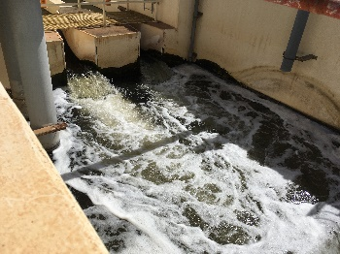
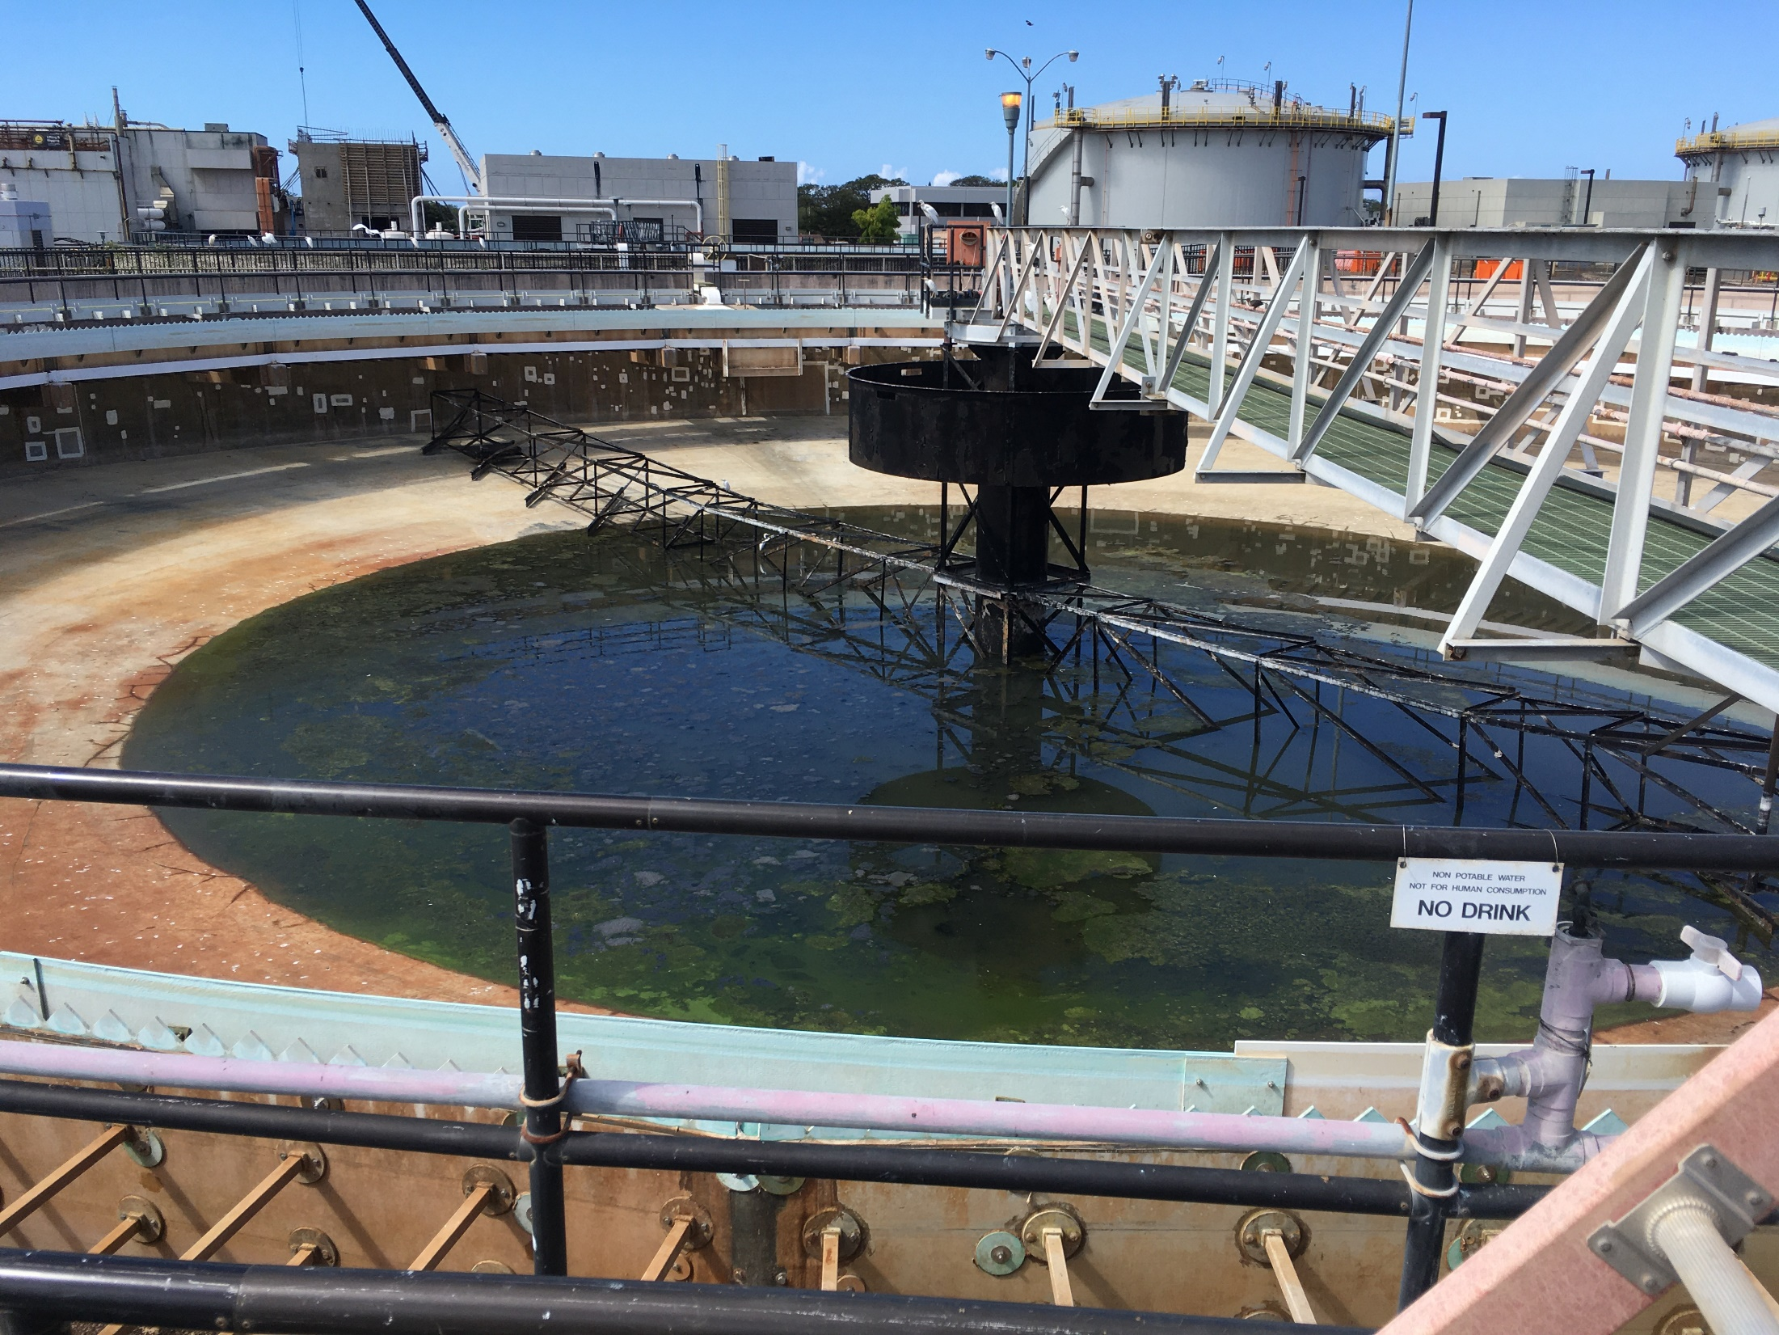
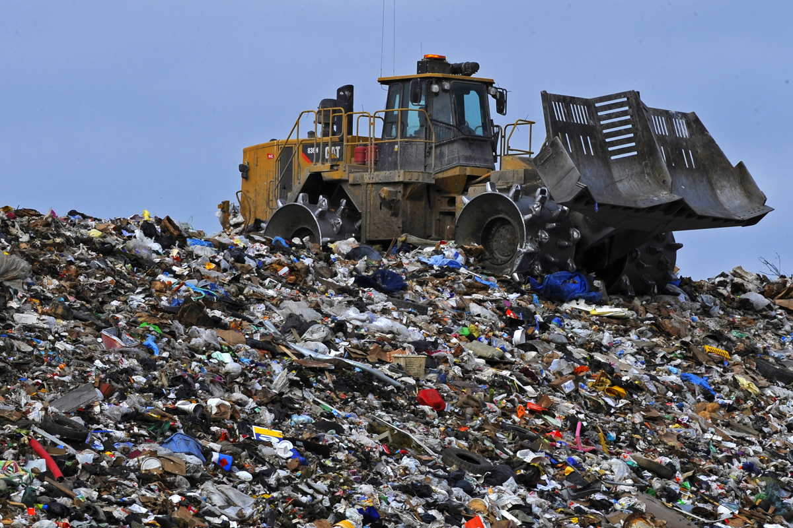


Hawai´i Field Study of PFAS and Assessment of “Total PFAS Risk”
(Sample Analyses: Pre-TOPs, Post-TOPs, TOF)
WWTPs (6)
Influent/Effluent
WWTPs (6)
Biosolids
Landfills (5)
Leachate
AFFF Releases (2)
Soil & Groundwater
Anthropogenic
Soil Background (9)
Hawaii Dept of Health Guidance:
Interim Soil and Water Environmental Action Levels (EALs) for Perfluoroalkyl and Polyfluoroalkyl Substances (PFASs), April 2024 (and updates https://health.hawaii.gov/heer/guidance/ehe-and-eals/
Field Study of PFASs Associated with WWTPs, Landfill Leachate and AFFF-Release Sites (November 2024).
Recorded Webinars: https://health.hawaii.gov/heer/guidance/heer-webinars/
PFAS Basics (chemistry, use, general toxicity):
ITRC 2020: Per- and Polyfluoroalkyl Substances (PFASs)
TOPs Methods:
Ateia et al., 2023, Total Oxidizable Precursor (TOP) Assay Best Practices, Capabilities and Limitations for PFAS Site Investigation and Remediation: Environmental Science and Technology Letters. Vol. 10, pp 292−301.

Slide 3
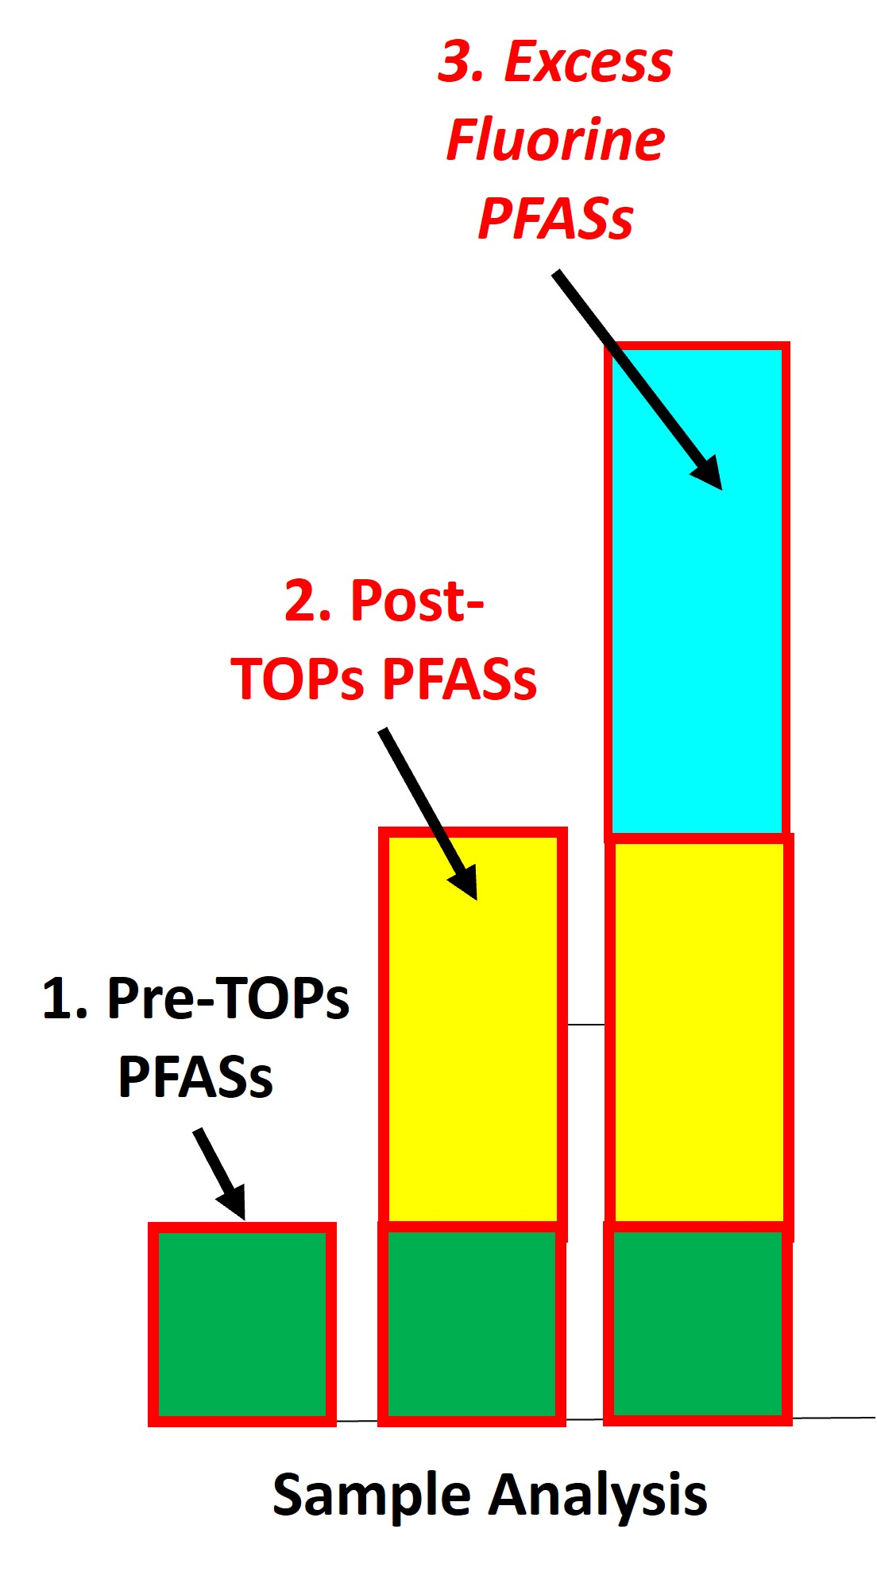
Designation of PFAS Groups and Calculation of “Total PFAS Risk”
Total PFASs Risk =
Primary Terminal Endpoint PFAS Risk (“Pre-TOPs PFASs”)
+ Precursor PFASs Risk (“Post-TOPs PFASs”)
+ Ultrashort PFASs Risk (“Excess Fluorine PFASs”)
?
Assessment of Health Risk:
Focus on noncancer hazard and protection of developing children and pregnant mothers;
Higher confidence in noncancer toxicity factors;
Cancer risk assessed separately (PFOS, PFOA);
Protection against noncancer hazards assumed protective of longer-term, cancer risk.
?

Slide 4
Toxicity Factors & Available for 18+ “Terminal Endpoint” PFASs
(2024 Hawaii Dept of Health Risk-Based Action Levels noted (+MCLs & MCLGs))
Terminal Endpoint Compound | # Carbons | Soil-res (µg/kg) | Tapwater (ng/L)
Perfluoro butane sulfonate (PFBS⁻) | 4 | 3,800 | 1,700 (2,000)
Perfluoro pentane sulfonate (PFPeS⁻) | 5 | 2,000 | 650
Perfluoro hexane sulfonate (PFHxS⁻) | 6 | 25 | 7.7 (10)
Perfluoro heptane sulfonate (PFHpS⁻) | 7 | 126 | 38
Perfluoro octane sulfonate (PFOS⁻) | 8 | 25 | 7.7 (*4)
Perfluoro decane sulfonate (PFDS⁻) | 10 | 126 | 38
Perfluoro ethanoate (PFEtA⁻) | 2 | pending | pending
Perfluoro propanoate (PFPrA⁻) | 3 | 5,000 | 510
Perfluoro butanoate (PFBA⁻) | 4 | 48,000 | 15,000
Perfluoro pentanoate (PFPeA⁻) | 5 | 5,100 | 1,500
Perfluoro hexanoate (PFHxA⁻) | 6 | 6,300 | 1,900
Perfluoro heptanoate (PFHpA⁻) | 7 | 250 | 77
Perfluoro octanoate (PFOA⁻) | 8 | 38 | 12 (*4)
Perfluoro nonanoate (PFNA⁻) | 9 | 38 | 12 (10)
Perfluoro decanoate (PFDA⁻) | 10 | 25 | 7.7
Perfluoro undecanoate (PFUnDA⁻) | 11 | 63 | 19
Perfluoro dodecanoate (PFDoDA⁻) | 12 | 84 | 26
Perfluoro tridecanoate (PFTrDA⁻) | 13 | 84 | 26
Perfluoro tetradecanoate (PFTeDA⁻) | 14 | 840 | 260
Ultrashort
Short
Long
Sulfonates
“Trifluoroacetate”
(toxicity factors pending)
Carboxylates

Slide 5
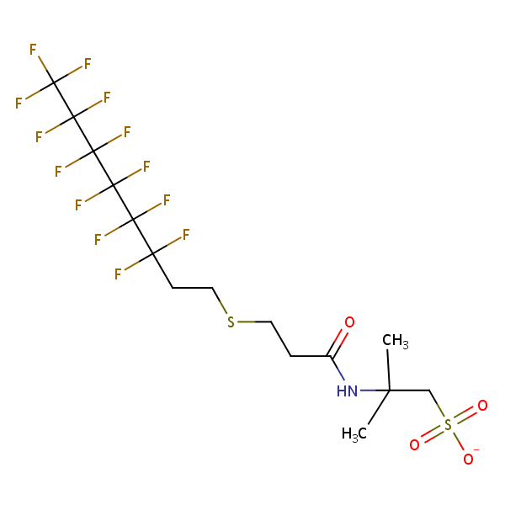
The Problem with Precursors…
“Parent” PFAS
PFAS “Precursor”
Perfluoro Heptanoic Acid
6:2 Fluorotelomer Thioether Amido Sulfonate
1
Dominant PFAS in AFFF since 2005;
Toxicity factors not widely available;
Not Reported by current laboratory methods;
Risk posed by AFFF-contaminated media potentially underestimated.
1
2
2
3
3
4
4
5
5
6
6
7
7
O
8
OH
Reported by Standard Lab Methods
“Functional Group”
Added

Slide 6



Use of “TOPs” Processing to Simulate Metabolism
Of Precursors and Estimate Precursor Mixture Toxicity
Total Oxidizable Precursors (TOPs) Method:
  Sample heated with an oxidizing agent under alkaline conditions;
  Strips functional groups from PFAS leaving terminal end products;
  Identifies presence of previously unreported ultrashort-, short- and long-chain PFASs precursor compounds in sample;
  Final terminal end-product mixture minus pre-TOPs mixture assumed to reflect metabolic products of original compound mixture (matches studies);
  Used to assess overall toxicity of precursor compounds.
TOPs
Precursors &
Metabolites
Terminal Compounds

Slide 7
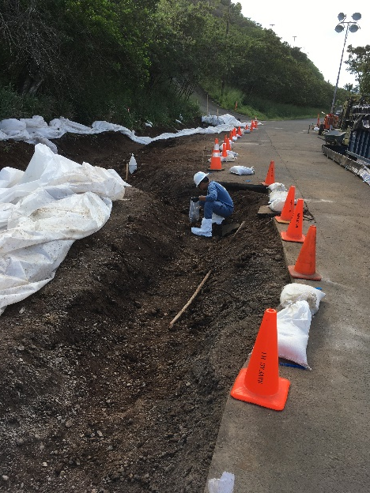

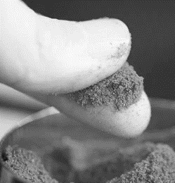
Importance of TOPs Processing for Solids (AFFF Release Site #1)
Stop the Grab!
Release of AFFF concentrate in 2022 (“Modern” AFFF);
Obviously impacted soil excavated;
45-Increment, 2kg Multi Increment Sample collected;
Pre-TOPs missed 99.9% of PFASs in soil (NTA = 6:2 FtTAoS).
X
X

Slide 8
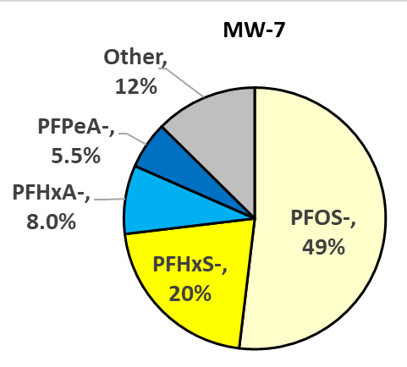
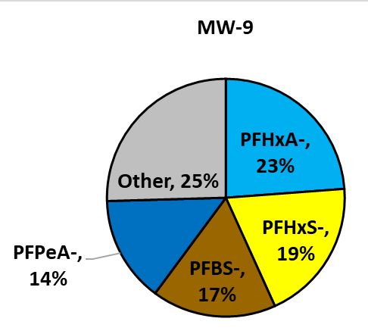
The Problem with “Excess Organic Fluorine…” (NTA Data = Ultrashorts)
Wastewater
Leachate
AFFF Groundwater
Total PFAS: 49 µg/L
AOF: 190 µg/L
AOF =
83,000 ng/L
AOF =
2,000 ng/L
Total PFAS: 8.0 µg/L
AOF: 18 µg/L
AOF =
51,000 ng/L
AOF =
1,600 ng/L

Slide 9
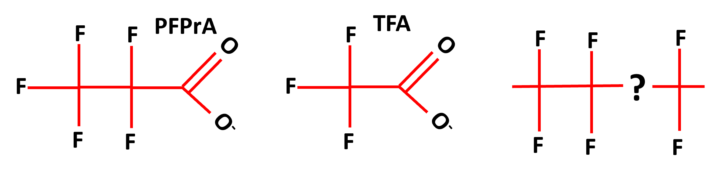
Use of PFPrA⁻ as a Surrogate for Excess Organic Fluorine PFASs Toxicity
Estimated Excess Organic Fluorine:
Assume Excess Fluorine = PFPrA⁻ (C₃HF₅O₂).
Adjust Excess Fluorine Concentration to reflect equivalent concentration of PFPrA⁻.
Compare to PFPrA⁻ Action Levels.
Calculate Hazard Quotient.
?
?
Excess Organic Fluorine PFASs Concentration:
?
= Excess Organic Fluorine x
PFPrA⁻ Molecular Weight (164)
F Atomic Mass (19) x # Fs (5)
= Excess Organic Fluorine Conc. X 1.73
HIDOH 2024 PFPrA⁻ Action Levels:
Soil Direct Exposure = 5,100 µg/kg
Drinking Water/Tapwater AL = 510 ng/L

Slide 10
Example Calculation of “Total PFAS Risk”
Total PFASs Risk =
Primary Terminal Endpoint PFAS Risk (“Pre-TOPs PFASs”)
+ Precursor PFASs Risk (“Post-TOPs PFASs”)
+ Ultrashort PFASs Risk (“Excess Fluorine PFASs”)
Assessment of Health Risk:
Focus on noncancer hazard and protection of developing children and pregnant mothers;
Higher confidence in noncancer toxicity factors; Cancer risk assessed separately (PFOS, PFOA);
Protection against noncancer hazards assumed protective of longer-term, cancer risk.

Slide 11
1. Calculation of Primary PFASs Risk (Pre-TOPs)
- WWTP Biosolids Example -
Potential Health Risk if Hazard Index >1 (rounded to single significant digit)

Slide 12
2. Calculation of Precursor PFASs Risk (Post-TOPs)
- WWTP Biosolids Example -
Pre-TOPs missed 90% of PFASs
Concentration of “Post TOPs PFASs” = Post-Tops minus Pre-TOPs Terminal PFAS data

Slide 13
2. Calculation of Precursor PFASs Risk (Post-TOPs)
- WWTP Biosolids Example -
Pre-TOPs PFASs + Post-TOPs PFAS HI = 1.5

Slide 14
3. Calculation of Ultrashorts PFASs Risk (Excess Organic Fluorine)
- WWTP Biosolids Example -
F Atomic Mass (19) x # Fs
Compound MW
OF = Conc x
Excess Organic Fluorine:
Predicted TOF = 265 µg/Kg
Measured TOF = 842 µg/Kg
Excess OF = 577 µg/Kg
Unidentified Ultrashorts
HQ =
577 µg/Kg x 1.73
5,100 µg/Kg
= 0.2

Slide 15
Final Total PFAS Risk
- WWTP Biosolids Example -
Total PFASs Risk =
Pre-TOPs PFASs Risk +
Post-TOPs PFASs Risk +
Excess Fluorine PFASs Risk
Total PFASs Risk
= 0.5 + 1.0 + 0.2
= 1.7
= 2 (*noncancer Hazard Index)
*Rounded to single digit

Slide 16
Hawai’i Total PFAS Risk Calculator:
Example: WWTP Biosolids (residential soil exposure)
Step 1:
Input Sample Information
Step 2:
Select Media Type
(solid or liquid)
Step 3:
Select Exposure Scenario

Slide 17
Hawai’i Total PFAS Risk Calculator:
Example: WWTP Biosolids (residential soil exposure)
Step 4:

Slide 18
Hawai’i Total PFAS Risk Calculator:
Example: WWTP Biosolids (residential soil exposure)
Total PFAS Risk Calculated
(Hazard Index)

Slide 19
HIDOH PFAS Study Observations
Media | Observations
Solids | TOPs Processing: Identified significant, additional short-chain and long-chain precursor PFASs in biosolids and soil (Precursor PFASs drive risk) Total Organic Fluorine: Identified significant, additional ultrashort compounds in biosolids Municipal WWTP Biosolids: Precursor PFASs drive risk AFFF-Impacted Soil: Pre-2005 AFFF: Primary PFASs drive risk Post-2005 AFFF: Precursor PFASs drive risk
Liquids | TOPs Processing: Did not identify significant additional short-chain or long-chain precursor PFASs (Post-TOPs PFASs < Pre-TOPs PFASs) Total Organic Fluorine: Identified significant, additional ultrashort compounds (dominate wastewater, leachate & AFFF impacted groundwater) Municipal WWTP Effluent: Ultrashorts drive risk over Primary PFASs? Landfill Leachate: Primary PFAS drive risk over Ultrashorts? AFFF-Impacted Groundwater: Source Area: Primary PFASs drive risk Distal Plume: Ultrashorts drive risk?

Slide 20


Questions? Ideas?
Ongoing Research:
Nature and toxicity of apparent ultrashorts;
Leaching of PFAS from soil/biosolids (action levels, SPLP batch test, modified Soil Column test);
Bioavailability of PFASs in soil & biosolids;
Uptake of PFASs into food crops;
PFAS Vapor Intrusion;
Other?
All models are wrong, but some are useful.
George Box
It’s better to be roughly right than precisely wrong.
John Maynard Keynes

Slide 21
Additional Slides

Slide 22
Additional Precursor Toxicity Factors
(action levels included in HIDOH guidance)
Fluorotelomer Alcohols (4:2, 6:2 and 8:2 FTOH)
6:2 Fluorotelomer Thioamido Sulfonate (6:2 FtTAoS)
6:2 fluorotelomer Sulfonate (6:2 FTS)
Developed By: Gibb & O’Leary Epidemiology Consulting for Hawaii Dept of Health
(Dr Herman Gibb – former USEPA epidemiologist)

Slide 23
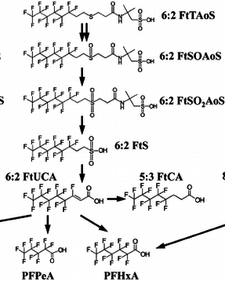
Natural Oxidation and Breakdown of 6:2 FtTAoS
Natural Biotransformation
of 6:2 FtTAoS
(Marjanoic et al. 2015)
Mixture of metabolites & Terminal PFASs appears to be common
Metabolites
(partial oxidation)
Terminal End PFASs
(anion form likely present)

Slide 24
Comparison of Relative PFAS Group Makeup (example data)
- Effluent vs Leachate vs AFFF-Impacted Groundwater -
(includes precursors)

Slide 25
Comparison of Relative PFAS Group Risk (example data)
- Effluent vs Leachate vs AFFF-Impacted Groundwater -
(includes precursors)

Slide 26
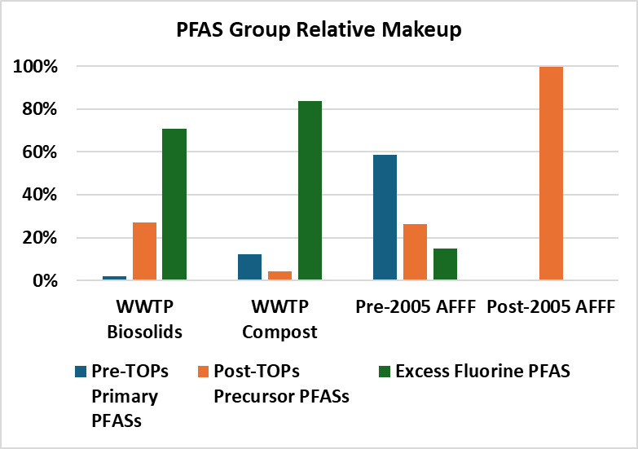
Comparison of Relative PFAS Group Makeup (example data)
- Biosolids vs Compost vs AFFF-Impacted Soil -
Variable
Pre-TOPs
PFAS 0.1%
EOF Not Tested

Slide 27
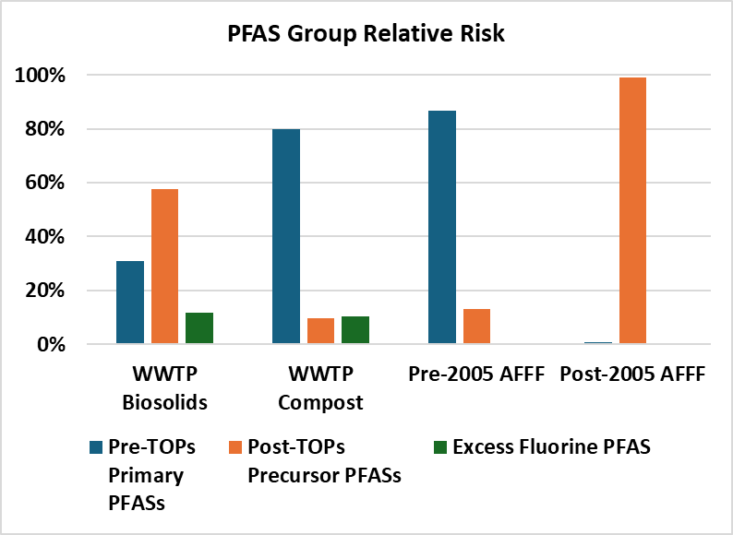
Comparison of Relative PFAS Group Risk (example data)
- Biosolids vs Compost vs AFFF-Impacted Soil -
Variable
Pre-TOPs
PFAS 1.0%
EOF Not Tested

Slide 28
Relative Source Strength in Terms of Risk:
-WWTP Effluent vs Landfill Leachate vs AFFF-Impacted Groundwater-
Effluent
Leachate
AFFF-Impacted Groundwater

Slide 29
Relative Source Strength in Terms of Risk:
-Biosolids vs Compost vs AFFF-Impacted Soil
Biosolids/Compost
AFFF-Impacted Soil
(Hazard Indices in unremediated
release areas will be much higher)
Hazard Index

