Slide 1

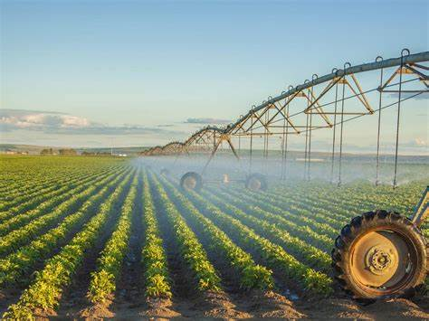
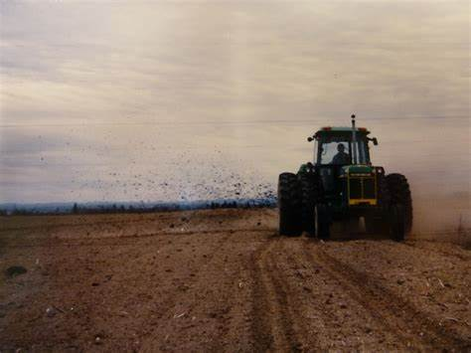
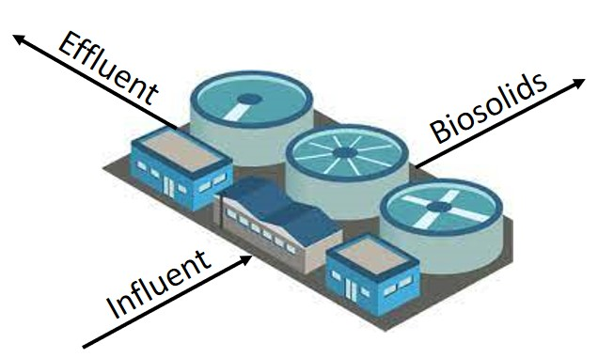
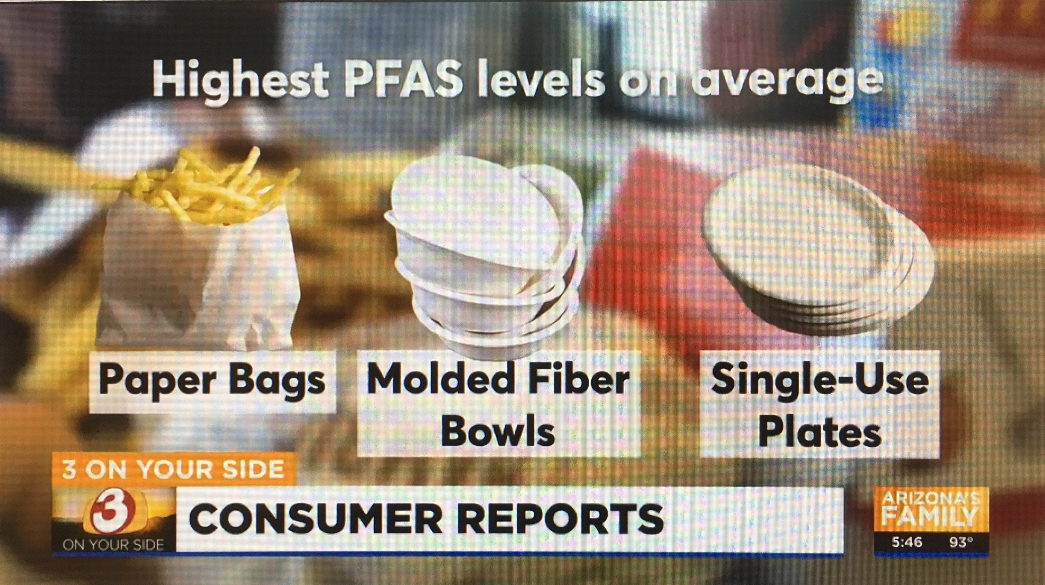

Per- and Poly-Fluoroalkyl Substances
- MCLs, MCLGs and Updates to “Hawaii’s” PFAS Guidance -
Roger Brewer, PhD,
Senior Environmental Scientist
Hawaii Department of Health
roger.brewer@doh.Hawaii.gov
State Risk Assessors Association
April 16, 2024
Australia PFASs & Sampling
Workshops (February 2024)
Wastewater
Irrigation
Biosolids
Soil Amendment
Fire Training Areas
(AFFF)
Food Wrappers &
Containers

Slide 2
Evolution of PFAS Science…
I know everything
high
There’s more to this
than I thought…
Ahah…
Confidence
?
I’m never going
to understand this
It’s starting to
make sense
low
Huh???
low
high
Knowledge in Field
"The aim of science is not to open the door to infinite wisdom, but to set a limit to infinite error."
Bertolt Brecht
Notes:
denial, anger, bargaining, depression and acceptance

Slide 3
PFAS References
Hawaii Dept of Health Guidance:
Interim Soil and Water Environmental Action Levels (EALs) for Perfluoroalkyl and Polyfluoroalkyl Substances (PFASs), April 2024: https://health.hawaii.gov/heer/guidance/additional-guidance-documents/
PFAS Basics:
ITRC 2020: Per- and Polyfluoroalkyl Substances (PFASs)
TOPs Methods:
Ateia et al., 2023, Total Oxidizable Precursor (TOP) Assay Best Practices, Capabilities and Limitations for PFAS Site Investigation and Remediation: Environmental Science and Technology Letters. Vol. 10, pp 292−301.
HIDOH PFAS Webpage:
https://health.hawaii.gov/heer/environmental-health/highlighted-projects/per-and-polyfluoroalkyl-substances-pfass/
HIDOH Recorded Webinars:
https://health.hawaii.gov/heer/guidance/heer-webinars/

Slide 4
Outline
Hawai‘i PFAS guidance update;
Environmental Concerns;
PFAS Basics (chemistry, toxicity, fate and transport);
Assessment of “Total PFAS Risk”:
  Primary Terminal Endpoint Compounds;
  Precursor Compounds;
  “Excess Fluorine” Compounds;
Fire Training Area Case Study:
  Groundwater;
  Soil (“risked-based” sampling).

Slide 5
Hawai‘i PFAS Guidance Update
April 2024
1.0 Terminology, Chemistry, Manufacture and Use
2.0 Sources of PFASs in Soil and Groundwater
3.0 Physiochemical Constants
4.0 Toxicity Factors
5.0 Environmental Fate and Transport
6.0 Environmental Action Levels (+MCLGs & MCLs)
7.0 Assessment of Total PFAS Risk
8.0 Sample Collection and Processing
9.0 Laboratory Test Methods
Limitations
+ Figures & Tables
Hawaii Dept of Health Guidance:
Interim Soil and Water Environmental Action Levels (EALs) for Perfluoroalkyl and Polyfluoroalkyl Substances (PFASs), April 2024: https://health.hawaii.gov/heer/guidance/additional-guidance-documents/

Slide 6
April 2024 PFAS Guidance Updates
Toxicity factors, physiochemical constants and action levels for following compounds added:
  Perfluoropentane sulfonate and Perfluoropropanoate (identified in water samples);
  6:2 fluorotelomer alcohol and 8:2 fluorotelomer alcohol (used to coat food wrappers and compostable food containers); and
  6:2 fluorotelomer thioether amido sulfonate (primary PFAS in modern AFFF);
MCLGs and MCLs added:
  MCLGs for PFBS, PFHxS, PFNA, HFPO-DA based on target noncancer Hazard Quotient of “1”;
  MCLs for PFOA and PFOS based on laboratory Method Reporting Limit of 4 ng/L (not risk-based);
Calculation of cumulative “Hazard Index” required for soil and drinking water data;
Guidance and accompanying Excel spreadsheet added for calculation of sample-specific “Total PFAS Risk.”

Slide 7

Plant
Uptake
Irrigation

Slide 8

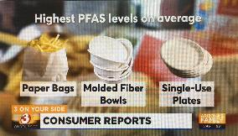
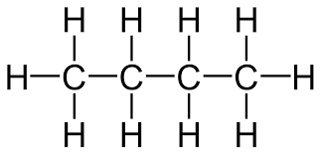
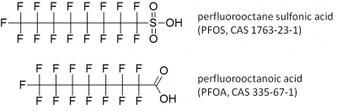

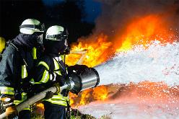
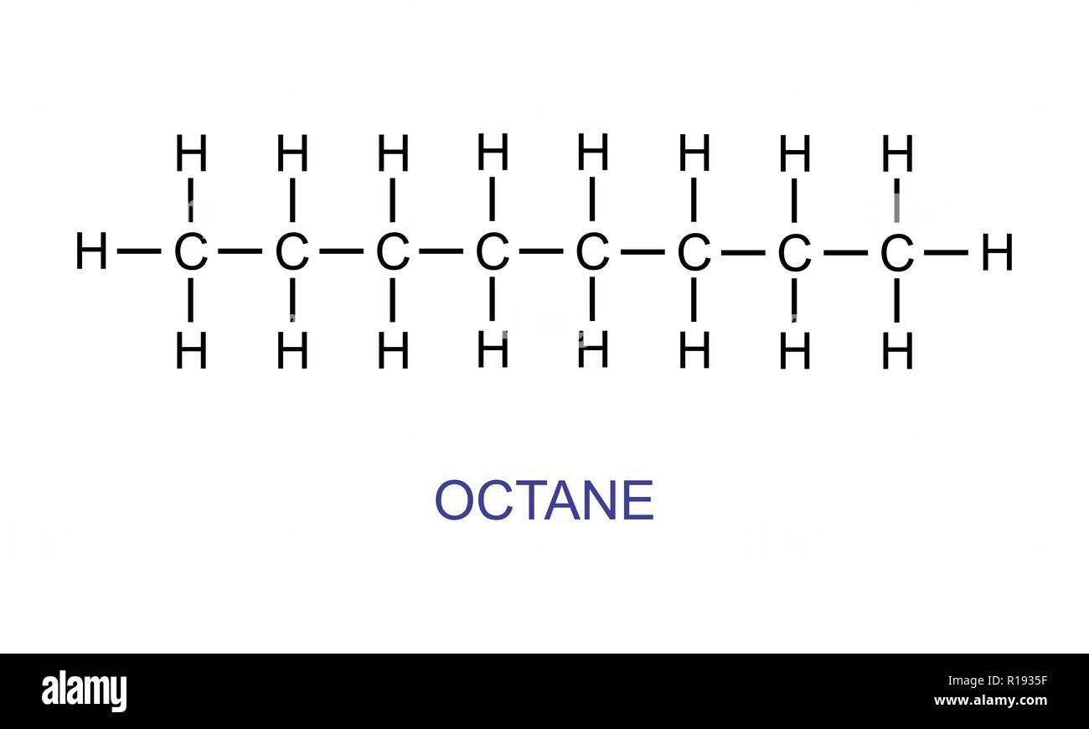
PFASs Chemistry Basics: Carboxylates & Sulfonates
Food
Wrappers
Butane (C₄H₁₀)
Perfluoro Butanoic Acid (perfluoro butanoate)
O⁻
Anionic forms most common in soil and water
Older
AFFF
Octane (C₈H₁₈)
Perfluoro Octanoic Acid (perfluoro octanoate)
O⁻

Slide 9

PFASs Toxicity
(based on references in HIDOH 2024)
Cancer
Skin
Developmental
Hematologic
Endocrine
Hepatic
Reproductive
Kidney
Immune
Cardiovascular
Metabolic
Nervous

Slide 10
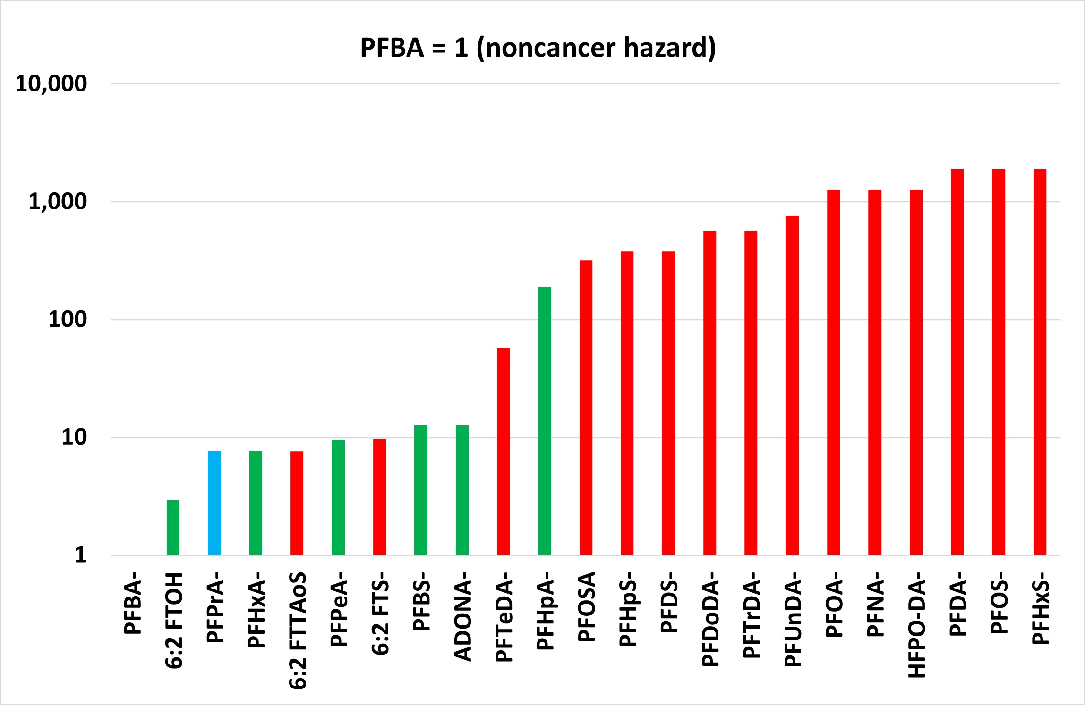
Relative PFAS Toxicity
(based on references in HIDOH PFAS guidance April 2024)
PFHxS⁻: Risk Driver in Distal Areas of Plumes?
Ultrashort Chain
Short Chain (lower toxicity)
Long Chain (higher toxicity)
Increasing Toxicity
CrVI
PCE
Benzene
Dioxins = 1,000X PFOS
DDT
TCE
Arsenic
PCBs

Slide 11
Hypothetical PFASs Groundwater Plume Separation
(based on sorption and mobility)
GW
Source
Area
Immediately Downgradient
Plume Leading Edge
HFPO DA⁻ | HFPO DA⁻ | HFPO DA⁻
PFHxA⁻ | PFHxA⁻ | PFHxA⁻
PFPeA⁻ | PFPeA⁻ | PFPeA⁻
PFBS⁻ | PFBS⁻ | PFBS⁻
PFHpA⁻ | PFHpA⁻ | PFHpA⁻
PFBA⁻ | PFBA⁻ | PFBA⁻
PFOA⁻ | PFOA⁻
PFHxS⁻ | PFHxS⁻
PFDA⁻ | PFDA⁻
6:2 FTS⁻ | 6:2 FTS⁻
PFNA⁻ | PFNA⁻
PFOS⁻ | PFOS⁻
PFHpS⁻ | PFHpS⁻
PFUnDA⁻
6:2 FTOH⁻
PFDS⁻
PFOSA⁻
6:2 FtTAOS⁻
PFDoDA⁻
PFTrDA⁻
PFTeDA⁻
Decreasing Mobility
Common in Groundwater with no apparent source
High sorption PFASs concentrated in and near source area;
Low sorption PFASs at leading edge of plume (including precursor breakdown products);
Very different PFAS mixtures in source area vs leading edge of the same plume.

Slide 12
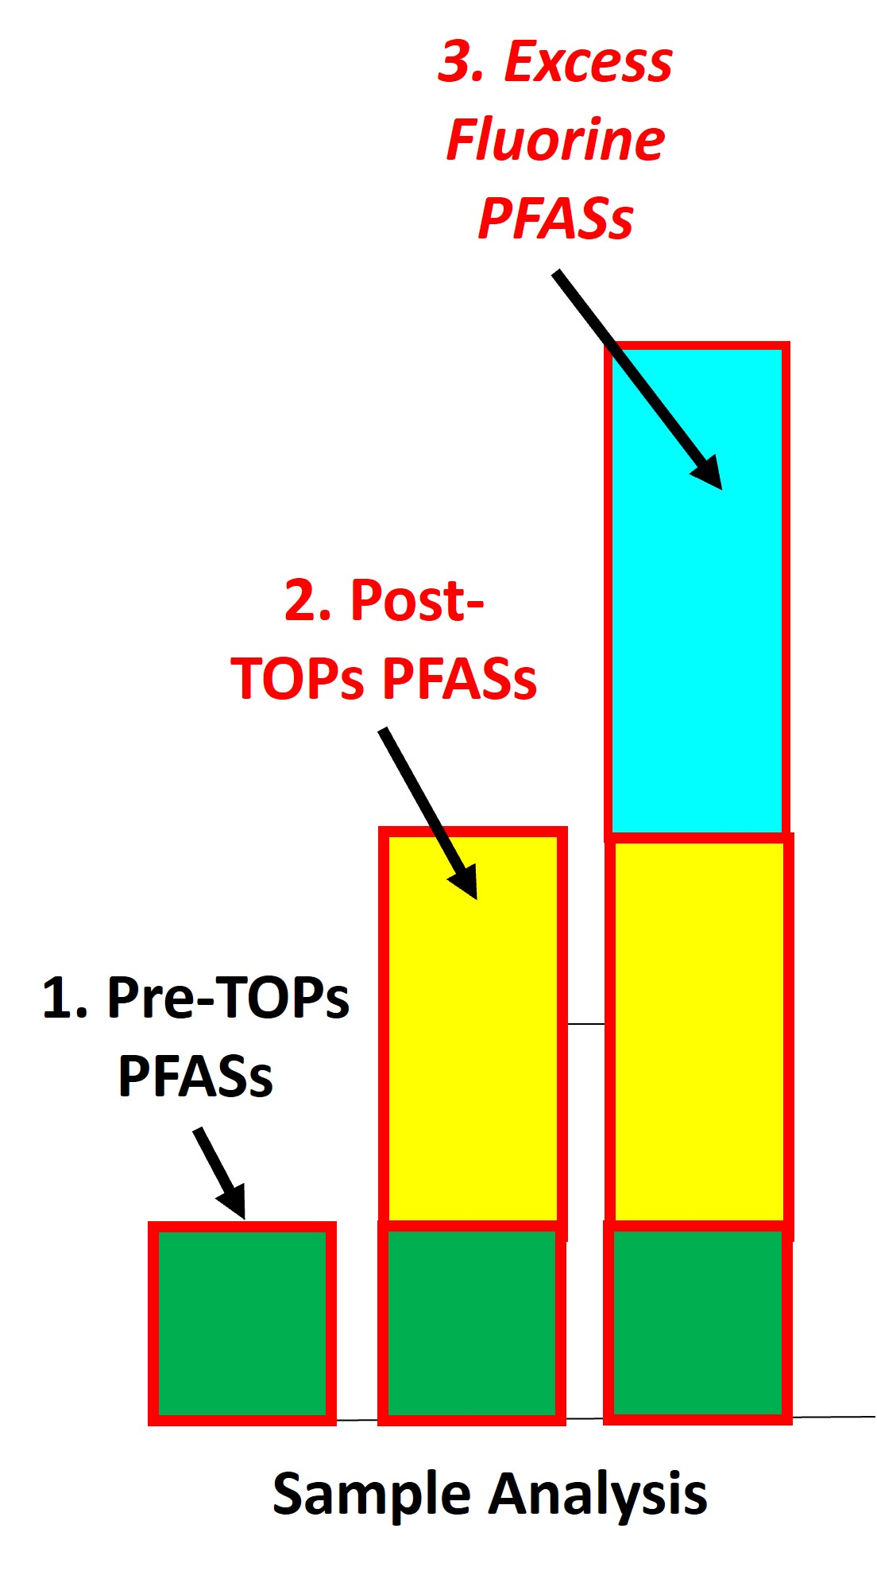
Assessment of Total PFAS Risk
PFAS Groups:
Terminal PFASs initially identified in sample;
Precursor PFASs identified by TOPs analysis
Other PFASs identified by TOF analysis
537/1633: Pre-TOPs lab method
TOPs: Total Oxidizable Precursors
TOF: Total Organic Fluorine (AOF, EOF)
Liquids: Absorbable Organic Fluorine
Solids: Extractable Organic Fluorine

Slide 13
18 “Terminal” PFASs Compounds With Toxicity Factors
(2024 Hawaii Dept of Health Risk-Based Action Levels noted (+MCLs & MCLGs))
Terminal Endpoint Compound | # Carbons | Soil-res (µg/kg) | Tapwater (ng/L)
Perfluoro butane sulfonate (PFBS⁻) | 4 | 3,800 | 1,700 (2,000)
Perfluoro pentane sulfonate (PFPeS⁻) | 5 | 2,000 | 650
Perfluoro hexane sulfonate (PFHxS⁻) | 6 | 25 | 7.7 (10)
Perfluoro heptane sulfonate (PFHpS⁻) | 7 | 126 | 38
Perfluoro octane sulfonate (PFOS⁻) | 8 | 25 | 7.7 (*4)
Perfluoro decane sulfonate (PFDS⁻) | 10 | 126 | 38
Perfluoro propanoate (PFPrA⁻) | 3 | 5,000 | 510
Perfluoro butanoate (PFBA⁻) | 4 | 48,000 | 15,000
Perfluoro pentanoate (PFPeA⁻) | 5 | 5,100 | 1,500
Perfluoro hexanoate (PFHxA⁻) | 6 | 6,300 | 1,900
Perfluoro heptanoate (PFHpA⁻) | 7 | 250 | 77
Perfluoro octanoate (PFOA⁻) | 8 | 38 | 12 (*4)
Perfluoro nonanoate (PFNA⁻) | 9 | 38 | 12 (10)
Perfluoro decanoate (PFDA⁻) | 10 | 25 | 7.7
Perfluoro undecanoate (PFUnDA⁻) | 11 | 63 | 19
Perfluoro dodecanoate (PFDoDA⁻) | 12 | 84 | 26
Perfluoro tridecanoate (PFTrDA⁻) | 13 | 84 | 26
Perfluoro tetradecanoate (PFTeDA⁻) | 14 | 840 | 260
Ultrashort
Short
Long
Sulfonates
Method
537/1633
Carboxylates
*PFOA & PFOS MCLs based on laboratory Method Reporting Limit (not risk-based)

Slide 14
Assessment of Health Risk
WWTP Biosolids: Standard PFAS Method (537/1633)
Potential Health Risk if Hazard Index >1 (rounded to single significant digit)

Slide 15
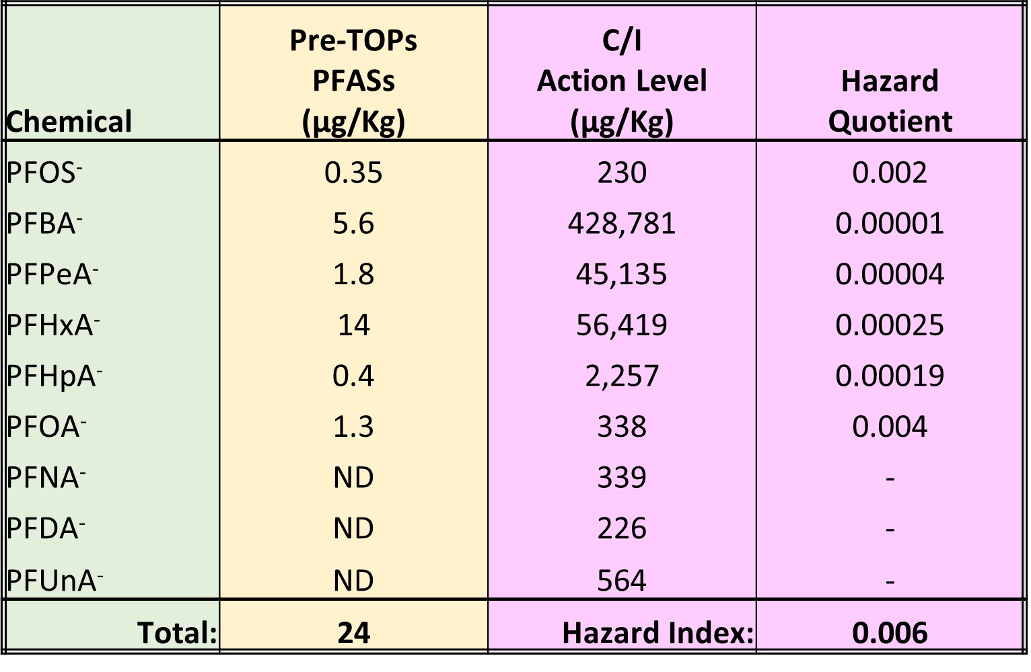
Assessment of Health Risk
AFFF-Impacted Soil: Standard PFAS Method (537/1633)
Potential Health Risk if Hazard Index >1 (rounded to single significant digit)

Slide 16
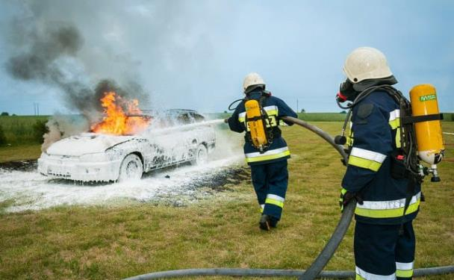

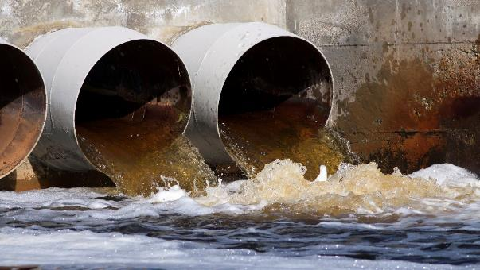
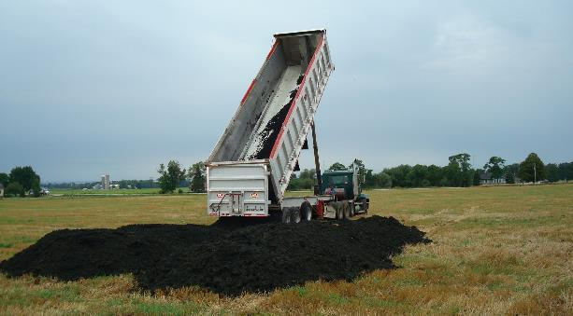
Problem: Hundreds of PFAS “Precursor” Compounds
(not reported by laboratory and/or lack toxicity factors)
AFFF (6:2 FtTAoS⁻)
Food Containers
& Wrappers (6:2FTOH⁻)
Biosolids
(metabolites)
Wastewater
(metabolites)

Slide 17
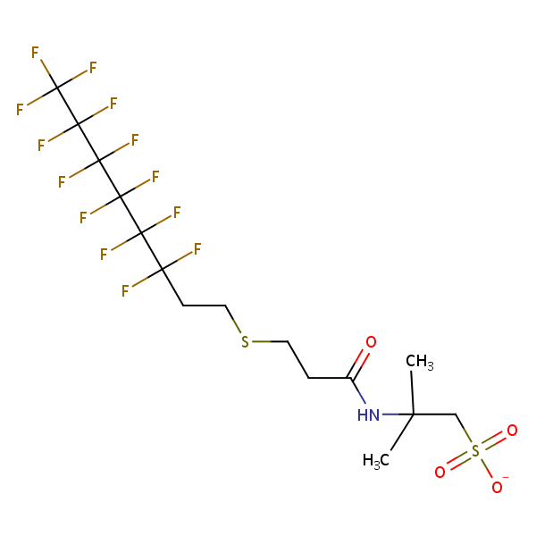
Seven “Precursor” Compounds With Toxicity Factors
(soil and water action levels included in 2024 HIDOH guidance)
Breakdown
Products
“Precursor” Compounds (color denotes main breakdown products)
Ammonium 4,8-Dioxa-3H-perfluoro nonanoate (ADONA-) ???
2,3,3,3-tetrafluoro-2-(heptafluoropropoxy) propanoate (HFPO DA-, “GenX”) ???
6:2 Fluorotelomer alcohol (6:2 FTOH-)
6:2 Fluorotelomer thioether amido sulfonate(6:2 FtTAoS-)
6:2 Fluorotelomer sulfonate (6:2 FTS-)
Perfluroroctane sulfonamide (PFOSA)
8:2 Fluorotelomer alcohol (8:2 FTOH-)
Ultrashort
Short
6:2 FtTAoS
Long
Method
537/1633

Slide 18
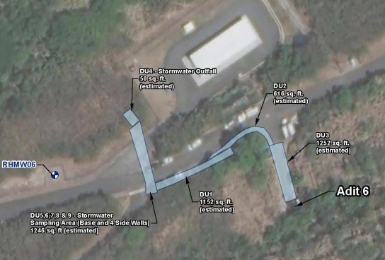
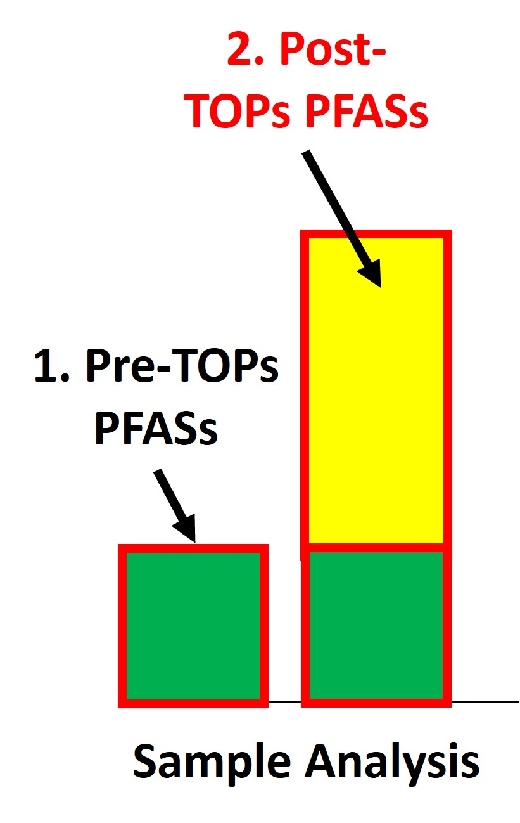
Standard Lab Method vs Total Oxidizable Precursors (TOPs) Soil Data (AFFF Spill Site)
DU-4A
Pre-TOPs: 16 µg/kg
Post-TOPs: 114 µg/kg
DU-2
Pre-TOPs: 144 µg/kg
Post-TOPs: 23,839 µg/kg
DU-3
Pre-TOPs: 264 µg/kg
Post-TOPs: 22,013 µg/kg
DU-4B
Pre-TOPs: 13 µg/kg
Post-TOPs: 643 µg/kg
TOPs

Slide 19
6:2 FtTAoS in “Modern” Aqueous Fire Fighting Foam (AFFF)
“Parent” PFAS
PFAS “Precursor” (since 2005)
Perfluoro Heptanoic Acid
6:2 Fluorotelomer Thioether Amido Sulfonate
1
Dominant PFAS in AFFF since 2005;
Toxicity factors not widely available;
Not Reported by current laboratory methods;
Risk posed by AFFF-contaminated media underestimated.
1
2
2
3
3
4
4
5
5
6
6
7
7
O
8
OH
Reported by Standard Lab Methods
“Functional Group”
Added

Slide 20
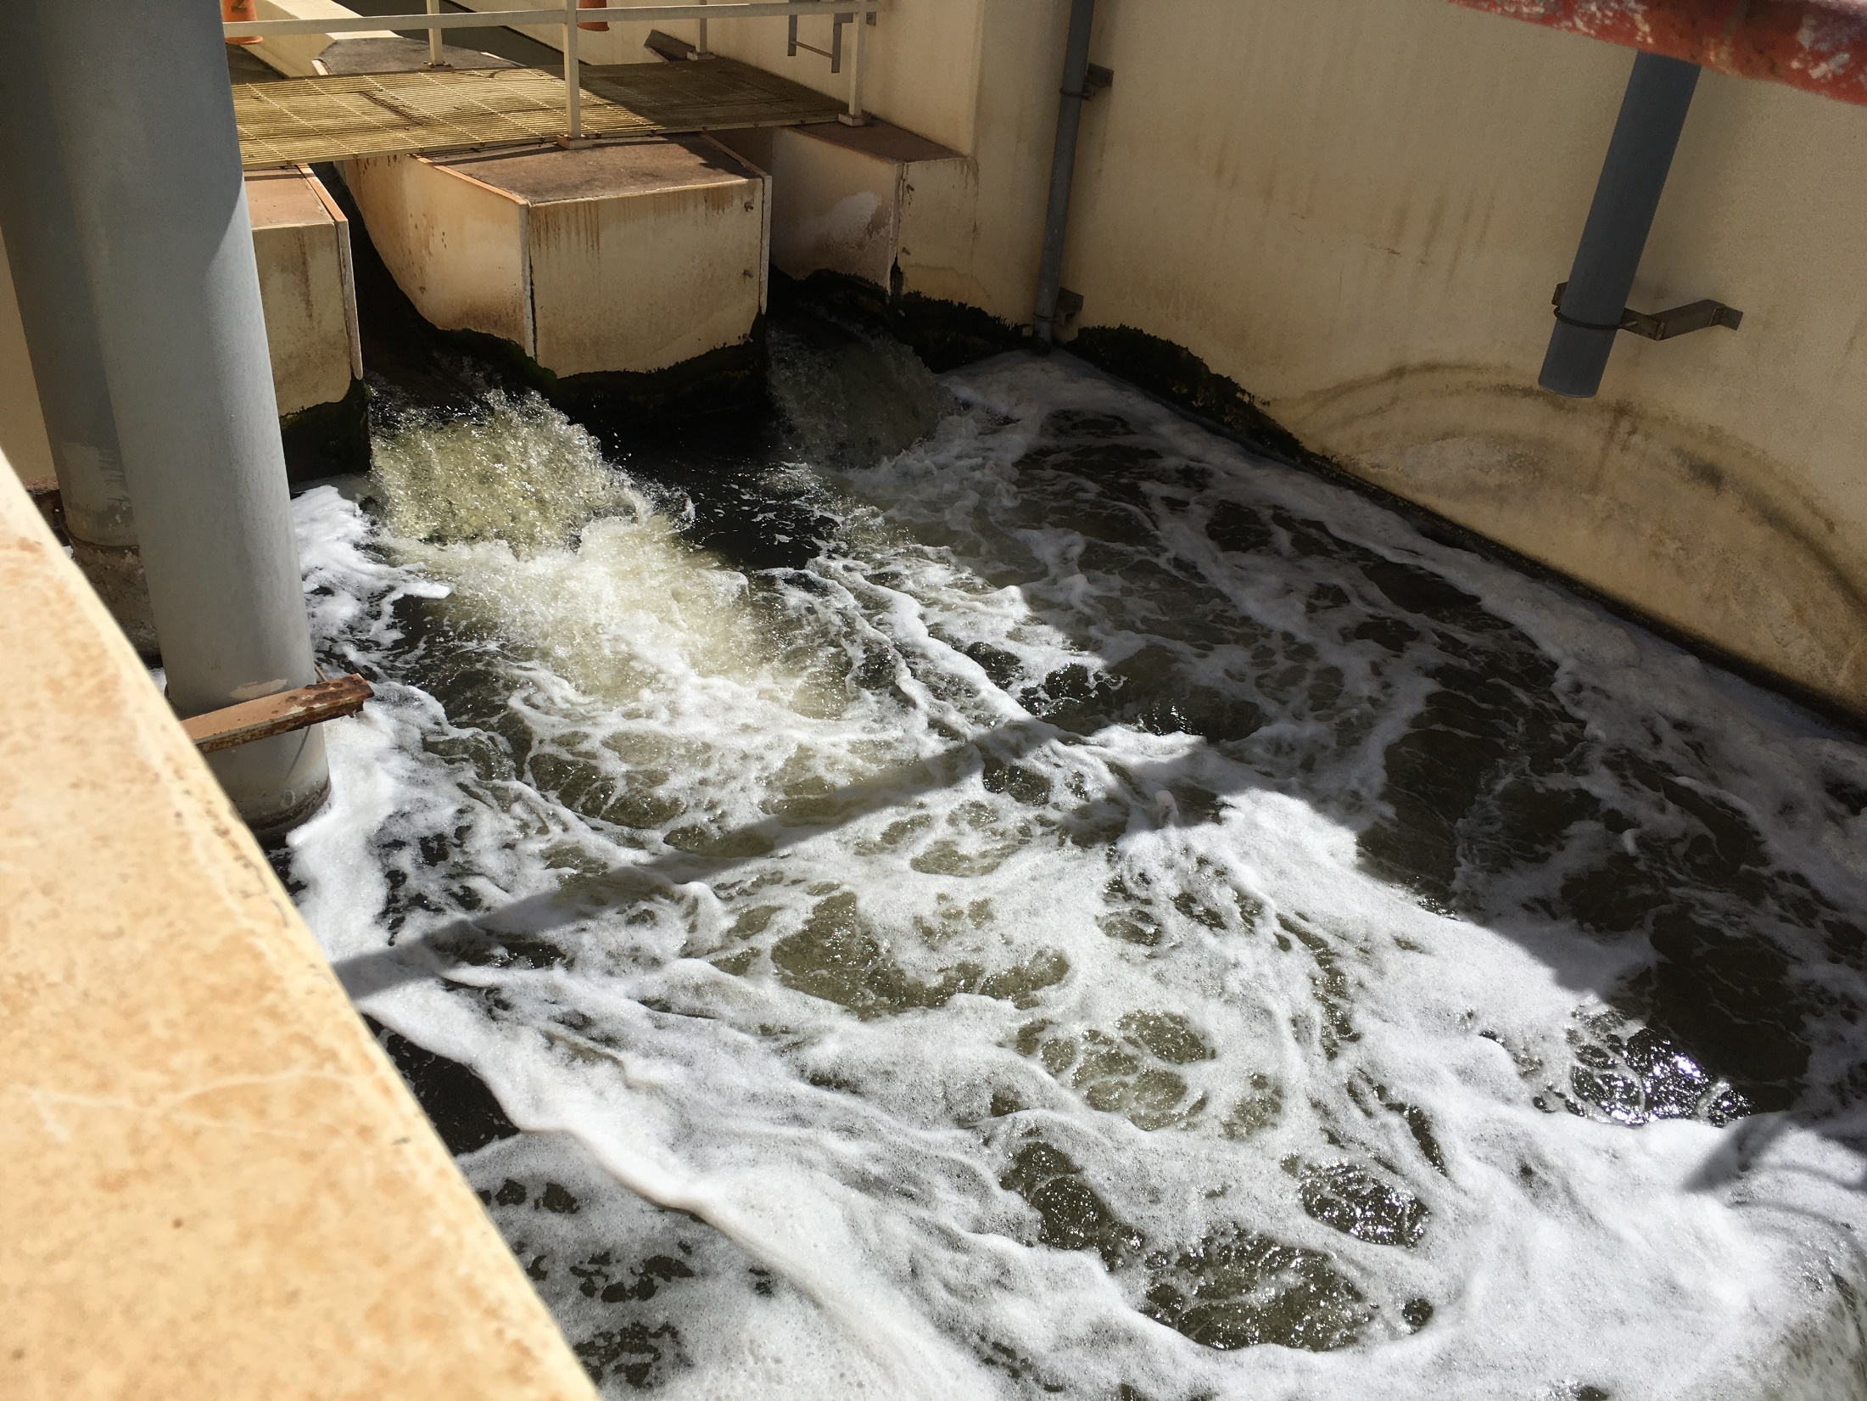

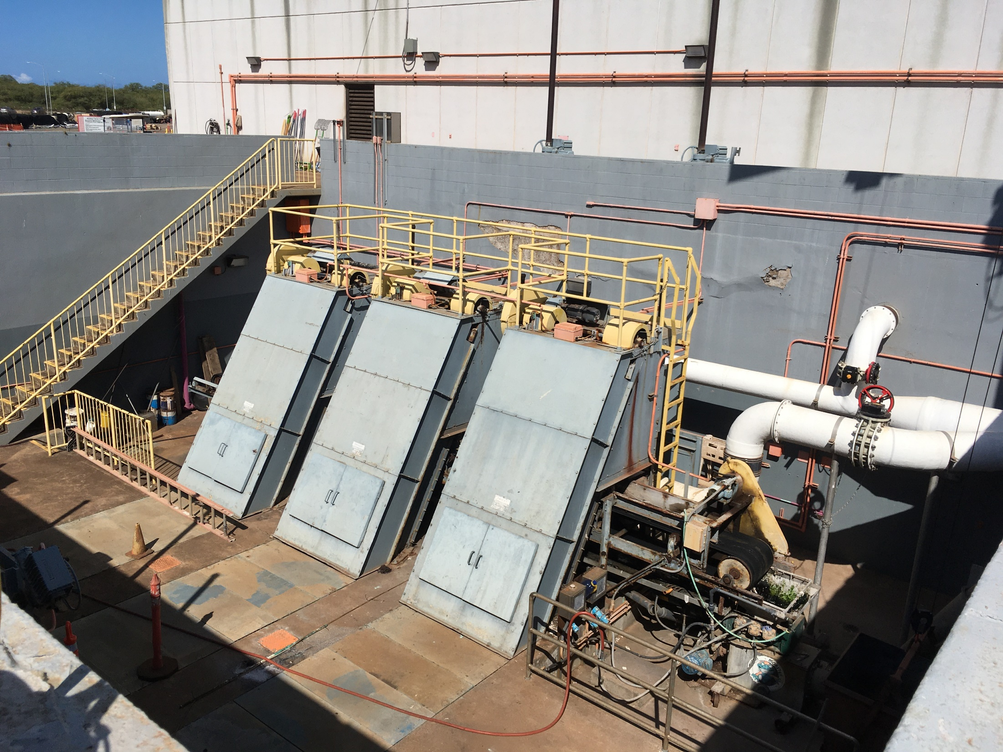
Highly Oxidized
Municipal WWTP
Expanded Analyte List
Other: PFBA⁻, PFBS⁻, PFHpA⁻, PFDA⁻, PFNA⁻, PFHxS⁻
Other: N-EtFOSE⁻, EtFOSAA⁻, PFDA⁻, PFDoA⁻, PFHxA⁻, PFDS⁻, 6:2 FTS⁻, PFTeDA⁻, PFUnA⁻, PFTrDA⁻, PFOA⁻, PFOSA⁻, PFBS⁻, N-MeFOSA⁻, PFNA⁻
Pre-TOPs Data
Effluent
Biosolids
Total PFAS: 36 ng/L
Biosolids
Pre-TOPs Total PFAS: 182 µg/kg
Post-TOPs Total PFAS: 624 µg/kg
>99.9% of PFAS sorbed to organic matter
Influent
Pre-TOPs Data:
Abundant metabolites
Partial oxidation of precursors
Reported by laboratory but no toxicity factors
Post TOPs Data:
Biosolids: Increase in Total PFASs indicates presence of significant additional PFASs precursors
Water: Minimal increase in water sample data
Other: 6:2 FTS⁻, PFPeA⁻, PFDA⁻, PFHpA⁻, PFDoA⁻, PFNA⁻, PFHxS⁻
Total PFAS: 66 ng/L

Slide 21
Assessment of Precursor PFASs
Precursor Mixture
Manufactured PFAS
?
Directly
Compare to Action Levels
Convert
Terminal PFASs
PFAS
Metabolites

Slide 22
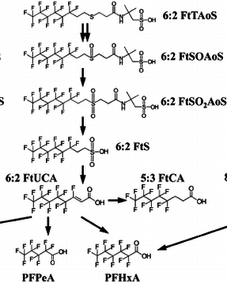
Natural Oxidation and Breakdown of 6:2 FtTAoS
Natural Biotransformation
of 6:2 FtTAoS
(Marjanoic et al. 2015)
Mixture of metabolites & Terminal PFASs appears to be common
Metabolites
(partial oxidation)
Terminal End PFASs
(anion form likely present)

Slide 23
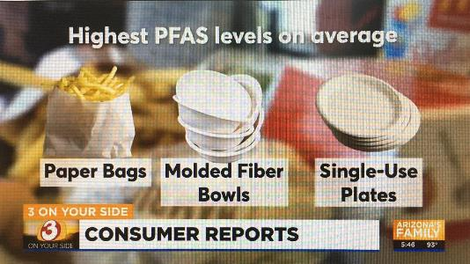
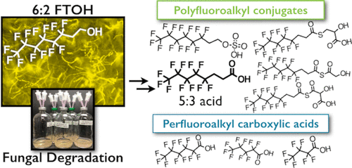
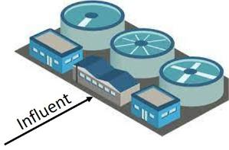

Natural Oxidation of FTOHs to Terminal PFASs
Fluorotelomer alcohols… used in materials in contact with food as non-stick agents (e.g., 6:2 FTOH, 8:2 FTOH, 10:2 FTOH)
Carnero et al., 2021, Presence of Perfluoroalkyl and Polyfluoroalkyl Substances (PFAS) in Food Contact Materials (FCM) and Its Migration to Food: Foods 2021, 10, 1443
Dietary secondary source of PFASs;
Mixtures common.
?
Hawaii tested WWTPs do not receive landfill leachate
PFHxA⁻
PFPeA⁻
PFBA⁻
Nancy Tseng, Ning Wang, Bogdan Szostek and Shaily Mahendra, 2014, Biotransformation of 6:2 Fluorotelomer Alcohol (6:2 FTOH) by a Wood-Rotting Fungus: Environ. Sci. Technol. 2014, 48, 7, 4012–4020,

Slide 24




Laboratory Breakdown of Precursors and Metabolites to Terminal PFASs using “TOPs” Methods
Total Oxidizable Precursors (TOPs) Method:
  Sample heated with an oxidizing agent under alkaline conditions;
  Strips functional groups from PFAS leaving terminal end products;
  Identifies presence of previously unreported ultrashort-, short- and long-chain PFASs precursor compounds in sample;
  Final terminal end-product mixture minus pre-TOPs mixture assumed to reflect metabolic products of original compound mixture.
TOPs
Hidden
PFASs
Precursors &
Metabolites
Terminal Compounds

Slide 25
Pre- vs Post-TOPs Makeup of WWTP Biosolids
(Pre-TOPs data missed 90% of PFASs in Sample)
Concentration of “Post TOPs PFASs” = Post-Tops minus Pre-TOPs Terminal PFAS data

Slide 26
Assessment of Post-TOPs PFASs Risk
Biosolids: Standard PFAS Method (537/1633)
Pre-TOPs PFASs + Post-TOPs PFAS HI = 5

Slide 27
Pre- vs Post-TOPs Makeup of Ansul AFFF
Concentration of “TOPs PFASs” = Post-Tops minus Pre-TOPs Terminal PFAS data;
Excess Post-TOPs PFASs represent oxidation products of PFASs missed by standard laboratory method (>99.9% of PFASs present);
“Non-targeted Analysis (NTA)” identified primary hidden PFAS as 6:2 FtTAoS.

Slide 28
Pre- vs Post-TOPs Makeup of AFFF-Impacted Soil (DU-2)
(Pre-TOPs data missed 99.9% of PFASs in Sample)
Concentration of “TOPs PFASs” = Post-Tops minus Pre-TOPs Terminal PFAS data;
Additional Post-TOPs PFASs represent oxidation products of PFASs missed by standard laboratory method (>99.9% of PFASs present).

Slide 29
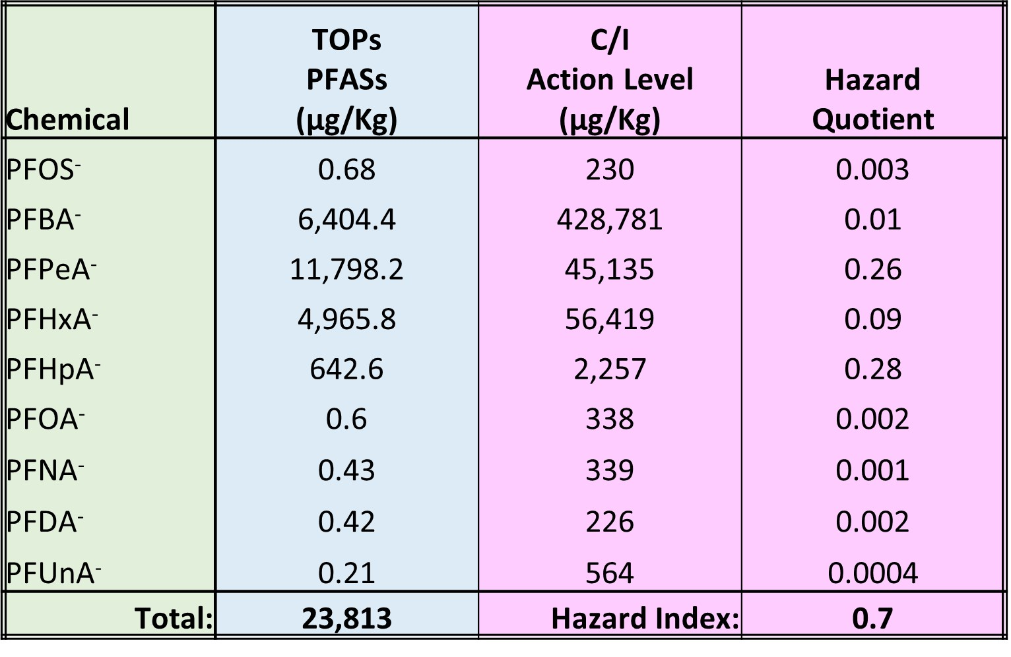
Assessment of Post-TOPs PFASs Health Risk
AFFF-Impacted Soil: Post-TOPs PFASs Risk (Method 537/1633)
Pre-TOPs PFASs Hazard + Post-TOPS PFASs Hazard = 0.706
(potential leaching risk being assessed separately)

Slide 30
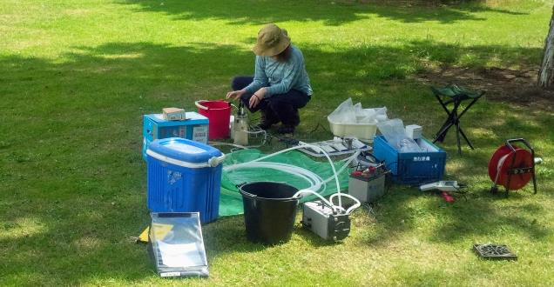

More Missing PFASs! Excess Organic Fluorine in Water!
?
Excess Fluorine
Concentration of TOF predicted based on fluorine content of
Post-TOPs PFAS
TOF Reported by Laboratory
Total Organic Fluorine (Method 1621)
Liquids: “Absorbable Organic Fluorine”
Solids: “Extractable Organic Fluorine”

Slide 31
Components of Total PFAS Risk
Total PFASs Risk =
Pre-TOPs PFASs Risk +
Post-TOPs PFASs Risk +
Excess Fluorine PFASs Risk
?
Excess fluorine not related to pre- or post-TOPs PFASs;
Primarily identified in water samples (higher detection limit in solids samples);
Limited Non-Targeted Analysis (NTA) analysis typically identifies ultrashort PFASs (e.g., PFPrA⁻).
O⁻

Slide 32
Assessment of “Excess Fluorine” PFASs Risk
Excess Fluorine Data:
Assume Excess Fluorine = PFPrA⁻ (C₃HF₅O₂).
Adjust Excess Fluorine Concentration to reflect equivalent concentration of PFPrA⁻.
Compare to PFPrA⁻ Action Levels.
Calculate Hazard Quotient.
?
Excess Fluorine PFASs Concentration:
= Excess EF Conc. x
PFPrA⁻ Molecular Weight (164)
F Atomic Mass (19) x # Fs (5)
= Excess EF Conc. X 1.73
HIDOH 2024 PFPrA⁻ Action Levels:
Soil Direct Exposure = 5,100 µg/kg
Drinking Water/Tapwater AL = 510 ng/L

Slide 33
Assessment of Total PFAS Risk
Total PFASs Risk =
Pre-TOPs PFASs Risk +
Post-TOPs PFASs Risk +
Excess Fluorine PFASs Risk
537/1633: Pre-TOPs lab method
TOPs: Total Oxidizable Precursors
TOF: Total Organic Fluorine (AOF, EOF)
Liquids: Absorbable Organic Fluorine
Solids: Extractable Organic Fluorine

Slide 34
Municipal WWTP Sample Data (report pending)
WWTP | *Sample Type | Units | ¹Total PFAS Pre-TOPs | ¹Total PFAS Post-TOPs | TOF
#1 | Influent | ng/L | NA | NA | NA
 | Effluent | ng/L | 24 | 22 | <40,000
 | Biosolids | µg/kg | (pending) | (pending) | (pending)
#2 | Influent | ng/L | NA | NA | NA
 | Effluent | ng/L | 834 | 698 | <40,000
 | Biosolids | µg/kg | (pending) | (pending) | (pending)
#3 | Influent | ng/L | NA | NA | NA
 | Effluent | ng/L | 37 | 30 | <40,000
 | Biosolids | µg/kg | 76 | 229 | (pending)
#4 | Influent | ng/L | 17 | - | -
 | Effluent | ng/L | 114 | - | -
 | Biosolids | µg/kg | 131 | - | -
#5 | Influent | ng/L | 66 | - | -
 | Effluent | ng/L | 36 | - | -
 | Biosolids | µg/kg | 183 | 678 | (pending)
#6 | Influent | ng/L | 40 | - | -
 | Effluent | ng/L | 32 | - | -
 | Biosolids | µg/kg | 86 | 945 | (pending)
#7 | Influent | ng/L | 22 | - | -
 | Effluent | ng/L | 144 | - | -
 | Biosolids | µg/kg | 124 | 785 | (pending)
1. Incudes reported precursor compounds if identified

Slide 35
Total PFAS Risk Calculator
Hawaii Dept of Health January 2024 (public review draft)

Slide 36
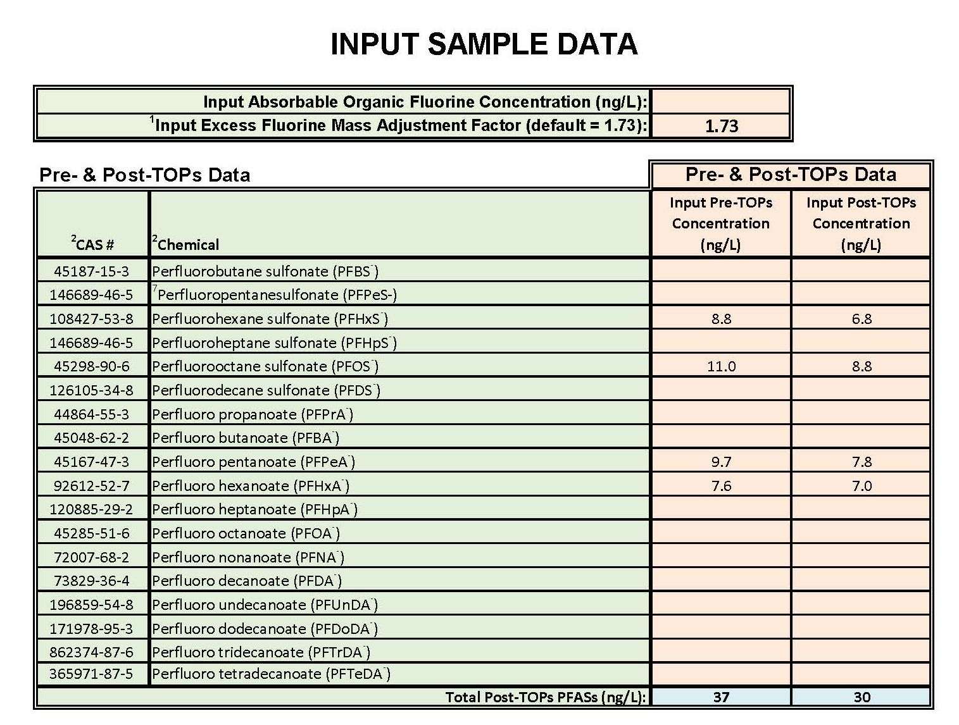
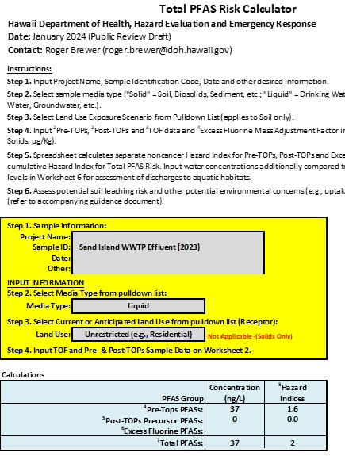
Example Total PFAS Risk:
WWTP Effluent as Hypothetical Drinking Water
*Input Pre-TOPs and Post-TOPs
Terminal Endpoint Compound Concentrations
Calculated
Total PFAS Risk
*AOF = ND (<40 µg/L)

Slide 37
Example Total PFAS Risk:
WWTP Effluent as Hypothetical Drinking Water
WWTP Effluent | Total Terminal PFAS (ng/L) | Hazard Index | Primary Risk Drivers (>50%, >10% or risk or Top 3 if HI <1)
#1 | 17 | 0.01 | None (Pre-TOPs PFPeA- & PFHxA-)
#2 | 868 | 0.57 | None (Pre-TOPs PFPeA-, PFHxA-)
#3 | 37 | 1.6 | Pre-TOPs PFOS- (+ PFPeA-, PFHxA-)
*#4 | 124 | 3.1 | Pre-TOPs PFOA-, PFDA-
*#5 | 32 | 0.8 | None (Pre-TOPs PFPeA- & PFHxA-)
*#6 | 17 | 0.69 | None (Pre-TOPs PFOS-, PFOA-, PFDA-)
*#7 | 144 | 2.3 | Pre-TOPs PFOA-, PFNA- (+ PFOS-)
*TOPs and TOF data not collected.
No precursor-related, Post-TOPs PFASs identified (all dissolved-phase precursors oxidized prior to discharge);
Excess Fluorine PFASs ND (Reporting Limit = 40 µg/L);
Reported at AFFF sites (ultrashorts estimated >50% of total PFASs);
Great toxicity of long-chain PFASs (>100X) negates likely significant, additional contribution to Total PFAS Risk from TOF-related ultrashorts?

Slide 38
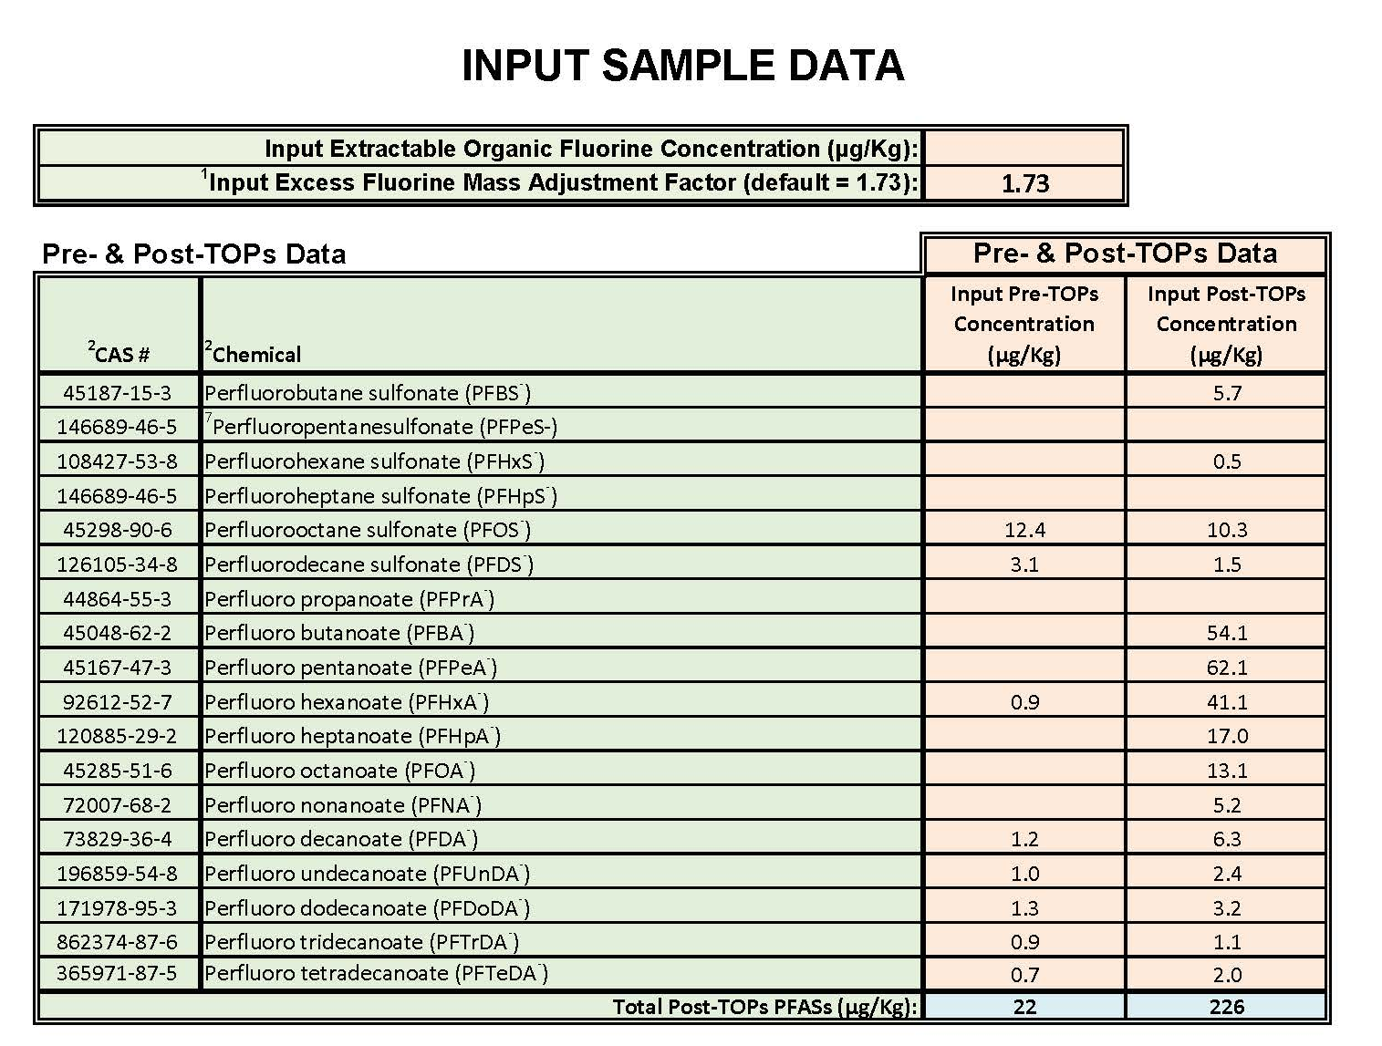
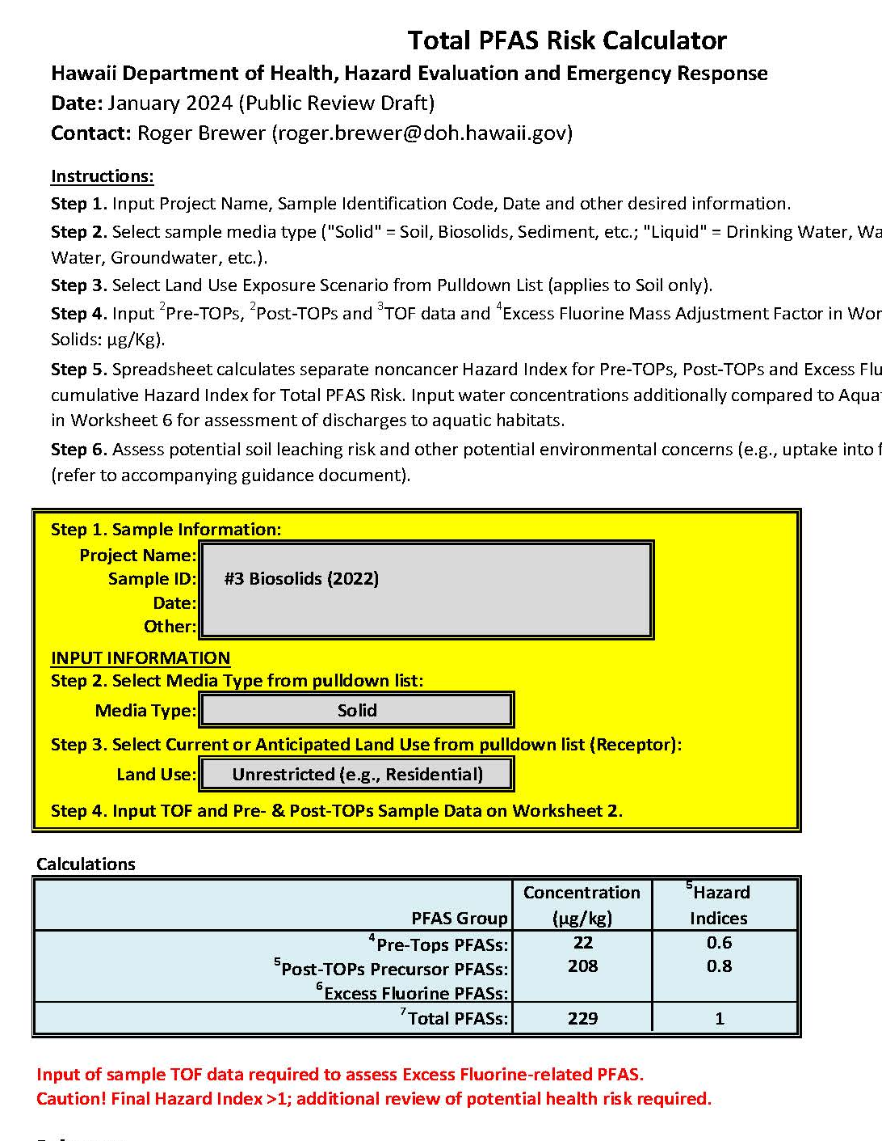
Example Total PFAS Risk:
Hypothetical Use of WWTP Biosolids as Residential Fill
*Input Pre-TOPs and Post-TOPs
Terminal Endpoint Compound Concentrations
Calculated
Total PFAS Risk
*EOF data pending

Slide 39
Example Total PFAS Risk:
Direct Exposure to Biosolids
*WWTP Biosolids | Total Terminal PFASs (µg/kg) | Hazard Index | Primary Risk Drivers (>10% or risk or Top 3 if HI <1)
#4 | 229 | 1 | PFPeA-, PFBA-, PFHxA- (57% Precursor PFASs)
#5 | 945 | 5 | PFBA-, PFPeA-, PFHxA- (92% Precursor PFASs)
#6 | 678 | 5 | PFBA-, PFPeA-, PFHxA- (72% Precursor PFASs)
#7 | 785 | 5 | PFBA-, PFPeA-, (71% Precursor PFASs)
*Includes Pre-TOPs and Post-TOPs data (TOF pending)
Precursor-related PFASs drive potential direct exposure risk over original (pre-TOPs) terminal endpoint PFASs in samples;
Additional risk posed by any Excess Fluorine-related PFASs present unknown (data pending; low assuming toxicity similar to PFPeA⁻???);
Limits proportion of biosolids that can be added to compost (similar to current consideration of metals).

Slide 40
HIDOH Total PFAS Risk Guidance (April 2024)
Pros:
Allows (forces) consideration of precursor compounds (vs ignoring);
Comes with easy-to-use spreadsheet that calculates Total PFAS risk;
Cancer risk assessed based on subset of well-studied, individual PFAS compounds (e.g., PFOA, PFOS – to be added in future spreadsheet model);
Similar to combined use of “TPH” and “BTEX-PAHs” for assessment of Total Petroleum risk.
Limitations:
TOPs methods still evolving;
TOPs methods produce similar results but don’t directly mimic biological processes (Too conservative? Not conservative enough?);
Some types of precursors not fully oxidized (e.g., chlorinated PFASs);
Toxicity of non-fluorinated functional group breakdown products not considered (but likely superseded by PFAS risk);
Total PFAS Risk approach does not consider synergistic effects of exposure to PFAS mixtures (common to all risk assessments).

Slide 41
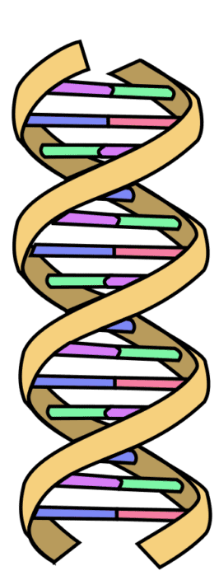

Reliable Assessment of Risk (and design of remedial actions) is Dependent on Reliable Collection of Representative Sample Data
18+ Only
(fake IDs accepted)
Sample Data Quality
Risk Assessment
Reliable Assessment of Risk requires
Sample Data that are reliably representative
of the Investigation Question being asked.

Slide 42
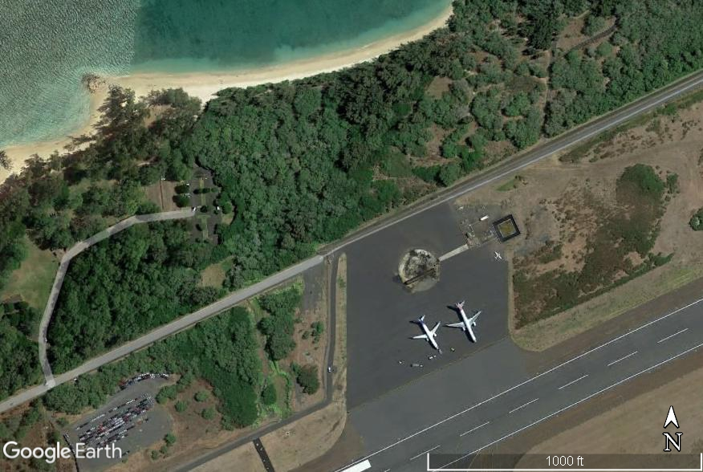
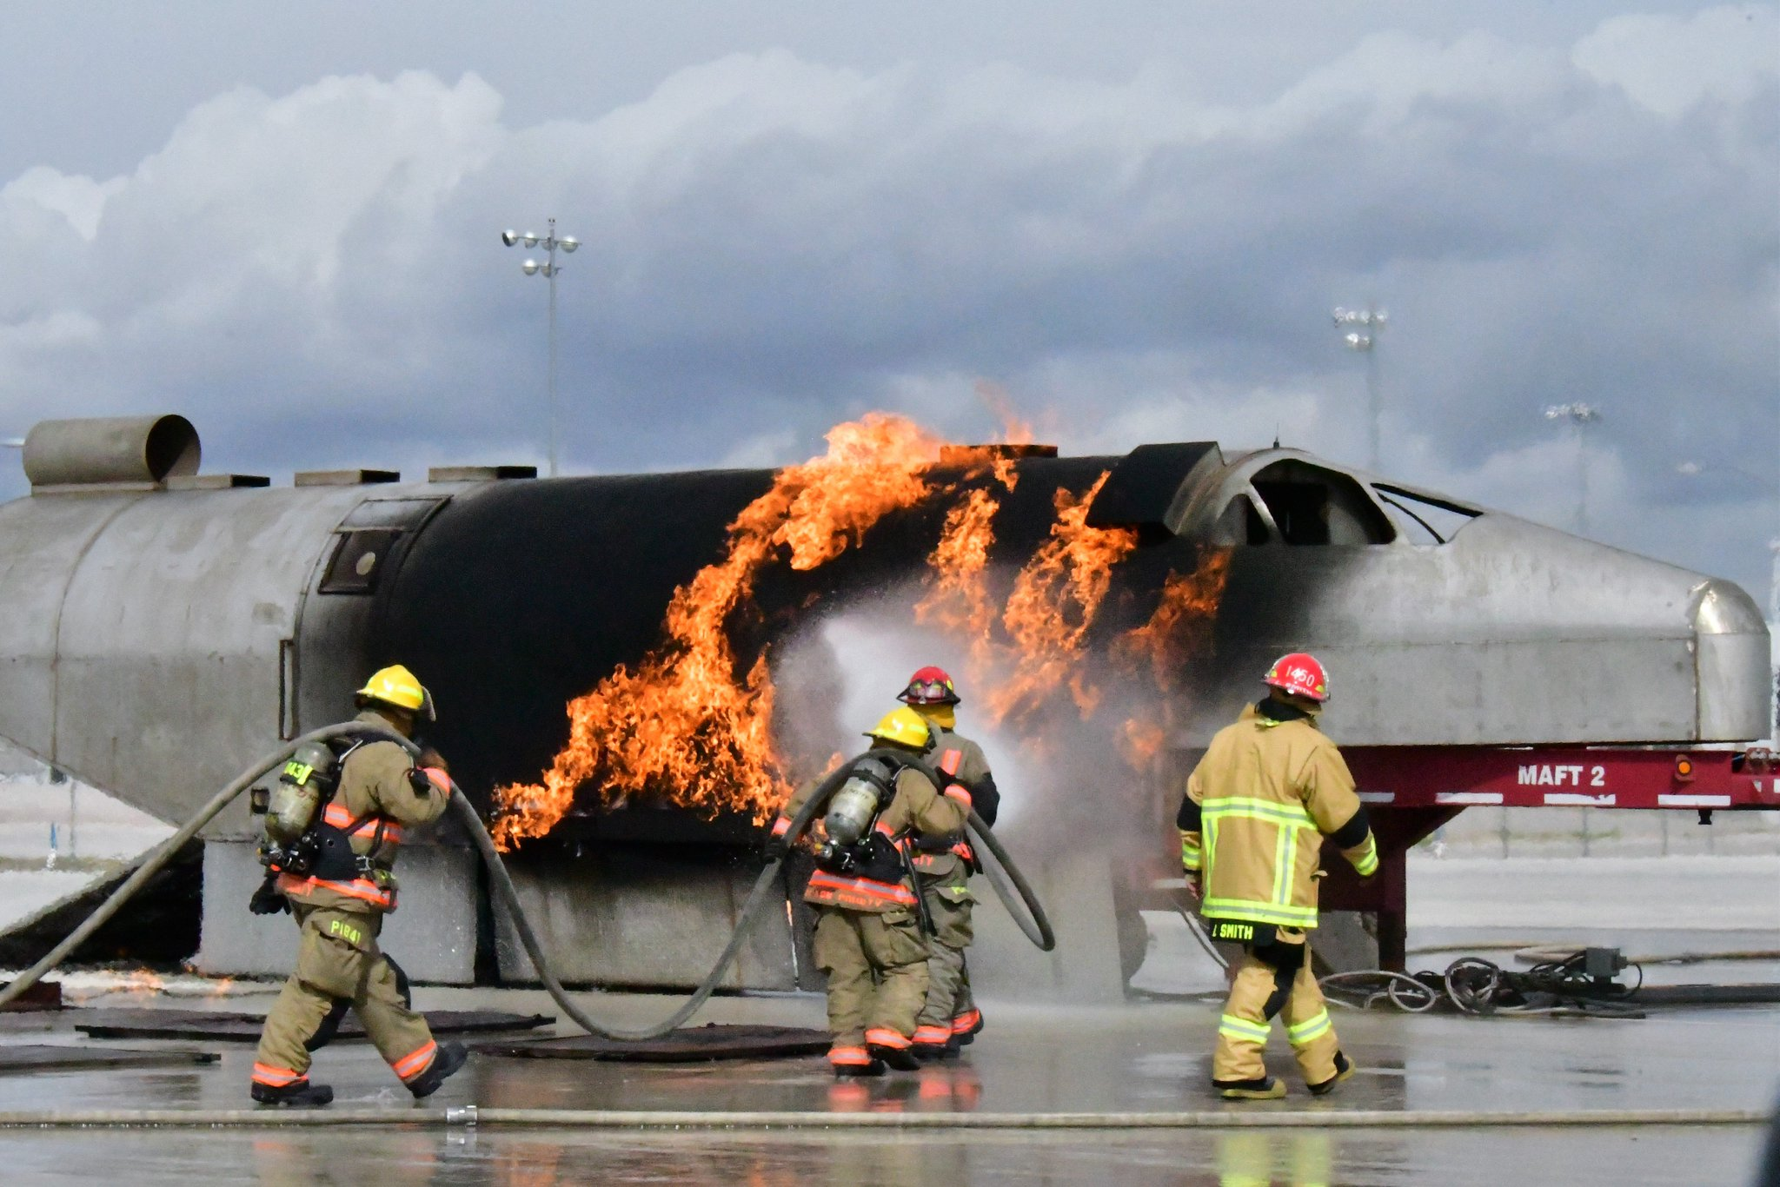
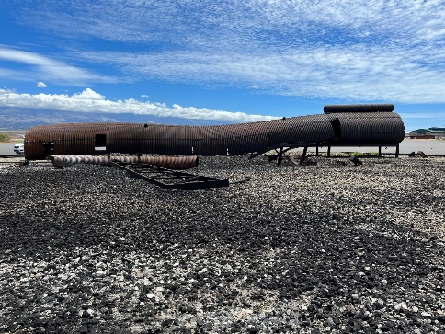
Risk-Based PFAS Investigation of Airport Fire Training Pit
800 ft
Anticipated
Groundwater
Flow
1977-1997: Unlined
Post 1997: Lined
paved
Unconsolidated sand
10’ to 15’ to groundwater

Slide 43
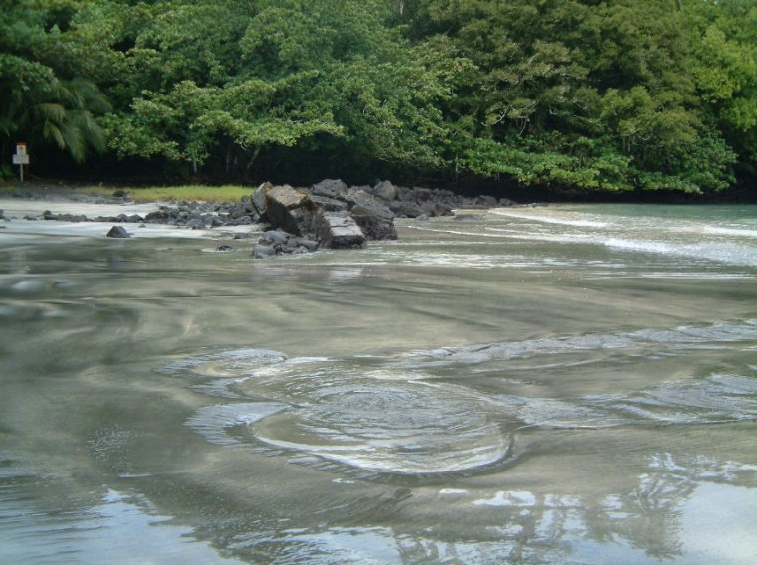

Groundwater Discharge to Shoreline
Shoreline
Freshwater Springs
(no “mixing zone”)
Groundwater must meet chronic aquatic toxicity screening levels at point of discharge
Spring Discharge Area?
For Example Only

Slide 44
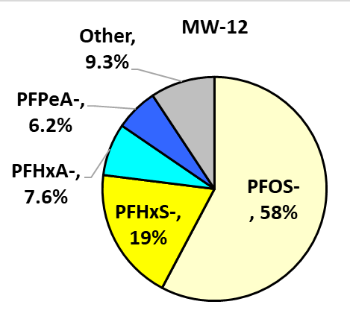
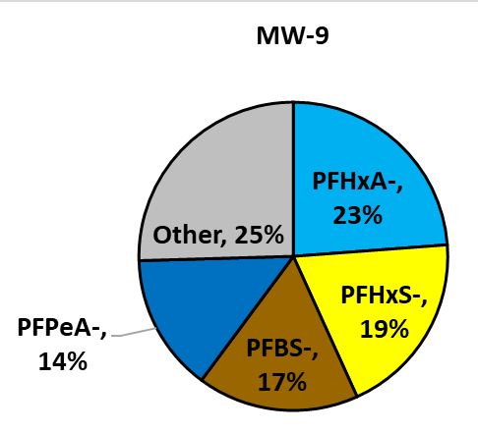
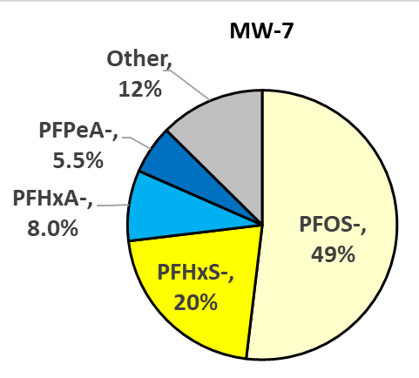
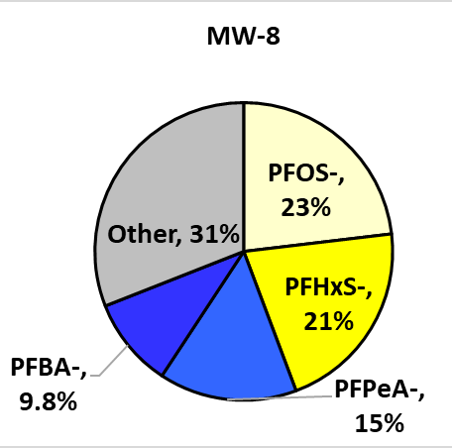
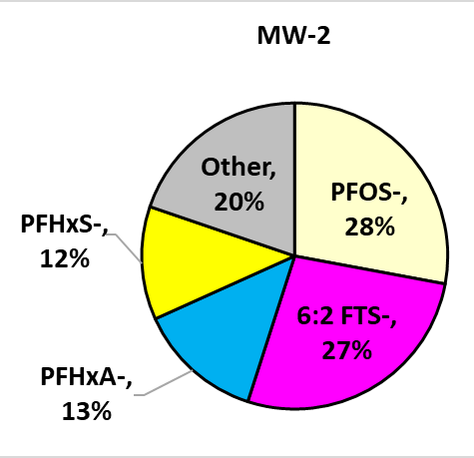
2023 PFAS Makeup (includes precursors)
Separation of PFASs in Migrating Plume & Revised GW Flow Direction
6:2 FTS stays in source area
PFOS moves with groundwater flow but does not diffuse outwards
5% PFOs⁻
Notes:
6:2 FTS⁻ remained in source area;
PFOS⁻ stays with plume in migration directions
More mobile PFASs diffuse laterally (e.g., PFHxA⁻, PFBS⁻, PFHxS⁻).

Slide 45
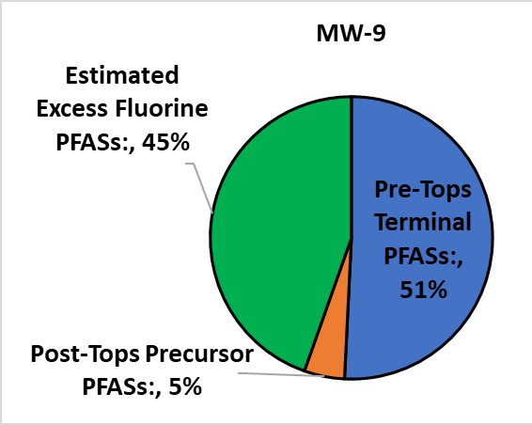
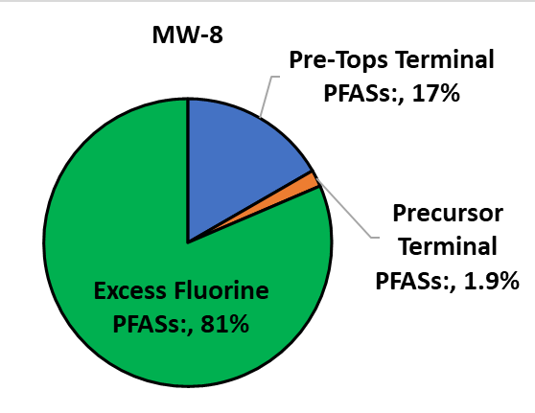
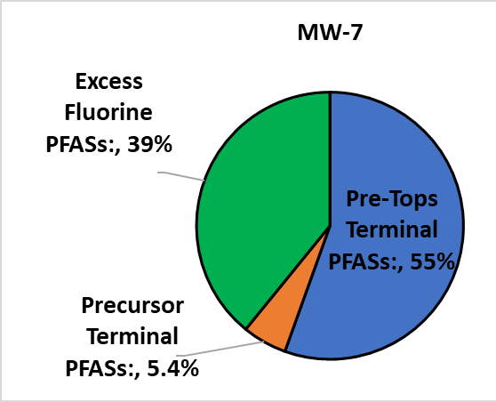
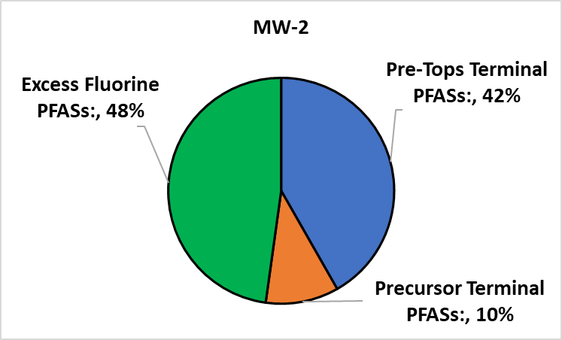
Hypothetical Drinking Water: PFAS Group Risk Driver
The Bad News: Lots of Excess Fluorine in Total PFAS!
MW-9
MW-7
MW-2
MW-8

Slide 46
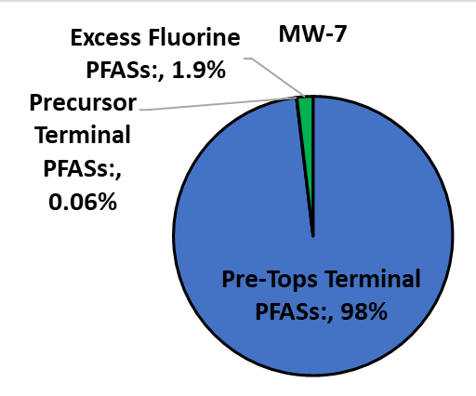
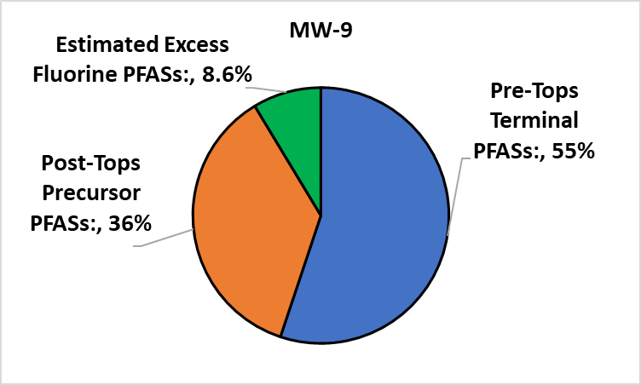
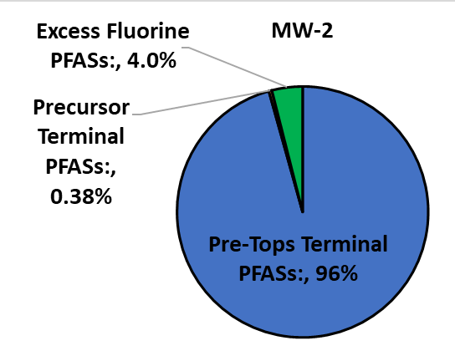
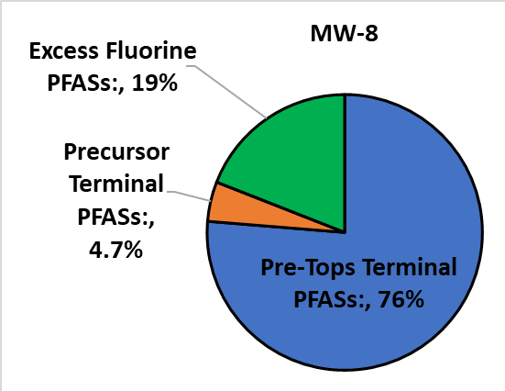
The Better News: Relative PFAS Group Risk Driver
(Excess Fluorine PFASs Much Less Toxic)
MW-9
MW-7
MW-2
? TOPs +PFOS⁻
MW-8
Notes:
NTA Report: There were several non-target analytes that were identified as potential PFAS parameters in these samples; Perfluorobutanesulfonamide (FBSA), Perfluorohexanesulfonamide (FHxSA) and Perfluoropropanesulfonic acid (PFPrS) were present in greatest apparent abundance. Perfluoropropanoic acid (PFPrA) was potentially present in several samples but has relatively poor response under the conditions of the NTA acquisition and its identification is less reliable.

Slide 47
Hypothetical Drinking Water Exposure Health Risk
Well | Total Terminal PFAS (µg/L) | Hazard Index | Primary Risk Drivers >50% (>10%)
MW-1 | 4,274 | 88,460 | PFOS⁻ (+PFHxS⁻)
MW-2 | 3,942 | 92,958 | PFOS⁻ (+PFHxS⁻)
MW-3 | 1,330 | 47,660 | PFOS⁻
MW-4 | 1,012 | 18,202 | PFOS⁻ (+PFHxS⁻)
MW-5 | 1,019 | 16,813 | PFOS⁻ (+PFHxS⁻)
MW-7 | 340 | 13,970 | PFOS⁻ (+PFHxS⁻)
MW-8 | 1.7 | 14 | PFOS⁻, PFHxS⁻, PFPrA⁻ (ultrashorts)
MW-9 | 31 | 312 | PFHxS⁻ (PFOS⁻)
Hazard Index >1 Indicates Potential Health Risk!

Slide 48
2022 Investigation of PFAS-Contaminated Soil
1. Exposure Area DUs (2):
Layer A: 0-6”
Layer B: 6-12”
DU-6
runoff area?
2. Source Area DUs (4)
Layer A: 0.5’ - 2.0’
Layer A: 2.0’ – 7.0’
Layer C: 7.0’ – 10’
DU-7
DU-1
Bike Path
?
DU-4
DU-2
MI Samples:
30 to 50 increments
1-2kg total
One set triplicates
DU-3
DU-5
runoff area?
Investigation Questions:
“Do PFASs in Exposure Area DUs pose a risk to park users?”
“What is the chemistry and total mass of PFASs in soil under the fire training pit?”
(proposed remediation method: Soil Washing)

Slide 49
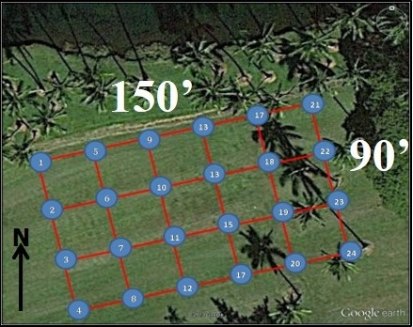
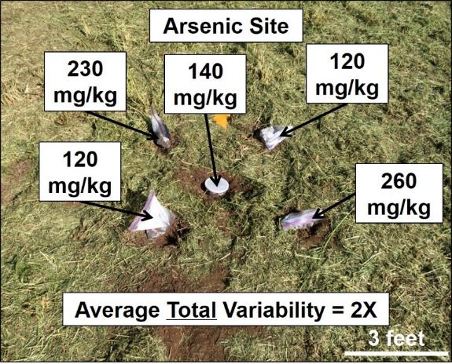


Limitations of “Discrete” Soil Data
All discrete data are random within a (largely) unknown range…
Hawaii Field Study of
Co-Located Discrete Samples (HIDOH 2014, 2017)

Slide 50

Are Discrete Sample Reliable for Risk Assessment?
Estimation of Mean Based on Replicate Sets
of Discrete Sample Data (HDOH 2017; 10 samples, 20 iterations)
Study Site | Range 95% UCL (mg/kg) | Range RSD
Site A (arsenic) | 403 to 776 | 34% to 67%
Site B (lead) | 201 to 439 | 20% to 86%
Site C (PCBs) | 9.4 to >1,000,000 | 124% to 315%
Concentration within predicted range for 10 randomly picked grid points used to estimate mean;
Estimated mean is random within an unknown range;
Representativeness of single, 10-sample data sets unknown;
Error in estimated mean or 95% UCL is unknowable.
“We did what we could with the data that they provided us.”
Anonymous USEPA Risk Assessor

Slide 51
Field Study Results
Roger Brewer, John Peard & Marvin Heskett (2017)
A critical review of discrete soil sample reliability:
Part 1 – Field study results
Part 2—Implications
Journal of Soil and Sediment Contamination.
Part 1: DOI: 10.1080/15320383.2017.1244172
http://dx.doi.org/10.1080/15320383.2017.1244171
Part 2: DOI: 10.1080/15320383.2017.1244172 http://dx.doi.org/10.1080/15320383.2017.1244172
Field report and recorded webinars posted to HEER DU-MIS Webpage:
https://health.hawaii.gov/heer/guidance/specific-topics/decision-unit-and-multi-increment-sampling-methods/

Slide 52




Collection of Risk-Based (“Representative”) Soil Samples
Decision Unit (DU)
Discrete Sample
Field: 100-200g
Lab: <1-10g
PFAS: 0.5g!
Multi Increment Sample
Field: 1-3kg
Lab: 10-30g
DU-2
DU-1
X
X
X
X
X
X
X
X
X
X
X
X
X
X
X
X
X
X
X
X
X
X
X
X
?
X
X
X
X
X
X
X
X
X
X
X
Multi Increment® is a registered trademark of EnviroStat, Inc.
DU-4
X
X
X
X
X
X
?
X
X
X
X
X
DU-3
X
X
X
X
DU: Area & volume of soil intended to be represented by the sample(s) collected.
Investigation Question (risk-based):
  “Does the mean concentration of Contaminant “X” in Decision Unit “Y” exceed Risk-Based Screening Level “Z”?
Multi Increment Sample (mining, agriculture, pharmaceutical & recycling industries):
  Collected from multiple points (“increments”) within a targeted area;
  Mass and # of “increments” included in sample based on Gy’s Theory of Sampling of “infinite element” particulate matter;
  Laboratory minimum 10-30g subsamples (10g PFAS subsamples achievable, +$150).

Slide 53




Subsurface Soil Sample Collection
Core Increment
Minimum 30 Core Increments per DU
Core Increment
A
B
C
DU-X Layer A
(0.5’-2.0’)
DU-X Layer B
(2.0’-7.0’)
DU-X Layer D
(7.0’-10’)
A
C
B
Optimal DU volume “Resolution” 100 to 300 cyds (input from remediation experts);
Targeted DU layers identified in each core (thickness can vary between cores);
Core increments subsampled to prepare final sample for DU Layer (e.g., ten, 5-gram plugs collected from each increment and combined for 1.5 kg MI sample);
Approach allows isolation of contamination and optimization of remediation.

Slide 54
2022 Investigation of PFAS-Contaminated Soil (no precursors or TOPs)
DU | Total PFAS (mg/kg) | % PFOS
DU-1A | 1.3 | 88%
DU-1B | 1.3 | 86%
DU-1C | 2.0 | 81%
DU-2A | 1.7 | 93%
DU-2B | 1.0 | 91%
DU-2C | 0.76 | 81%
DU-3A | 0.12 | 79%
DU-3B | 0.18 | 89%
DU-3C | 0.06 | 78%
DU-4A | 0.53 | 91%
DU-4B | 1.0 | 95%
DU-4C | 2.9 | 89%
DU-5A | 0.37 | 78%
DU-5B | 1.1 | 94%
DU-6A | 0.81 | 99%
DU-6B | 0.27 | 89%
DU-7A | 0.27 | 98%
DU-7B | 0.08 | 93%
DU-6
DU-7
DU-1
Bike Path
?
DU-4
DU-2
DU-3
DU-5
Good replicate precision;75-99% PFOS (no TOPs data);
Significant 6:2 FTS in groundwater under pit suggests
high concentration of 6:2 FtTAoS in soil;
Total PFASs in soil likely underestimated by >100X;
Pending: Additional soil samples beneath fire training with Pre- & Post-TOPs to estimate 2022 data error.

Slide 55




2023 Collection of MI Samples from DU-5
Exposure Area DU;
Area: 3,200 ft² (300 m²)
Thickness: 0-4” (10 cm);
Gravelly soil;
45 increments (even spacing between cell mid points);
Flat edge trowel;
Heavy duty freezer bag;
Two sets of triplicate 2kg samples collected (sent to two separate labs);
+ Laboratory triplicates on three samples;
Pre- & Post-TOPs, TOF, NTA;
X
X
X
X
X
X
X
X
X
X
X
X
DU-5
B
E
A
C
D
F

Slide 56
DU-5 Pre- vs Post-TOPs
(good field sample and laboratory subsample replicate precision)
Oxidation of
6:2 FtTAoS plus
minor 6:2 FTS and ???
Analyte | KFTA-DU5 (replicate average)
 | Pre-TOPs µg/Kg | Post-TOPs µg/Kg | % Difference
PFBA⁻ | 13 | 76 | 475%
PFPeA⁻ | 16 | 74 | 360%
PFHxA⁻ | 14 | 124 | 770%
PFHpA⁻ | 2.5 | 21 | 770%
PFOA⁻ | 4.0 | 26 | 559%
PFHxS⁻ | 35 | 42 | 21%
PFOS⁻ | 745 | 832 | 12%
6:2 FTS⁻ | 20 | 0.0 | -100%
8:2 FTS⁻ | 7.1 | 0.0 | -100%
Other | 48 | 61 | 13%
Total: | 904 | 1,256
DU-2
?
DU-5
40% Post-Tops increase in Total PFAS;
Small amount of 6:2 FtTAoS present;
Only minor runoff of AFFF since paving.

Slide 57

DU-5 Soil sample (average of replicates)
- Soil Exposure Health Risk -
PFAS Group | Concentration (µg/kg) | Hazard Indices
 |  | Residential Land Use | Commercial Land Use
¹Pre-Tops PFASs: | 870 | 32 | 3.5
Post-TOPs Precursor PFASs: | 385 | 4.9 | 0.5
²Excess Fluorine PFASs: | (error) | - | -
Total PFASs: | 1,134 | 36 | 4
1. Terminal endpoint PFASs only
2. Measured Extractable Organic Fluorine below TOF predicted by Post-TOPs data.
Minor contribution of Precursor PFASs to Total Risk (primary risk driver PFOS⁻);
“Site-specific” risk assessment would conclude no significant risk to airport workers (restricted access);
Precursor PFASs from 6:2 FtTAoS and 6:2 FTS will likely drive direct exposure risk in soil underlying Fire Training Pit.

Slide 58
Key Points and Lessons Learned
Do PFASs in DU-5 soil pose a leaching risk to groundwater?
- SPLP Laboratory Batch Leaching Tests -
Synthetic Precipitation Leaching Procedure (SPLP);
100 grams of soil placed in two liters of simulated rainwater and agitated;
Leachate solution tested for target compounds;
Ratio of original concentration in to soil concentration in water denotes how tightly bound the contaminant is to the soil (“Kd” sorption coefficient);
Kd values <20 indicate potential leaching risk;
Does not address leaching of PFAS precursor compounds.
Compound | DU-5A (1) Soil (µg/kg) | SPLP Solution (ng/L) | Kd (cm³/g) | Notes
PFOS- | 940 | 3.8 | 230 | Not mobile
PFHxS- | 44 | 2.1 | 0.95 | Highly mobile
PFHxA- | 34 | 2.0 | (error) | Kd Not Determine: PFAS mass in solution exceeds PFAS mass in soil sample (soil subsampling +/- analytical error)
PFPeA- | 25 | 1.4 | (error)
PFBA- | 19 | 1.2 | (error)
6:2 FTS⁻ | 14 | 1.1 | (error)
Notes:
Dean Crumbling (USEPA HQ).

Slide 59
Pending: Soil Column Leaching Test (modified Method 1314)
More directly reflects Investigation Question being asked;
Multi Increment sample representative of subject field (or material) placed in column;
Water pumped upwards from bottom at established rate (removes trapped air);
Modified to reflect leaching due to irrigation of farm fields
  Larger soil column to accommodate 1-3kg Multi Increment Sample;
  Two-tests of leachate (vs 9): “First Flush” and long-term average impacts to groundwater;
Experiments underway at laboratory in Canada.
Notes:
Dean Crumbling (USEPA HQ).

Slide 60

Assessment of PFAS Risk - Still Evolving…
Future Research Ideas:
Tiered approach to leaching of PFAS from soil/biosolids (action levels, SPLP batch leaching test, modified Method 1314 Soil Column leaching test);
Bioavailability of PFASs in soil & biosolids;
Uptake of PFASs into food crops;
“Risk-Based” sampling of groundwater monitoring;
Other?
All models are wrong, but some are useful.
George Box

