Slide 1


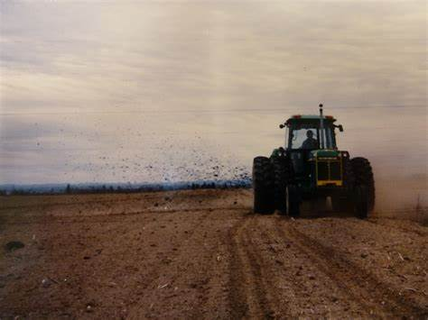
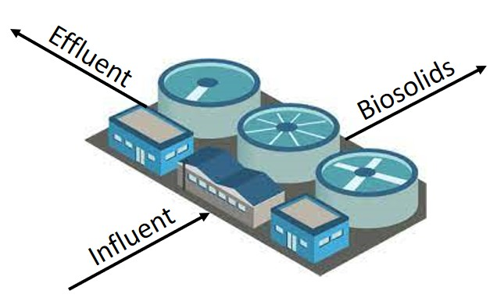
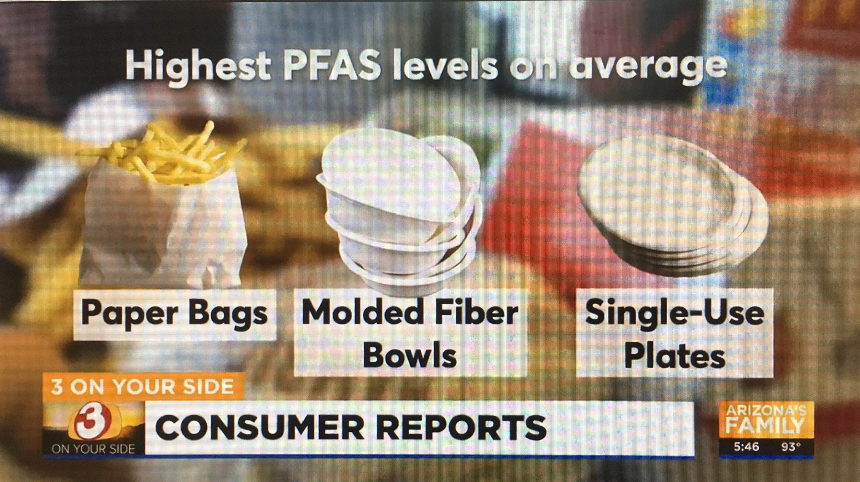

Per- and Poly-Fluoroalkyl Substances
- Updates to Hawaii’s PFAS Guidance -
Roger Brewer, PhD,
Senior Environmental Scientist
Hawaii Department of Health
roger.brewer@doh.Hawaii.gov
March 12, 2024
Australia PFASs & Sampling
Workshops (February 2024)
Wastewater
Irrigation
Biosolids
Soil Amendment
Fire Training Areas
(AFFF)
Food Wrappers &
Containers

Slide 2
Other PFAS References
Hawaii Dept of Health Guidance:
Interim Soil and Water Environmental Action Levels (EALs) for Perfluoroalkyl and Polyfluoroalkyl Substances (PFASs), January 2024 (draft): https://health.hawaii.gov/heer/guidance/additional-guidance-documents/
PFAS Basics:
ITRC 2020: Per- and Polyfluoroalkyl Substances (PFASs)
TOPs Methods:
Ateia et al., 2023, Total Oxidizable Precursor (TOP) Assay Best Practices, Capabilities and Limitations for PFAS Site Investigation and Remediation: Environmental Science and Technology Letters. Vol. 10, pp 292−301.
HIDOH PFAS Webpage:
https://health.hawaii.gov/heer/environmental-health/highlighted-projects/per-and-polyfluoroalkyl-substances-pfass/
HIDOH Recorded Webinars:
https://health.hawaii.gov/heer/guidance/heer-webinars/

Slide 3
PFAS Guidance Update
January 2024 (Draft)
1.0 Terminology, Chemistry, Manufacture and Use
2.0 Sources of PFASs in Soil and Groundwater
3.0 Physiochemical Constants
4.0 Toxicity Factors
5.0 Environmental Fate and Transport
6.0 Environmental Action Levels for Individually Targeted PFASs (indoor air and soil vapor action level added for PFPrA⁻)
7.0 Assessment of Total PFAS Risk
8.0 Sample Collection and Processing
9.0 Laboratory Test Methods
Limitations
+ Figures & Tables
Hawaii Dept of Health Guidance:
Interim Soil and Water Environmental Action Levels (EALs) for Perfluoroalkyl and Polyfluoroalkyl Substances (PFASs), January 2024 (draft): https://health.hawaii.gov/heer/guidance/additional-guidance-documents/

Slide 4
January 2024 PFAS Guidance Main Updates
Reference Concentration for 6:2 FTS corrected (MIDEGLE 2020);
Toxicity factors, physiochemical constants and action levels for following compounds added:
  Perfluoropentane sulfonate and Perfluoropropanoate (identified in water samples);
  6:2 fluorotelomer alcohol and 8:2 fluorotelomer alcohol (used to coat food wrappers and compostable food containers); and
  6:2 fluorotelomer thioether amido sulfonate (primary PFAS in modern AFFF);
Target noncancer Hazard Quotient of “1” used to generate soil action levels;
Calculation of cumulative “Hazard Index” required for soil and drinking water data;
Guidance and accompanying Excel spreadsheet added for calculation of sample-specific “Total PFAS Risk.”

Slide 5

Plant
Uptake
Irrigation

Slide 6


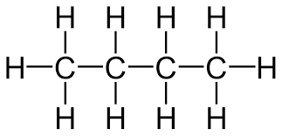
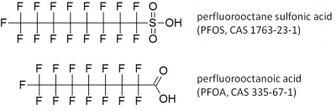
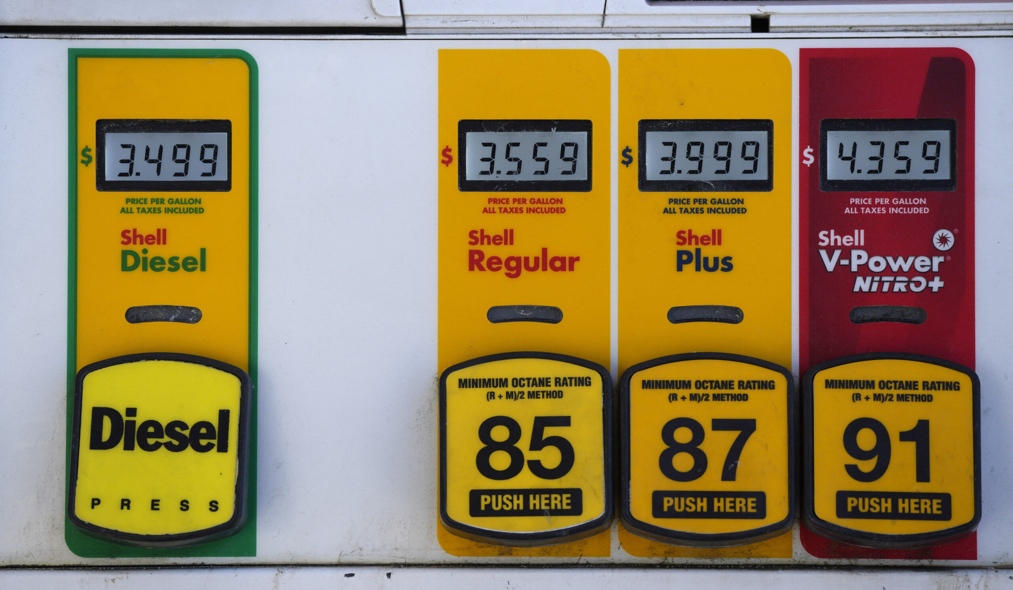
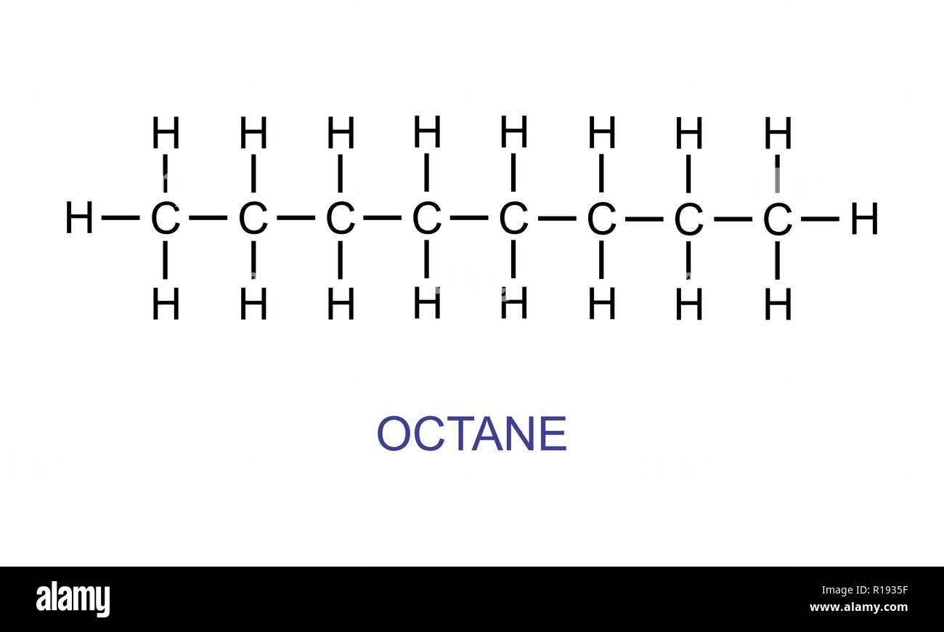
PFASs Chemistry Basics: Carboxylates & Sulfonates
Food
Wrappers
Butane (C₄H₁₀)
Perfluoro Butanoic Acid (perfluoro butanoate)
O⁻
Anionic forms most common in soil and water
Older
AFFF
Octane (C₈H₁₈)
Perfluoro Octanoic Acid (perfluoro octanoate)
O⁻

Slide 7
History of PFASs Toxicity Studies
(after EWG: https://www.ewg.org/research/decades-polluters-knew-pfas-chemicals-were-dangerous-hid-risks-public)
First Manufactured in 1930s
Water- & grease-resistant materials
Food Packaging Concerns
Food Packaging Concerns
Tumors, Immune System
PFAS Buildup in Humans
PFAS Buildup in Mice
Liver & Spleen Damage
Toxic to Fish
Damage
To Fetuses
1950s | 1960s | 1970s | 1980s
Proposed Drinking
Water Standards
PFOS Phased Out
Reduction in Food Packaging
Industry Scientist Concern
PFOA Phased Out
Additional Toxicity Studies
Cancer, etc.
In Workers
Impacted
DW Wells
1990s | 2000s | 2010s | 2020s
7

Slide 8

PFASs Toxicity
(based on references in HIDOH 2024)
Cancer
Skin
Developmental
Hematologic
Endocrine
Hepatic
Reproductive
Kidney
Immune
Cardiovascular
Metabolic
Nervous

Slide 9
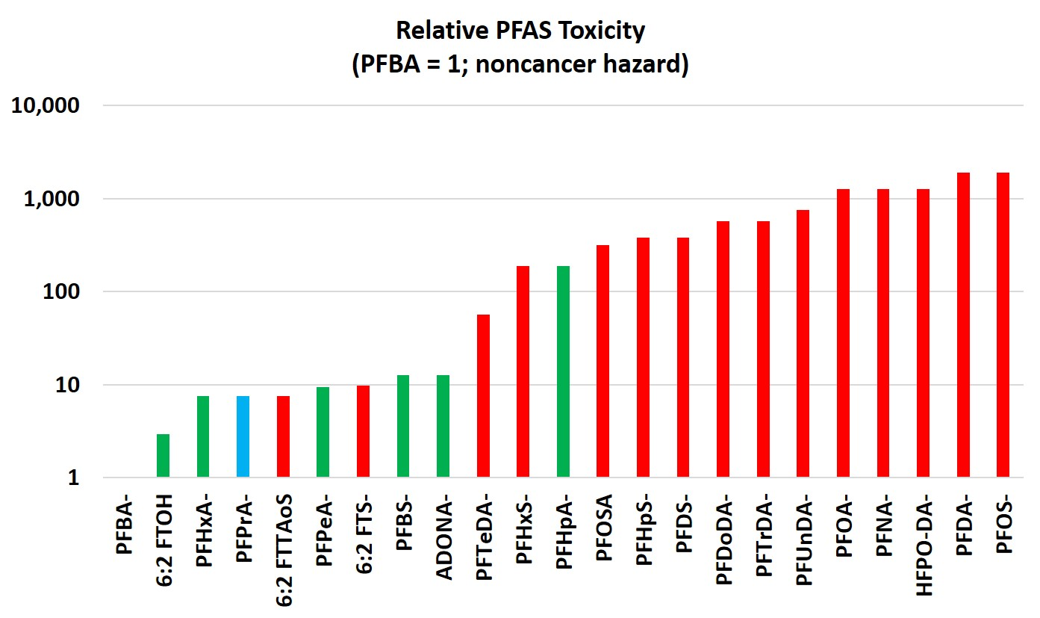
Relative PFAS Toxicity
(based on references in HIDOH PFAS guidance 2024)
Ultrashort Chain
Short Chain (lower toxicity)
Long Chain (lower toxicity)
Increasing Toxicity
CrVI
PCE
Benzene
Dioxins = 1,000X PFOS
DDT
TCE
Arsenic
PCBs

Slide 10
18 “Terminal” PFASs Compounds With Toxicity Factors
(2024 Hawaii Dept of Health Action Levels noted)
Terminal Endpoint Compound | # Carbons | Soil-res (µg/kg) | TapWater (ng/L)
Perfluoro butane sulfonate (PFBS⁻) | 4 | 3,800 | 1,700
Perfluoro pentane sulfonate (PFPeS⁻) | 5 | 2,000 | 650
Perfluoro hexane sulfonate (PFHxS⁻) | 6 | 250 | 77
Perfluoro heptane sulfonate (PFHpS⁻) | 7 | 126 | 38
Perfluoro octane sulfonate (PFOS⁻) | 8 | 25 | 7.7
Perfluoro decane sulfonate (PFDS⁻) | 10 | 126 | 38
Perfluoro propanoate (PFPrA⁻) | 3 | 5,000 | 510
Perfluoro butanoate (PFBA⁻) | 4 | 48,000 | 15,000
Perfluoro pentanoate (PFPeA⁻) | 5 | 5,100 | 1,500
Perfluoro hexanoate (PFHxA⁻) | 6 | 6,300 | 1,900
Perfluoro heptanoate (PFHpA⁻) | 7 | 250 | 77
Perfluoro octanoate (PFOA⁻) | 8 | 38 | 12
Perfluoro nonanoate (PFNA⁻) | 9 | 38 | 12
Perfluoro decanoate (PFDA⁻) | 10 | 25 | 7.7
Perfluoro undecanoate (PFUnDA⁻) | 11 | 63 | 19
Perfluoro dodecanoate (PFDoDA⁻) | 12 | 84 | 26
Perfluoro tridecanoate (PFTrDA⁻) | 13 | 84 | 26
Perfluoro tetradecanoate (PFTeDA⁻) | 14 | 840 | 260
Ultrashort
Short
Long
Sulfonates
Method
537/1633
Carboxylates

Slide 11
Assessment of Health Risk
WWTP Biosolids: Standard PFAS Method (537/1633)
Potential Health Risk if Hazard Index >1 (rounded to single significant digit)

Slide 12
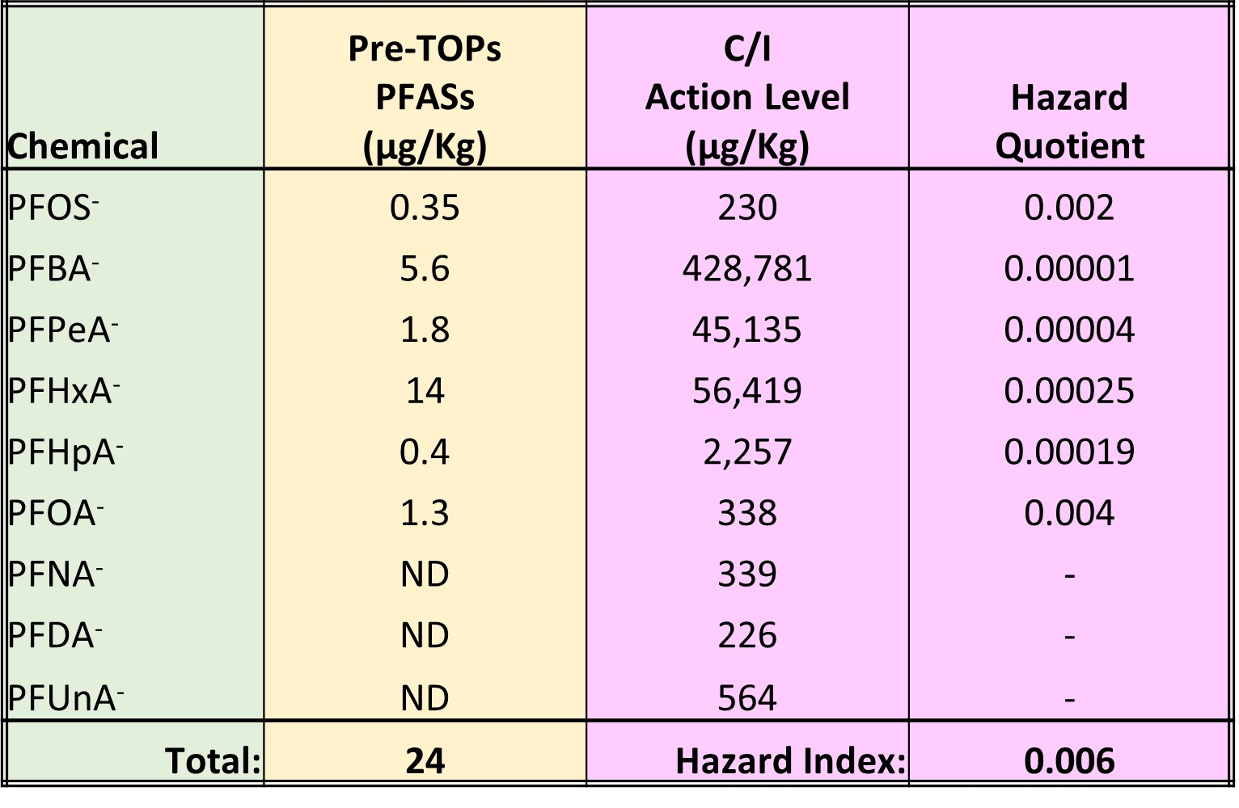
Assessment of Health Risk
AFFF-Impacted Soil: Standard PFAS Method (537/1633)
Potential Health Risk if Hazard Index >1 (rounded to single significant digit)

Slide 13
Evolution of PFAS Science…
I know everything
high
There’s more to this
than I thought…
Ahah…
Confidence
I’m never going
to understand this
It’s starting to
make sense
low
Huh???
low
high
Knowledge in Field
"The aim of science is not to open the door to infinite wisdom, but to set a limit to infinite error."
Bertolt Brecht
Notes:
denial, anger, bargaining, depression and acceptance

Slide 14
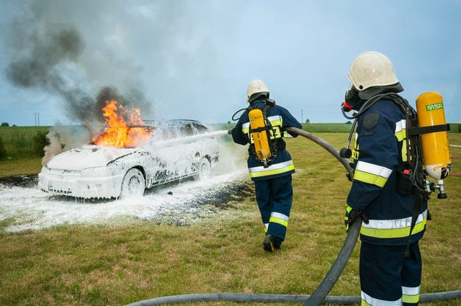

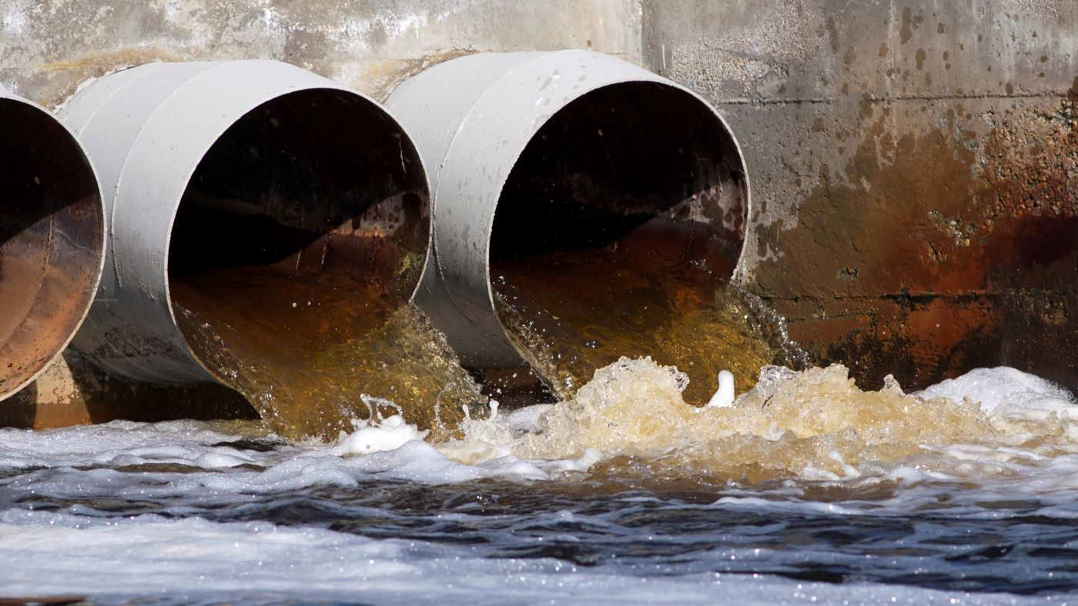
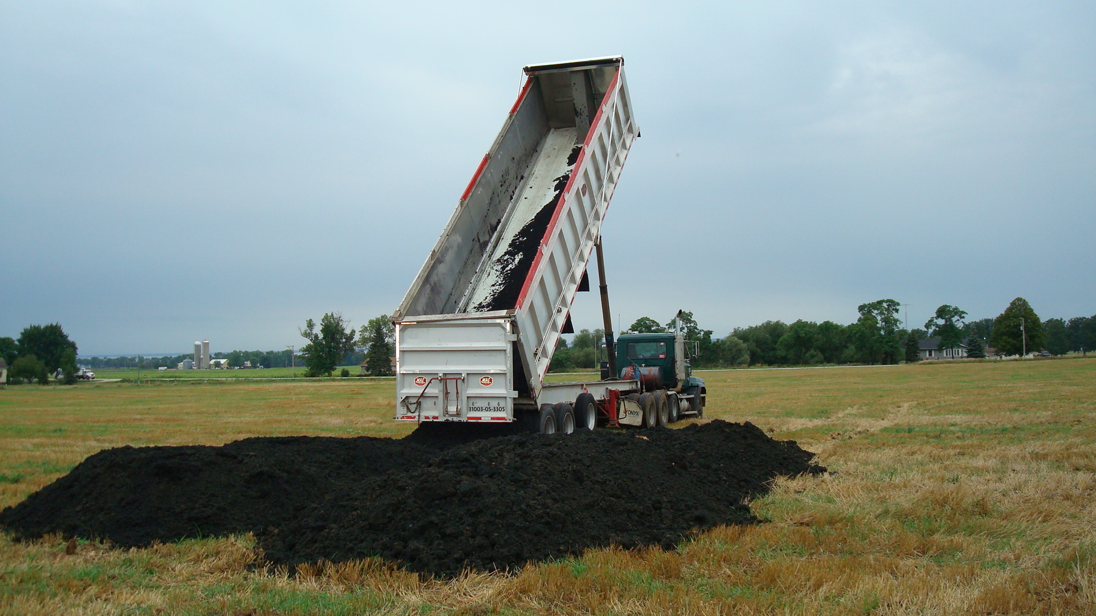
Problem: Hundreds of PFAS “Precursor” Compounds
(not reported by laboratory and/or lack toxicity factors)
AFFF (6:2 FtTAoS⁻)
Food Containers
& Wrappers (6:2FTOH⁻)
Biosolids
(metabolites)
Wastewater
(metabolites)

Slide 15
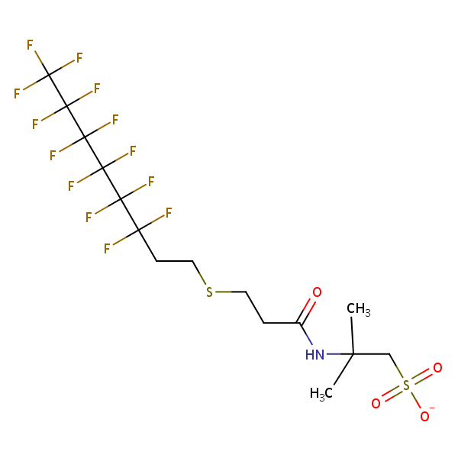
Seven “Precursor” Compounds With Toxicity Factors
(soil and water action levels included in 2024 HIDOH guidance)
Breakdown
Products
“Precursor” Compounds (color denotes main breakdown products)
Ammonium 4,8-Dioxa-3H-perfluoro nonanoate (ADONA-) ???
2,3,3,3-tetrafluoro-2-(heptafluoropropoxy) propanoate (HFPO DA-, “GenX”) ???
6:2 Fluorotelomer alcohol (6:2 FTOH-)
6:2 Fluorotelomer thioether amido sulfonate(6:2 FtTAoS-)
6:2 Fluorotelomer sulfonate (6:2 FTS-)
Perfluroroctane sulfonamide (PFOSA)
8:2 Fluorotelomer alcohol (8:2 FTOH-)
Ultrashort
Short
6:2 FtTAoS
Long
Method
537/1633

Slide 16
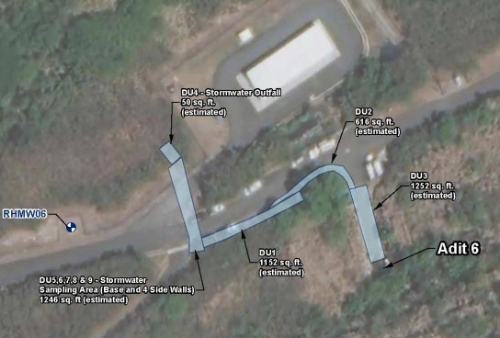
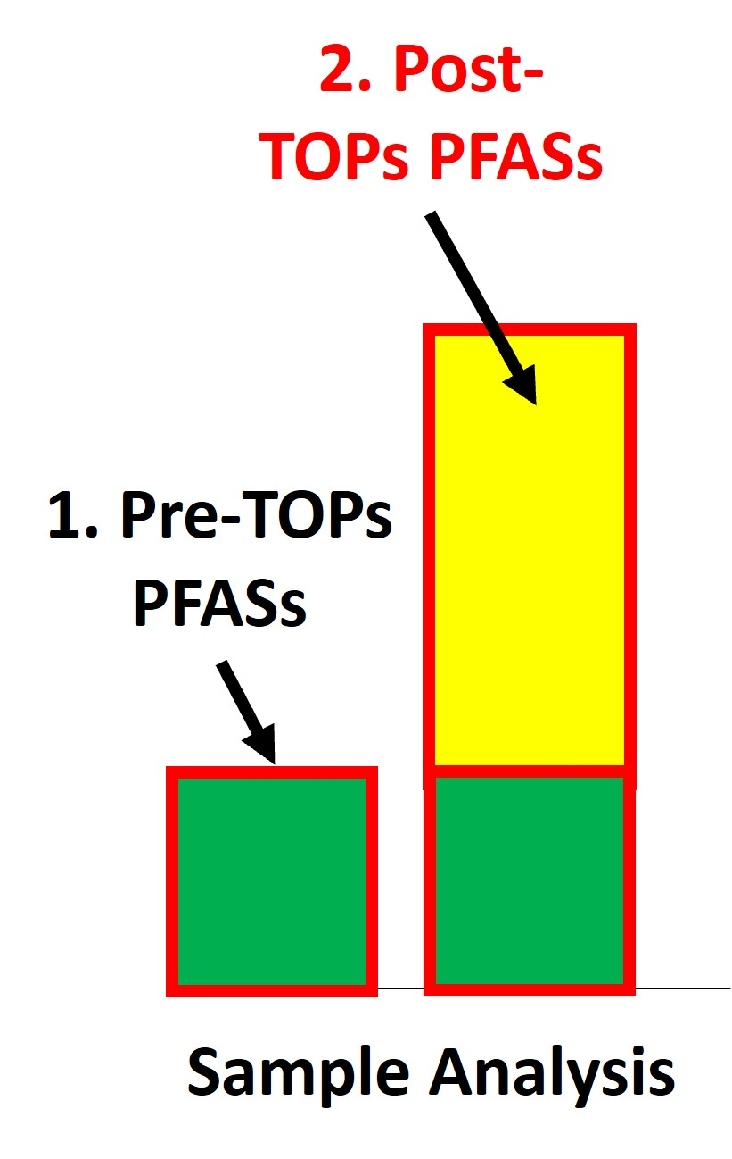
Standard Lab Method vs Total Oxidizable Precursors (TOPs) Soil Data (AFFF Spill Site)
DU-4A
Pre-TOPs: 16 µg/kg
Post-TOPs: 114 µg/kg
DU-2
Pre-TOPs: 144 µg/kg
Post-TOPs: 23,839 µg/kg
DU-3
Pre-TOPs: 264 µg/kg
Post-TOPs: 22,013 µg/kg
DU-4B
Pre-TOPs: 13 µg/kg
Post-TOPs: 643 µg/kg
TOPs

Slide 17
6:2 FtTAoS in “Modern” Aqueous Fire Fighting Foam (AFFF)
“Parent” PFAS
PFAS “Precursor” (since 2005)
Perfluoro Heptanoic Acid
6:2 Fluorotelomer Thioether Amido Sulfonate
1
Dominant PFAS in AFFF since 2005;
Toxicity factors not widely available;
Not Reported by current laboratory methods;
Risk posed by AFFF-contaminated media underestimated.
1
2
2
3
3
4
4
5
5
6
6
7
7
O
8
OH
Reported by Standard Lab Methods
“Functional Group”
Added

Slide 18
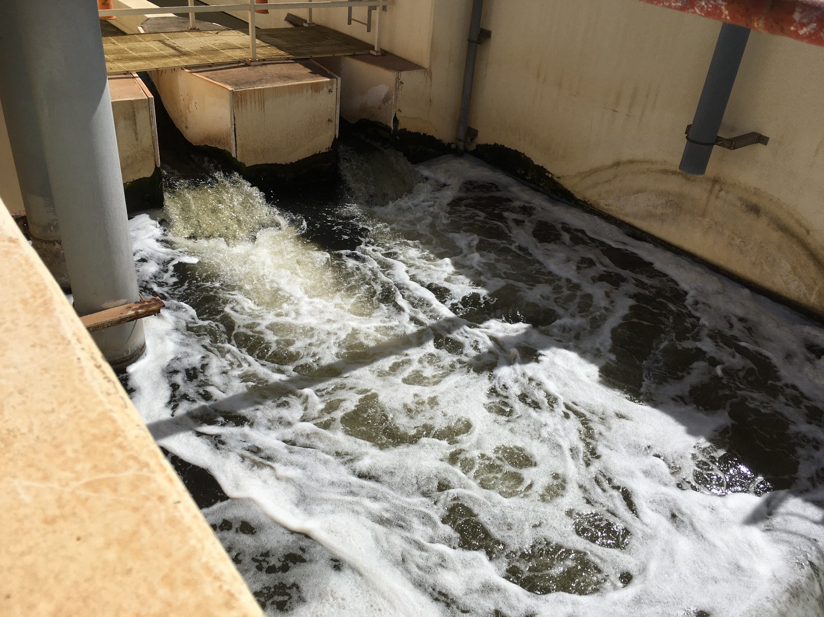

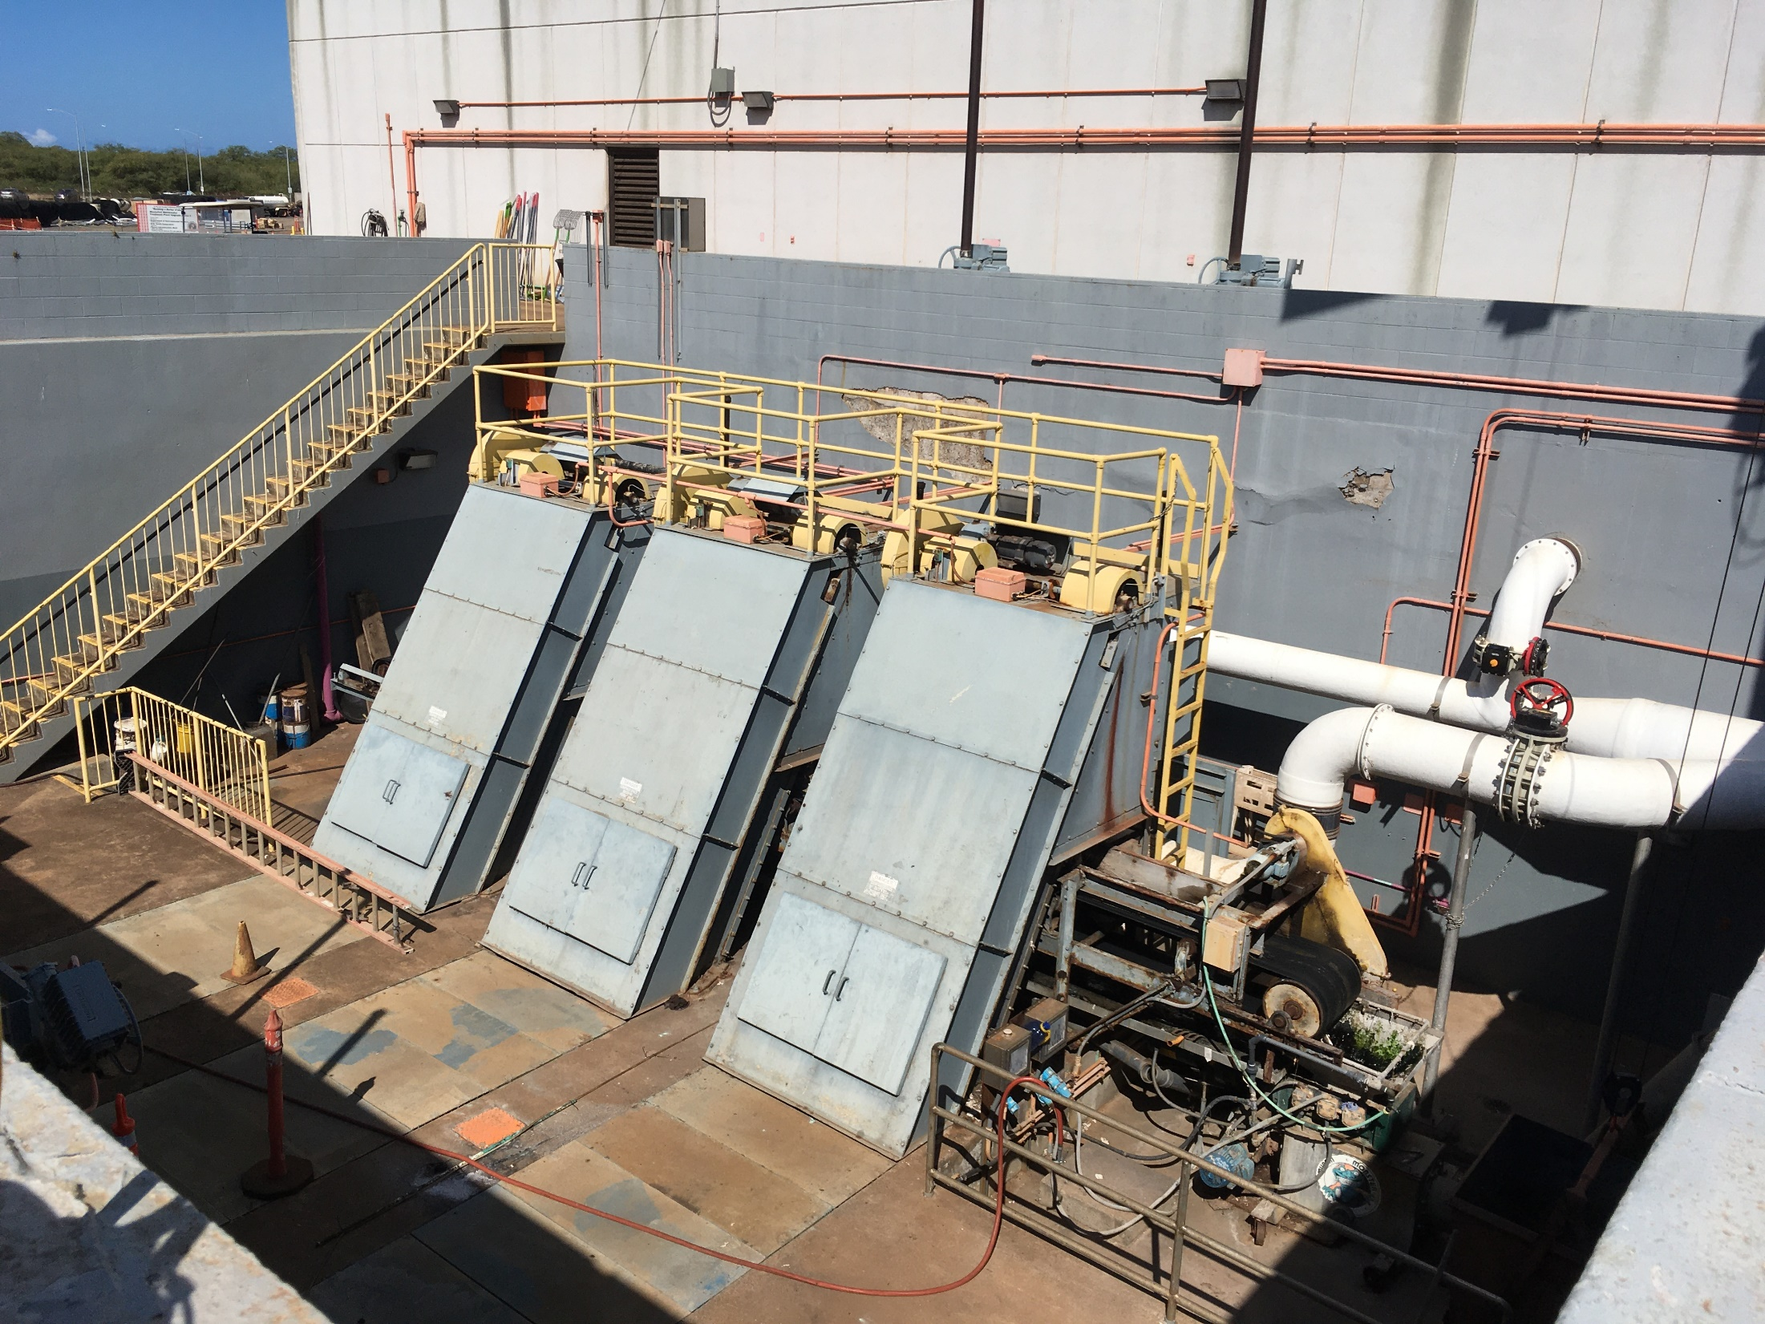
Highly Oxidized
Municipal WWTP
Expanded Analyte List
Other: PFBA⁻, PFBS⁻, PFHpA⁻, PFDA⁻, PFNA⁻, PFHxS⁻
Other: N-EtFOSE⁻, EtFOSAA⁻, PFDA⁻, PFDoA⁻, PFHxA⁻, PFDS⁻, 6:2 FTS⁻, PFTeDA⁻, PFUnA⁻, PFTrDA⁻, PFOA⁻, PFOSA⁻, PFBS⁻, N-MeFOSA⁻, PFNA⁻
Pre-TOPs Data
Effluent
Biosolids
Total PFAS: 36 ng/L
Biosolids
Pre-TOPs Total PFAS: 182 µg/kg
Post-TOPs Total PFAS: 624 µg/kg
>99.9% of PFAS sorbed to organic matter
Influent
Pre-TOPs Data:
Abundant metabolites
Partial oxidation of precursors
Reported by laboratory but no toxicity factors
Post TOPs Data:
Biosolids: Increase in Total PFASs indicates presence of significant additional PFASs precursors
Water: Minimal increase in water sample data
Other: 6:2 FTS⁻, PFPeA⁻, PFDA⁻, PFHpA⁻, PFDoA⁻, PFNA⁻, PFHxS⁻
Total PFAS: 66 ng/L

Slide 19
Evolution of PFAS Science…
I know everything
high
There’s more to this
than I thought…
Ahah…
Confidence
I’m never going
to understand this
It’s starting to
make sense
low
Huh???
low
high
Knowledge in Field
"The aim of science is not to open the door to infinite wisdom, but to set a limit to infinite error."
Bertolt Brecht
Notes:
denial, anger, bargaining, depression and acceptance

Slide 20
Assessment of Precursor PFASs
Precursor Mixture
Manufactured PFAS
?
Directly
Compare to Action Levels
Convert
Terminal PFASs
PFAS
Metabolites

Slide 21
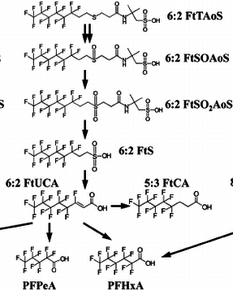
Natural Oxidation and Breakdown of 6:2 FtTAOS
Natural Biotransformation
of 6:2 FtTAOS
(Marjanoic et al. 2015)
Mixture of metabolites & Terminal PFASs appears to be common
Metabolites
(partial oxidation)
Terminal End PFASs
(anion form likely present)

Slide 22
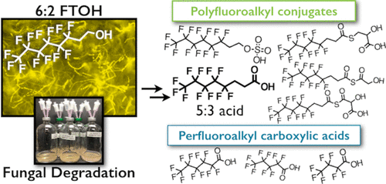
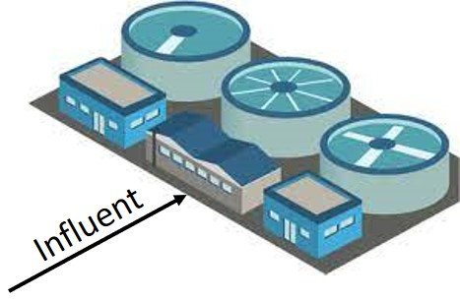

Natural Oxidation of FTOHs to Terminal PFASs
Fluorotelomer alcohols… used in materials in contact with food as non-stick agents (e.g., 6:2 FTOH, 8:2 FTOH, 10:2 FTOH)
Carnero et al., 2021, Presence of Perfluoroalkyl and Polyfluoroalkyl Substances (PFAS) in Food Contact Materials (FCM) and Its Migration to Food: Foods 2021, 10, 1443
Dietary secondary source of PFASs;
Mixtures common.
?
Hawaii tested WWTPs do not receive landfill leachate
PFHxA⁻
PFPeA⁻
PFBA⁻
Nancy Tseng, Ning Wang, Bogdan Szostek and Shaily Mahendra, 2014, Biotransformation of 6:2 Fluorotelomer Alcohol (6:2 FTOH) by a Wood-Rotting Fungus: Environ. Sci. Technol. 2014, 48, 7, 4012–4020,

Slide 23



Laboratory Breakdown of Precursors and Metabolites to Terminal PFASs using “TOPs” Methods
Total Oxidizable Precursors (TOPs) Method:
  Sample heated with an oxidizing agent under alkaline conditions;
  Strips functional groups from PFAS leaving terminal end products;
  Identifies presence of previously unreported ultrashort-, short- and long-chain PFASs precursor compounds in sample;
  Final terminal end-product mixture minus pre-TOPs mixture assumed to reflect metabolic products of original compound mixture.
TOPs
Hidden
PFASs
Precursors &
Metabolites
Terminal Compounds

Slide 24
Pre- vs Post-TOPs Makeup of WWTP Biosolids
(Pre-TOPs data missed 90% of PFASs in Sample)
Concentration of “Post TOPs PFASs” = Post-Tops minus Pre-TOPs Terminal PFAS data

Slide 25
Assessment of Post-TOPs PFASs Risk
Biosolids: Standard PFAS Method (537/1633)
Pre-TOPs PFASs + Post-TOPs PFAS HI = 5

Slide 26
Pre- vs Post-TOPs Makeup of Ansul AFFF
Concentration of “TOPs PFASs” = Post-Tops minus Pre-TOPs Terminal PFAS data;
Excess Post-TOPs PFASs represent oxidation products of PFASs missed by standard laboratory method (>99.9% of PFASs present);
“Non-targeted Analysis (NTA)” identified primary hidden PFAS as 6:2 FtTAoS.

Slide 27
Pre- vs Post-TOPs Makeup of AFFF-Impacted Soil (DU-2)
(Pre-TOPs data missed 99.9% of PFASs in Sample)
Concentration of “TOPs PFASs” = Post-Tops minus Pre-TOPs Terminal PFAS data;
Additional Post-TOPs PFASs represent oxidation products of PFASs missed by standard laboratory method (>99.9% of PFASs present).

Slide 28
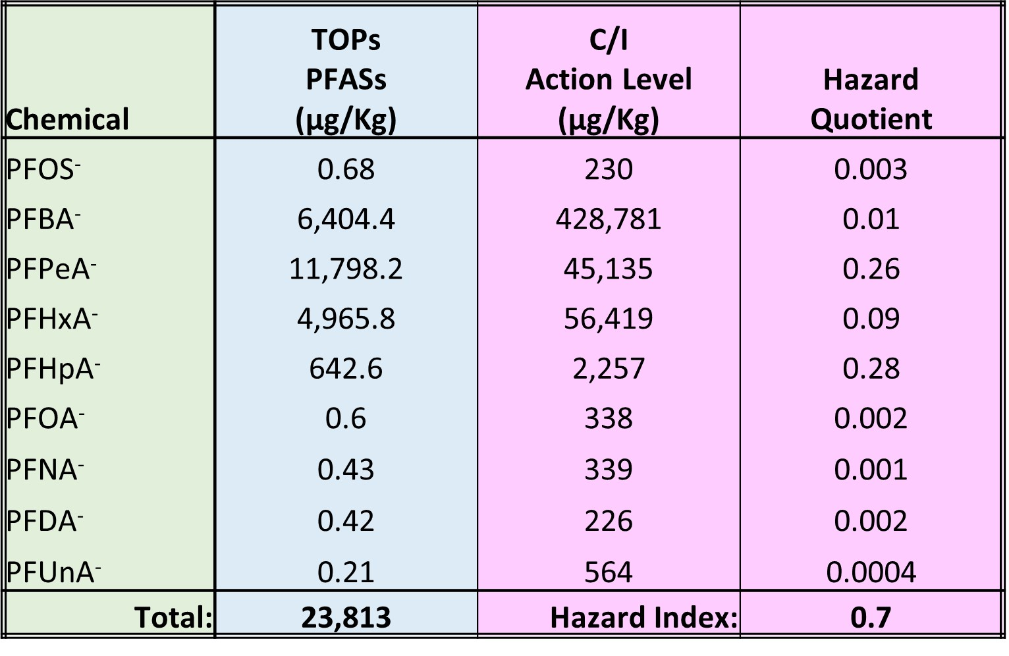
Assessment of Post-TOPs PFASs Health Risk
AFFF-Impacted Soil: Post-TOPs PFASs Risk (Method 537/1633)
Pre-TOPs PFASs Hazard + Post-TOPS PFASs Hazard = 0.706
(potential leaching risk being assessed separately)

Slide 29
Evolution of PFAS Science…
I know everything
high
?
Ahah…
There’s more to this
than I thought…
Confidence
I’m never going
to understand this
It’s starting to
make sense
low
Huh???
low
high
Knowledge in Field
"The aim of science is not to open the door to infinite wisdom, but to set a limit to infinite error."
Bertolt Brecht
Notes:
denial, anger, bargaining, depression and acceptance

Slide 30
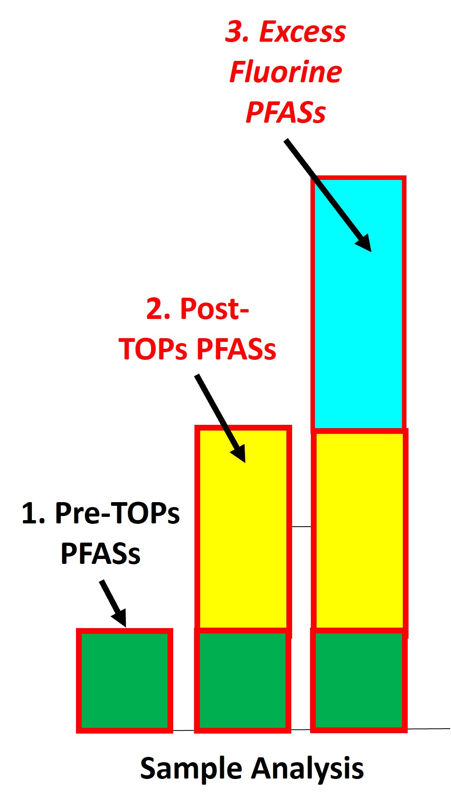
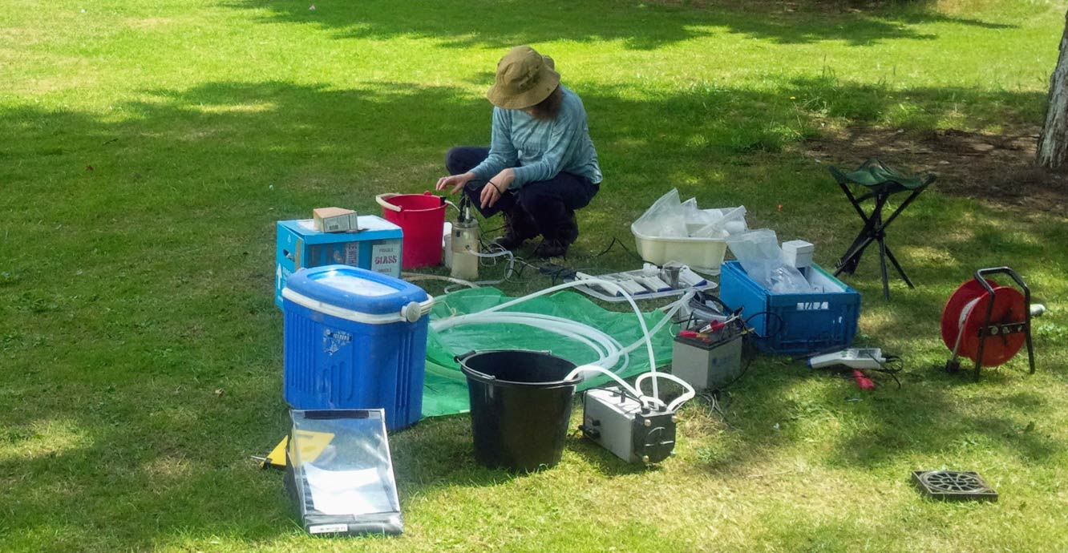

More Missing PFASs! Excess Organic Fluorine in Water!
?
Excess Fluorine
Concentration of TOF predicted based on fluorine content of
Post-TOPs PFAS
TOF Reported by Laboratory
Total Organic Fluorine (Method 1621)
Liquids: “Absorbable Organic Fluorine”
Solids: “Extractable Organic Fluorine”

Slide 31
Components of Total PFAS Risk
(Example Mainland Drinking Water Data)
Total PFASs Risk =
Pre-TOPs PFASs Risk +
Post-TOPs PFASs Risk +
Excess Fluorine PFASs Risk
?
Excess fluorine not related to pre- or post-TOPs PFASs primarily identified in water samples (higher detection limit in solids samples)
Limited Non-Targeted Analysis (NTA) analysis typically identifies ultrashort PFASs (e.g., PFPrA⁻).
O⁻

Slide 32
Assessment of “Excess Fluorine” PFASs Risk
Excess Fluorine Data:
Assume Excess Fluorine = PFPrA⁻ (C₃HF₅O₂).
Adjust Excess Fluorine Concentration to reflect equivalent concentration of PFPrA⁻.
Compare to PFPrA⁻ Action Levels.
Calculate Hazard Quotient
?
Excess Fluorine PFASs Concentration:
= Excess EF Conc. x
PFPrA⁻ Molecular Weight (164)
F Atomic Mass (19) x # Fs (5)
= Excess EF Conc. X 1.73
HIDOH 2024 PFPrA⁻ Action Levels:
Soil Direct Exposure = 5,100 µg/kg
Drinking Water/Tapwater AL = 510 ng/L

Slide 33
Assessment of Total PFAS Risk
Total PFASs Risk =
Pre-TOPs PFASs Risk +
Post-TOPs PFASs Risk +
Excess Fluorine PFASs Risk
537/1633: Pre-TOPs lab method
TOPs: Total Oxidizable Precursors
TOF: Total Organic Fluorine (AOF, EOF)
Liquids: Absorbable Organic Fluorine
Solids: Extractable Organic Fluorine

Slide 34
Municipal WWTP Sample Data (report pending)
WWTP | *Sample Type | Units | ¹Total PFAS Pre-TOPs | ¹Total PFAS Post-TOPs | TOF
#1 | Influent | ng/L | (pending) | (pending) | (pending)
 | Effluent | ng/L | 24 | 22 | <40,000
 | Biosolids | µg/kg | (pending) | (pending) | (pending)
#2 | Influent | ng/L | (pending) | (pending) | (pending)
 | Effluent | ng/L | 834 | 698 | <40,000
 | Biosolids | µg/kg | (pending) | (pending) | (pending)
#3 | Influent | ng/L | (pending) | (pending) | (pending)
 | Effluent | ng/L | 37 | 30 | <40,000
 | Biosolids | µg/kg | 76 | 229 | (pending)
#4 | Influent | ng/L | 17 | - | -
 | Effluent | ng/L | 114 | - | -
 | Biosolids | µg/kg | 131 | - | -
#5 | Influent | ng/L | 66 | - | -
 | Effluent | ng/L | 36 | - | -
 | Biosolids | µg/kg | 183 | 678 | (pending)
#6 | Influent | ng/L | 40 | - | -
 | Effluent | ng/L | 32 | - | -
 | Biosolids | µg/kg | 86 | 945 | (pending)
#7 | Influent | ng/L | 22 | - | -
 | Effluent | ng/L | 144 | - | -
 | Biosolids | µg/kg | 124 | 785 | (pending)
1. Incudes reported precursor compounds if identified

Slide 35
Total PFAS Risk Calculator
Hawaii Dept of Health January 2024 (public review draft)

Slide 36
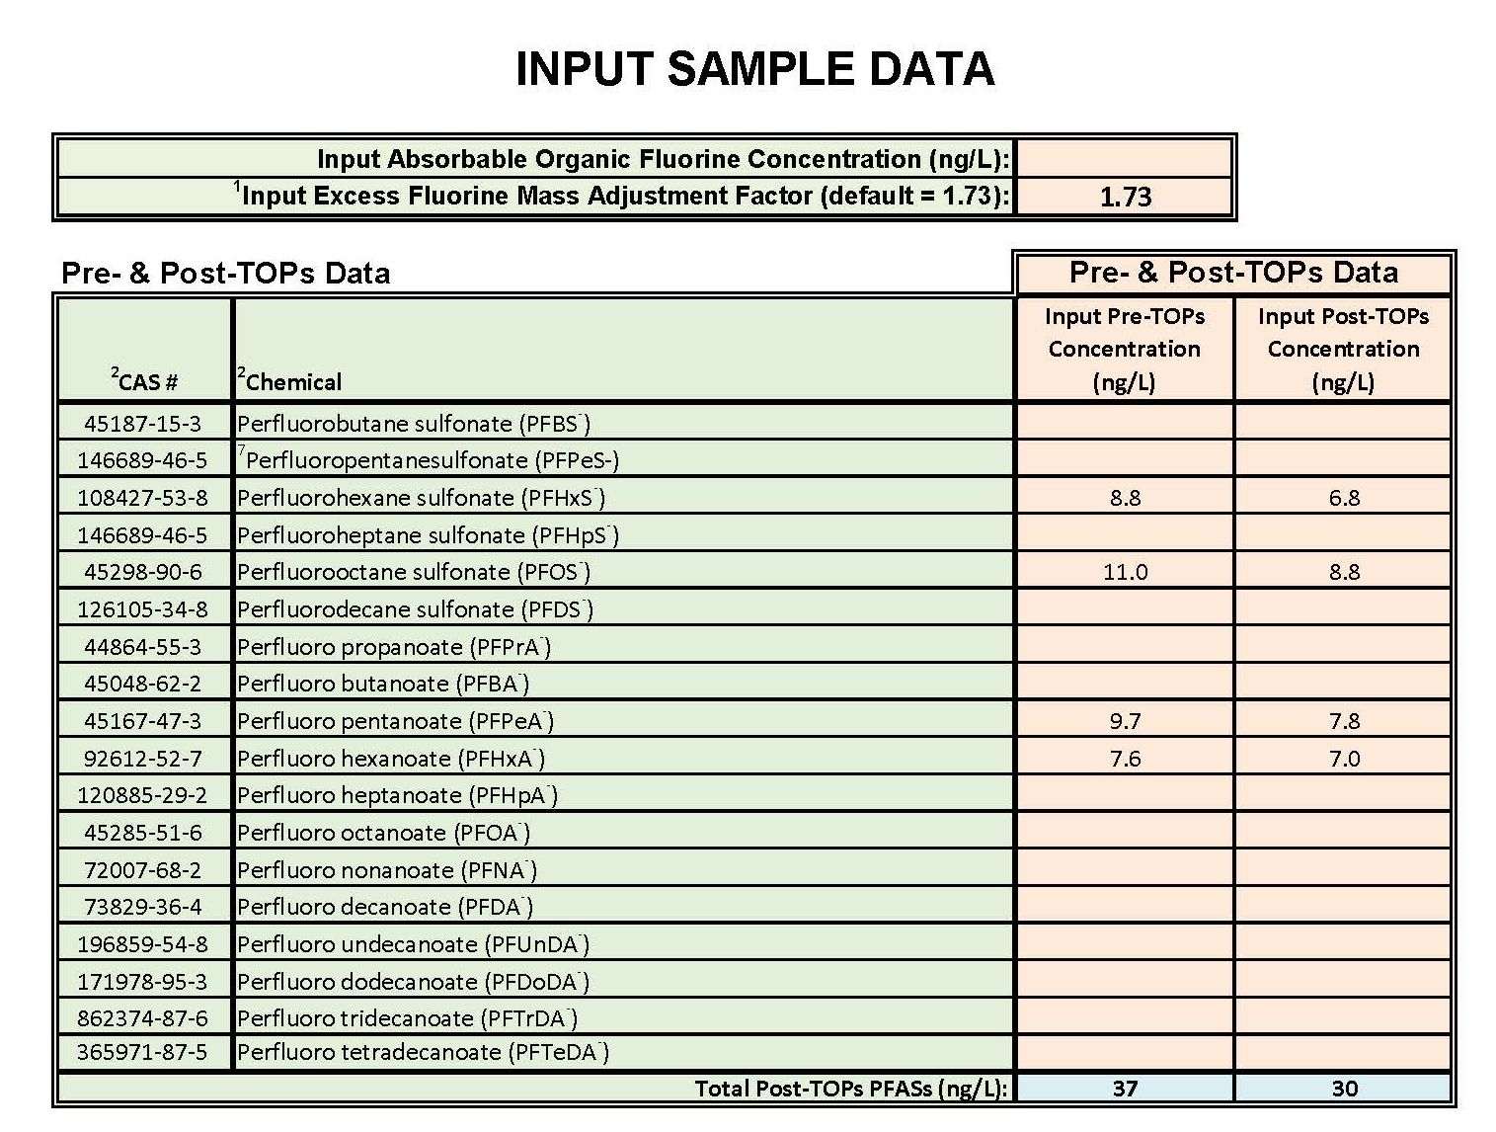
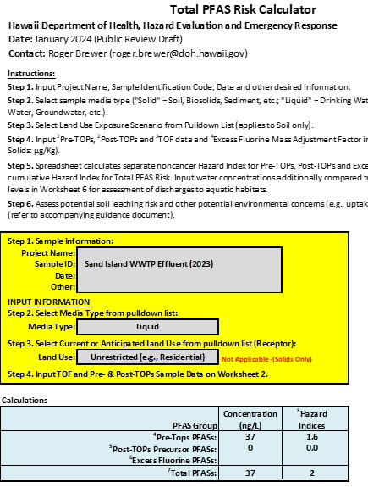
Example Total PFAS Risk:
WWTP Effluent as Hypothetical Drinking Water
*Input Pre-TOPs and Post-TOPs
Terminal Endpoint Compound Concentrations
Calculated
Total PFAS Risk
*AOF = ND (<40 µg/L)

Slide 37
Example Total PFAS Risk:
WWTP Effluent as Hypothetical Drinking Water
WWTP Effluent | Total Terminal PFAS (ng/L) | Hazard Index | Primary Risk Drivers (>50%, >10% or risk or Top 3 if HI <1)
#1 | 17 | 0.01 | None (Pre-TOPs PFPeA- & PFHxA-)
#2 | 868 | 0.57 | None (Pre-TOPs PFPeA-, PFHxA-)
#3 | 37 | 1.6 | Pre-TOPs PFOS- (+ PFPeA-, PFHxA-)
*#4 | 124 | 3.1 | Pre-TOPs PFOA-, PFDA-
*#5 | 32 | 0.8 | None (Pre-TOPs PFPeA- & PFHxA-)
*#6 | 17 | 0.69 | None (Pre-TOPs PFOS-, PFOA-, PFDA-)
*#7 | 144 | 2.3 | Pre-TOPs PFOA-, PFNA- (+ PFOS-)
*TOPs and TOF data not collected.
No precursor-related, Post-TOPs PFASs identified (all dissolved-phase precursors oxidized prior to discharge);
Excess Fluorine PFASs ND (Reporting Limit = 40 µg/L);
Reported at AFFF sites (ultrashorts estimated >50% of total PFASs);
Great toxicity of long-chain PFASs (>100X) negates likely significant, additional contribution to Total PFAS Risk from TOF-related ultrashorts?

Slide 38
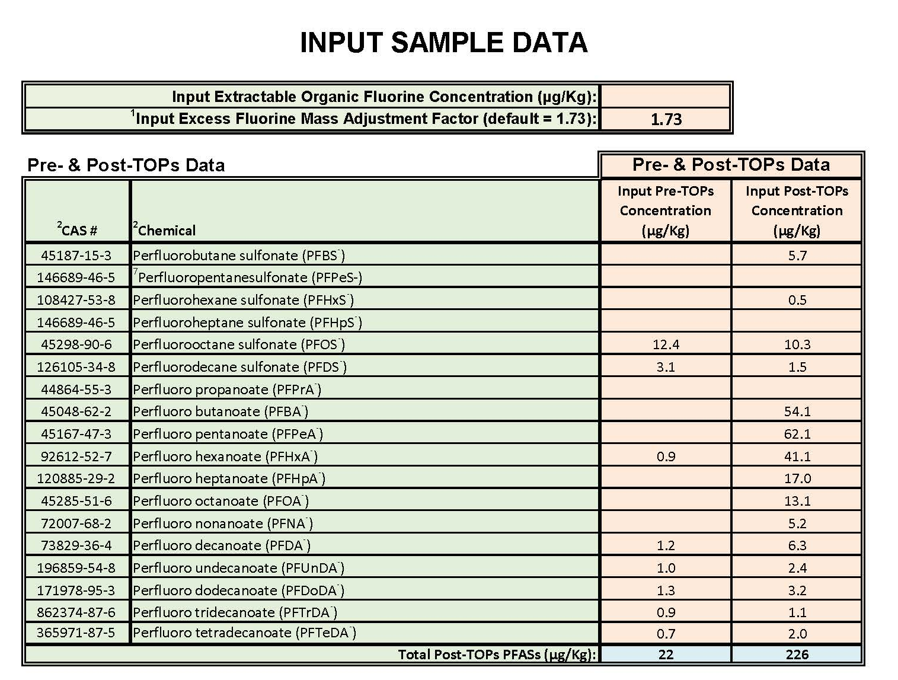
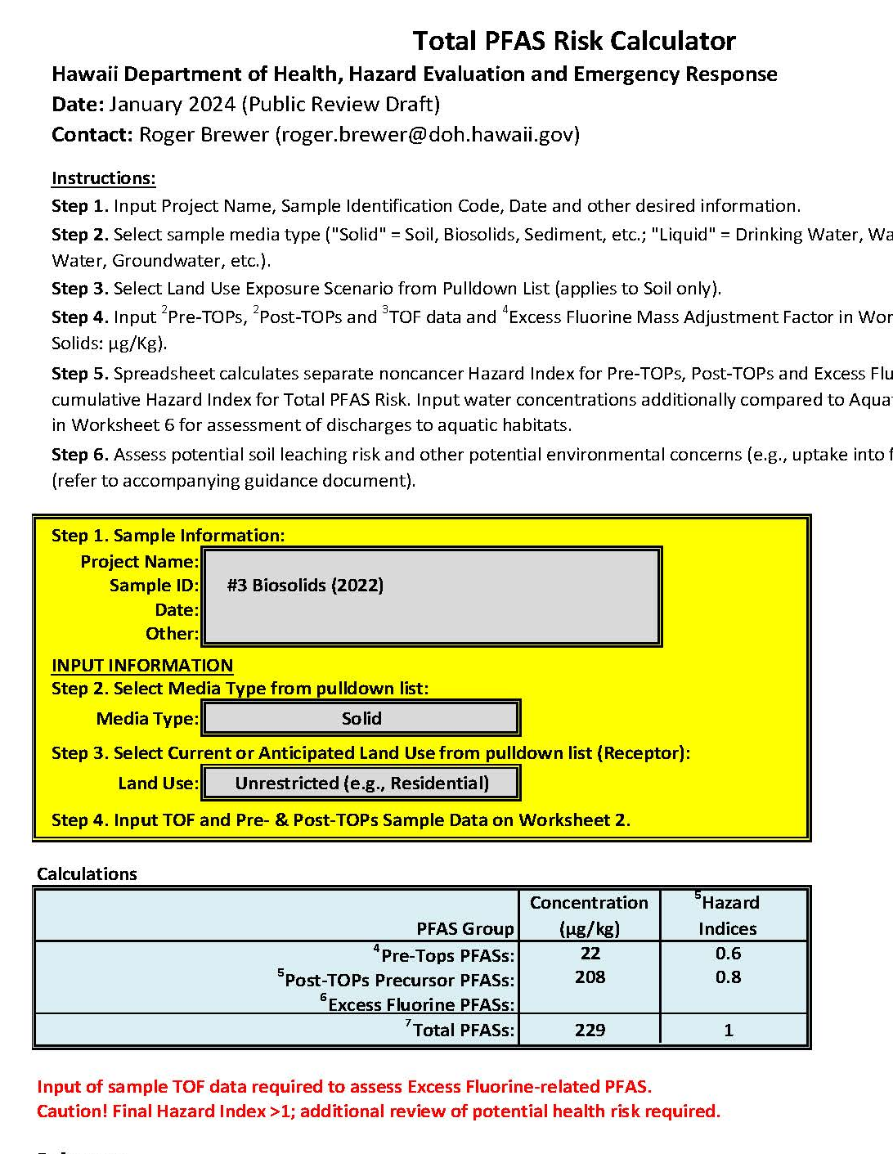
Example Total PFAS Risk:
Hypothetical Use of WWTP Biosolids as Residential Fill
*Input Pre-TOPs and Post-TOPs
Terminal Endpoint Compound Concentrations
Calculated
Total PFAS Risk
*EOF data pending

Slide 39
Example Total PFAS Risk:
Direct Exposure to Biosolids
*WWTP Biosolids | Total Terminal PFASs (µg/kg) | Hazard Index | Primary Risk Drivers (>50%, >10% or risk or Top 3 if HI <1)
#4 | 229 | 1 | PFPeA-, PFBA-, PFHxA- (57% Precursor PFASs)
#5 | 945 | 5 | PFBA-, PFPeA-, PFHxA- (92% Precursor PFASs)
#6 | 678 | 5 | PFBA-, PFPeA-, PFHxA- (72% Precursor PFASs)
#7 | 785 | 5 | PFBA-, PFPeA-, (71% Precursor PFASs)
*Includes Pre-TOPs and Post-TOPs data (TOF pending)
Precursor-related PFASs drive potential direct exposure risk over original (pre-TOPs) terminal endpoint PFASs in samples;
Additional risk posed by any Excess Fluorine-related PFASs present unknown (data pending; toxicity equal to PFPeA⁻).

Slide 40
HIDOH Total PFAS Risk Guidance (posted January 2024)
Pros:
Allows (forces) consideration of precursor compounds (vs ignoring);
Comes with easy-to-use spreadsheet that calculates Total PFAS risk;
Cancer risk assessed based on subset of well-studied, individual PFAS compounds (e.g., PFOA – to be added in future spreadsheet model);
Similar to combined use of “TPH” and “BTEX-PAHs” for assessment of Total Petroleum risk.
Limitations:
TOPs methods still evolving;
TOPs methods produce similar results but don’t directly mimic biological processes (Too conservative? Not conservative enough?);
Some types of precursors not fully oxidized (e.g., chlorinated PFASs);
Toxicity of non-fluorinated functional group breakdown products not considered (but likely superseded by PFAS risk);
Total PFAS Risk approach does not consider synergistic effects of exposure to PFAS mixtures (common to all risk assessments).

Slide 41
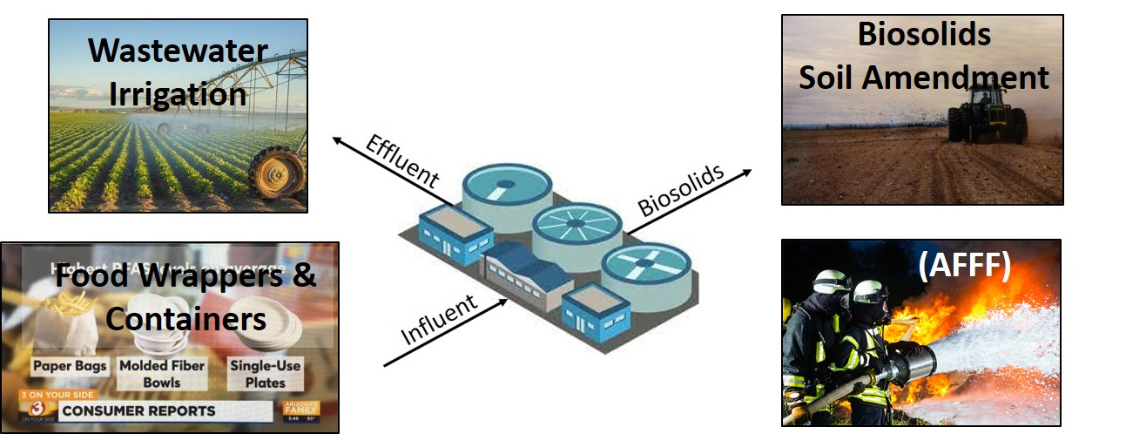
Questions, Ideas?
Future Research Ideas:
Tiered approach to leaching of PFAS from soil/biosolids (action levels, SPLP batch leaching test, modified Method 1314 Soil Column leaching test);
Bioavailability of PFASs in soil & biosolids;
Uptake of PFASs into food crops;
“Risk-Based” frequency of groundwater monitoring;
Other?
Notes:
denial, anger, bargaining, depression and acceptance

Slide 42
Additional Slides

Slide 43
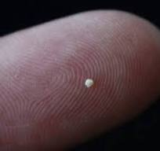

Toxicity Factors: “Dose Makes The Poison”
Chemical | “¹Safe” Average Daily Dose | Chronic Health Effect
Water | One liter?/hour | Hyponatremia
Aspirin | 81 mg/day (“mini-tab”) | G/I tract
Arsenic | 4.5 µg/day (1mm grain/3.5 yrs) | Multiple
PCBs | 300 ng/day (1mm grain/20 yrs) | Multiple
PFOS | 30 ng/day (1mm grain/165 yrs) | Multiple
1. Child (15kg), chronic exposure over 6 years (noncancer HQ = 1.0). Toxicity factors typically includes 10-100+ fold safety factor. For example only (safe dose varies with route of exposure, child vs adult, etc.).
“All things are poison, and nothing is without poison; the dosage alone makes it so a thing is not a poison.”
Paracelsus, 1538
Notes:
Point: All chemicals potentially toxic at some dose.
Acute = Health effects instant to within three months.
Chronic = Long-term exposure (30 years).
Maximum Daily Dose without noncancer health effects via ingestion (varies wrt to route of exposure)
Potential unacceptable chronic health risk (noncancer) when maximum daily dose is exceeded (based on toxicity studies).
Cancer risks also estimated in a similar manner.
Forward vs backward risk assessments.

Slide 44
Calculation of Risk-Based Screening Levels (noncancer)
Reference Dose (RfD): Long-term, daily exposure predicted to be “safe.”
PFOS RfD: 2.0 nanograms per kilogram of Body Weight per day (2.0 ng/kg-day)
15 kg child: “Tolerable Daily Exposure = 2.0 ng/kg-d x 15kg = 30 ng/day
Max Daily Exposure
30 ng/day
Exposure
Allotment:
Diet (60%)
18 ng
Water (20%)
6.0 ng
Soil (20%)
6.0 ng
Child
Exposure:
500 grams/day
0.78 Liters/day
200 mg/day
18 ng PFOS
500g Food
6.0 ng PFOS
0.78 L Water
6.0 ng PFOS
200 mg Soil
Screening Level:
= 36 ng/kg
= 7.7 ng/L
= 30 µg/kg
(25 µg/kg)

