Slide 1


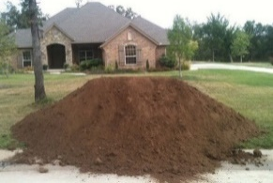
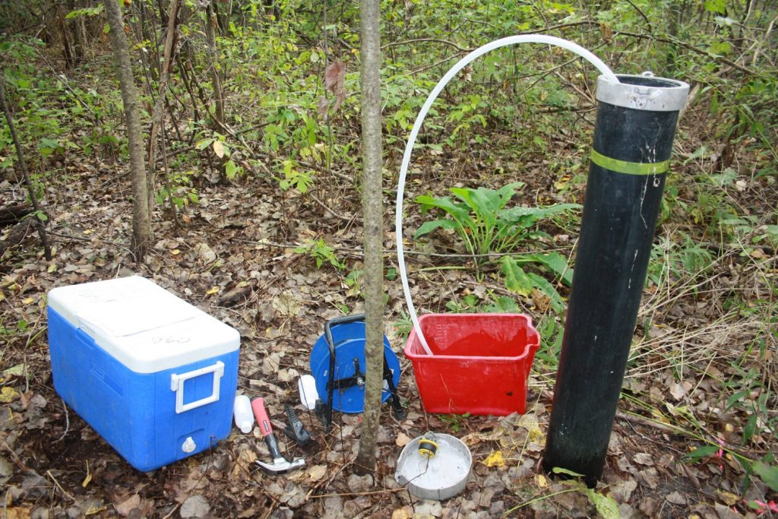
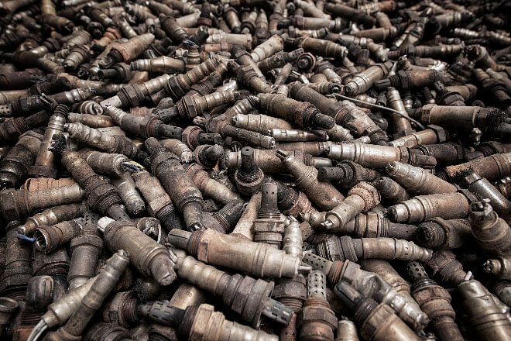

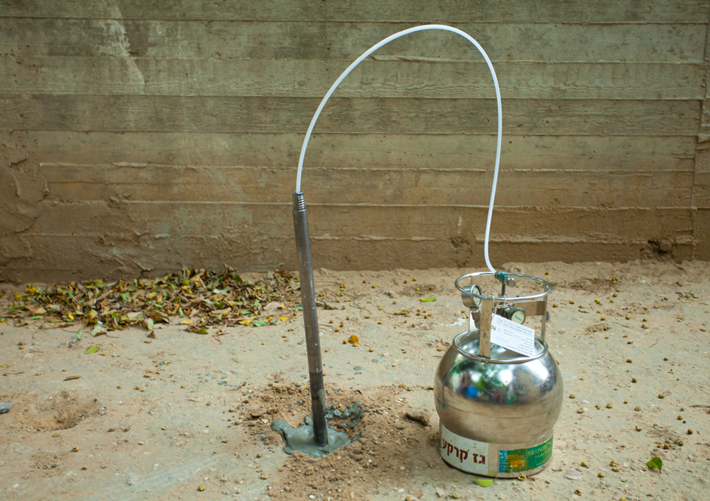
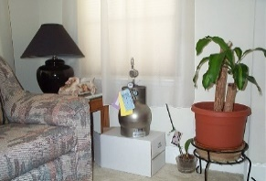
Faster, Better, Cheaper: Incorporation of
Theory of Sampling into Environmental Investigations
Roger Brewer, PhD, Senior Environmental Scientist
Hawai´i Department of Health, Honolulu, Hawai´i, USA (roger.brewer@doh.hawaii.gov)
Michigan EGLE
October 26, 2023
Commodities
Industry
Environmental
Industry
GroundWater
Mining
Ag
Soil
Pharm
Soil
Vapor
Recycling
Air

Slide 2
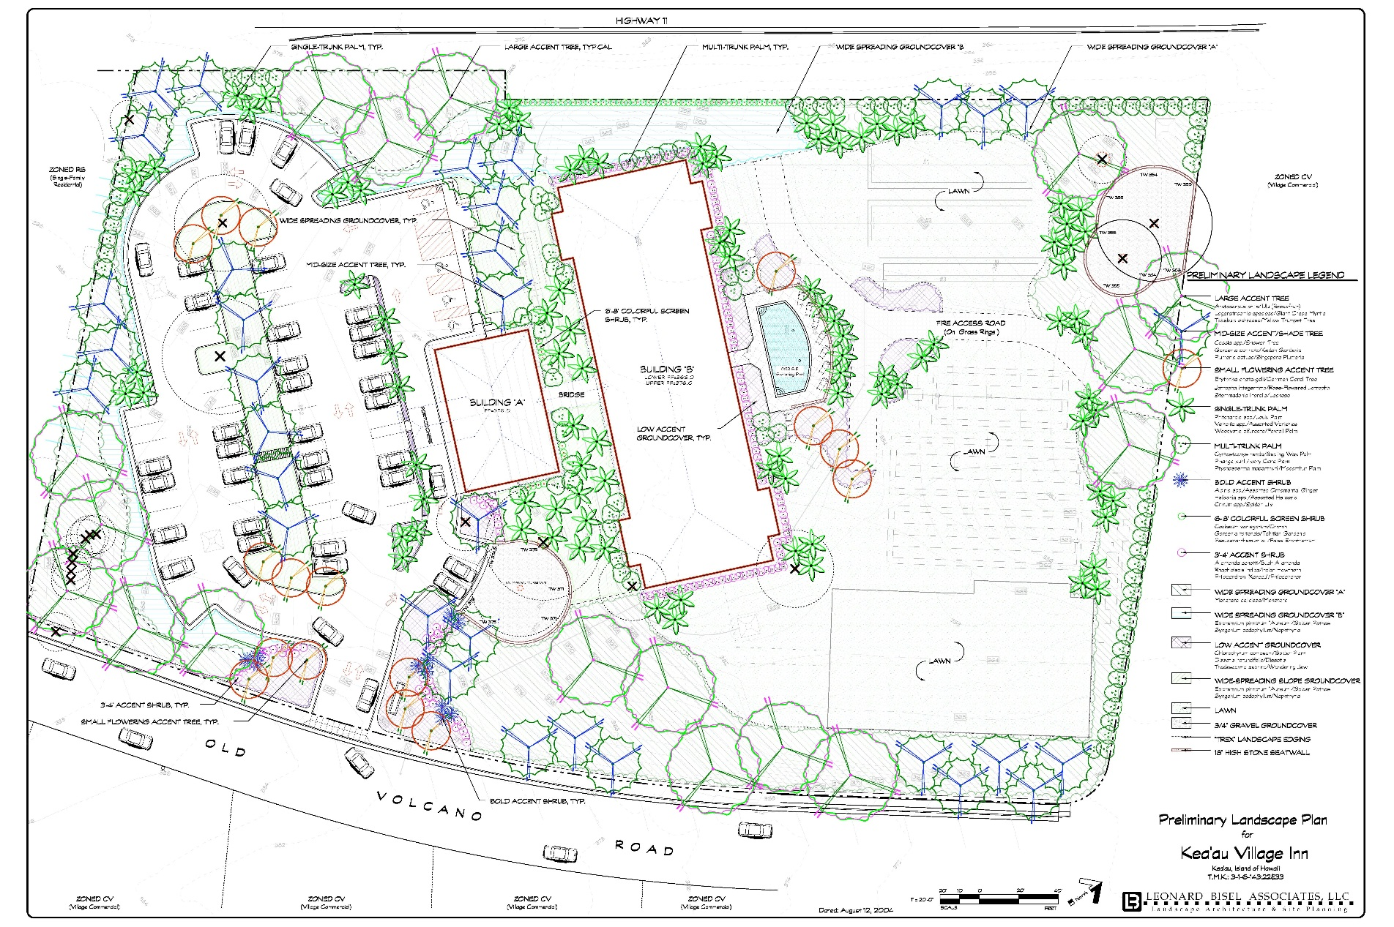

HIDOH 2004: Former Arsenic Mixing Area
4 Acres
363
737
624
419
467
1,930
526
794
45
30
48
34
9.2
101
1,300
140
1,420
789
1,300
46
36
36
7.2
4.8
44
2.5
162
507
520
217
1,080
51
42
4.0
164
42
208
184
211
243
191
1,680
925
385
202
209
254
994
285
55
66
323
562
1,280
282
431
194
196
235
50’
363 =
Total arsenic in soil (mg/kg)
Fifty-foot grid of surface soil samples collected (total 60+ samples)
Increasing randomness with increasing number of samples!
Similar variability identified in individual samples;
Isoconcentration maps based on discrete sample data not reliable.
733 Bishop St.,
Pacific Guardian Center
Suite 1872
Honolulu, HI 96813
Figure 3. Decision Unit on Proposed Village Inn
TMK: 3-1-6-143: 33

Slide 3
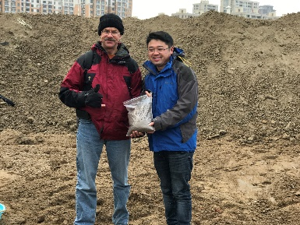
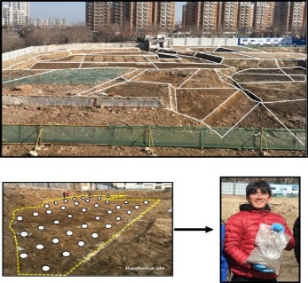
“Risk-Based” Investigation Methods (updated July 2023)
(downloadable pdf files; web-based documents under construction)
Hawai´i Technical Guidance Manual (TGM):
Part 1: Fact Sheets (Appendix A):
Part 2: Overview (Section 3)
Part 3: Detailed Appendices (17+; Section 4)
HDOH, 2023, Technical Guidance Manual: Hawai‘i Department of Health, Office of Hazard Evaluation and Emergency Response.
https://health.hawaii.gov/heer/guidance/specific-topics/decision-unit-and-multi-increment-sampling-methods/
2023 Updates Overview: https://health.hawaii.gov/heer/guidance/heer-webinars/
China National Standard (2023): Soil Quality – Decision Unit and Multi Increment Sampling Methods (Overview): National Standardization Administration Committee, GB/T-42489-2023

Slide 4
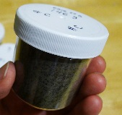
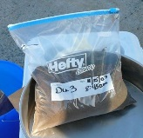
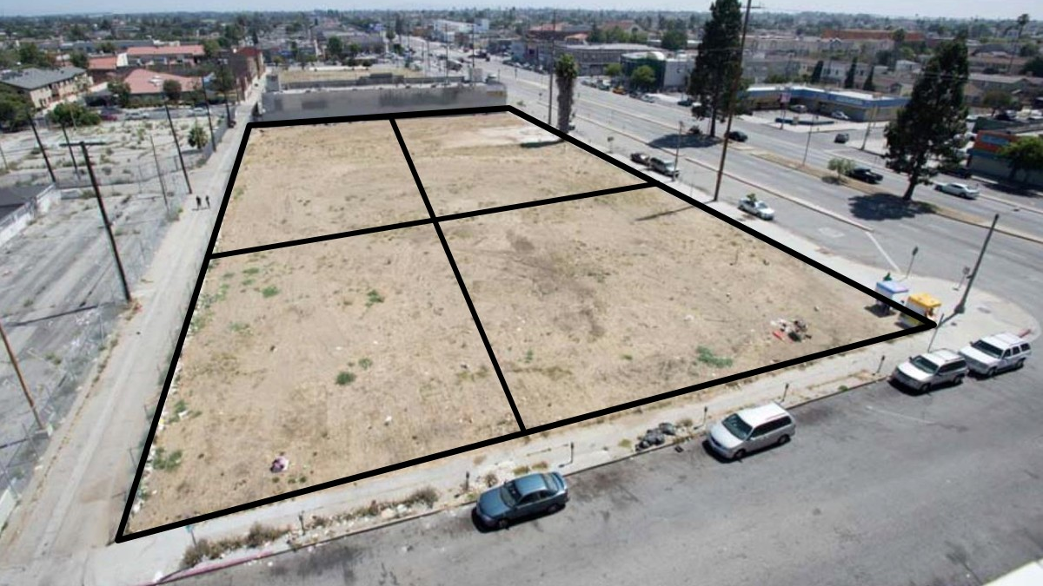
Terminology
Decision Unit (DU)
Discrete
Sample
(100-200g)
DU-2
Multi Increment® Sample
(1-2+kg)
DU-1
X
X
X
X
X
X
X
X
X
X
X
X
X
X
X
X
X
X
X
X
X
X
X
X
?
X
X
X
X
X
X
X
X
X
X
X
DU-4
X
X
X
X
X
X
?
X
X
X
X
X
DU-3
X
X
X
Multi Increment® is a registered trademark of EnviroStat, Inc.
X
DU: Area/volume of soil you would collect and test as a single mass, if you could…;
Discrete Sample (USEPA 1980s):
  Collected from a single point within a targeted area (“single increment sample”);
  Mass collected based on laboratory needs (typically 100-200 grams).
Multi Increment Sample (relatively “new” idea):
  Collected from multiple points (“increments”) within a targeted area;
  Mass and # of “increments” included in sample based on Gy’s Theory of Sampling.

Slide 5


Outline
Still living in the 1980s
The problem with discrete samples
“TOS” & catching up with the commodity industries
Case examples
Implementing the transition
Famous Band
Let me tell you why you’re here. You’re here because you know something. What you know you can’t explain. But you felt it. You felt it your entire life. That there’s something wrong with the world. You don’t know what it is, but it’s there. Like a splinter in your mind – driving you mad.
Morpheus (The Matrix )

Slide 6
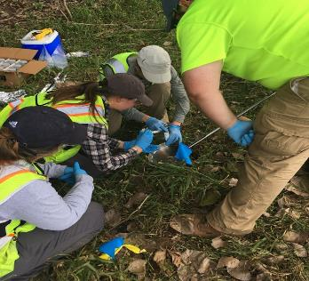
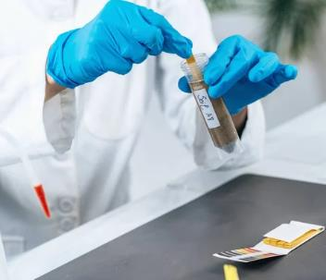



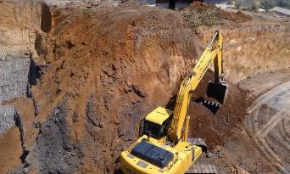
Doing Our Own Things Since the 1980s…
# Samples =
Lab Budget/Cost per Sample
Smaller = Cheaper
What if we moved it over a foot?
What if I tested a different pinch of dirt?
Regulator
1. Sample Collection
I need more numbers…
2. Lab Analysis
What’s the endpoint? Are you sure it’s clean?
There’s a lot more here than they told us…
3. Risk Assessment
5. RPs, Lawyers, Bankers, Insurers
4. Remediation

Slide 7

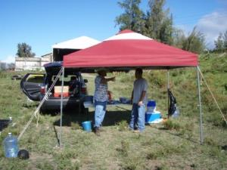
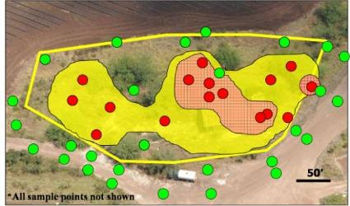
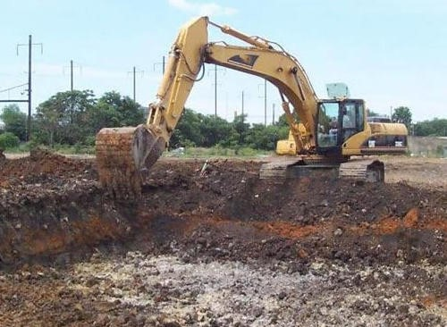

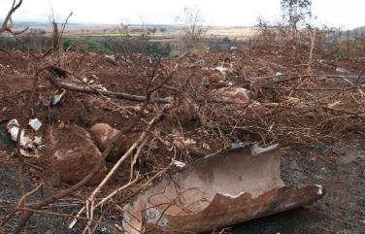
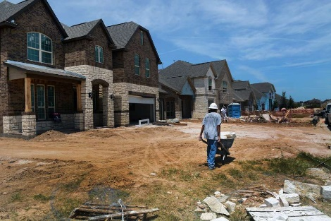
“How’s that working for you?”
Need for multiple remobilizations and “step-out” investigations
“Highly variable” data and failed confirmation samples
Remediated sites later found to still be contaminated

Slide 8


Origin of Discrete Sample Guidance (USEPA 1980s)
“The… level is assumed to be uniform within (a contaminated area) and zero outside it.”
USEPA 1985: Verification of PCB Spill Cleanup
X
X
X
X
“When there is little distance between points it is expected that there will be little variability between points.”
USEPA 1989: Methods for Evaluating the Attainment of Cleanup Standards
X
X
If true:
A few, small samples collected from single points across a site under investigation will be adequate to identify contamination and assess risk;
Allows direct comparison of individual, discrete samples to risk-based screening levels;
Not used in any other sampling intensive industry (mining, agriculture, etc.).

Slide 9
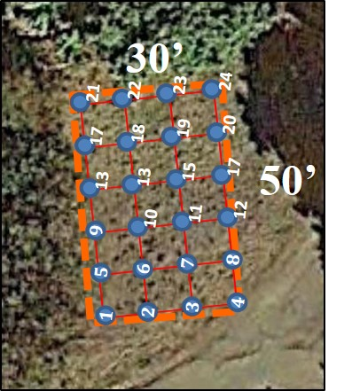
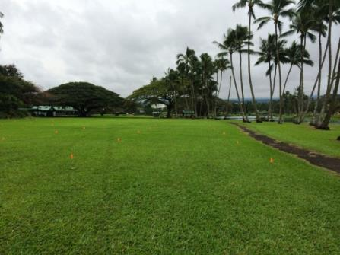
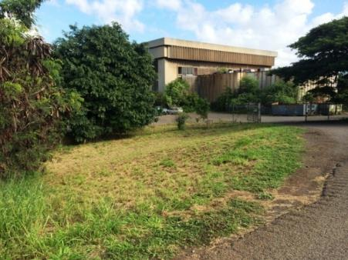
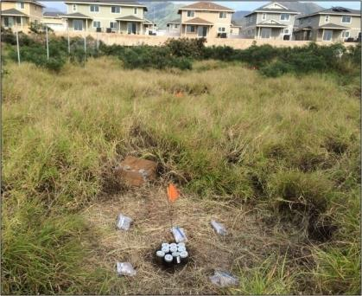
HDOH 2014-2016
Discrete Soil Sample Variability Field Study
Three known-contaminated sites studied;
24 grid points designated at each site;
Hundreds of discrete samples collected;
Multi Increment samples (triplicates) collected from same areas.
Study Site A
(arsenic in wastewater)
Study Site B
(lead in incinerator ash)
Study Site C
(PCBs transformer oil)
13,500 ft² area
1,500 ft² area
6,000 ft² area

Slide 10
Field Study Results
Roger Brewer, John Peard & Marvin Heskett (2017)
A critical review of discrete soil sample reliability:
Part 1 – Field study results
Part 2—Implications
Journal of Soil and Sediment Contamination.
Part 1: DOI: 10.1080/15320383.2017.1244172
http://dx.doi.org/10.1080/15320383.2017.1244171
Part 2: DOI: 10.1080/15320383.2017.1244172 http://dx.doi.org/10.1080/15320383.2017.1244172
Field report and recorded webinars posted to HEER DU-MIS Webpage:
https://health.hawaii.gov/heer/guidance/specific-topics/decision-unit-and-multi-increment-sampling-methods/

Slide 11
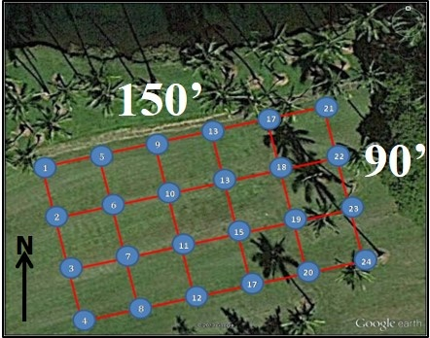
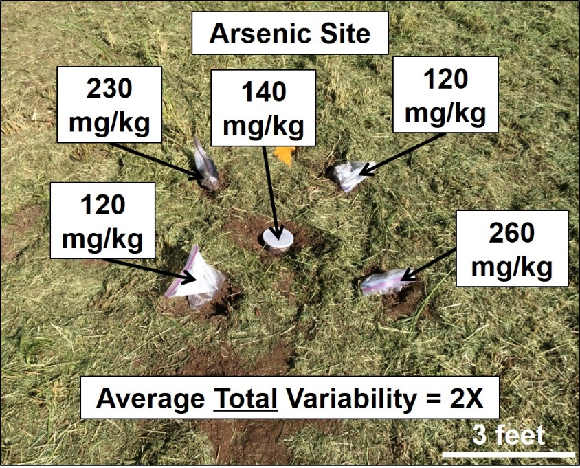
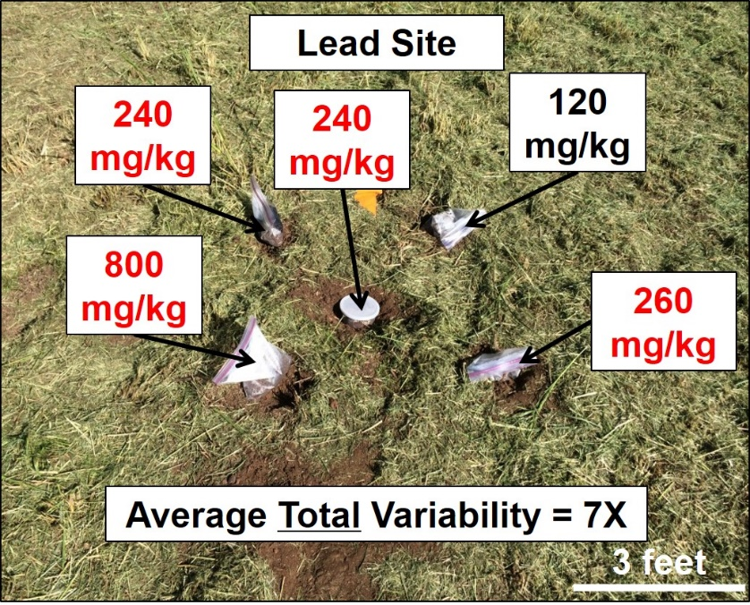
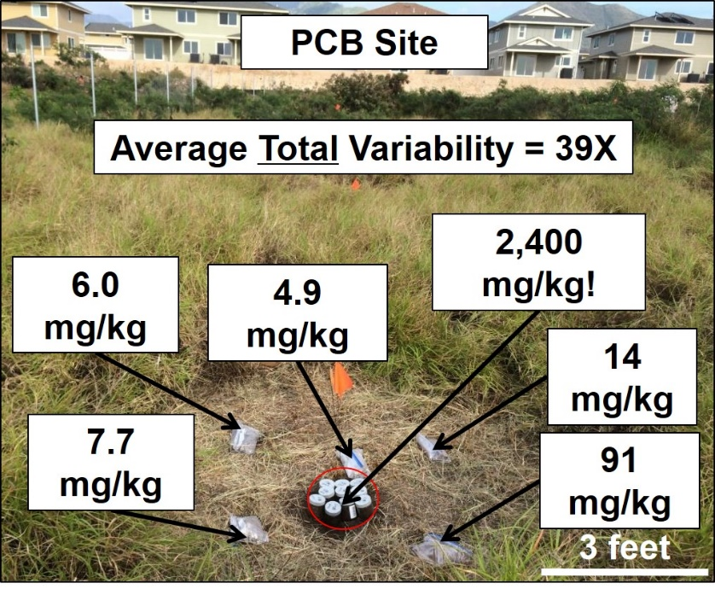
Conclusion: Discrete sample data for a given point are random within a (largely) unknown range…
Total Discrete Sample Variability

Slide 12
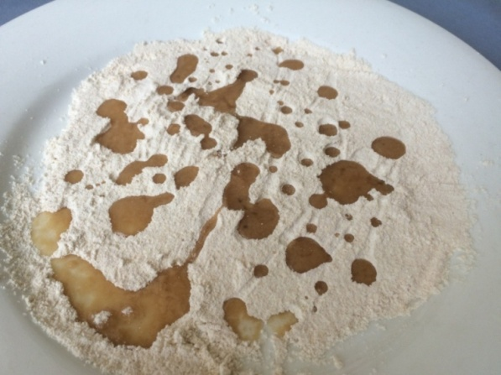
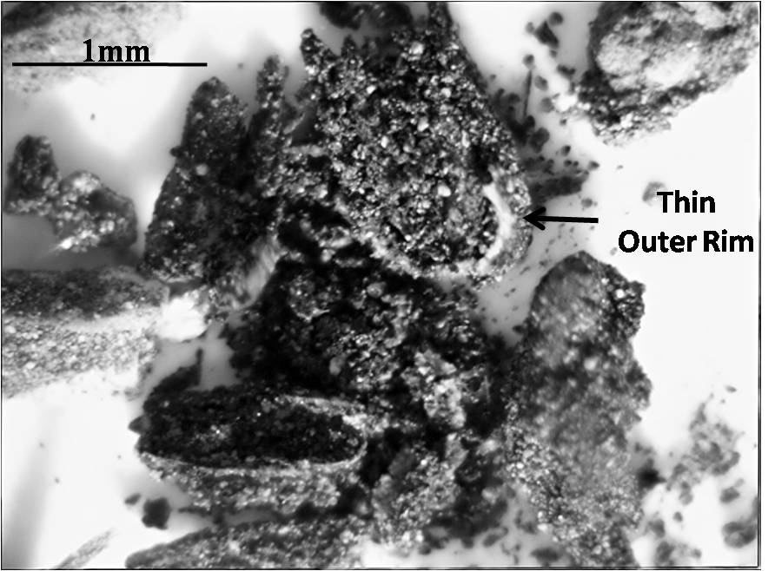
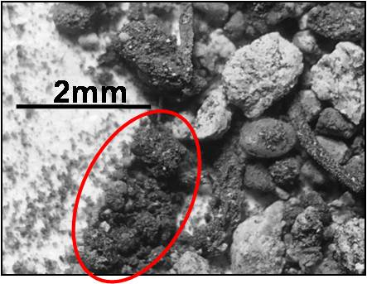
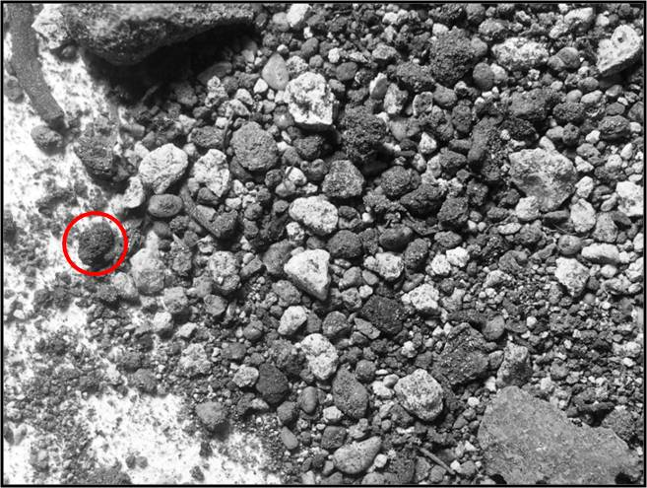
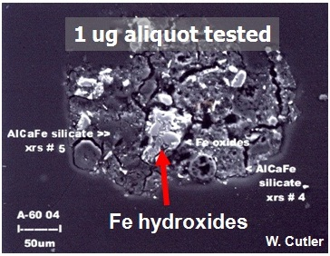
PCB-Infused Tar Balls and “Distributional Heterogeneity”
The Myth of “Maximum” Contaminant Concentrations in Soil
1mm
10,000s ppm
1,000s ppm
2mm
1cm
10s ppm
Concentration #3
(PCB matrix)
Concentration #2
(single nugget)
Soil samples cannot be “homogenized” to the scale of a laboratory subsample;
Reported concentration varies with volume/mass of soil tested;
Maximum concentration always either 0 % (absent) or 100% (present);
Risk-based objective is always the mean/true concentration for a specified area & volume of soil.
Concentration #1
(whole sample)
Arsenic
Nuggets

Slide 13

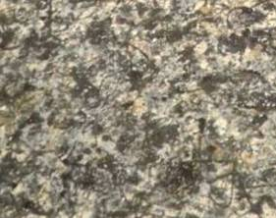
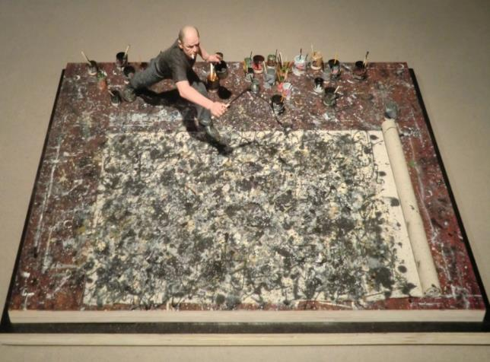
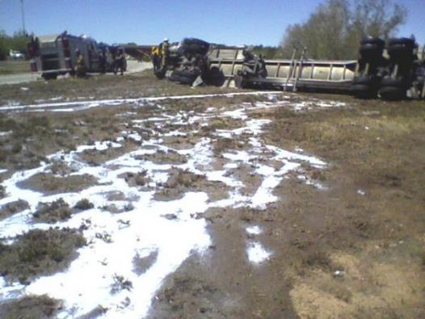
What Contamination in Soil Would
Look Like if You Could Actually See It
X
Discrete Samples
Jackson Pollock
splatter painting
Spilled milk following low areas
(similar in cross section)
Discrete sample data not reliably representative of immediately surrounding area.

Slide 14
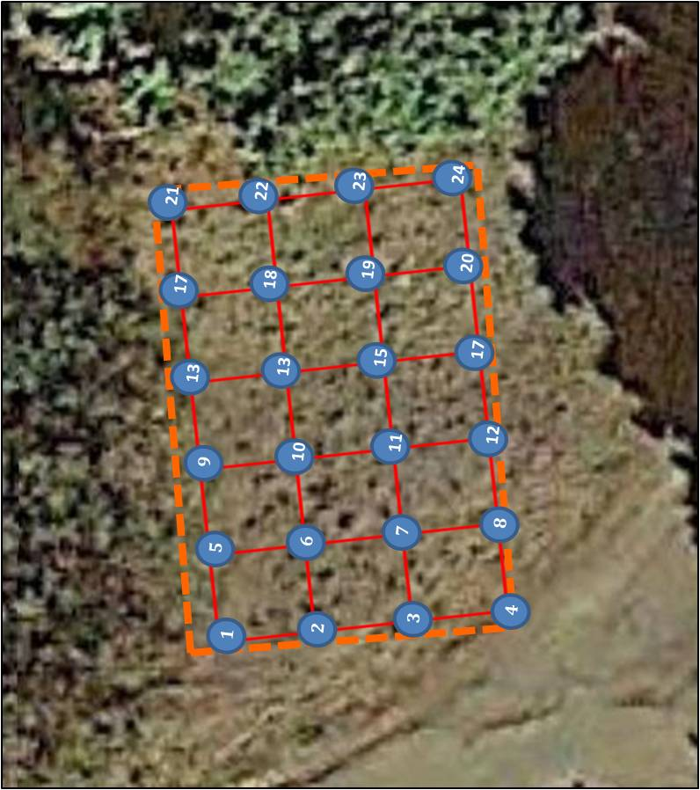
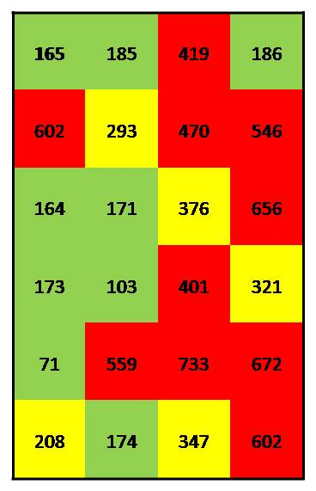
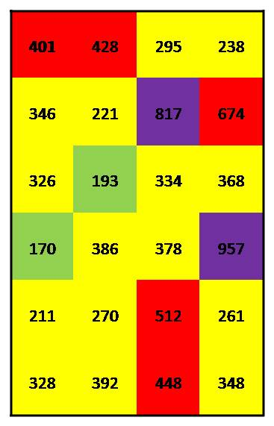
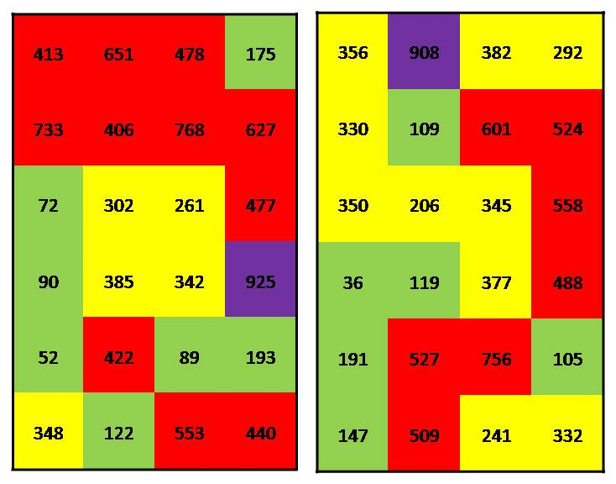
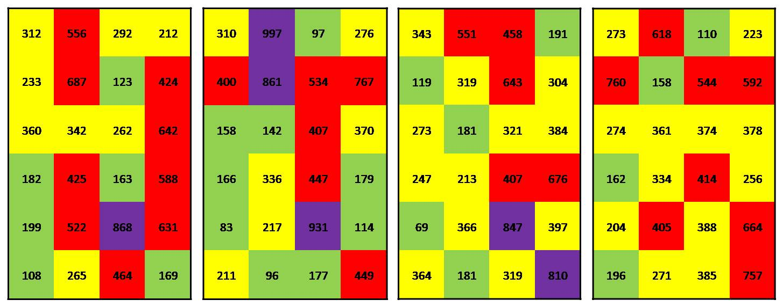
Artificial Discrete “Hot Spot” & “Cold Spot” Patterns
Grid Pt #21
103-419 mg/kg
Study Site B (lead): Random lead concentration assigned within estimated range for grid point
165
401
>800 mg/kg
>400 mg/kg
>200 mg/kg
<200 mg/kg
Notes:
Isolated “hot spots” and “cold spots” are an artificial reflection of small-scale, random heterogeneity.

Slide 15
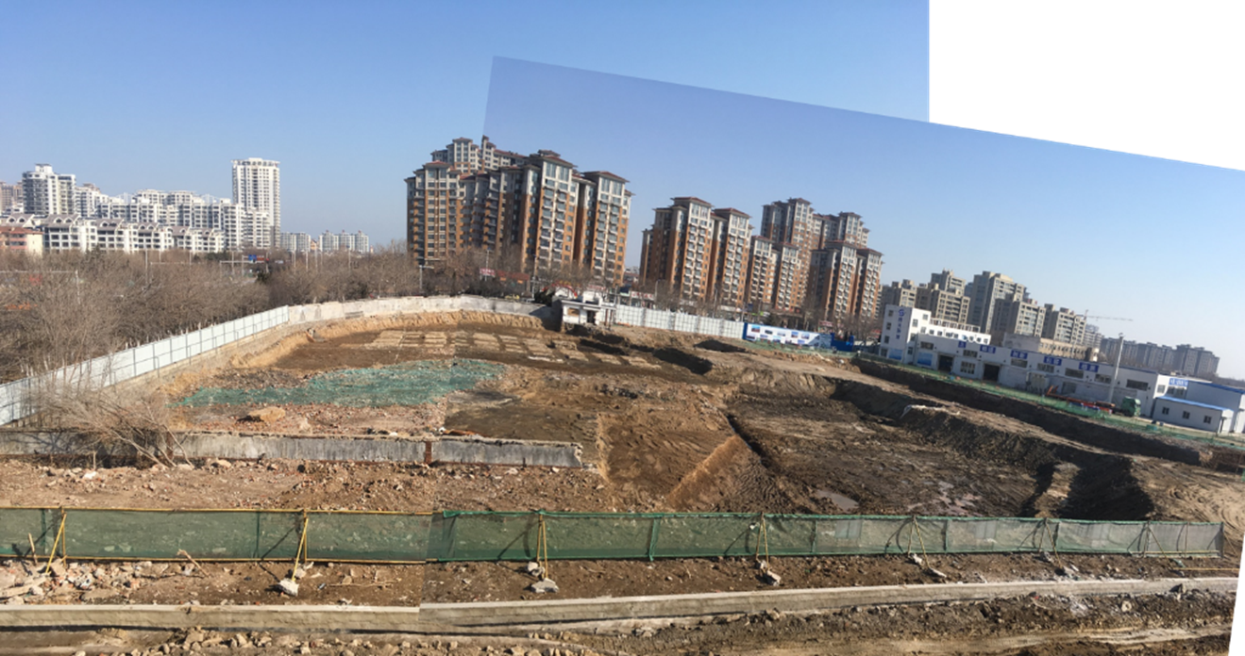
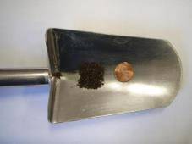
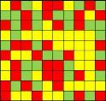
“Failed” confirmation samples. Need for repeat investigations with no clear endpoint…, etc.
Lab data not reliably representative of sample;
Sample not reliably represented of area where it was collected.
Problem can’t be fixed by collecting more discrete samples;
Problem can’t be fixed by statistical evaluation of discrete sample data.

Slide 16
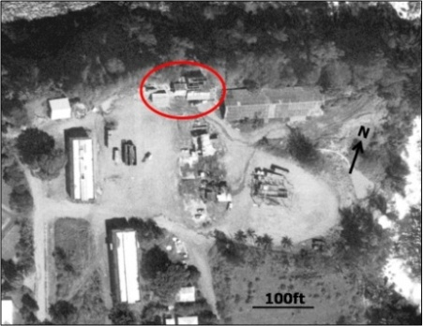
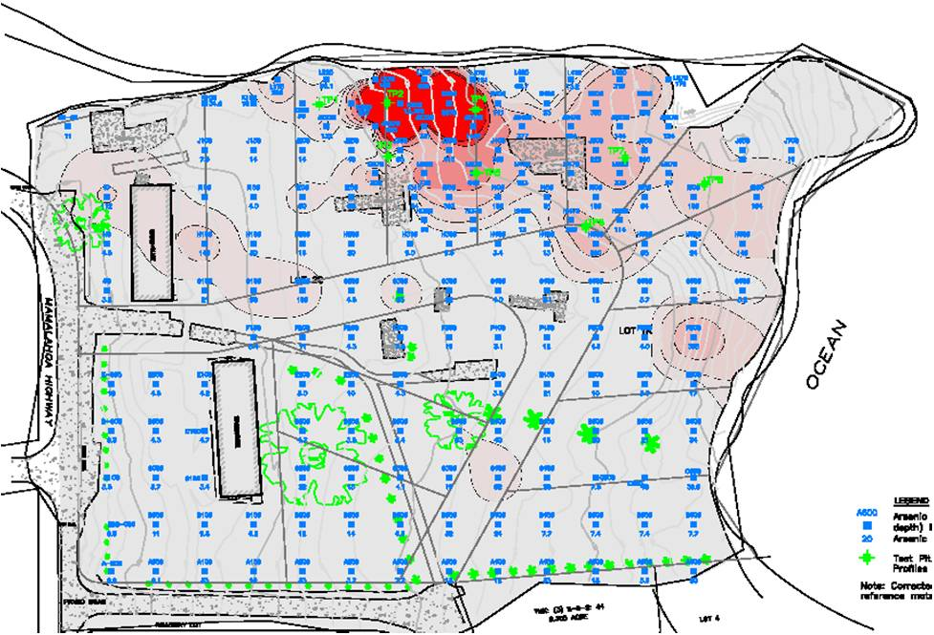
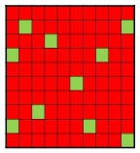
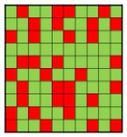
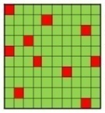
Large-Scale Patterns Can Be Real
Field XRF and tight grid of 100+ discrete samples used to identify spill area;
Large-scale patterns real but exact borders uncertain;
Highest error in Zone B – false isolated “hot spots” and “cold spots”;
Removal of isolated “hot spots” in Zone B will not significantly reduce risk;
Some sites are all “Type B” contamination.
Pesticide
Mixing Area
Type A: Any Discrete Samples Above Screening Level
Arsenic Contamination
9 Acres
B
A
Type B: Discrete Sample Range overlaps Screening Level
B
C
Type C: Any Discrete Samples below Screening Level
Field discrete samples
Notes:
Structures removed. No obvious spill areas observable in the field.

Slide 17
Are Discrete Sample Reliable for Risk Assessments?
Estimation of Mean Based on Replicate Sets
of Discrete Sample Data (HDOH 2017; 10 samples, 20 iterations)
Study Site | Range 95% UCL (mg/kg) | Range RSD
Site A (arsenic) | 403 to 776 | 34% to 67%
Site B (lead) | 201 to 439 | 20% to 86%
Site C (PCBs) | 9.4 to >1,000,000 | 124% to 315%
Concentration within predicted range for 10 randomly picked grid points used to estimate mean;
Estimated mean is random within an unknown range;
Representativeness of single, 10-sample data sets unknown;
Error in estimated mean or 95% UCL is unknowable.
“We did what we could with the data that they provided us.”
Anonymous Risk Assessor

Slide 18
Multiple Early Warnings
About Discrete Sample Data Reliability…
(refer to Part 2 and Supplement of Brewer et al. 2017)
Soil is a very heterogeneous material. Samples with very small support volume… may vary from zero to very high concentrations.
USEPA 1989. Soil Sampling Quality Assurance User’s Guide
The so-called grab sample is not really a sample but a specimen of the material that may or may not be representative of the sampling unit (“Decision Unit”). Great care must be exercised when interpreting the meaning of these samples.
USEPA (1992) Preparation of Soil Sampling Protocols
A common error has been to reject “outliers” that cannot be made to fit (a statistical) model... The tendency… has been to make the data fit a preconceived model instead of searching for a (more appropriate way to collect samples).
Pitard 2009 (Theory of Sampling)

Slide 19
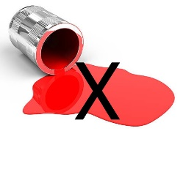
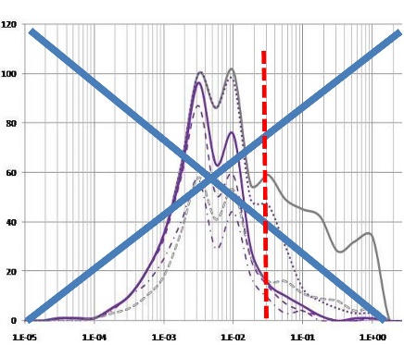

Heterogeneity of Subslab Vapor Plumes
(Negates Scientific Validity of USEPA’s Default 0.03 SSAF)
Conc Indoor Air
Conc. Subslab Vapors
Fiction
SSAF? =
Reality
“The default (vapor intrusion attenuation factors) assume (that) …the subsurface (vapor plume) is reasonably homogeneous”
CAEPA 2011: Guidance for the Evaluation and Mitigation of Subsurface Vapor Intrusion to Indoor Air.
Subslab Soil Vapor:
Brewer, Nagashima, Rigby, Schmidt and O'Neill (2014), Estimation of Generic Subslab Attenuation Factors for Vapor Intrusion Investigations. Groundwater Monitoring & Remediation, 34: 79–92. doi: 10.1111/gwmr.12086.
HIDOH, 2017. Field Study of High-Density Passive Sampler and Large-Volume Purge Methods to Characterize Subslab Vapor Plumes: Hazard Evaluation and Emergency Response, Hawaii Department of Health, July 2017.
Field report and recorded webinars posted to HEER webpage
http://eha-web.doh.hawaii.gov/eha-cma/Leaders/HEER/Webinar

Slide 20


Think About the Implications…
You take the red pill – you stay in Wonderland and find out how deep the rabbit hole goes.
Morpheus (starting Neo on his journey in The Matrix )
Cypher: I know what you're thinking, 'cause right now I'm thinking the same thing… Why oh why didn't I take the BLUE pill?

Slide 21


Thirty+ Years of Kicking the Can Down the Road…
“Future changes in EPA policy may invalidate some of the discussions in this (guidance).”
USEPA 1989: Methods for Evaluating the Attainment of Cleanup Standards, Volume 1: Soils and Solid Media.
“We searched for a non-conventional statistical sampling theory that… takes into account the nature of particulate materials… In 1989, we hit “pay dirt,” …the Pierre Gy sampling theory for particulate materials. (However) we were only moderately successful at transferring this technology to the environmental community.”
USEPA 2003: Guidance for Obtaining Representative Laboratory Analytical Subsamples from Particulate Laboratory Samples.
Problem: Lack of guidance specific to the Environmental Industry.

Slide 22





Learning from the Commodities Industry
Same Questions: “What is the concentration of ‘X’ in ‘Y’”?
(Brewer et al. 2022; refer to WCSB 10 presentation recording)
Commodities
Industry
Environmental
Industry
Mining
GroundWater
Ag
Soil
Pharm
Soil
Vapor
Recycling
Air
Correct Use of
“Decision Unit” and
“Multi Increment®” Type
Sampling Methods
Incorrect Use of
Single Point
“Discrete/Grab”
Sampling Methods
X X X X X X xX X XX
X
Single large sample collected from multiple points within a well-thought-out Decision Unit volume of the targeted media
Multiple small samples collected from single points and independently analyzed
Notes:
*Multi Increment® sample is a registered trademark of EnviroStat, Inc.

Slide 23




Theory of Sampling
Overlooked by the Environmental Industry…
Original mining industry guidance in French (1980s)
“World Conference on Sampling and Blending”
Johannesburg, South Africa (May 2024)

Slide 24
Example Theory of Sampling References
AAFCO, 2015, GOODSamples: Guidance on Obtaining Defensible Samples: Association of American Feed Control Officials, October 2015, Champaign. Illinois. http://www.aafco.org/Portals/0/SiteContent/Publications/GOODSamples.pdf
AAFCO, 2018, Good Test Portions: Guidance on Obtaining Defensible test Portions: Association of American Feed Control Officials, June 2018, Champaign, Illinois. http://www.aafco.org/Publications/GOODTestPortions
Esbensen, Kim, 2020, Introduction to the Theory and Practice of Sampling: IM Publications, ISBN: 978-1-906715-29-8.
Chuck Ramsey (Envirostat, Inc.; www.envirostat.org)
Introduction to sampling theory and Multi Increment Sample site investigations (four days);
Post training support;
Training in Hawaii since 1990s (China 2019).
HIDOH DU-MIS Webpage: Field Studies, Sampling Guidance, Recorded Webinars, etc. https://health.hawaii.gov/heer/guidance/specific-topics/decision-unit-and-multi-increment-sampling-methods/
Notes:
7

Slide 25





Missing Link: Designation of Decision Units for Sample Collection
DU: An area and volume of media you would send to the laboratory as a single sample for testing, if you could.
Assess Risk
Optimize Remediation
Exposure Area DUs
Source Area DUs
Source Boundary DUs
Subsurface DUs
Exploratory Pits, Trenches
and Borings DUs

Slide 26

HDOH TGM Section 3: Systematic Planning Overview
The only two reasons to collect a sample:
  Assess risk.
  Optimize remediation.
Systematic Planning
State Problem (draft CSM, Investigation Question(s));
Identify Objectives and COPCs;
Identify Data Needs & Uses;
Define Decision Units (DUs);
Develop Decision Statements;
Develop SAP and Collect Samples;
Evaluate Data Quality/Usability;
Identify Potential Environmental Hazards (e.g., using HDOH EALs)
Refine CSM and/or Recommend Additional Actions
Assess Risk/Remedial Design

Slide 27
HDOH TGM Section 4: Site Investigation Design and Implementation Appendices
Fact Sheets
Conceptual Site Models
Example Decision Unit Designation Schemes
Theory of Sampling for “Infinite Element” Particulate Matter
Use and Misuse of Discrete Sample Data
Collection of Surface Soil Samples (spacing, tools, etc.)
Collection of Subsurface Soil Samples (tools, subsamples, etc.)
Collection of Excavation and Stockpile Samples (methods, volumes, etc.)
Sample Collection for Volatile Contaminants (methanol, alternatives, etc.)
Collection of Sediment Samples
Laboratory Processing of Multi Increment Samples (subsample mass)
Replicate Sample Collection and Data Quality Review
General Field Operations (field tips)
Common Investigation Errors and Problems
DU-MIS Investigations Under TSCA
Clean Fill Guidance
References

Slide 28


Investigation Questions and Decision Units Designation
Systematic Planning:
Steps 1 & 2: Prepare a draft CSM and formulate a specific Investigation Question: “Does the concentration of Contaminant X in apples/soil pose a potential long-term (chronic) health risk?”
Step 3 & 4: Identify Data Needs and designate Decision Units for sample collection: Determine representative concentration of Contaminant X data for specified DU volume of apples/soil (edible parts only).
Step 5: Develop the Decision Statement: “If the concentration of Contaminant X in the DU exceeds the action level, then the media must be disposed of.”

Slide 29

Collection of a Representative Sample
(20 years of good and bad ideas…)
Site preparation
DU demarcation
Soil type vs sampling tools
Surface soils
Subsurface soils
Excavations
Stockpiles
Sediment
Sampling for VOCs
Equipment decontamination
Notes:
Kea`au Middle School garden

Slide 30

Laboratory Sample Processing and Analysis
Air Dry, Sieve, Subsample
Laboratory Subsample Triplicates (10%)
Sample Preparation Method | *Subsample Collection Method
 | Sectoral Splitter | Manual
Unground (<2mm) | 10g | *30g
Ground (<100 µm) | 5g | 5g
Ideal Minimum Subsample Mass
Recommended subsample masses based on discussions with sampling statisticians trained and experienced in Gy’s Theory of Sampling.
*Minimum of 10g currently allowed for unground soil if necessary but include laboratory replicates (increases error in data).

Slide 31

Data Quality Evaluation
Sample Data Quality and Usability Checklist
(main sources of error)
Laboratory
“Data Validation”
important but rarely the main source of error
Decision Making

Slide 32

Working Together in the 21st Century
This is making my job so much easier…
We can isolate the source area with a few more DUs and save $ on cleanup.
I’ll need triplicates in 10% of the DUs.
Here’s a map of draft DUs for sample collection.
MI processing is $125 per sample.
TAT 3 weeks.
Should be done by July. My client will cover all costs as part of escrow.

Slide 33
App C: Example DU Designation Schemes (case studies)
C.1 Commercial/Industrial Sites
Small Spills
Former Power Plant
Chemical Mixing and Storage
Hotel Redevelopment
C.2 Single-Family Homes
C.3 High-Density Housing
C.4 Schools
C.5 Large Single-Use Areas
Former Golf Course
Former Agricultural Field
C.6 Very Small Areas
C.7 Subsurface Decision Units
Buried Waste Pit
Above Ground Storage Tanks
C.8 Stockpiles
C.9 Building Demolition
Concrete Structures
Concrete and Asphalt Pavement
Sweep Material
Subslab Soil
C.10 Large Industrial Complexes
Textile & Alloy Manufacturing
C.11 Petroleum Releases
Crude Oil Pipeline
Active Gas Station
C.12 Gas Station Closure
C.13 Sediment Decision Units
Drainage Canal
Wastewater Outfall
Transformer Spill
Estuary Wastewater Discharges
Harbor Dredging
Future Additions?
Excavations (e.g., USTs)
Fire-Impacted Urban Areas

Slide 34





Case Studies
“Arsenic Hotel”
Maui Urban Fires
Mega Industrial Complex
Buried Waste Pit

Slide 35
Former Arsenic Mixing Area:
Proposed Hotel Redevelopment
4 Acres
363
737
624
419
467
1,930
526
794
45
30
48
34
9.2
101
1,300
140
1,420
789
1,300
46
36
36
7.2
4.8
44
2.5
162
507
520
217
1,080
51
42
4.0
164
42
208
184
211
243
191
1,680
925
385
202
209
254
994
285
55
66
323
562
1,280
282
431
194
196
235
50’
363 =
Total arsenic in soil (mg/kg)
Investigation Question: “Does the mean concentration of arsenic in currently or potentially exposed soil pose a potential health risk to future hotel workers and visitors?”
DU = Surface soil (0-15cm), <2mm particle size.
733 Bishop St.,
Pacific Guardian Center
Suite 1872
Honolulu, HI 96813
Figure 3. Decision Unit on Proposed Village Inn
TMK: 3-1-6-143: 33

Slide 36
Former Arsenic Mixing Area: MI Sample Data
Spill Area DU
906 mg/kg
Exposure
Area DU
Exposure Area DU
300 mg/kg
275 mg/kg
Exposure Area DU
500/481/490 mg/kg
Exposure Area DUs designated based on planned hotel redevelopment;
Existing discrete sample data used to isolate apparent Source Area DU;
Single 30-increment MI sample collected in each DU (triplicates in one DU);
MI data higher than mean of discrete sample data (discretes missed “hot spots”);
Entire site requires remediation (cleanup level 95 mg/kg bioaccessible arsenic).
733 Bishop St.,
Pacific Guardian Center
Suite 1872
Honolulu, HI 96813
Figure 3. Decision Unit on Proposed Village Inn
TMK: 3-1-6-143: 33

Slide 37



Assessment of Fire-Impacted Urban Areas in Maui
Primary COPCs: Heavy metals (especially arsenic and lead)
Investigation Questions:
“Do contaminants in fine-grained ash and soot (“ash”) pose a potential health risk to workers clearing fire-related debris throughout residential & commercial areas?”
“Do contaminants in potential airborne dust from fire-impacted areas pose a potential health risk to residents and school students and staff in surrounding areas?”

Slide 38

Decision Unit Designation: Lahaina
DU = All of the fine ash (<250µm) within the residential or commercial area.
Elementary
School
High School
DU-1
Intermediate
School
Residential
(>400 homes)
DU-2
Commercial
(no access)
Single DU for each area;
Single, 100-increment sample to be collected from residential area.
Three 30ml scoops from 100 lots.

Slide 39



Decision Unit Designation: Kula
Discontinuous areas of burned houses (total 25+);
Eight lots available for sample collection (September 2023);
Single DU – Total volume of <250µm ash for the combined, individual lots.

Slide 40




DU Characterization: Sample Collection Challenge
Kula Ash-Soot Samples (HDOH Sept 21, 2023)
Stay Focused!
?
Stay focused on Investigation Questions (mean of fine ash for combined lots)!
Thirty, 30 ml (2 tbls) increments collected from each of 8 lots (semi-systematic random);
Collected a single 240-increment, 3kg sample (no field replicates);
Submitted to lab for MI processing and testing (air dry, sieve, min 10-gram subsample).
As: 3,193 mg/kg
Pb: 618 mg/lg

Slide 41

Buried Waste Pit
(metals and solvents)
New, anticipated clean fill
Older, anticipated contaminated fill
Buried, anticipated contaminated waste pit
Native soil – Impacted by leaching?
Native soil – Anticipated clean.
Waste pit exposed during excavation for redevelopment;
Suspected contamination with heavy metals and solvents.
Investigation Questions:
Do contaminants in soil pose a direct exposure risk or vapor intrusion risk for future commercial-residential redevelopment?
Do contaminants in soil pose a potential leaching risk and aquatic toxicity concern for underlying groundwater and discharge to adjacent canal (not a source of drinking water)?

Slide 42
Buried Waste Pit
(Focus on Source Area and Boundary DUs)
DU-7 (A,B,C,D,E)
DU-3 (A,B,C,D,E)
Waste Pit Source Area DU-1
(DU Layers 1A,1B,1C,1D,1E)
DU-2 (A,B,C,D,E)
DU-6 (A,B,C,D,E)
DU-4 (A,B,C,D,E)
DU-8 (A,B,C,D,E)
DU-5 (A,B,C,D,E)
DU-9 (A,B,C,D,E)
Treated as a single, Source Area DU with five distinct, DU Layers;
Trenching used to identify approximate lateral boundaries of waste pit;
Lateral and vertical Boundary DUs designated to isolate contamination;
DU locations and volumes designated to optimize anticipated remediation;
Outer ring of Boundary DUs and DU Layer E units predicted to be clean.

Slide 43



Buried Waste Pit
(Subsurface Decision Unit Layers)
Minimum 30 Core Increments per DU
Core Increment
DU-X Layer A
DU-X Layer B
DU-X Layer C
DU-X Layer D
DU-X Layer E
Maximum DU volume “resolution” 50 m³ (input from remediation experts);
Targeted DU layers identified in each core (thickness can vary between cores);
Core increments subsampled to prepare final sample for DU Layer (e.g., ten, 5-gram plugs collected from each increment and combined for 1.5 kg MI sample);
Separate samples to be tested for VOCs placed in methanol in the field;
Approach allows isolation of contamination and optimization of remediation.

Slide 44

Mega Industrial Complex: Where to Start???
Start with ONE DU
Hypothetical Industrial Complex Redevelopment
Is the 50-acre area as a whole contaminated above risk-based screening levels?
100m
Not acceptable for redevelopment or remediation (too large);
Progressively subdivide site into smaller DUs until resulting sample data will meet all site investigation questions and objectives.

Slide 45

Subdivide Site Based on Past Use
Are the individual, past use areas as a whole impacted above screening levels?
Industrial Operations
Office Buildings
Residential Housing
100m
Site subdivided into three areas based on historical land use;
Testing of former office building area as a single, Exposure Area DU might be acceptable (assumed clean);
Further subdivision of housing and industrial operations areas required.

Slide 46
Subdivide Based on Age of Housing and
Individual Factory Areas
Are the individual neighborhoods and factory areas impacted above screening levels?
FA-3
FA-4
Multiple Chemicals
FA-5
FA-1
FA-2
OB-1
WH-4
WH-3
Lead Paint, Termiticides?
WH-1
WH-5
WH-2
100m
Four housing areas defined (based on construction time) and five factory areas defined (based on past operations);
Still too large to designate as exposure area DUs and assess risk;
Factory areas known to be heavily contaminated (optimize remediation).

Slide 47
Worker Housing: What’s Your Question?
Do half-acre DU areas within the former worker housing areas exceed screening levels?
FA-3
FA-4
FA-5
FA-1
FA-2
OB-1
WH-4
WH-3
Lead Paint, Termiticides?
WH-1
WH-5
WH-2
100m
Half-acre areas designated as Exposure Area DUs (e.g., risk-based resolution of data required for redevelopment by overseeing regulatory agency).
Entire former worker housing area ultimately tested (total 36 DUs).

Slide 48


Individual Factory Areas: Remediation Required
Designate DUs based on known/suspect spills, tanks, dumps, storage areas, assumed clean areas, etc.;
Small DUs used to isolate contaminated soil and optimize remediation;
Max DU size = default, ½ acre exposure area (agency required resolution);
Concurrent testing of surface and subsurface soils DUs;
Data use to prepare remedial action plan.

Slide 49

Complex Sites – But a Clear End Point
Entire site subdivided and tested based on needs for risk assessment and optimization of remedial actions;
Minimized need for retesting after one or two mobilizations for sample collection;
Initial soil removal confirmed with DU-MIS data;
Requires more time upfront but expedites reliable completion of project.

Slide 50
Hawaii’s Transition from Discretes to DU-MIS
(2005-2009)
  Completed Projects:
  Retesting of past, completed investigations not required;
  Some properties being retested as part of new property transactions.
  Currently Active Projects:
  Existing discrete sample can be used for initial remedial actions;
  DU-MIS data required for confirmation.
  New Projects:
  Discrete sample data sometimes used for screening and DU designation (e.g., metals and portable XRF);
  DU-MIS data normally used to complete investigation and design final remedial actions;
  DU-MIS data required for confirmation.

Slide 51


Questions? Ideas?
Why We Bother:
Good science
Fairness to regulated public (time, money, clear endpoint)
Unforeseen liability of stakeholders and consultants (and regulators)
Competition with other consultants (Get In. Get Out. Get it Right)
Regulatory requirement:
  Laboratory data must be representative of the sample provided
  Sample provided must be representative of area of collection
Van Halen
Wrong Question: “When are DU-MIS methods applicable?”
Right Question: “Knowing what we now know, when (if ever) are discrete sampling methods still acceptable?”
The future is already here – It’s just unevenly distributed.
William Gibson (Neuromancer)

