Slide 1
Aloha,
The Hawaii DU-MIS Site Investigation Guidance Updates on Monday, October 2nd, 2023. Presented by Roger Brewer Hawaii Department of Health (HDOH) HEER Office.
Will start at 9:00 am, Hawaii Standard time.
REMINDER: Everyone will be muted during the webinar except the presentation team. Please do not unmute your microphone if you join online or your phone if you call in. Background noise from unmuted mics and phones can disrupt the presentation.
There will be a Question & Answer session via Instant Messaging (Chat) at the end of the presentation. There will not be an option to directly ask questions over the phone lines.
Questions posted during a presentation will be read by the moderator and discussed by the presenter.
Mahalo!

Slide 2
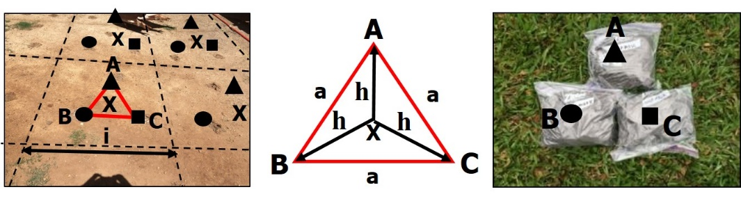
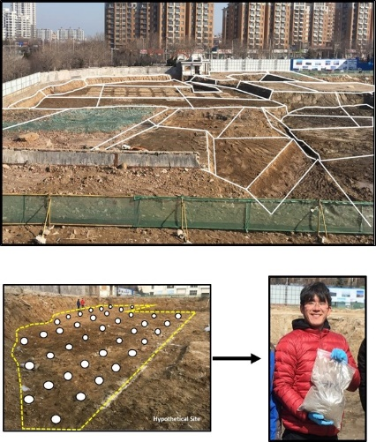
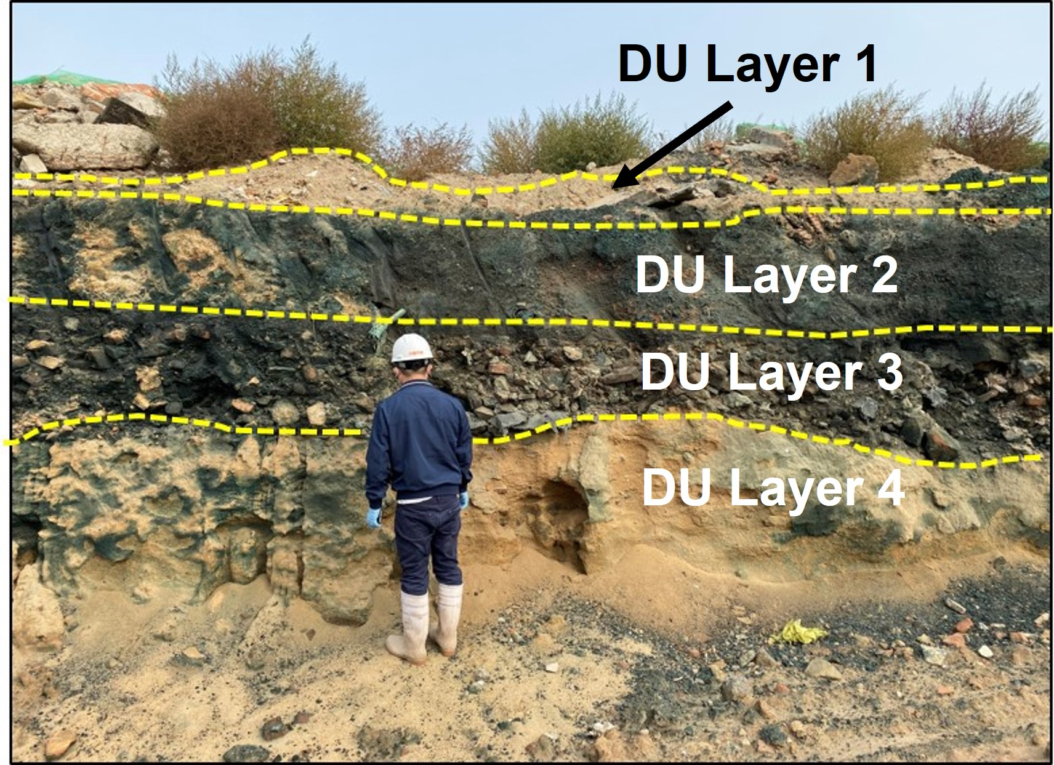
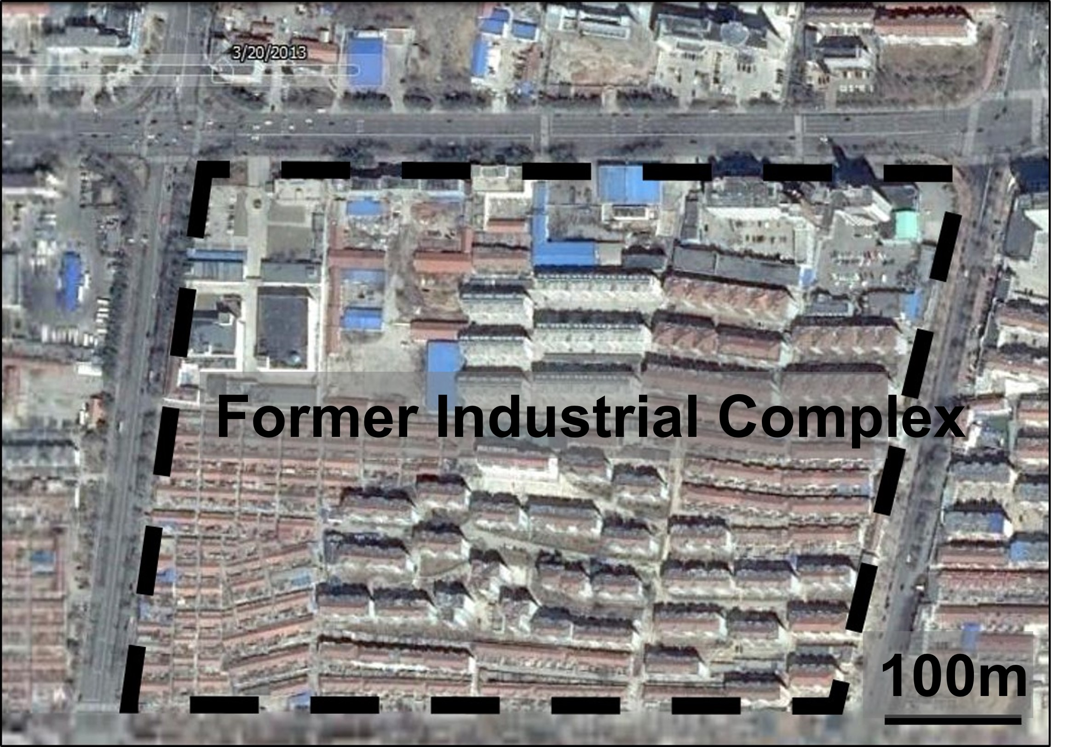
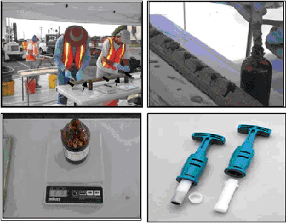
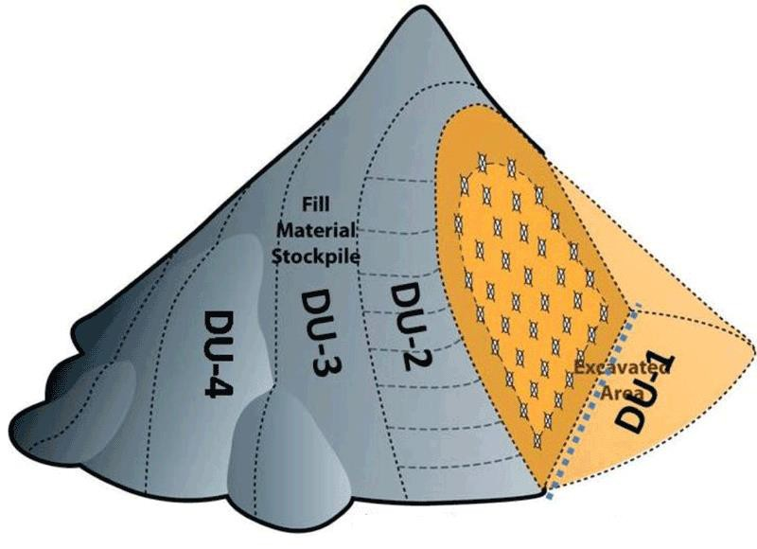
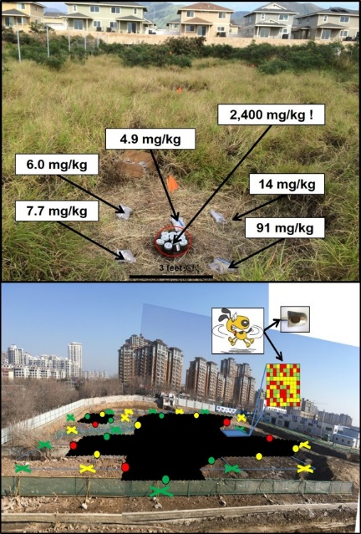
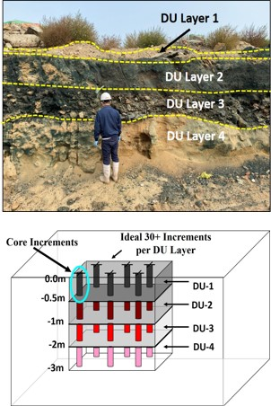
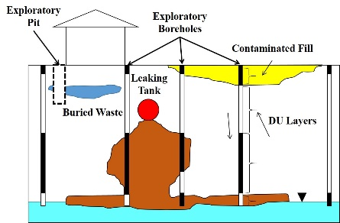
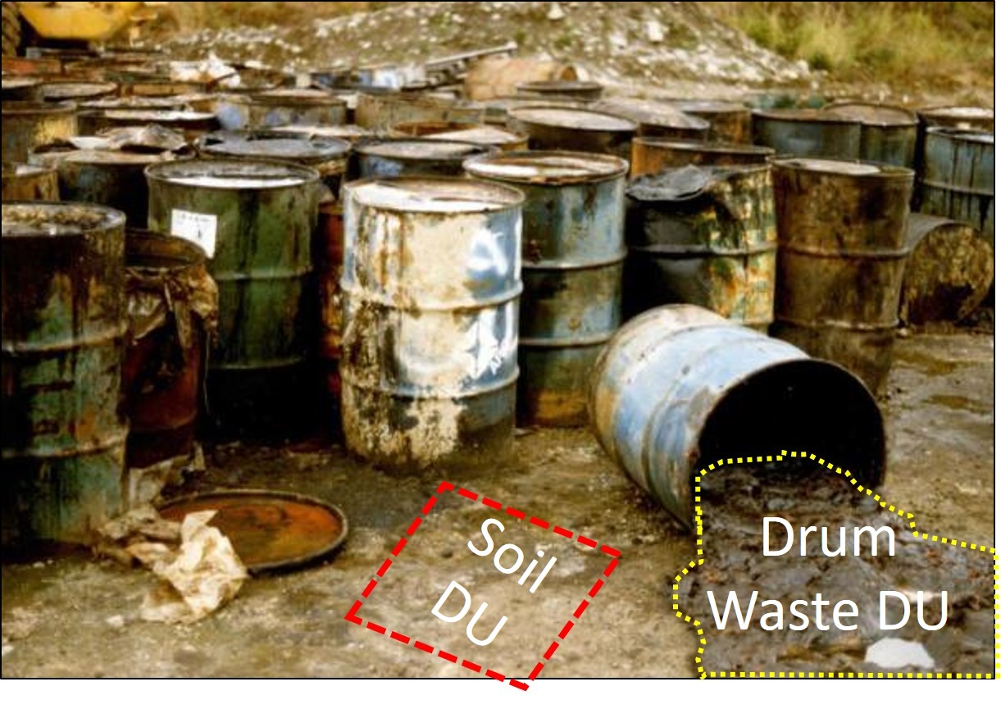
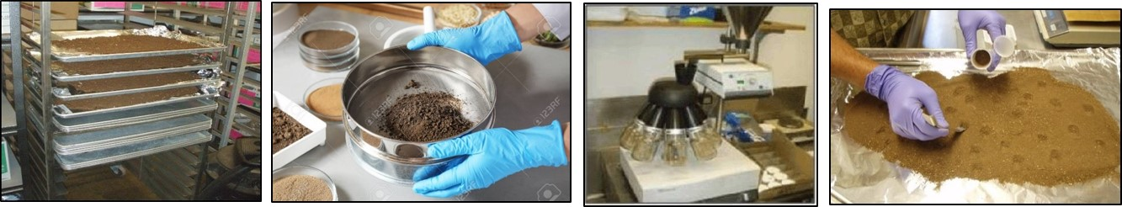
Updates to Hawaii’s Site Investigation Design
and Implementation Guidance
Roger Brewer, PhD
Hawai´i Department of Health
Hazard Evaluation and Emergency Response
(roger.brewer@doh.Hawaii.gov)
October 2, 2023

Slide 3
Outline
Previous Updates
Purpose of 2023 Updates
Organization and Highlights
Case Study
Future Webinars
Notes:
7土壤质量决策单元-多点增量采样法
tǔrǎng zhìliàng juécè dānyuán-duō diǎn zēngliàng cǎiyàng fǎ

Slide 4
Previous Updates
Sections 3, 4 & 5 (updated 2016-2021):
Systematic Planning of Environmental Investigations
Sampling Theory, Collection of Multi Increment Samples
Field Implementation (site preparation, demarcation, tools., etc.)
Section 6: Surface Water and Groundwater Investigations (updated 2021)
Section 7: Indoor Air and Soil Gas Investigations (updated 2017)
2017 Six-Part Training Series (posted to HEER YouTube channel):
Systematic Planning
Decision Units
DU Characterization (Sampling Theory)
Field Implementation
Sample Processing
EHE-EALs
DU-MIS Webpage (includes links to previous recorded webinars):
https://health.hawaii.gov/heer/guidance/specific-topics/decision-unit-and-multi-increment-sampling-methods/
Notes:
7土壤质量决策单元-多点增量采样法
tǔrǎng zhìliàng juécè dānyuán-duō diǎn zēngliàng cǎiyàng fǎ

Slide 5
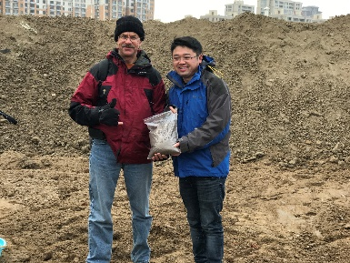
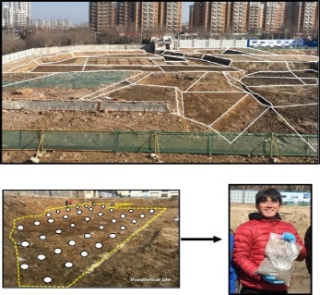
2023 Updates to TGM Sections 3, 4 & 5
“Risk-Based” Investigation Methods
(downloadable pdf files; web-based documents under construction)
Part 1: Fact Sheets (Appendix A):
Part 2: Overview (new Section 3)
Part 3: Detailed Appendices (17+; new Section 4)
Section 5 (reserved): DU-MIS for UST sites?
China National Standard (2023): Soil Quality – Decision Unit and Multi Increment Sampling Methods (Overview): National Standardization Administration Committee, GB/T-42489-2023
HDOH, 2023, Technical Guidance Manual: Hawai‘i Department of Health, Office of Hazard Evaluation and Emergency Response,
https://health.hawaii.gov/heer/guidance/specific-topics/decision-unit-and-multi-increment-sampling-methods/

Slide 6
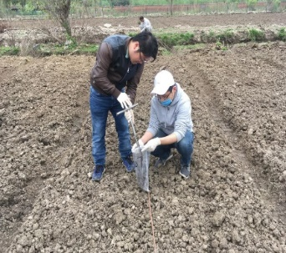

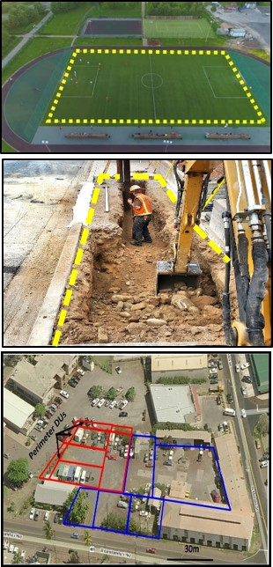
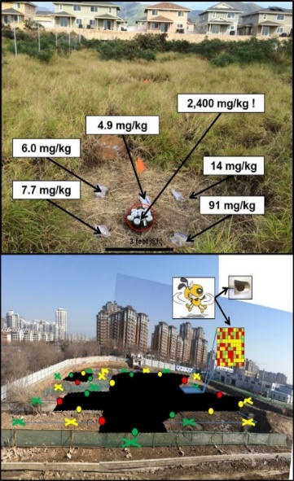
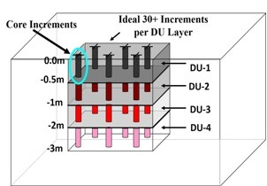
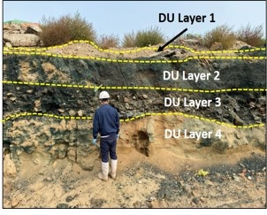

Fact Sheet #1 : Use of DU-MIS Sampling Methods for Risk-Based Investigation of Contaminated Soil and Sediment
What is DU-MIS?
How is DU-MIS Implemented in the Field?
Step 1: Review the Site History
Step 2: Develop the Site Investigation Question(s) and the Designate Decision Unit(s)
Step 3: Collect a Sample Representative of the DU(s)
Step 4: Process and Analyze Sample
Step 5: Review Data and Make Decisions
Why are DU-MIS Sampling Methods Necessary?
Where can I get more information?

Slide 7
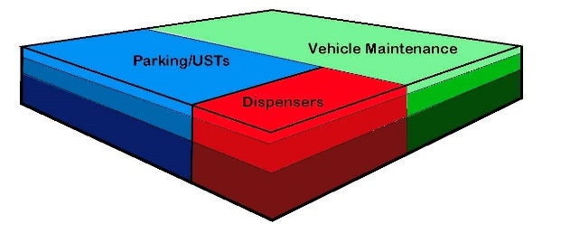
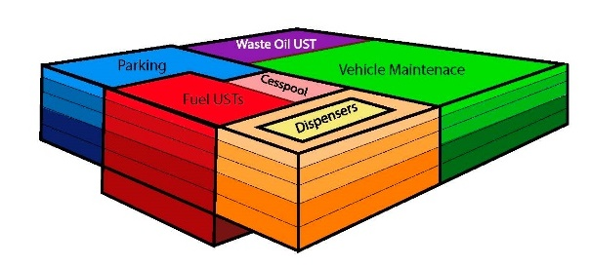
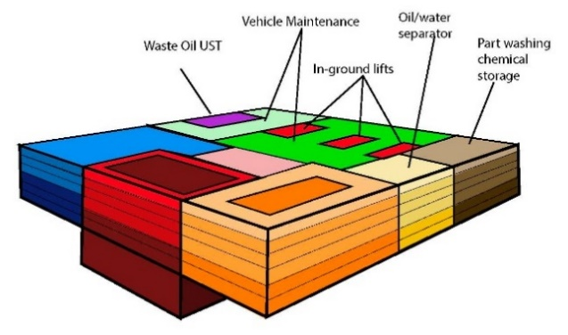
Fact Sheet #2:
Sampling Plan Essentials for Responsible Parties
Option 1: Quick and Cost-Effective Screening
Option 2: Sampling for Minimum Property Use Restrictions
Option 3: Sampling for Cleanup Savings
Includes: Tips for Adapting Your Sampling Plan
(Time vs Money/Potential Need for Remobilization)

Slide 8
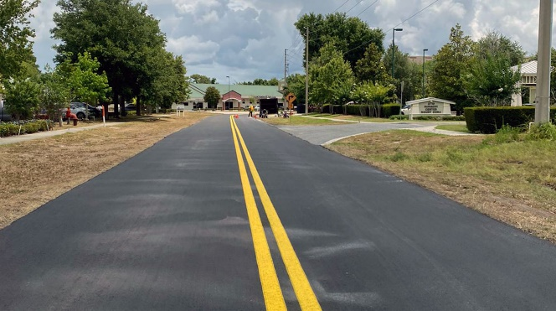
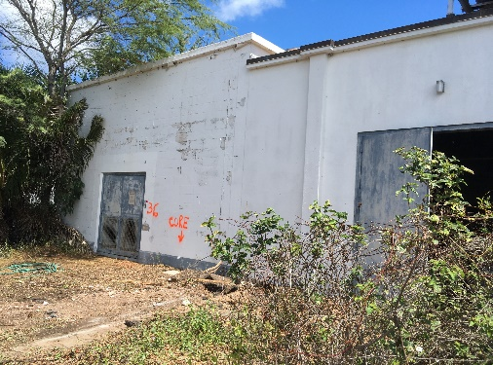
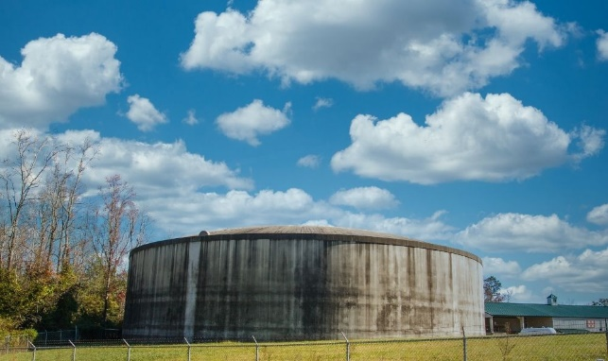
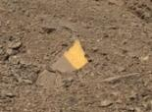
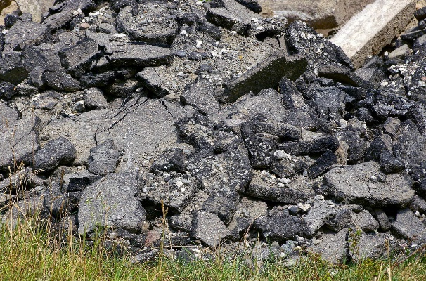
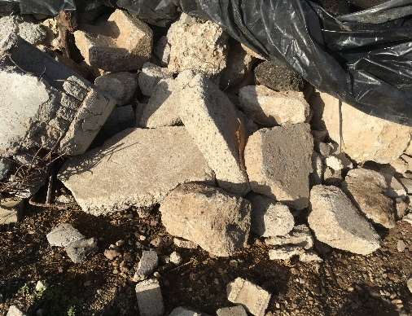
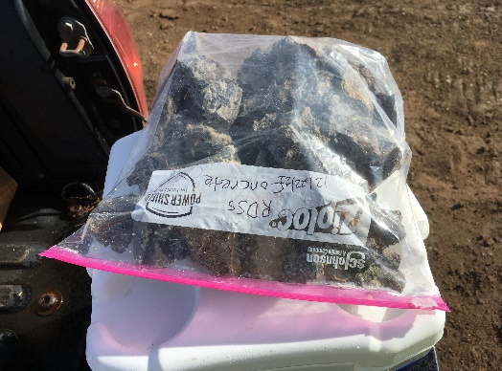
Fact Sheet #3: Sampling Roadway and Construction Debris
(pending; case study in Appendix C)
What’s the question???
Recycle: “Does lead or PCBs in the paint/sealant pose a potential health risk?”
(“Attractive Nuisance” - Remove lead- &/or PCB-based paint/sealant)
Disposal: “What is the concentration of Lead/PCBs in the building material as a whole?”
(Collect MI sample(s) before demolition through entire thickness of material)

Slide 9
Section 3: Site Investigation Design and Implementation: Overview
3.0 Application Scope
3.1 Terms and Definitions
3.2 Systematic Planning Process
3.3 Designation of Decision Units
3.4 Sampling and Analysis Plans
3.5 Site Investigation Reports
3.6 Decision Unit Characterization
3.7 Laboratory Sample Processing and Testing
3.8 Data Quality Evaluation
3.9 Using Data for Decision Making
3.10 References

Slide 10
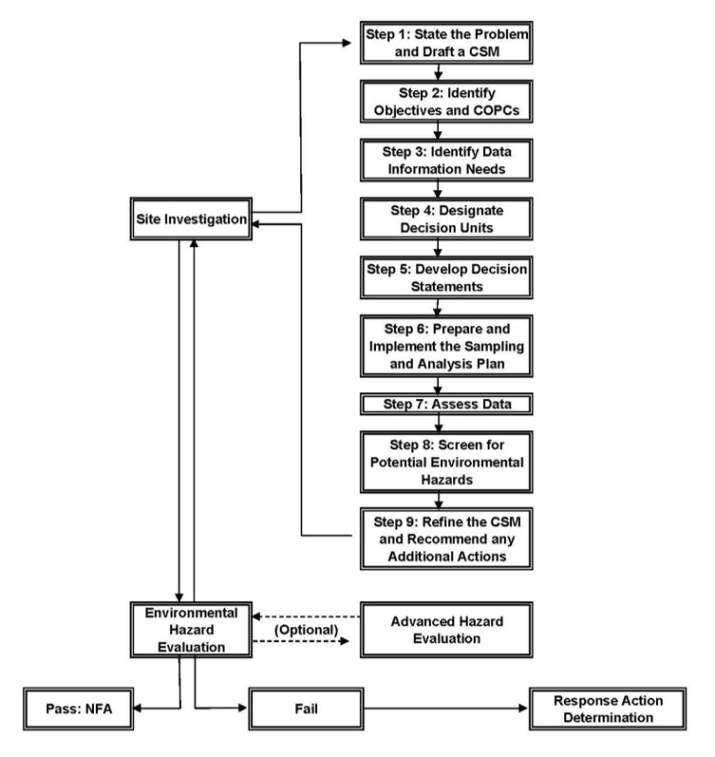
Section 3.2: Systematic Planning (App B)
The only two reasons to collect a sample:
  Assess risk.
  Optimize remediation.
State Problem (draft CSM, (Investigation Question(s));
Identify Objectives and COPCs;
Identify Data Needs & Uses;
Define Decision Units (DUs);
Develop Decision Statements;
Develop SAP and Collect Samples;
Evaluate Data Quality/Usability;
Identify Potential Environmental Hazards (e.g., using EALs)
Refine CSM and/or Recommend Additional Actions
Prepare an Environmental Hazard Evaluation

Slide 11
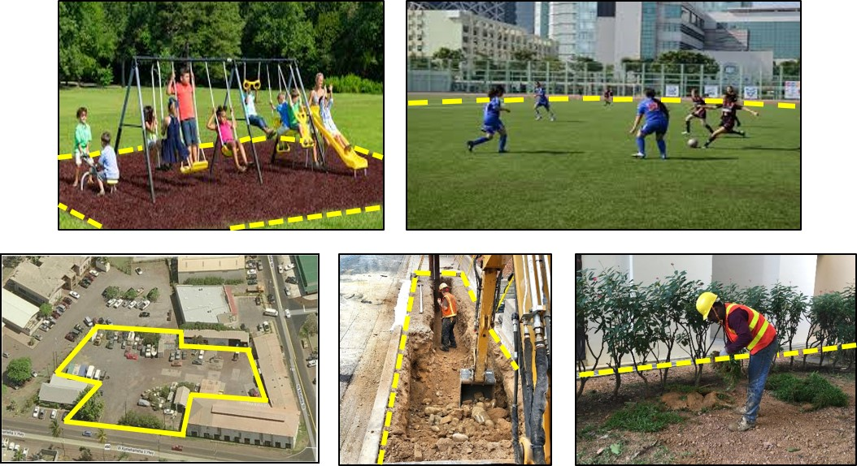
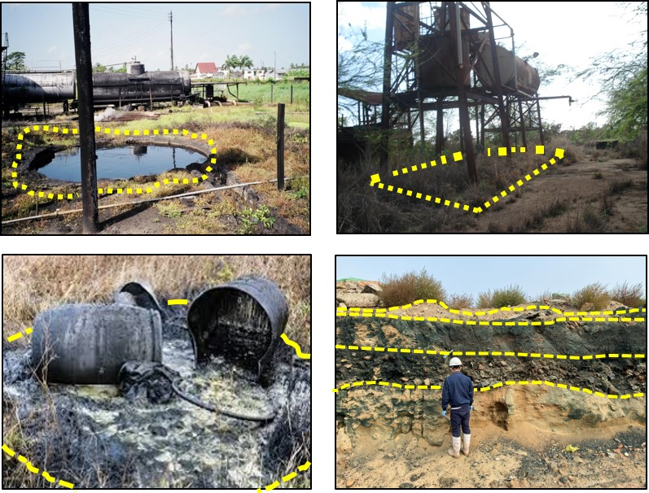
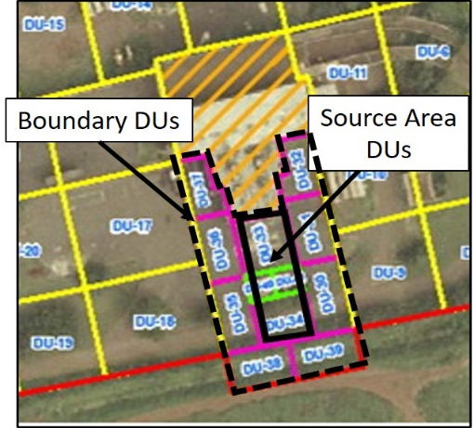
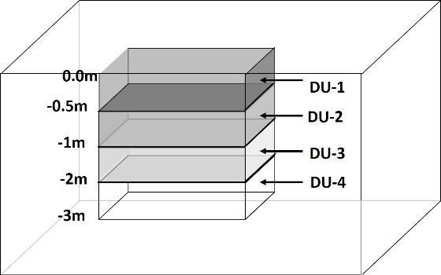
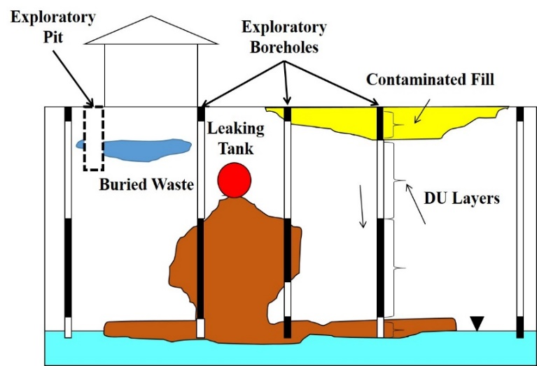
Section 3.3: Decision Unit Designation (App C)
(area and volume of soil, etc., in question)
Assess Risk
Optimize Remediation
Exposure Area DUs
Source Area DUs
Source Boundary DUs
Subsurface DUs
Exploratory Pits, Trenches
and Borings DUs

Slide 12
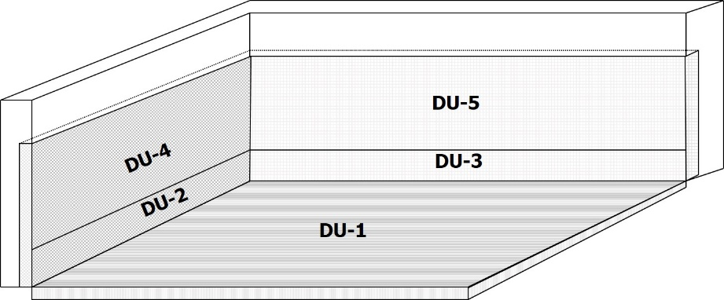
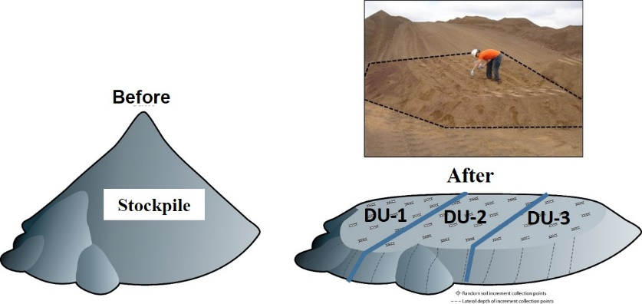
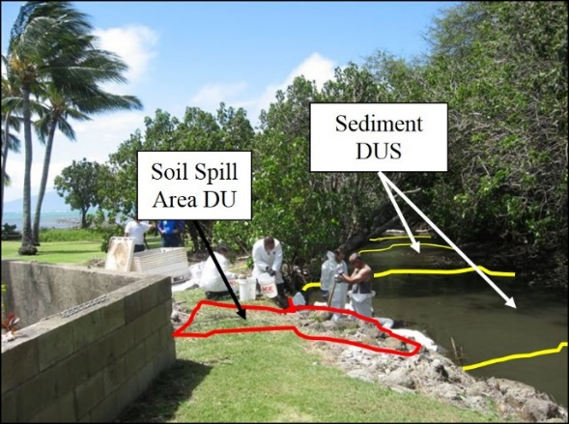
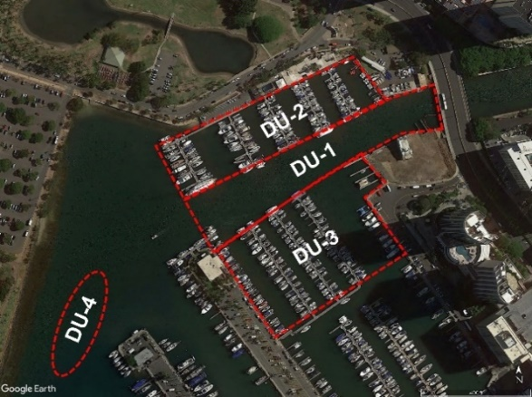
Section 3.3: Decision Unit Designation (App C)
Excavation DUs
Stockpile DUs
Sediment DUs

Slide 13
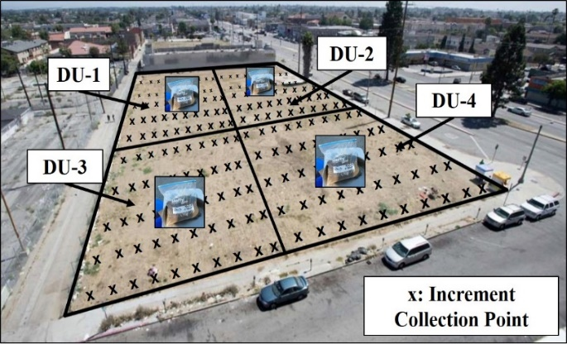
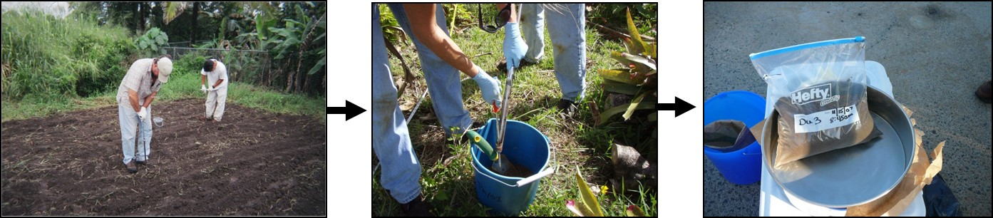
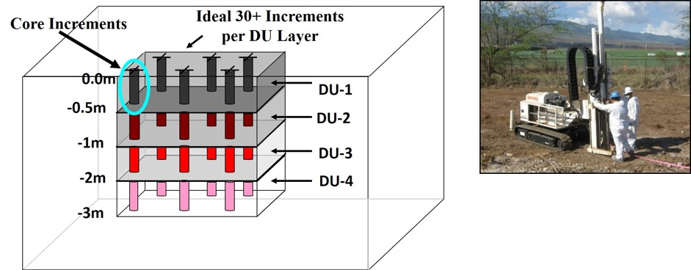
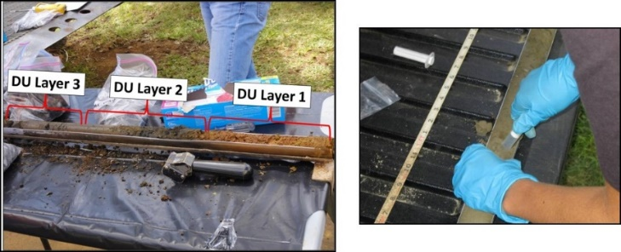
Section 3.6: Decision Unit Characterization
(App D and topic-specific appendices)
Multi Increment Samples
(App D)
Surface Soil (App F)
Subsurface Soil (App G)

Slide 14
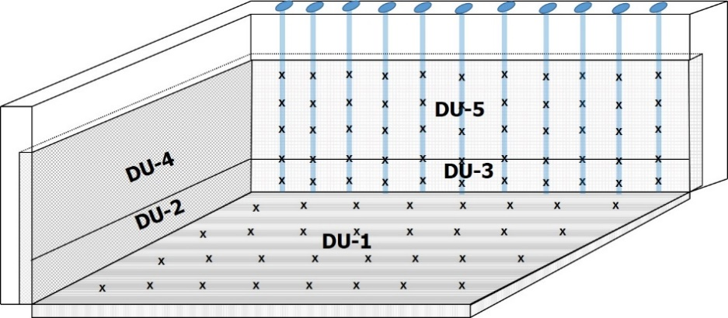
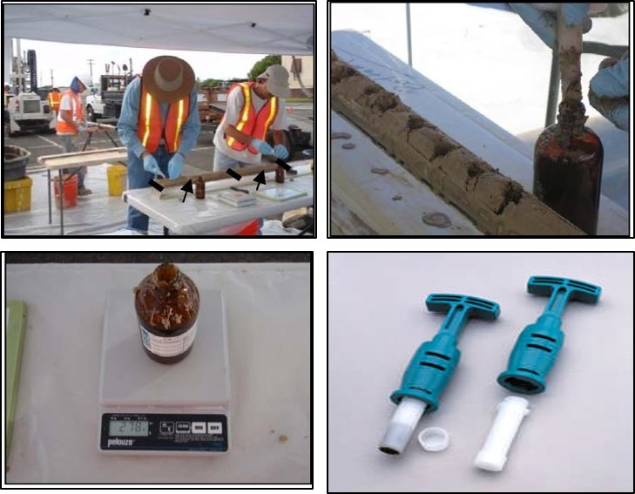
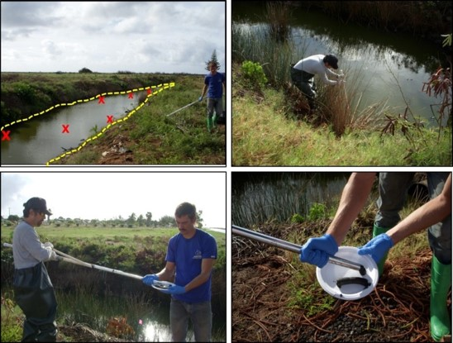
Section 3.6: Decision Unit Characterization
(App D and topic-specific appendices)
Excavations (App H)
Stockpiles
(App H)
Volatile Contaminants (App I)
Sediment Samples (App J)

Slide 15

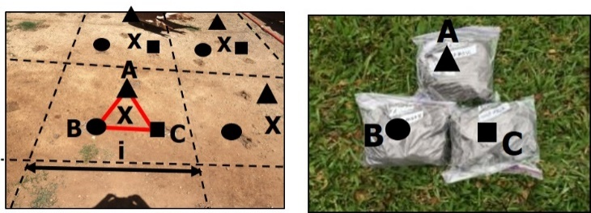

Section 3.6: Field Sampling Quality Control
(Appendix L)
Field Replicate Samples (10%)
Subsample Replicates (10%)

Slide 16
Section 3.7: Laboratory Sample Processing and Analysis
(Appendix K)
Air Dry, Sieve, Subsample
Laboratory Subsample Replicates (10%)
Sample Preparation Method | *Subsample Collection Method
 | Sectoral Splitter | Manual
Unground (<2mm) | 10g | *30g
Ground (<100 µm) | 5g | 5g
Ideal Minimum Subsample Mass
Recommended subsample masses based on discussions with sampling statisticians trained and experienced in Gy’s Theory of Sampling.
*Minimum of 10g currently allowed for unground soil if necessary but note in report (increases error in data).

Slide 17
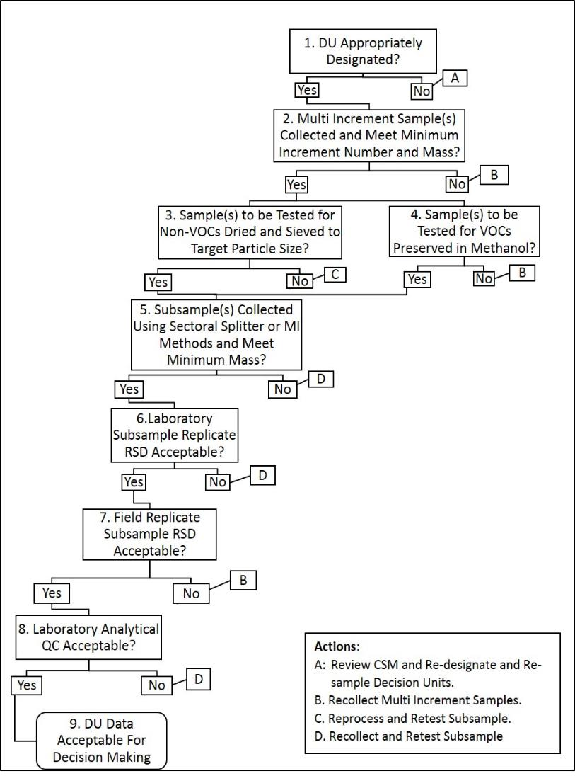
Section 3.8:
Data Quality Evaluation Process
(Appendix L)
Sample Data Quality and Usability Checklist
(main sources of error)
Laboratory
“Data Validation”
important but rarely the main source of error
Section 3.9:
Decision Making

Slide 18
Section 4: Site Investigation Design and Implementation: Appendices (17)
Fact Sheets
Conceptual Site Models
Example Decision Unit Designation Schemes
Theory of Sampling for “Infinite Element” Particulate Matter
Use and Misuse of Discrete Sample Data (contamination zones: A, B, C)
Collection of Surface Soil Samples (spacing, tools, etc.)
Collection of Subsurface Soil Samples (tools, subsamples, etc.)
Collection of Excavation and Stockpile Samples (methods, volumes, etc.)
Sample Collection for Volatile Contaminants (methanol, alternatives, etc.)
Collection of Sediment Samples
Laboratory Processing of Multi Increment Samples (subsample mass)
Replicate Sample Collection and Data Quality Review
General Field Operations (field tips)
Common Investigation Errors and Problems
DU-MIS Investigations Under TSCA
Clean Fill Guidance
References

Slide 19
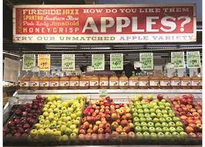
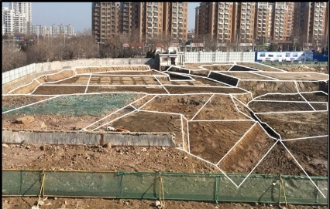
App B: Conceptual Site Models, Data Needs &
App C: Decision Units Designation
Systematic Planning:
Steps 1 & 2: Prepare a draft CSM and formulate a specific Investigation Question: “Does the concentration of Contaminant X in apples/soil pose a potential long-term (chronic) health risk?”
Step 3 & 4: Identify Data Needs and designate Decision Units for sample collection: Obtain pesticide data for specified DU volume of apples/soil (edible parts only).
Step 5: Develop the Decision Statement: “If the concentration of Contaminant X in the DU exceeds the action level, then the media must be disposed of.”

Slide 20
App C: Example DU Designation Scheme (case studies)
C.1 Commercial/Industrial Sites
Small Spills
Former Power Plant
Chemical Mixing and Storage
Hotel Redevelopment
C.2 Single-Family Homes
C.3 High-Density Housing
C.4 Schools
C.5 Large Single-Use Areas
Former Golf Course
Former Agricultural Field
C.6 Very Small Areas
C.7 Subsurface Decision Units
Buried Waste Pit
Above Ground Storage Tanks
C.8 Stockpiles
C.9 Building Demolition
Concrete Structures
Concrete and Asphalt Pavement
Sweep Material
Subslab Soil
C.10 Large Industrial Complexes
Textile & Alloy Manufacturing
C.11 Petroleum Releases
Crude Oil Pipeline
Active Gas Station
C.12 Gas Station Closure
C.13 Sediment Decision Units
Drainage Canal
Wastewater Outfall
Transformer Spill
Estuary Wastewater Discharges
Harbor Dredging
Future Additions?
Excavations (e.g., USTs)
Fire-Impacted Urban Areas

Slide 21
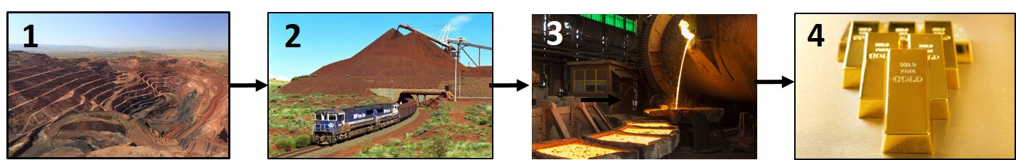


App D: Theory of Sampling
Early Mineral Exploration Industry
Development of Gy’s Theory of Sampling
Sampling of “Finite” vs “Infinite Element” Media
Origin & Nature of “Multi Increment” Sampling Methods
Application to Environmental Sampling
Why the Mining, Recycling, Agriculture and Pharmaceutical Industries are 50+ years ahead of the Environmental Industry
$$$$
“Compositional Heterogeneity”
(“Fundamental Error” - Controls sample & subsample mass)
“Distributional Heterogeneity”
(Controls # of increments and designation of DUs to optimize remediation)

Slide 22




“World Conference on Sampling and Blending”
Johannesburg, South Africa (May 2024)

Slide 23



APP D: DU Characterization &
Multi Increment Sample Collection
MI sample
Systematic Planning:
Steps 1 & 2: Prepare a draft CSM and formulate a specific Investigation Question: “Does the concentration of Contaminant X in apples/soil pose a potential long-term health risk?”
Step 3 & 4: Designate Decision Units for Data Collection: Specific volume of apples/soil in question (edible parts only).
Step 5: Develop the Decision Statement: “If the concentration of Contaminant X in the DU exceeds the screening level then the media must be disposed of.”
Step 6 & 7: Develop Sampling and Analysis Plan and Collect a Sample that is representative of the DU and the Investigation Question being asked.

Slide 24






APP E: “Discrete” vs Multi Increment Sampling Methods
Discrete Sample
(example 9 samples)
DU-MIS Investigation
(example 9 samples)
1-200g of soil collected from single point;
Samples not properly processed or tested;
Data not reliably representative of sample;
Sample not reliably representative of collection area;
Mean of samples for targeted area not reliably representative of true mean;
Cause of repeated remobilizations, remediation delays and future liability.
Area divided into one or more DUs based on risk &/or remedial optimization;
Single 30- to 75-increment sample collected from each “DU” (triplicates in one DU to test total precision);
Dried, sieved, subsampled (+replicates);
Data representative of sample;
Sample representative of DU area.
Assessment of risk and project completion significantly expedited.

Slide 25
Section 4: Site Investigation Design and Implementation: Appendices (17)
Fact Sheets
Conceptual Site Models
Example Decision Unit Designation Schemes
Theory of Sampling for “Infinite Element” Particulate Matter
Use and Misuse of Discrete Sample Data (contamination zones: A, B, C)
Collection of Surface Soil Samples (spacing, tools, etc.)
Collection of Subsurface Soil Samples (tools, subsamples, etc.)
Collection of Excavation and Stockpile Samples (methods, volumes, etc.)
Sample Collection for Volatile Contaminants (methanol, alternatives, etc.)
Collection of Sediment Samples
Laboratory Processing of Multi Increment Samples (subsample mass)
Replicate Sample Collection and Data Quality Review
General Field Operations (field tips)
Common Investigation Errors and Problems
DU-MIS Investigations Under TSCA
Clean Fill Guidance
References

Slide 26




Case Study (new)
Assessment of Fire-Impacted Urban Areas in Maui
Investigation Questions:
“Do contaminants in fine-grained ash and soot (“ash”) pose a potential health risk to workers clearing fire-related debris throughout residential & commercial areas?”
“Do contaminants in potential airborne dust from fire-impacted areas pose a potential health risk to residents and school students and staff in surrounding areas?”

Slide 27
Contaminants of Potential Concern
Primary COPCs:
Heavy metals (especially arsenic and lead);
Polyaromatic hydrocarbons (PAHs);
Dioxins and furans.
Other COPCs:
Polychlorinated biphenyls (PCBs);
Residual Range Organics (tar, heavy petroleum, etc.);
Per- and Polyfluorinated Substances (PFASs);
Polybrominated diphenyl esters (PDBE; flame retardants);
Organophosphates esters (flame retardants);
Asbestos containing materials;
Organochlorine pesticides (e.g., chlordane).

Slide 28

Decision Unit Designation (Lahaina)
DU = All of the ash (<250µm) within the targeted area.
Elementary
School
High School
DU-1
Intermediate
School
Residential
(>400 homes)
Commercial
(no access)
DU-2
Investigation Questions:
Exposure of workers to ash?
Offsite exposure to airborne ash?

Slide 29



Decision Unit Designation (Kula)
Same Questions;
Discontinuous areas of burned houses (total 25+);
DU includes total volume of <250µm ash for the combined, individual lots.

Slide 30




DU Characterization: Sample Collection Challenge
Kula Ash-Soot Samples (HDOH Sept 21, 2023)
Stay Focused!
?
Stay focused on Investigation Questions (mean of fine ash for combined lots)!
Thirty, 30 ml (2 tbls) increments collected from each of 8 lots (semi-systematic random);
Collected a single 240-increment, 3kg sample (no field replicates);
Submitted to lab for MI processing and testing (air dry, sieve, min 10-gram subsample).

Slide 31
Laboratory Sample Processing and Analysis
Air Dry, Sieve, Subsample
Laboratory Subsample Replicates (10%) for Primary COPCs
Sample Preparation Method | *Subsample Collection Method
 | Sectoral Splitter | Manual
Unground (<2mm) | 10g | *30g
Ground (<100 µm) | 5g | 5g
10g to be tested
Recommended subsample masses based on discussions with sampling statisticians trained and experienced in Gy’s Theory of Sampling.
*Minimum of 10g currently allowed for unground soil if necessary but note in report (increases error in data).

Slide 32


XRF Data: Kula Ash-Soot Samples
Example Portable XRF Reading
(HDOH 9/25/23)
Probably typical of average concentrations of metals in ash;
Arsenic is the primary heavy-metal risk driver for dust and ingestion:
  (>10-times DOH soil action level of 23 mg/kg);
  Low 100s ppm to >10,000 ppm.
Combined elevated copper, chromium and arsenic suggest CCA-treated wood source;
Moderate levels of dioxins almost certain likely present also but still arsenic likely the pose the highest health risk;
Average lead in low hundreds ppm (not an apparent significant risk).
PPM

Slide 33
XRF Analysis of Sample – Arsenic Primary Risk Driver
(6 of 8 homes post-1980; relative low lead in sample)
Kula Home Ash Example XRF Reading
 | PPM | %
Copper | 1,947 | 42%
Chromium | 1,980 | 42%
Arsenic | 741 | 16%
Total: | 4,668
Higher ratio of copper likely due to burned wiring
Copper-Chromium-Arsenic Wood Treatment (+/- Canec)
http://www.noccawood.ca/docs/cca_wood_what_is.html
Table 1 Composition of CCA-Type A, B, and C (AWPA, 1996)
 | CCA-Type A | CCA-Type B | CCA-Type C
Chromium as CrO3 | 65.5% | 35.3% | 47.5%
Copper as CuO | 18.1% | 19.6% | 18.5%
Arsenic as As2O5 | 16.4% | 45.1% | 34,0%

Slide 34


Lahaina Ash-Soot Samples (pending, October 2023?)
(test 100 lots; One 100-increment (3kg) sample)
One Increment = Three 30 ml Scoops From a Single Lot

Slide 35


Lahaina Ash-Soot Samples (pending, October 2023?)
(test 100 lots; One 100-increment (3kg) sample)
Two to Three Sample Collection Teams
(example increment collection paths)

Slide 36
Ideas for Focused Webinar Series & Discussions?
(other topics to be woven into webinars)
“Risk-Based Investigation” Overview (Section 3)
Use and Misuse of Discrete Sample Data (characterization & risk assessments)
Example Decision Unit Designation Schemes
Theory of Sampling of “Infinite Element” Particulate Matter (MI samples)
Collection of Surface & Subsurface Soil Samples (including replicates)
Sample Collection for Volatile Contaminants (methanol, alternatives, etc.)
Collection of Excavation and Stockpile Samples (volumes, imported fill, etc.)
Pavement and Building Demolition Debris
Collection of Sediment Samples
Laboratory Processing of Multi Increment Samples
Suggestions? Questions?
“If you’ve got the truth you can demonstrate it. Talking doesn’t prove it.”
Robert Heinlein
Stanger in a Strange Place

Slide 37
Additional Slides

Slide 38


App E: Use and Misuse of “Discrete Sample Data”
(misapplication of “Finite Element” Sampling Methods)
Lab data not reliably representative of sample submitted;
Sample not reliably representative of area where it was collected.
Artificial Hot & Cold Spots
Laboratory
Subsample
Site Characterization: Erroneous interpretation of extent of contamination;
Risk Assessment: Error in estimate of mean for Exposure Areas unknown;
Projects stalled for years or property abandoned (“brownfields”).

Slide 39
Environmental Industry Learning
From the Mining Industry
Factors | Mining Industry | Environment Industry
Investigation Target: | Commodities | Contaminants
Example Media: | Crushed Ore | Soil and Sediment
Field Characterization: | Designation of Lots | Designation of DUs
Basis: | Economic Viability Optimization of Commodity Extraction | Risk to Human Health and the Environment Optimization of remedial actions
Sample Collection: | Multi Increment Samples | Multi Increment Samples
Typical Sample Mass: | 100s to 1,000 kilograms | 1 to 3 kilograms
Quality Control: | Field Lot Replicates Laboratory Replicates Analytical QC | Field DU Replicates Laboratory Replicates Analytical QC
Required Replicate Data Precision: | RSD 3-5% | RSD <35%

Slide 40
Replicate Sample Precision and Data Usability
(How much error can you tolerate?)
Replicate Precision | Use of DU Data for Decision Making (partial)
Good (RSD≤35%) | Compare unadjusted MIS data directly with target screening values (use arithmetic mean of replicate sample data).
Moderate (35%<RSD ≤50%) | Review and discuss sampling methods and laboratory processing and analysis methods and summarize potential sources of error in reports for future reference;
Poor (50%<RSD ≤100%) | Consider retesting affected DUs using samples with a greater number of increments and total bulk mass;
Very Poor (RSD>100%) | Consider the collection of new samples in DUs (isolate source areas, more increments, larger samples, etc.)

