Slide 1
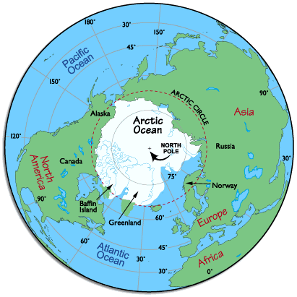
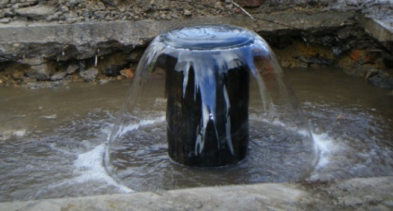
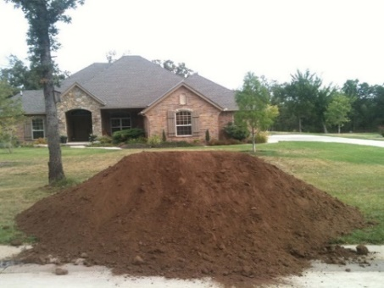
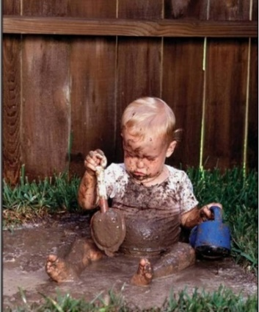
Fake Data? The Need for Theory of Sampling Concepts in Environmental Research and Investigations
*Roger Brewer (Hawai´i Department of Health)
Chuck Ramsey (EnviroStat)
Marvin Heskett (Element Environmental)
Song Jing (Chinese Academy of Sciences)
*(roger.brewer@doh.hawaii.gov)
WCSB10
10th World Conference on Sampling and Blending, Kristiansand, Norway, May 31-June 2, 2022

Slide 2
Conference Paper
Brewer, R., Ramsey, C., Heskett, M. and J. Song, 2022, Fake Data? The Need for Theory of Sampling Concepts in Environmental Research and Investigations: Proceedings of the 10th World Conference on Sampling and Blending, TOS Forum Issue 11, 193–205 (2022), ISSN: 2053-969X, doi: https://doi.org/10.1255/tosf.149
Notes:
7

Slide 3
Hawai´i Guidance
(since 2004; only US state with mandatory TOS-based sampling guidance)
HDOH, 2021, Technical Guidance Manual: Hawai‘i Department of Health, Office of Hazard Evaluation and Emergency Response,
https://health.hawaii.gov/heer/guidance/specific-topics/decision-unit-and-multi-increment-sampling-methods/
Systematic Planning of Environmental Investigations
Sampling Theory, Soil and Sediment Sample Collection
Field Implementation (site clearing, demarcation, tools., etc.)
Surface Water and Groundwater Sample Collection
Indoor Air and Soil Gas Sample Collection
Recorded Webinars (includes six-part training series):
https://health.hawaii.gov/heer/guidance/specific-topics/decision-unit-and-multi-increment-sampling-methods/
Notes:
7

Slide 4
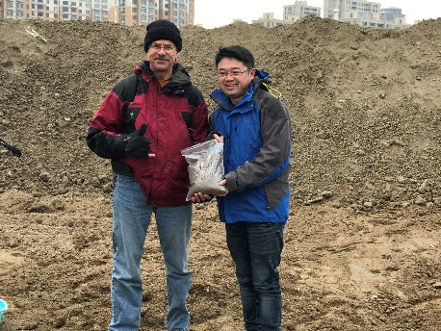
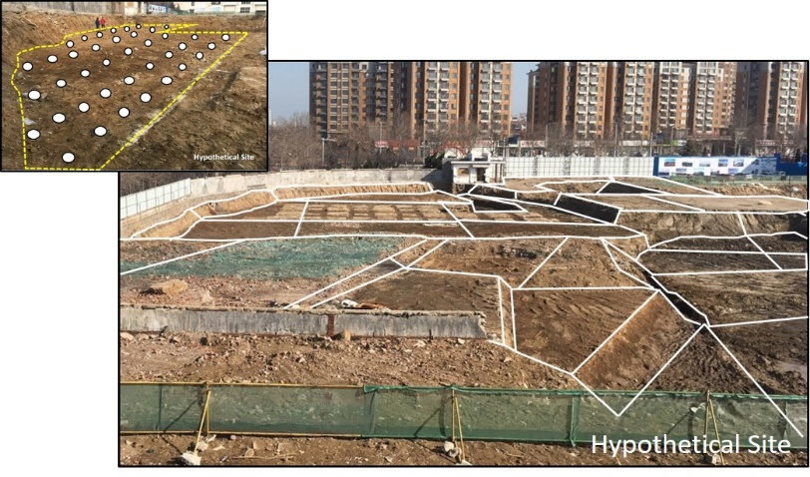
Upcoming Environmental Guidance in China
(national soil sampling standard, anticipated fall 2022)
Brewer, R. and J. Song, 2022, Environmental Characterization and Assessment of Contaminated Soil and Sediment: Chinese Academy of Sciences, English adaptation of Chinese National Standard XXX, XXX 2022.
Fact Sheet
Overview
Detailed Appendices (15)

Slide 5
Scientific Progress in the Commodities
vs Environmental Industries
Environmental
Industry
I know everything
Cognitive Dissonance Hurdle
high
Five Stages of Grief (denial, anger, bargaining, depression and acceptance)
There’s more to this
than I thought…
Ahah…
Confidence
Commodities
Industry
I’m never going
to understand this
It’s starting to
make sense
low
Huh???
low
high
Knowledge in Field
The aim of science is not to open the door to infinite wisdom, but to set a limit to infinite error.
Bertolt Brecht
Notes:
denial, anger, bargaining, depression and acceptance

Slide 6
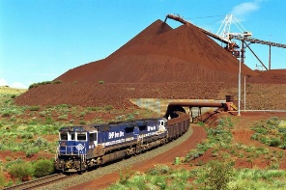
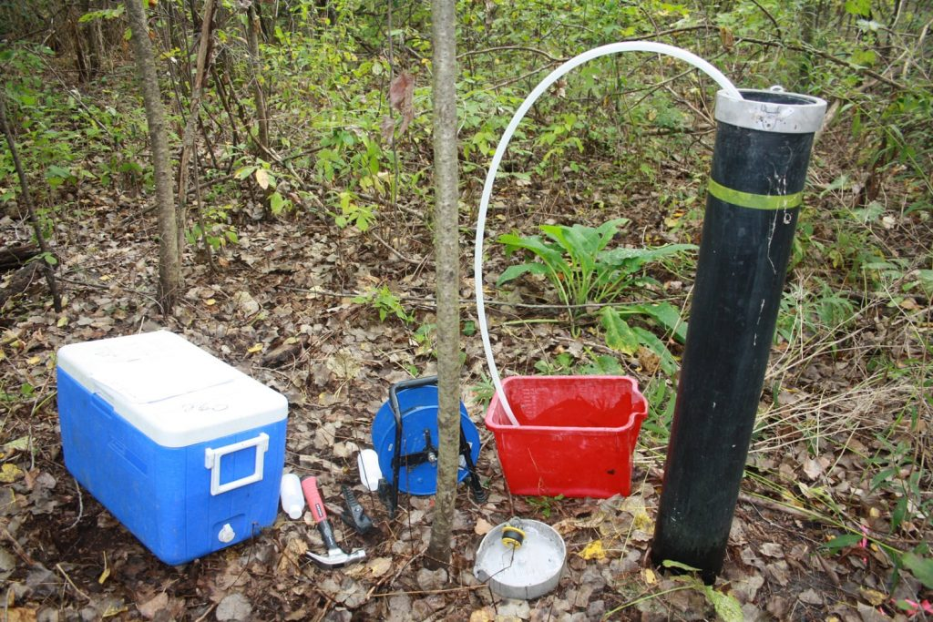
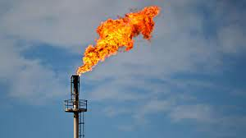
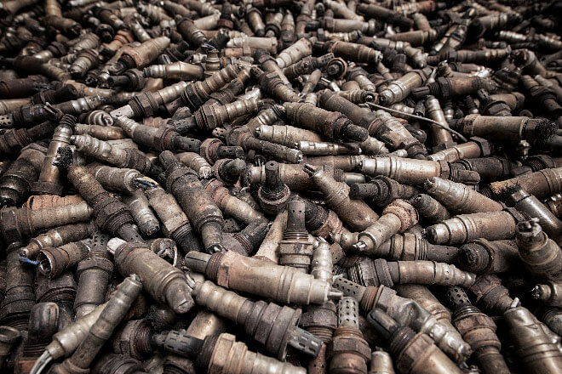
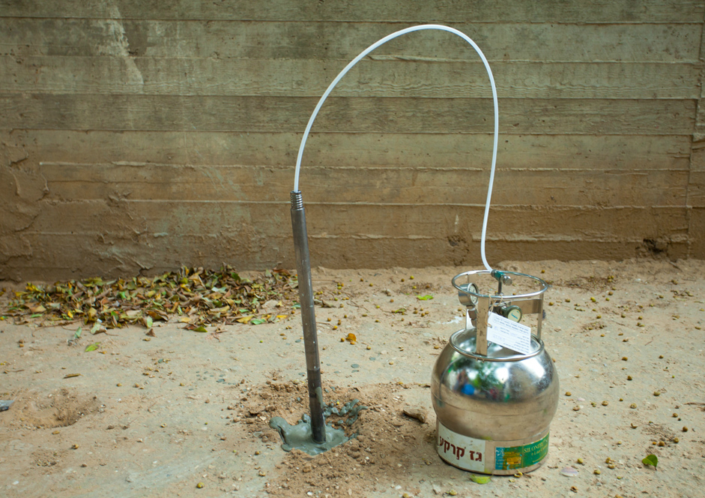
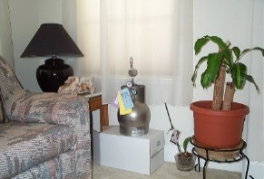
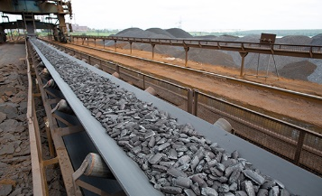
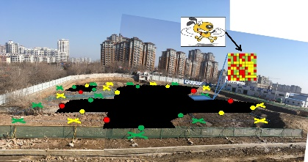
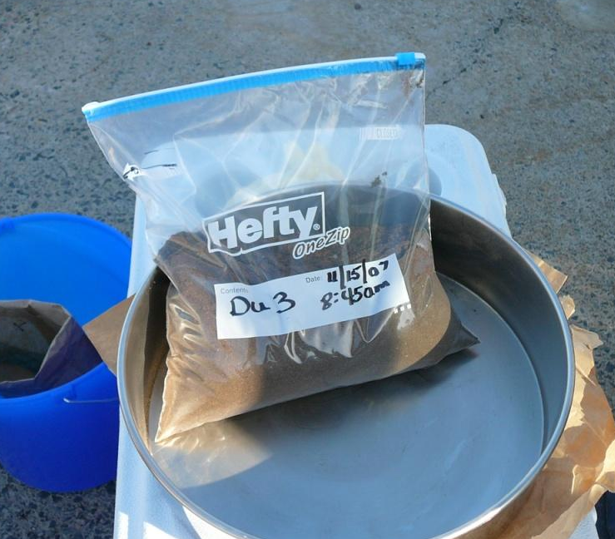
Different Motivations/Same Questions
“What is the mean concentration of ‘X’ in ‘Y’”?
Commodities
Industry
Environmental
Industry
Mining
Ag
GroundWater
Oil & Gas
Soil
Pharm
Soil
Vapor
Recycling
Air
Correct Use of
“Infinite Element”
“Multi Increment®” Type
Sampling Methods
Incorrect Use of
“Finite Element”
“Discrete/Grab”
Sampling Methods
X X X X X X xX X XX
Single large sample collected from multiple points within a designated Decision Unit volume of the targeted media
Multiple small samples collected from single points and independently analyzed
Notes:
*Multi Increment® sample is a registered trademark of EnviroStat, Inc.

Slide 7
Theory of Sampling
Overlooked in the Environmental Industry…

Slide 8
Example Theory of Sampling References
AAFCO, 2015, GOODSamples: Guidance on Obtaining Defensible Samples: Association of American Feed Control Officials, October 2015, Champaign. Illinois. http://www.aafco.org/Portals/0/SiteContent/Publications/GOODSamples.pdf
AAFCO, 2018, Good Test Portions: Guidance on Obtaining Defensible test Portions: Association of American Feed Control Officials, June 2018, Champaign, Illinois. http://www.aafco.org/Publications/GOODTestPortions
Esbensen, Kim, 2020, Introduction to the Theory and Practice of Sampling: IM Publications, ISBN: 978-1-906715-29-8.
Chuck Ramsey (Envirostat, Inc.; www.envirostat.org)
Introduction to sampling theory and Multi Increment Sample site investigations (four days);
Post training support;
Training in Hawaii since 1990s (China 2019).
HIDOH DU-MIS Webpage: Field Studies, Sampling Guidance, Recorded Webinars, etc. https://health.hawaii.gov/heer/guidance/specific-topics/decision-unit-and-multi-increment-sampling-methods/
Notes:
7

Slide 9
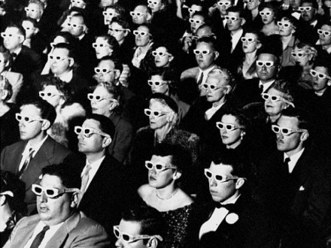
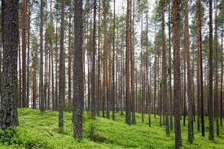
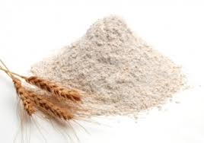
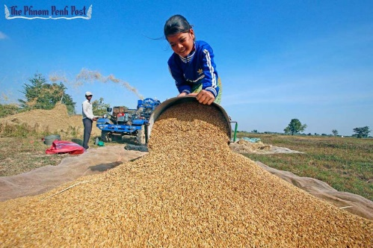
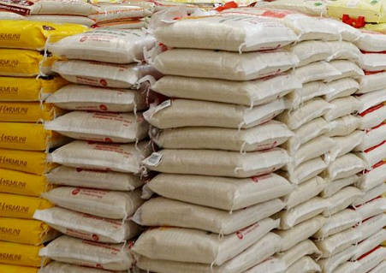
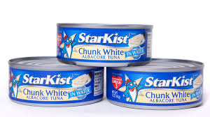
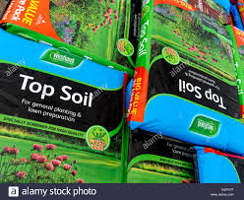
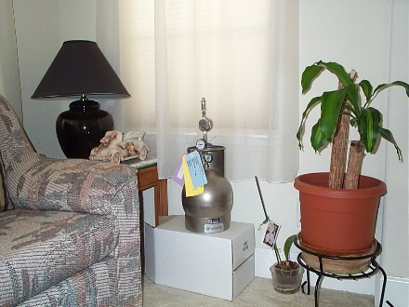
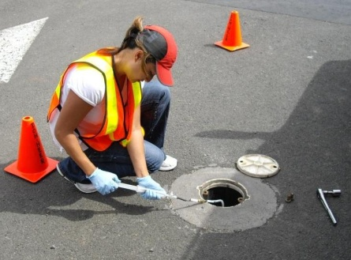
Different Types of Sampling Challenges (AAFCO)
“Finite Element” Media
(elements individually identified and randomly selected)
“Infinite Element” Media
(elements cannot be individually identified or randomly selected)
room of people
forest of trees
pile of flour
pile of rice
cans of tuna
pile of soil
lake of water
bags of rice
bags of soil
bottles of water
room of air
subslab vapors
9

Slide 10
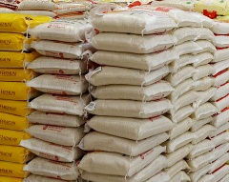
Testing of “Finite Element”
vs “Infinite Element” Media
Testing of Finite Element Media (classical statistics, easiest media to sample):
Definition: Media composed of elements that can be individually identified and individually selected at random;
Common DQOs: Variability between elements, estimates of “minimum” or “maximum”, other quality control parameters;
Sample prepared by collecting and independently testing individual elements (“Survey Sampling”);
Only variable is the number of elements selected.
Testing of Infinite Element Media (risk-based, more challenging to sample):
Definition: Media composed of elements that cannot be individually identified nor individually selected at random;
Common DQOs: Mean of targeted “Decision Unit” area & volume of targeted media;
Sample prepared by collecting & combining groups or “increments” of individual elements into single, bulk sample for processing & testing (“Multi Increment” sample);
Variables include sample mass, # increments, collection method, etc.

Slide 11
Early Assumptions of Contaminant “Homogeneity” and of Misapplication of “Finite Element” (aka “discrete”) Sampling Methods (never tested in the field)
“The… level is assumed to be uniform within (an area of contaminated soil) and zero outside it.”
USEPA 1985: Verification of PCB Spill Cleanup
“(Groundwater) samples taken in close proximity (e.g., within a few meters)… are highly auto-correlated. …Dense spatial monitoring… runs the risk of redundant data”
USEPA 1996: USEPA, Low Flow (Minimal Drawdown) Ground-Water Sampling Procedures.
“The default (vapor intrusion attenuation factors) assume (that) …the subsurface (vapor plume) is reasonably homogeneous”
CAEPA 2011: Guidance for the Evaluation and Mitigation of Subsurface Vapor Intrusion to Indoor Air.

Slide 12
Early Warnings of Contaminant Heterogeneity
“The so-called grab (soil) sample is not really a sample but a specimen of the material that may or may not be representative of the sampling unit.”
USEPA 1992: Preparation of Soil Sampling Protocols: Sampling Techniques and Strategies.
“The probability is small that any body of still (surface) water is relatively homogeneous… A single sampling point generally is not adequate to describe the physical and chemical properties of the water body.”
USGS 2006: National Field Manual for the Collection of Water-Quality Data, Chapter A4 – Collection of Water Samples.
“Spatial variability in subslab soil gas... (invalidates) the use of the USEPA vapor intrusion database for (assessment of vapor intrusion risk).”
Brewer et al. 2014: Estimation of Generic Subslab Attenuation
Factors for Vapor Intrusion Investigations, Groundwater Monitoring & Remediation 34, no. 4/ Fall 2014/pages 79–92.

Slide 13
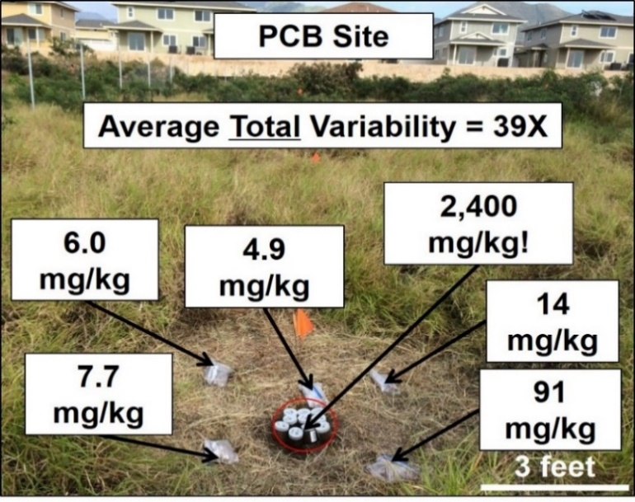
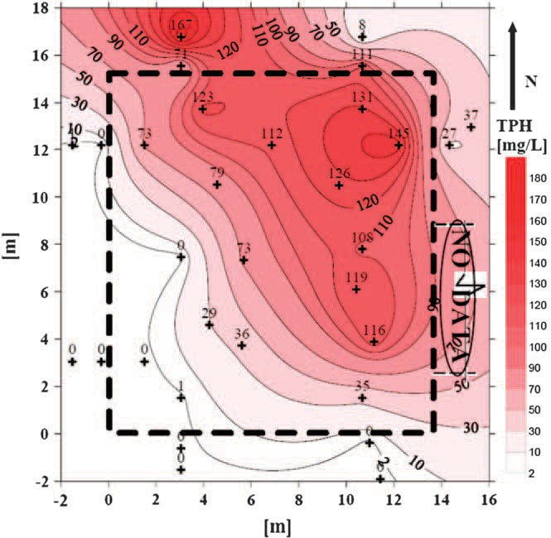
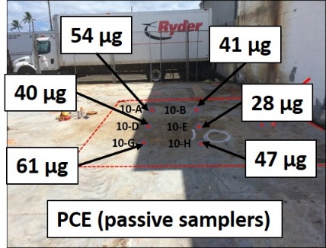
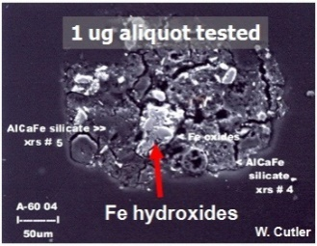
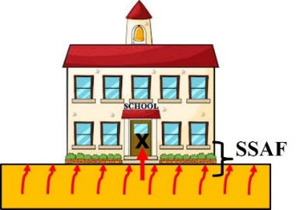
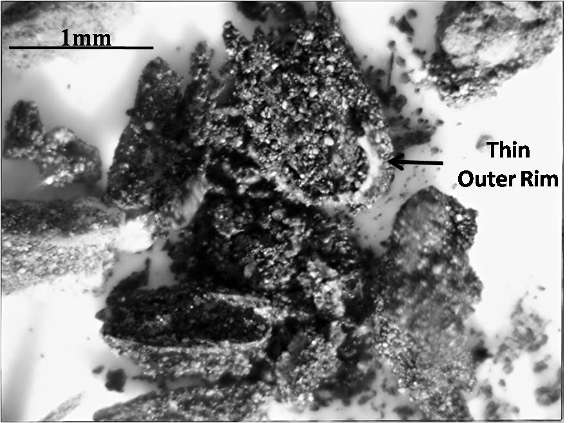
Field Studies of Contaminant
Compositional & Distributional Heterogeneity
Heterogeneous Nature of Contaminants in Soil (Brewer et al. 2017)
Heterogeneous Nature of Contaminants in Subslab Soil Gas (Luo et al. 2009)
PCB Nuggets
Arsenic Nuggets
HIDOH 2017
Subsurface
Vapor
Intrusion
Notes:
Ironically – The least heterogeneous media is air but indoor air experts by far take the most care in sample collection.

Slide 14
Field Study of Discrete Sample Data Reliability (Heterogeneity is Inherent in Environmental Contamination)
Soil:
Brewer, Peard and Marvin Heskett (2017), A critical review of discrete soil sample reliability: Journal of Soil and Sediment Contamination. Part 1: Field Study; Part 2: Implications.
Subslab Soil Vapor:
Brewer, Nagashima, Rigby, Schmidt and O'Neill (2014), Estimation of Generic Subslab Attenuation Factors for Vapor Intrusion Investigations. Groundwater Monitoring & Remediation, 34: 79–92. doi: 10.1111/gwmr.12086.
HIDOH, 2017. Field Study of High-Density Passive Sampler and Large-Volume Purge Methods to Characterize Subslab Vapor Plumes: Hazard Evaluation and Emergency Response, Hawaii Department of Health, July 2017.
Field report and recorded webinars posted to HEER webpage
http://eha-web.doh.hawaii.gov/eha-cma/Leaders/HEER/Webinar

Slide 15
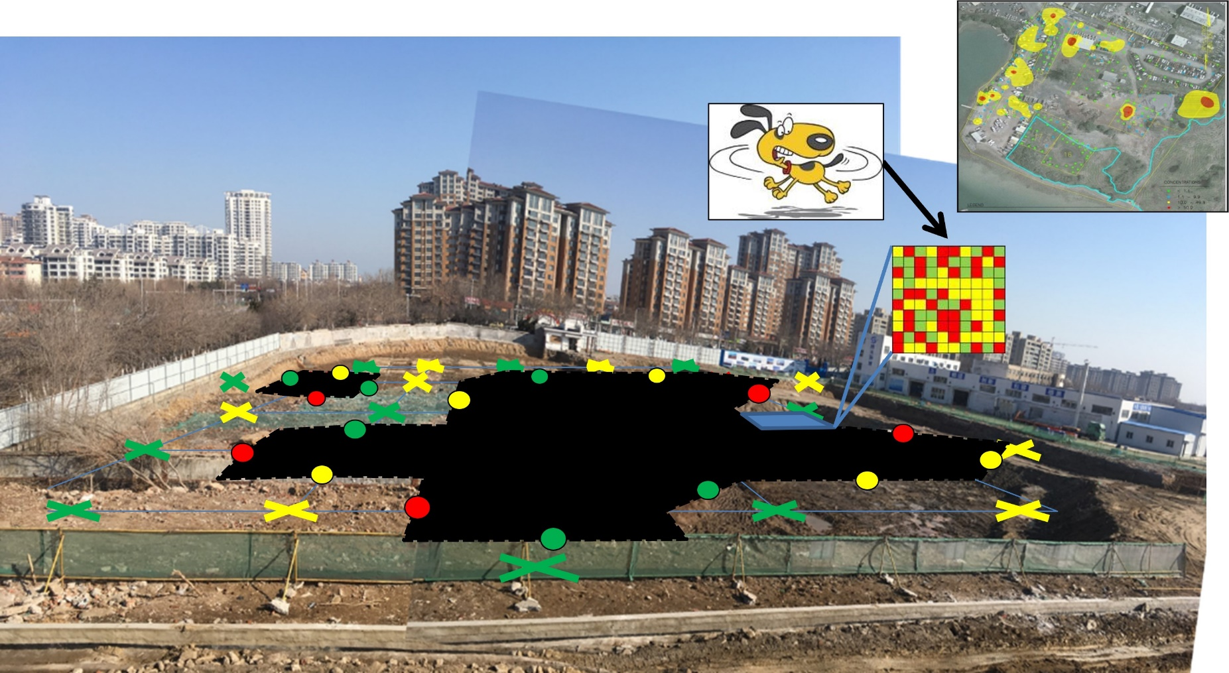
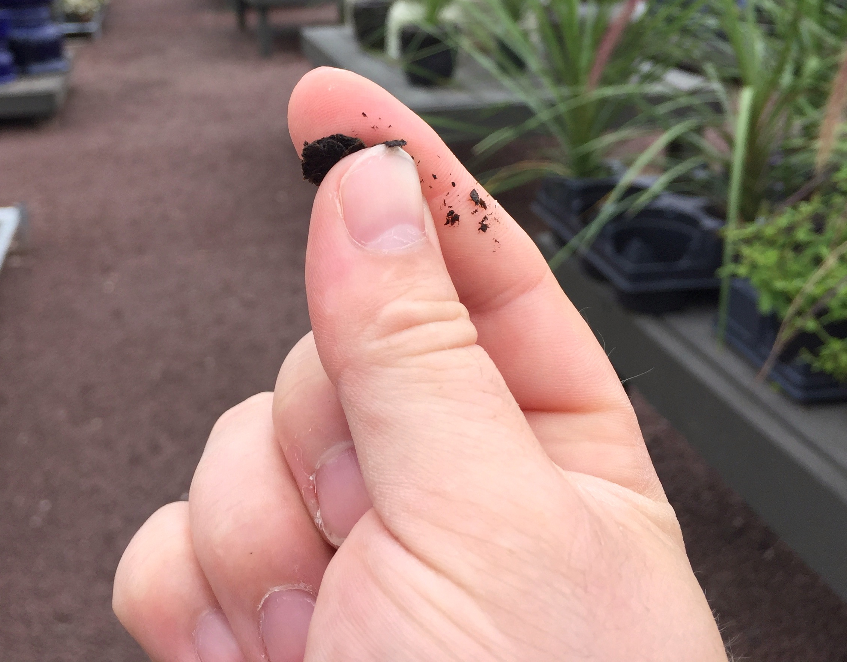
Results of Misapplication of Finite Element Sampling Methods in the Environmental Industry
Lab data not reliably representative of sample submitted;
Sample not reliably representative of area where it was collected.
Artificial Hot & Cold Spots
Laboratory
Subsample
Multiple remobilizations for sample collection with no clear endpoint;
Uninterpretable, “highly variable” data;
Error in data unknown;
Projects stalled for years or property abandoned (“brownfields”).

Slide 16
Thirty+ Years of Kicking the Can Down the Road…
“Future changes in EPA policy may invalidate some of the discussions in this (guidance).”
USEPA 1989: Methods for Evaluating the Attainment of Cleanup Standards, Volume 1: Soils and Solid Media.
“We searched for a non-conventional statistical sampling theory that… takes into account the nature of particulate materials… In 1989, we hit “pay dirt,” …the Pierre Gy sampling theory for particulate materials. (However) we were only moderately successful at transferring this technology to the environmental community.”
USEPA 2003: Guidance for Obtaining Representative Laboratory Analytical Subsamples from Particulate Laboratory Samples.
“As bureaucracies accumulate power, they become immune to their own mistakes. Instead of changing their stories to fit reality, they can change reality to fit their stories. In the end external reality matches their bureaucratic fantasies, but only because they forced reality to do so.”
Yuval Noah Harari, Homo Deus

Slide 17
Why Heterogeneity Was Overlooked (or ignored…)
by the Environmental Industry
Mining Industry | Environmental Industry
Geologic Map | Site Conceptual Site Model
Ore Body Identification | Preliminary Source Area Identification
Mining and stockpiling | +/- Excavation and stockpiling
Lot Designation | Poor concept of Decision Units (DUs)
Field Sample Collection: TOS | Field Sample Collection: grab/discrete
Laboratory Testing: TOS | Laboratory Testing: grab/discrete
Data Quality Review Sample collection method Field replicate precision Laboratory replicate precision Analytical precision Error in data controlled Clear business repercussions for overseeing entity for bad data | Data Quality Review Sample collection method ignored Minimal testing of field sample or lab subsample precision Validation of analytical method only Error in data unknown No repercussions for overseeing entity (government) for bad data
Economic Feasibility Assessment | Environmental Risk Assessment
Commodity Extraction/Marketing | Contaminant Removal or Isolation

Slide 18
Motivating Factors in Sampling Intensive Industries
Four Classic Tools to Motivate Change
Logic
(science)
Bribery
(profit)
Shame
(publicity)
Violence
(lawsuits)
Industry
Commodities:
Environmental:
Commodity Industries:
Routine, third-party confirmation of sample data (e.g., erroneous mass of extracted ore, contaminated grain, ineffective drugs, etc.);
Direct repercussions on decision makers (significant financial loss, company goes out of business, fired, etc.);
Environmental Industry:
Rare to no third-party confirmation (sampling errors not obvious);
Burden of negative publicity, financial loss, lawsuits, etc., placed on consultants and responsible parties vs overseeing govt agencies;
No direct repercussions for “decision makers”.

Slide 19
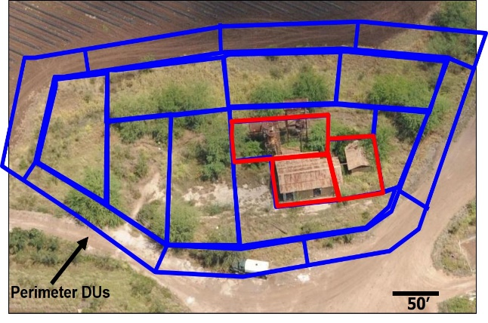
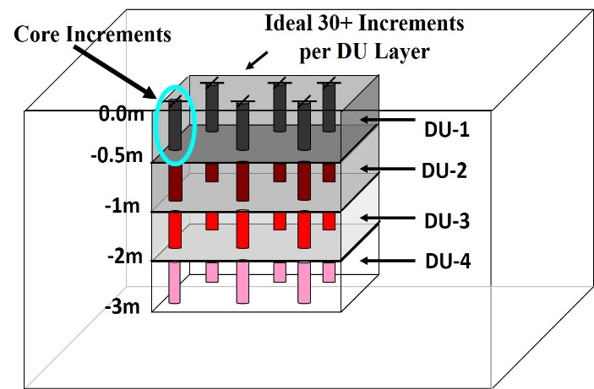
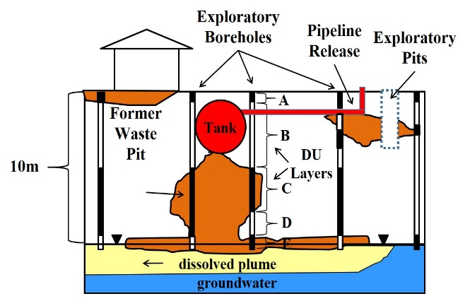
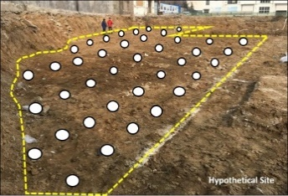
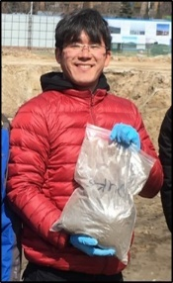
TOS Applied to Particulate Matter (HIDOH 2021)
Question: “Does the mean concentration of ‘X’ in DU volume of soil (etc.) ‘Y’ exceed the screening level or risk ‘Z’ ”?
Surface Soil DUs
Subsurface DUs, “Exploratory Boreholes”, VOCs, etc.
Data Needs: What is the mean concentration of “X” in soil for the targeted risk- or remediation-based DU?
Decision Unit: Designated based on high-risk exposure areas and/or optimization of remediation.
Ideal: Send entire volume of soil to lab.
Worst: Test small-volume (e.g., <1-10g) discrete samples.
Risk-Based: Single 50-increment, 1-3kg Multi Increment sample + replicates in 10% of DUs to check precision.
Concentration for individual small volumes is irrelevant
Notes:
LVP sample: Hypothetical production well and drinking water or irrigation water risk.
Core-shaped sample:

Slide 20
TOS Applied to Indoor Air (already well done)
Question: “Does the mean concentration of ‘X’ in DU volume of air ‘Y’ exceed the screening level or risk ‘Z’ ”?
Default Home
Volume
= 244,000 liters
Default 24-Hour
Indoor Air Exchange
Volume (0.35 times/hr)
= 2,050,000 liters/day
Approx.
To Scale
Data Needs: What is the mean concentration of “X” in indoor air during the specified, exposure period?
Decision Unit: Volume of air circulating within structure during the specified exposure period.
Collection of a Representative Sample:
Ideal: Send entire volume of circulating air to lab
Worst: Test small-volume (1L), instantaneous samples.
Risk-Based: Collect single, continuous sample of circulating air during targeted exposure time.
Concentration for individual small volumes is irrelevant

Slide 21
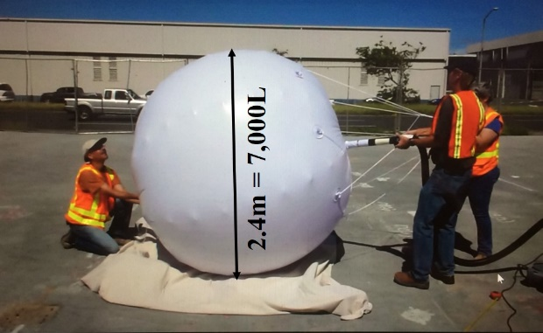
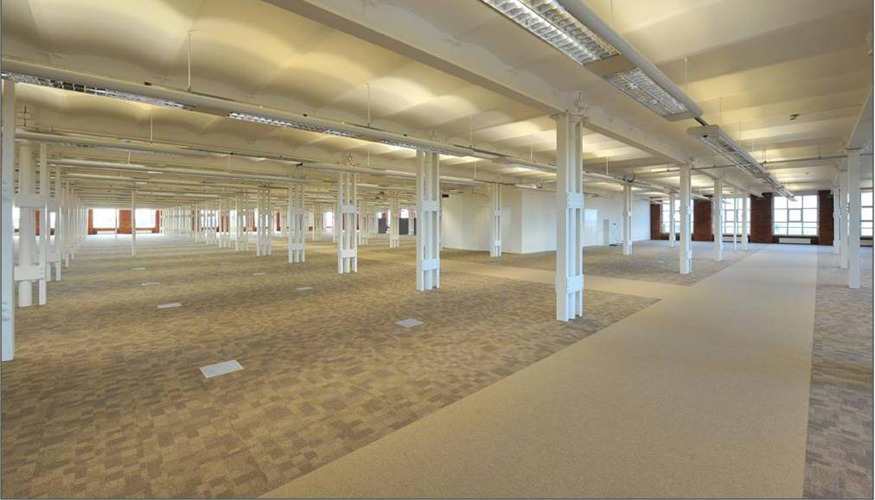
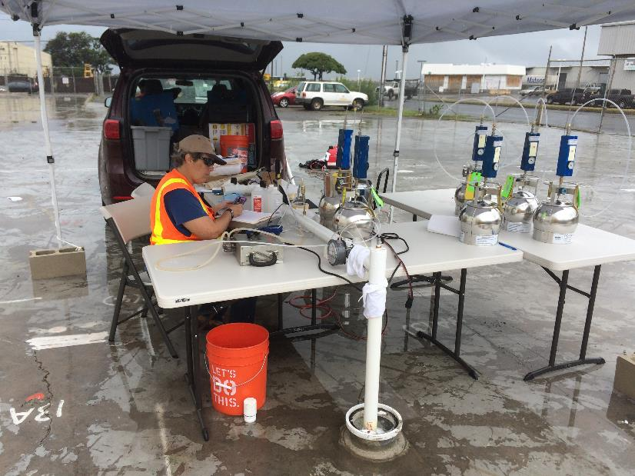
TOS Applied to Building Subslab Vapors (vapor intrusion)
Question: “Does the mean concentration of ‘X’ in DU volume of subslab vapor ‘Y’ exceed the screening level or risk ‘Z’ ”?
Default Home
Volume
= 244,000 liters
Default Vapor Entry Rate Volume (cold climates:
5 L/min)
= 7,200 L/day
Approx. To Scale
(refer to 2022 AVIP webinar)
Data Needs: What is the mean concentration of “X” in intruding vapors during the specified, exposure period?
Decision Unit: Volume of subslab vapors anticipated to intrude structure during the specified exposure period.
Collection of a Representative Sample:
Ideal: Send entire volume of intruding vapors to lab
Worst: Test small-volume (1L), instantaneous samples.
Risk-Based: Collect a single, continuous sample of vapors intruding a point in slab over specified time period.
Concentration for individual small volumes is irrelevant

Slide 22
Collection of “Large Volume Purge (LVP)”
Subslab Vapor Samples
Building in this Example Demolished
Flow Meters
Summa Canister Connected to Purge Stream
Shop Vac
Vacuum Gauge
Hypothetical Vapor Entry Point
Building
Slab
Similar to an SVE pilot test;
Continuous, 6L Summa sample collected from line during purge;
Five consecutive, 6,500L purges (five days of vapor entry);
Compressor and Guard Air Type device used for flammable VOCs.
Notes:
Guard Air type pump used for potentially explosive vapors

Slide 23
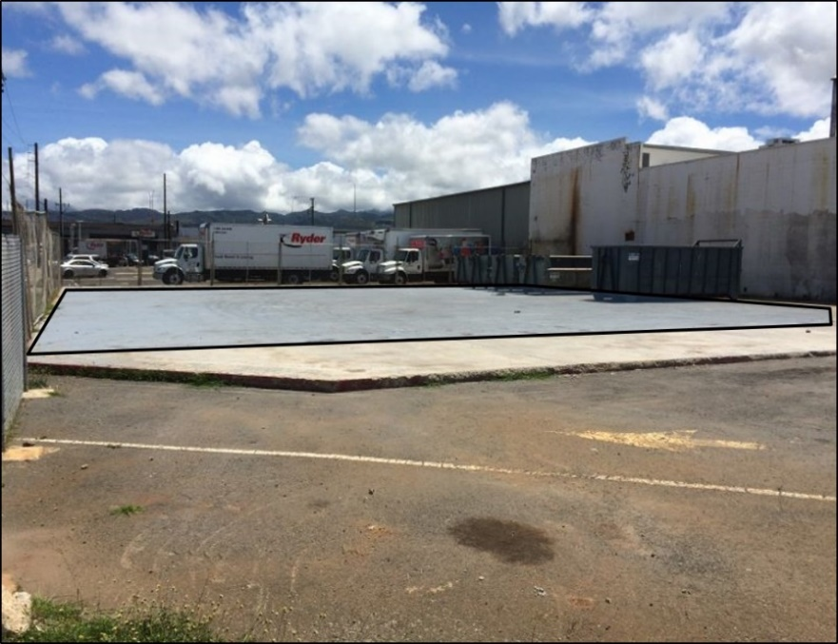
Collection of LVP Subslab Vapor Samples
(HDOH 2014 field study)
LVP PCE Results (6,500L purges):
Sample #1: 17,000 µg/m³
Sample #2: 36,000 µg/m³
Sample #3: 50,000 µg/m³
Sample #4: 51,000 µg/m³
Sample #5: 54,000 µg/m³
X
LVP Point
Early “discrete” subslab vapor samples suggested limited risk;
LVP collection point placed in center of slab or over suspected source area;
Commercial/Industrial subslab vapor screening level = 8,000 µg/m³;
Note increasing concentration with increasing purge volume;
Large volume purge samples capture distributional heterogeneity and isolated hot spots that could be easily missed by “discrete” samples (similar to increasing the number of increments for testing of soil).

Slide 24
LVP Soil Vapor Sampling References
McAlary, T.A., Nicholson, P.J., Yik, L.K., Bertrand, D.M. and G. Thrupp. 2010. High Purge Volume Sampling - A New Paradigm for Subslab Soil Gas Monitoring: Ground Water Monitoring and Remediation. 30 (2): pp 73–85.
HDOH, 2017. Field Study of High-Density Passive Sampler and Large-Volume Purge Methods to Characterize Subslab Vapor Plumes: Hazard Evaluation and Emergency Response, Hawaii Department of Health, July 2017.
HDOH, 2021, Technical Guidance Manual: Hawai‘i Department of Health, Office of Hazard Evaluation and Emergency Response (Section 7: Indoor and Soil Vapor). http://www.hawaiidoh.org/
Reports and Recorded Webinars: Hawaii DOH Webinar Webpage,
http://eha-web.doh.hawaii.gov/eha-cma/Leaders/HEER/Webinar

Slide 25
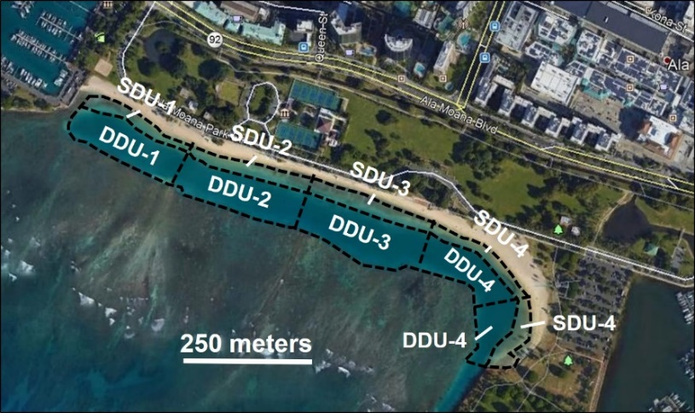
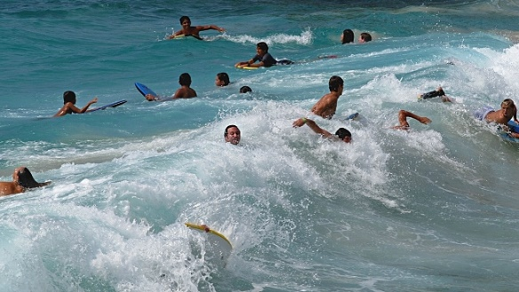
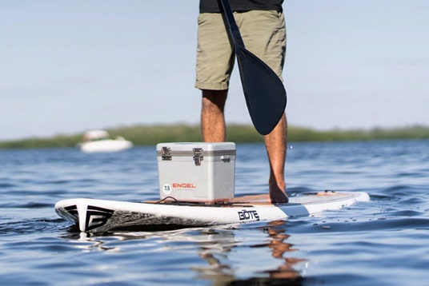
TOS Applied to Surface Water (mixed implementation)
Question: “Does the mean concentration of ‘X’ in DU volume of surface water ‘Y’ exceed the screening level or risk ‘Z’ ”?
Exposure to Bacteria in Beach Areas
Swimming Area DUs (depth 1m)
Data Needs: What is the mean concentration of bacteria “X” in the beach swimming areas?
Decision Unit: Volume of water within area typically used by an individual person.
Ideal: Send entire volume of water to lab.
Worst: Test small-volume (e.g., 1L) discrete samples.
Risk-Based: Collect a single MI sample from throughout the targeted Decision Unit.
Concentration for individual small volumes is irrelevant

Slide 26
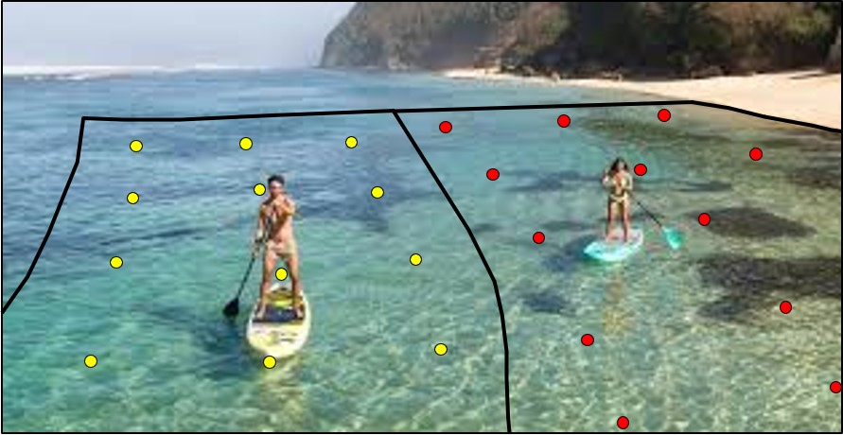
Collection of “Multi Increment”
Surface Water Samples
Aloha Sampler® (EnviroStat)
DU Depth
Designate Decision Unit areas and depth;
Determine appropriate volume of final bulk sample number of increments (e.g., field studies of replicate data precision);
Collect increments in systematic random fashion;
Push sampler down at each increment point at consistent speed;
Sample sent to laboratory for analysis.
HIDOH, 2021, Technical Guidance Manual: Hawai‘i Department of Health, Office of Hazard Evaluation and Emergency Response (Section 6: Surface Water and Groundwater). http://www.hawaiidoh.org/

Slide 27
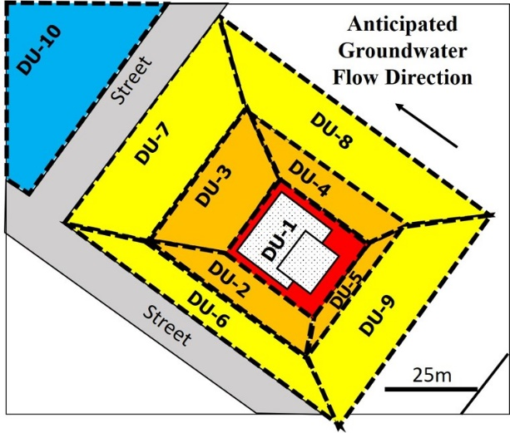
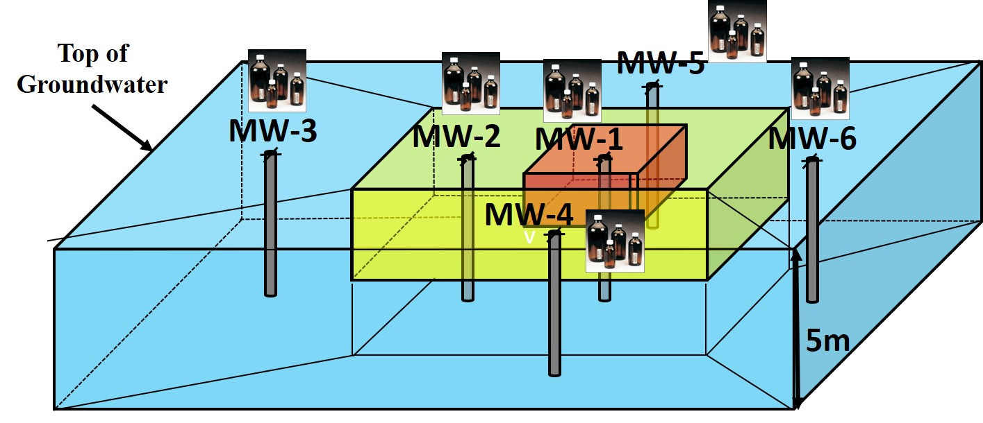
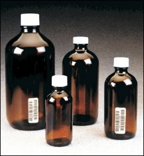
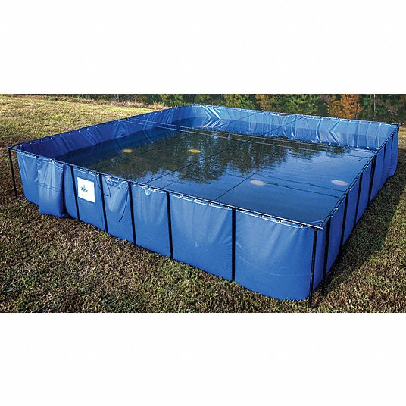
TOS Applied to Groundwater Investigations (challenging)
Question: “Does the mean concentration of ‘X’ in DU volume of groundwater ‘Y’ exceed the screening level or risk ‘Z’ ”?
Groundwater DUs
LVP or “Core Increment” (MI not feasible)
DU
Interval
See HIDOH TGM Section 6
Data Needs: What is the mean concentration of “X” in drinking water during the specified, exposure period?
Decision Unit: Volume of water child or adult will drink over target exposure period (e.g., 1,638 L over six years).
?
Ideal: Send entire volume of water to lab.
Worst: Test small-volume (e.g., 1L) discrete samples.
Risk-Based: MI sample not feasible. Collect LVP sample (discharge risk) or core-shaped sample (extent, VI, etc.).
LVP Sample
VOC loss, disposal, etc.
Notes:
LVP sample: Hypothetical production well and drinking water or irrigation water risk.
Core-shaped sample:

Slide 28
Making Progress But Still Struggling
ITRC “Incremental Sampling Methodology” (2020) Interstate Technology and Regulatory Council (USA)
Useful discussion of discrete sample unreliability;
Useful basic introduction to sampling theory;
Useful basic overview of field implementation of soil sample collection and processing methods;
Complete absence of review of mining industry research;
Misapplied discussions of finite element statistical concepts;
Erroneous implied requirement for the collection of replicate samples in all DUs and use of 95% UCL of mean for decision making;
Holdover from discrete sampling – “poison pill” for expanded use of TOS in environmental industry due to time and cost constraints.
HIDOH, 2020, Critique and Use of ITRC Incremental Sampling Methodology Guidance Document in Hawai´i: Hawaii Department of Health, November 23, 2020. Critique and recorded webinar posted to HIDOH DU-MIS webpage.https://health.hawaii.gov/heer/guidance/specific-topics/decision-unit-and-multi-increment-sampling-methods/
Notes:
Dean Crumbling (USEPA HQ).

Slide 29
Making Progress but Still Work to Do…
Questions, Ideas?
I know everything
high
Environmental
Industry
There’s more to this
than I thought…
Ahah…
Confidence
Commodities
Industry
I’m never going
to understand this
It’s starting to
make sense
low
Huh???
low
high
Knowledge in Field
“Things take longer to happen than you think they will, and then they happen much faster than you thought they could.”
Rudi Dornbusch
Notes:
denial, anger, bargaining, depression and acceptance

