Slide 1
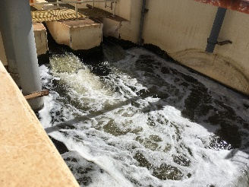
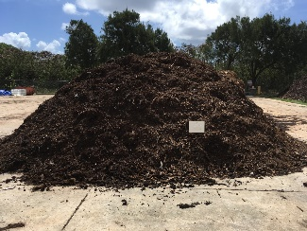

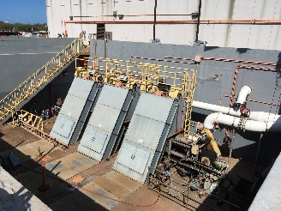
Field Study of Perfluoroalkyl Substances (PFASs)
In WWTP Influent, Effluent and Biosolids
- Preliminary Data from Hawaii -
Roger Brewer, Senior Environmental Scientist
Dr Diana Felton, State Toxicologist
Hawaii Department of Health
September 22, 2022
USEPA FSTRAC
Effluent
Crop Irrigation
Drinking Water
Aquatic Habitats
Biosolids
Direct Exposure
Leaching
Plant Update
Influent

Slide 2
References
PFASs: Interim Soil and Water Environmental Action Levels (EALs) for Perfluoroalkyl and Polyfluoroalkyl Substances (PFASs), April 2021 (and updates): https://health.hawaii.gov/heer/guidance/additional-guidance-documents/
EALs Technical Background: Evaluation of Environmental Hazards at Sites with Contaminated Soil and Groundwater (EALs; HIDOH 2017):
https://health.hawaii.gov/heer/guidance/ehe-and-eals/
Sample Collection, Processing and Testing: Technical Guidance Manual (HIDOH 2021): https://health.hawaii.gov/heer/guidance/specific-topics/decision-unit-and-multi-increment-sampling-methods/
Other: ITRC 2020: Per- and Polyfluoroalkyl Substances (PFAS)
HIDOH PFAS Webpage:
https://health.hawaii.gov/heer/environmental-health/highlighted-projects/per-and-polyfluoroalkyl-substances-pfass/
HIDOH Recorded Webinars:
https://health.hawaii.gov/heer/guidance/heer-webinars/

Slide 3
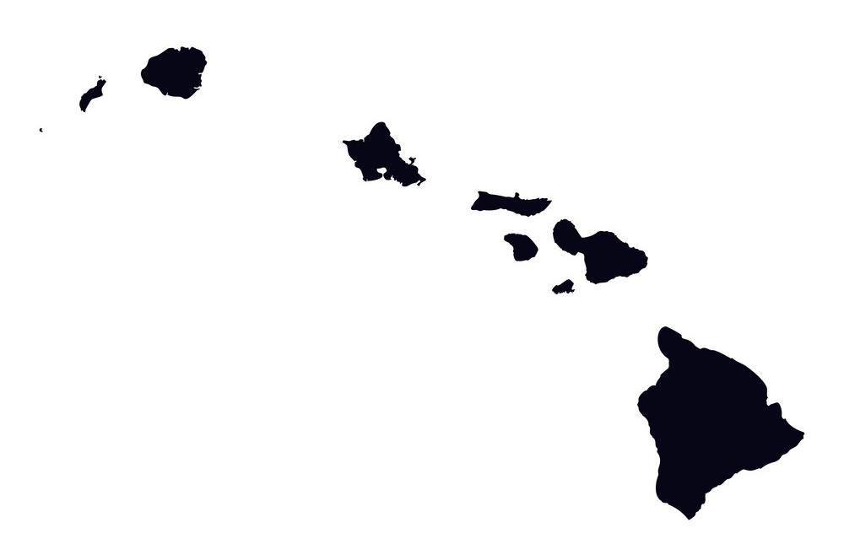
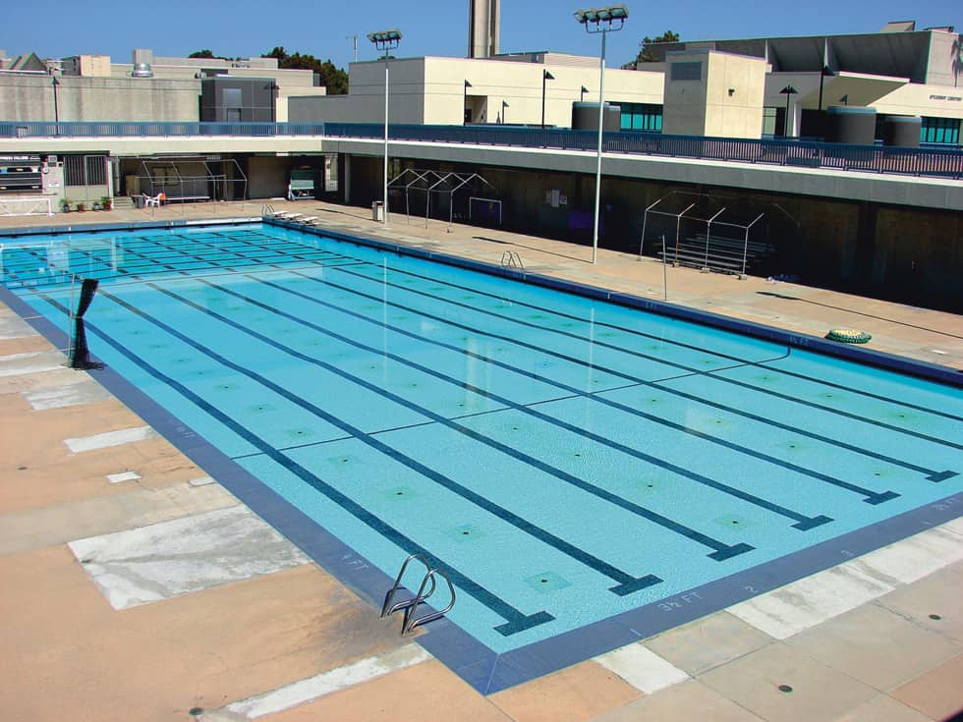
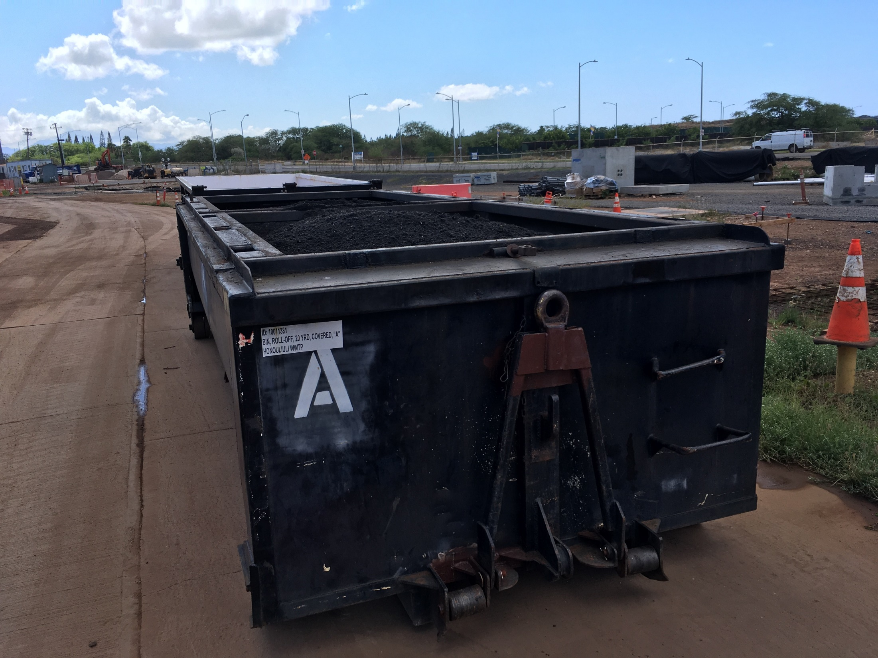
Wastewater Treatment Plant Study Sites
(samples collected from 3 of 8 WWTPs)
660,00 gal
20 tons
Pending: Five WWTPs on O’ahu
WWTP | ¹Influent Rate | ²Biosolids Generation | Notes
A | 1.2 MGD | 30 tons/week | Residential/Commercial Fixed Film Biotower
B | 3.7 MGD | 150 tons/week | Residential/Commercial Secondary treatment design?
C | 2.8 MGD | 40 tons/week | Residential/Commercial Activated Sludge
Landfill leachate not disposed of at noted WWTPs.
Wet weight (average 85% water, density 0.95 tons/cyd).

Slide 4
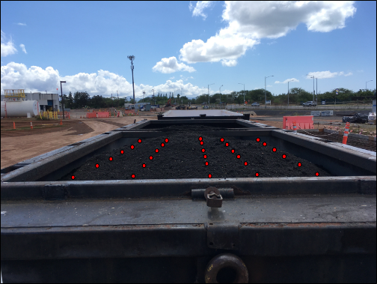
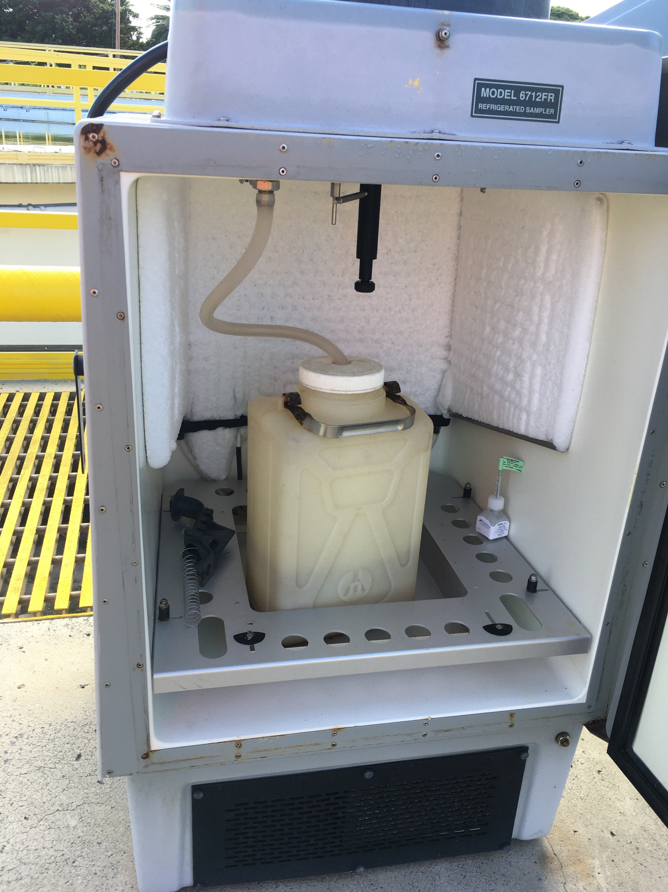
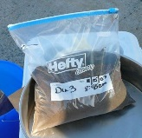
Study Objectives and Methods
(“A day in the life of a WWTP”)
Investigation Questions:
“What is the average makeup and concentration of PFAS in the influent, effluent and biosolids during a 24-hour period at the WWTP?”
“Are PFASs significantly leachable from the biosolids generated?”
Data Needs:
Mean concentration of PFASs in the volume of influent, effluent and biosolids generated over a 24-hour period;
Relative amount of PFAS sorbed to biosolids vs leached into solution.
Sample Collection Methods:
Water: 24-hour sampler;
Biosolids: Single, Multi Increment sample (30+ increment, 1-2 kg; air dried and MI subsampled; 5-10 gram subsample tested with added fee);
Laboratory: SGS AXYS Analytical Services.
24hr water sampler
Biosolids MI Sample

Slide 5
“Decision Unit” & “Multi Increment Sample” Investigation Guidance (DU-MIS)
HDOH, 2021, Technical Guidance Manual: Hawai‘i Department of Health, Office of Hazard Evaluation and Emergency Response, http://www.hawaiidoh.org/
Hawaii DOH DU-MIS Webpage:
https://health.hawaii.gov/heer/guidance/specific-topics/decision-unit-and-multi-increment-sampling-methods/
Six-Part DU-MIS Investigation Training Series;
Field study of discrete sample error;
DU-MIS case studies;
Recorded webinars; etc.

Slide 6
18 Targeted PFASs with Toxicity Factors
and Physiochemical Constants (HIDOH 2021)
¹Compound | CAS Number | ¹Abbreviation
Perfluoro butane sulfonate | 45187-15-3 | PFBS⁻
Perfluoro hexane sulfonate | 108427-53-8 | PFHxS⁻
Perfluoro heptane sulfonate | 146689-46-5 | PFHpS⁻
Perfluoro octane sulfonate | 45298-90-6 | PFOS⁻
Perfluoro decane sulfonate | 126105-34-8 | PFDS⁻
Perfluoro butanoate | 45048-62-2 | PFBA⁻
Perfluoro pentanoate | 45167-47-3 | PFPeA⁻
Perfluoro hexanoate | 92612-52-7 | PFHxA⁻
Perfluoro heptanoate | 120885-29-2 | PFHpA⁻
Perfluoro octanoate | 45285-51-6 | PFOA⁻
Perfluoro nonanoate | 72007-68-2 | PFNA⁻
Perfluoro decanoate | 73829-36-4 | PFDA⁻
Perfluoro undecanoate | 196859-54-8 | PFUnDA⁻
Perfluoro dodecanoate | 171978-95-3 | PFDoDA⁻
Perfluoro tridecanoate | 862374-87-6 | PFTrDA⁻
Perfluoro tetradecanoate | 365971-87-5 | PFTeDA⁻
Perfluoro octane sulfonate | 45298-90-6 | PFOSA⁻
2,3,3,3-tetrafluoro-2-(heptafluoropropoxy) propanoate | 122499-17-6 | HFPO-DA⁻
1. Anion form assumed found in the environment listed (affects predicted fate and transport).

Slide 7
Additional Detected PFASs without Toxicity
Factors and Physiochemical Constants
^{1,2}Compound | CAS Number | ¹Abbreviation
Perfluoro pentane sulfonate | 175905-36-9 | PFPeS⁻
6:2 Fluorotelomer sulfonate (ammonium salt) | 59587-39-2 | 6:2 FTS⁻
8:2 Fluorotelomer sulfonate (ammonium salt) | 149724-40-3 | 8:2 FTS⁻
N-Methyl-perfluoro octane sulfonamide | 31506-32-8 | N-MeFOSA⁻
2-(N-Methyl-perfluorooctane sulfonamido) acetate | 909405-48-7 | MeFOSAA⁻
N-ethyl perfluoro octane sulfonamido acetate | ? | EtFOSAA⁻
N-Methyl perfluoro octane sulfonamide ethanol | 24448-09-7 | N-MeFOSE⁻
N-Ethyl-N-(2-hydroxyethyl) perfluoro octane sulfonamide | 1691-99-2 | N-EtFOSE⁻
5:3 Fluorotelomer carboxylate | 1799325-94-2 | 5:3 FTCA⁻
7:3 Fluorotelomer carboxylate | ? | 7:3 FTCA⁻
1. FTS⁻ compounds: CAS for anionic ammonium salt form noted.
2. Check anion form name and CAS #s (incomplete).

Slide 8
HDOH Groundwater Action Levels (April 2021)
(parts per trillion)
Compound | ¹Drinking Water Toxicity (ng/L) | ²Chronic Aquatic Toxicity (ng/L)
PFBS⁻ | 600 | 130,000,000
PFHxS⁻ | 19 | 10,000
PFHpS⁻ | 20 | -
PFOS⁻ | 40 | 1,100
PFDS⁻ | 20 | -
PFBA⁻ | 7,600 | 830,000
PFPeA⁻ | 800 | -
PFHxA⁻ | 4,000 | 6,300,000
PFHpA⁻ | 40 | -
PFOA⁻ | 40 | 8,300
PFNA⁻ | 4.0 | 8,0000
PFDA⁻ | 4.0 | 10,000
PFUnDA⁻ | 10 | 10,000
PFDoDA⁻ | 13 | 20,000
PFTrDA⁻ | 13 | -
PFTeDA⁻ | 130 | -
PFOSA | 24 | -
HFPO-DA⁻ | 160 | -
1. Assumes: Body Weight=15kg, Relative Source Contribution=0.2; HQ=0.5.
2. Drinking water action level used if aquatic toxicity level not available.

Slide 9
HDOH Soil Action Levels (April 2021)
(parts per million)
Compound | ¹Direct Exposure (mg/kg) | ²Leaching to Drinking Water Aquifer (mg/kg)
PFBS⁻ | 0.38 | 0.003
PFHxS⁻ | 0.012 | 0.002
PFHpS⁻ | 0.013 | 0.004
PFOS⁻ | 0.025 | 0.007
PFDS⁻ | 0.013 | 0.013
PFBA⁻ | 4.8 | 0.099
PFPeA⁻ | 0.51 | 0.003
PFHxA⁻ | 2.5 | 0.013
PFHpA⁻ | 0.025 | 0.0003
PFOA⁻ | 0.025 | 0.001
PFNA⁻ | 0.003 | 0.0008
PFDA⁻ | 0.003 | 0.0005
PFUnDA⁻ | 0.006 | 0.005
PFDoDA⁻ | 0.008 | (use lab test)
PFTrDA⁻ | 0.008 | (use lab test)
PFTeDA⁻ | 0.084 | (use lab test)
PFOSA | 0.015 | 50
HFPO-DA⁻ | 0.10 | 0.0003
1. Noncancer hazard to young children (Body Weight=15kg, Relative Source Contribution=0.2; HQ=0.5).
2. Soil leaching action level calculated based on generic SESOIL model.

Slide 10
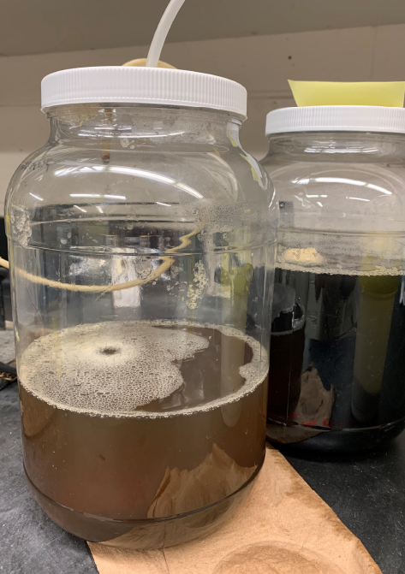
Biosolids Leaching Tests
(samples required filtering of obtain dissolved-phase data)
1. Synthetic Precipitation Leaching Procedure (SPLP)
2. Soil Column
Leaching Test (modified LEAF 1314)
(murky leachate required filtering)
Requires reliable MI sample data;
SPLP solution does not directly represent leachate (data not directly comparable to screening levels);
Used to estimate sample-specific sorption coefficient (Kd);
Input Kd into equilibrium partitioning model to estimate leachate conc.
Column modified to accommodate MI samples;
Water pumped upwards through media;
Default SOP simulates two-years of infiltrating irrigation water (approx. 120 cm/yr);
Leachate solution data directly comparable to water screening level;
Collect entire volume of leachate and test as a single sample (+/- “first flush” sample?; vs default SOP nine sequential tests).

Slide 11
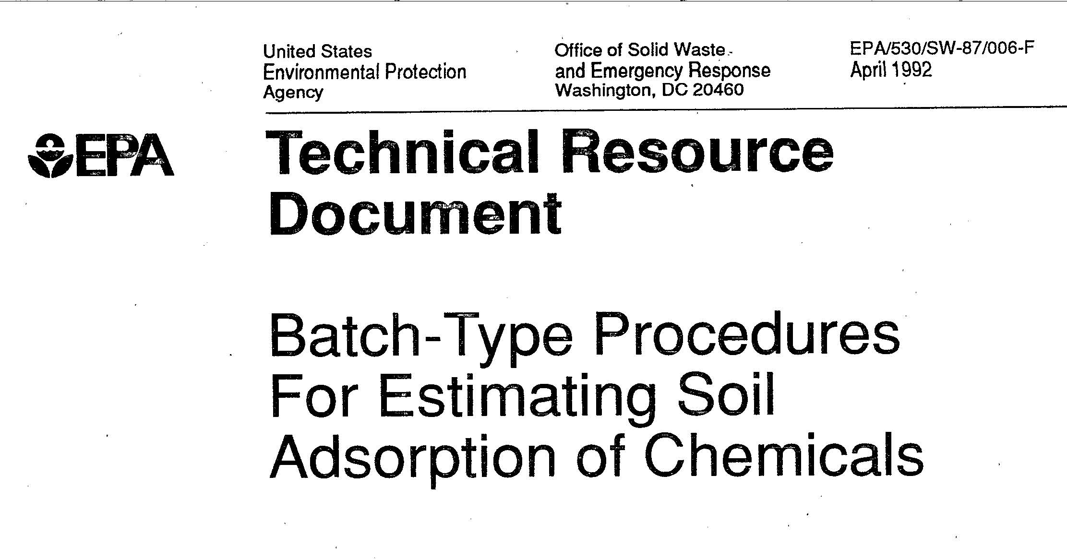
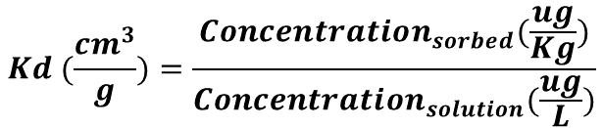
SPLP Calculation of Sorption Coefficients (Kd)
Predicted Mobility in Soil Leachate
BaP: 587
Dioxin: 250
*Default
Kd
Not
Significantly
Mobile
DDT, PCBs
20
Slight
Dieldrin
10
SPLP: Measured Sorption Coefficient (Kd)
Mod
Diesel
$$Kd (\frac{{cm}^{3}}{g})=\frac{{Concentration}_{sorbed}(\frac{ug}{Kg})}{{Concentration}_{solution}(\frac{ug}{L})}$$
1
High
MTBE, PCE,
Atrazine
(Retardation Factor approaches 100 as Kd approaches 20)
HDOH, 2017, Use of laboratory batch tests to evaluate potential leaching of contaminants from soil (and updates): Hawai‘i Department of Health, Office of Hazard Evaluation and Emergency Response. https://health.hawaii.gov/heer/guidance/ehe-and-eals/
Notes:
Retardation Factor = 1+ (Media Bulk Density/Water-Filled Porosity) x Kd (Fetter 1993, Contaminant Hydrogeology)

Slide 12
Preliminary Data
For Example Only
WWTP A
Other: MeFOSAA⁻, PFDS⁻, EtFOSAA⁻, PFDoA⁻, PFHxA⁻, PFDA⁻, PFTeDA⁻, PFTrDA⁻, PFUnA⁻, PFOSA⁻, PFOA⁻
Other: PFDA⁻, PFHxS⁻, PFBS⁻, PFHpA⁻,
MeFOSAA⁻
Effluent
Total PFAS: 32 ng/L
Total PFAS:
84 µg/kg
Biosolids
Leachate
(no leachate from landfills)
Influent
Red: Kd >20
(low mobility?)
Other: PFPeA⁻, 6:2 FTS⁻, PFHxS⁻, PFDA⁻, PFHpA⁻
Total PFAS: 40 ng/L
Other: PFBA⁻, PFOA⁻, PFBS⁻, PFDA⁻, MeFOSAA⁻, PFHpA⁻, PFNA⁻, PFTrDA⁻, PFDoA⁻

Slide 13
WWTP B
Preliminary Data
For Example Only
Other: PFBA⁻, PFBS⁻, PFHpA⁻, PFDA⁻, PFNA⁻, PFHxS⁻
Other: N-EtFOSE⁻, EtFOSAA⁻, PFDA⁻, PFDoA⁻, PFHxA⁻, PFDS⁻, 6:2 FTS⁻, PFTeDA⁻, PFUnA⁻, PFTrDA⁻, PFOA⁻, PFOSA⁻, PFBS⁻, N-MeFOSA⁻, PFNA⁻
Total PFAS: 36 ng/L
Effluent
Total PFAS: 182 µg/kg
Biosolids
FTCA MRL = 10 ng/L
Leachate
(no leachate from landfills)
Influent
Red: Kd >20
(low mobility?)
Other: 6:2 FTS⁻, PFPeA⁻, PFDA⁻, PFHpA⁻, PFDoA⁻, PFNA⁻, PFHxS⁻
Total PFAS: 66 ng/L
Other: PFBA⁻, PFOS⁻, PFPeA⁻, PFBS-, PFHpA⁻, PFDA⁻, MeFOSAA⁻, PFHxS⁻, PFNA⁻, EtFOSAA⁻, PFDoA⁻, PFOSA⁻

Slide 14
WWTP C
Preliminary Data
For Example Only
Other: PFOA⁻, PFPeA⁻, PFHxA⁻, MeFOSAA⁻, PFTeDA⁻, EtFOSAA⁻, PFBS⁻, PFUnA⁻, PFTrDA⁻, PFNA⁻, N-MeFOSA⁻, PFHpA⁻, PFOSA⁻
Other: PFHpA⁻, PFOS⁻, PFDA⁻, PFHxS⁻, PFNA⁻
Effluent
Total PFAS: 144 ng/L
Total PFAS: 122 µg/kg
Biosolids
FTCA MRL = 10 ng/L
Leachate
(no leachate from landfills)
Influent
Red: Kd >20
(low mobility?)
Other: PFOS⁻, PFHxS⁻, PFDA⁻, PFNA⁻
Total PFAS: 22 ng/L
Other: PFBS⁻, PFBA⁻, PFDA⁻, PFOS⁻, PFHpA⁻, PFNA⁻, MeFOSAA⁻, 6:2 FTS⁻, PFDoA⁻, PFHxS⁻, EtFOSAA⁻, PFUnA⁻

Slide 15
HIDOH Action Level Exceedances
(draft/preliminary)
WWTP | Water |  | Biosolids
 | ¹Drinking Water | ^{1,2}Aquatic Toxicity | ^{1,3}Direct Exposure | ^{1,4}Leaching to Groundwater
A | (none) | (none) | (none) | PFDA⁻ (N-MeFOSE⁻, 5:3 FTCA⁻, 7:3 FTCA⁻)
B | (none) | (none) | PFDA⁻ | PFBA⁻, PFOA⁻, PFDA⁻, PFOS⁻ (MeFOSAA⁻, EtFOSAA⁻, N-MeFOSE⁻, N-EtFOSE⁻, 5:3 FTCA⁻, 7:3 FTCA⁻)
C | (none) | (none) | PFDA⁻, PFDoDA⁻ | PFPeA⁻, PFHpA⁻, PFOA⁻, PFNA⁻, PFDA⁻, PFOS⁻ (5:3 FTCA⁻, 7:3 FTCA⁻)
Action levels for assumed end point PFAS applied to precursors (not adjusted with respect to molecular weight; ok for direct exposure but not for leaching?).
Data compared to chronic aquatic toxicity action level.
Cumulative Hazard Index likely to be <1 (ignoring other PFAS sources).
Assumes groundwater is a source of drinking water. SPLP batch leaching test run on sample if leaching based soil action level exceeded.

Slide 16
WWTP A: Biosolids Predicted vs Measured Kd and
Potential Leaching Risk (based on SPLP Batch Test Data)
Other Measured Kd:
5:3 FTCA = 31 cm³/g
7:3 FTCA = 157 cm³/g
KD=20
Preliminary Data
For Example Only

Slide 17
WWTP B: Biosolids Predicted vs Measured Kd and
Potential Leaching Risk (based on SPLP Batch Test Data)
Mod
Leaching
Risk
Reduced Leaching Risk
Minimal Leaching Risk
Other Measured Kd:
5:3 FTCA = 19 cm³/g
7:3 FTCA = 51 cm³/g
KD=20
Preliminary Data
For Example Only

Slide 18
WWTP C: Biosolids Predicted vs Measured Kd and
Potential Leaching Risk (based on SPLP Batch Test Data)
Mod
Leaching
Risk
Reduced Leaching Risk
Minimal Leaching Risk
Other Measured Kd:
5:3 FTCA = 21 cm³/g
7:3 FTCA = 67 cm³/g
KD=20
Preliminary Data
For Example Only

Slide 19
Summary (in progress)
Data for single day – longer-term studies needed;
Toxicity & physiochemical factors needed for precursor compounds (assume degradation to final PFAS form?);
PFAS makeup of influent variable between WWTPs;
Presence of 5:3 FTCA in influent not related to landfill leachate;
PFAS makeup of effluent reflects WWTP design?
PFAS drinking water action levels not exceeded in influent or effluent;
PFAS aquatic toxicity action levels not exceeded in influent or effluent;
PFAS makeup of biosolids similar;
PFASs in tested biosolids do not appear to pose a significant direct-exposure risk;
Most PFASs appear tightly bound to organic material and not significantly leachable? (Kd >20);
Shorter chain PFASs could be moderately leachable in some cases;
Contamination of groundwater from biosolids-amended fields due to PFASs in water content of biosolids (85% water)?
Further leaching studies planned using soil column tests.

Slide 20
Additonal Slides

Slide 21
High
Med
Low
Risk
Low Toxicity
High Mobility
Low Toxicity
Low Mobility
Migration into Water & Uptake into Plants
Stuck in Soil and Sediment
<1.0E-03
Increasing Toxicity
RfD (mg/kg-day)
<1.0E-05
High Toxicity
High Mobility
High Toxicity
Low Mobility
Koc (cm³/g)
Increasing Mobility

Slide 22
PFASs with Toxicity Factors
and Physiochemical Constants
Physiochemical Constants | USEPA, European Chemical Agency, ITRC, etc.
HH Toxicity Factors (main) | Compounds (18)
USEPA (2014, 2016, 2018) | PFBS, PFOS⁻, PFOA, HFPO-DA
Michigan (2019) | PFHxS⁻, PFNA
Minnesota (2018) | PFBA⁻
Texas (2016) | PFOSA⁻ (+RfCs for 8 PFASs)
Europe (RIVM 2018) | PFHpS, PFDS, PFPeA, PFHxA, PFHpA, PFDA, PFUnA, PFDoDA, PFTrDA, PFTeDA

Slide 23
Aquatic Toxicity (acute and chronic)
(limited action levels available)
*Reference | Compounds (9)
Giesey et al (2010) | PFBS⁻
Australia (2018) | PFOS⁻, PFOA⁻
European Chemical Agency (2018) | PFHxA⁻
UNDEP (2018) | PFHxS⁻ (assumed = PFOS⁻)
Various | PFNA⁻, PFDA⁻, PFUnDA⁻, PFDoDA⁻
*Washington State DOE compilation (2020)
Drinking water action level used as temporary surrogate for if aquatic toxicity if latter not available;
Laboratory bioassay tests recommended if exceeded;
Uptake and bioaccumulation in food chain not considered (yet).

