Slide 1
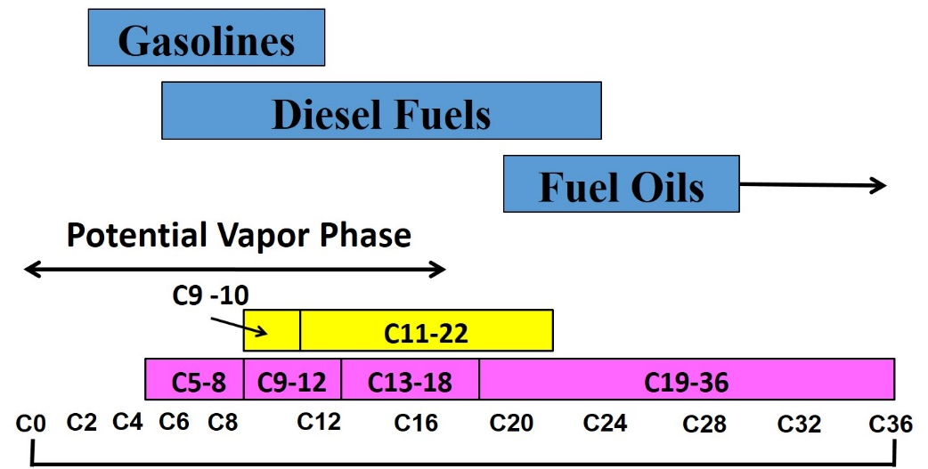



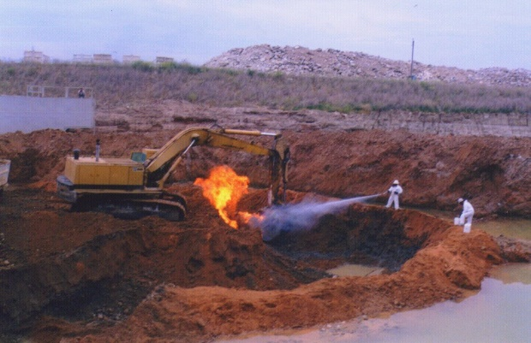

TPH and the Assessment of Petroleum Risk
Roger Brewer (Hawaii DOH, roger.brewer@doh.Hawaii.gov)
WRRC, University of Hawai′i
April 1, 2022

Slide 2
Terminology
  BTEX(MN): Benzene, Toluene, Ethylbenzene and Xylenes +/- naphthalene and methylnaphthalenes
  PAHs: Polyaromatic Hydrocarbons (e.g., naphthalene, benzo(a)pyrene;
  TPH: Total Petroleum Hydrocarbon – Remaining mixture of non-specific hydrocarbons and (for now) hydrocarbon-related degradation compounds;
  HOPs (new): Hydrocarbon Oxidation Products. Assumed to have the same toxicity as the parent hydrocarbons.
  Action Level: Concentration of a contaminant in a media at or below which no adverse health or other environmental affects are anticipated.
  Risk Driver: Compound(s) in a mixture that poses the greatest risk to human health and the environment (e.g., would still exceed an action level when action levels for all other compounds are met).

Slide 3
Petroleum Risk Misconceptions
1. TPH is only useful as a qualitative screening tool.
TPH and hydrocarbon-related degradation compounds often dominant contamination and must be quantitatively evaluated as part of an environmental hazard evaluation (risk assessment).
2. Methods are not available to quantitatively assess risk posed by TPH compounds.
  TPH risk can be quantitatively assessed in the same manner as individual chemicals like BTEX and PAHs (available since the 1990s).
3. TPH only needs to be considered if benzene and other individually targeted compounds are not detected.
  The TPH component of petroleum can still pose a risk when concentrations of BTEX and PAHs meet target risks or action/screening levels.
  4. Pre-approved TPH Environmental Action Levels are not necessary.
  Efficient assessment of 100s of thousands of release sites requires pre-approved action levels.

Slide 4
Hawai’i DOH TPH References
Risk-Based TPH Action/Screening Levels (similar to CalEPA ESLs):
HIDOH, 2017, Evaluation of Environmental Hazards at Sites with Contaminated Soil and Groundwater (Fall 2017): Hawai’i Department of Health, Office of Hazard Evaluation and Emergency Response.
TPH Risk Case Studies:
HIDOH, 2018, Collection and Use of Total Petroleum Hydrocarbon Data for the Risk-Based Evaluation of Petroleum Releases - Example Case Studies: Hawaii Department of Health, Hazard Evaluation and Emergency Response Office. August 2018.
Chemistry & Toxicity of Petroleum Vapors:
HIDOH, 2012, Field Investigation of the Chemistry and Toxicity of TPH in Petroleum Vapors: Implications for Potential Vapor Intrusion Hazards: Hawai‘i Department of Health, Office of Hazard Evaluation and Emergency Response
Brewer et al. 2014. Risk-Based Evaluation of Total Petroleum Hydrocarbons in Vapor Intrusion Studies: International Journal of Environmental Research and Public Health, Volume 10, pp 2441-2467.
Above Refs: https://health.hawaii.gov/heer/guidance/ehe-and-eals/
HDOH Recorded Webinars: https://health.hawaii.gov/heer/guidance/heer-webinars/

Slide 5
Other TPH References
TPHCWG, 1997. Analysis of Petroleum Hydrocarbons in Environmental Media: Total Petroleum Hydrocarbon Criteria Working Groun
MADEP, 1997. Characterizing Risks Posed by Petroleum Contaminated Sites: Implementation of the MADEP VPH/EPH Approach: Massachusetts Department of Environmental Protection,
MADEP, 2003, Updated Petroleum Hydrocarbon Fraction Toxicity Values for the VPH/EPH/EPH Methodology/
WADOE, 2006, Cleanup Levels and Risk Calculations Focus Sheets: Reference Doses for Petroleum Mixtures; Washington Department of Ecology.
USEPA, 2009. Provisional Peer-Reviewed Toxicity Values for Complex Mixtures of Aliphatic and Aromatic Hydrocarbons;
CAEPA, 2016, Petroleum Metabolites Literature Review and Assessment Framework: California Environmental Protection Agency, San Francisco Bay Regional Water Quality Control Board, June 27, 2016.
ITRC, 2018, TPH Risk Evaluation at Petroleum Contaminated Sites.

Slide 6
Outline
  Environmental Hazard Evaluation basics.
  What is petroleum made of?
  What is “TPH” and how are toxicity and risk evaluated?
  How do individual TPH components partition released to the environment?
  What drives risk – TPH (& HOPs) or BTEXN?
  How are TPH and HOPs tested for?
  Questions

Slide 7
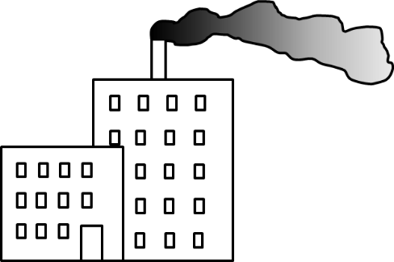


Potential Environmental Concerns Posed by Contaminated Soil and Groundwater
Commercial
Industrial
Prevailing Wind
Direction
1. Direct
Exposure
Residential
2. Ecotoxicity
3. Vapor
Intrusion
4. Leaching
Soil
Stream
Leaching
Stream
Free Product
6. Discharge to
aquatic habitats
7. Gross
Contamination
Dissolved plume
Groundwater
5. Drinking Water
Notes:
Also referred to as “Exposure Pathways.” Other potential problems include uptake of contaminants in plants or animals used for food.

Slide 8
Environmental Hazard Evaluation and
Environmental Action (Screening) Levels
(aka “risk assessment”)
Example Information Needs:
Toxicity Factors;
Physiochemical Constants;
Exposure Assumptions;
Soil and groundwater properties.
Separate Models and Approaches:
Direct exposure;
Vapor intrusion;
Leaching;
Gross contamination;
Ecotoxicity (site-specific).

Slide 9
Benzene Risk-Based Action Levels (residential setting, HDOH 2017)
0.36 µg/m³
INDOOR AIR
Vapor Intrusion 0.77 mg/kg
Gross Cont. 500 mg/kg
Human Health
Terrestrial
Habitats
(site specific)
Direct Exposure
1.2 mg/kg
SOIL
SOIL GAS
Leaching: 0.30 mg/kg
720 µg/m³
Aquatic Habitats
71 µg/L
GROUNDWATER
Vapor Intrusion
2,300 µg/L
Drinking Water
5 µg/L
Gross Cont.
170 µg/L
Human Health

Slide 10
Toxicity Factors and Risk-Based Action Levels
Chemical | ¹Chronic Toxicity Factor (maximum long-term safe dose) | ³Health Effect
Water | a few gallons/day (adult) | Acute Hyponatremia
Aspirin | 81 mg/day (“minitabs”) | Gastro-intestinal affects
²Barium | 3 mg/day (Two 1mm grains/day) | Multiple noncancer
²Arsenic | 0.0045 mg/day (One 1mm grain/two years) | Multiple noncancer
1. For example only. Average daily exposure over many years (“chronic”) that is predicted to not result in an adverse health effect. Varies with route of exposure, target cancer risk and noncancer hazard, child vs adult, etc. Exceedance warrants further evaluation.
2. Examples reflect daily exposure of children (BW 15kg) and noncancer hazard.
3. Must consider cumulative routes of exposure, other sources, similar contaminants, etc.
Toxicity
Silver Maximum Daily Dose = 75 µg/day
Child Water Consumption = 0.78 L/day
Drinking Water Action Level = 96 µg/L
Risk
Assessment
Notes:
Point: All chemicals potentially toxic at some dose.
Acute = Health effects instant to within three months.
Chronic = Long-term exposure (30 years).
Maximum Daily Dose without noncancer health effects via ingestion (varies wrt to route of exposure)
Potential unacceptable chronic health risk (noncancer) when maximum daily dose is exceeded (based on toxicity studies).
Cancer risks also estimated in a similar manner.
1mm diameter sphere weight (density = 1) =

Slide 11
“Dose makes the poison”
Risk = Toxicity x Dose
Dose = Concentration x Exposure
 |  | Toxicity
 |  | Low | High
Dose | Low | No Risk | Low Risk
 | Med | Low Risk | High Risk
 | High | High Risk | Acute Risk
A high dose of low-toxicity compound (e.g., barium) can pose a greater health risk than a low dose of a high-toxicity compound (e.g., arsenic)
Notes:
Exposure to a high concentration of an otherwise low-toxicity chemical can pose an equal or even greater health risk than exposure to a very low concentration of a highly toxic chemical.

Slide 12
HDOH 2017 Site Investigation and “Environmental Hazard Assessment” Webinar Series
Part 1: Systematic Planning and Site Investigation Design (TGM Section 3)
Part 2: Decision Unit Designation (TGM Section 3)
Part 3: Sampling Theory & DU Characterization (TGM Section 4)
Part 4: Field Implementation of DU-MIS Methods (TGM Sections 5 & 8)
Part 5: Laboratory Processing of MI Samples (TGM Section 4)
Part 6: Environmental Hazard Evaluation (TGM Section 13).
HEER Technical Guidance Manual Webinars:
https://health.hawaii.gov/heer/guidance/heer-webinars/

Slide 13
Outline
  Environmental Hazard Evaluation basics.
  What is petroleum made of?
  What is “TPH” and how are toxicity and risk evaluated?
  How do individual TPH components partition released to the environment?
  What drives risk – TPH (& HOPs) or BTEXN?
  How are TPH and HOPs tested for?
  Questions

Slide 14
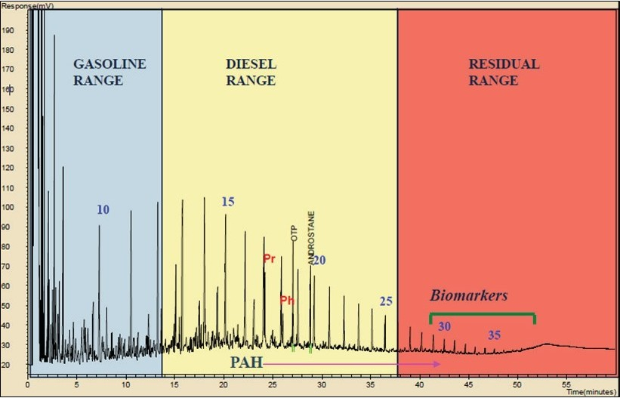
Laboratory Reporting of TPH
Labs run three different tests to estimate the total concentration of TPH in a sample (e.g., gas chromatography Method 8105M;
A single fuel can overlap several ranges (e.g., kerosenes, diesels)
The sum of the individual ranges represents the Total TPH for the tested sample (e.g., Total TPH = GRO + DRO + RRO);
Compare total the TPH action level specific to that fuel type;
Individually targeted compounds can be subtracted.
“Gasoline Range”
Compounds
(GRO/TPHg)
“Diesel Range”
Compounds
(DRO/TPHd)
“Residual Range”
Compounds
(RRO/TPHo)
C5-C12
C12-C24
C24-C40+
Response
BTEX
Heavy Oil, Tar
PAHs
ITRC 2018
Retention Time (boiling point, molecular weight, etc.)

Slide 15
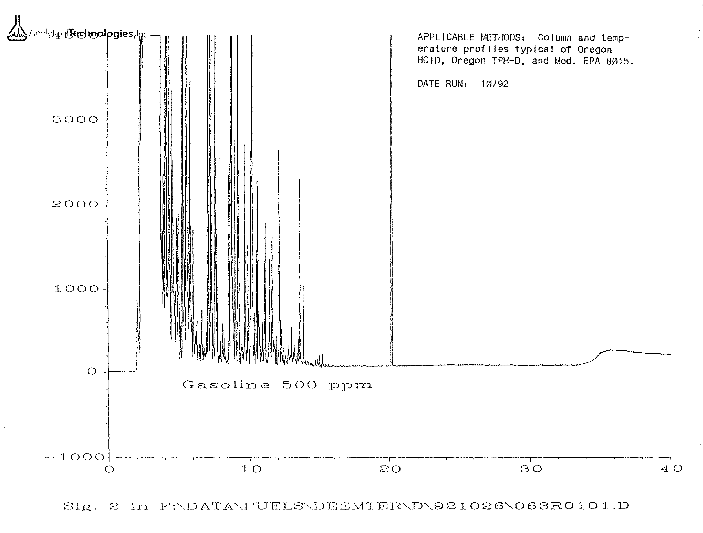
Gasoline Fuel Chromatogram
More Volatile
C12
C10
C8
C16
?
GRO
DRO
Varies
Fuel dominated by other 100s of other compounds collectively referred to as “Total Petroleum Hydrocarbon (TPH)”
Analytical Technologies, lnc.
Fuel Reference Library

Slide 16
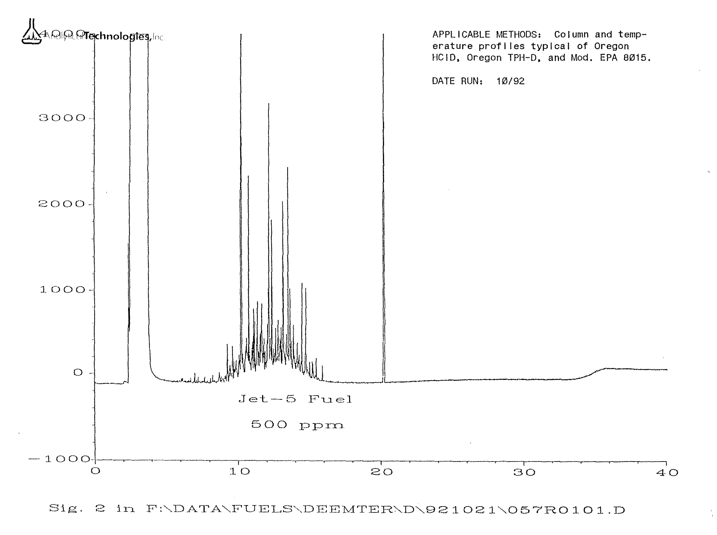
Kerosene Fuel (e.g., JP-5) Chromatogram
More Volatile
More Volatile
C12
C10
C8
C16
?
GRO
DRO
Varies
Lower BTEXMN in newer formulations
Analytical Technologies, lnc.
Fuel Reference Library

Slide 17
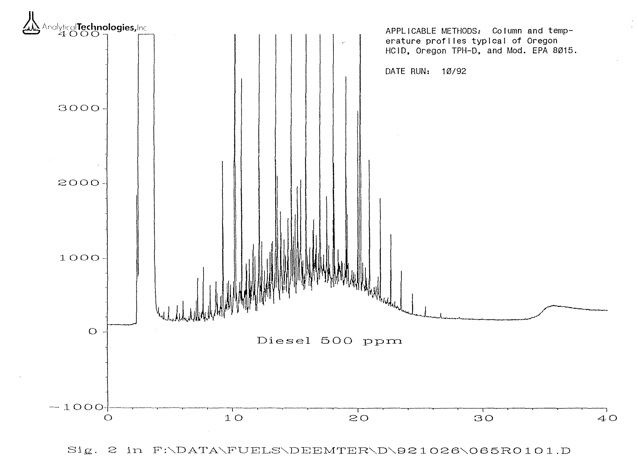
Diesel Fuel Chromatogram
More Volatile
More Volatile
C12
C10
C8
C16
?
GRO
DRO
Varies
Analytical Technologies, lnc.
Fuel Reference Library

Slide 18

Useful Moments of Enlightenment!
No BTEX = No Risk?
Former Gas Station (1990s)
Flammable Gasoline Vapors In Soil
After Passing a BTEX-PAH Risk Assessment
Non BTEX-PAH “TPH” related gasoline vapors also likely posed vapor intrusion toxicity risks to indoor air for future buildings.

Slide 19
Outline
  Environmental Hazard Evaluation basics.
  What is petroleum made of?
  What is “TPH” and how are toxicity and risk evaluated?
  How do individual TPH components partition released to the environment?
  What drives risk – TPH (& HOPs) or BTEXN?
  How are TPH and HOPs tested for?
  Questions

Slide 20
Toxicity of Total Petroleum Hydrocarbons
TPH Working Group (mid/late 1990s)
Additional TPH Toxicity Reviews
Massachusetts DEP (1997+)
ATSDR (1999)
Washington DOE (2006)
California EPA (DTSC 2009)
USEPA (2009)

Slide 21
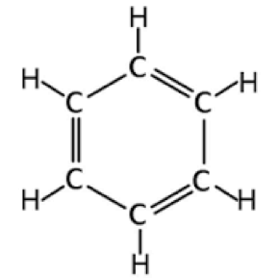
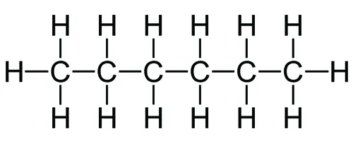
Risk-Based TPH Aliphatic and Aromatic “Carbon Ranges”
Gasolines
hexane
Middle Distillates
benzene
Fuel Oils
Potential Vapor Phase
Aromatics
>EC8 -10
Aliphatics
>EC10-22
EC5-8
>EC8-12
>EC12-18
>C18-36
C0
C2
C4
C6
C8
C12
C16
C20
C24
C28
C32
C36
EC = Effective Carbon. Related to the boiling point & MW (TPHCWB 1997)
TPH = Sum of Aromatics + Aliphatics (excluding BTEX & PAHs)
Notes:
Benzene (6): EC 6.5
Toluene (7): EC 7.6
Ethylbenzene (8): EC 8.5
Xylenes (8): EC 8.6
Naphthalene (10): EC 11.7
2-Methylnaphthalene (11): EC12.84
1-Methylnaphthalene (11): EC 12.99

Slide 22
Carbon Range Physiochemical Constants
Equivalent Carbon Range Group | MW | VP (atms) | Solubility (µg/L) | H’ | k_{oc} (cm³/g) | Diffusion Coefficient (cm²/s)
 |  |  |  |  |  | air | water
EC5-8 Aliphatics | 93 | 0.1 | 11,000 | 54 | 2,265 | 0.08 | 1 x 10⁻⁵
>EC8-12 Aliphatics | 149 | 8.7 x 10⁻⁴ | 70 | 65 | 150,000 | 0.07 | 1 x 10⁻⁵
>EC12-18 Aliphatics | 170 | 1.4 x 10⁻⁴ | 10 | 69 | 680,000 | 0.07 | 5.0 x 10⁻⁶
>EC18-36 Aliphatics | 280 | 1.1 x 10⁻⁶ | 0.0000015 | 110 | 4.0 x 10⁻⁸ | - | -
>EC8-C10 Aromatics | 120 | 2.9 x 10⁻³ | 51,000 | 0.33 | 1,778 | 0.07 | 1 x 10⁻⁵
>EC10-22 Aromatics | 150 | 3.2 x 10⁻⁵ | 5,800 | 0.03 | 5,000 | 0.06 | 1 x 10⁻⁵
HIDOH 2017; after MADEP 2002

Slide 23
Carbon Range *Toxicity Factors
(HDOH 2017; after MADEP 2002, USEPA 2009)
Chemical/ Carbon Range | Oral RfD (mg/kg-day) | Inhalation RfC (µg/m³)
EC5-EC8 Aliphatics | 0.04 | 600
>EC8-EC18 Aliphatics | 0.01 | 100
>EC18-EC36 Aliphatics | 3.0 | na
>EC8 Aromatics | 0.03 | 100
*Dermal absorption toxicity factors calculated separately.

Slide 24
Partitioning of Petroleum in the Environment
Conc. Gas
Conc. Water
Chemical/ Carbon Range | Solubility | *Henry’s Constant
EC5-8 Aliphatics | 11,000 | 54
>EC8-12 Aliphatics | 70 | 65
>EC12-18 Aliphatics | 10 | 69
>EC18-36 Aliphatics | 0.0000015 | 110
>EC8-C10 Aromatics | 51,000 | 0.33
>EC10-22 Aromatics | 5,800 | 0.03
Benzene | 1,780 | 0.23
Toluene | 526 | 0.27
Ethylbenzene | 169 | 0.32
Xylenes | 178 | 0.29
Naphthalene | 31 | 0.018
Aliphatics Prefer to be in the Vapors
Aromatics Prefer to be in the Water
*Theoretical ratio of vapor-phase mass to dissolved-phase mass at equilibrium. Vapor-phase dominates if H’ >1.0.

Slide 25
TPH Carbon Range Composition vs Exposure Pathway
(carbon range makeup can vary with specific fuel formulation)
BTEXN
(new)
(old)
GASOLINE
Kerosene
DIESEL
TPH
Air
(mostly aliphatics)
TPH
TPH
TPH
Soil
(fuel - depleted
over time)
?
TPH
TPH
TPH
Water
(mostly aromatics)
TPH
TPH
TPH
?
?
?
BTEXN
TPH or
BTEXN
TPH or
BTEXN

Slide 26
C5-C8
Aliphatics
Carbon Range Makeup of TPH in Fuel, Vapors & Water
(For example only; -DOH EALs to be updated in 2022)
>C8-C18 Aliphatics
GASOLINE
Kerosene
DIESEL
JP-8
>C8
Aromatics
Vapors
(measured)
JP-5
No C5-C8
Aliphatics?
Fuel
(published/
measured)
(CAEPA LUFT 2015)
(DoD 1990s Fuel Spec)
(CAEPA LUFT 2015)
Dissolved
(measured?)
?
?
?

Slide 27
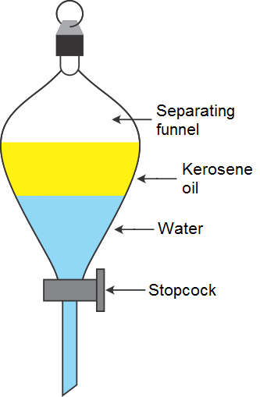
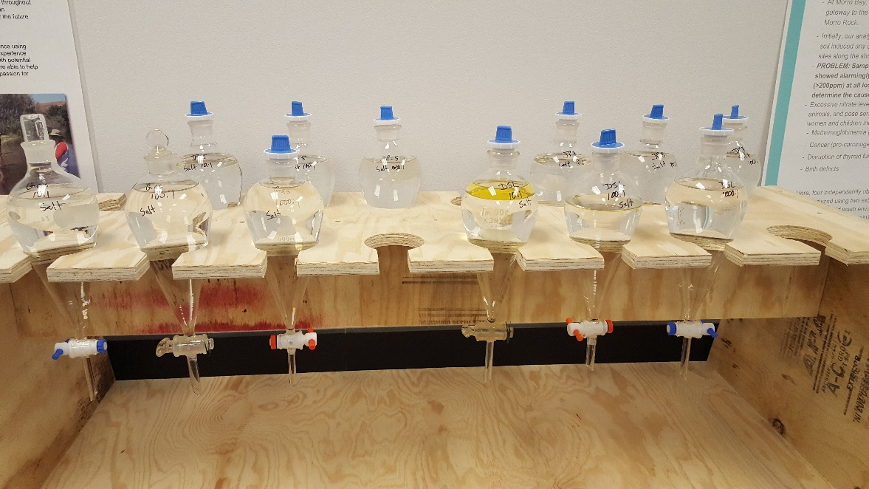
HIDOH Dissolved-Phased Petroleum Study
(2019-2021)
Layer of fresh fuel placed on water (gasoline, diesel, JP-5, JP-8)
Allowed to equilibrate for 20 days;
Water tested for BTEX, PAH and carbon range makeup of dissolved-phase hydrocarbons;
Weighted toxicity factors calculated for mixture;
To be used to develop toxicity-based action levels (e.g., drinking water);
Labs could not reliable separate aliphatic vs aromatic carbon ranges.
Air
Fuel
Water

Slide 28
C5-C8
Aliphatics
Carbon Range Makeup of TPH in Fuel, Vapors & Water
(For example only; -DOH EALs to be updated in 2022)
>C8-C18 Aliphatics
GASOLINE
Kerosene
DIESEL
Varies Between
Sites
JP-8
>C8
Aromatics
Vapors
(measured)
JP-5
?
Aliphatics in vapors?
Fuel
(published)
(CAEPA LUFT 2015)
(DoD 1990s Fuel Spec)
(CAEPA LUFT 2015)
Dissolved
(modeled)
?
Varies with fuel
?
?

Slide 29
Carbon Range Based Action Levels? Possible but not practical… (cost-benefit, lab limitations, degraded mixtures, etc.)
___ µg/m³
INDOOR AIR
Vapor Intrusion ___ mg/kg
Gross Cont. ___ mg/kg
Human Health
Terrestrial
Habitats
(site specific)
Direct Exposure
___ mg/kg
SOIL
SOIL GAS
Leaching: ___ mg/kg
___mg/m³
Aquatic Habitats
___ µg/L
GROUNDWATER
Vapor Intrusion ___mg/L
Drinking Water
___ µg/L
Gross Cont.
___ µg/L
Human Health

Slide 30

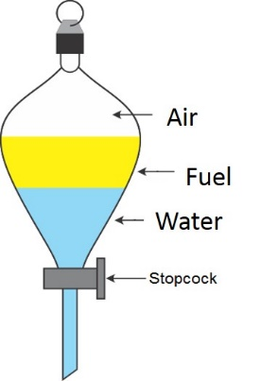

Weighted Toxicity of Cookies and TPH Mixtures
(Defined Range of Possible Weighted Calories or Toxicity Factors)
Ingredients
Ingredients
Total Calories (weighted toxicity) Calculated Based on Recipe and calories per mass for individual ingredients;
Possible Caloric Range:
Highest = Pure chocolate (most toxic)
Lowest = Pure flour (least toxic)
Benzene
Toluene
Ethylbenzene
Xylenes
Naphthalene
EC5-8 Aliphatics
>EC8 -18 Aliphatics
>EC18 Aliphatics
>EC8 Aromatics
v
v
v
v
Weighted Toxicity $=\frac{1}{\begin{aligned}[ \frac{\left(\% Fraction A\right)}{Fraction A Toxicity Factor}+\frac{\left(\% Fraction B\right)}{Fraction B Toxicity Factor}+etc.]\end{aligned}}$
(Harmonic Mean)

Slide 31
References – Calculation of Weighted Toxicity Factors
General Approach (fuel, air, water):
HIDOH, 2017, Evaluation of Environmental Hazards at Sites with Contaminated Soil and Groundwater (Fall 2017): Hawai’i Department of Health, Office of Hazard Evaluation and Emergency Response.
Updated Tapwater Approach (interim draft):
HIDOH, 2022, Recommended Risk-Based Drinking Water Action Levels for Total Petroleum Hydrocarbons (TPH) Associated with Releases of JP-5 Jet Fuel: internal Technical Memorandum to Kathy Ho from Roger Brewer, Hawai’i Department of Health, Office of Hazard Evaluation and Emergency Response, February 12, 2022.

Slide 32
Calculation of Weighted TPH Toxicity Factors Based on Carbon Range Makeup (DRAFT examples only; to be updated in 2022)
C5-C8
Aliphatics
>C8-C18 Aliphatics
GASOLINE
Kerosene
DIESEL
Varies Between
Sites
JP-8
>C8
Aromatics
RfC = 281 µg/m³
RfC = 225 µg/m³
RfC = 126 µg/m³
Vapors
(measured)
JP-5
?
+ Dremal RfDs
Fuel
(published)
RfDo = 0.025 mg/kg-day
RfDo = 0.012 mg/kg-day
RfDo = 0.012 mg/kg-day
Dissolved
(modeled)
?
Varies with fuel
?
?
RfDo = 0.035
RfDd = 0.072
RfC = 195
RfDo = 0.030
RfDd = 0.034
RfC = 111
RfDo = 0.029
RfDd = 0.030
RfC = 100

Slide 33
Example TPHmd Action Levels (HIDOH 2017, *DW action levels under revision)
130 µg/m³
INDOOR AIR
Vapor Intrusion (use soil gas)
Gross Cont. 500 mg/kg
Human Health
Terrestrial
Habitats
(site specific)
Direct Exposure
220 mg/kg
SOIL
SOIL GAS
Leaching: 940 mg/kg
260,000 mg/m³
Aquatic Habitats
640 µg/L
GROUNDWATER
Vapor Intrusion (use soil gas)
*Drinking Water
400 µg/L
Gross Cont.
500? µg/L
Human Health

Slide 34
Outline
  Environmental Hazard Evaluation basics.
  What is petroleum made of?
  What is “TPH” and how are toxicity and risk evaluated?
  How do individual TPH components partition released to the environment?
  What drives risk – TPH (& HOPs) or BTEXN?
  How are TPH and HOPs tested for?
  Questions

Slide 35
*Carbon Range-Weighted TPH Action Levels for Soil
(HIDOH 2017)
Fuel Type | ¹Soil Action Level (mg/kg)
Benzene | 0.30
TPH (gasoline fuels) | 100
TPH (diesel fuels) | 220
TPH (residual fuels) | 500
TPH Action Level Exceeded When Benzene
<0.30 mg/kg?
¹TPH action levels based on noncancer Hazard Quotient of 1.0. Benzene action level based on 10⁻⁶ cancer risk.

Slide 36
TPH vs BTEXN as Fuel Risk Driver
(exposure to fuel in soil)
Data Source | Site/Fuel Type | TPH Drives Risk | *BTEXN Drives Risk
Field Studies | Gasoline | (X) | X?
 | Kerosene | X | -
 | Diesel | X | -
“X” Drives risk if 10⁻⁶ cancer risk applied to benzene (0.36 µg/m³).
“(X)” Drives risk if 10⁻⁵ cancer risk applied to benzene (3.6 µg/m³).
Point: TPH almost ways drives risk for middle distillate releases and can for gasoline releases if a 10⁻⁵ cancer risk is used to screen benzene.

Slide 37
“Dose makes the poison”
Risk = Toxicity x Dose
Dose = Concentration x Exposure
 |  | Toxicity
 |  | Low | High
Dose | Low | No Risk | Low Risk
 | Med | Low Risk | High Risk
 | High | High Risk | Acute Risk
BTEX-PAHs
TPH
TPH as the “risk driver”
Notes:
Exposure to a high concentration of an otherwise low-toxicity chemical can pose an equal or even greater health risk than exposure to a very low concentration of a highly toxic chemical.

Slide 38
*Carbon Range-Weighted TPH Action Levels for Air
(HIDOH 2017; Brewer et al 2014)
Fuel Type | ¹Air Action Level (µg/m³)
Benzene | 0.36
TPH (gasoline fuels) | 290
TPH (kerosene fuels) | 230
TPH (diesel fuels) | 130
TPH Action Level Exceeded When Benzene
<0.36 µg/m³?
¹TPH action levels based on noncancer Hazard Quotient of 1.0. Benzene action level based on 10⁻⁶ cancer risk.
*Carbon range makeup varies between fuels and between sites. Site-specific data recommended for calculation of weighted toxicity factors and action levels.

Slide 39
TPH vs Benzene as Indoor Air Risk Driver
(based on field data in Brewer et al. 2014)
Data Source | Site/Fuel Type | TPH Drives Risk | *BTEXN Drives Risk
Vapors From Fresh Fuel | Gasoline | (X) | X
 | Diesel (varies) | (X) | X?
 | JP-8 (varies) | (X) | X?
Field Studies Aged Releases | USEPA Gasoline Vapor Database | (X) | X?
 | Site C (JP-8) | X (X)
 | Site E (diesel) | X (X)
“X” Drives risk if 10⁻⁶ cancer risk applied to benzene (0.36 µg/m³).
“(X)” Drives risk if 10⁻⁵ cancer risk applied to benzene (3.6 µg/m³).
Point: TPH almost ways drives risk for middle distillate releases and can for gasoline releases if a 10⁻⁵ cancer risk is used to screen benzene.

Slide 40
¹Example Carbon Range-Weighted TPH Action Levels
for Tapwater: Fresh (volatile) Plumes
Fuel Type | ¹Tapwater Action Level (µg/L)
²Benzene | 5.0
³TPH (gasoline fuels) | 339
⁴TPH (kerosene fuels) | 211
³TPH (diesel fuels) | 189
TPH Action Level Exceeded When Benzene
<5.0 µg/L?
¹TPH action levels based on noncancer Hazard Quotient of 1.0. Benzene action level based on 10⁻⁶ cancer risk.
1. For example only (pending review and finalization).
2. USEPA-HIDOH drinking water MCL (10⁻⁵ cancer risk).
3. DRAFT-Based on carbon range makeup presented in CAEPA LUFT Manual (2015).
4. DRAFT-Based on carbon range makeup for JP-5 implied in 1990s Military Spec (HIDOH 2022; likely overestimates BTEXN in current fuels).

Slide 41
TPH vs BTEXN as Tapwater Risk Driver
Data Source | Site/Fuel Type | TPH Drives Risk | *BTEXN Drives Risk
*Fresh (volatile) Plumes | Gasoline |  | X
 | Kerosene | X? | X?
 | Diesel | X? | X?
*Hydrocarbons in most plumes of contaminated water are at least partially degraded by the time testing takes place.
Point: TPH almost ways drives risk for middle distillate releases and can for gasoline releases if a 10⁻⁵ cancer risk is used to screen benzene.

Slide 42
Weighted Toxicity of HOPs Mixtures in Water
(mixture of degraded TPH & BTEXN)
BTEXN
(new)
(old)
GASOLINE
JP-5
DIESEL
TPH
Air
(mostly aliphatics)
TPH
TPH
TPH
Soil
(fuel depleted
over time)
?
TPH
TPH
TPH
Water
(mostly aromatics)
TPH
TPH
TPH
?
?
?
BTEXN
TPH or
BTEXN
TPH or
BTEXN

Slide 43
Chemistry and Toxicity of
Degraded of Petroleum in Water (HIDOH 2018)
Hydrocarbon Oxidation Products
(new term)
BTEXN
HOPs
Reported as “TPH” in absence of silica gel cleanup
TPH
Polar acids/esters, alcohols, ketones, phenols
Better Test Methods Needed
“It is the mark of an instructed mind to rest easy with the level of precision that the decision requires, and not to try an exactness that is unnecessary for the problem.”
Aristotle (paraphrased)

Slide 44
¹Example Carbon Range +BTEXN Weighted HOPs Action Levels for Tapwater – Degraded (non-volatile) Plumes
Fuel Type | ¹Tapwater Action Level (µg/L)
²Benzene | 5.0
³TPH (gasoline fuels) | 190
⁴TPH (kerosene fuels) | 447
³TPH (diesel fuels) | 232
Includes degraded benzene
Includes degraded xylenes
¹TPH action levels based on noncancer Hazard Quotient of 1.0. Benzene action level based on 10⁻⁶ cancer risk.
1. For example only (pending review and finalization).
2. USEPA-HIDOH drinking water MCL (10⁻⁵ cancer risk).
3. DRAFT-Based on CR + BTEXN makeup presented in CAEPA LUFT Manual (2015).
4. DRAFT-Based on CR + BTEXN makeup for JP-5 implied in 1990s Military Spec (HIDOH 2022; likely overestimates proportion of lower-toxicity xylenes in current fuels and underestimates weighted toxicity of degraded mixture).

Slide 45
TPH vs BTEXN as Tapwater Risk Driver
Data Source | Site/Fuel Type | TPH/HOPs Drives Risk | *BTEXN Drives Risk
Fresh (volatile) Plumes | Gasoline |  | X
 | Kerosene | X? | X?
 | Diesel | X? | X?
*Degraded (non-volatile) Plumes | Gasoline | X
 | Kerosene | X
 | Diesel | X
*Hydrocarbons in most plumes of contaminated water are at least partially degraded by the time testing takes place.
Point: TPH and/or HOPs almost always risk for middle distillate releases and can for gasoline releases if a 10⁻⁵ cancer risk is applied to benzene.

Slide 46
Outline
  Environmental Hazard Evaluation basics.
  What is petroleum made of?
  What is “TPH” and how are toxicity and risk evaluated?
  How do individual TPH components partition released to the environment?
  What drives risk – TPH (& HOPs) or BTEXN?
  How are TPH and HOPs tested for?
  Questions

Slide 47
Laboratory Measurement of “TPH” and “HOPs”
TPH Action Levels apply to the total concentration of TPH-related compounds in the mixture (e.g., gasolines, middle distillates, residual fuels, etc.)
Lab would ideally identify the fuel type and report a single concentration for both TPH and HOPs combined (initial screening);
Site-specific carbon range data and action levels can be useful for vapor intrusion investigations (e.g., TPH as sum of C5-12);
Better test methods are needed for both total TPH and total HOPs.
Total TPH for Sample =
“Gasoline Range” + “Diesel Range” + “Residual Range”
C5-C12
C12-C24
C24-C40+
ITRC 2018

Slide 48
Summary
No BTEX-PAHs does not mean No Risk.
Methods are available to assess risk posed by TPH compounds.
TPH always needs to be considered even if benzene and other individually targeted compounds are detected.
TPH-related compounds often drive risk at petroleum-release sites (i.e., TPH compounds can still pose a risk even if concentrations of BTEX and PAHs meet action levels.
Better test methods are needed for both TPH and HOPs.
Carbon range data and site-specific action levels are primarily useful for testing of parent fuel associated with large, fresh releases and testing of indoor air and/or soil gas associated with middle distillate fuels.
Site-specific action levels are allowed but will fall within a narrow range of possibilities.

Slide 49
Questions, Comments, Ideas???
Risk
Assessment
Decision
Making
Sample
Collection
Laboratory
Analysis
“There are... problems yet to be identified because they only show up after we've learned... to even ask such questions. That's what excites me about the entire, moving frontier of science."
Neil deGrasse Tyson

Slide 50
Example Analyses for Site-Specific Studies
Compound | Fuel/Soil (F&T) | Water (Toxicity) | Vapors (Toxicity)
Benzene | X | X | X
Toluene | X | X | X
Ethylbenzene | X | X | X
Xylenes (total) | X | X | X
Naphthalene | X | X | X
C5-C6 Aliphatics | X | X | X
>C6-C8 Aliphatics | X
>C8-C10 Aliphatics | X | X | X
>C10-C12 Aliphatics | X
>C12-C16 Aliphatics | X
>C16-C18 Aliphatics | X
>C18-C32 Aliphatics | X | X
>C8-C10 Aromatics | X | X | X
>C10-C12 Aromatics | X
>C12-C16 Aromatics | X
>C16-C21 Aromatics | X
>C21-C32 Aromatics | X
Other targeted compounds, additives, degradation products, etc.
Notes:
More detailed summary of carbon ranges needed for site-specific testing of fuels and soils in order to predict fate and transport. Testing of water and vapors based primarily on toxicity groupings.

Slide 51
Petroleum HOPs Toxicity References
1. Zemo et al., 2016, Life Cycle of Petroleum Biodegradation Metabolite Plumes, and Implications for Risk Management at Fuel Release Sites. Integrated Environmental Assessment and Management. DOI: 10.1002/ieam.1848 (based on field studies of fuel degradation in groundwater)
2. HIDOH, 2018, Collection and Use of Total Petroleum Hydrocarbon Data for the Risk-Based Evaluation of Petroleum Releases - Example Case Studies: Hawaii Department of Health, Hazard Evaluation and Emergency Response Office. August 2018. (see Attachment 5: Example Calculation of Metabolite Suite-Weighted, Risk-Based Screening Levels for Tapwater).

Slide 52
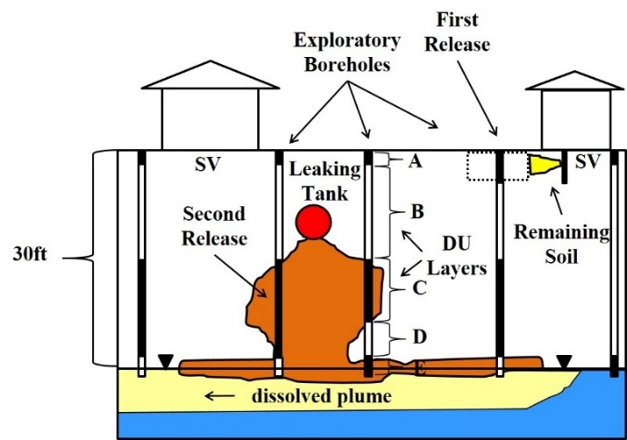
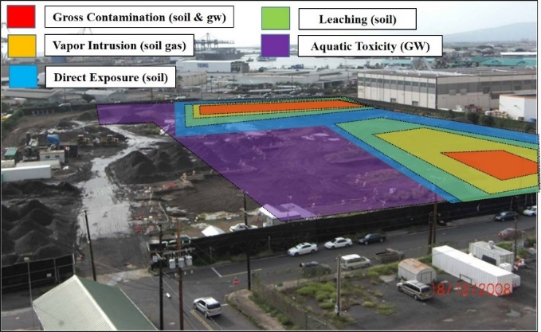
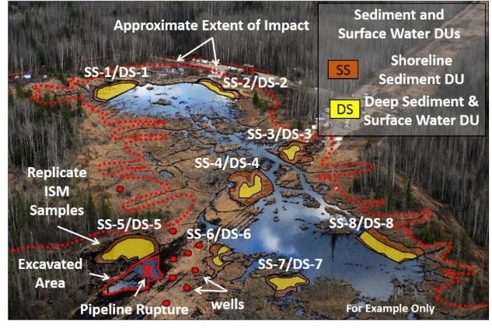
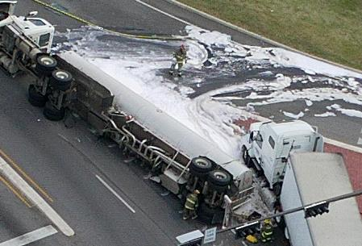
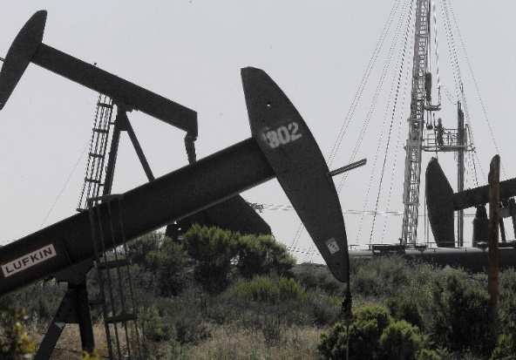
“Metabolite” Tapwater Toxicity in ITRC Case Studies
Roger Brewer, Hawaii Dept of Health
ITRC TPH Risk Team, September 19, 2017
(TPH Risk Case Studies Part 2 https://health.hawaii.gov/heer/guidance/heer-webinars/)
Study #2: Gas Station
Study #1: Fuel Terminal
Study #3: Oil Pipeline
Study #4: Tanker Truck
Study #5: Oil Field

Slide 53
Similar Weighted Mixture Toxicity Approach Can (in Theory) be Applied to TPH-Related Metabolites in Drinking Water (Case Studies Attachment 5)
Step 1: Designate Metabolite Families and Assign Toxicity Factors
Step 2: Estimate Metabolite Family Makeup of Degraded TPH
Step 3: Calculate Metabolite Suite-Weighted Toxicity Factors
Step 4: Calculate Metabolite Suite-Weighted Screening Levels

Slide 54
Step 1: Metabolite Families & Toxicity Factors
Toxicity Ranking of TPH-Related Metabolites
(Zemo et al. 2016)
Metabolite Family | Toxicity Ranking | Estimated Range Ingestion RfD (mg/kg-day)
 |  | Low | High
Alcohols | Low | 0.1 | 1.0
Acids/Esters | Low | 0.1 | 1.0
*Ketones | Low/Low-Mod | 0.01 | 1.0
Aldehydes | Low to Mod | 0.01 | 0.1
*Phenols | Low/Mod | 0.001 | 1.0
*Estimated toxicity of ketone and phenol mixtures varies between degradation stages.
Oxidized hydrocarbons assumed not significantly volatile;
Focus on ingestion and dermal route of exposure for tapwater.

Slide 55
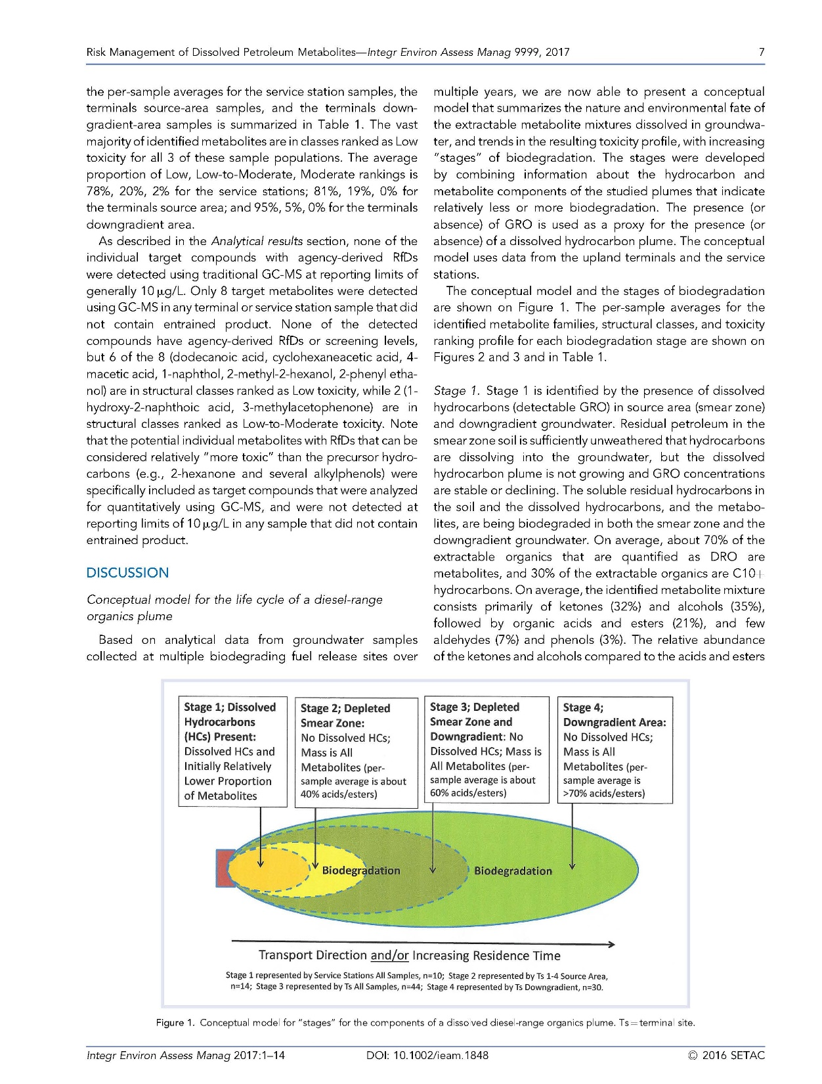
Step 2: Degradation Stages vs Metabolite Family Makeup
Degradation Stages (Zemo et al. 2016)
Stage 1:
Source Area (dissolved HC + metabolites)
Stage 2:
Smear Zone
(metabolites only, no dissolved HC)
Stage 3:
Transition Zone
(ave Stages 2 & 4)
Stage 4:
Downgradient
(metabolites only and outside of smear zone)
Transport Direction and/or Increasing Residence Time
Dissolved TPH & BTEXN hydrocarbons in Stage 1 must be evaluated separately and cumulative risk posed by metabolites + hydrocarbons assessed.

Slide 56
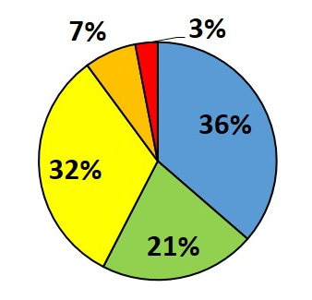
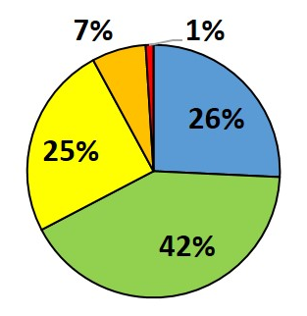
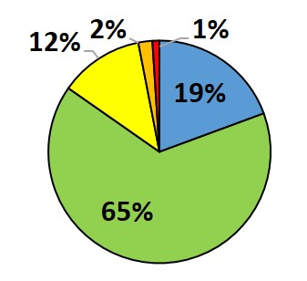
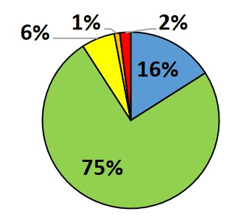
Step 2: Degradation Stage vs Metabolite Makeup
(Zemo et al. 2016)
Stage 1
Stage 2
Phenols
Aldehydes
Ketones
Acids/Esters
Alcohols
Decreasing Toxicity
Stage 3
Stage 4

Slide 57
Step 3: Metabolite Suite-Weighted Toxicity Factors
HIDOH 2018 (after Zemo et al. 2016):
Degradation Stage | Estimated *Weighted Oral RfD (mg/kg-d) (dissolved metabolite mixture)
 | Low | High
Stage 1 | 0.02 | 0.20
Stage 2 | 0.04 | 0.37
Stage 3 | 0.05 | 0.55
Stage 4 | 0.07 | 0.69
*Weighted toxicity of metabolite mixture based on lowest (most conservative) toxicity for individual metabolite families presented in Zemo et al. 2016.
This Presentation:
Fuel Type | Estimated *Weighted Oral RfD (mg/kg-d) (dissolved CR+BTEXN mixture)
Gasoline | 0.035
Kerosene | 0.030
Diesel | 0.029

Slide 58
Example Drinking Water Screening Levels
for TPH-Related Metabolites
(after Zemo et al. 2016; most conservative toxicity factors applied)
Stage 1:
*Source Area (+dissolved HC)
<420 µg/L
Stage 2:
Smear Zone
(metabolites only)
<740 µg/L
Stage 3:
Transition Zone
(ave Stages 2 & 4)
<1,100 µg/L
Stage 4:
Downgradient
(metabolites only)
<1,400 µg/L
Dermal absorption not considered.
Accuracy of toxicity factors?
Taste & Odor Threshold?
Transport Direction and/or Increasing Residence Time
*Non-degraded, TPH hydrocarbons must be evaluated separately and cumulative risk considered.

Slide 59
Summary
Weighed carbon range approach to calculate TPH screening levels for drinking water in use for 15+ years;
Similar approach possible for TPH-related degradation compounds (HOPs) in drinking water;
Focus on ingestion & dermal exposure pathway (assumed low volatility);
Most conservative toxicity factors for Degradation Stage 1 & 2 metabolite suites would generate tapwater action levels similar to TPH parent compounds;
Higher action levels potentially applicable to Stage 3 & 4 metabolite suites, assuming proposed toxicity factors appropriate;
Within or above range of likely “TPH” taste and odor threshold levels?

