Slide 1
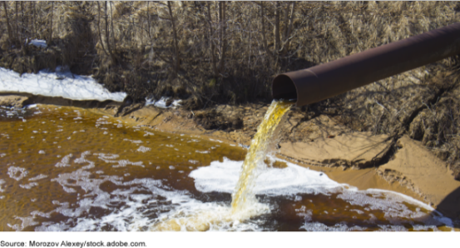
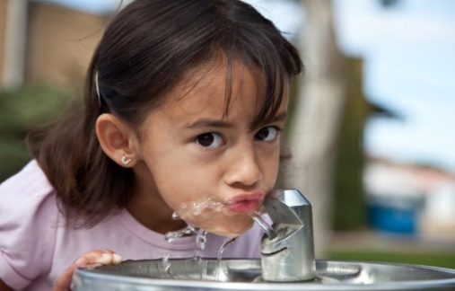
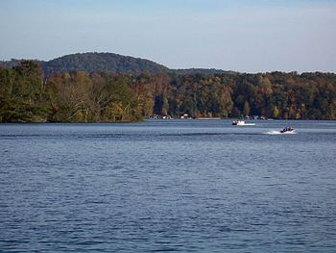
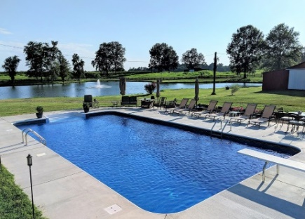
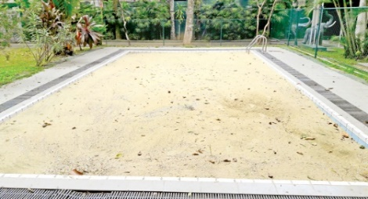
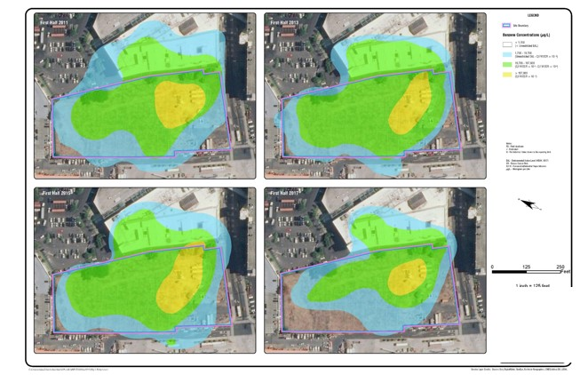
Investigations of Contaminated Water:
More Than Just Putting Water in a Jar
Roger Brewer, PhD, Senior Environmental Scientist
Hawai´i Department of Health, Honolulu, Hawai´i, USA (roger.brewer@doh.hawaii.gov)
USEPA Engineering Forum IS Subcommittee, November 17, 2021
“If I were given one hour to save the world, I would spend 59 minutes defining the problem and one minute solving it.”
Albert Einstein

Slide 2
Science Learning Curve
I know everything
I know everything
high
Soil & Sediment
There’s more to this
than I thought…
Close enough
Hmmm…
Confidence
It’s starting to
make sense
I’m never going
to understand this
Groundwater
low
Huh???
Huh???
low
high
low
Knowledge in Field
The aim of science is not to open the door to infinite wisdom, but to set a limit to infinite error.
Bertolt Brecht

Slide 3
References
HIDOH, 2021, Technical Guidance Manual: Hawai‘i Department of Health, Office of Hazard Evaluation and Emergency Response,
Sections 3-5: Sampling Theory & DU-MIS (soil & sediment)
Section 6: Groundwater and Surface Water Sampling
Revise to incorporate concepts of Systematic Planning (e.g., DUs)
Think about reliability of “single-increment” water samples
Section 7: Indoor Air and Soil Vapor Sampling (LVP)
AAFCO, 2015, Good Samples: Guidance on Obtaining Defensible Samples: Association of American Feed Control Officials.
AAFCO, 2018, Good Test Portions: Guidance on Obtaining Defensible Test Portions: Association of American Feed Control Officials
HIDOH Recorded Webinars:
https://health.hawaii.gov/heer/guidance/heer-webinars/

Slide 4
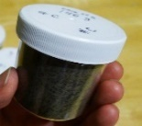
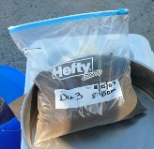
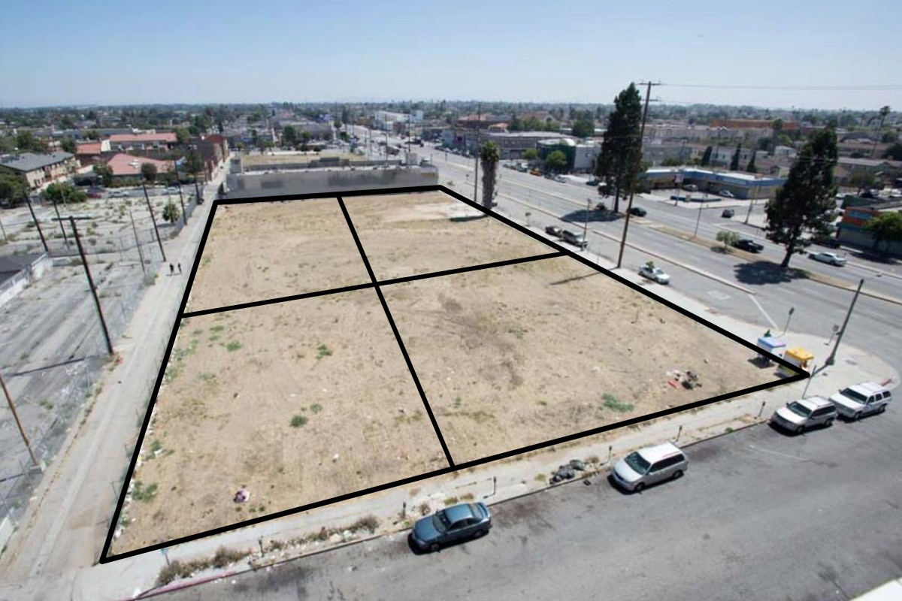
Terminology
Decision Units
Discrete
Sample
(100-200g)
DU-1
DU-2
X
Multi Increment® Soil Sample (e.g., 50 increments, 1-2+kg)
X
X
X
X
X
X
X
X
X
X
X
X
X
X
X
DU-4
X
DU-3
X
X
X
X
X
X
X
X
?
X
X
X
X
X
X
X
X
X
X
X
X
X
X
X
X
X
X
X
X
?
X
X
X
X
X
Risk is Always assessed based on the mean concentration for the DU as a whole.
DU: Area/volume of soil or other media you would collect and test as a single mass/volume, if you could…;
Discrete Sample (used since 1980s):
Collected from a single point within a targeted area (“single increment sample”);
Mass collected based on laboratory needs;
# samples often based on budget.
Multi Increment Sample (Gy’s Theory of Sampling):
Collected from multiple points (“increments”) within a targeted area (systematic random grid);
Mass and # of “increments” included in sample based on Gy’s sampling theory.

Slide 5
Application of Sampling Theory to
Environmental Investigations
The Two Objectives of any Investigation:
Assessment of Risk; and/or
Optimization of Remediation.
Theory of Sampling:
Step 1: What’s the question?
Step 2: What’s the Decision Unit?
Step 3: How can a representative sample be collected?
Step 4: How will the data be used to make decisions?
“It’s what you left in the ground that’s most important, not what you put in the jar.”
Chuck Ramsey (Sampling for Defensible Environmental Decisions; https://www.envirostat.org/)

Slide 6
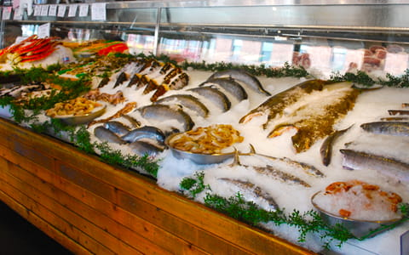
Theory of Sampling Explained With Fish
Does PFOS⁻ in fish pose a chronic health risk (meals over 6-24 years)? | The Investigation Question
Which Fish? These fish! | The Decision Unit
The whole fish? The fillets! | Refining the DU
Collect and individually test 10 fillets and guestimate a mean? No! | Sampling Method: Collect a single, Multi Increment sample plus two independent replicates to test overall sampling method precision.
Ban fish from market if the mean concentration of PFOS exceeds “X.” | The Decision statement

Slide 7
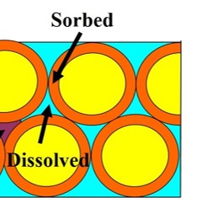
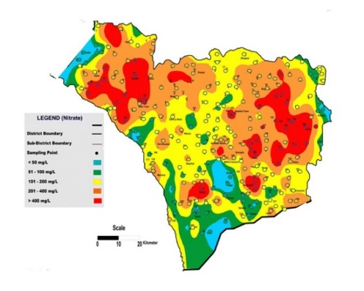
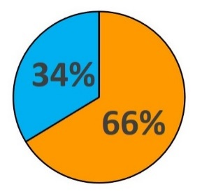
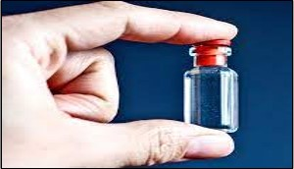
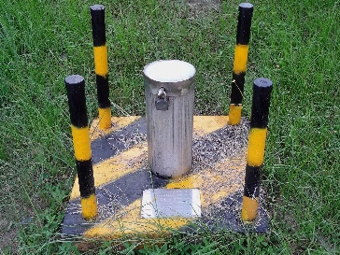
Red Flags In Groundwater Sample Data Representativeness (similar to soil)
Sorbed
PCE
S
D
Dissolved
0.6% TOC
Assumed
Small-Scale Uniformity
Isolated
“Hot Spots” & “Cold Spots”?
Tiny Sample
Volumes
Lack of “Replicate”
Data?
Sample Volume = Volume Required by Lab for Testing (vs risk/remediation);
Assumed small-scale uniformity of contaminant concentrations;
Lack of replicate (or co-located) sets of well to test data reproducibility;
# of Monitor Wells = Monitoring Well Budget/Cost Per Well (vs well-thought-out Decision Units);
Over-resolution of isoconcentration maps (artificial hot spots and cold spots);
Scale of error in data?

Slide 8
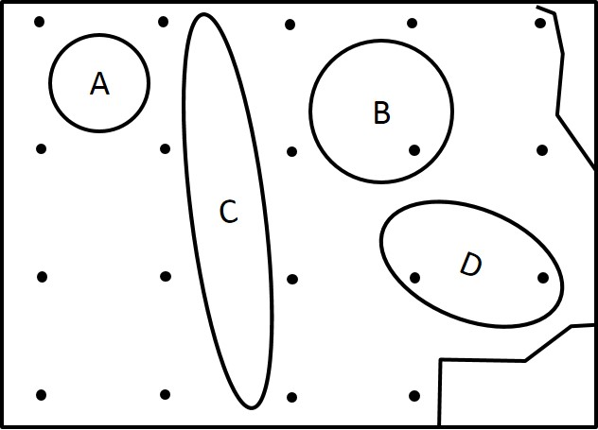
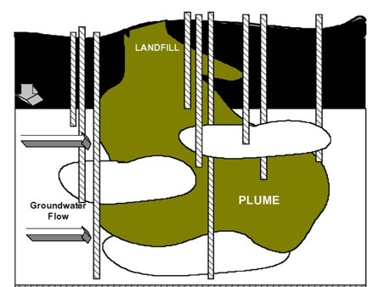
Uniform Plumes and the
Search for Hot Spots (sounds familiar…)
Oops…
Supporting Field Studies?
Spacing of Discrete Soil Sample to Identify “Uniform” Hot Spots
Spacing of Discrete Groundwater MWs to Identify Uniform Plumes
USEPA (2001)
“When there is little distance between points it is expected that there will be little variability between points.”
USEPA (1989): Methods for Evaluating the Attainment of Cleanup Standards
“Samples taken in close proximity (e.g., within distances of a few meters)… are highly auto-correlated… Dense spatial monitoring… runs the risk of redundant data”
USEPA (1996): Low-Flow Groundwater Sampling Procedures

Slide 9
Starting at the Beginning…
Theory of Sampling applied to indoor air, soil/sediment, subslab vapor;
TOS applied to surface water and groundwater;
What’s the question?
What’s the Decision Unit?
How can a representative sample be collected?
Progressively more complex examples:
Water tank;
Bottled water;
Open swimming pool;
Sand-filled swimming pool;
Layered dirt-filled swimming pool;
Dry cleaner test case.
Notes:
9
Steps 1-5: Typically considered DQO process: Use TGM fore example CSMs, sampling strategy, and help ID COPCs - DU decisions always critical in the end,
Step 6: Sampling/Analytical Plan, Application of Sampling Theory, and Implementation (Use TGM Sections 3, 4, and 5)
Steps 7-10: Data Assessment:
EALs for Screening hazards (review all hazards above EALs, use Residential EALs to screen, can also list C/I use EALs for reference)
Inference to entire DU if collected properly (note areas cannot sample), Statistics (with MIS, means and RSD%,
QC for Field and Lab replicate data (e.g. triplicates, RSD% (Sect. 4 guidance)
Interpretation of data by comparing to EALs (look at all hazards > EAL)
Potential Issues with not following a systematic approach include:
Fuzzy objectives, Multiple mobilizations, Higher analytical costs
Investigations not designed to optimize remediation, Repeated excavations, Underestimate contaminant mass for in situ treatment
Once EHE completed – a decision on action can be made … typically an NFA or removal/remediation action. In some cases more investigation or special risk assessment.

Slide 10
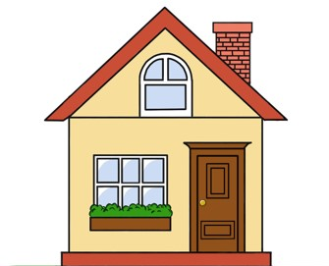
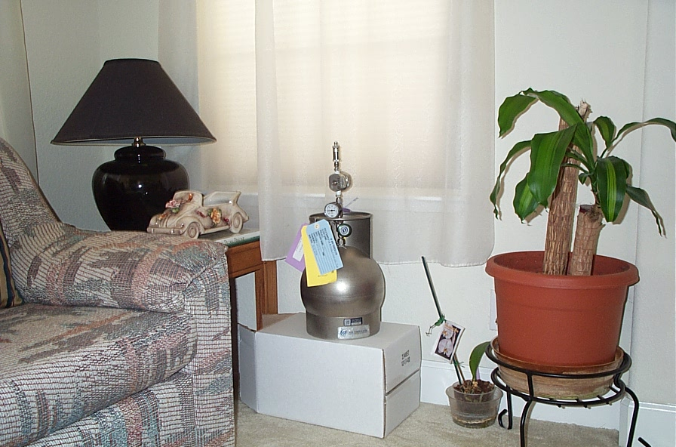
Testing Indoor Air (mostly well done)
Question: Does contaminant X in indoor air pose a chronic health risk?
Default Home
Volume
= 244,000 liters
Default 24-Hour
Indoor Air Exchange
Volume (0.35 times/hr)
= 2,050,000 liters/day
Approx.
To Scale
Data Needs: What is the mean concentration of “X” in indoor air during the specified, exposure period?
Decision Unit: Volume of air circulating within structure during the specified exposure period.
Not Risk-Based: Collect and individually test 10+ random, 1L samples and calculate a mean.
Risk-Based: Collect single, continuous sample of circulating air during targeted exposure time.
Concentration in individual small volumes is irrelevant

Slide 11
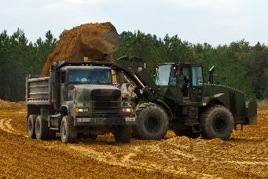
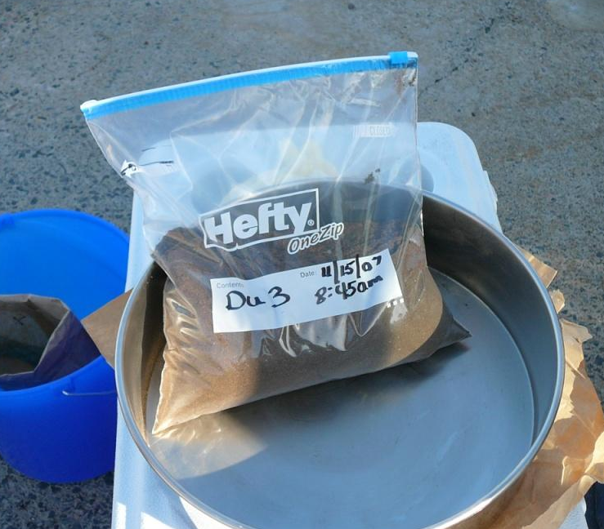
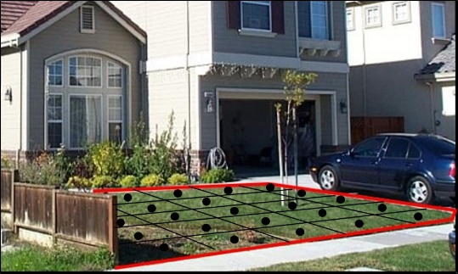
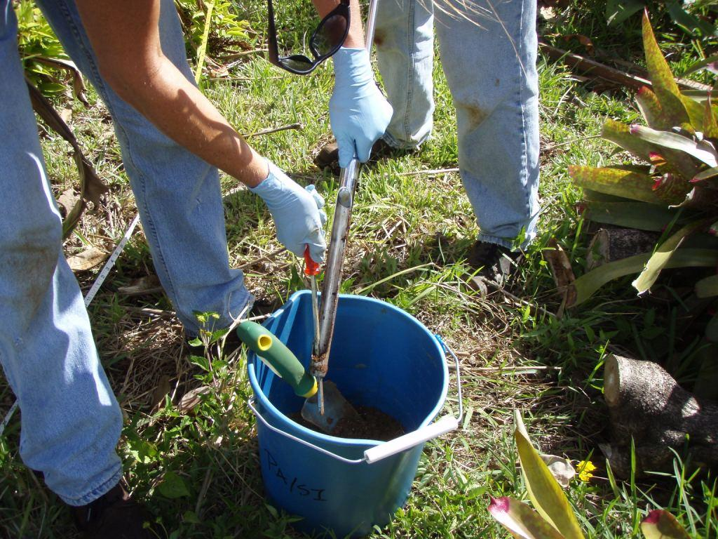
Testing Soil or Sediment (poorly done in past)
(DU-MIS Sampling Methods; HIDOH 2021)
Question: Does contaminant X in exposed soil pose a direct exposure risk?
10 truckloads
Multi Increment
Sample
Default Residential Exposure Area
= 500 m² (75 m³)
(triplicates used to test precision)
Data Needs: What is the mean concentration of “X” in surface soil (during the specified, exposure period)?
Decision Unit: Volume of soil included in exposure area.
Not Risk-Based: Collect and individually test a few random, 100-200g discrete samples and calculate a mean (or use “max”).
Risk-Based: Collect and test a single, 1-2 kg sample from 30-75+ points (increments) throughout the Decision Unit.
Concentration in individual increments is irrelevant

Slide 12
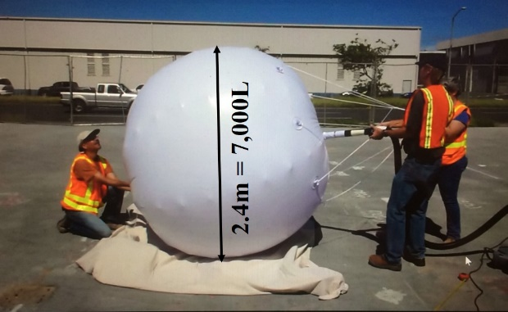
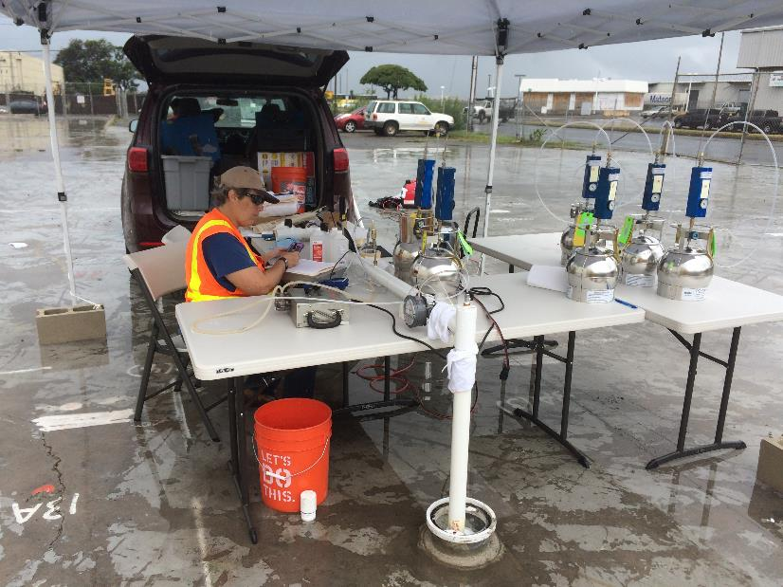
Testing Subslab Vapors (similar to groundwater?)
(Large Volume Purge Sampling Methods; HIDOH 2021)
Question: Does contaminant X in subslab vapors air pose a vapor intrusion risk?
Default Home
Volume
= 244,000 liters
Default Vapor Entry Rate Volume (cold climates; 5 L/min)
= 7,200 L/day
Approx. To Scale
Data Needs: What is the mean concentration of “X” in intruding vapors during the specified, exposure period?
Decision Unit: Volume of subslab vapors anticipated to intrude structure during the specified exposure period.
Not Risk-Based: Collect and test a few random, 1L subslab samples and calculate a mean (or use “max”).
Risk-Based: Collect a single, continuous sample of vapors intruding a point air during specified time period (LVP).
Concentration in individual small volumes is irrelevant

Slide 13
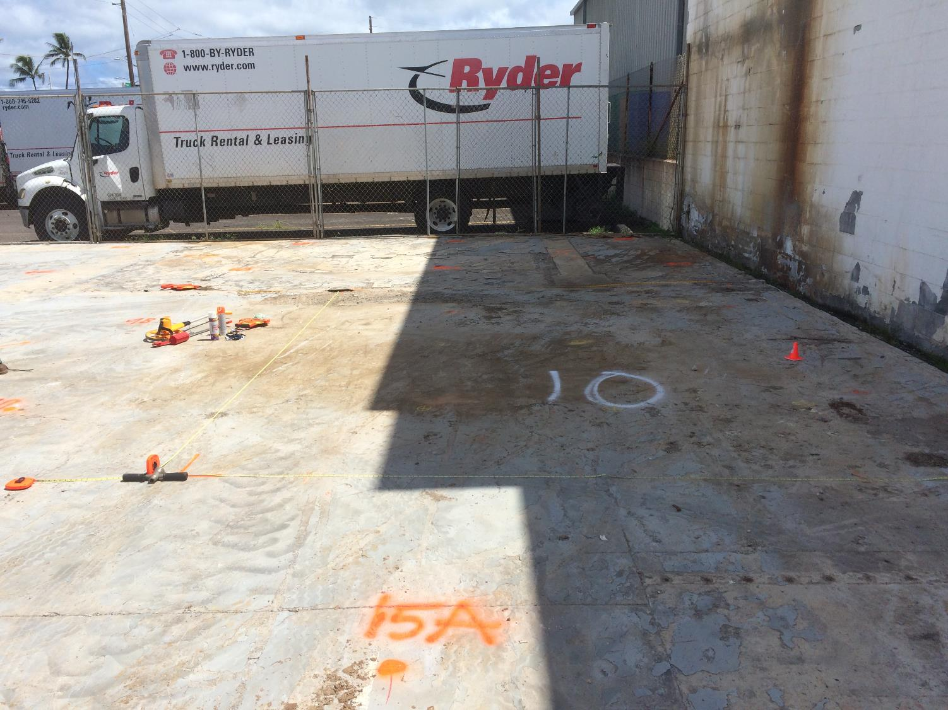
Hidden Heterogeneity Between Co-Located
Small-Volume Soil Vapor Samples (HIDOH 2017)
Sampler # | PCE (ng) | TCE (ng)
10A | 54,417 | 4,950
10B | 41,162 | 3,535
10D | 39,575 | 2,522
10E | 28,131 | 1,564
10G | 61,194 | 6,631
10H | 47,177 | 4,229
Large-scale map patterns can be reasonable semi-accurate (sometimes…);
Two-to four-fold plus random variability between co-located samples;
Small-scale map patterns can be artificial (isolated hot spots and cold spots).
X
10-A
10-B
10-C
X
Cell # 10
10-D
10-E
10-F
X
10-G
10-H
10-I
Problem: Brewer, R., Nagashima, J., Rigby, M., Schmidt, M. and O'Neill, H. (2014), Estimation of Generic Subslab Attenuation Factors for Vapor Intrusion Investigations: Groundwater Monitoring & Remediation, 34: 79–92. doi: 10.1111/gwmr.12086 (negates USEPA VI “Empirical” Database)
One Solution: HIDOH. 2017. Field Study of High-Density Passive Sampler and Large-Volume Purge Methods to Characterize Subslab Vapor Plumes (July 2017): Hawaii Department of Health, Hazard Evaluation and Emergency Response. https://health.hawaii.gov/heer/guidance/specific-topics/decision-unit-and-multi-increment-sampling-methods/
HIDOH Recorded Webinars: https://health.hawaii.gov/heer/guidance/heer-webinars/

Slide 14
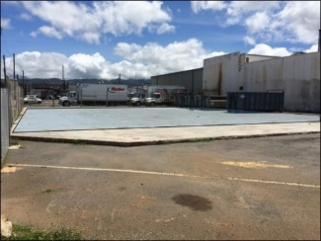
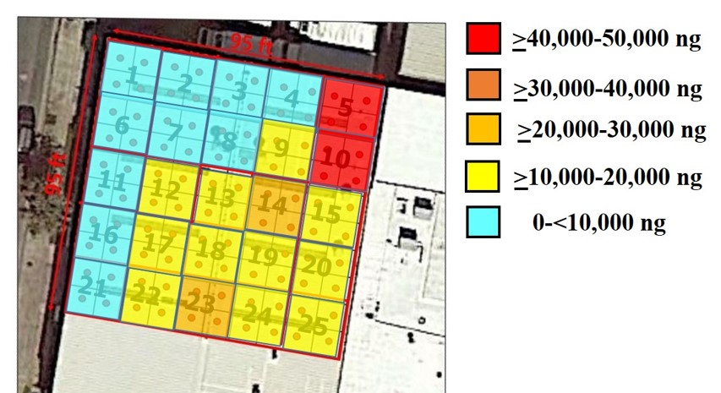
Misleading Discrete Sample Isoconcentration Maps
(similar problem with water data?)
Discrete Sample Data
(9 points, 1L Summas)
MIS Sample Data
(25 cells, 4-Increments)
PCE
Artificial “Hot Spots” and “Cold Spots”
More Representative
Isoconcentration Map
Soil Vapor Data Reliability Webinar:
https://health.hawaii.gov/heer/guidance/heer-webinars/

Slide 15
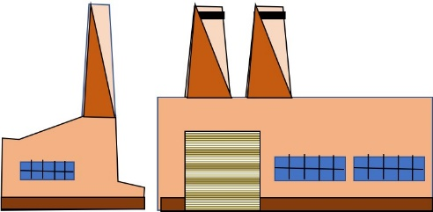
Testing Surface Water and Groundwater
(revision of HIDOH TGM Section 6)
Systematic Planning:
Site history review
Investigation objectives
Designation of Decision Units;
Collection of representative samples;
Data quality evaluation.
Well
Wastewater
Leachate
Surface
Water
Groundwater

Slide 16
What is the Question?
Potential Environmental Concerns
Well
Leachate
Drinking Water
Aquatic Habitats
Drinking Water
Irrigation
Discharge to Aquatic Habitats
Vapor Intrusion
Groundwater
Surface
Water
“Does contamination in (leachate, wastewater, surface water, groundwater) pose a potential (leaching, drinking water, aquatic habitat, vapor intrusion) risk to human health and/or the environment?”

Slide 17
What are the DUs? Not a New Idea…
DU Designation (USEPA 1996, Low-Flow Sampling):
Distributional Heterogeneity: “A sampling plan… must take into account the potential scale of changes in site conditions through space.”
Risk-Based DUs: “The prevailing conceptual ideas included (testing of) large and relatively homogeneous (aquifers).”
Source Area DUs: “There is an awareness that in most cases a primary concern… is characterization of contaminant flow paths (thin layers of contamination) rather than entire aquifers.”
Vertical DU Resolution (USEPA, 1992, Error in GW Sampling):
Capturing Heterogeneity: “When ground-water contamination is vertically stratified, composite samples collected from a long-screened well represent some sort of average of concentrations.”
Risk-Based DUs: “When defining human receptors this may not be an issue.”
Source Area DUs: “Short intakes (short screens)… open to a single strata or zone of contamination and are more likely to provide samples that represent specific depth intervals.”

Slide 18
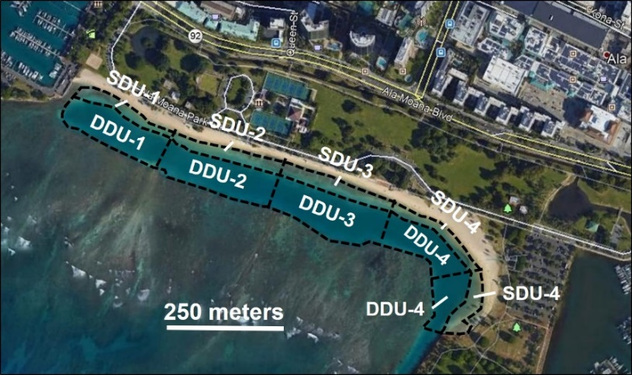
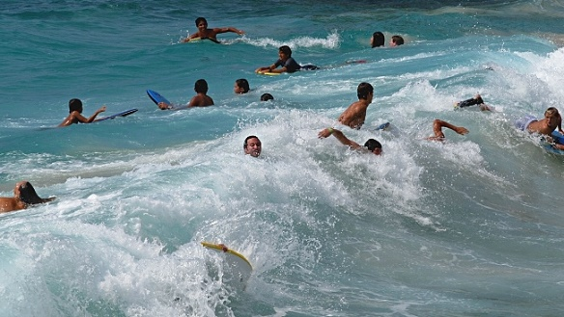
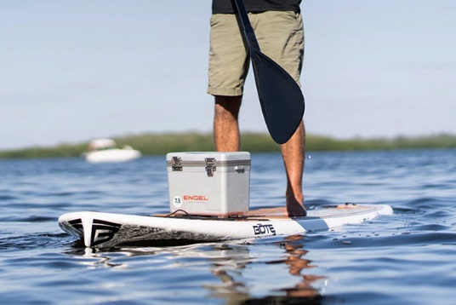
Characterization of Surface Water (easiest)
Question: Does contaminant “X” in surface water
pose a direct exposure risk?
Exposure to Bacteria in Beach Areas
Swimming Area DUs (depth 1m)
Anticipated High Distributional Heterogeneity
Data Needs: What is the mean concentration of bacteria “X” in the beach swimming areas?
Decision Unit: Volume of water within area typically used by an individual person.
Not Risk-Based: Collect and test a few random, 1 L samples of water and calculate a mean (or use “max”).
Risk-Based: Collect a single MI sample from throughout the targeted Decision Unit (e.g., Aloha Sampler®).

Slide 19
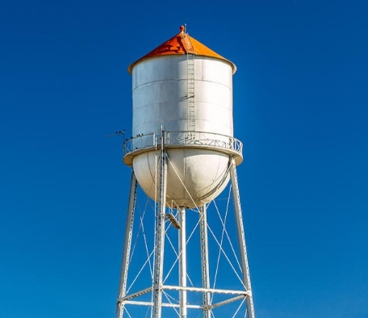
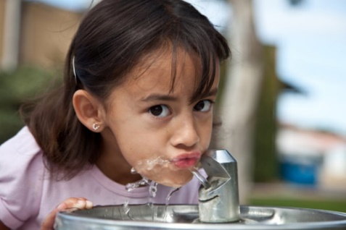
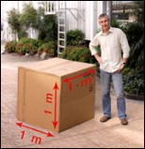
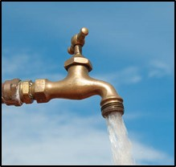
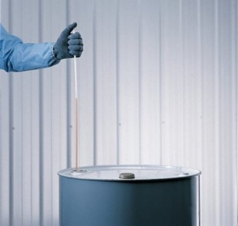
Characterization of Drinking Water (Water Tank)
Question: Does contaminant “X” in drinking water
pose a direct exposure risk?
DW Exposure Volume:
Child (6 yrs) = 1,638 L
Adult (24 yrs) = 22,638 L
Water Tank
(1,000,000 L)
Anticipated Low Distributional Heterogeneity
1 m³
Data Needs: What is the mean concentration of “X” in drinking water during the specified, exposure period?
Decision Unit: Volume of water in the tank.
Not Risk-Based: Assume uniformity of water throughout tank. Collect adequate volume for laboratory test. (Ok?)
Risk-Based: Collect single sample throughout the entire tank (Coliwasa? Not necessary for dissolved COPCS?).

Slide 20
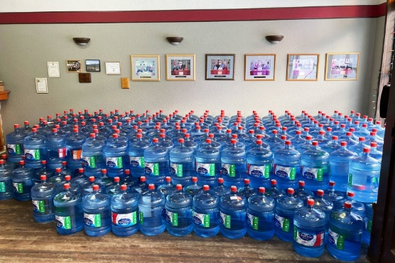
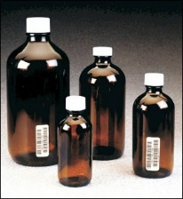
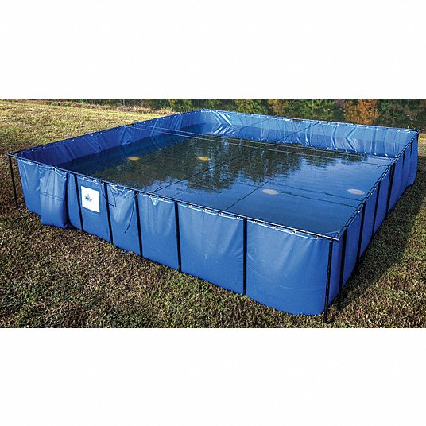
Characterization of Drinking Water (Bottled Water)
Question: Does contaminant “X” in drinking water
pose a direct exposure risk?
DW Exposure Volume:
Child (6 yrs) = 1,638 L
Adult (24 yrs) = 22,638 L
Bottled Water (1,638 L)
Anticipated Low Distributional Heterogeneity
1 m³
Data Needs: What is the mean concentration of “X” in drinking water during the specified, exposure period?
Decision Unit: Collective volume of water in the bottles.
Not Risk-Based: Collect and individually test samples from 10+ individual bottles and estimate a mean.
Risk-Based: Combine increments of water from multiple bottles and test as a single sample (# of bottles?).

Slide 21
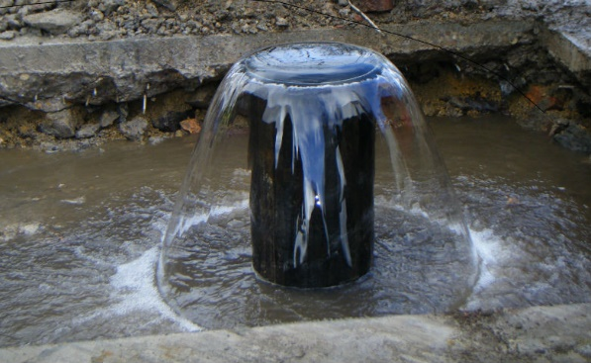
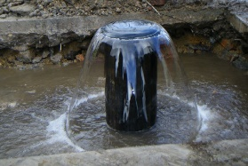
Ex Situ Characterization of Groundwater (Water Well)
Question: Does contaminant “X” in drinking water
pose a direct exposure risk?
DW Exposure Volume:
Child (6 yrs) = 1,638 L
Adult (24 yrs) = 22,638 L
Water Well
(minimum 750 L/day)
Distributional Heterogeneity???
1 m³
Data Needs: What is the mean concentration of “X” in drinking water during the specified, exposure period?
Decision Unit: Volume of water consumed during the exposure period.
Not Risk-Based: Collect and test a random small-volume (e.g., 1 L) sample of water every three months.
Risk-Based: Collect a Large Volume Purge sample every three months (e.g., purge 1,638 L)?

Slide 22
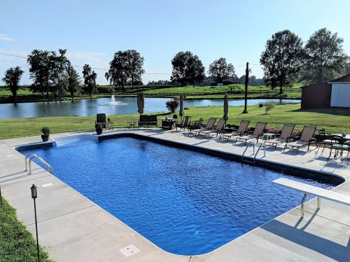
In Situ Characterization of Groundwater
Question: Does contaminant “X” in drinking water
pose a direct exposure risk?
DW Exposure Volume:
Child (6 yrs) = 1,638 L
Adult (24 yrs) = 22,638 L
Swimming Pool
Anticipated Low Distributional Heterogeneity
1 m³
Data Needs: What is the mean concentration of “X” in drinking water during the specified, exposure period?
Decision Unit: Volume of water in the swimming pool.
Not Risk-Based: Assume uniformity of water throughout pool. Collect adequate volume for laboratory test. (Ok?)
Risk-Based: Collect single sample throughout the entire pool (Coliwasa? Not necessary for single-phase media?).

Slide 23
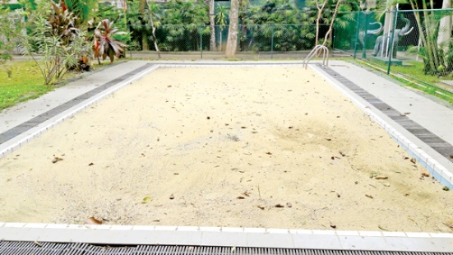
In Situ Characterization of Groundwater
Question: Does contaminant “X” in drinking water
pose a direct exposure risk?
Swimming Pool
Filled with Clean, Inert Sand
DW Exposure Volume:
Child (6 yrs) = 1,638 L
Adult (24 yrs) = 22,638 L
Anticipated Low Distributional Heterogeneity
MW
1 m³
Data Needs: What is the mean concentration of “X” in drinking water during the specified, exposure period?
Decision Unit: Volume of water in the swimming pool.
VOC loss, disposal, etc.
Not Risk-Based: Assume uniformity of water throughout pool. Collect small, discrete sample from one well? (Ok?)
Risk-Based: Collect an LVP sample from a risk-based purge (e.g., 1,638 L).

Slide 24
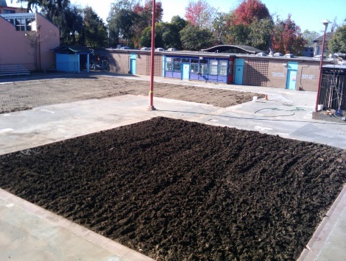
In Situ Characterization of Groundwater
Question: Does contaminant “X” in drinking water
pose a direct exposure risk?
DW Exposure Volume:
Child (6 yrs) = 1,638 L
Adult (24 yrs) = 22,638 L
Swimming Pool
Filled with Variable Layers of Dirt
Distributional Heterogeneity???
?
1 m³
Data Needs: What is the mean concentration of “X” in drinking water during the specified, exposure period?
Decision Unit: Volume of water in the swimming pool.
?
VOC loss, disposal, etc.
Not Risk-Based: Assume uniformity of water throughout pool. Collect discrete sample from one well? (Not ok...?)
Risk-Based: Collect MI sample throughout entire pool via multiple monitoring wells (getting complicated)?

Slide 25
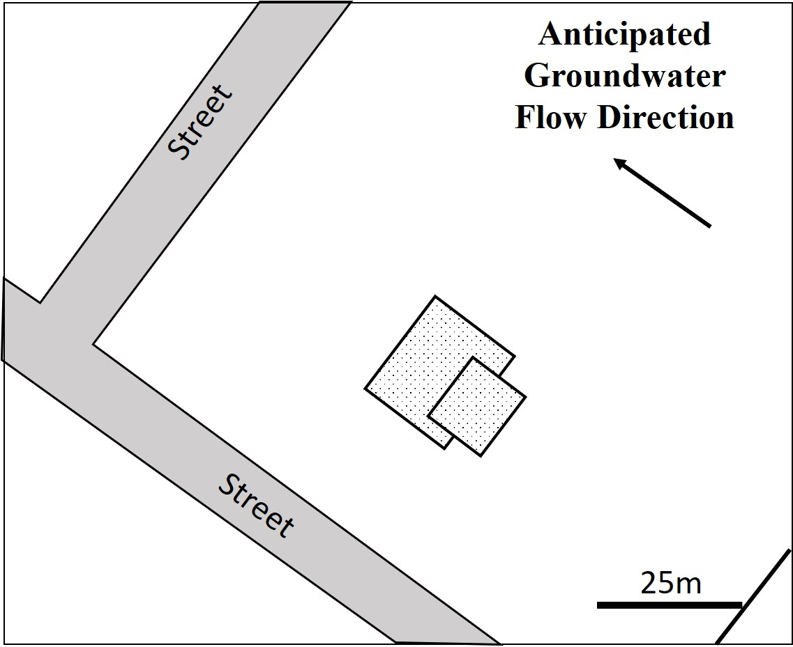
Dry Cleaner Test Case
Former Dry Cleaner
?
Suspected PCE Release Under Building
?
?
?
Step 1: Formulate investigation questions:
Vapor intrusion risk?
Drinking water risk?

Slide 26
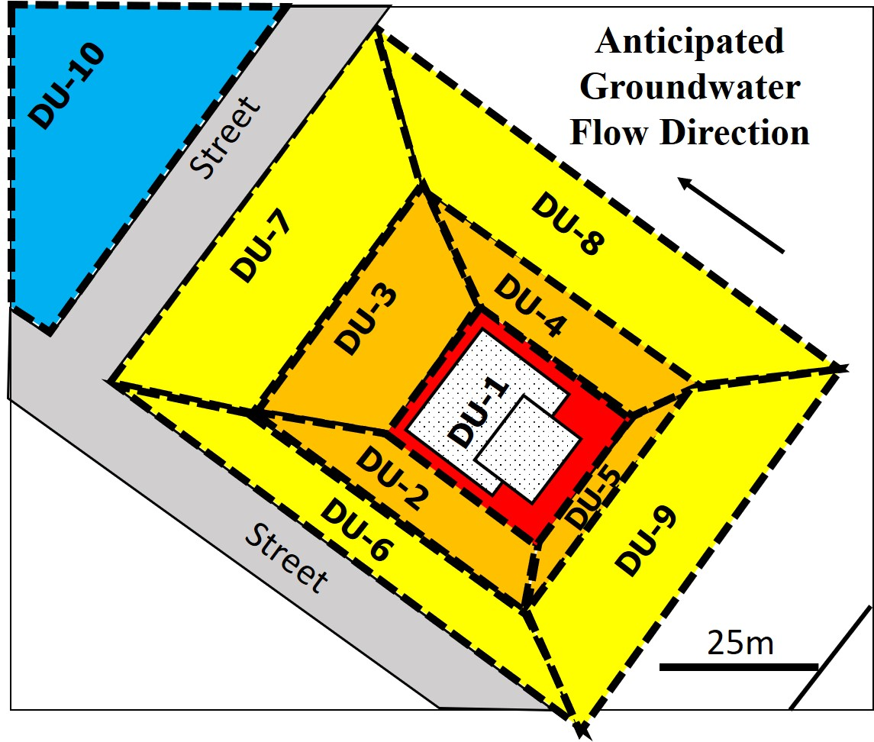
Step 2: Designate Groundwater DUs
(lateral - similar to typical placement of monitoring wells)
DW Risk DU
DU = Hundreds to Thousands of Cubic Meters of Water
VI Risk & Source Area DU
(default minimum VI DU area = 100 m²)
Boundary Area DUs
Data Needs: Mean concentration of VOC in each DU volume of water.
DU: Lateral and vertical component (area + volume).
“It is the mark of an instructed mind to rest easy with the level of precision that the decision requires, and not to try an exactness that is unnecessary for the problem.”
Aristotle (circa 350 BC; paraphrased)

Slide 27
Designate Vertical DU “Resolution”
Risk-Based
DU Designation
(one DU)
Remediation-Based
DU Designation
(multiple DUs)
Localized Source Zones Not Relevant
Groundwater Unit
of Interest
Suspected Source Zones
DU Interval resolution required to assess risk and/or optimize remediation?
Focus on groundwater in high-permeability formations and/or groundwater in low-permeability formations?
Collective decision between risk assessors and remediation experts.

Slide 28
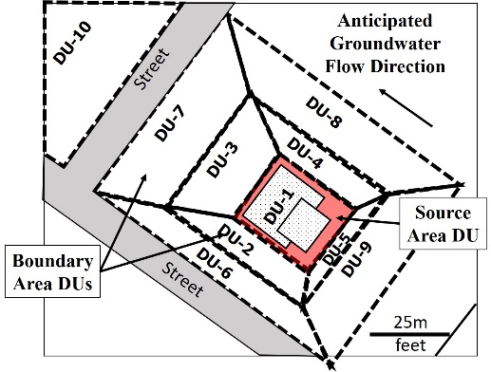
Vapor Intrusion Risk DUs
(similar to typical placement of monitoring well screens)
Former Dry Cleaner
Groundwater
Flow
Subslab Vapor DU
0m
DU-3A
DU-1A
DU-5A
5m
Sand/Silt/Clay
Vapor Source Zone
20m
Sand/gravel
Aquifer
40m
50m
Not to scale
Upper 0.5m of groundwater assumed to be primary source of vapors and risk to overlying building;
Relatively small, risk- and remediation-based DU areas/volumes of groundwater designated for testing;
Concurrent designation of soil vapor DU(s) for testing immediately beneath building slab (TGM Section 7).

Slide 29
Drinking Water Risk DUs
(similar to typical placement of monitoring well screens)
Former Dry Cleaner
Groundwater
Flow
0m
5m
Sand/Silt/Clay
DU-5C
20m
Sand/gravel
DU-
3C
X
No Aquifer
= No DU
DU-7C
DU-1C
DU-
9C
DU-10C
40m
50m
Not to scale
Relatively small, remediation-based DUs designated beneath suspect source area for testing;
Larger downgradient, risk-based DU designated for assessment of potential impacts above drinking water screening levels;
Aquifer formation assumed to abruptly terminate in upgradient direction (aquifer DU not present; no sample collected).

Slide 30
Surface Water Discharge Risk DUs
(similar to typical placement of monitoring well screens)
Former Dry Cleaner
Groundwater
Flow
0m
DU-7A
DU-3A
DU-1A
DU-5A
DU-9A
5m
Sand/Silt/Clay
Dewatering Zone
20m
Sand/gravel
Aquifer
40m
50m
Not to scale
Upper 5m of groundwater assumed to be vulnerable to natural offsite flow and/or dewatering during future construction;
Relatively small, groundwater management DU areas/volumes of groundwater designated for testing;
Very common issue in areas adjacent to water bodies.

Slide 31
Remediation-Based DUs – Optimization of Treatment
Former Dry Cleaner
0m
DU-3A
DU-1A
DU-5A
5m
Sand/Silt/Clay
7A/B
3B
1B
5B
9A/B
20m
Focused In Situ Treatment Directly Under Building
(monitoring in perimeter DUs)
Sand/gravel
7C
3C
1C
9C
5C
40m
50m
Not to scale
DUs designated to monitor results of in situ remediation;
Treatment focused in DUs 1A, 1B and 1C;
Other DU areas/volumes used for monitoring (some DUs combined);
Other DUs used to monitor effectiveness of treatment.

Slide 32
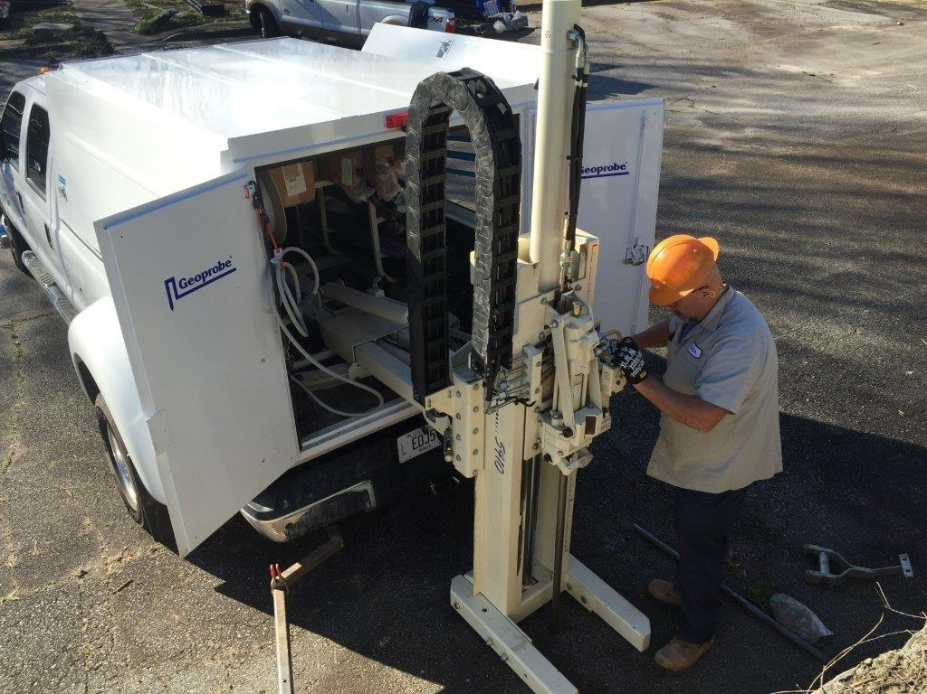
Step 3: Characterization of Groundwater DUs
Top of Groundwater
Sample Collected from Multiple Points within DU
Source Area DU
5m
Option 1: Collect and test entire volume of DU volume of ground water;
Option 2: Collect MI sample of groundwater (# of increments? Total sample volume? Not feasible in most cases…);
Option 3: Develop alternative method and test limitations of data.

Slide 33
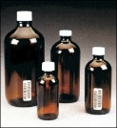
Alternative Collection of Single-Increment
(Single Well) Groundwater Samples
Top of Groundwater
MW-5
MW-3
MW-2
MW-1
MW-6
MW-4
v
5m
Concerns:
Assumes insignificant, small-scale, random distributional heterogeneity of dissolved phase contaminants in groundwater;
Move well a few meters?
Collection of sample representative of entire DU interval thickness?
Representativeness of small-volume (e.g., 40 ml to 1 L), “discrete” water samples of immediately surrounding groundwater (10s m³)?

Slide 34
Assessment of Vapor Intrusion Risk
(permeability too low for GW LVP, small-volume samples required)
Former Dry Cleaner
Groundwater
Flow
0m
V
V
V
5m
Sand/Silt/Clay
V: Subslab Vapor
20m
DU-2A
DU-1A
DU-5A
Sand/gravel
40m
50m
Not to scale
Install monitoring wells screened across target DU interval;
Collect a standard, small-volume sample representative of entire DU Interval water column in surrounding formation;
Collect concurrent LVP subslab/subpavement vapor samples.

Slide 35
Assessment of Drinking Water Aquifer Risk
(high permeability, LVP samples appropriate)
Former Dry Cleaner
Groundwater
Flow
0m
?
?
?
?
5m
Sand/Silt/Clay
DU-5C
V: Subslab Vapor
20m
Start in Source Area DUs and work outwards as needed
Sand/gravel
DU-
2C
DU-3C
DU-1C
DU-4C
40m
50m
Not to scale
Install single monitoring well within each DU screened across targeted aquifer production zone;
Collect a single Large Volume Purge (LVP) water sample (vs traditional small-volume “discrete” sample) from each well;
Method to minimize loss of VOCs?
Onsite injection/infiltration of excess water vs disposal?

Slide 36
Assessment of Discharge to Surface Water
(permeability too low for GW LVP, small-volume samples required)
Former Dry Cleaner
Groundwater
Flow
0m
DU-7A
DU-3A
DU-1A
DU-5A
DU-9A
5m
Sand/Silt/Clay
Dewatering Zone
20m
Sand/gravel
Aquifer
40m
50m
Not to scale
Upper 5m of groundwater assumed to be vulnerable to natural offsite flow and/or dewatering during future construction;
Relatively small, groundwater management DU areas/volumes of groundwater designated for testing;
Very common issue in areas adjacent to water bodies.

Slide 37
Optimization and Monitoring of Remedial Actions
(mixed formation permeability)
Former Dry Cleaner
Groundwater
Flow
0m
V
V
V
5m
Sand/Silt/Clay
V: Subslab Vapor
20m
Sand/gravel
40m
50m
Not to scale
Install monitoring wells screened across target DU interval;
Collect a sample representative of water in surrounding formation from each well;
Collect concurrent LVP subslab/subpavement vapor samples;
Method to avoid loss of VOCs in water sample?
Onsite injection/infiltration of excess water vs disposal?

Slide 38
Discrete Groundwater Sample Data Error???
(detailed field studies needed)
Potential Sources of Small-Scale Heterogeneity in Groundwater:
Heterogeneity of soil matrix (e.g., TOC and clay);
Vertical heterogeneity of strata (layers);
Variability of permeability within the same unit;
Pulses of releases over time vs steady release;
Variability in degradation (“moldy bread”); etc.
“Representative” Sample Requirements:
Capture vertical heterogeneity within targeted DU interval (controlled by well design, sample collection method and bulk sample volume);
Assess lateral reproducibility of data for single well via co-located, “replicate” wells around X% of monitoring wells in anticipated high-variability areas.

Slide 39
When to Worry (or perhaps not…): “Soil Contaminant Distribution Zones” (Brewer et al. 2017)
Zone A: Any given small volume of soil above screening level;
Zone B: Any given small volume of soil could be above or below screening level – Primary cause of data error in decision making.
Zone C: Any given small volume of soil below screening level;
Artificial? Isolated
“Hot Spots”
Discrete Data Above Screening Level
9 acres
B
A
Discrete Data Range overlaps Screening Level
B
C
Discrete Data Range below Screening Level
For example only
Field discrete samples
Notes:
Structures removed. No obvious spill areas observable in the field.

Slide 40
More Realistic Sample Data Resolution
Zone A: Any given small volume of soil above screening level;
Zone B: Any given small volume of soil could be above or below screening level – Primary cause of data error in decision making.
Zone C: Any given small volume of soil below screening level;
Heavy Contamination
9 acres
A
B
Moderate
Contamination
B
High Risk of False Negatives
C
Low/No
Contamination
For example only
Notes:
Structures removed. No obvious spill areas observable in the field.

Slide 41
Groundwater Contaminant Distribution Zones?
Artificial Over-Resolution of Data
Arsenic in Soil
(USGS 2014)
Nitrate in
Groundwater
500km
20km
More Realistic Resolution of Data
For Example Only
A
C
C
A
C
A
A
A
C
A
B
A
A
B
A
A
A
B
B
C
A
Resolution could be improved by local knowledge
A
C
C
C
20km
C
500km
?

Slide 42
“Highly Variable Spatial or Temporal Data”
= Poor Sampling Method?
Correlations
Direct Exposure
Vapor Intrusion
Concentration Y
?
X
X
(Brewer et al. 2017)
(Brewer et al. 2014)
Concentration X
Trends
Monitoring
Well Data
Bacteria in Swimming Areas
X
Concentration
X
Time

Slide 43
Simple Problem, Difficult Solution…
“Discrete” Soil/Vapor/Water Samples are too SMALL to overcome, random, small-scale, distributional heterogeneity within targeted, risk-based volume of media
Discrete Sample Data Only Represent Volume Tested
VOCs: 40 ml
Other: 1 L
DW Exposure Volume:
Child (6 yrs) = 1,638 L
Adult (24 yrs) = 22,638 L
1 m³

Slide 44
Reducing Sample Error in
“Single Borehole Soil DUs”
Collection of Soil Samples from “Exploratory Borehole” (HDOH TGM Sections 3&4)
Exploratory Boreholes
Targeted DU Layers
Objective: Collect sample representative of entire, targeted DU Layer;
No Discretes! Entire core interval sent to lab for processing or carefully subsampled in field (placed in methanol for VOCs);
Presence or absence only (i.e., very high or very low);
Estimate lateral or vertical extent of contamination;
Risk of false negatives or false positives in “Zone B” contamination zone areas.
Notes:
Sample subsampled in lab using same method as standard MI samples.

Slide 45
Reducing Sample Error in
“Single Well Groundwater DUs”
Sample Data Bias Juggling Act:
Coverage of targeted DU interval;
Purge vs Non-Purge;
Loss of contaminant during sample collection;
Degradation of sample during shipment and storage;
Laboratory processing of sample for analysis;
Analytical method used to test subsample.
Example Sample Collection Methods
Passive Diffusion
Bag
Small
Volume
Purge
Large
Volume
Purge
Snap
Sampler
HydraSleeve
Bailer
Biases to High Permeability
Units

Slide 46
Single-Well Sample Collection Method Ranking
(Draft! For Discussion Purposes Only!)
Source of Bias | Sample Quality Versus Sample Collection Method
 | ^{1,6,7,9} PDBs | ^{2,6,7,9} Hydra Sleeve | ^{3,8,9} Bailer | ^{4,7,9?} Snap Sampler | ^{5,8} Low-Flow/ SVP | ^{5,8,9} LVP
DU Interval Coverage: | VG | VG | P-M? | M-G | P-G | P-VG
⁸Collection Efficiency: | G | G | P-G | G | P-M | M-G
⁹Sample Preparation: | M | M | P-M | M | P-G | M
IDW: | G | G | G | G | G | P
¹⁰Overall Ranking: | ? | ? | ? | ? | ? | ?
1. PDBs not available for all contaminants (e.g., TPH?). 2. Can be difficult to assess accurate DU interval deployment? 3. Can’t be tailor-made to match DU interval (relies on available sizes). 4. Gaps left between sample containers. 5. Pump intake needs to access and represent entire DU Interval of water. 6. Assumes sampler can be tailor-made to made to match DU interval 7. No purge method (not suitable for near stagnant groundwater?). 8. Water column disturbed during sample collection. 9. Requires subsampling and transfer of primary sample to smaller container. 10. Ranking for specific project depends on numerous site-specific factors.
Notes:
6

Slide 47
Summary
Systematic Planning (not that new):
Identify primary contaminants of concern;
Formulate investigation questions;
Designate lateral and vertical Decision Units based on risk and/or optimization of remediation;
Install one or more monitoring wells in each DU (for now…), screened to allow testing of targeted DU Interval;
Collect risk-based, Large Volume Purge (LVP) samples from high-permeability formations (issues include retainment of VOCs, disposal of excess water, etc.);
Use column-type samplers that collect from the entire DU interval for low-permeability formations (vs low-flow?);
Install and test “replicate” monitoring wells in DUs where small-scale heterogeneity could cause random variability of contaminant concentrations both above and below target screening levels.
Understand and document potential limitations of data.

Slide 48
Lots of Questions?
high
I know everything
Groundwater
There’s more to this
than I thought…
Confidence
Next Steps?
It’s starting to
make sense
I’m never going
to understand this
low
Huh???
low
high
Knowledge in Field
The aim of science is not to open the door to infinite wisdom, but to set a limit to infinite error.
Bertolt Brecht

Slide 49
But what about “acute” risk?
Example Acute
DU Exposure Volumes:
Sip: 25 ml Glass: 250 ml Daily: 0.78 L 14 days: 10 L
Drinking Water Aquifer
Risk Assessor Question to Field Sampler:
Does the concentration of “X” in any given, DU volume of water “Y” within the subject drinking water aquifer exceed “Z” µg/L? (hypothetical acute toxicity)
Sampling Approach (testing every DU volume in aquifer not practical):
Step 1: Define the risk-based DU volume (e.g., 25 ml to 10L);
Step 2: Define desired level of confidence (e.g., “95% confidence that 95% of DU volumes of water in the aquifer do not exceed acute screening level);
Step 3: Test corresponding number of samples collected throughout aquifer in a systematic, random manner (e.g., 59; sample volume = DU volume);
Not practical (plus acute toxicity factors not available for most chemicals);
If a real concern exists, then don’t use the water.

