Slide 1
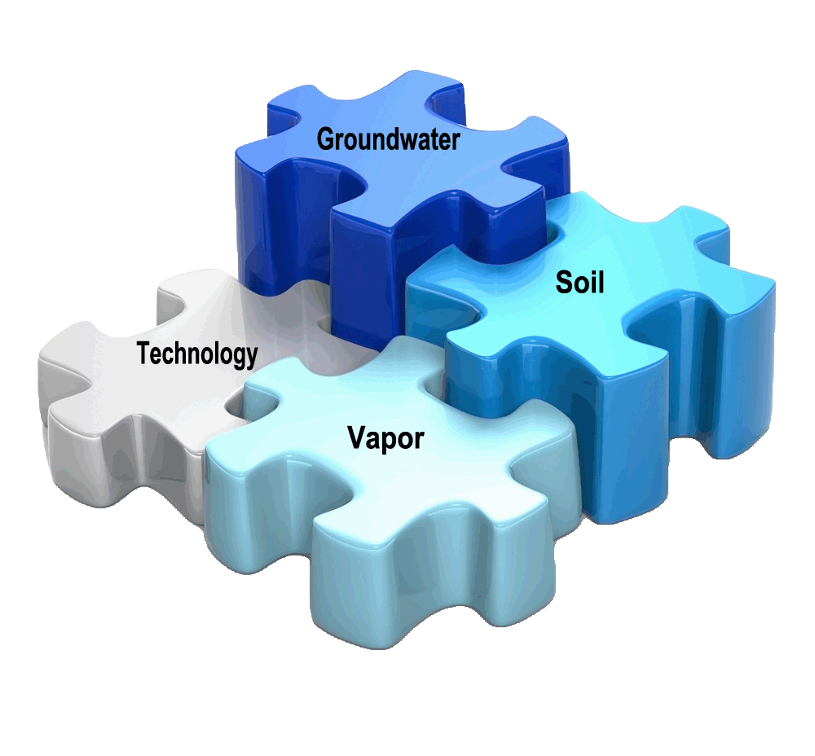
Integrated Site Remediation
Targeting Contaminants in Soil, Groundwater, and Vapor
Notes:
Introduction:
New Pacific District Manager for Northern California, Utah and Hawaii.
Started in June 2013
For those of you who worked with Jack Peabody, he recently retired with Regenesis after a very successful eighteen-year career.
Background:
17 yrs as account manager/regional business development for national remediation/geotechnical firm that specialized in in-situ stabilization/soil mixing
I would to share with the value of Regenesis vs our competitors:
Regenesis Offers the following Free of Charge
- Technical support:
-workplan development
- WDR permitting process
- Onsite assistance with pilot testing and full scale injections (TRG used own injection equipment)
- Data interpretation and recommendations
I’d like to be credible technical resource to you; creating innovative solutions for soil and groundwater impacted sites.

Slide 2
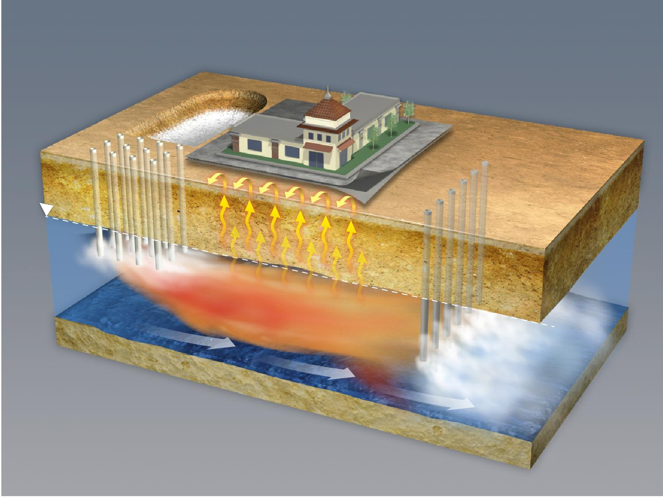
Integrated Site Remediation
Soil-Vadose/Smear Zone
Vapor
Groundwater – Saturated Zone
© Regenesis 2011
Notes:
So what does integrated treatment look like?
Let’s take our UST site from earlier as an example; Remediation of this site may consist of excavating the source area and applying ORC-A as a liner or mixed in the clean backfill
we may include some direct grid injection treatment of an ISCO agent to oxidize the plume and/or injection of bio enhancement (ORC-A)
at the site perimeter we could look at putting in long-term controlled-release oxygen as a barrier to prevent off-site migration of the contaminant plume;
ability to mitigate current or potential future effects of vapor intrusion by installing a vapor barrier (both new and existing construction)
-The ultimate goal is to remediate or mitigate your sites. Regenesis believes that integration of technologies can provide a quicker, cheaper, and more permanent solution to yours and your clients’ contamination problems

Slide 3
ISR Technology Categories and Technologies – NEW!
  In Situ Chemical Oxidation:
  RegenOx®
  Persulfox™
Enhanced Desorption:
  PetroCleanze™
  Accelerated Bioremediation:
  PlumeStop
  Vapor Intrusion Mitigation:
  Geo-Seal®
  Vapor-Vent™
  Retro-Coat™
  Remediation Services:
  RRS Group
Enhanced Bioremediation:
  Aerobic:
    ORC Advanced®
    ORC Advanced® PELLETS
    Replaceable Filter Socks
    Anaerobic:
    3-D Microemulsion® Factory Emulsified
    Hydrogen Release Compound (HRC®)
    Anaerobic Bioaugmentation:
    Bio-Dechlor Inoculum® PLUS
    Chemical Reducing Solution (CRS)
Notes:
12-11 Partial list,
-comprehensive umbrella-list of all the products and services we offer. Notice: those released within the last year are highlighted in orange
-may be familiar with ORC or HRC product lines, but as you can see our toolbox of options is actually much bigger as we offer many more technologies:
Everything from enhanced bio (both aerobic and anaerobic), to ISCO and enhanced desorption, to ISCR, Vapor Mitigation, and we even offer application assistance with our RRS group- we’ve got your remediation needs covered and provide a wide variety of strategies as well.
-We can protect clean backfill, handle residual contaminants, and enhance biological activity with our ORC-A; direct push and permanent wells, soil mixing, in situ and ex situ treatment- you name it.
-we are also constantly developing new/innovative ways to apply and integrate treatment
-it may actually seem overwhelming- with the number of options you have, but that’s why we also have an awesome team of experienced and knowledgable people to help you; I should also mention that we offer free site evaluation and design proposals for any potential sites…

Slide 4


Next Generation Technology Challenges
Matrix diffusion
Migration of plumes
Risk associated with GW contamination
Timeframe of in situ treatments
4

Slide 5


PlumeStop™ – principal technology features
Rapid reduction of groundwater concentrations
  Multiple order of magnitude concentration reductions in days / weeks
Ability to secure stringent clean-up targets
Wide subsurface distribrution
Ability to address areas of restricted access, deep plumes etc.
Long-term efficacy
  The reagent is not consumed – it regenerates in situ

Slide 6
PlumeStop™ – what’s novel
Hence…
The ability to widely disperse a sorptive medium through the subsurface
  no fracture-emplacement – no soil-mixing – no well-blockage – no patchy treatment
The fastest groundwater risk reduction / remediation technology presently available
  Risk-reduction secured through sorption
  Long-term destruction secured through in-matrix biodegradation
Improved in situ bioremediation performance
  Contaminants and bacteria concentrated together – faster net degradation rate
  No diminishing returns – ability to pursue degradation to very low concentrations
A means of addressing matrix back-diffusion (remediation tailing / rebound)
  Maintains a diffusion gradient out of the immobile porosity while protecting groundwater
  Will theoretically remain active for decades – not consumed in process – bio-regenerates

Slide 7
PlumeStop™ – how it works
Concentrating bacteria and growth substrate together increases degradation rate.
PlumeStop quickly sorbs contaminants from the dissolved-phase
Bacteria colonise the PlumeStop surface creating a bio-matrix
The interaction between the bacteria and the PlumeStop is synergistic
Notes:
Note – this assumes substrate availability is the rate-limiting factor, and other growth factors such as electron donors / acceptors are abundant (i.e. available in excess)
Increased collision frequency – microbe and substrate are brought together
The actual bio-matrix that develops comprises the PlumeStop and bacteria in combination. The PlumeStop particles themselves are the size of (copiotrophic) bacteria, therefore there will not be a cluster or film of bacteria growing on the PlumeStop surface as would occur on GAC pellets. Instead, the bacteria will grow interspersed between PlumeStop particles progressively forming biofilms – a mass of polysaccharide ropes and nets – within which the PlumeStop particles will be incorporated. This will further bind the PlumeStop to the soil particles.
The PlumeStop will behave synergistically with the bacteria, providing reservoirs for substrate, nutrients, and dissolved oxygen (Çeçen and Aktas, 2011 Section 6.1.3.) and supporting faster degradation to lower concentrations, while the PlumeStop’s sorptive capacity is regenerated by the bacteria (bio-regeneration).

Slide 8
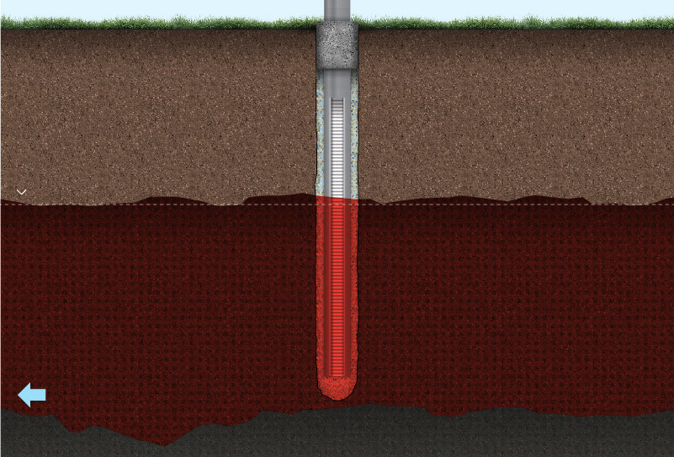
Fracturing Carbon: Compromises Monitoring Wells
Monitoring Well
Contaminated Groundwater

Slide 9
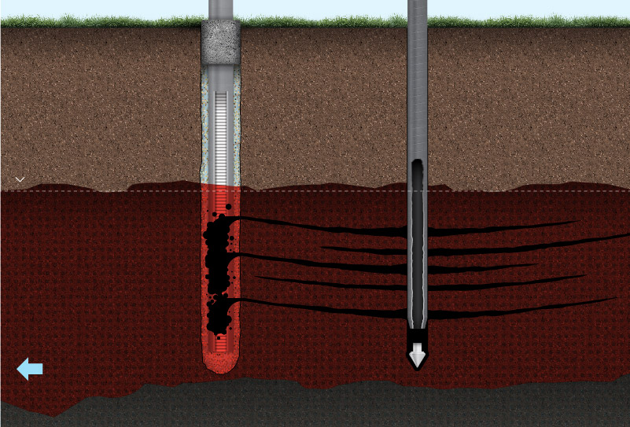
Fracturing Carbon: Compromises Monitoring Wells
As fracture impacts well, it preferentially fills well filter pack with carbon
Notes:
Like pressure grouting....

Slide 10
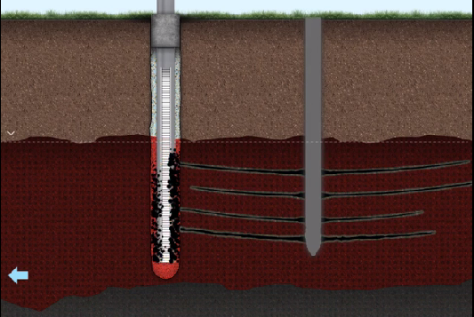
Fracturing Carbon: Compromises Monitoring Wells
NET RESULT:
Well shows
false data
Subsurface still highly contaminated

Slide 11
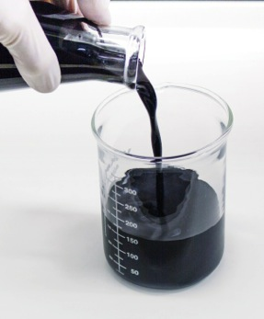
PlumeStop™ – what it is
Colloidal activated carbon (1 – 2 µm)
  Size of a bacterium – suspends as ‘liquid’
  Huge surface area – extremely fast sorption
  Support in-matrix contaminant biodegradation
Notes:
anti-clumping / distribution supporting surface treatment

Slide 12
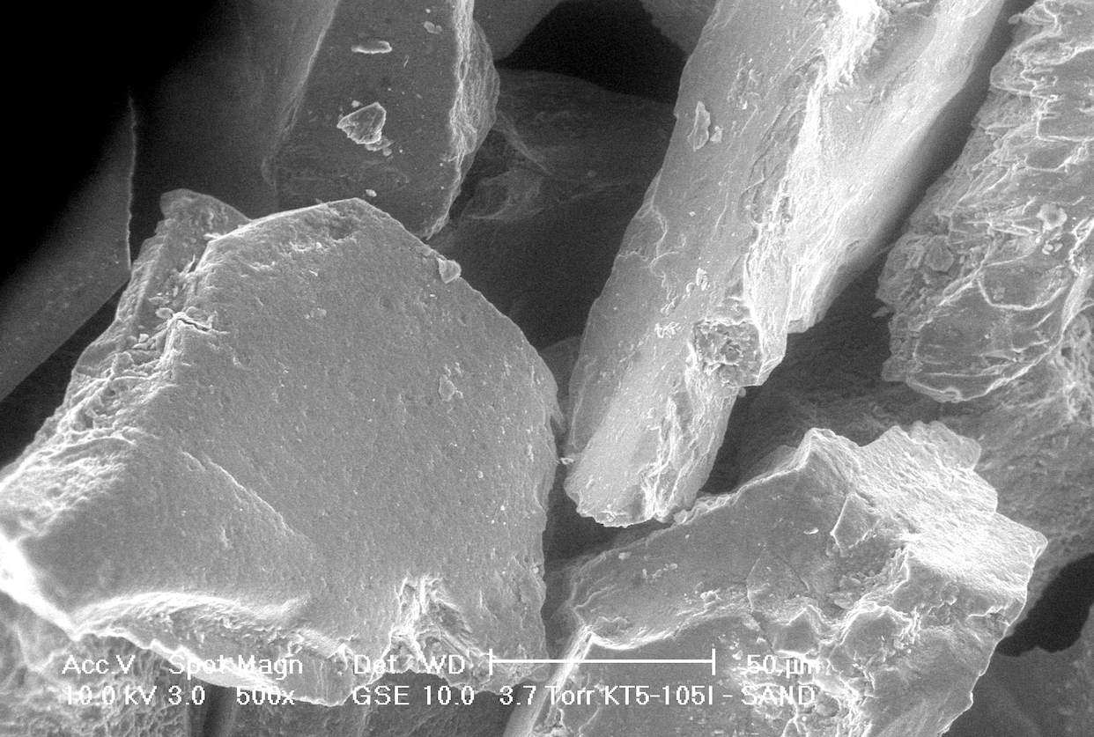
PlumeStop™: reagent distribution
SEM image of sand particles without PlumeStop
Notes:
SEM = Scanning Electron Micrograph

Slide 13
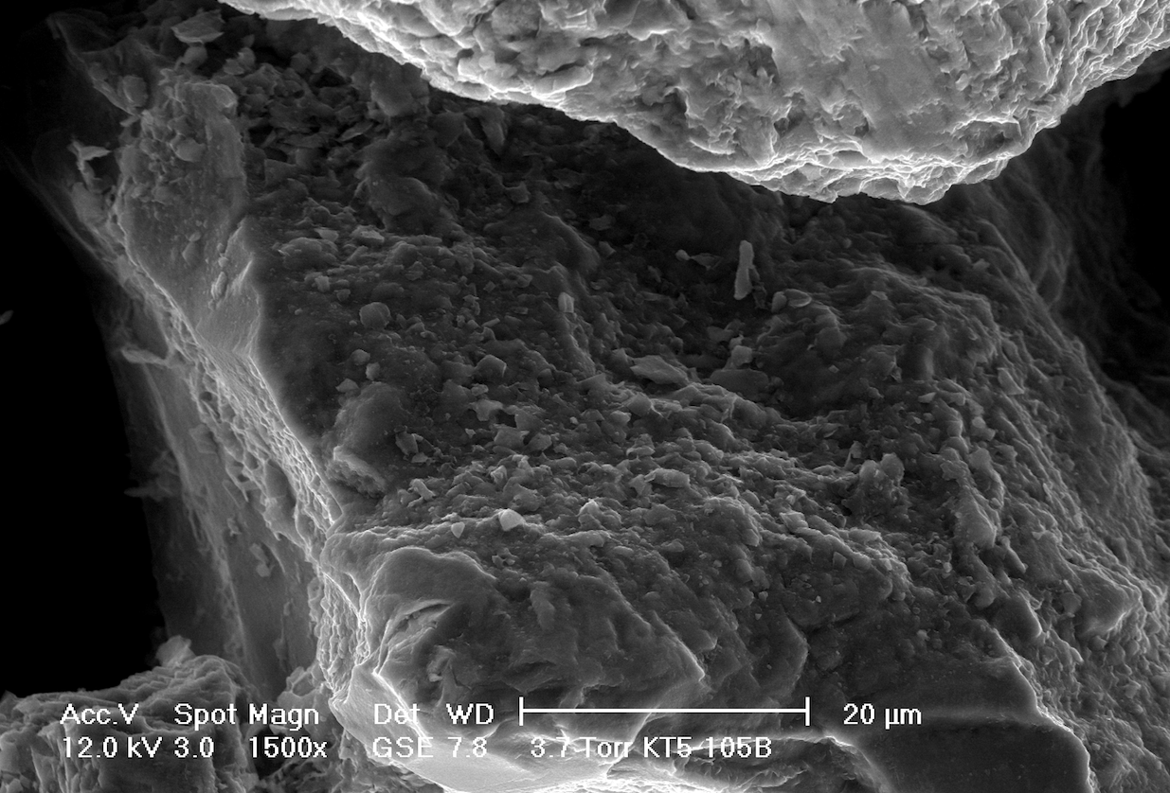
PlumeStop™: reagent distribution
SEM image of sand particle coated with PlumeStop
Notes:
Note PlumeStop particle size of 1 – 2 µm versus scale bar and sand particle

Slide 14
PlumeStop™: reagent distribution
Q: Can the reagent be effectively distributed through a saturated soil medium?
Column Study – 50 mm x 600 mm (2” x 2’)
Loamy Coarse Sand (48% coarse grain; 31% medium; 8% fine; 2% very fine; 11% fines)
PlumeStop™ versus Powdered Activated Carbon (PAC)
  25 g of 0.6% PlumeStop – equal mass and conc. of PAC
Gravity Feed – equal flow
Total of three pore volumes

Slide 15
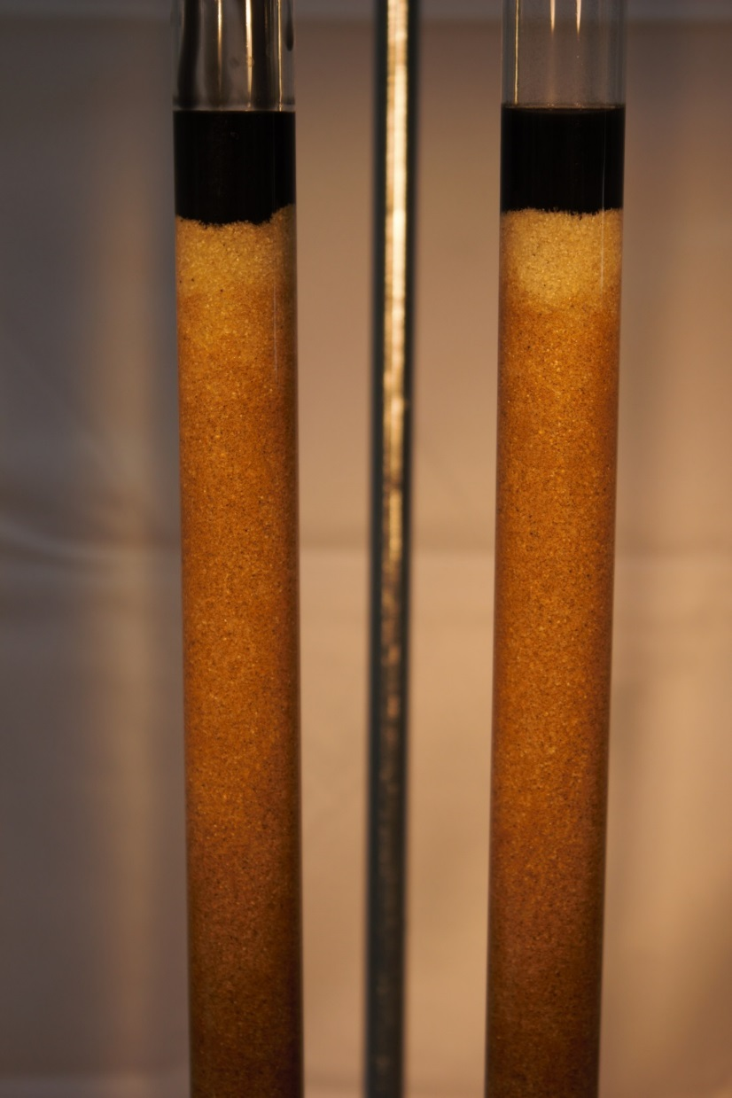
Plume Stop
PAC

Slide 16
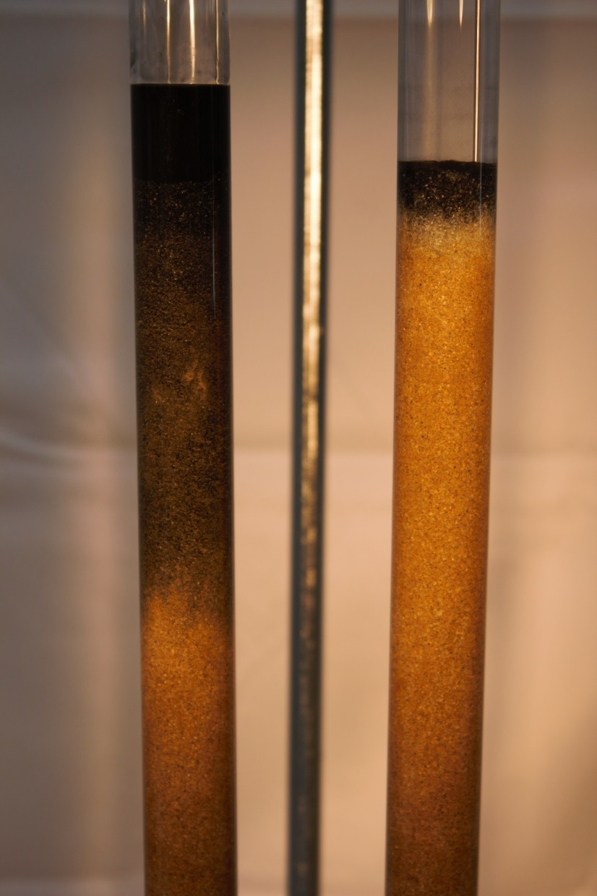
Plume Stop
PAC

Slide 17
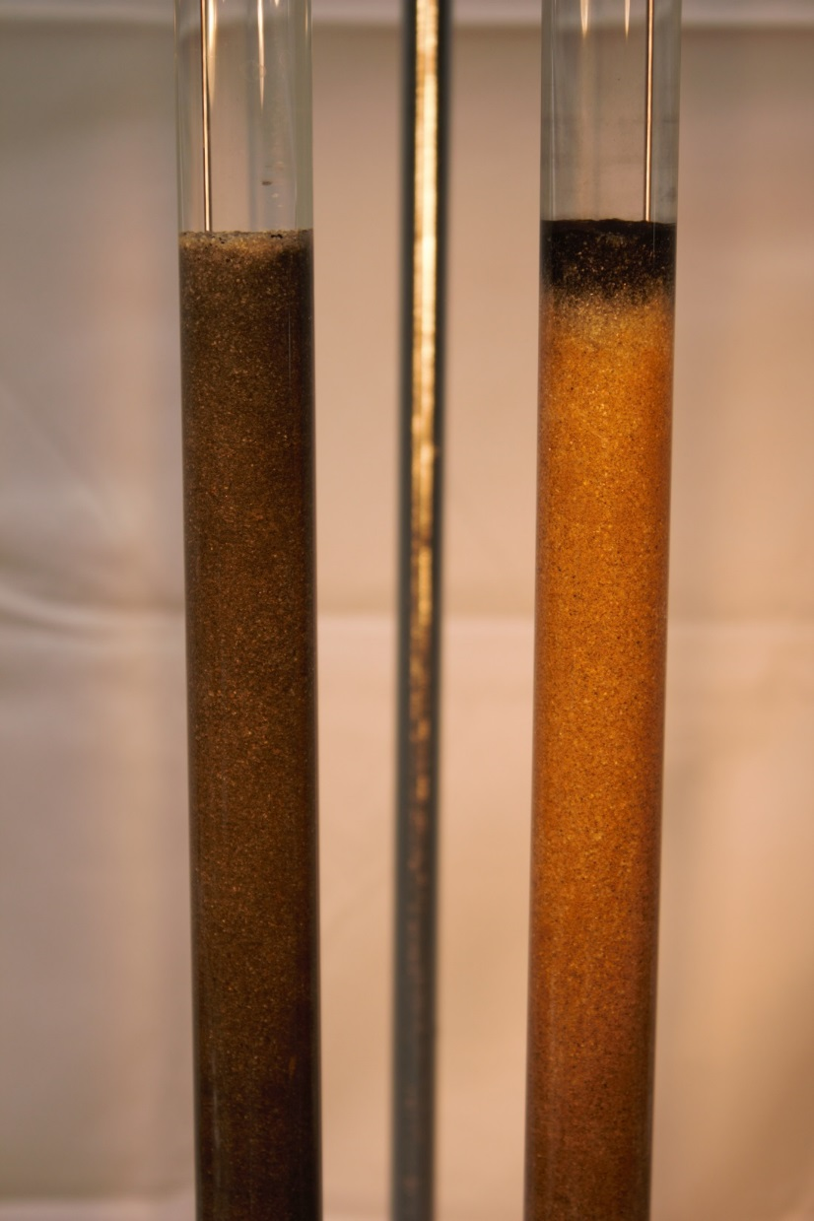
PlumeStop
PAC

Slide 18


–performance –
chlorinated solvents – post-sorption degradation – lines of evidence

Slide 19
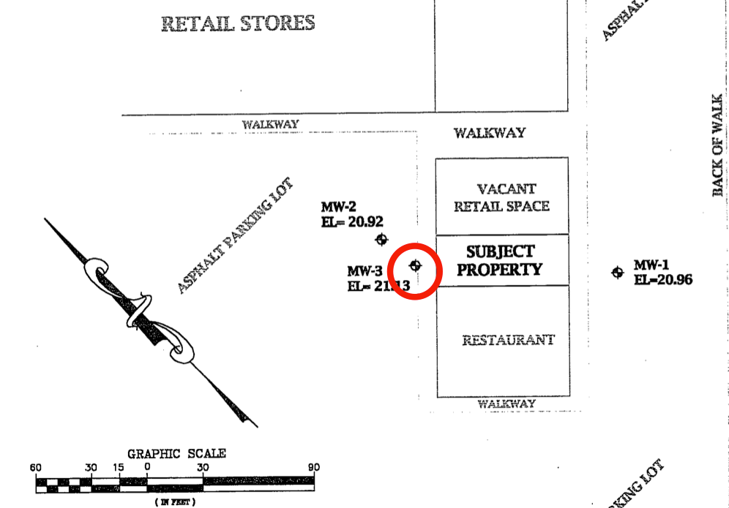
California Site
‘Dune Sand’ formation
DTW~13 ft. bgs.
30ft/year groundwater flow
High redox conditions (aerobic)
No attenuation evident
PCE 550 µg/L
No daughter products
PlumeStop™
Electron donor and bacteria
Notes:
Site has been open since the 2001
Site is under the jurisdiction of the CCRWQCB
Closure request not granted since last 5 years due to one offending well.
No nearby sensitive receptors.
CCRWQCB agreed to close site if MW3 shows decreasing trend.
Regenesis proposed beta testing to assist in closure for case studies.

Slide 20
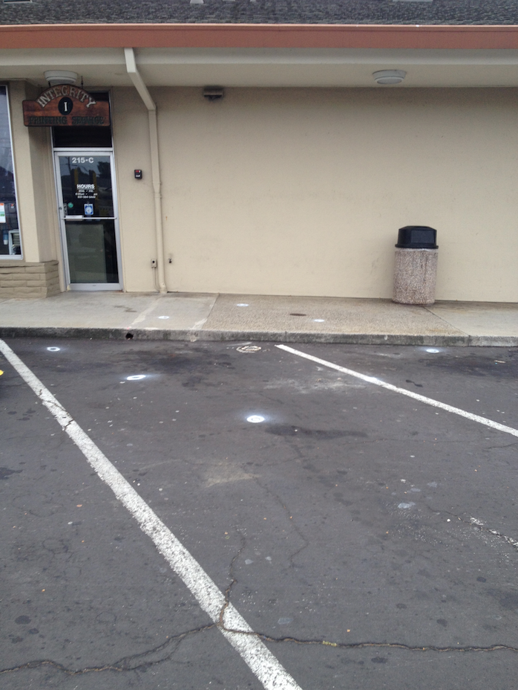


Pilot Test Arrangement
Injection Interval: 8 – 25 ft. bgs
3,200lbs PlumeStop™ into 8 pts.
540lbs. HRC, and
6.12L. BDI Plus ®
Groundwater ≈10m/year
Notes:
3 : 2 : 3 arrangement around test well
Question for Craig – where was the donor and HRC added?
NB: proof of concept trial rather than remediation project – does NOT represent a typical field application design – this is just around one well.

Slide 21
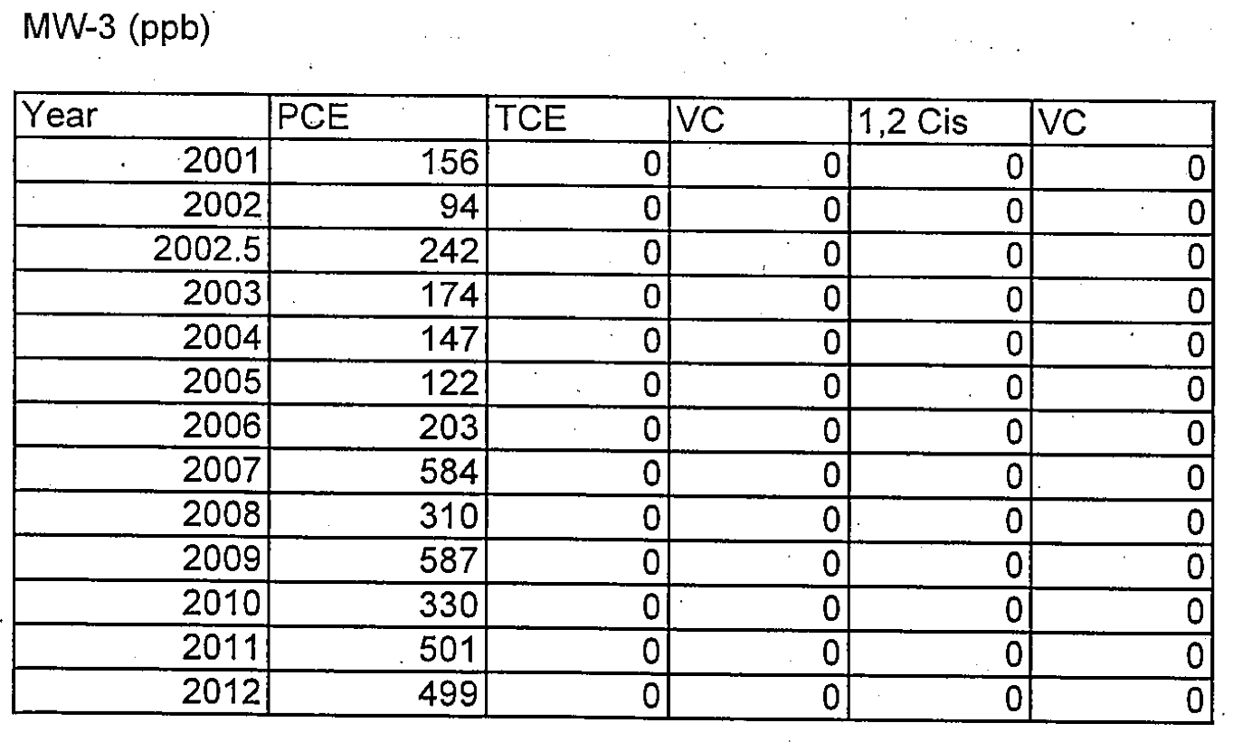
Historic Data
Steadily increasing PCE
No daughter products
(aerobic conditions)

Slide 22
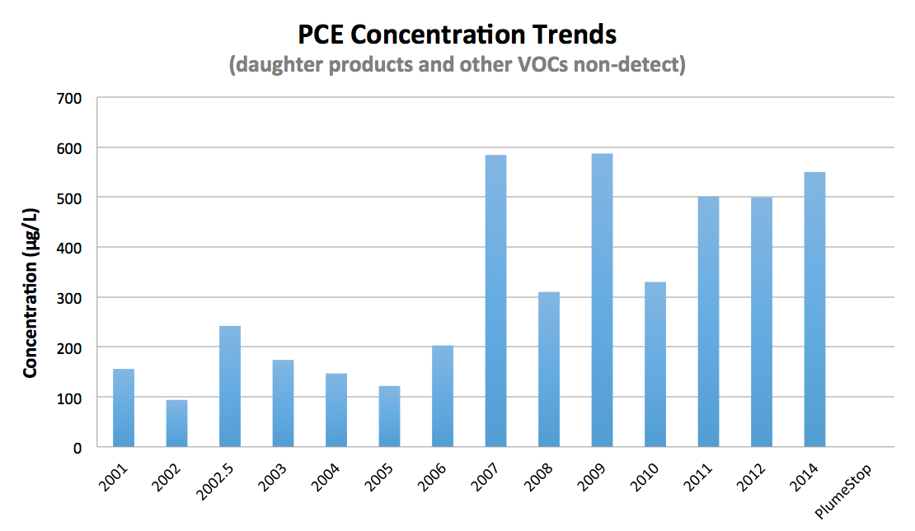
(<0.5µg/L)
Notes:
So 550 µg/L to <0.5 µg/L is three orders of magnitude reduction = 1000x reduction

Slide 23
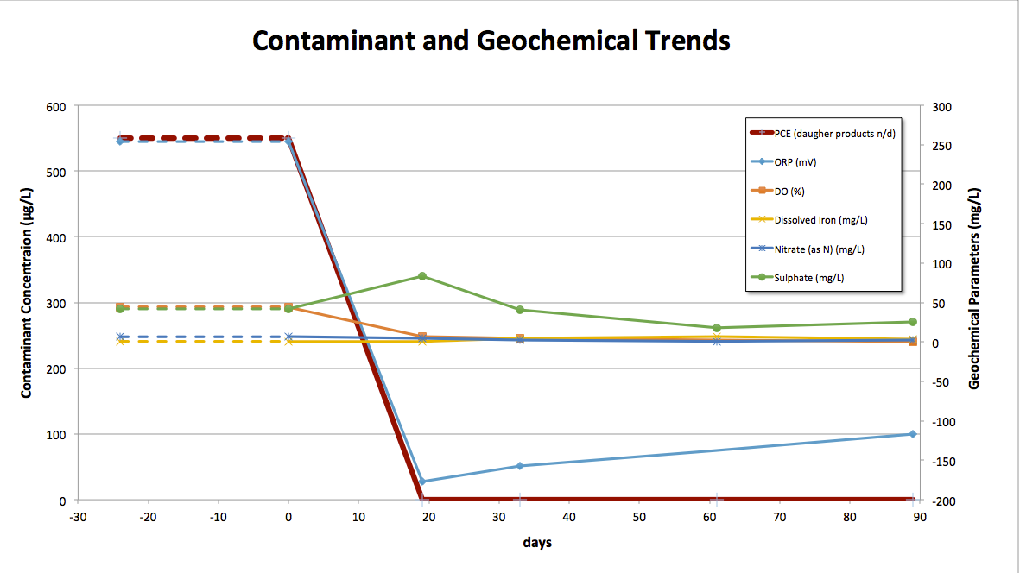
application
Redox ‘sweet spot’ establishes
Competing TEA’s decline
(note zero on 2º axis)
Notes:
T.E.A. = Terminal Electron Acceptor (i.e. oxygen, nitrate, iron, sulphate).
Note that all geochemical parameters are on the secondary axis.
Note also that this shows that the PCE stays n/d through the study period – the previous slide was more about historical context with a single post-PlumeStop data point.

Slide 24
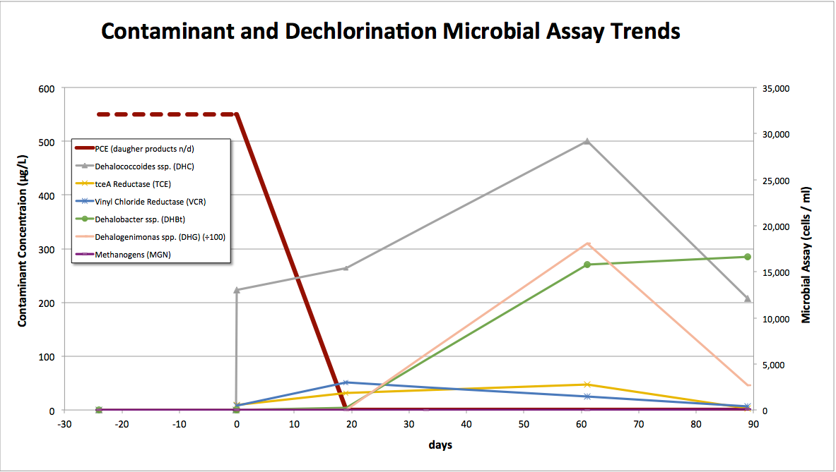
application
PCE immediately ⬇︎ to ND (<5µg/L)
Micro parameters increase post-app then decrease after ～two months
225%
3,000 x
(init. ND)
676%
541%
(no methanogenesis)
Notes:
Note: Sheep in a car park
Baseline (-24 day) data are shown for all parameters but trendline to t=0 is forced through zero. It would otherwise appear that PCE began to decline and DHC etc began to rise from -24 days, whereas PCE was static / increasing.
Key point: if the bacteria were not degrading the solvents, they would decline following the inoculation spike. The fact that they increase post-inoculation suggests they are living off something that enables them to grow. Given that these are solvent degrading species and specific solvent-degrading enzymes suggests they are degrading the solvents rather than living off the HRC (or each other) as the inoculum itself does not contain solvents.
DHC: 225% (only DHC can anaerobically degrade DCE and VC)
TCE reductase 541% (a DHC enzyme for TCE and DCE to VC)
VC reductase 676% (a DHC enzyme for VC to ethene)
Note that the activity of DHC increases by more than the microbial numbers.
Dehalobacter spp. ‘Infinite’ (non-detect to 16,600 cells/ml) (PCE and TCE to cis-DCE)
Dehalogenimonas spp. 4 orders of magnitude (3000x) (594 to 1.8M cells/ml) (the joker in the pack – this is a chlorinated alkane degrader – BUT: some strains have been shown to grow during hydrogenolysis of trans-DCE to ethene). Manchester et al. Appl. Environ. Microbiol. 2012, 78(15):5280
Note also that the methanogens never get off the ground – all the above occurs without entering methanogenic conditions (below approx -240 mV) (see previous slide).

Slide 25
Data Summary
>99% (two OOM) PCE concentration reduction within 14 days
  550 µg/L to non-detect (<5 µg/L)
Optimal dehalorespiration conditions established
  Redox from +254 mV to -150 mV (±30 mV) ‘sweet spot’
  Competing electron acceptors depleted
Post-inoculation microbial trends
  Increase then decrease in dechlorination species and enzymes
  Consistent with solvent metabolism and depletion

Slide 26
Well ID |  |  | MW-3
 |  |  | treatment zone | treatment zone | treatment zone | treatment zone | treatment zone | treatment zone
Sample ID |  |  | MW-3 | MW-3 | MW-3 | MW-3 | MW-3 | MW-3
Date Sampled |  |  | 4/1/2014 | 5/14/2014 | 5/29/2014 | 6/25/2014 | 7/23/2014 | 10/15/2014
Days |  |  | -24 | 19 | 33 | 61 | 89 | 160
Monitoring Event |  |  | baseline | 2 week | 1 month | 2 month | 3 month | 6 month
Analyte
1,1 Dichloroethene | µg/L | 0.5 | < 0.50 | < 5 | < 5 | < 0.50 | < 0.50 | < 0.50
Carbon disulfide | µg/L |  | < 1.0 | < 10 | < 10 | < 1.0 | 1.8 | 1.3
cis-1,2-Dichloroethene | µg/L | 0.5 | < 0.50 | < 5 | < 5 | < 0.50 | < 0.50 | < 0.50
Methylene chloride | µg/L | 1 | < 1.0 | 11 | < 10 | < 1.0 | < 1.0 | < 1.0
Tetrachloroethene | µg/L | 5 | 550 | < 5.0 | < 5.0 | 0.72 | < 0.50 | < 0.50
trans-1,2-Dichloroethene | µg/L | 0.5 | < 0.50 | < 5 | < 5 | < 0.50 | < 0.50 | < 0.50
Trichloroethene | µg/L | 0.5 | < 0.50 | < 5 | < 5 | < 0.50 | < 0.50 | < 0.50
Vinyl chloride | µg/L | 0.5 | < 0.50 | < 5 | < 5 | < 0.50 | < 0.50 | < 0.50
Total VOC | µg/L |  | 550 | 11 | 0 | 0.72 | 1.8 | 1.3
% VOC Reduction | µg/L |  | --- | 98% | < 99% | < 99% | < 99% | < 99%

Slide 27
Conclusions
PlumeStop™ - depletion of GW solvents to n/d within 14 days
Lines of evidence for post-sorption degradation secured
All data obtainable from groundwater samples alone
closed
Notes:
See Yang and McCarty
-data 14 months post PlumeStop injection shows PCE and daughter products at non-dedect.
-subsequent vapor sampling performed to see if any relic vapors generated post treatment.
-Successful pilot lead to 2 additional beta tests at dry cleaning sites under CVWQCB oversight

Slide 28

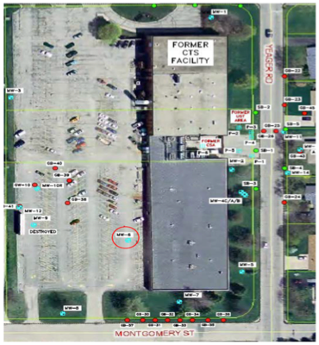
–performance –
chlorinated solvent site

Slide 29
PlumeStop™ - Performance - Field
Former electronics facility
  TCE 1,390 µg/L
  TCA 3,550 µg/L
Sand to silty-sand
Depth to groundwater 3 – 4 m (10 – 13 feet)
Seepage velocity 3.7 m/yr (12 ft/yr) to the southwest

Slide 30
PlumeStop™ - Performance - Field
One test area, down-gradient of sources
  Plume only – no NAPL
PlumeStop application by direct push injection
  10 point grid array at 1.5 – 2 m spacing (5 – 6.5 ft)
  Target interval 2.75 – 6.5 m (9 – 21 feet) below ground surface
HRC® applied up-gradient and between points
  Creates conditions appropriate for microbial colonisation and activity
Soil cores pre and post PlumeStop application
  Distribution evaluation

Slide 31
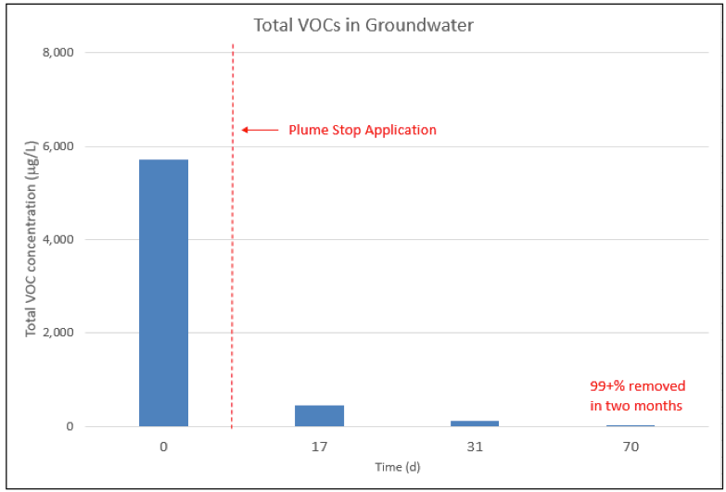
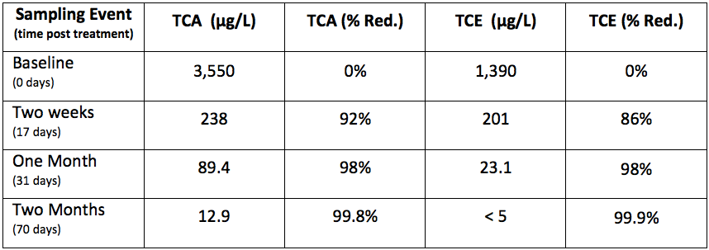
PlumeStop™ - Performance - Field
Notes:
The immediate sorption is evident, with further sorption proceeding as the concentrations equilibrate and contaminant partitioning into the PlumeStop continues.
Subtle additional point to be aware of, but not recommended as part of your talk. Note that the concentration decline post immediate sorption (i.e. the decline from 17 days through 70 days) is possibly linked to the rate at which the residual PlumeStop sorbs to the soil matrix – the period that the water is still black in other words. This is because the contamination will sorb equally to suspended or ‘parked’ PlumeStop, therefore the black in the black water will have contaminant sorbed within it. This will show up in the analysis – unless the sample is filtered.

Slide 32
PlumeStop™ – product usage indicators
When time is critical
For control of migrating contamination
To secure stringent clean-up targets
As a long–term means of addressing matrix back-diffusion
When remediation performance is flat-lining
(skip detail)

