Slide 1
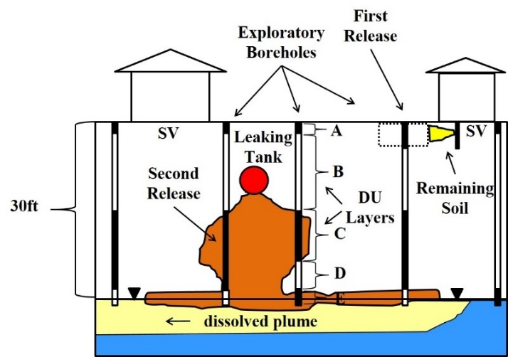
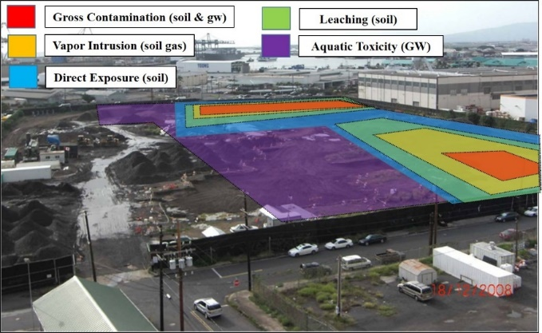
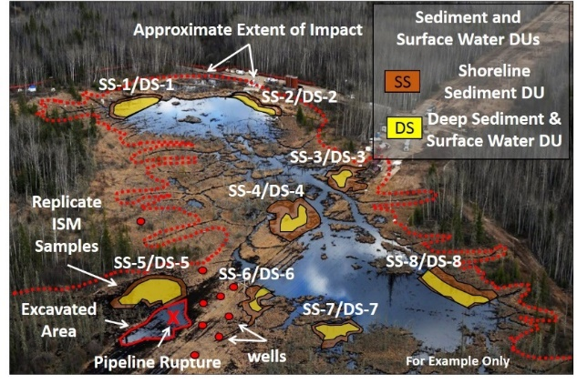
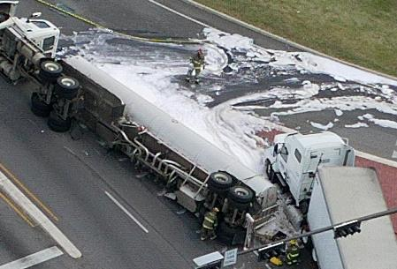
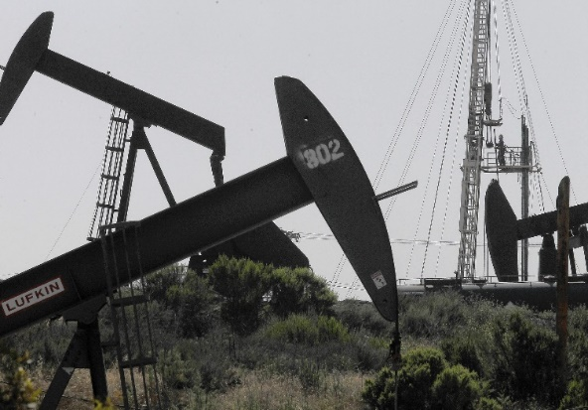
“Metabolite” Tapwater Toxicity in ITRC Case Studies
Roger Brewer, Hawaii Dept of Health
ITRC TPH Risk Team, September 19, 2017
Study #2: Gas Station
Study #1: Fuel Terminal
Study #3: Oil Pipeline
Study #4: Tanker Truck
Study #5: Oil Field

Slide 2
References
1. *Zemo et al. 2016. Life Cycle of Petroleum Biodegradation Metabolite Plumes, and Implications for Risk Management at Fuel Release Sites. Integrated Environmental Assessment and Management. DOI: 10.1002/ieam.1848
(based on field studies of fuel degradation in groundwater)
2. Case Studies Attachment 5: Example Calculation of Metabolite Suite-Weighted, Risk-Based Screening Levels for Tapwater (after Zemo et al. 2016)

Slide 3
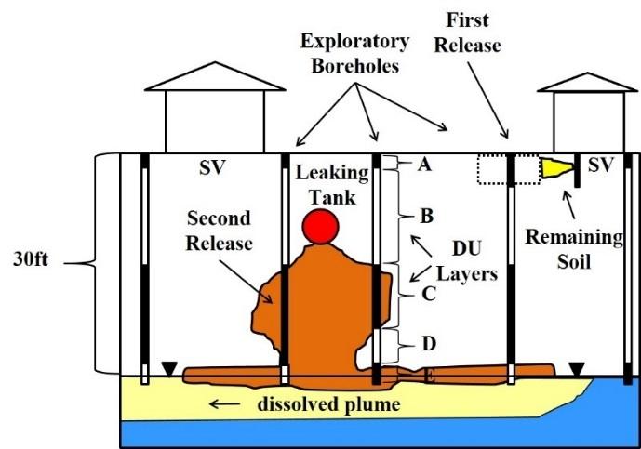
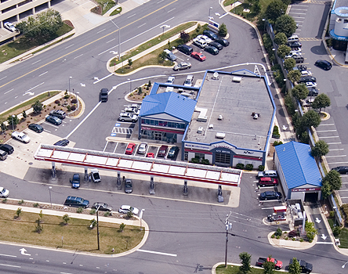
Case Study #2: Gas Station
Site Status: Active
Petroleum Type: Gasoline
Impacted Media: Soil, Soil Vapor, Groundwater
Dissolved-phase plume of degraded petroleum migrating offsite;
Potential impacts to shallow, irrigation well at adjacent school;
Sometimes used as source of drinking water by worker and students;
Mixed TPH and TPH-related metabolites in source area but dominated by metabolites downgradient area;
Drinking water screening levels?

Slide 4
Calculation of Screening Levels
for TPH in Drinking Water
(after HDOH, CAEPA, etc.)
Step 1: Designate Carbon Ranges and Assign Toxicity Factors
Step 2: Estimate Carbon Range Makeup of TPH Fuel Types
Step 3: Calculate Carbon Range-Weighted TPH Toxicity Factors
Step 4:Calculate Carbon Range-Weighted TPH Screening Levels

Slide 5
Calculation of Carbon Range-Weighted
TPH Toxicity Factors & Screening Levels
(after HDOH, CAEPA, etc.)
Step 1: Example Carbon Range Toxicity Factors
Carbon Range | *Ingestion RfD (mg/kg-day) | *Inhalation RfC (mg/m³)
C5-C8 aliphatics | 0.04 | 0.6
C9-C18 aliphatics | 0.01 | 0.1
C19+ aliphatics | 3.0 | NA
C9-C16 aromatics | 0.03 | 0.1
*Lower number = higher toxicity
RfD = Milligrams of chemical per kilogram of body weight per day

Slide 6
In English: “Safe” Average Daily Exposure
(assuming 15 kg Child)
Carbon Range | *Ingestion (mg/day)
C5-C8 aliphatics | 0.6
C9-C18 aliphatics | 0.15
C19+ aliphatics | 45
C9-C16 aromatics | 0.45
Aspirin | 81
PCBs | 0.0003
*For example only; not adjusted for exposure frequency
“Dose Makes the Poison”

Slide 7
Calculation of Carbon Range-Weighted
TPH Toxicity Factors & Screening Levels
(after HDOH, CAEPA, etc.)
Step 2: Assumed Carbon Range Makeup of Fuels
Fuels (for example only):
Carbon Range | TPH_{gasoline} | TPH_{diesel} | TPH_{resfuels}
C5-C8 aliphatics | 45% | 0.4% | 0%
C9-C18 aliphatics | 12% | 35% | 0%
C19+ aliphatics | 0% | 43% | 75%
C9-C16 aromatics | 43% | 22% | 25%
Fuel Vapors (for example only):
Carbon Range | TPH_{gasoline} | TPH_{diesel}
C5-C8 aliphatics | 77% | 25%
C9-C18 aliphatics | 7.3% | 75%
C9-C16 aromatics | 15% | 0%

Slide 8
Carbon Range-Weighted Toxicity Factors
(after HDOH, CAEPA)
Step 3: *Carbon Range-Weighted TPH Toxicity Factors
Carbon Range | *RfD (mg/kg-day) | *RfC (mg/m³)
TPHg | 0.03 | 0.28
TPHd | 0.02 | 0.13
TPHro | 0.12 | NA
*Biased toward more toxic components

Slide 9
Carbon Range-Weighted Toxicity Factors
& Screening Levels (after HDOH, CAEPA)
Step 4: Carbon Range-Weighted TPH Screening Levels
USEPA RSL Tapwater model (child exposure)
*Exposure Pathway | TPHg (µg/L) | TPHd (µg/L) | TPHro (µg/L)
Drinking Water (ingestion only) | 600 | 400 | 2,400
Drinking Water (ingestion + inhalation) | 300 | 160 | 2,400
*Assumes child water ingestion rate of 0.78 liters/day, 350 days per year for 6 years.

Slide 10
Similar Approach Can (in Theory) be Applied to
TPH-Related Metabolites in Drinking Water
(Case Studies Attachment 5; based on Zemo et al. 2016)
Step 1: Designate Metabolite Families and Assign Toxicity Factors
Step 2: Estimate Metabolite Family Makeup of Degraded TPH
Step 3: Calculate Metabolite Suite-Weighted Toxicity Factors
Step 4: *Calculate Metabolite Suite-Weighted Screening Levels

Slide 11
Step 1: Metabolite Families & Toxicity Factors
Toxicity Ranking of TPH-Related Metabolites
(Zemo et al. 2016)
Metabolite Family | Toxicity Ranking | Estimated Range Ingestion RfD (mg/kg-day)
 |  | Low | High
Alcohols | Low | 0.1 | 1.0
Acids/Esters | Low | 0.1 | 1.0
*Ketones | Low/Low-Mod | 0.01 | 1.0
Aldehydes | Low to Mod | 0.01 | 0.1
*Phenols | Low/Mod | 0.001 | 1.0
*Estimated toxicity of ketone and phenol mixtures varies between degradation stages.
Oxidized hydrocarbons not significantly volatile;
Focus on ingestion route of exposure for tapwater.

Slide 12
Step 2: Degradation Stages vs Metabolite Family Makeup
Degradation Stages (Zemo et al. 2016)
Stage 1:
Source Area (dissolved HC + metabolites)
Stage 2:
Smear Zone
(metabolites only, no dissolved HC)
Stage 3:
Transition Zone
(ave Stages 2 & 4)
Stage 4:
Downgradient
(metabolites only and outside of smear zone)
Transport Direction and/or Increasing Residence Time

Slide 13
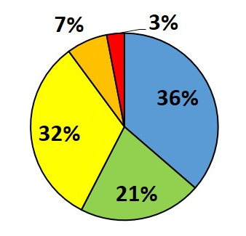
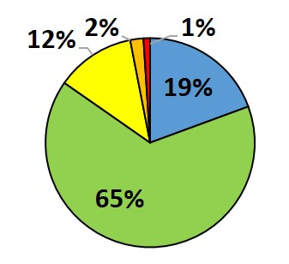
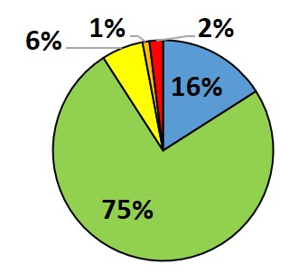
Step 2: Degradation Stage vs Metabolite Makeup
(Zemo et al. 2016)
Stage 1
Stage 2
Alcohols
Acids/Esters
Ketones
Aldehydes
Phenols
Stage 3
Stage 4

Slide 14
Step 3: Metabolite Suite-Weighted Toxicity Factors
Degradation Stage | Estimated Range *Weighted Ingestion RfD (mg/kg-day)
 | Low | High
Stage 1 | 0.02 | 0.20
Stage 2 | 0.04 | 0.37
Stage 3 | 0.05 | 0.55
Stage 4 | 0.07 | 0.69
*Biased toward more toxic components

Slide 15
Step 4: Metabolite Suite-Weighted Screening Levels
For example only!
*Drinking Water (ingestion only) | Stage 1 (µg/L) | Stage 2 (µg/L) | Stage 3 (µg/L) | Stage 4 (µg/L)
Most Conservative RfDs | 420 | 740 | 1,100 | 1,400
Least Conservative RfDs | 4,200 | 7,400 | 11,000 | 14,000
*Assumes child water ingestion rate of 0.78 liters/day for 350 days per year.
Carbon Range-Weighted Screening Levels
*Exposure Pathway | TPHg (µg/L) | TPHd (µg/L) | TPHro (µg/L)
Drinking Water (ingestion only) | 600 | 400 | 2,400
Drinking Water (ingestion + inhalation) | 300 | 160 | 2,400
*Assumes child water ingestion rate of 0.78 liters/day for 350 days per year.

Slide 16
Example Drinking Water Screening Levels
for TPH-Related Metabolites
(most conservative toxicity factors applied)
Stage 1:
*Source Area (+dissolved HC)
420 µg/L
Stage 2:
Smear Zone
(metabolites only)
740 µg/L
Stage 3:
Transition Zone
(ave Stages 2 & 4)
1,100 µg/L
Stage 4:
Downgradient
(metabolites only)
1,400 µg/L
Transport Direction and/or Increasing Residence Time
*Non-degraded, TPH hydrocarbons must be evaluated separately and cumulative risk considered.

Slide 17
Summary
Weighed carbon range approach to calculate TPH screening levels for drinking water in use for 15+ years;
Similar approach possible for TPH-related degradation compounds (“metabolites”) in drinking water;
Focus on ingestion exposure pathway (low volatility);
Degradation Stage 1 & 2 metabolite suites generate screening levels similar to TPH parent compounds (400-700 µg/L);
Higher screening levels potentially applicable to Stage 3 & 4 metabolite suites, assuming proposed toxicity factors appropriate (e.g., 1,100-1,400 µg/L);
Within or above likely “TPH” taste and odor threshold range of 500-1,000 µg/L (i.e., receptor will know water is contaminated).

