Slide 1

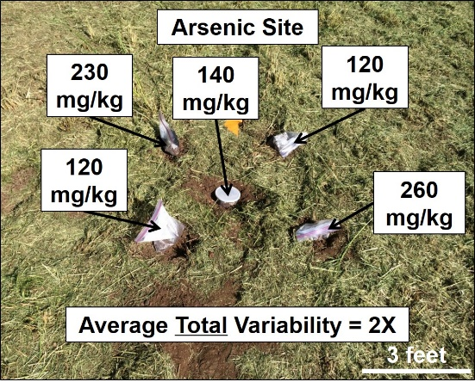
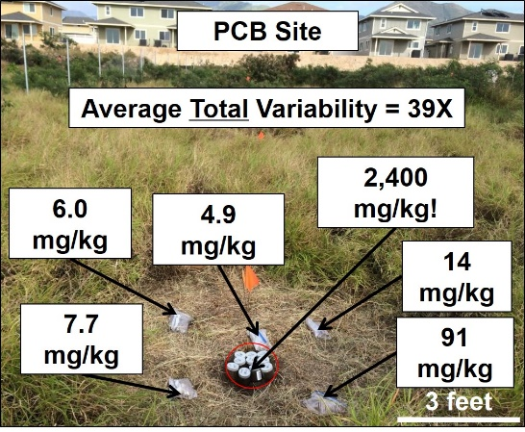
Risk-Based Investigation and Characterization of Contaminated Soil and Sediment
Roger Brewer, PhD, Senior Environmental Scientist
Hawai´i Department of Health, Honolulu, Hawai´i, USA (roger.brewer@doh.hawaii.gov)
February 20, 2019
Let me tell you why you’re here. You’re here because you know something. What you know you can’t explain. But you felt it. You felt it your entire life. That there’s something wrong with the world. You don’t know what it is, but it’s there. Like a splinter in your mind – driving you mad.
Morpheus (The Matrix )

Slide 2
References
HDOH, 2016, Technical Guidance Manual: Hawai‘i Department of Health, Office of Hazard Evaluation and Emergency Response, http://www.hawaiidoh.org/
HDOH, 2017, Evaluation of Environmental Hazards at Sites with Contaminated Soil and Groundwater: Hawai‘i Department of Health, Office of Hazard Evaluation and Emergency Response,
www.hawaii.gov/health/environmental/hazard/eal2005.html

Slide 3
Six-Part Webinar Training Series (2017, recorded)
Site Investigation Design;
Decision Unit Designation;
Decision Unit Characterization (sampling theory);
Field Implementation of DU-MIS Methods;
Laboratory Processing;
Environmental Hazard Evaluation (aka “risk assessment”).
Hawaii DOH Webinar Webpage:
http://eha-web.doh.hawaii.gov/eha-cma/Leaders/HEER/Webinar

Slide 4
Webinar Topics
Terminology
Risk Assessment Basics
Origin of Discrete Soil Sampling Methods
Field Study of Discrete Sample Data Reliability
“Decision Unit” and “Multi Increment” Sample Site Investigation Methods (DU-MIS)
Case studies
Regulatory transition from discrete to DU-MIS
If I had one hour to solve the problems of the world I would spend 59 minutes on explaining the problem and 1 minute on explaining the answer.
Albert Einstein

Slide 5
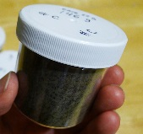
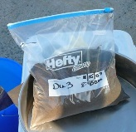
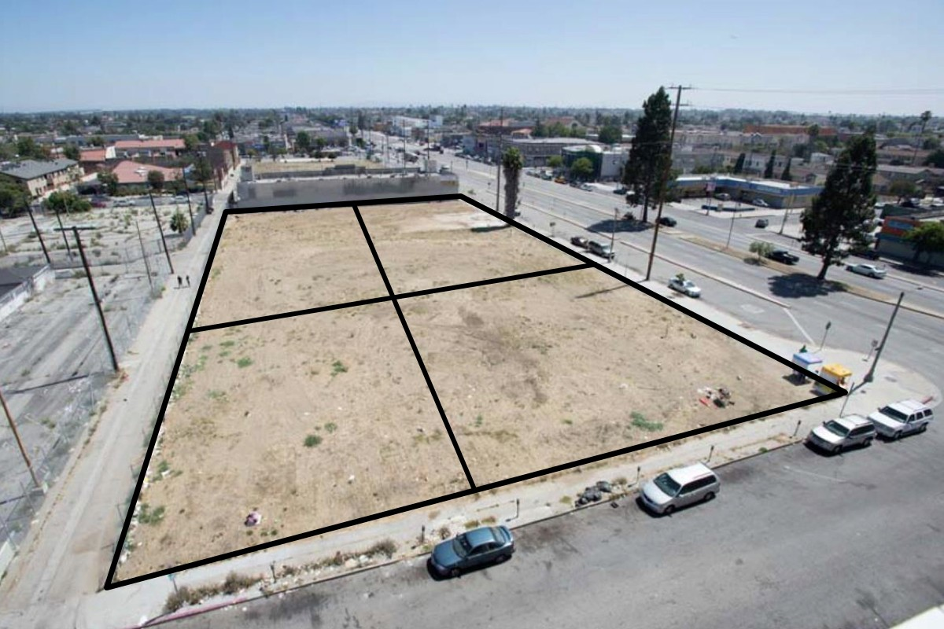
Terminology
Decision Unit (DU)
Discrete
Sample
(100-200g)
DU-2
Multi Increment® Sample
(1-2+kg)
X
X
X
X
DU-1
X
X
X
X
X
X
X
X
X
X
X
X
X
X
X
X
X
X
X
X
X
X
X
?
X
X
X
X
X
X
X
X
X
X
X
X
X
DU-4
X
X
X
X
X
?
X
X
X
X
X
Multi Increment® is a registered trademark of EnviroStat, Inc.
DU-3
DU: Area/volume of soil you would collect and test as a single mass, if you could…;
Discrete Sample (used since 1980s):
  Collected from a single point within a targeted area (“single increment sample”);
  Mass collected based on laboratory needs (typically 100-200 grams).
Multi Increment Sample (relatively “new” idea):
  Collected from multiple points (“increments”) within a targeted area;
  Mass and # of “increments” included in sample based on Gy’s sampling theory.

Slide 6



“Composited” Discrete Samples
(as defined in TSCA and other regulations)
“Composited”
Discrete
Samples
DU-2
DU-1
DU-4
DU-3
Original: Separate decision to be made on each, separate “DU” sample collection area;
Soil from different areas “composited” in order to save on laboratory costs;
Potential under-representation of higher concentration area(s) by composite data;
Laboratory result multiplied by number of “DU areas” (i.e., discrete samples) included in composite for comparison to cleanup level.

Slide 7


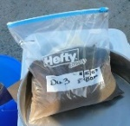
Theoretical Compositing of Multi Increment Samples
(not allowed!)
“Composited”
Multi Increment
Samples
X
X
X
X
X
X
X
X
X
X
X
X
X
X
X
X
X
X
X
X
X
X
X
X
X
X
X
X
X
X
X
X
X
X
X
X
X
X
X
X
X
X
X
X
X
X
X
X
X
X
X
X
X
X
X
X
X
X
X
X
X
X
X
X
X
X
X
X
X
X
X
X
X
X
X
X
X
X
X
X
X
X
X
X
X
X
X
X
X
X
X
X
X
X
X
X
X
X
X
X
X
X
X
X
X
X
X
DU-2
X
X
X
X
X
X
X
X
X
X
X
X
X
X
X
X
X
X
X
X
X
X
X
X
X
X
X
X
X
X
X
X
X
X
X
X
X
X
X
X
X
X
X
X
X
X
X
X
X
X
X
X
X
X
X
X
X
X
X
X
X
DU-1
X
X
X
X
X
X
X
X
X
X
X
X
X
X
X
X
X
X
X
X
X
X
X
X
X
X
X
X
X
X
X
X
X
X
X
X
X
X
X
X
X
X
X
X
X
X
X
X
X
X
X
X
X
X
X
X
X
X
X
X
X
X
X
X
X
X
X
X
X
X
X
X
X
X
X
X
X
X
X
X
X
X
X
X
X
X
X
X
X
X
X
X
X
X
X
X
X
X
X
X
X
X
X
X
X
X
X
X
X
X
X
X
X
X
X
X
X
X
X
X
X
X
X
X
X
X
X
X
X
X
X
X
X
X
X
X
X
X
X
X
X
X
X
X
X
X
X
X
X
X
DU-4
X
X
X
X
X
X
X
X
X
X
X
X
X
X
X
X
X
X
X
X
X
X
X
X
X
X
X
X
X
X
X
X
X
X
X
X
X
X
X
X
X
X
X
X
X
X
X
X
X
X
X
DU-3
X
X
X
X
X
X
X
X
X
X
X
X
X
X
X
X
X
X
X
X
X
A single MI sample collected within a single DU area is not a composite under TSCA and other USEPA regulations;
Compositing of MI samples not allowed under HDOH guidance;
Avoid use of term “composite” in reports.

Slide 8
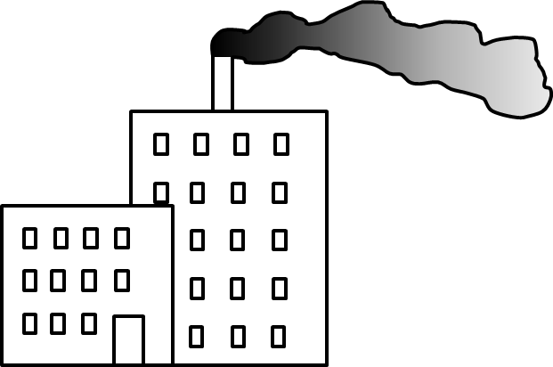
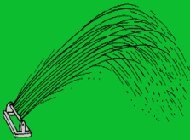
Risk Assessment Basics (Training Series Part 6)
Risk based on average daily exposure to low concentrations of contaminants over many years (chronic risk);
Requires collection of sample data representative of assumed exposure.
Commercial
Industrial
Air
Residential
Direct
Exposure
Ecotoxicity
Vapor
Intrusion
Soil
Stream
Leaching
Leaching
Stream
Free Product
Discharge to
aquatic habitats
Gross
Contamination
Dissolved plume
Groundwater
Drinking Water
Notes:
Also referred to as “Exposure Pathways.” Other potential problems include uptake of contaminants in plants or animals used for food.

Slide 9
Assessment of Chronic Health Risk
(similar for air, water, soil, food, etc.)
Simplified Risk Equation:
Cancer/Noncancer
Risk
Ave Exposure
Concentration
Exposure
Factors
=
x
x
Toxicity
The concentration term in the (chronic risk) intake equation is an estimate of the arithmetic average concentration for a contaminant (in a defined, exposure area) based on a set of site sampling results.
USEPA 1992: A Supplemental Guidance to RAGS: Calculating the Concentration Term

Slide 10
Calculation of Risk-Based Screening Levels
(similar for air, water, soil, food, etc.)
Simplified RBSL Equation:
Risk-Based
Screening Level
Acceptable Risk
=
Exposure
Factors
x
Toxicity
RBSL = Allowable, average contaminant concentration for targeted area & volume of soil;
Key part of 1990s Risk-Based Corrective Action (RBCA);
Significantly expedites risk assessment process;
Problem: Lack of guidance for equivalent, “Risk-Based Site Characterization.”

Slide 11
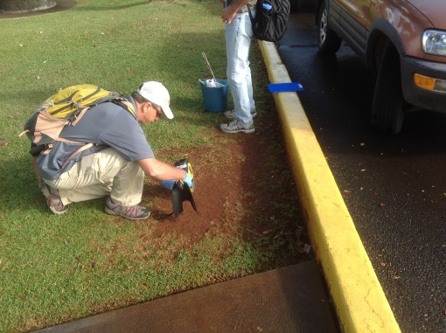
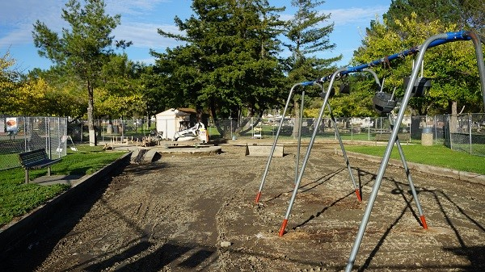
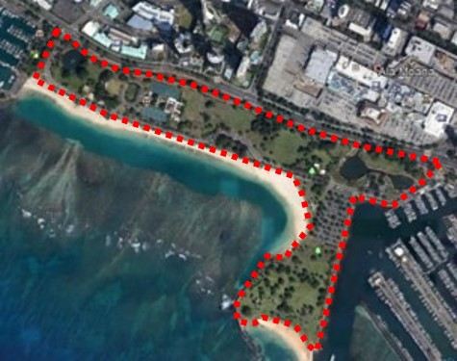
Incorporation of Risk in Site Investigations
(HDOH Training Series Part 1)
What are the primary environmental concerns?
What are the Site Investigation Objectives (aka “DQOs”)?
What data resolution is needed to meet the SIOs?
How can representative samples be collected?
Every Spot?
Each Playground?
The Entire Park?
Ideal: Risk as well as potential remediation questions and needs to be considered upfront in site characterization design;
Reality: Risk assessors and remediation specialists often get stuck with inadequate, after-the-fact data and no time or money to collect additional samples.

Slide 12
Are “Discrete" Soil Samples “Representative”?
“The… level is assumed to be uniform within (a contaminated area) and zero outside it.”
USEPA 1985: Verification of PCB Spill Cleanup
“When there is little distance between points it is expected that there will be little variability between points.”
USEPA 1989: Methods for Evaluating the Attainment of Cleanup Standards
If true:
A few samples collected from single points across site under investigation adequate to characterize contamination and assess risk;
Allows direct comparison of individual, discrete samples to risk-based screening levels.

Slide 13

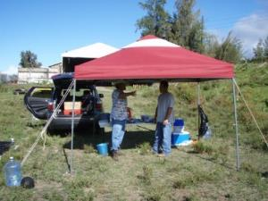
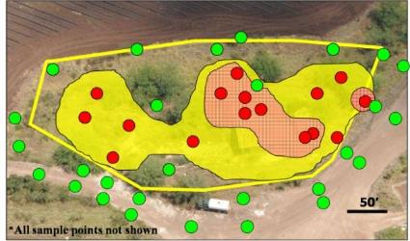
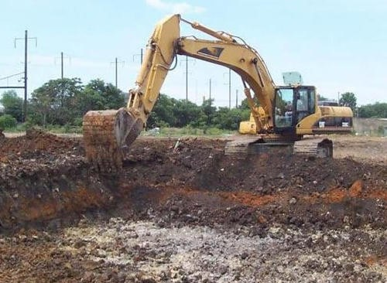

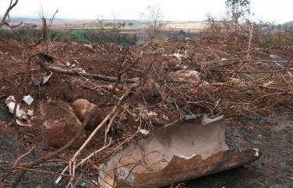
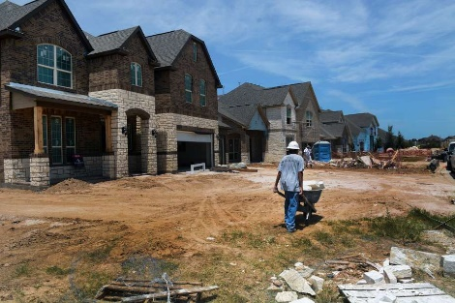
“How’s that working for you?”
Need for multiple remobilizations and “step-out” investigations
“Highly variable” data and failed confirmation samples
Remediated sites later found to still be contaminated

Slide 14
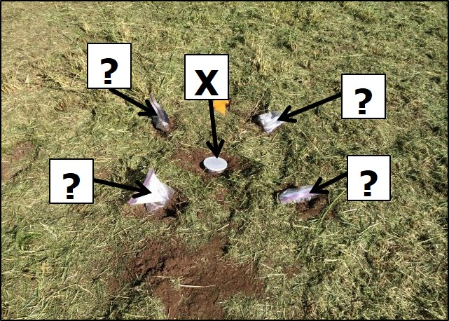
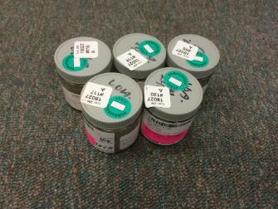
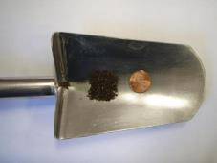

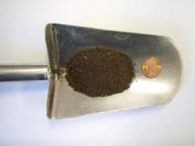
Every wonder...
“What if I moved my sample point over a few feet?
“What if the lab tested a different aliquot of soil?”
Metals:
0.5-1.0 grams
VOCs:
5 grams
PCBs, Pesticides, TPH, PAHs:
10-30 grams
Soil samples cannot be reliably “homogenized” to the scale of a laboratory subsample (1-30g);
Discrete sample data can only be assumed to represent the actual mass of soil tested.

Slide 15
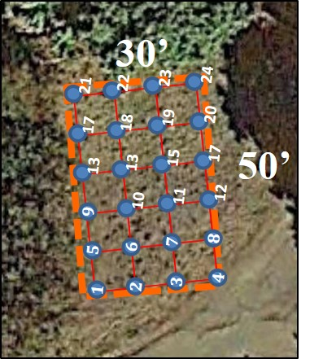
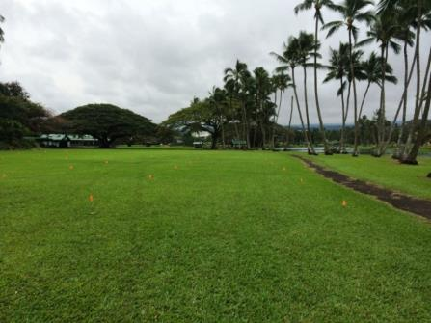
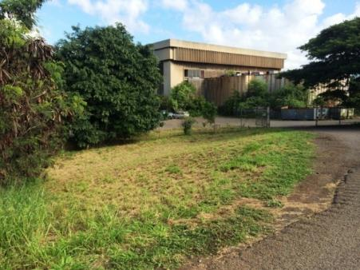
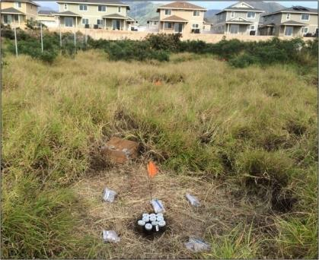
So did we… Discrete Soil Sample Variability Field Study
Three known-contaminated sites studied;
24 grid points designated at each site;
Hundreds of discrete samples collected;
Multi Increment samples (triplicates) collected from same areas.
Study Site A
(arsenic in wastewater)
Study Site B
(lead in incinerator ash)
Study Site C
(PCBs transformer oil)
13,500 ft² area
1,500 ft² area
6,000 ft² area

Slide 16
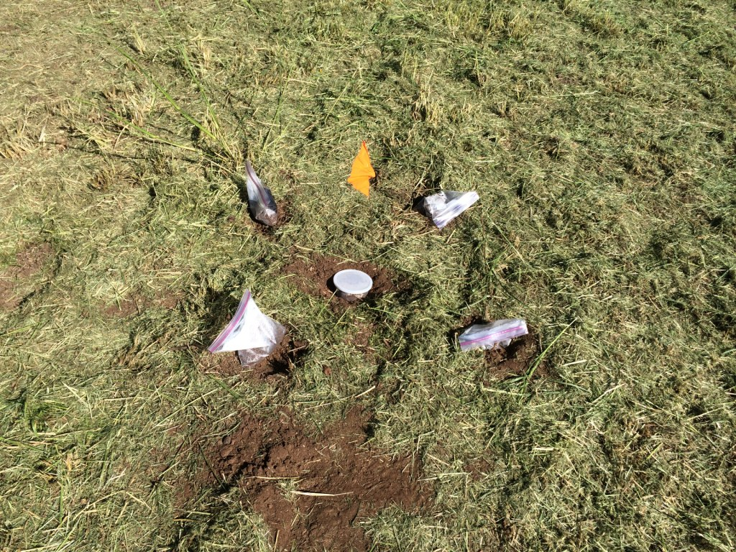
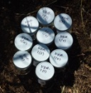
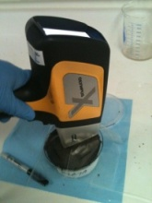
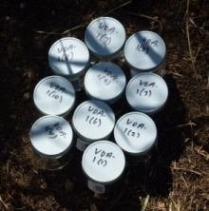
Evaluation of Intra-Sample Variability
(variability within single sample)
Single discrete sample tested ten times
3 feet
Metals: Portable XRF analysis in lab;
PCBs: Discrete sample split into ten subsamples for individual analysis.
Metals
(1g)
PCBs
(10g)

Slide 17
Evaluation of Inter-Sample Variability
(variability between co-located samples)
3 feet
Five “co-located” discrete samples tested at each grid point
Samples “MIS (ISM)” processed for testing (dried, sieved and subsampled);
Data assumed representative of sample.

Slide 18
Field Study Results
Roger Brewer, John Peard & Marvin Heskett (2017)
A critical review of discrete soil sample reliability:
Part 1 – Field study results
Part 2—Implications
Journal of Soil and Sediment Contamination.
Part 1: DOI: 10.1080/15320383.2017.1244172
http://dx.doi.org/10.1080/15320383.2017.1244171
Part 2: DOI: 10.1080/15320383.2017.1244172 http://dx.doi.org/10.1080/15320383.2017.1244172
2015 Field report and recorded webinars posted to HEER webpage
http://eha-web.doh.hawaii.gov/eha-cma/Leaders/HEER/Webinar

Slide 19
“Low” Intra-Sample Variability at Arsenic Study Site
(arsenic-contaminated wastewater, fine-grained soils)
Intra-Sample Variability
Grid Pt #2
141 mg/kg
204 mg/kg
161 mg/kg
199 mg/kg
165 mg/kg
196mg/kg
165 mg/kg
169 mg/kg
172 mg/kg
172 mg/kg
Variability within a single sample
Average Max:Min = 1.5X
Maximum Max:Min = 2.5X

Slide 20
“Low” Inter-Sample Variability at Arsenic Study Site
(arsenic-contaminated wastewater, fine-grained soils)
Inter-Sample Variability
Grid Pt #2
230
mg/kg
140
mg/kg
120
mg/kg
120 mg/kg
260
mg/kg
Variability between co-located samples
Average Max:Min = 1.4X
Maximum Max:Min = 2.2X
3 feet

Slide 21
“Moderate” Intra-Sample Variability at Lead Study Site
(lead-contaminated ash in fill soil)
Intra-Sample Variability
Grid Pt #1
176 mg/kg
234 mg/kg
219 mg/kg
Hawai’i Lead EAL = 200 mg/kg
225 mg/kg
222 mg/kg
269 mg/kg
224 mg/kg
231mg/kg
244 mg/kg
232 mg/kg
Variability within a single sample
Average Max:Min = 4X
Maximum Max:Min = 15X
3 feet

Slide 22
“Moderate” Inter-Sample Variability at Lead Study Site
(lead-contaminated ash in fill soil)
Inter-Sample Variability
Grid Pt #1
300
mg/kg
120 mg/kg
150 mg/kg
Hawai’i Lead EAL = 200 mg/kg
290 mg/kg
220
mg/kg
Variability between co-located samples
Average Max:Min = 2X
Maximum Max:Min = 7X
3 feet

Slide 23

“High” Intra-Sample Variability at PCB Study Site
(waste electric oil dumped on bare soil)
Intra-Sample Variability
Grid Pt #24
Average Max:Min = 17X
Maximum Max:Min = 116X
Average = 2,400 mg/kg
810 mg/kg
5,700 mg/kg
910 mg/kg
3,200 mg/kg
1,000 mg/kg
3,100 mg/kg
1,400 mg/kg
2,600 mg/kg
2,700 mg/kg
2,700 mg/kg

Slide 24
“High” Inter-Sample Variability at PCB Study Site
(waste electric oil dumped on bare soil)
Inter-Sample Variability
Grid Pt #24
Average Max:Min = 11X
Maximum Max:Min = 490X
2,400! mg/kg
4.9 mg/kg
6.0 mg/kg
14 mg/kg
7.7 mg/kg
91 mg/kg
3 feet

Slide 25
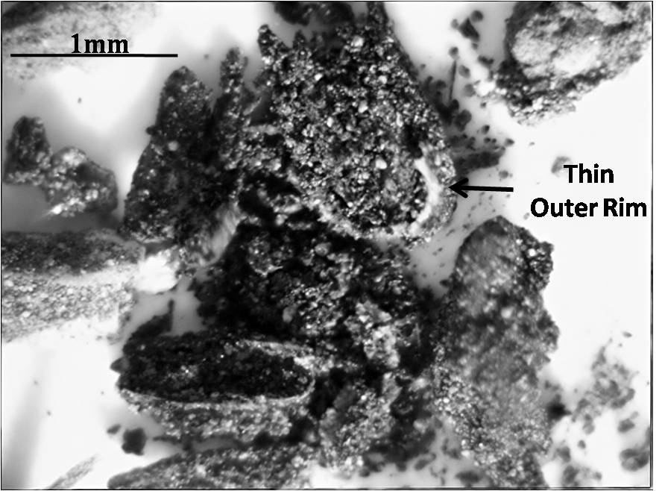
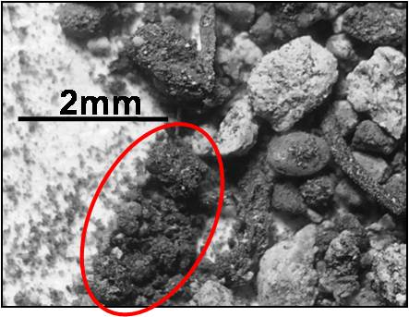
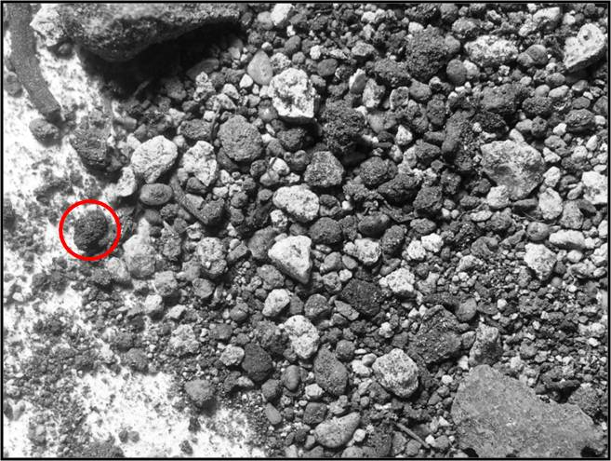
PCB-Infused Tar Balls and “Distributional Heterogeneity”
The Myth of “Maximum” Contaminant Concentrations in Soil
1mm
10,000s ppm
1,000s ppm
2mm
10s ppm
1cm
Concentration #3
(PCB matrix)
Concentration #2
(single nugget)
Reported concentration varies with volume/mass of soil tested;
Maximum concentration always either
0 % (absent) or 100% (present);
Risk-based objective is always the mean for a specified sample/area/volume of soil.
Concentration #1
(whole sample)

Slide 26
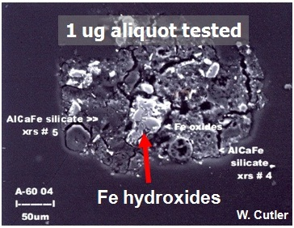
Particles with High Loadings are Called “Nuggets” (“nugget effect”)
Arsenic (whitish color) sorbed to iron hydroxide particles
Contaminants adsorbed to distinct particles form “nuggets” of high concentration
“the iron in a cubic yard of soil [1-1.5 tons] is capable of adsorbing 0.5 to 5 lbs of soluble metals …or organics”
(Vance 1994).
Photo courtesy of Roger Brewer, HDOH
ITRC, ISM-1, Section 2.2 hyperlinks
Notes:
Speaker Notes
Particulate iron minerals, such as oxides, are very good at binding contaminants.
One researcher stated that the Fe in a cubic yard of soil can adsorb ½ to 5 lbs of soluble metals or organics.
The photomicrograph shows microscopic iron hydroxide grains coated with arsenic. The arsenic appears as a light-colored deposit covering Fe-OH grains (see red arrow).
Silicate minerals make up most of the soil mass in the photo. Arsenic does not adsorb to those minerals, so they are dark gray.
Photo provided by Roger Brewer with the Hawaii Dept. of Health
Supplemental Information
See ISM-1 Section 2.2 hyperlinks
--------------------------------------------------------
Quote from the journal article: “Given the average concentration in soil, the iron in a cubic yard of soil is capable of adsorbing from 0.5 to 5 pounds of soluble metals as cations, anionic complexes, or a similar amount of organic[s].” (Vance, 1994). [Reference = David B. Vance. “Iron – The Environmental Impact of a Universal Element,” National Environmental Journal, May/June. 1994 Vol.4 No. 3 page 24-25. see also URL = http://2the4.net/iron.htm]

Slide 27
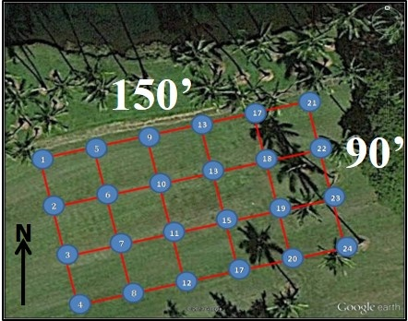

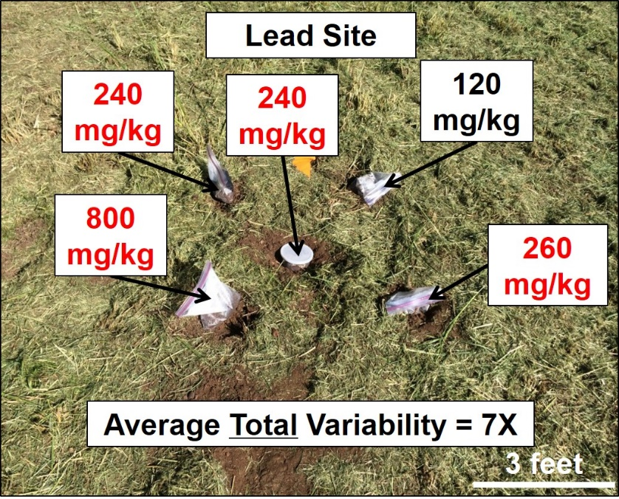

Conclusion: Discrete sample data are random within a (largely) unknown range…
Total Discrete Sample Variability

Slide 28

Think About the Implications…
You take the red pill – you stay in Wonderland and (find out) how deep the rabbit hole goes.
Morpheus (starting Neo on his journey in The Matrix )
ITRC ISM 2012
Five Stages of Grief:
Denial Anger Bargaining Depression Acceptance

Slide 29
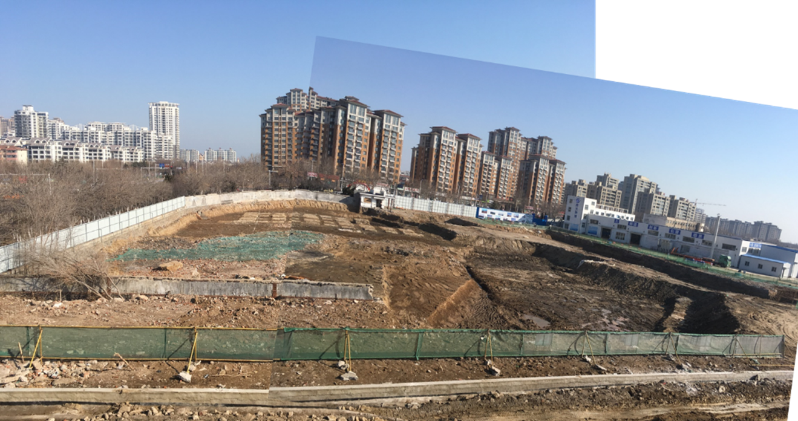


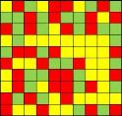
“Failed” confirmation samples…;
Need for repeat investigations with no clear endpoint…, etc.
Lab data not reliably representative of sample;
Sample not reliably represented of area where it was collected.
Problem can’t be fixed by collecting more discrete samples;
Problem can’t be fixed by statistical evaluation of discrete sample data.

Slide 30
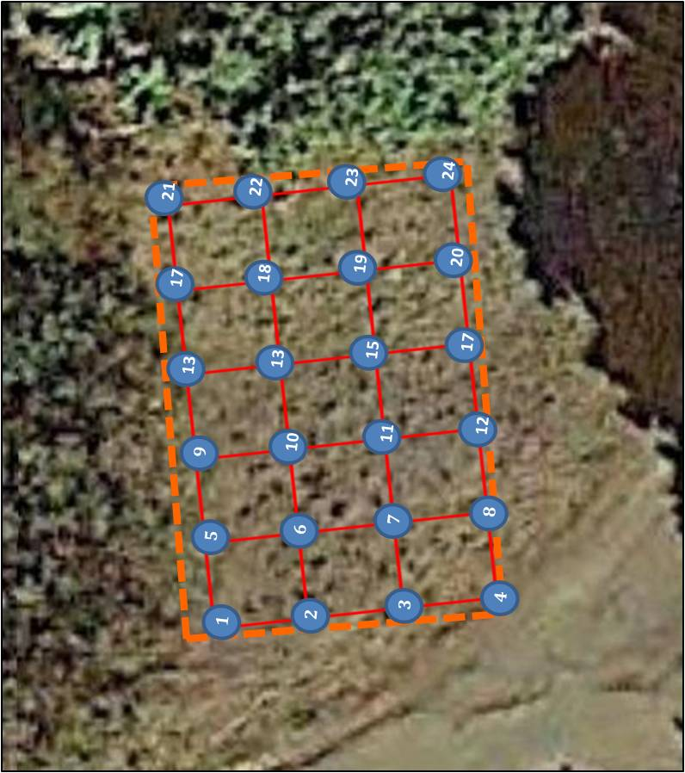
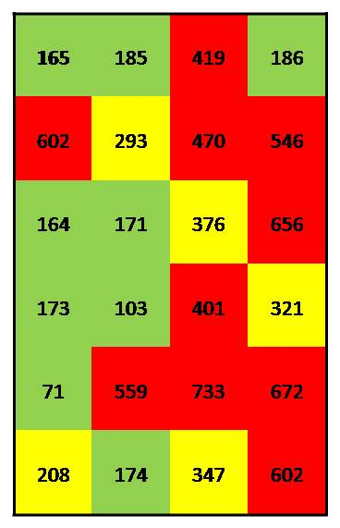
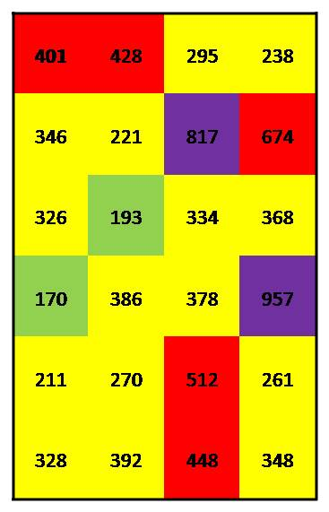
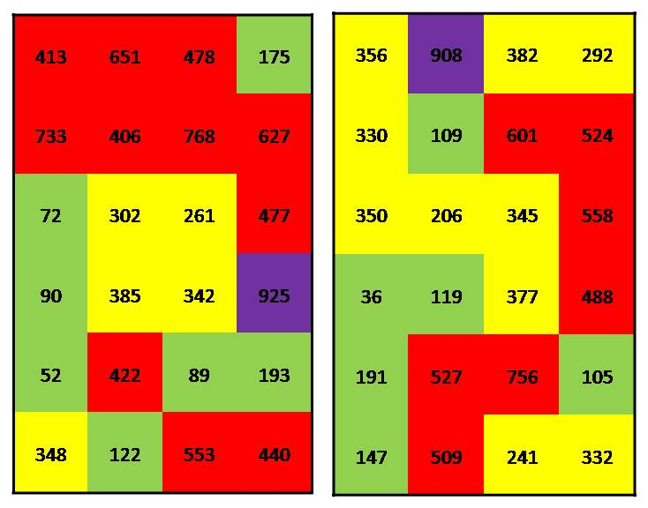
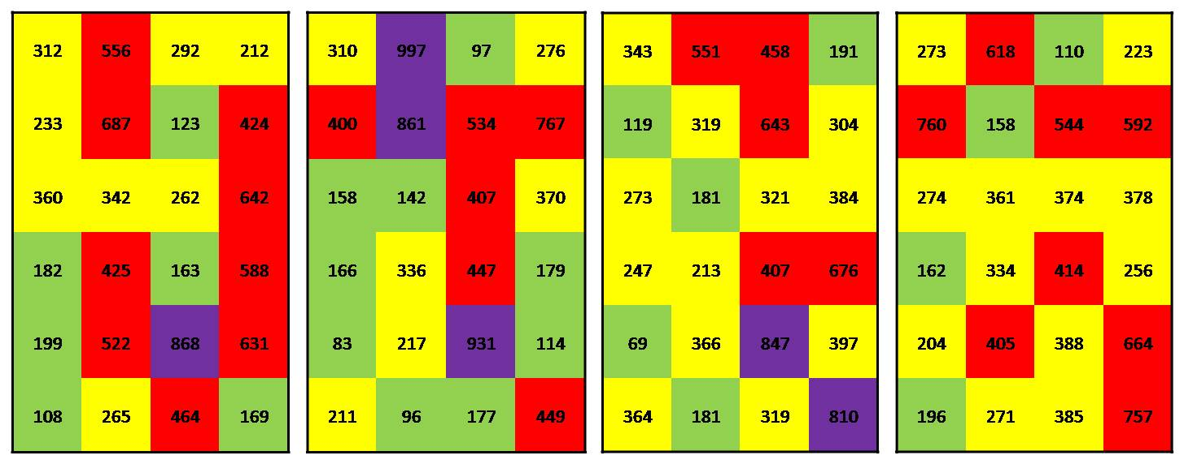
Fake, Discrete “Hot Spot” & “Cold Spot” Patterns
Grid Pt #21
103-419 mg/kg
Study Site B (lead): Random lead concentration assigned within estimated range for grid point
165
401
>800 mg/kg
>400 mg/kg
>200 mg/kg
<200 mg/kg
Notes:
Isolated “hot spots” and “cold spots” are an artificial reflection of small-scale, random heterogeneity.

Slide 31
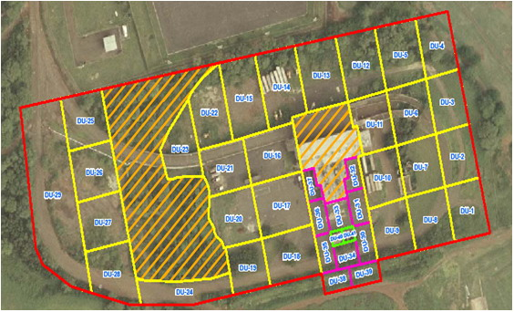
Which Lead Pattern is “Real”? (Hint: None…)
(results of area-wide DU-MIS investigation)
10 acres
Study Area C
Entire, 10-acre property is contaminated with lead;
False negatives would be quickly reached (50/50 chance);
Unavoidable, premature termination of initial site investigation;
Failed confirmation samples and/or premature termination of cleanup efforts.

Slide 32
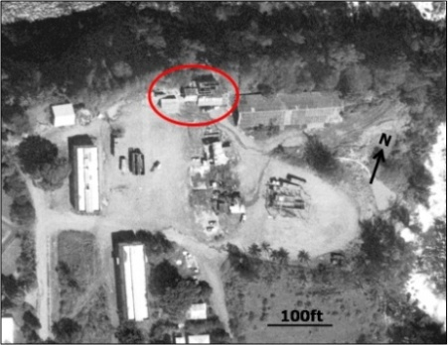
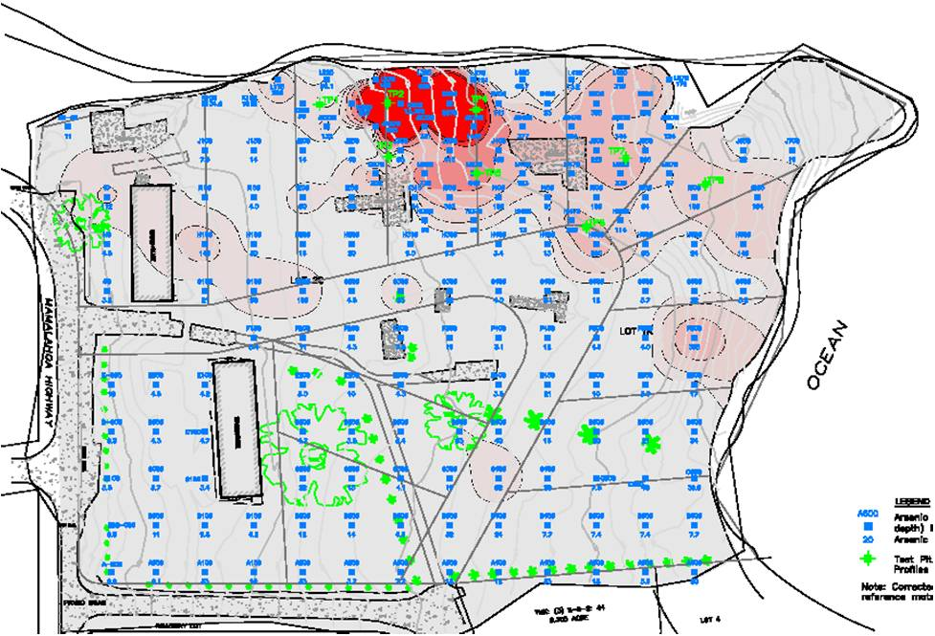
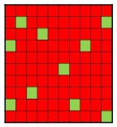
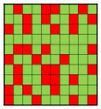
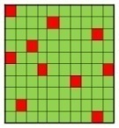
Large-Scale Patterns Can Be Real
Field XRF and tight grid of discrete samples used to identify spill area;
Large-scale patterns likely real;
Zone B marked by small, likely artificial “hot spots” and “cold spots”;
Removal of isolated “hot spots” in Zone B will not significantly reduce risk.
Isolated
“Hot Spots”
Discrete Sample Range Above Screening Level
9 acres
B
A
Discrete Sample Range overlaps Screening Level
B
C
Discrete Sample Range below Screening Level
For example only
Field discrete samples
Notes:
Structures removed. No obvious spill areas observable in the field.

Slide 33

A Simple Problem…
Discrete Soil Samples are too SMALL to overcome
small-scale, distributional heterogeneity
Discrete Sample Data Only Represent Mass Tested
Metals:
0.5-1.0 grams
VOCs:
5 grams
PCBs, Pesticides, Dioxins, TPH, PAHs:
10-30 grams

Slide 34
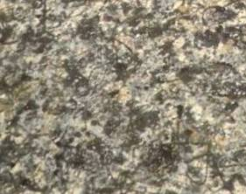
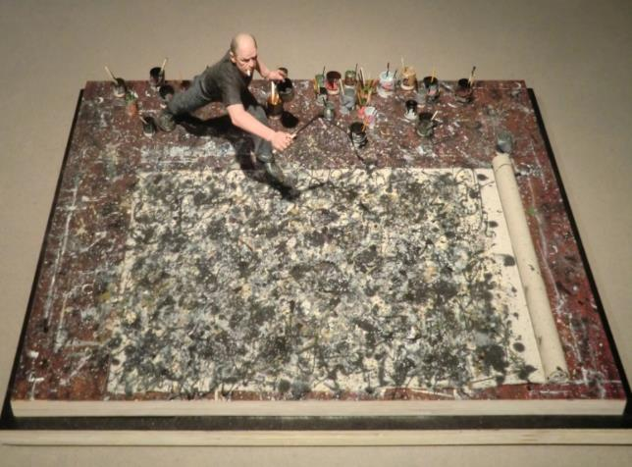
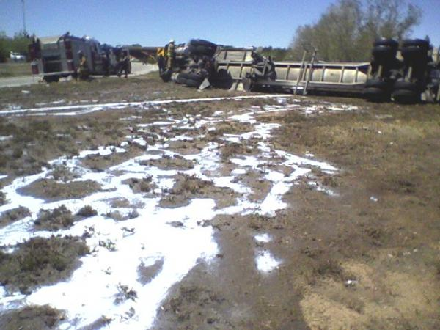
What Soil Contamination Would
Look Like if You Could Actually See It
Discrete Samples
(actual size)
Jackson Pollock
splatter painting
Spilled milk following low areas
Can’t be reliably characterized using discrete samples

Slide 35
Multiple Early Warnings
About Discrete Sample Data Unreliability…
(refer to Part 2 and supplement to Brewer et al. 2017)
The so-called grab sample is not really a sample but a specimen of the material that may or may not be representative of the sampling unit (DU). Great care must be exercised when interpreting the meaning of these samples.
USEPA 1992, Preparation of Soil Sampling Protocols

Slide 36

Risk Assessors Got it Right (almost…)
Front Yard Exposure Area:
Area: 400 ft²
Depth: 4”
Targeted Exposure Area
Discrete sample data can be highly variable within a targeted area;
Mean (true) concentration used to calculate risk or compare to risk-based screening levels.

Slide 37

Ideal: 1) Excavate and send the entire volume of exposure area soil to lab for testing; 2) Use data to assess risk.
Targeted Exposure Area
Entire mass of soil extracted by laboratory;
Single concentration of contaminant “X” reported;
Represents the “true” mean;
Not practical…

Slide 38


Alternative: 1) Collect 10+ discrete samples; 3) Test each sample individually; 4) Use statistical test to estimate mean.
Targeted Exposure Area
Problems:
Risk assessors not involved in sampling design;
10+ samples rarely available for single area (“use maximum”);
High laboratory analytical costs;
Representativeness of sample set and estimated mean unknown;
Statistical analysis only evaluates the precision of the statistical test employed to estimate a mean for the data provided.

Slide 39
Are Discrete Sample Data 95% UCLs “Real”?
Estimation of Mean Based on Multiple Sets of “Replicate” Discrete Sample Data (10 samples, 20 iterations)
Study Site | Range 95% UCL (mg/kg) | Range RSD
*Site A (arsenic) | 403 to 776 | 34% to 67%
*Site B (lead) | 201 to 439 | 20% to 86%
Site C (PCBs) | 9.4 to >1,000,000 | 124% to 315%
*XRF data (not directly comparable to MIS 6010B data)
Concentration within predicted range for 10 randomly picked grid points used to estimate mean;
Estimated mean is random within an unknown range;
Representativeness of single, 10-sample data sets unknown.

Slide 40
Are Discrete Sample Data 95% UCLs “Real”?
Estimation of Mean Based on Multiple Sets of “Replicate” Discrete Sample Data (24 grid points, 20 iterations)
Study Site | Range 95% UCL (mg/kg) | Range RSD
*Site A (arsenic) | 395 to 492 | 39% to 54%
*Site B (lead) | 280 to 394 | 49% to 80%
Site C (PCBs) | 652 to 8,884 | 251% to 434%
*Discrete sample XRF data (not directly comparable to MI Sample 6010B data)
Concentration within predicted range for full suite of 24 grid points used to estimate mean;
Estimated means more consistent for Sites A & B;
Consistency does not equal accuracy;
Representativeness of 24-sample data sets unknown.

Slide 41


Better Approach: 1) Combine all “samples” into a single, bulk sample; 2) Process thoroughly; 3) Report ONE concentration.
Targeted Exposure Area
Targeted Exposure Area
Large, single sample collected from multiple points (“increments”) within defined “Decision Unit” area (“Multi Increment” sample);
Sample carefully processed and subsampled for testing;
Replaces need for statistical analysis of individual, discrete samples;
??? How many increments should the final, MI sample include?
??? What is the minimum, required mass of the final, MI sample?

Slide 42


Gy’s Sampling Theory for “Infinite Particle” Media
and the Collection of Representative Soil Sample
(Training Series Part 3)
Considerations for Representative Samples:
Sample Mass;
Sample Increments;
Sample Collection;
Sample Processing & Subsampling;
Subsample Analysis (least error);
Bottom Line: 1-2kg sample, 50-increments for <2mm soil and ppm data resolution.
Used in mining and agriculture industries since 1950s.
Variables:
Particle size/shape/density
Desired concentration resolution, etc.
Acceptable total error (FE)
$$Sample Mass=\frac{clfgⅆ^{3}}{Fⅇ^{2}}$$

Slide 43
Sampling Theory Training Courses
Envirostat, Inc.: Chuck Ramsey (www.envirostat.org)
Four-day, detailed introduction to sampling theory and Multi Increment Sample site investigations;
Francis Pitard Sampling Consultants, LLC: Francis Pitard (www.fpscsampling.com)
Advanced statistical sampling concepts with a focus on optimization of sampling protocols and mining exploration.

Slide 44

Gy’s Sampling Theory Explained with a Salad
(DU-MIS Training Series Part 3)
Primary Concern: Long-term, chronic exposure to tomatoes
(assume salad eaten over a lifetime)
Wrong Questions:
What is the maximum concentration of tomato in this salad?
What is the concentration of tomato at point “X”?
Right Question:
What is the mean/true concentration of tomato in this salad?

Slide 45

Gy’s Sampling Theory Explained with a Salad
(DU-MIS Training Series Part 3)
Option 1: Test entire salad as a single Decision Unit;
Option 2: Divide salad into smaller Decision Units based on suspect “spill areas”, suspect clean areas, etc.
Sample representative of targeted area
A
B
C
Suspect Spill Area
DU-1
DU-2
DU-3
Assume ahead of time that salad will likely fail for tomatoes;
One Multi Increment Sample collected from each DU area (e.g., 50 pts);
“Triplicate” samples collected in DU-2 to test data precision (three total).

Slide 46


Laboratory Processing and Subsampling
-Repeat Method Used in Field-
Sample spread out into thin layer;
Subsample collected in systematic random method for testing (minimum mass required by sampling theory);
Subsample representative of original sample;
Compare replicates to test precision.
Aliquot
Tested
by Lab

Slide 47


Soil Sample Processing and Subsampling
(DU-MIS Training Series Part 4)
Sample air dried and sieved (preserved in methanol for VOCs);
30-50+ increment subsample collected for analysis;
Minimum 10g subsample for <2mm particles;
Collect laboratory replicates to test subsampling precision;
Labs have been recommending this for decades but not pushed by regulators (plus added cost).
Laboratory data representative of sample submitted
40
Notes:
Evenly distribute prepped materials onto a tray covered with Aluminum foil, butcher paper or other inert cover. The sample layer should have a depth similar to the depth of the rectangular scoop that will be used for sampling.
For inorganic metals digestion, use a smaller scoop to sub-sample an aliquot size of 10g or more and store in a pre-cleaned container. For organic extraction, use a rectangular metal scoop to obtain an aliquot size of at least 30g in a pre-cleaned container.
Perform the sub-sampling by taking random scoops from the sample on the tray. The scoop should be taken evenly from the top to the bottom of the soil. A stratified random approach should be used. Each scoop must represent approximately 1/30th of the desired target mass of 0.33g or 1 g respectively. Practice on a few scoops before proceeding on the entire sample by measuring the weight of one scoop of soil. This may be done less frequently with knowledge of the type of soil. Once the desired amount is achieved, take scoops to represent the entire area of the tray in a random fashion. Record the final weight, which should be at least 10 or 30g. If the final amount is less than the required amount, take a few more scoops. If the amount is much greater than the desired amount, it may be necessary to recombine the sub-sample and start over.

Slide 48
Study Site Multi Increment Sample Data
Triplicate 50- to 60-increment MI samples collected from each study area (1-2+ kg);
Processed and subsampled in accordance with Gy’s sampling theory.
Study Site A
(arsenic in wastewater)
Study Site B
(lead in incinerator ash)
Study Site C
(PCBs transformer oil)

Slide 49
MI Sample Data for Study Sites
Study Site | MIS Data (average of triplicates)
 | (mg/kg) | RSD
*Site A (arsenic) | 233 | 6.5%
*Site B (lead) | 287 | 20%
Site C (PCBs) | 104 | 138%
*Method 6010B data (not directly comparable to discrete XRF data)
RSD Interpretation
<35% | Good precision
>35% to <50% | Moderate precision (discuss errors)
>50% to <100% | Poor precision (consider 95% UCL)
>100% | Very poor precision (consider retesting)

Slide 50
Discrete vs Multi Increment Sample Data
-Sample Support-
Sampling Method | Number of DU Points | Total Mass of Soil Represented (grams) | Total Number of Analyses
Discrete Sample Data (24): | 24 | 24 (240) | 24
MI Sample Data (Triplicates): | 180 | 4,500+ | 3
Multi Increment data provide far better sample support.

Slide 51


Are Discrete Sample Data Ever Useful? (Yes!)
Initial identification of contaminants of potential concern;
Initial estimate of risk;
Initial removal of large areas of contaminated;
Designation of DUs for MI sample confirmation;
Always confirm initial conclusions with DU-MIS data.
Example arsenic site
DUs 8-17
DU-7
DU-4
DU-5
DU-6
DU-1
DU-2
DU-3

Slide 52
But what about “acute” risk?
Front Yard:
Area: 400 ft²
Depth: 4”
Risk Question:
Does the concentration of “X” in any (potential) discrete soil sample collected from the yard exceed “Y” mg/kg? (hypothetical acute toxicity)
Sampling Considerations:
Total Soil Mass: 1,800 kg
Discrete Sample Mass: 100g
Lab Aliquot Mass: 1g (metals)
Unanswerable Question (in terms of cost and field feasibility):
1,800,000 potential 1 gram “samples” (laboratory aliquot);
9,000,000 potential 200 mg “samples” (default child soil ingestion rate);
180,000 potential 10 gram “samples” (pica child ingestion rate);
Minimum 59 samples to attain 95% confidence that 95% of untested “samples” do not exceed maximum level reported;
Testing for acute risk with a reasonable degree of uncertainty is not practical;
Acute toxicity factors not available for most chemicals;
If a real concern then remove or cap suspect soil.

Slide 53






It’s All About the Decision Units (Training Series Part 1,2)
DU = An area and volume of soil you would send to the laboratory as a single sample for testing, if you could;
Set DUs to size adequate for decision making (minimize retesting)!
Spill Area DUs
Exposure Area DUs
Boundary DUs

Slide 54

Field Collection of MI Samples
(Training Series Part 4)
Site preparation
DU demarcation
Soil type vs sampling tools
Surface soils
Subsurface soils
Excavations
Stockpiles
Sediment
Sampling for VOCs
Equipment decontamination
Notes:
Kea`au Middle School garden

Slide 55

Where to Start???
Start with ONE DU
Hypothetical Industrial Complex Redevelopment
Is the 50-acre area as a whole contaminated above risk-based screening levels?
100m
Not acceptable for redevelopment or remediation (too large);
Progressively subdivide site into smaller DUs until all site investigation objectives will be met.

Slide 56
Subdivide Site Based on Past Use
Are the individual, past use areas as a whole impacted above screening levels?
Industrial Operations
Office Buildings
Residential Housing
100m
Site subdivided into three areas based on historical land use;
Testing of former office building area as a single, Exposure Area DU might be acceptable (assumed clean);
Further subdivision of housing and industrial operations areas required.

Slide 57
Subdivide Based on Age of Housing and
Individual Factory Areas
Are the individual neighborhoods and factory areas impacted above screening levels?
FA-3
FA-4
Multiple Chemicals
FA-5
FA-1
FA-2
OB-1
WH-4
WH-3
Lead Paint, Termiticides?
WH-1
WH-5
WH-2
100m
Four housing areas defined (based on construction time) and five factory areas defined (based on past operations);
Still too large to designate as exposure area DUs and assess risk;
Factory areas known to be heavily contaminated (optimize remediation).

Slide 58
Worker Housing: What’s Your Question?
Were termiticides or lead-based paint used at worker housing buildings?
FA-3
FA-4
FA-5
FA-1
FA-2
OB-1
WH-4
WH-3
Lead Paint, Termiticides?
WH-1
WH-5
WH-2
100m
Test fraction of building lots in each neighborhood;
Assume present at all buildings within neighborhood if identified and manage soil appropriately (i.e., assume entire neighborhood contaminated).

Slide 59
Worker Housing: What’s Your Question?
Do half-acre DU areas within the former worker housing areas exceed screening levels?
FA-3
FA-4
FA-5
FA-1
FA-2
OB-1
WH-4
WH-3
Lead Paint, Termiticides?
WH-1
WH-5
WH-2
100m
Half-acre areas designated as Exposure Area DUs (e.g., risk-based resolution of data required for redevelopment by overseeing regulatory agency).
Entire former worker housing area ultimately tested (total 36 DUs).

Slide 60


Individual Factory Areas: Remediation Required
Designate DUs based on known/suspect spills, tanks, dumps, storage areas, assumed clean areas, etc.;
Small DUs used to isolate contaminated soil and optimize remediation;
Max DU size = default, ½ acre exposure area (agency required resolution);
Concurrent testing of surface and subsurface soils DUs;
Data use to prepare remedial action plan.

Slide 61

Complex Sites – But a Clear End Point
Entire site subdivided and tested based on needs for risk assessment and optimization of remedial actions;
Minimized need for retesting after one or two mobilizations for sample collection;
Initial soil removal confirmed with DU-MIS data;
Requires more time upfront but expedites reliable completion of project.

Slide 62


DU-MIS for Very Large Areas
(former ag field being redeveloped for homes)
Baseline Investigation:
Isolate and separately test suspected localized areas of heavy contamination;
Divide field into large DUs based on past crop history, pesticide use, soil type, topography, development plans, etc.;
MI sample collected in each DU (10% triplicates);
Requires walk through of entire site;
Use to select primary COPCs;
Evaluate large-scale buildup of pesticides;
Worth proceeding for redevelopment?
Lot-Scale Investigation:
Test 59+ random, hypothetical, one-acre lots.
“Did you test my yard?”
“No but we tested your neighborhood and a random number of lots.”
Notes:
Here’s an example of neighborhood-size decision units across a 400-acre former ag land site being considered for residential housing.
Advantages to screening at the neighborhood scale:
-Walk entire area (identify additional brownfield areas - dumps, abandoned buildings, etc.)
-Narrow down list of target contaminants for yard-scale investigation. Only test for initial contaminants of potential concern if detected during screening level investigation.
-Answer the question: “Did you test my yard? No, but we tested your neighborhood and a random selection of lots.”

Slide 63
Hawaii’s Transition from Discretes to DU-MIS
(2005-2009)
  Completed Projects:
  Retesting of past, completed investigations not required;
  Some properties being retested as part of new property transactions.
  Currently Active Projects:
  Existing discrete sample can be used for initial remedial actions;
  DU-MIS data required for confirmation.
  New Projects:
  Discrete sample data sometimes used for screening and DU designation (e.g., metals and portable XRF);
  DU-MIS data normally used to complete investigation and design final remedial actions;
  DU-MIS data required for confirmation.

Slide 64


Questions?
NOT Just Another Tool in the Tool Box…
Discrete Sample
Investigation Methods
DU-MIS
Investigation Methods
It’s an entirely NEW and IMPROVED set of tools.
Wrong Question: “When are DU-MIS methods applicable?”
Right Question: “Knowing what we now know, when are discrete sampling methods still acceptable?”

