Slide 1
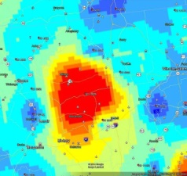
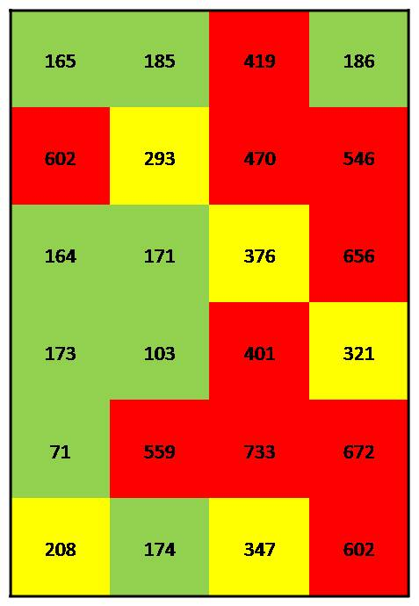
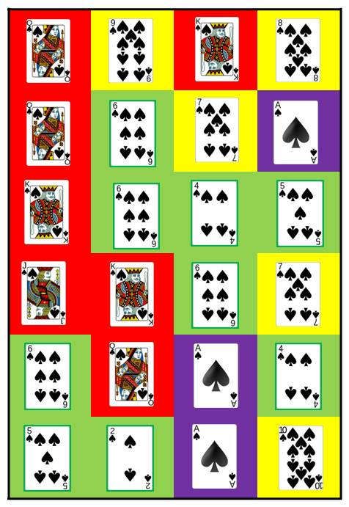
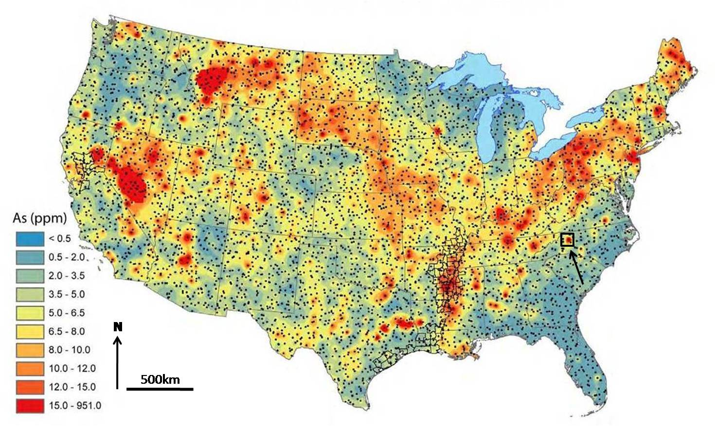
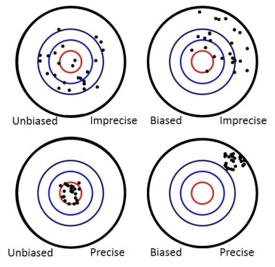
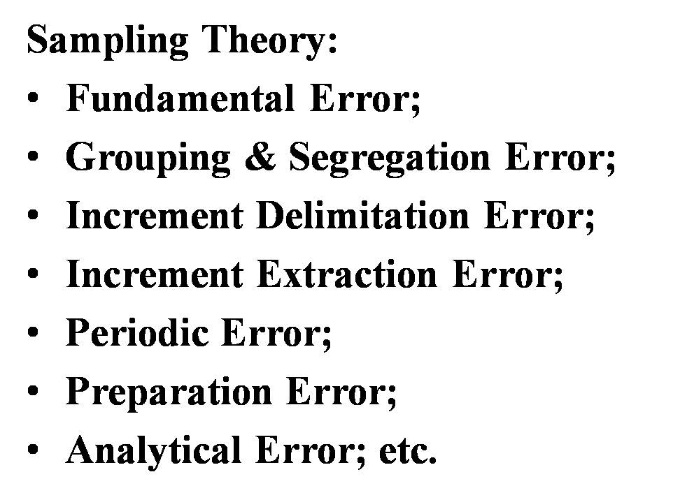
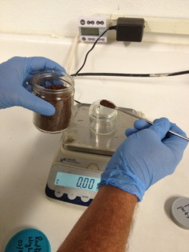
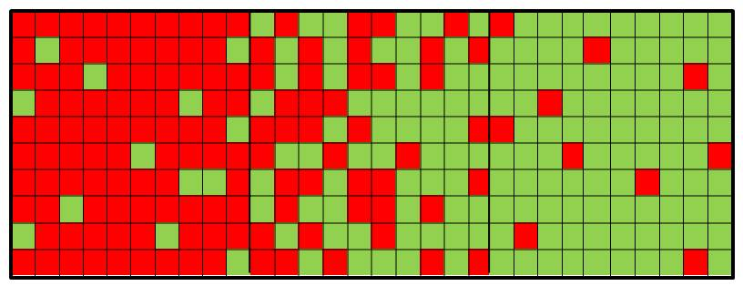
Small-Scale Variability of Discrete Soil Sample Data Part 2: Implications for Environmental Investigations
October 21, 2015
Roger Brewer, John Peard, Jordon Nakayama, (Hawai’i Dept of Health)
Marvin Heskett (Element Environmental)
Contact: roger.brewer@doh.Hawaii.gov
Bias vs Precision
Hot Spots
vs
Hot Areas
95% UCL
TSCA…
Inliers and Outliers

Slide 2
Acknowledgements
Too many people to count…
The following is a compilation of experience, thoughts and ideas for new approaches based on talks with many people over the past ten years. This is an evolving field and we anticipate many more discussions and new discoveries to come.

Slide 3
References
1. *Small-Scale Variability of Discrete Soil Sample Data (June 2015):
Part 1: Field Investigation of Discrete Sample Variability,
Part 2: Causes and Implications for Use in Environmental Investigations
2. Technical Guidance Manual (2009, updates in progress)
Hawai′i Department of Health, Hazard Evaluation and Emergency Response: http://eha-web.doh.hawaii.gov/eha-cma/Org/HEER/
*Current Posting: “What’s New” (July 2015)
All data available on web page in Excel format

Slide 4
Just Another Tool in the Tool Box?
Multi Increment Sampling

Slide 5
Change Can Be Disrupting…
Perhaps the sentiments contained in the following pages, are not yet sufficiently fashionable to procure them general Favor; a long habit of not thinking a Thing wrong gives it a superficial appearance of being right, and raises at first a formidable outcry in defense of Custom. But the Tumult soon subsides. Time makes more Converts than Reason.
Thomas Paine, 1776 (Common Sense, on succession and independence of the new United States from Great Britain)

Slide 6
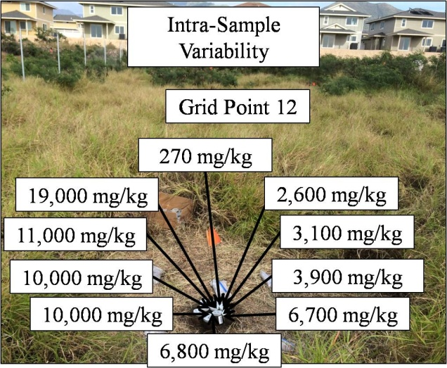
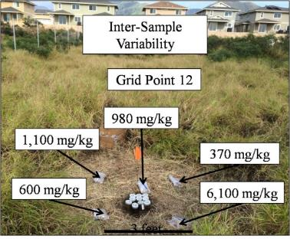
Small-Scale Variability of Discrete Soil Sample Data Part 1: Field Investigation of Discrete Sample Variability
October 7, 2015
Roger Brewer, John Peard, Jordan Nakayama, (Hawai’i Dept of Health)
Marvin Heskett (Element Environmental)
Contact: roger.brewer@doh.Hawaii.gov
If I had one hour to solve the problems of the world I would spend 59 minutes on explaining the problem and 1 minute on explaining the answer.
Albert Einstein

Slide 7
1980s Origin of Discrete Soil Sampling Methods
(based on testing of industrial chemicals and waste)
“The implicit assumption (that…) contamination is… likely to be (uniformly) present anywhere within the sampling area is reasonable.”
“The PCB level is assumed to be uniform within (a contamination zone/spill area) and zero outside it.”
USEPA 1985: Verification of PCB Spill Cleanup (basis of TSCA regulations and guidance)
“When there is little distance between points it is expected that there will be little variability between points.”
USEPA 1989: Methods for Evaluating the Attainment of Cleanup Standards

Slide 8
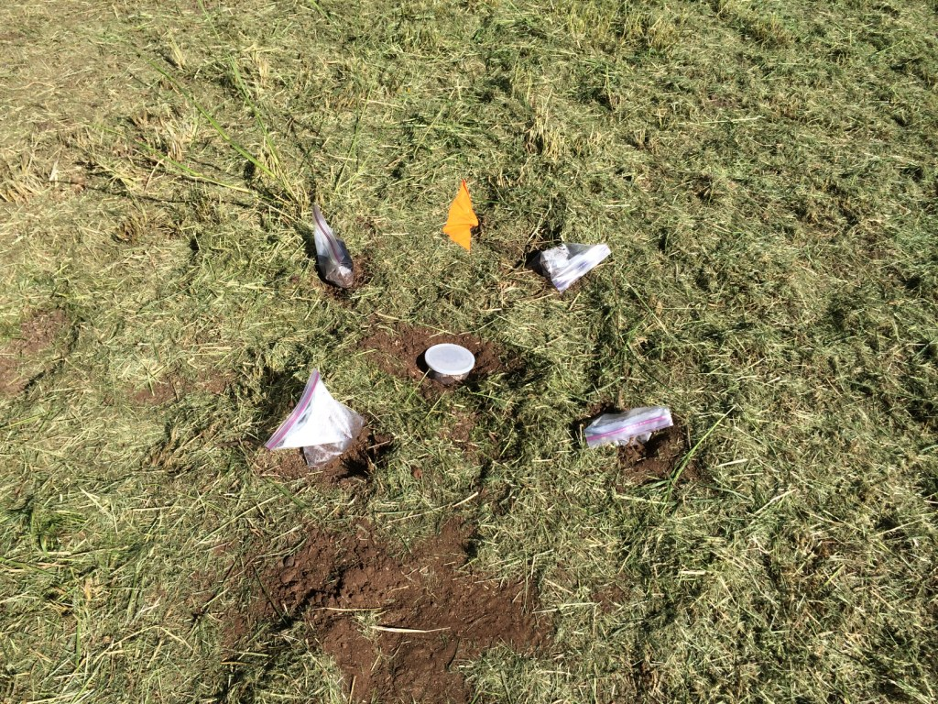
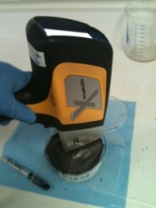
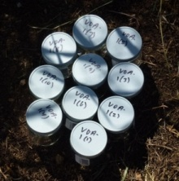
Study Question: How variable are contaminant concentrations in co-located, discrete soil samples?
Total 15 concentrations obtained per grid point
3 feet
1. Intra-Sample Variability
(one sample tested ten times)
2. Inter-Sample Variability
(five MIS processed samples tested)
Metals
PCBs

Slide 9
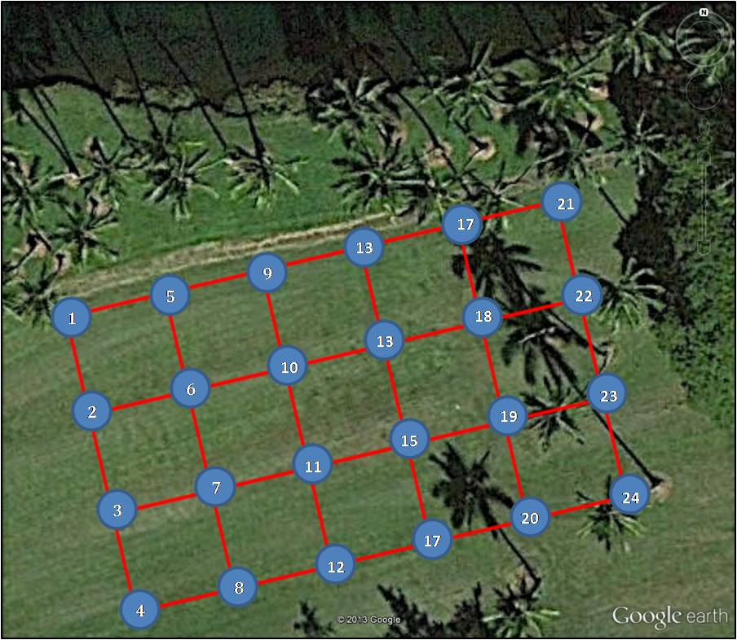
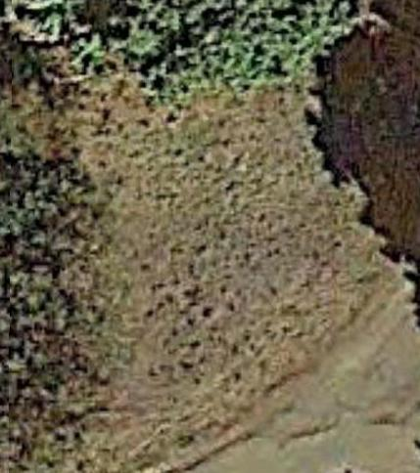
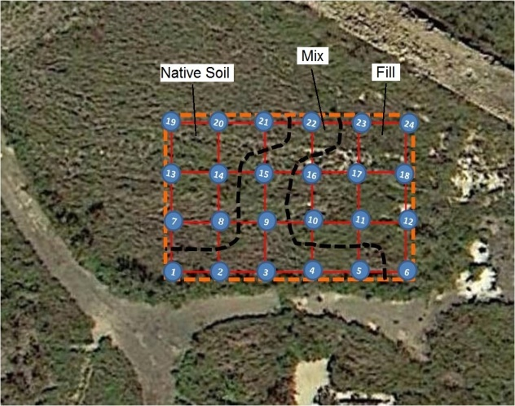
Discrete Sample Variability Field Study - Results
24 grid points designated at each site;
Discrete surface soil samples collected (average 0-4”);
Variability within single samples and between co-located samples evaluated;
Triplicate Multi Increment samples also collected.
Study Site A
(arsenic in wastewater)
Study Site B
(lead in incinerator ash)
Study Site C
(PCBs transformer oil)
30’
150’
N
90’
17
21
60’
9
13
5
22
1
13
18
50’
2
6
10
23
N
15
19
120’
3
7
11
24
17
20
4
8
12

Slide 10
Study Site A (Arsenic)
-Estimated Total Discrete Sample Variability-
Median Max:Min = 2.0X
Maximum Max:Min = 4.0X
(lumpy porridge)
(quartiles plus minimum, median and maximum)
Data for discrete soil sample collected at grid point can be highly random;
Any given sample unlikely to be representative of grid area mean.
*Arsenic bioavailability at site very low (<10%), minimal exposure risk.
Notes:
Study Site A Summary Notes:
-XRF data average 31% higher than 6010B data (inefficient extraction of arsenic at lab)
-Relatively low variability within and between co-located samples
-Variability is random, no distinct increasing/decreasing trends toward adjacent grid points
-Magnitude of variability similar within and between co-located samples
-Processing sample (e.g., dry, sieve, subsample) will minimize intra-sample variability (i.e., data reasonably representative of sample) but does not address inter-sample variability.

Slide 11
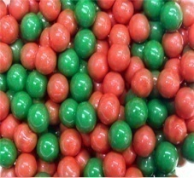
Study Site B (Lead)
-Estimated Total Discrete Sample Variability-
Median Max:Min = 7.5X
Maximum Max:Min = 42X
(house salad)
400 mg/kg
(USEPA)
200 mg/kg
(HDOH)
(quartiles plus minimum, median and maximum)
Potential discrete samples above and below 200 mg/kg at 23 of 24 grid points;
Potential discrete samples above and below 400 mg/kg at 20 of 24 grid points.
Notes:
Study Site B Summary Notes:
-XRF data average -7% lower than 6010B data (moisture effects?)
-Relatively high variability within samples but lower between samples
-Variability is random, no distinct increasing/decreasing trends toward adjacent grid points
-Different handfuls of the same salad, highly variable with a sample but similar to nearby samples
-Discrete samples above and below 200 mg/kg at 23 or 24 grid points

Slide 12
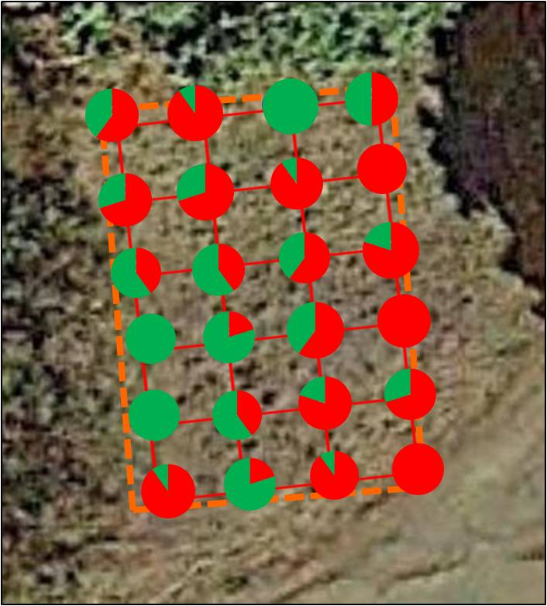
Study Site B (Lead)
Fraction of Intra-Sample Data
Above and Below 200 mg/kg
N

Slide 13
Study Site C (PCBs)
-Estimated Total Discrete Sample Variability-
Log Scale
Median Max:Min = 39X
Maximum Max:Min = >1,000X
(salad bar)
50 mg/kg
PCBs mg/kg
1.1 mg/kg
(quartiles plus minimum, median and maximum)
Degree of variability similar between high and low concentration areas;
Suggest presence of PCB “nuggets” in soil.
Notes:
Study Site C Summary Notes:
-Very high variability within samples but lower between samples
-Variability is random, no distinct increasing/decreasing trends toward adjacent grid points
-Any given concentration random, like randomly selecting multi-colored gumballs from a jar
-PCBs above and below potential screening levels at majority of points.

Slide 14
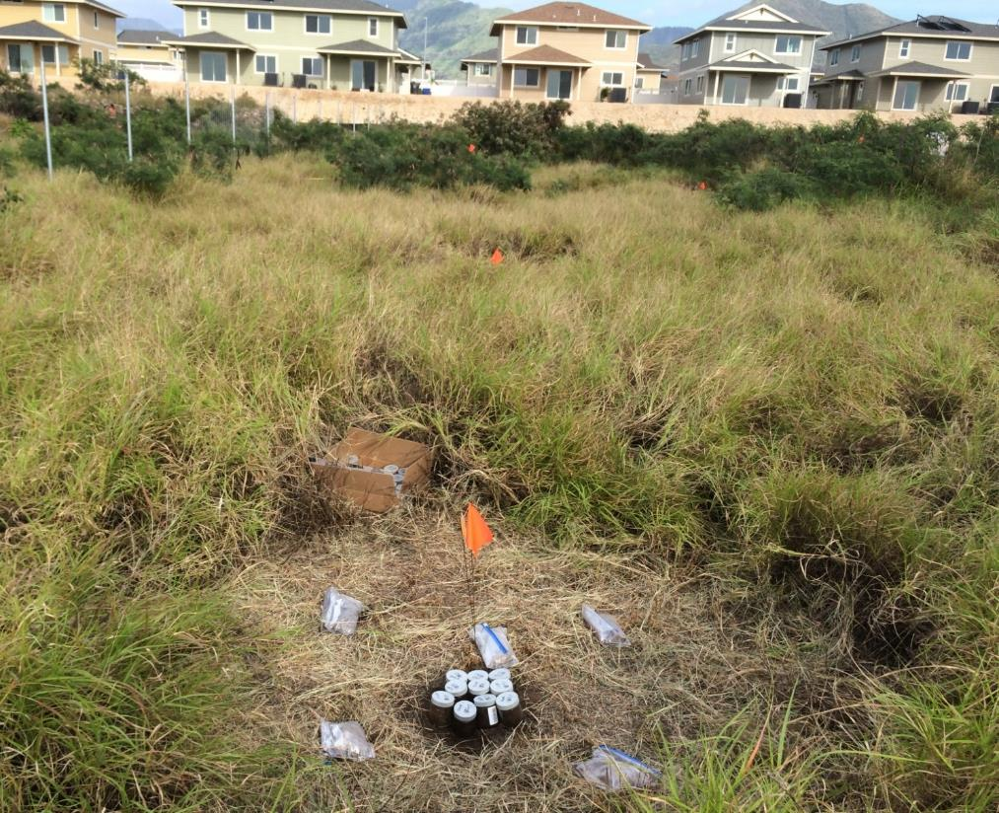
Study Site C (PCBs)
A True Hot “Spot”
Grid Pt VOA-24
*Processed samples; variability for unprocessed samples would be even greater.
Intra-Sample Test Average
2,400! mg/kg
4.9 mg/kg
6.0 mg/kg
14 mg/kg
7.7 mg/kg
91 mg/kg
3 feet
Take home Point: Concentration reported for any given discrete sample is random within a potentially significant large range of possibilities.

Slide 15
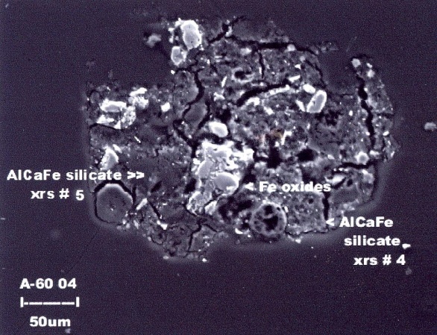
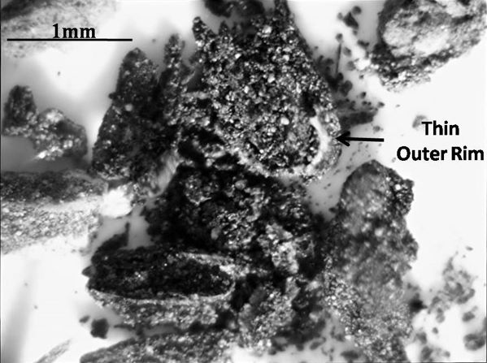
Nugget Effect and Discrete Sample Variability
(aka “Distributional Heterogeneity”)
Study Site A
Study Site B
Study Site C
1mm
Small pockets of
concentrated ash
(visible in field)
Cutler 2011
Arsenic-Infused Clumps of Iron Hydroxide
PCB-Infused Tar Balls?
Variability within and between samples reflects “distributional heterogeneity;”
“Maximum” concentration is always either 0% or 100%;
Pre-designation of mass (area/volume) of soil targeted for estimation of mean concentration critical (i.e., “Decision Unit”);
Risk-based screening levels apply to mean for the targeted mass (e.g., exposure area), not discrete samples within this area.

Slide 16
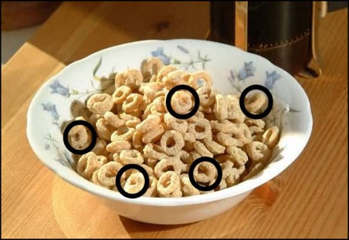
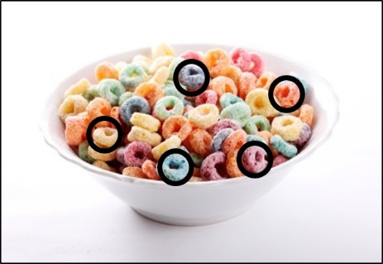
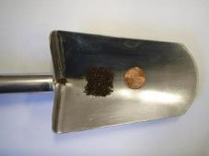
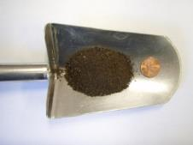
Discrete Samples are too SMALL to Capture and Represent Small-Scale Variability in Soil
1980s Wishful Thinking
Sample collection method and mass not important
2010s Reality
Lab Subsamples
Sample collection method and mass very important

Slide 17
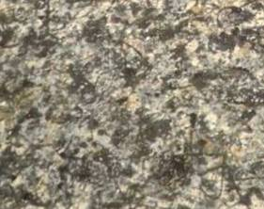
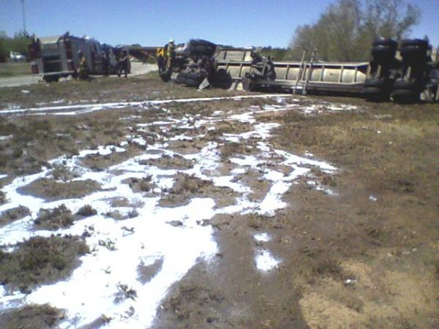
What Soil Contamination Would
Look Like if You Could Actually See It
Discrete Samples
(actual size)
Jackson Pollock
splatter painting
Spilled milk following low areas
Can’t be reliably characterized using discrete samples

Slide 18
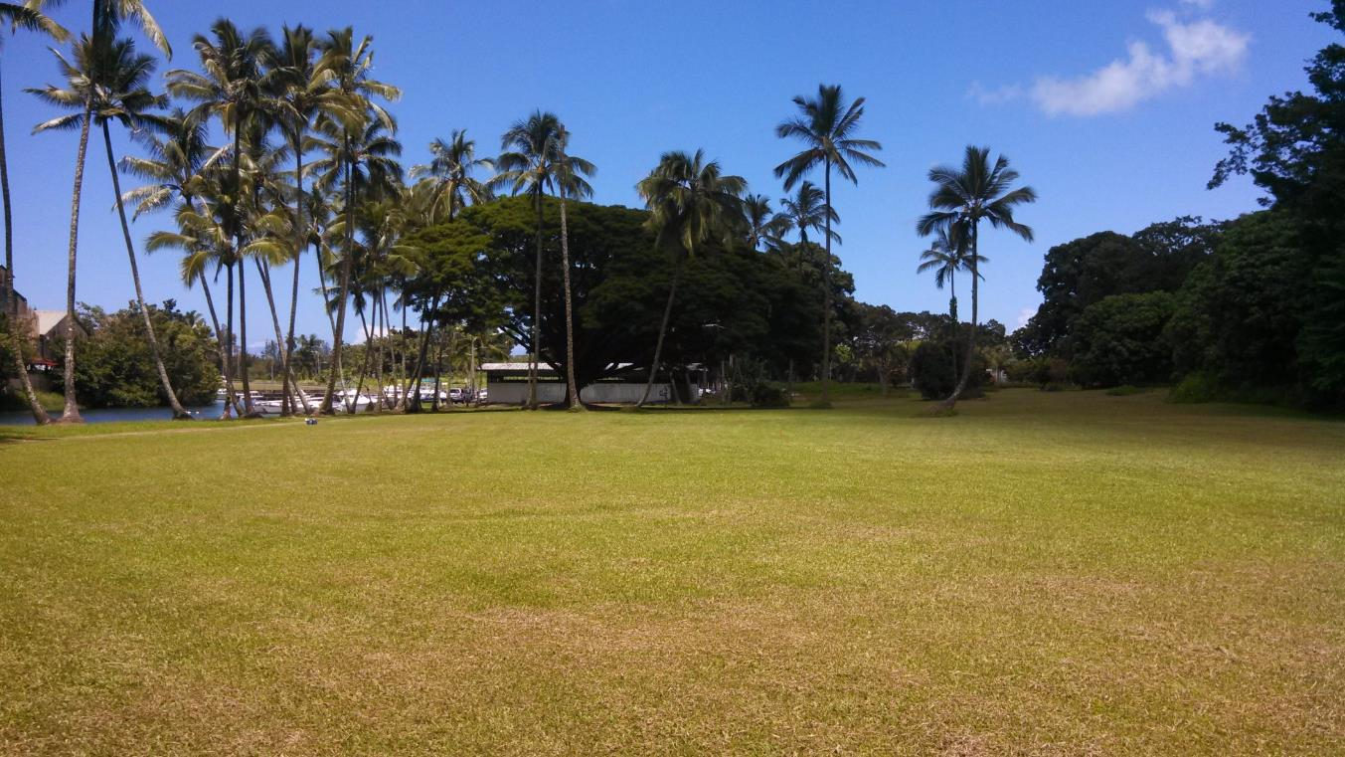
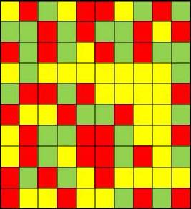
Problem Can’t be Fixed by Collecting More Discrete Samples
Small-scale, random variability of contaminant concentrations over a few inches or feet;
Concentration reported for any given discrete sample is largely random;
Statistics can’t fix bad data.
Concentrations highly variable around any given grid point

Slide 19
Update to Original Assumptions
“The implicit assumption (that…) contamination is… likely to be (uniformly) present anywhere within the sampling area IS NOT reasonable.”
“The PCB level CANNOT assumed to be uniform within (a contamination zone/spill area) and zero outside it.”
2015 update to USEPA 1985: Verification of PCB Spill Cleanup (basis of TSCA regulations and guidance)
“When there is little distance between points it is expected that there will be SIGNIFICANT variability between points.”
2015 update to USEPA 1989: Methods for Evaluating the Attainment of Cleanup Standards

Slide 20
Implications…
This is your last chance…
After this, there is no turning back.
You take the red pill – you stay in Wonderland and (find out) how deep the rabbit hole goes.
Morpheus (starting Neo on his journey in The Matrix )

Slide 21
Part 2 - Implications
Outline:
Representativeness of laboratory data;
Mapping extent of contamination;
Interpretation of isoconcentration maps;
Exposure concentrations and risk assessments;
Sampling Theory and DU-MIS investigations;
Regulatory hurdles.

Slide 22
Representativeness of Laboratory Data
“…mixing should be performed as needed or feasible to homogenize the sample until the subsampling variance is less than the data quality objectives (SW 846 Chapter 3, USEPA 2007).”
No standard laboratory protocol for “homogenization” of soil samples;
Fines settle to bottom with stirring;
Bulk soil samples can’t be efficiently “homogenized” without grinding;
Single, random, 1-30g subsample unlikely to be representative bulk sample (if entire sample mass could be tested).
Metals: 1g
VOCs: 5g
Organics: 10-30g

Slide 23
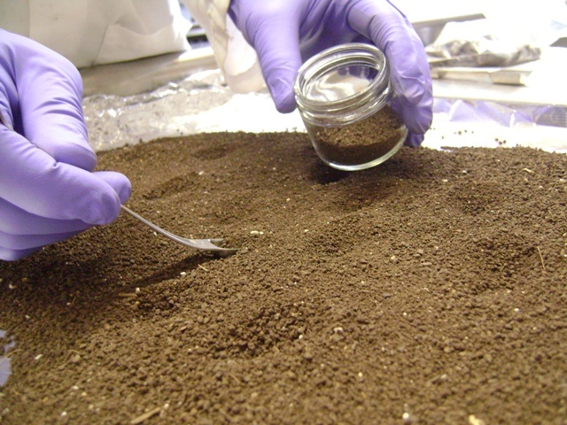
Laboratory Processing and Subsampling
Sample air dried and sieved (preserved in methanol for VOCs);
30-50+ increment subsample collected for analysis;
Preserves field representativeness of original bulk sample;
Test precision of subsampling laboratory replicates;
Labs have been recommending this for decades but not pushed by regulators (plus added cost).
Notes:
Evenly distribute prepped materials onto a tray covered with Aluminum foil, butcher paper or other inert cover. The sample layer should have a depth similar to the depth of the rectangular scoop that will be used for sampling.
For inorganic metals digestion, use a smaller scoop to sub-sample an aliquot size of 10g or more and store in a pre-cleaned container. For organic extraction, use a rectangular metal scoop to obtain an aliquot size of at least 30g in a pre-cleaned container.
Perform the sub-sampling by taking random scoops from the sample on the tray. The scoop should be taken evenly from the top to the bottom of the soil. A stratified random approach should be used. Each scoop must represent approximately 1/30th of the desired target mass of 0.33g or 1 g respectively. Practice on a few scoops before proceeding on the entire sample by measuring the weight of one scoop of soil. This may be done less frequently with knowledge of the type of soil. Once the desired amount is achieved, take scoops to represent the entire area of the tray in a random fashion. Record the final weight, which should be at least 10 or 30g. If the final amount is less than the required amount, take a few more scoops. If the amount is much greater than the desired amount, it may be necessary to recombine the sub-sample and start over.

Slide 24
Part 2 - Implications
Outline:
Representativeness of laboratory data;
Mapping extent of contamination;
Effects of randomness in discrete data;
Examples mapping errors;
Interpretation of isoconcentration maps;
Exposure concentrations and risk assessments;
Sampling Theory and DU-MIS investigations;
Regulatory hurdles.

Slide 25
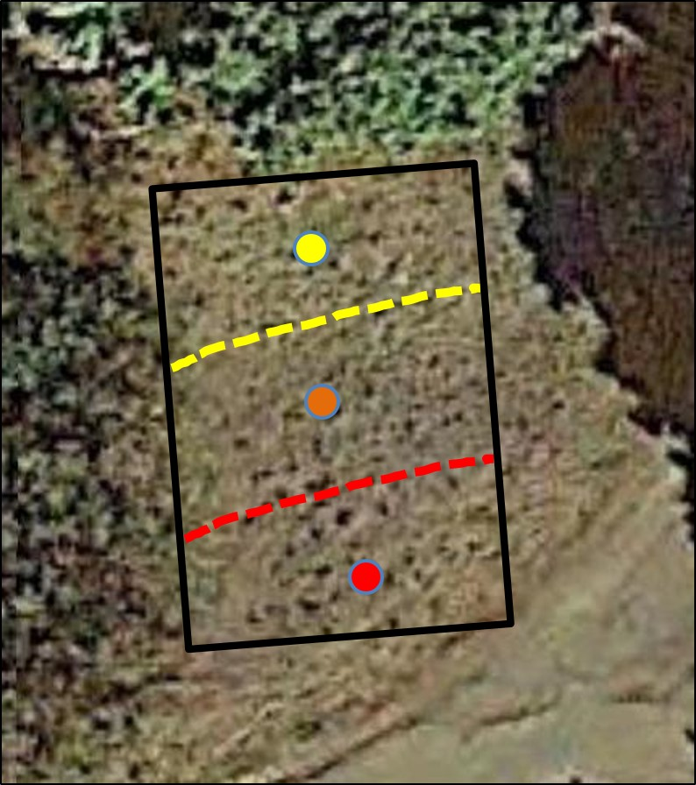
In an Ideal World…
Field sample and lab subsample mass not important;
Discrete sample are representative of surrounding area;
Laboratory data are representative of sample submitted.
Ideal
What you hope is happening…
Discrete Soil Samples
Subsample
Randomly Selected and Tested by Lab
Apparent
“Hot Area” Identified

Slide 26
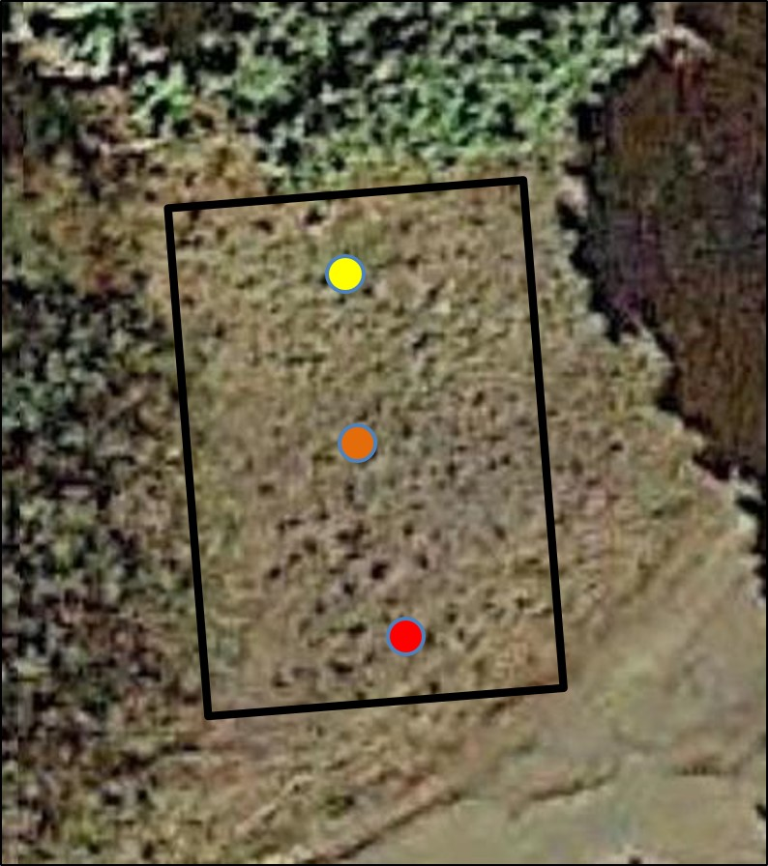
Randomness of Discrete Sample Data;
Field sample and lab subsample mass very important;
Discrete samples are random specimens of field heterogeneity;
Laboratory data are random specimens of sample heterogeneity.
Reality
What is really happening…
Discrete Soil Samples
Subsample
Randomly Selected and Tested by Lab
“Uniformly” heterogeneous contamination across area

Slide 27
Not a New Discovery…
Soil is a very heterogeneous material. Samples with very small support volume… may vary from zero to very high concentrations.
USEPA 1989. Soil Sampling Quality Assurance User’s Guide
The so-called grab sample is not really a sample but a specimen of the material that may or may not be representative of the sampling unit. Great care must be exercised when interpreting the meaning of these samples.
USEPA 1992, Preparation of Soil Sampling Protocols

Slide 28
Part 2 - Implications
Outline:
Representativeness of laboratory data;
Mapping extent of contamination;
Effects of randomness in discrete data;
Examples mapping errors;
Interpretation of isoconcentration maps;
Exposure concentrations and risk assessments;
Sampling Theory and DU-MIS investigations;
Regulatory hurdles.

Slide 29
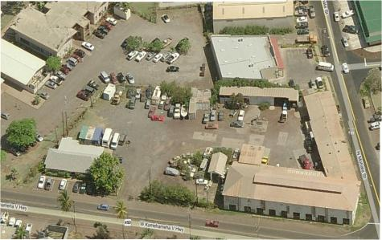
Inliers, Outliers and Misinterpretation of Discrete Data
Progression of Investigation
Over Time
What’s Really Happening…
Assume clean boundaries
Unnecessary Removal of Soil
Large Areas of Contaminated Soil Left
Exposure Area A
(mean fails)
Exposure Area B
(mean fails)
Exposure Area C
(mean passes)
Encountering False Negatives and Positives is Unavoidable

Slide 30
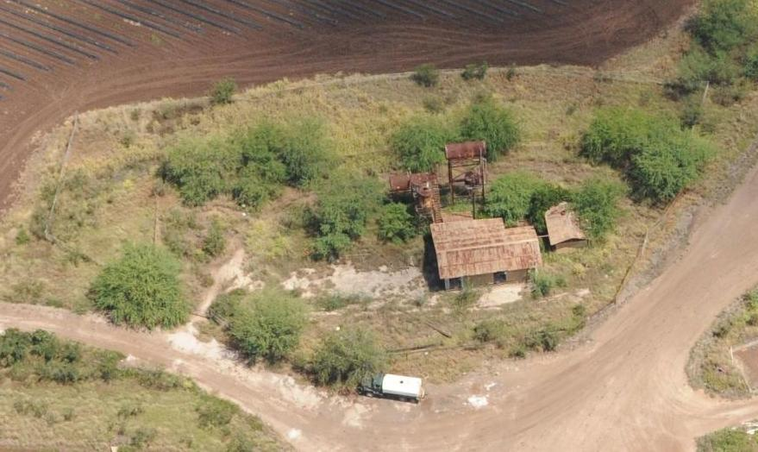
Former Pesticide Mixing Area Discreet Sample Data (>100 *samples)
Dioxins and Arsenic
50’
*All sample points not shown
For Example Only
Contamination <3’bgs (ave. 1.5’ bgs; est. 1,300 yds³)
Contamination >3’-10’bgs (est. 2,000 yds³)
After ITRC (2014)
Notes:
Speaker Notes
Long-scale heterogeneity is the spatial scale at which differences in concentration are expected.
Sampling programs are generally designed to search for variation in concentrations at this scale.

Slide 31
MIS-DU Investigation Results
(significantly more contamination identified)
Lateral and vertical extent of contamination underestimated by discrete data
50’
Perimeter DUs
<Screening Levels
For Example Only
Contamination <3’bgs (est. 2,000 yds³)
Contamination >3’-10+’bgs (est. 5,500 yds³)

Slide 32
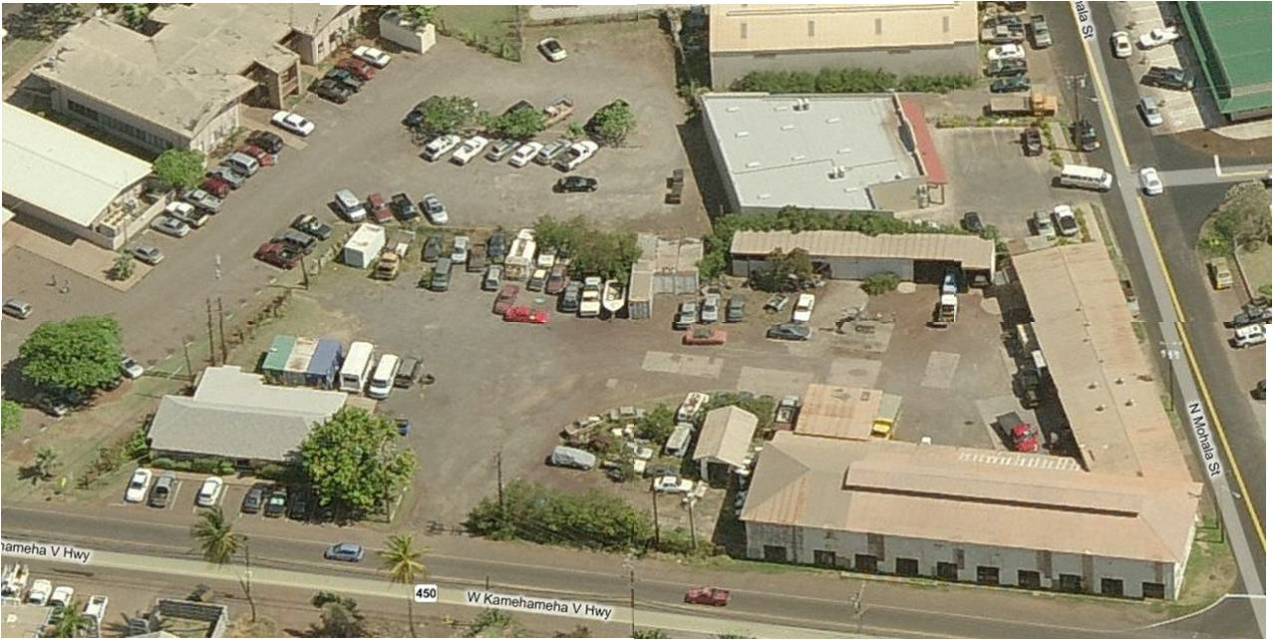
Why DUs (and ISM) are Important (Discrete Sample Data)
>Action Level
<Action Level
PCBs
Discrete data: Estimated 10,000 ft² soil
?
Discrete Sample
100’
PCB sample aliquot = 30 grams (one spoonful of soil)
After ITRC (2014)
Notes:
No associated notes.

Slide 33
Why DUs (and ISM) are Important (ISM Sample Data)
> Action Levels
< Action Levels
PCBs
MIS Data: Estimated 25,000+ ft² soil
(perimeter DUs pending)
Perimeter DUs
100’
After ITRC (2014)
Notes:
No associated notes.

Slide 34
Why DUs (and ISM) are Important (ISM Sample Data)
> Action Levels
< Action Levels
PCBs
2015 Status Update:
Higher concentrations of PCBs reported using MIS;
Reversion to discrete sampling currently being required by USEPA under TSCA (almost 1,000 samples!);
USEPA scientists aware of problem;
Working with USEPA attorneys (and HDOH) to develop regulatory pathway forward (e.g., Risk-Based Option.)
Perimeter DUs
The best way to get a bad law (or policy) repealed is to enforce it strictly.
Abraham Lincoln
After ITRC (2014)
Notes:
No associated notes.

Slide 35
Part 2 - Implications
Outline:
Representativeness of laboratory data;
Mapping extent of contamination;
*Interpretation of isoconcentration maps;
Heterogeneity and artificial “hot spots”;
Example over-interpretation of data;
Exposure concentrations and risk assessments;
Sampling Theory and DU-MIS investigations;
Regulatory hurdles.
*For example only. Parties associated with examples provided are aware of data interpretation limitations

Slide 36
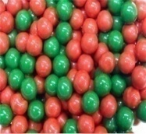
What Does Random, Discrete Sample Variability Look Like on a Map?
Study Site B: Estimated Total Grid Pt Variability
Grid Pt #21
103-419 mg/kg
400 mg/kg
(USEPA)
200 mg/kg
(HDOH)
(quartiles plus minimum, median and maximum)
Potential discrete samples above and below 200 mg/kg at 23 of 24 grid points;
Potential discrete samples above and below 400 mg/kg at 20 of 24 grid points.
Notes:
Study Site B Summary Notes:
-XRF data average -7% lower than 6010B data (moisture effects?)
-Relatively high variability within samples but lower between samples
-Variability is random, no distinct increasing/decreasing trends toward adjacent grid points
-Different handfuls of the same salad, highly variable with a sample but similar to nearby samples
-Discrete samples above and below 200 mg/kg at 23 or 24 grid points

Slide 37
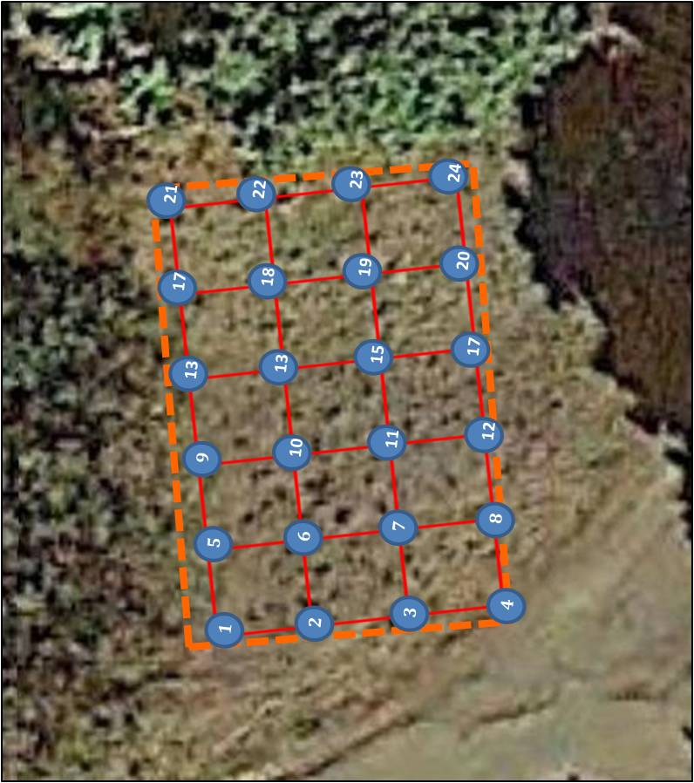
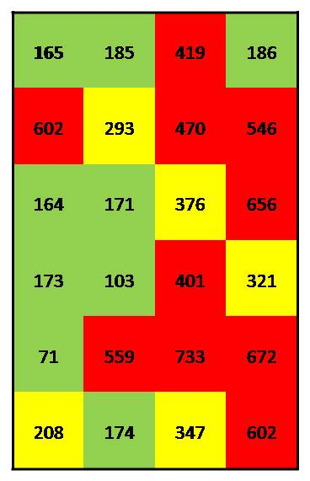
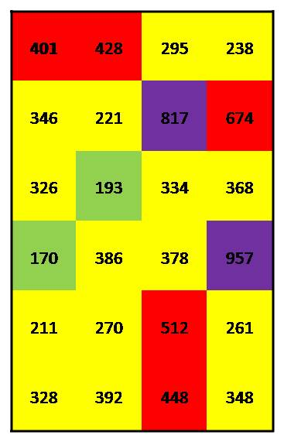
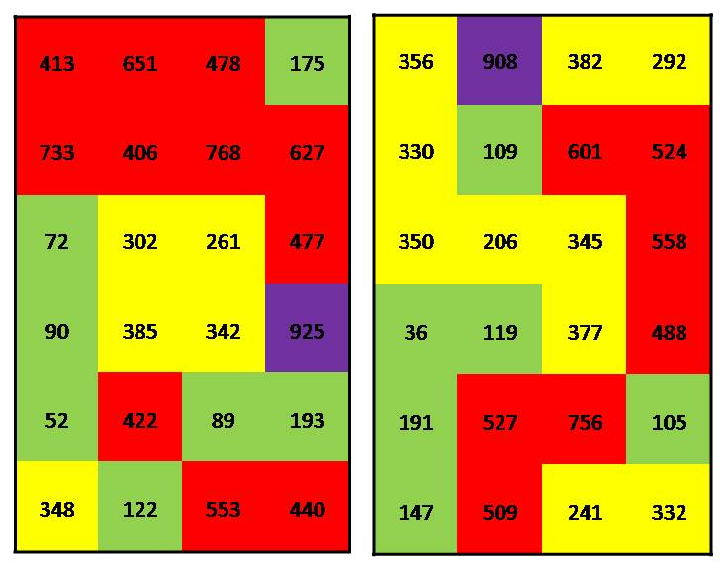
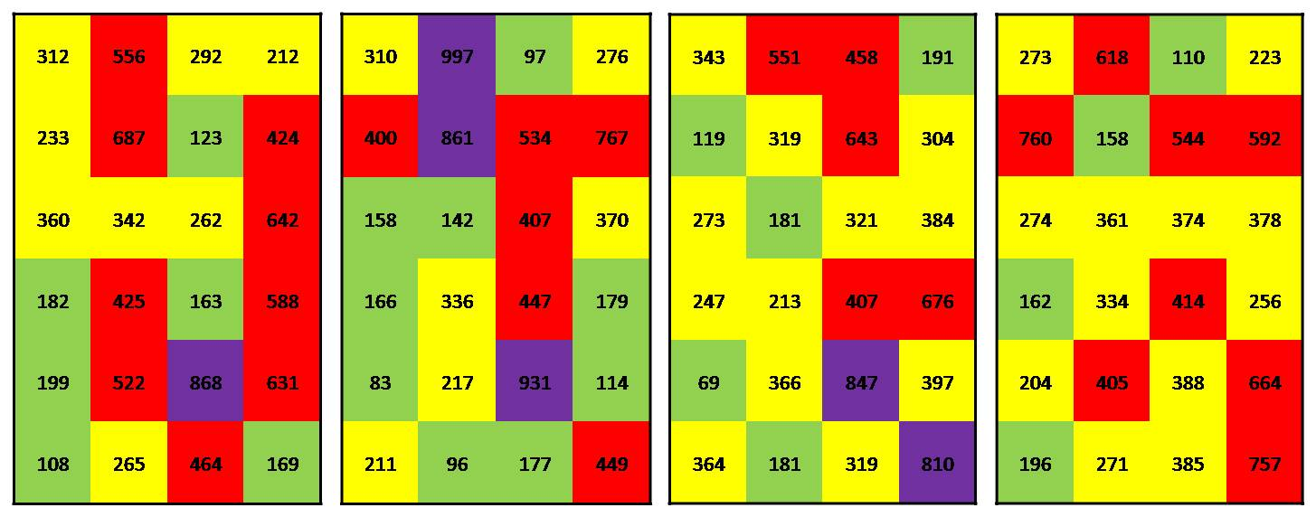
Random Map Patterns and Artificial “Hot Spots”
Grid Pt #21
103-419 mg/kg
Study Site B (lead): Random lead concentration assigned within estimated range for grid point
165
401
>800 mg/kg
>400 mg/kg
>200 mg/kg
<200 mg/kg
Notes:
Isolated “hot spots” and “cold spots” are an artificial reflection of small-scale, random heterogeneity.

Slide 38
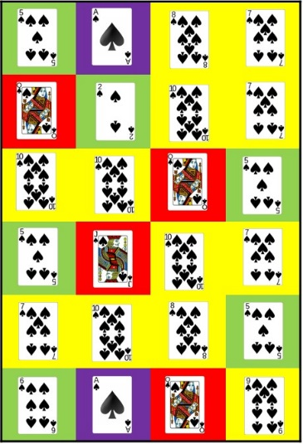
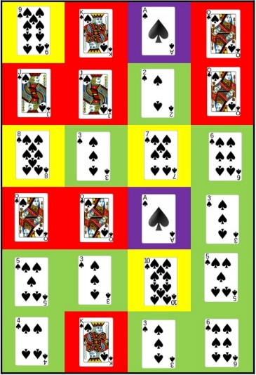
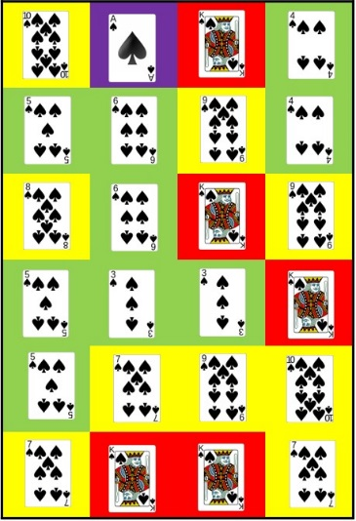
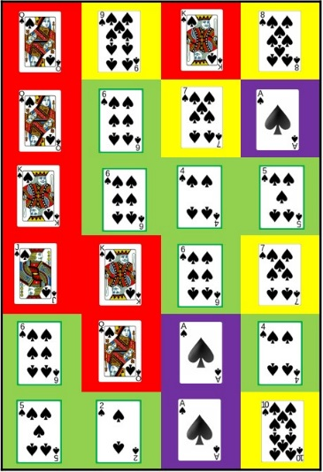
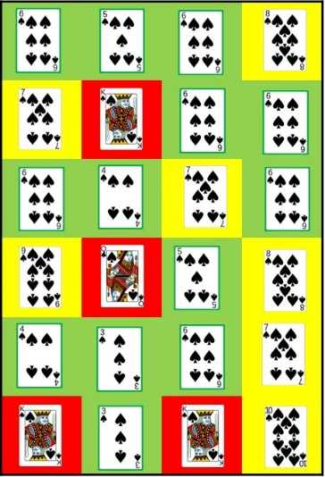
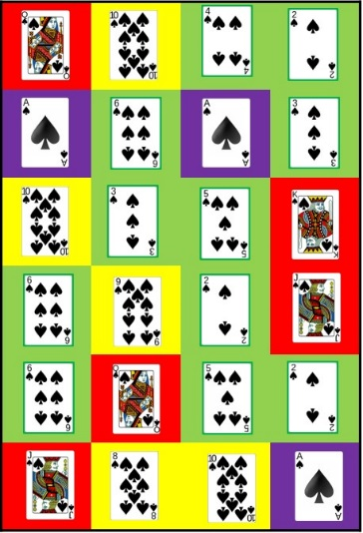
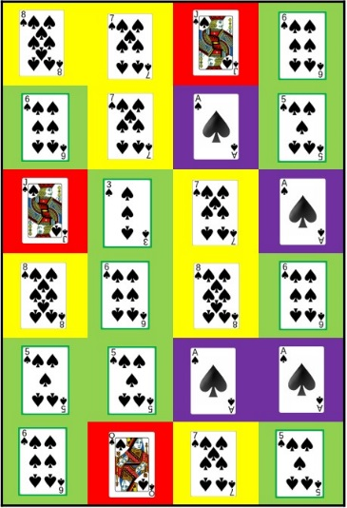
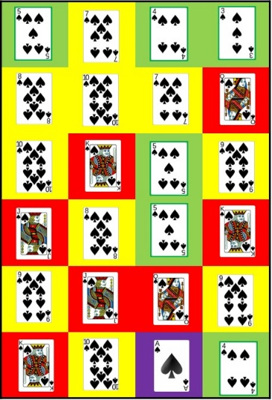
How to Make Artificial “Hot Spots” with Cards
Pick a Card…
Deck of cards placed on each grid point;
Every grid point is identical (no isolated “spots”);
Randomly drawn card creates artificial patterns.
Ace
Face Card
7-10
2-6
Notes:
Isolated “hot spots” and “cold spots” are an artificial reflection of small-scale, random heterogeneity.

Slide 39
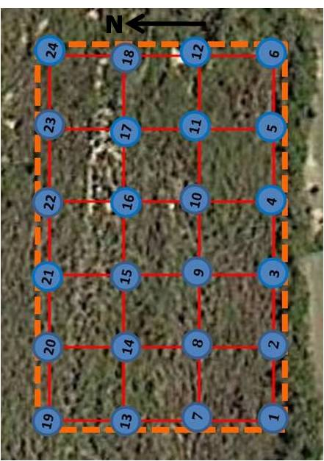
Large-Scale Patterns Can be Real: Study Site C (PCBs)
Grid Pt #24
1.6-215 mg/kg
Consistent, large-scale pattern in upper area;
Random small-scale patterns within.
145
38
>250 mg/kg
>50 mg/kg
>1.1 mg/kg
<1.1 mg/kg
Notes:
Isolated “hot spots” and “cold spots” are an artificial reflection of small-scale, random heterogeneity.

Slide 40
Part 2 - Implications
Outline:
Representativeness of laboratory data;
Mapping extent of contamination;
*Interpretation of isoconcentration maps;
Heterogeneity and artificial “hot spots”;
Example over-interpretation of data;
Exposure concentrations and risk assessments;
Sampling Theory and DU-MIS investigations;
Regulatory hurdles.
*Parties associated with examples provided are aware of data interpretation limitations

Slide 41
Real Large-Scale Patterns and
Artificial Small-Scale “Hot Spots”
Arsenic in US Surface Soil (USGS 2014)
Based on approximately 4,000, 1m² ground samples
NC
N
500km
OK

Slide 42
US Geologic Map
Basin & Range volcanics
Felsic igneous?
Glacial cover
Paleozoic black shales, coal, etc.
Blue Ridge & Piedmont MM & igneous rocks
Rocky Mountains
Coastal Plain
Floodplain deposition from upper watershed and/or As from rice farms?
Large-scale arsenic map patterns correlate well with regional geology

Slide 43
False Resolution Within Large-Scale Patterns
(Oklahoma/Texas)
125km
Approximately 300 samples collected from 400K km² area;
Large-scale patterns likely tied to geologic provinces, etc.;
Small-scale “hot spots” and “cold spots” within larger areas likely reflect random, small-scale heterogeneity;
Similar small-scale patterns if samples recollected but in different locations.
Notes:
Structures removed. No obvious spill areas observable in the field.

Slide 44
Artificial 2,400 km² Arsenic “Hot Spot” in NC
Discrete sample location
25km
X
Based on single, 1m² discrete soil sample,
Heterogeneous, metamorphic geologic terrane;
Sample likely collected from random, narrow mineralized zone;
Significant over interpretation of discrete sample data.
Notes:
Structures removed. No obvious spill areas observable in the field.

Slide 45
More Realistic Resolution of USGS As Data
(example only, not included in report)
N
500km
Small Print: “The resulting data sets are not appropriate for the accurate estimation of the concentration of a given element or mineral at a site where a sample was not collected (USGS 2014).”

Slide 46
Former Pesticide Mixing Area - Arsenic
Field XRF and tight grid of discrete samples used to identify spill area;
Large-scale patterns likely real;
Transition zone marked by small, likely artificial “hot spots” and “cold spots”;
Reflects random, small-scale variability above and below screening level.
Isolated
“Hot Spots”
Heterogeneity Range Above Screening Level
B
A
Heterogeneity Range overlaps Screening Level
B
C
Heterogeneity Range below Screening Level
9 acres
For example only
Field discrete samples
Notes:
Structures removed. No obvious spill areas observable in the field.

Slide 47
Realistic Screening Level Data Resolution
Most defensible interpretation of discrete sample data;
Boundaries between “contaminated zones” very fuzzy;
Upfront removal of heavily contaminated area possible;
Passage or failure of Zone B uncertain;
Designation of DU and collection of MI confirmation required.
Heavy Contamination
For example only
B
A
Moderate
Contamination
B
B
C
Low/No
Contamination
C
9 acres
Notes:
Structures removed. No obvious spill areas observable in the field.

Slide 48
Same Confusion at Depth…
Discrete samples identify multiple contaminated areas;
Meaning of isolated “hot spots” at depth uncertain;
Excavation plan developed.
Above Screening Level
Below Screening Level
Discrete
Sample
Borings
1
2
3
4
5
6
7
8
9
0’
-5’
-10’
-15’

Slide 49
Fooled Again by Heterogeneity…
Reported concentrations for discrete samples are random within an unknown range;
Isolated “hot spots” and “cold spots” reflect heterogeneity;
Discretes catch core but miss contamination in Zone B .
Above Screening Level
Below Screening Level
Heterogeneity Zones
Borings
C
B
A
B
C
1
2
3
4
5
6
7
8
9
0’
-5’
-10’
-15’

Slide 50
Part 2 - Implications
Outline:
Representativeness of laboratory data;
Mapping extent of contamination;
Interpretation of isoconcentration maps;
Exposure concentrations and risk assessments;
Comparison of data to screening levels;
What are we looking for?
Representativeness of discrete data sets;
Interpretation of “outlier” data;
Sampling Theory and DU-MIS investigations;
Regulatory hurdles.

Slide 51
1st Red Flag: Risk-Based Screening Levels Do Not Apply to Individual Discrete Samples
“The concentration term in the intake equation is the arithmetic average of the concentration that is contacted over the exposure period.”
USEPA 1989: Methods for Evaluating the Attainment of Cleanup Standards
For Superfund assessments, the concentration term in the intake equation (used to generate the RSLs) is an estimate of the arithmetic average concentration for a contaminant based on a set of site sampling results.
USEPA 1992: A Supplemental Guidance to RAGS: Calculating the Concentration Term

Slide 52
Exposure Area Means
“Risk estimates (are) developed for a particular exposure area and time period….
The mean concentration (should) be less than the cleanup standard and… (the) area of contaminated soil (should not) be larger than a specified size (e.g., target exposure area)…”
“Although this concentration does not reflect the maximum concentration that could be contacted at any one time, it is regarded as a reasonable estimate of the concentration likely to be contacted over time.”
USEPA 1989. Risk Assessment Guidance for Superfund, Volume I, Human Health Evaluation Manual

Slide 53
Risk Assessment vs Field Mapping
Small numbers of discrete soil samples routinely used to define edges of contamination;
Unlikely to be representative of true contaminant mean in those areas;
Can result in over or under estimation of contamination above levels of potential concern.
Sampling data from Superfund sites have shown that data sets with fewer than 10 samples per exposure area provide poor estimates of the mean concentration.
USEPA 1992: A Supplemental Guidance to RAGS: Calculating the Concentration Term

Slide 54
Side Thought: Evolution of Environmental Data
Statistical Analysis of Discrete Data Sets
Individual
Discrete Samples
*Multi Increment Sampling Methods
Mineral Exploration, Agriculture, etc.
Pre-1950s?
1960-1980s?
1980s-1990s
Environmental
Risk Assessment
mid 1980s
late 1980s
2000s
Environmental
Field Investigations
X
mid 1980s
2000s
*First sampling theory methods published in 1950s. US Army Corps initiated use of DU-MIS methods for environmental investigations in 1990s

Slide 55
Part 2 - Implications
Outline:
Representativeness of laboratory data;
Mapping extent of contamination;
Interpretation of isoconcentration maps;
Exposure concentrations and risk assessments;
Comparison of data to screening levels;
What are we looking for?
Representativeness of discrete data sets;
Interpretation of “outlier” data;
Sampling Theory and DU-MIS investigations;
Regulatory hurdles.

Slide 56
Decision Units (DUs) – Nothing New
DU: Area and volume of soil you would send to the lab as a single sample, if you could.
Source Area DUs
Exposure Area DUs
Notes:
Refer to ITRC ISM-1 Section 3.3.1 Exposure Area Decision Units and
ITRC ISM-1 Section 3.3.2 Source Area Decision Units

Slide 57
Early Concepts of “Spill Area Decision Units”
Historical information on production, discharge or storage of chemicals of potential concern can be used to identify separate (hot spot) areas (for characterization).
USEPA 1991: Guidance for Data Usability in Risk Assessment

Slide 58
Grid Spacing Based on Anticipated Spill Area Size
“To apply this (grid-based discrete sampling) method, the following assumptions are required… The shape and size of the contaminated zone must be known at least approximately.”
USEPA 1987: Data Quality Objectives for Remedial Response Activities
“When choosing a sampling plan, one must know the concentration patterns likely to be present (within the investigation area). Advance information on these patterns is used… An example is to divide a heterogeneous (investigation area) into more homogeneous parts (i.e., “DUs”)… and to select samples independently within each part.”
Gilbert 1987. Statistical Methods for Environmental Pollution Monitoring

Slide 59
The Search for BIG “Hot Spots”
If the particles (of contaminants) were all concentrated in the soil so that they formed a “hot spot” of perhaps the top ten cm of one acre…, it would be important to locate the hot spot (i.e., the one-acre area) so that remedial action could be taken.
USEPA 1989: Soil Sampling Quality Assurance User’s Guide
The (person setting the grid spacing) must determine… the acceptable probability of not finding an existing contaminated zone in the suspected area. For instance, it might be determined that a 20 percent chance of missing a 100ft-by-100ft (10,000ft²) contaminated zone is acceptable but only a 5 percent chance of missing a 200ft-by-200ft (40,000ft²) zone is acceptable.
USEPA, 1987, Data Quality Objectives for Remedial Response Activities

Slide 60
Part 2 - Implications
Outline:
Representativeness of laboratory data;
Mapping extent of contamination;
Interpretation of isoconcentration maps;
Exposure concentrations and risk assessments;
Comparison of data to screening levels;
What are we looking for?
Representativeness of discrete data sets;
Interpretation of “outlier” data;
Sampling Theory and DU-MIS investigations;
Regulatory hurdles.

Slide 61
Are 20 to 30 samples really enough?
Sampling data from Superfund sites have shown that… data sets with 20 to 30 samples provide fairly consistent estimates of the mean.
USEPA 1992: A Supplemental Guidance to RAGS: Calculating the Concentration Term

Slide 62
Estimation of Means from Random Discrete Data Sets
Hypothetical data sets generated by random selection of grid points and intra-sample data;
Purely random 10-point data sets;
Random data for 24-point grid;
20 iterations each scenario;
ProUCL used to calculate 95% mean.
Study Site A
(arsenic in wastewater)
Study Site B
(lead in incinerator ash)
Study Site C
(PCBs transformer oil)
30’
150’
N
90’
17
21
60’
9
13
5
22
1
13
18
50’
2
6
10
23
N
15
19
120’
3
7
11
24
17
20
4
8
12

Slide 63
Purely Random Intra-Sample Data Sets
(10 grid points, 20 iterations)
Study Site | Range 95% UCL (mg/kg) | Range RSD
Site A (arsenic) | 403 to 776 | 34% to 67%
Site B (lead) | 201 to 439 | 20% to 86%
Site C (PCBs) | 9.4 to >1,000,000 | 124% to 315%
Ten samples not consistent

Slide 64
Random Intra-Sample Data Sets for Full Grid
(24 grid points, 20 iterations)
Study Site | Range 95% UCL (mg/kg) | Range RSD
Site A (arsenic) | 395 to 492 | 39% to 54%
Site B (lead) | 280 to 394 | 49% to 80%
Site C (PCBs) | 652 to 8,884 | 251% to 434%
*24 samples more consistent;
Moderate to high RSD at arsenic and lead sites;
Very high RSD with 24 samples at PCB site;
*Representativeness of 24-point grid unknown.

Slide 65
Study Site Multi Increment Data
Triplicate 50- to 60-increment MI samples collected from each study site;
Most reliable data for estimation of mean contaminant within targeted area and decision making.
Study Site A
(arsenic in wastewater)
Study Site B
(lead in incinerator ash)
Study Site C
(PCBs transformer oil)

Slide 66
Study Site A (Arsenic) MI Triplicates
Study Site A
(arsenic in wastewater)
Study Site A
Triplicate MI Sample Data
Sample A: | 220 mg/kg
Sample B: | 250 mg/kg
Sample C: | 230 mg/kg
RSD: | 6.5%
Mean: | 233 mg/kg
*95% UCL: | 259 mg/kg
*Student's t
60-increment MI samples;
Very good precision (<35%);
Exceeds default arsenic background of 24 mg/kg;
Obtain bioaccessibility data for highest sample (SBRC-g) for comparison to BA Arsenic action level (23 mg/kg).

Slide 67
Study Site B (Lead) MI Triplicates
Study Site B
(lead in incinerator ash)
Study Site B
Triplicate MI Sample Data
Sample A: | 240 mg/kg
Sample B: | 270 mg/kg
Sample C: | 350 mg/kg
RSD: | 20%
Mean: | 287 mg/kg
*95% UCL: | 346 mg/kg
*Student's t
55-increment MI samples;
Reasonably good precision (<35%);
Exceeds HDOH action level of 200 mg/kg.

Slide 68
Study Site C (PCBs) MI Triplicates
Study Site C
(PCBs transformer oil)
Study Site C
Triplicate MI Sample Data
Sample A: | 270 mg/kg
Sample B: | 24 mg/kg
Sample C: | 19 mg/kg
RSD: | 138 %
Mean: | 104 mg/kg
*95% UCL: | 467 mg/kg
*Chebyshev
60-increment MI samples;
Very poor precision (>100%);
Retest of samples at lab showed good precision (field error);
Reliability of sample mean and 95% UCL low;
Subdivide original DU into smaller DUs, increase increment count (75+) and sample mass and recharacterize.

Slide 69
Who’s Right?
Multi Increment vs Discrete Sample Data
Study Site | Discrete Data (24 Grid Points ave) |  | MIS Data (triplicate samples)
 | Range 95% UCL (mg/kg) | Range RSD | 95% UCL (mg/kg) | RSD
Site A (arsenic) | 395 to 492 | 39% to 54% | 259 | 6.5%
Site B (lead) | 280 to 394 | 49% to 80% | 346 | 20%
Site C (PCBs) | 652 to 8,884 | 251% to 434% | 467 | 138%
Multi Increment data provide far better statistical precision.

Slide 70
Multi Increment vs Discrete Sample Data
-Sample Support-
Sampling Method | Number of DU Points | Total Mass of Soil Represented (grams) | Total Number of Analyses
Discrete Sample Data (24): | 24 | 24 | 24
MI Sample Data (Triplicates): | 180 | 4,500 | 3
Multi Increment data provide far better sample support.

Slide 71
How do you know if a set of discrete samples is representative of targeted area? (Ideas needed)
Statistical evaluation of single data set only addresses precision with respect to test used and data set provided;
Field representativeness of single data set can’t be directly evaluated in absence of replicate data sets (?);
Samples must also meet Sampling Theory requirements for sufficient mass, distribution, shape, subsampling, etc. (i.e., test every increment).
Notes:
1. Mean and 95% UCL based on use of lowest, mean, median and maximum concentration reported for each grid point.
2. ProUCL Version 5.0 (recommended UCL noted)

Slide 72
Part 2 - Implications
Outline:
Representativeness of laboratory data;
Mapping extent of contamination;
Interpretation of isoconcentration maps;
Exposure concentrations and risk assessments;
Comparison of data to screening levels;
What are we looking for?
Representativeness of discrete data sets;
Interpretation of “outlier” data;
Sampling Theory and DU-MIS investigations;
Regulatory hurdles.

Slide 73
Seek and Yee Shall Find…
The more (discrete) samples collected, the more likely that one sample will exceed a cleanup standard (i.e., “outliers” will be identified).
USEPA, 1989, Methods for Evaluating the Attainment of Cleanup Standards
Also:
The smaller mass tested, the more likely that one sample will exceed a cleanup standard (e.g., 30g vs 10g vs 1g);
The maximum concentration of a contaminant in soil (at a small enough scale) is always 0% or 100%.

Slide 74
Disruptive Outliers?
Delete the “outliers” after you find them?
Outliers distort… statistics of interest. Therefore, it is desirable to… not to compute… statistics by accommodating a few low probability outliers.
USEPA 2013. ProUCL User Guide.
Statisticians often get stuck with un-interpretable data…

Slide 75
“Outliers” are Important
Keep outlier data…
All data not known to be in error should be considered valid… High concentrations are of particular concern for their potential health and environmental impact.
USEPA 1989. Methods for Evaluating the Attainment of Cleanup Standards
All the constituents of the lot (DU) to be sampled must be given an equal probability… of being selected and preserved as part of the sample (data).
Pitard 2005

Slide 76
Forced to Fit In
Outlier data for soil are artifacts of improper sampling.
(Improper) sampling protocol (for particulate matter) introduces an enormous fundamental error (in the data set) that confuses the interpretation of the data (and) subsequent geostatistical studies.
Pitard 1993.
A common error has been to reject “outliers” that cannot be made to fit (a statistical) model...
The tendency… has been to make the data fit a preconceived model instead of searching for a (more appropriate way to collect samples).
Pitard 2009

Slide 77
Improving Performance by Ignoring Data…
(Study Site C – Mean Intra-Sample Data)
Study Site C
20 “Good” Discrete Samples
X
X
X
4 “Bad” “Outliers”?
X
Calculation Method | 95% *UCL (mg/kg | RSD
With “Outliers” | 1,851 | 328%
Without “Outliers” | 41 | 133%
*Chebyshev

Slide 78
Gold Miners Love Outliers!
Capturing and representing distributional heterogeneity within a targeted area/volume of soil (or rock) is critical to correct sampling;
“Outlier” areas of higher concentrations often drive decision making;
Entire DU eventually dug up and extracted (ultimate test of sample representativeness);
It’s the sampling method, not the statistical models.
Outliers Are Golden
What is the mean concentration of gold in this ore body?

Slide 79
Excavating “Outliers” Isn’t The Answer Either
Study Site C
“Hot spots” can be random artifacts of heterogeneity;
Removing grid point “hot spots” misleading;
Resampling of full area required to re-estimate mean.
Hot Spots IDd
X
Surprise! Bouncing Hot Spots!
145
38
X
>250 mg/kg
>50 mg/kg
>1.1 mg/kg
<1.1 mg/kg
Notes:
Isolated “hot spots” and “cold spots” are an artificial reflection of small-scale, random heterogeneity.

Slide 80
I know what you’re thinking…
I know what you're thinking, 'cause right now I'm thinking the same thing. Actually, I've been thinking it ever since I got here:
Why oh why didn't I take the BLUE pill?
Cypher (to Neo in The Matrix )

Slide 81
Solution: Sampling Theory -Decision Units & Multi Increment Samples-
Sometimes the questions are complicated and the answers are easy.
Dr Seuss
Particulate sampling theory is new to most environmental investigators even though the techniques used to apply the theory to soil sampling are familiar.
USEPA 1992, Preparation of Soil Sampling Protocols

Slide 82
Part 2 - Implications
Outline:
Representativeness of laboratory data;
Mapping extent of contamination;
Interpretation of isoconcentration maps;
Exposure concentrations and risk assessments;
Sampling Theory and DU-MIS investigations;
Sampling Theory explained with salad;
Regulatory hurdles.

Slide 83
Sampling Theory – Detailed Details…
Causes of Erroneous Data:
Fundamental Error;
Grouping & Segregation Error;
Increment Delimitation Error;
Increment Extraction Error;
Periodic Error;
Preparation Error;
Analytical Error; etc.

Slide 84
Sampling Theory Explained With Salad
Wrong Questions:
What is the maximum concentration of tomato in this salad?
What is the concentration of tomato at point “X”?
Primary Concern:
Long-term exposure to tomatoes

Slide 85
Step 1: Define Objectives and Designate Decision Units
Right Question:
What is the mean concentration of tomato in this salad?
Random bits of salad to be eaten over a lifetime;
Entire salad represents the “Exposure Area” DU.

Slide 86
Step 2. Collect a Representative Sample
Collect evenly spaced increments collection from targeted DU Area;
Sample must capture representative # of “hot spots” and “cold spots”;
Minimum 30 (low heterogeneity) to 75+ (high heterogeneity) points.
Increments
Incremental Sample

Slide 87
Sampling Theory - Collect a BIG Sample (in order to capture and represent random, small-scale variability)
Capture the “outliers,” don’t toss them!
Soil Samples: Typical 30-50g increments and minimum 1-2+kg bulk MI sample

Slide 88
Step 3: Laboratory Processing and Subsampling -Repeat Method Used in Field-
Bulk soil IS sample dried and sieved;
Subsampling process repeated to collect aliquot for testing (minimum 30 increments);
Preserves field quality of original sample;
Minimum 10-30g mass tested (normal metals = 1g).
Aliquot
Tested
by Lab

Slide 89
Step 4. REPEAT Two More Times and Compare Data to Test Precision (“Triplicates”)
1
Analysis
2
Analysis
3
Analysis

Slide 90
Increase Resolution of Data as Needed
Use smaller DUs to isolate and test suspected “hot areas;”
Optimizes “remediation” and quickly clears “clean” areas;
Designated optimal DU sizes at start of investigation.
Suspect Spill Area
Perimeter DUs
DU-1
DU-2
DU-3
*Suspected “hot” spill area and “clean” perimeters tested separately

Slide 91
Sampling Theory Training
Envirostat, Inc.: Chuck Ramsey (www.envirostat.org)
Four-day, detailed introduction to sampling theory and Multi-Increment Sample® (MIS) site investigations.
ITRC: Incremental Sampling Methodology (ISM) Introduction to basics of sampling theory and incremental sampling (guidance + semi-annual webinars)
http://itrcweb.org/ism-1/
Hawai’i DOH Technical Guidance Manual & Workshops
Implementation of DU-MIS investigations in the field (1st edition 2009, updates in preparation)
http://eha-web.doh.hawaii.gov/eha-cma/Org/HEER/

Slide 92
Hawaii DOH Technical Guidance Manual
(draft updates to be posted by end of 2015)
Sampling theory;
Decision Unit examples;
Multi Increment samples;
Use and limitations of discrete samples;
Common mistakes and problems;
Field implementation (tools, etc.)
Volatile contaminants;
Excavations;
Stockpiles;
Trenches;
Subsurface investigations;
Ecological investigations; etc.

Slide 93
Details, Details (see HDOH TGM)
Field Tools (vary with soil type & depth)
Increment Shape
Good
Not good
Subsample cores
Core wedges
Plugs (+/- COH₄)
Notes:
Kea`au Middle School garden

Slide 94
Part 2 - Implications
Outline:
Representativeness of laboratory data;
Mapping extent of contamination;
Interpretation of isoconcentration maps;
Exposure concentrations and risk assessments;
Sampling Theory and DU-MIS investigations;
Regulatory hurdles.

Slide 95
Agency Policies and Regulations
No specific regulatory prohibition against use of Multi Increment (“Incremental”) sampling methods;
Innovation and improvement in efficiency of site investigations methods generally encouraged;
Current hurdles primarily due to lack of awareness of discrete sample unreliability and lack of experience with DU-MIS approaches;
Similar situation in Hawai’i in early 2000s.

Slide 96
DU-MIS and PCBs Under TSCA
Discrete sampling approaches developed in mid 1980s;
Based on erroneous assumption of contaminant “uniformity” in soil;
Risk assessment guidance concurrently being developed;
Confusion over applicability of risk-based screening levels to any testable mass of soil (no) vs mean PCB concentration over a targeted, exposure area (yes).
Future changes in EPA policy may invalidate some of the discussions in this (guidance).
USEPA 1985: Verification of PCB Spill Cleanup

Slide 97
Discrete Sample Grids Spaced to ID Spill Areas
“The implicit assumption (that…) contamination is… likely to be (uniformly) present anywhere within the sampling area (contaminated zone) is reasonable.”
USEPA 1985: Verification of PCB Spill Cleanup
“Any (single discrete) sample located within the contaminated zone will identify the contamination.”
USEPA 1987: Data Quality Objectives for Remedial Response Activities
“To apply this (grid-based discrete sampling) method… the shape and size of the contaminated zone must be known at least approximately.”
USEPA 1987: Data Quality Objectives for Remedial Response Activities

Slide 98
The Search for PCB Spill Areas Under TSCA
Original grid spacing guidance based on assumed size of spill areas (100s-1,000’s ft²);
Single discrete sample assumed representative;
Spill area DU size can’t exceed Exposure Area DU.
Example Spill Area Size
40 CFR 761.61(a) Self-implementing on-site cleanup and disposal of PCB remediation waste;
Default grid spacings presented (basis unclear).

Slide 99
MI Samples Improve Data Representativeness
DUs designated DUs based on suspect spill areas, assumed clean perimeters, exposure areas etc;
MI sample collected across entire DU;
Samples processed, subsampled and tested.
X
X
X
X
X
X
X
X
X
X
X
X
X
X
X
X
X
X
X
X
X
X
X
X
X
X
X
X
X
X
X
X
X
X
X
X
X
X
X
X
X
X
X
X
X
X
X
X
X
X
X
X
X
X
X
X
X
X
X
X
X

Slide 100
*DU-MIS and “Dilution” Under TSCA
Intentional combination of anticipated PCB spill areas with anticipated clean areas for testing may violate “anti-dilution” clause in TSCA (40 CFR761.1(b)(5)):
“"No person may avoid any provision specifying a PCB concentration by diluting the PCBs unless otherwise provided”;
Requires careful designation of Spill (Source) Area DUs in coordination with overseeing regulatory agency.
*HDOH interpretation of TSCA intent

Slide 101
Limited “Compositing” and “Dilution” Allowed Under TSCA to Save on Lab Costs
Composite
Potential Spill Area
Soil combined across different DUs are composites;
Potential dilution of higher concentration in localized spill areas;
Laboratory result divided by number of discrete samples included in composite for comparison to cleanup level;
Ensures that no single “sampling area” (DU) exceeds target cleanup level.

Slide 102
Theoretical Compositing of Multi Increment Samples From Separate DUs
Composite
X
X
Potential Spill Area
X
X
X
X
X
X
X
X
X
X
X
X
X
X
X
X
X
X
X
X
X
X
X
X
X
X
X
X
X
X
X
X
X
X
X
X
X
X
X
X
X
X
X
X
X
X
X
X
X
X
X
X
X
X
X
X
X
X
X
A single MI sample collected within a single DU is not a composite (i.e., of multiple DU samples);
Compositing of MI samples not allowed under HDOH guidance.

Slide 103
DU-MIS Improvements to TSCA
Better understanding of “hot spots” and “Decision Units” (e.g., “Spill/Source” Areas and risk-based “Exposure Areas”);
Multi Increment (“incremental”) sample rather than discrete sample required to characterize a targeted DU area;
Replicate MI samples used to test precision (not required for discrete sampling);
Greater upfront time and cost but ultimately more reliable, faster and cost-effective.

Slide 104
Proposed Path Forward: Incorporation of DU-MIS (ISM) Under TSCA “Risk-Based” Option
40 CFR 761.61(c)(1) Risk-based disposal approval:
“Any person wishing to sample, cleanup, or dispose of PCB remediation waste in a manner other than prescribed in paragraphs (a) or (b) of this section… must apply in writing to the EPA Regional Administrator in the Region.”
Hawai‘i DOH has proposed a formal agreement with USEPA IX for use of DU-MI sample data at PCB sites that come under joint oversight in accordance with HDOH guidance (currently in discussions).

Slide 105
Summary
Concentrations of contaminants within and between co-located discrete soil samples can randomly vary by orders of magnitude over short distances;
This is predictable from Sampling Theory;
Laboratory data are not reliably representative of the discrete sample provided;
Discretes samples are not reliably representative of the area where they were collected;
This results in unnecessary delays and added cost to site cleanup;
DU-MIS approaches are designed to address these deficiencies and improve reliability and efficiency of environmental investigations.

Slide 106
NOT Another Tool in the Tool Box…
Discrete Sampling
Multi Increment Sampling
It’s an entirely new and improved set of tools.
DU-MIS investigation methods were specifically developed to address well-known, serious deficiencies in traditional, discrete sampling methods.

Slide 107
Questions?
The only real learning results from hangups, where instead of expanding the branches of what you already know, you have to stop and drift laterally for a while until you come across something that allows you to expand the roots of what you already know.
Robert Pirsig (Zen and the Art of Motorcycle Maintenance)

