Slide 1

CDC-RFA-DP-23-0003

Slide 2




What is the WISEWOMAN Program?
Goal of the program is to help women understand and reduce their risk for heart disease

Slide 3
Priority Population
Women enrolled in BCCCP
  Patient navigation participants are eligible for WISEWOMAN
Women 35 – 64 years old
Uninsured or Underinsured
Low Income

Slide 4
WISEWOMAN Program Purpose
Health Equity
Social Needs
CVD Assessment
Improve cardiovascular health with a focus on
advancing health equity.
Help program
participants achieve the best health
possible by addressing social determinants of health and the effects of unfair opportunity structures.
Provide CVD assessments,
referrals for treatment and social needs, and support for lifestyle change among
participants who are eligible for Hawaii Breast and Cervical Cancer Control Program (HBCCCP) services. ​

Slide 5

Office Visit Policy
INTEGRATED OFFICE VISIT
ENROLL IN WISEWOMAN
All HBCCCP Participants
Any follow-up for HBCCCP
Height & weight measures
Blood Pressure
Smoking assessment
PAP Test
HPV Test
CBE
Labs: HbA1C, lipids, glucose, cholesterol
Social Needs Assessment
Risk Reduction Counseling
Healthy Behavior Support Services
HBCCCP Participants at risk for CVD
Participants aged
21-64 who are eligible for HBCCCP
Any follow-up for WISEWOMAN
IDENTIFY PARTICIPANTS AT RISK FOR CVD
HBCCCP funds for reimbursement
WISEWOMAN funds for reimbursement
Integrated Office Visit: BCCCP and WISEWOMAN provider sites
WISEWOMAN funds must be payor of last resort

Slide 6
Risk Reduction Counseling
Ensure participants understand their CVD risk compared to other participants their age
Discuss a participants clinical and health risk assessment results
Motivational interviewing skills
Refer participants to community-based resources

Slide 7
Healthy Behavior Support Services (HBSS)
HBSS Include:
Health Coaching
Healthy Heart Ambassador (HHA) Blood Pressure Self Monitoring Program
Diabetes Prevention Program
Key Components:
Bi-directional Referral Mechanism
Social Services and Support
Community Based Resources

Slide 8

Social Services and Supports
Resources should reflect identified social needs of priority population. ​
Resources can supplement healthy behavior support services. ​
Program participants should continue to have access to immediate and ongoing community-based resources and social services and support.
WISEWOMAN funds should be used for CDC approved health coaching or lifestyle programs, not for community-based resources and social services and support needs.

Slide 9
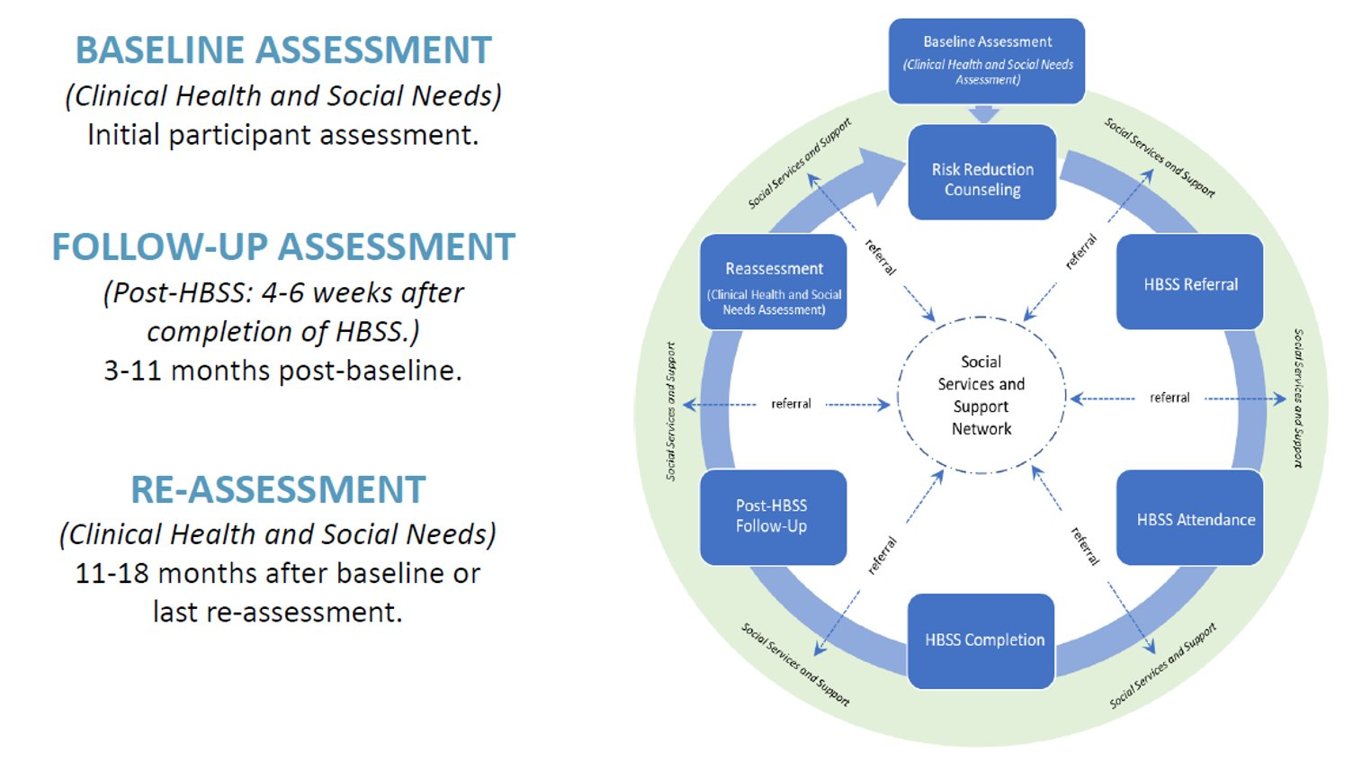
WISEWOMAN Program Flow
BASELINE ASSESSMENT
  Initial participant assessment to evaluate clinical health and social needs
FOLLOW UP ASSESSMENT
  Conducted 4-6 weeks after completion of HBSS
  3-11 months after baseline assessment
REASSESSMENT
  Conducted 11-18 months after baseline (or last reassessment) to re-evaluate clinical health and social needs

Slide 10
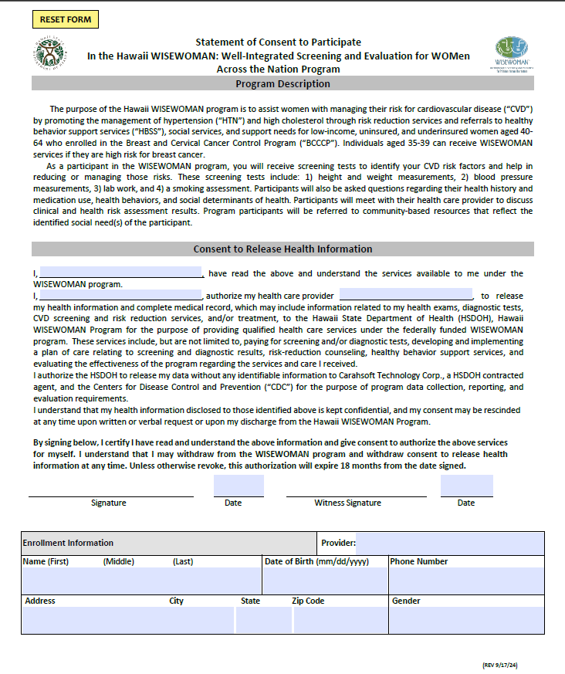
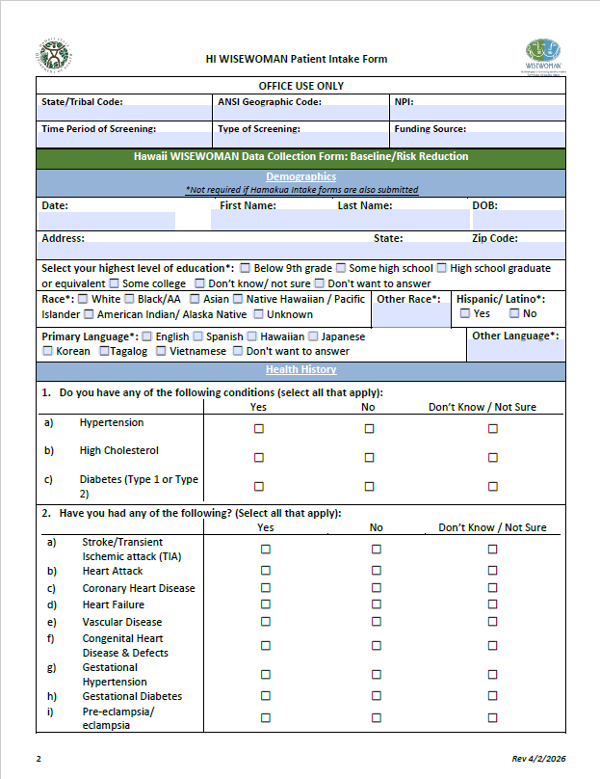
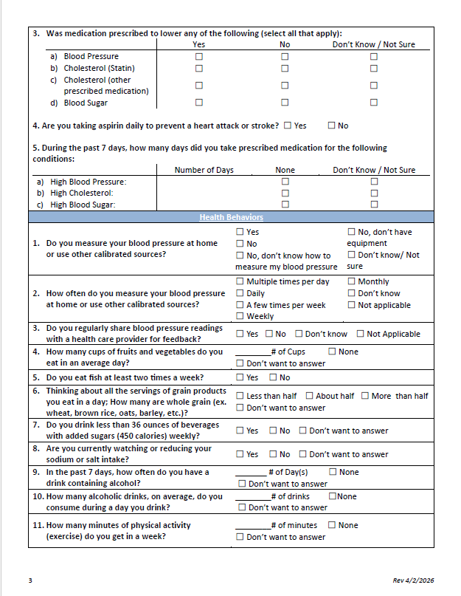
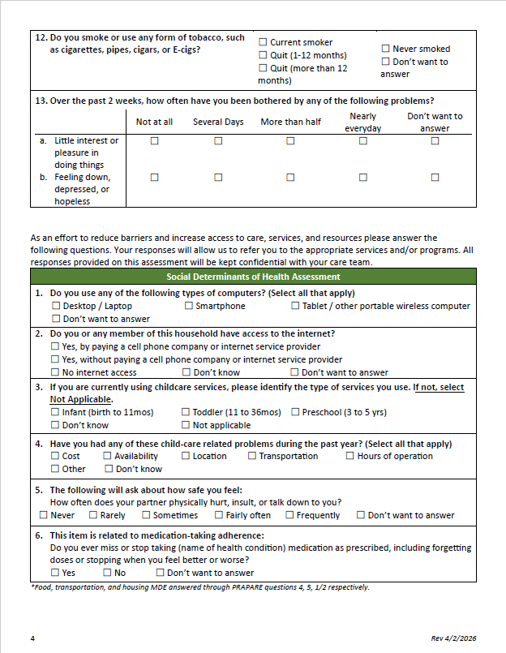
Reporting Requirements
1. Patient Consent Form
2. Patient Intake Form
Notes:
Administrative
Enrollment site ID, time period of screening assessment
Demographics
Month/Year of birth, primary language
Health History and Medication Use
History of high cholesterol and other conditions
Behavioral
Measuring blood pressure, nutrition, other health behaviors
Clinical Value MDE Specifications
Height, weight, blood pressure, cholesterol, A1C percentage
Risk Reduction Counseling MDE specifications
Completion date
Healthy Behavior Support MDE specifications
Lifestyle program/health coaching
Social Determinants of Health MDE specifications
Internet access, transportation, nutrition, etc.

Slide 11
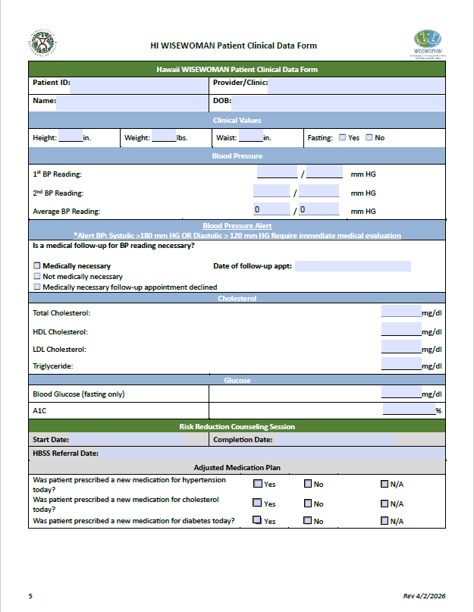
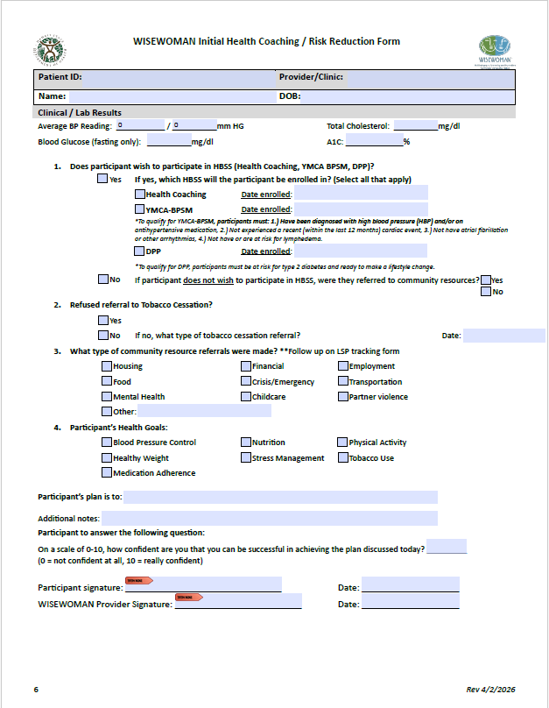
Reporting Requirements
3. Patient Clinical Data
4. Health Coaching/Risk Reduction Form

Slide 12
WISEWOMAN Reimbursement Rates
WISEWOMAN Services
0403T | Health and behavior intervention for prevention of diabetes (DPP), minimum 60 minutes | $25.00
G9886 | Behavioral counseling for diabetes prevention, in-person, group, 60 minutes | $26.00
G9887 | Behavioral counseling for diabetes prevention, distance learning, 60 minutes | $26.00
G9888 | Maintenance 5% WL from baseline in months 7-12 | $8.00
BPSM | BPSM Program – Monthly reimbursement for CDC-approved 4-month BPSM program. Course provider reimbursement. | $50.00
HC001 | Health coaching – Reimbursement per session (3 sessions, 20 minutes) | $33.00
RISKRC | Risk Reduction Counseling | $50.00
SCRNB | Screening Bundle – includes program enrollment form, consent form, provider-driven baseline screening form, and initial biometric screening data. Clinic reimbursement. | $25.00
PARTLWW | WISEWOMAN partial completion bundle – Clinic (Attended a minimum of at least two sessions, but client did not complete the minimum # of sessions- Includes documentation of participation and follow-up oﬃce visit. Provider reimbursement. Applies only to CDC-approved DPP, YMCA/CDC-approved BPSM, and CDC-approved Health Coaching. | $150.00
COMPLWW | WISEWOMAN completion bundle – Clinic – Includes tracking attendance & client completion of CDC-approved DPP (min. 9 sessions) and/or YMCA/CDC-approved BPSM program (min. 4 nutrition classes/8 sessions with program staﬀ/8 self BP readings) and/or CDC approved Health Coaching (min. 3 sessions), and documentation to follow-up oﬃce visit 4-6 weeks after HBSS completion. Provider Reimbursement. Cannot be charged in addition to WISEWOMAN partial completion bundle. Applies only to CDC-approved DPP, YMCA/CDC-approved BPSM, and CDC-approved Health Coaching. | $300.00
Billing Code | Billing Code Description | 2025 Rate
Lab Services
36415 | Collection of venous blood by venipuncture | $3.00
80048 | Blood Test, Basic group of blood chemicals (calcium, total) | $11.70
80061 | Blood test, Lipids (Cholesterol and triglycerides) | $18.51
82465 | Cholesterol, Serum or whole blood, Total | $6.02
82947 | Glucose ; Quantitative, Blood (Except reagent strip) | $5.42
82948 | Glucose; Blood, Reagent strip | $4.37
82951 | Blood glucose (sugar) tolerance test, 3 specimens | $17.80
83036 | Hemoglobin; Glycosylated (A1C) | $13.42
83718 | Lipoprotein, Direct measurement; High density cholesterol (HDL Cholesterol) | $11.31
Oﬃce Visits*
99203 | New patient oﬃce or other outpatient visit, 30-44 minutes | $115.15
99204 | New patient oﬃce or other outpatient visit, 45-59 minutes | $171.56
99205 | New patient oﬃce or other outpatient visit, 60-74 minutes | $225.65
99211 | Oﬃce or other outpatient visit for the evaluation and management of an established patient. | $25.27
99213 | Established patient oﬃce or other outpatient visit, 20-29 minutes | $94.44
99214 | Established patient oﬃce or other outpatient visit, 30-39 minutes | $132.79
G9012 | Other speciﬁed case management | $60.00

Slide 13

Mahalo!
Raiza Dalofin
WISEWOMAN Program Specialist
Email: raiza.dalofin@doh.hawaii.gov

