Slide 1
GHG Rules & Statewide
GHG Emission Inventories
August 28, 2017
Clean Air Branch

Slide 2
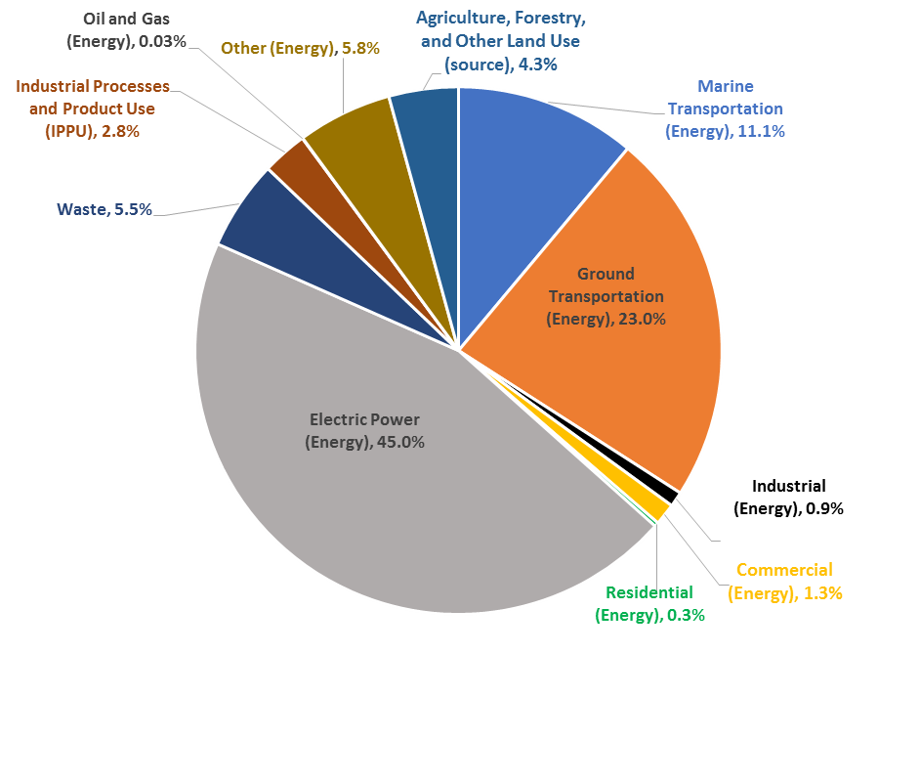
Introduction
The GHG Rules are required by Hawaii Act 234, 2007.
Sets statewide greenhouse gas emissions limit to equal or below 1990 levels by 2020 (13.66 million metric tons per year of CO₂e, excluding aviation and international bunker fuel emissions and includes carbon sinks).
Prior 2007 Statewide GHG Emissions Inventory from ICF.
2007
Notes:
Carbon dioxide equivalent emissions are determined by multiplying the mass amount of each greenhouse gas by its associated global warming potential and adding them up.
Biogenic CO₂ is excluded from the cap.
Statewide GHG emissions limit is equal to or below 13.66 million metric tons (or 15.06 million tons) per year of CO₂e. The GHG limit excludes aviation and international bunker fuel emissions and include carbon sinks.
Sink is a carbon reservoir that removes greenhouse gas from the atmosphere. The main sinks are the oceans and growing vegetation that absorb CO₂.
The GWP is a scale of how effective a greenhouse gas is in heating up the atmosphere in comparison to carbon dioxide with the global warming potential of one.

Slide 3
GHG Emissions CAP
To help meet goal – GHG emission cap specified for stationary sources.
Potential CO₂e emissions threshold of 100,000 tons/year.
Cap is set at 16% below facility’s baseline emission level unless alternate cap is approved if 16% reduction cannot be achieved.
Use 2010 or as baseline or alternate approved baseline emission level for establishing the cap.
Statewide Stationary Source GHG Emission Levels
16% reduction*
Year 2010
Year 2020
* 13.2% + Factor of Safety = 16% Reduction
Notes:
Carbon dioxide equivalent emissions are determined by multiplying the mass amount of each greenhouse gas by its associated global warming potential and adding them up.
Biogenic CO₂ is excluded from the cap.
Statewide GHG emissions limit is equal to or below 13.66 million metric tons (or 15.06 million tons) per year of CO₂e. The GHG limit excludes aviation and international bunker fuel emissions and include carbon sinks.
Sink is a carbon reservoir that removes greenhouse gas from the atmosphere. The main sinks are the oceans and growing vegetation that absorb CO₂.
The GWP is a scale of how effective a greenhouse gas is in heating up the atmosphere in comparison to carbon dioxide with the global warming potential of one.

Slide 4
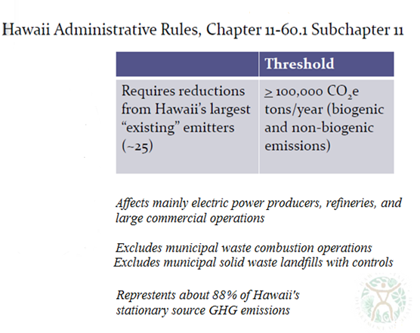
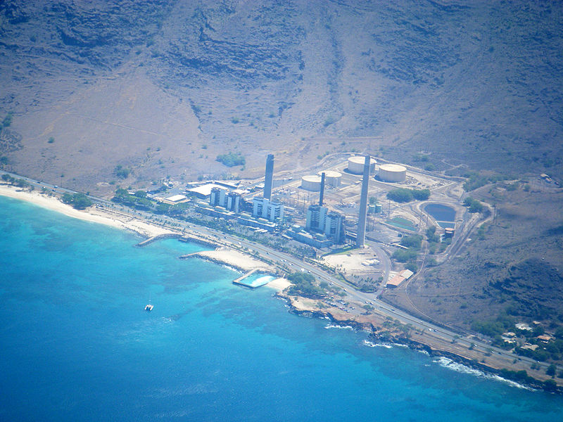
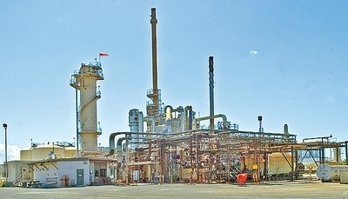
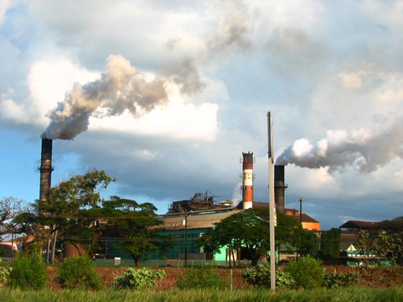
Stationary Sources
(18)
Notes:
http://en.wikipedia.org/wiki/File:HECO_West_Oahu.jpg#filelinks
http://the.honoluluadvertiser.com/article/2010/Jan/20/bz/hawaii1200326.htmlhttp://en.wikipedia.org/wiki/File:Puunene_mill.jpg

Slide 5
HAR 11-60.1-204(k)
GHG Rules
DOH must conduct annual evaluations to determine progress in achieving the statewide GHG emissions limit.
If DOH determines that the statewide GHG emissions limit is met before 2020, the GHG cap is no longer applicable to the affected facilities.
Notes:
State Measures: Measures that are adopted, implemented, and enforced as a matter of State law. Such measures are enforceable only per State law, and are not included as part of the federally enforceable State plan.
CPP was issued on August 3, 2015.
Hawaii, Alaska, Guam, and Puerto Rico were deferred from requirements of the CPP until CO2 performance goals are established for these regions.
Under the Clean Energy Incentive Program – EPA providing allowances equal to 300 million short tons for helping states meet CO2 performance goals.

Slide 6
ICF Incorporated, L.L.C
Statewide GHG Inventories
Provide three annual reports with:
1) Updated Statewide GHG emissions for prior
inventories (1990, 2007, & 2010);
2) Compile new 2015, 2016, and 2017 statewide
GHG inventories; and
3) GHG Projections for 2020 and 2025.
Evaluate EPA State Inventory and Projection Tool.
Notes:
State Measures: Measures that are adopted, implemented, and enforced as a matter of State law. Such measures are enforceable only per State law, and are not included as part of the federally enforceable State plan.
CPP was issued on August 3, 2015.
Hawaii, Alaska, Guam, and Puerto Rico were deferred from requirements of the CPP until CO2 performance goals are established for these regions.
Under the Clean Energy Incentive Program – EPA providing allowances equal to 300 million short tons for helping states meet CO2 performance goals.

Slide 7
Update Prior Statewide GHG Inventories
Update Prior GHG Inventories
Updated
Notes:
1990 GHG emissions have increased of about 3%.
2007 GHG emission have increased about 4%.
Aviation: Aviation is part of the transportation source category but wasn’t included because aviation is excluded from the statewide GHG emissions limit. In 2007 statewide GHG emissions were 4.8 million metric tons per year.

Slide 8
Where’s Program Now?
Status
Received GHG Emission Reduction Plans from 18 Affected Facilities.
DBEDT, DOT, and DOH are providing data to ICF for compiling statewide GHG emission inventories.
Initial annual report from ICF is expected early in 2018 that will Include:
1) New 2015 Statewide GHG Inventory;
2) Updated 1990, 2007, and 2010 GHG Inventories; and
3) Statewide GHG projections for 2020 and 2025.
Annual report will be reviewed by DOH and other state agencies prior to finalizing.
Notes:
State Measures: Measures that are adopted, implemented, and enforced as a matter of State law. Such measures are enforceable only per State law, and are not included as part of the federally enforceable State plan.
CPP was issued on August 3, 2015.
Hawaii, Alaska, Guam, and Puerto Rico were deferred from requirements of the CPP until CO2 performance goals are established for these regions.
Under the Clean Energy Incentive Program – EPA providing allowances equal to 300 million short tons for helping states meet CO2 performance goals.

Slide 9
Thank You
Conclusions
Conclusions
Statewide GHG emission inventories will be used to track progress in achieving Statewide GHG Reduction Goals.
Electric Power and Transportation Sectors are a large part of the Statewide GHG emissions.
Clean Air Branch
586-4200
919 Ala Moana Boulevard, Room 203
CAB Home Page: http://health.hawaii.gov/cab/

