Slide 1
@disasterdr
#beyondebola

Slide 2
Pandemic: Business and Workplace Impacts
Mark Keim, MD, MBA
CEO, DisasterDoc LLC
Senior Science Advisor, National Center for Disaster Medicine and Public Health
Disaster Medicine Faculty, Harvard Medical School
Adjunct Professor, Emory University

Slide 3
Which camp is at higher risk for cholera?
1
2

Slide 4
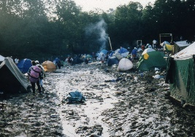
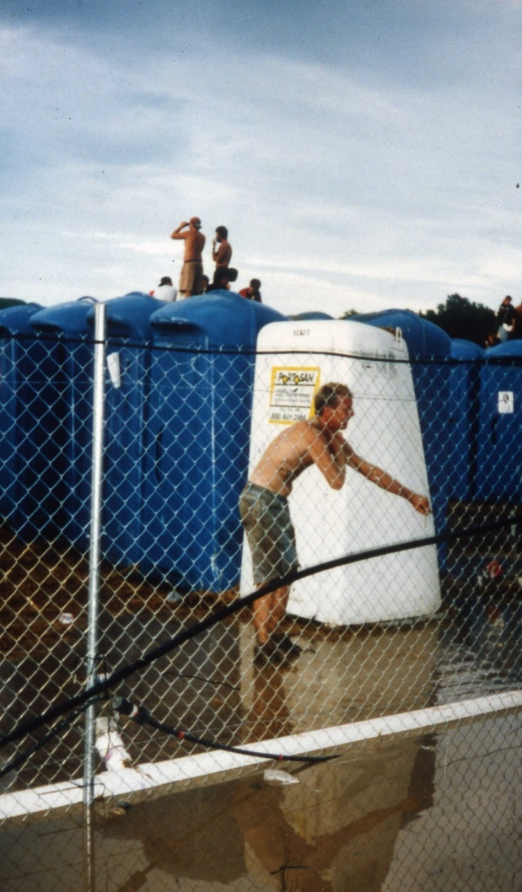

Slide 5
Use of the term “disruptor”
Term popularized by Clayton Christensen, Harvard Business School
Uprooting and changing how we do business day-to-day
Displaces an existing market, industry, or technology and produces something new and more efficient and worthwhile.
Both destructive and creative.

Slide 6
Emerging diseases can be global disruptors
Examples of business impacted by SARS
Estee Lauder
Atlanta Scientific
FedEx
Nortel
Las Vegas tourism
50% losses in 2nd quarter
AIG global insurance firm lost 30% of annual revenue

Slide 7
SARS impact on airlines
$6 billion in Asia Pacific
$1 billion in North America
SARS impact on transportation affected oil demand
300,000 barrels/day

Slide 8
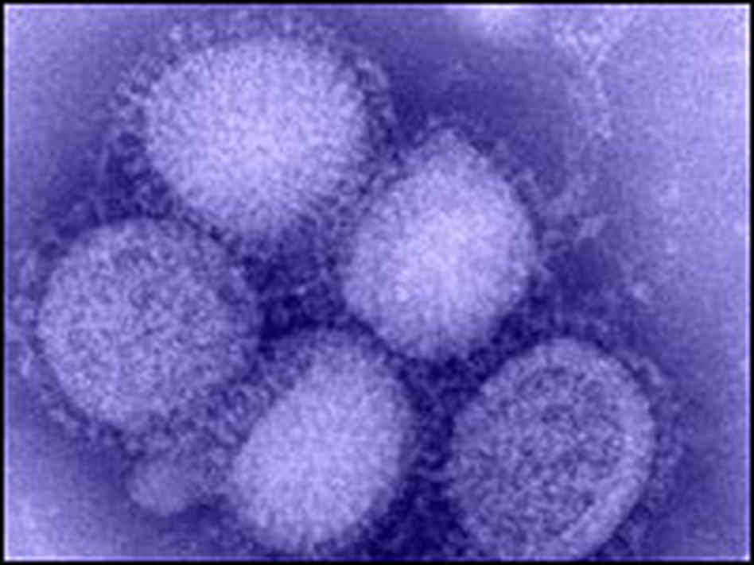
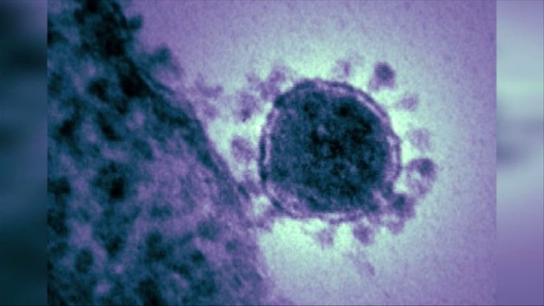
Current threats
Re-emerging Diseases
Emerging Diseases

Slide 9
What are emerging infectious diseases?
An infectious disease that has newly appeared in a population or that has been known for some time but is rapidly increasing in incidence or geographic range.
Examples
Ebola – 1976
HIV – 1983
Influenza H5N1 - 1997
Coronavirus
SARS – 2003
MERS- 2012
Zika - 2015

Slide 10
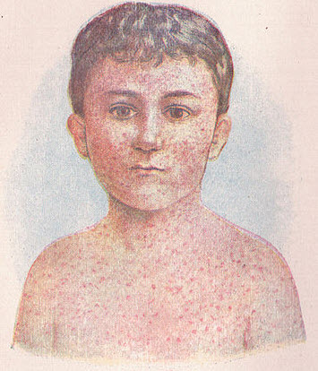
What are re-emerging infectious diseases?
Diseases that have been around for decades or centuries, but have come back in a different form or a different location
Examples:
Measles
Chikungunya

Slide 13
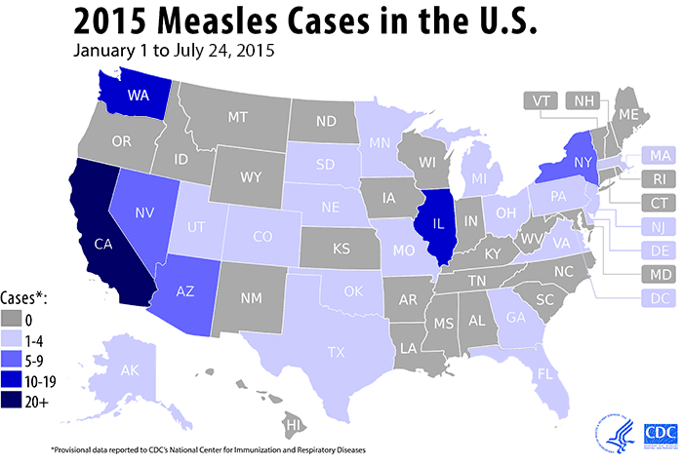
Re-emerging Measles in the US
Number of measles cases by year since 2010
Year Cases
2010 63
2011 220
2012 55
2013 187
2014 667
2015 188
2016 70
2017 28
183 cases in 24 states
Outbreak likely imported by overseas traveler that visited Disneyland (n=117)
Strain matches 2014 Philippines outbreak

Slide 14
Re-emerging measles in Europe
500 cases during January 2017
Endemic in 1/3 of Europe
Immunization coverage < 95%
Increases risk of large outbreaks
Current outbreaks in Italy and Romania

Slide 15
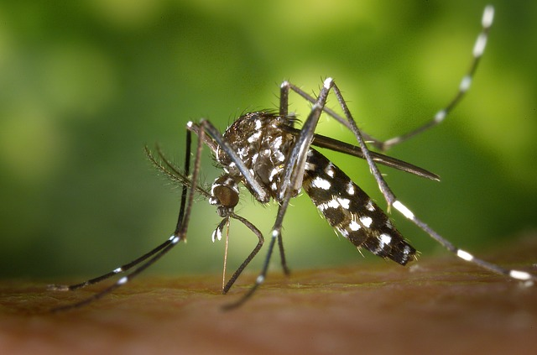
Re-emerging Chikungunya
Spread by mosquitoes
1.2 million cases 2013-15:
Caribbean islands
Latin America
USA
Canada
Cases halved in 2016

Slide 16
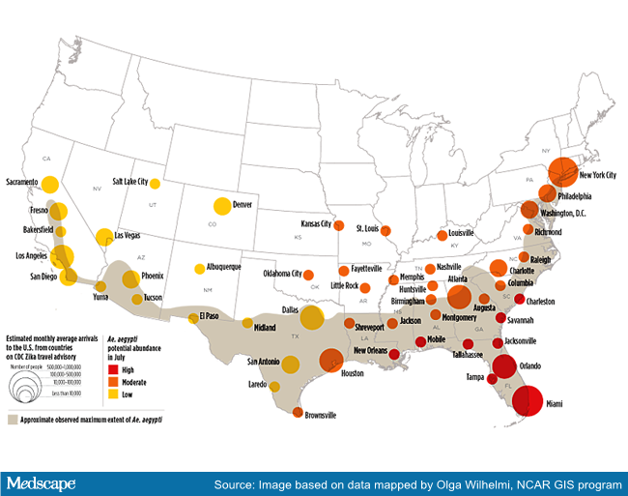
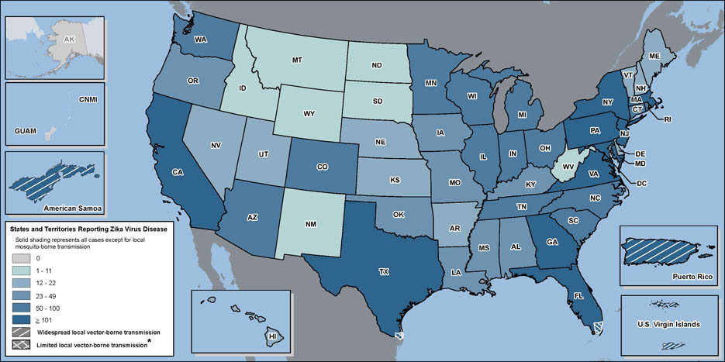
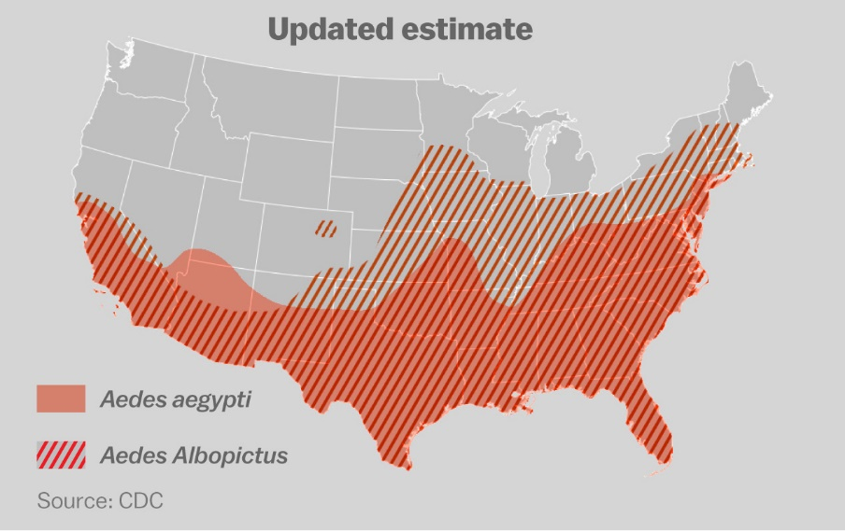
In CONUS, Zika risk depends on mosquito habitat and human travel patterns

Slide 17
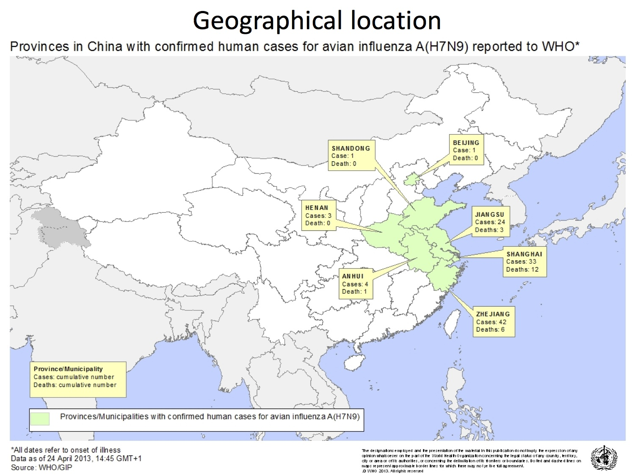
924 human cases on H7N9 Influenza as of January 2017
Seasonal peaks are growing
Limited human-human transmission

Slide 18
Global pandemic could trigger a world recession§
Decrease global economic output by 4.8%
Cost > $ 3 trillion
Annual seasonal flu losses
in the US
111 million lost workdays
$7 billion lost productivity
§ World Bank, 2008
Lee B, et al. Vaccine.
2010 28(37): 5952–5959.
@disasterdr

Slide 19
WHO pandemic alert phases
Phases 1-3
Mostly animals
Post peak
Possibly recurrent events
Post pandemic
Disease at seasonal levels
Phase 4
Phases 5-6
Few humans
Sustained human-human transmission
Pandemic
Widespread human infection
Preparedness
Mitigation
Response
Recovery
You are here

Slide 20
The cost-effectiveness of employer-sponsored vaccination
Employer-sponsored vaccination was cost-saving for the median wage
It was almost cost-neutral for low-paid occupations, and a clear benefit for high-paid ones.
Lee B, et al. Vaccine. 2010 28(37): 5952–5959.

Slide 21
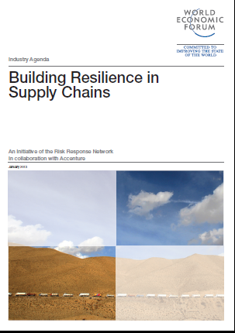
Emerging diseases threaten global supply chains
Significant supply chain disruptions reduce the share price of affected companies by as much as 7% on average §
80% of companies worldwide see better protection of supply chains as a priority §
§Accenture, World Economic Forum: Davos 2013

Slide 22
Hard lessons about supply chain sensitivity
25 most costly insured catastrophes have occurred in the past 40 years, two-thirds since 2001§
85% of companies reported at least one supply chain disruption in 2011 with about 50 percent facing more than one disruption †
Yet only 8% of companies said they ask to see their suppliers’ business continuity plans
§ 2012 World Economic Forum
† Zurich Financial Services

Slide 23
EBOLA

Slide 24
Economic impact in Ebola-affected nations (% change in GDP 2014-15)
Sierra Leone
Liberia
Guinea

Slide 25
Factors affecting economic losses
Mobility restrictions, trade and transport
* Border closures (20-75% of GDP)
Agriculture
* Disruption of planting season
* 150% increase in food prices
* Doubling of inflation rate
Mining
* Scaling down
Ore mining: China Union and Arcelor Mittal
Petroleum: Canadian Overseas Petroleum
Financial sector
* Liquidity issues as large depositors withdraw
Tourism
* 5 airlines ban flights

Slide 26
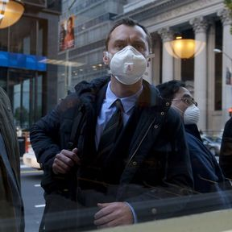
What is really driving the loss?
“…not as a result of the direct costs
…(i.e. “mortality, morbidity, caregiving, and associated losses to working days”)…
but rather those resulting from aversion behavior driven by fear of contagion”
World Bank, 2015

Slide 27
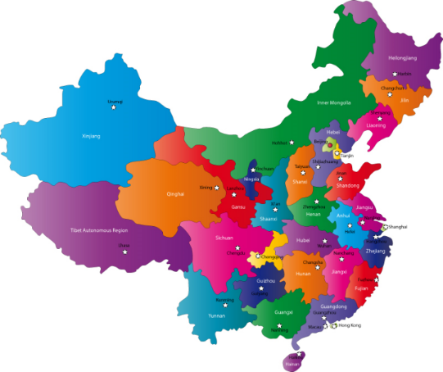
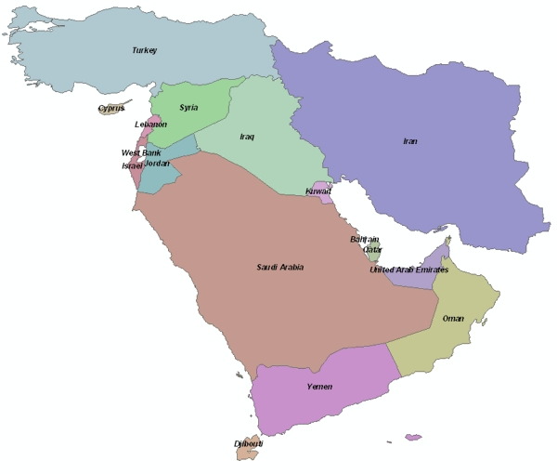
New (emerging) corona viruses
SARS CoV – 2003
>8,000 cases
775 deaths, 50% elderly
MERS-CoV – 2012-2017
>1936 cases
>690 deaths (36%)

Slide 28
2015 Korea MERS Outbreak
36 deaths
Requested WHO assistance
>2,500 persons quarantined
>1,800 schools closed nationwide

Slide 29
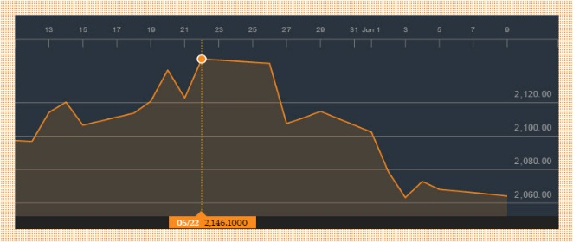
Korea MERS
First case:
68 yr-old national of the Republic of Korea
History of recent travel to 4 countries in the Middle East
Other cases
Family members
Hospital-acquired
* Patients
* Caregivers
Korea reports more cases
Korea reports MERS case #1
Korea Stock Exchange (KOSPI) Index

Slide 30
“Disruptor Dashboard”
SARS
MERS CoV
Chikungunya
Influenza
Zika
Measles
Ebola

Slide 31
Closing advice: Beware the “squeaky wheel”

Slide 33
This lecture is available for FREE download at: disasterdocacademy.com

