Slide 1
eWIC: From the WIC Vendor Perspective
A Presentation to Hawaii WIC Vendors

Slide 2
Introduction
The Hawaii WIC Program is in the process of planning for a transition to EBT, also known as eWIC, and has contracted with MAXIMUS for planning support.
About MAXIMUS
Provides eWIC planning and technical assistance
More than 15 years experience with eWIC
Provided planning support to more than 30 WIC State Agencies
MAXIMUS’ role in the Hawaii eWIC project
Assisting in planning and analysis activities for eWIC
Supporting development of required documentation for USDA and eWIC procurement
Providing technical assistance as needed

Slide 3
Purpose of this Presentation
eWIC is coming, there is a mandate that all WIC State Agencies convert to eWIC issuance by 2020
HI WIC is currently in the planning phase of the eWIC project
This presentation provides high level information for stores about how eWIC works

Slide 4
Overview
Background and History
Basics
In the Store
Benefits and Challenges
Next Steps

Slide 5
eWIC Background & History

Slide 6
eWIC History
Year(s) | Milestone
1995 | First smartcard eWIC pilot in Wyoming
2002 | Wyoming is first state-wide smartcard eWIC system
2004-09 | Texas and New Mexico rollout smartcard eWIC
2005 | Online eWIC pilots implemented Michigan and Washington
2006 | Kentucky begins development of an online system
2009 | Michigan, first state-wide online WIC EBT system
2010 | Congress mandates eWIC by 2020
Notes:
There has been more than 20 years of eWIC activity. The majority of the implementations have occurred in the last 10 years.

Slide 7
State Agencies Operating eWIC
14 State Agencies Online Nationwide
Chickasaw Nation
Florida
Kentucky
Massachusetts
Michigan
Nevada
Oregon
Virginia
Wisconsin
West Virginia
Indiana (Pilot)
Iowa (Pilot)
Oklahoma (Pilot)
Vermont (Pilot)

Slide 8
eWIC Basics

Slide 9
EBT Technology
Uses magnetic stripe cards to access account information on the eWIC system
Like debit or SNAP/cash EBT
Transactions occur live between the retail system and the eWIC system
The eWIC system calculates the payment amount based on transactions that occur during a set 24 hour timeframe

Slide 10
Paper vs. eWIC: Issuance
Paper System
Food items, sizes and quantities are printed on a paper check
Checks are issued to each participant within a household
eWIC
Food items are represented in an account, using a coding system of food categories, and total amount available for each food category
Participant benefits are combined into one household account
=
03,000
=
52,000
02,000
Notes:
Benefit issuance in an eWIC system is different from in the current environment. In a paper system, foods are represented by what is printed on a paper check, but in eWIC that information is represented by a computerized code than can be understood by the WIC information system, the eWIC host system, and the retail systems.
Another key difference between the issuance processes is that within a paper environment, checks are issued individually to each participant meaning that a household will receive multiple checks for each member of the household that they will have to maintain and use over the next few months. With eWIC, all participants in a household are still issued benefits individually, but the benefits are combined or aggregated into one account for the household. This means that the household will receive one card that can been used to access all members’ benefits.

Slide 11
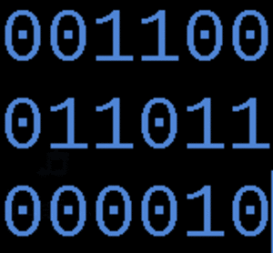
Food Categorization
Foods are represented by codes for:
Category (Cat)
Subcategory (Subcat)
Cat is the high level food group, examples:
Low Fat/Fat Free Milk
Legumes (Beans)
Subcat is the specific food within the Cat group, examples:
Skim milk; powdered milk; lactose free milk
Peanut butter; dry beans/peas; canned beans
Notes:
In order for the systems to understand the benefit issuance information, a coding system has been developed. The coding system takes the information previously printed on checks and converts it into categories and subcategories.
A category (or cat), is the high level food group. These are things like whole milk, low fat/fat free milk, cheese, eggs, legumes (beans/peas/peanut butter), infant formula, cereal, etc.
A subcategory (or subcat) is the next level down which represents the specific types of food in a cat. For example in low fat/fat free milk there are subcats for 1%, skim, lactose free, powdered, evaporated, etc. Similarly the cat for legumes breaks down into the subcats of peanut butter, dried beans/peas, and canned beans.

Slide 12
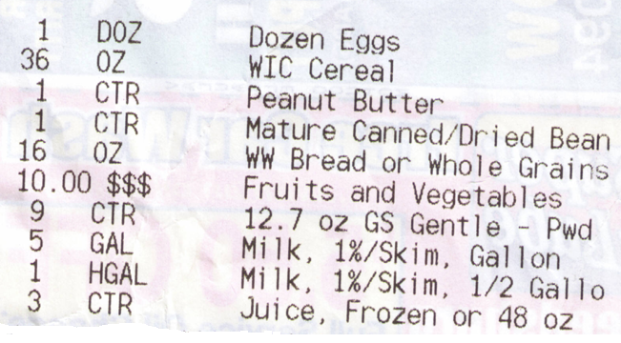
Benefit Balance
A WIC benefit balance is a combination of food balances. For example:
Notes:
Unlike a SNAP balance which is a single dollar amount, a WIC balance is actually a series of sub-balances by subcat. This slide provides an example of how a WIC balance might appear.

Slide 13
Food Categorization
Food Item | Cat | Subcat | Description | Unit of Measure
Cheese | 02 | 000 | Cheese all types | Pound
 |  | 001 | Cheese | Pound
 |  | 002 | Reduced Fat Cheese | Pound
 |  | 003 | Low Sodium Cheese | Pound
 |  | 004 | Tofu | Pound
Eggs | 03 | 000 | Eggs all types | Dozen
 |  | 001 | Fresh eggs in Dozen Cartons | Dozen
Cereal | 05 | 000 | Cereal all types | Ounce
 |  | 001 | Cereal - hot and cold | Ounce
Legumes/ Beans | 06 | 000 | Legumes/Beans all types | Cont
 |  | 001 | Peanut Butter 18 oz | Cont
 |  | 002 | Dry or Can Beans/Peas 16 oz | Cont
 |  | 003 | Canned Beans (4 cans = 1 Container) | Cont
This example is from the National Food Category / Subcategory List. Specific offerings/sizes may vary from state to state.
Notes:
USDA FNS maintains a standard list of cats/subcats for use by WIC state agencies. The table in this slide provides a snapshot of the list. The full list can be found on the USDA FNS web site at http://www.fns.usda.gov/apd/wic-ebt-document-library . States are encouraged to use the standard list, but are able to make some state specific modifications to address program differences or cost containment methodologies.

Slide 14
Access to Balance Information
eWIC system always has the current balance
Balance can be obtained through:
Retail or clinic balance inquiry
Automated phone line
Web portal
Phone app
Text messaging
Transaction data available immediately as soon as transaction is processed

Slide 15
Fruit & Vegetables
Fruit & Vegetable Check in eWIC called Fruit & Vegetable Benefits (FVB)
FVBs are not treated as different, but as a Food Category
Value represented in dollars and cents
If FVB not used at one time, remaining FVB are available through the end of the issuance period
Notes:
For the purchase of fruits and vegetables, participants will still receive a benefit representing a dollar value as they do in the paper system. In eWIC, rather than referring to this as a fruit and vegetable check, it is call a fruit and vegetable benefit (FVB). This benefit is treated like all other food benefits, it is issued based on a cat/subcat and unit of measure which in this case is dollars and cents.

Slide 16
Fruit & Vegetable Balance
Below is an example of how the FVB will appear in an eWIC balance

Slide 17
Benefit Aggregation
Benefits for participants within a household are combined into a single household account.
The benefits of all participants in the household can be accessed from one card.
Requires that all benefits issued in a household/family have the same last date to use.
Families experience the ability to better manage their benefits.
Notes:
As mentioned in the previous slide, under eWIC benefits among individuals within a household are combined into a single account. This slide addresses the benefits and requirements associated with benefit aggregation.
The reason it is necessary for benefits of all household members to be have the same end date is to reduce confusion about the account balance. If members benefits expired and new ones loaded at different times during the month it would make it much more difficult for the household to keep track of their balance.

Slide 18
Paper vs. eWIC: Redemption
Paper WIC Redemption
eWIC Redemption
Participants must sign
WIC items are separated
Cashier must:
Know WIC items
Check valid use dates
Determine if items can be purchased
Record purchase amount
Vendor must write the vendor number on the checks and deposit checks in bank.
Cardholders use a PIN
WIC items may not have to be separated (depends on store system)
The system determines items that can be purchased
Automatic payment
Notes:
When we talk about redemption in eWIC, it is always helpful to compare to the current paper environment. In this slide, the differences between the two approaches are identified.
As you will see, the paper environment relies on the casher to validate the transaction information, while in the eWIC environment this is handled by the eWIC system.
It is important to note that while the system will take over this responsibility, the cashiers should still be knowledgeable about the WIC food list in order to troubleshoot issues or explain to customers why a product they are trying to buy is not being paid by their eWIC card.

Slide 19
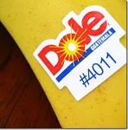
UPCs, PLUs and APLs
All UPCs and PLUs for approved WIC items are distributed to retail systems in the Approved Product List (APL) file.
UPCs and PLUs are associated with Categories/ Subcategories in the APL
Retail systems download the APL everyday to process new or updated items
The APL is used as part of the purchase along with the balance to identify what can be purchased by the cardholder
Notes:
As we discussed with issuance, for eWIC redemption we had to find a way to code the food items so that they could be understood by the systems involved. The same cat/subcat system is used to do this.
Every WIC state agency maintains a food list. When they move into eWIC they must collect all of the UPCs associated with the products on that food list and code associated them with an eWIC cat, subcat and unit of measure as well assign a quantity. This data is added to an electronic file called the approved products list or APL. The data in this file is maintained by the state agency and made available to vendors by the eWIC system for download. Retail systems use this file as part of the transaction to identify WIC authorized vs. non-WIC items. The file also contains all of the allowed PLUs for WIC fruits and vegetables.

Slide 20
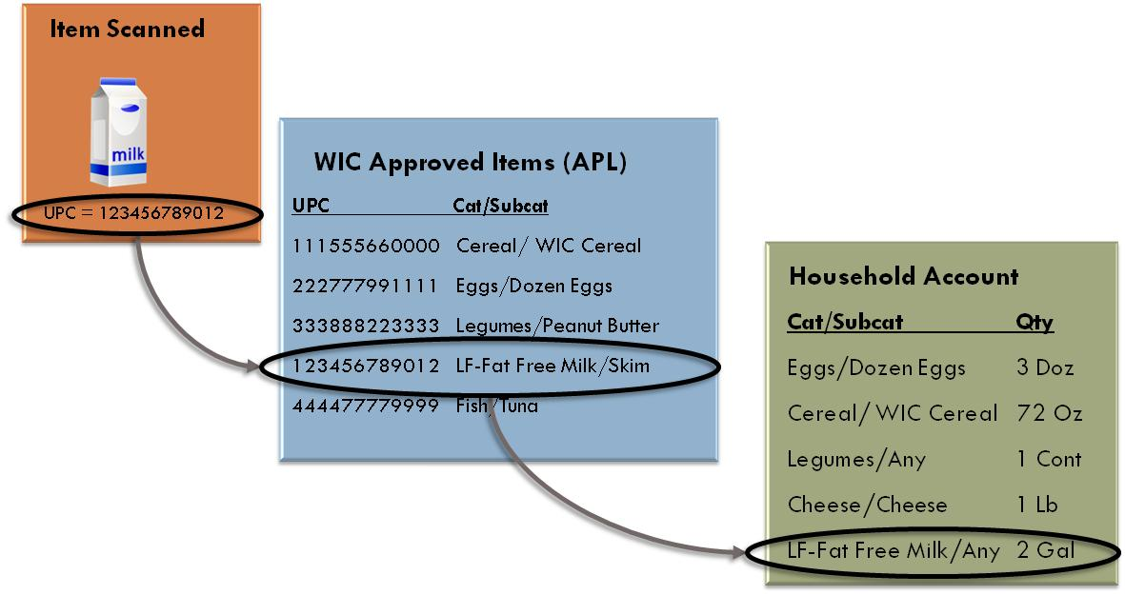
How UPCs are Used in Redemption

Slide 21
eWIC in the Store
21

Slide 22
Retail Requirements for eWIC
The retail system must be able to:
Use the authorized products list (APL) to identify WIC products based on a UPC or PLU during a purchase
Use the account balance in determining items that can be purchased in the eWIC transaction
Electronically submit eWIC transactions
The retail system must be certified
Vendor must maintain a bank account for the ACH transaction for eWIC settlement payments
Notes:
In order for a vendor to accept an eWIC card, they must have a retail system that can process eWIC transactions. This slide identifies the requirements for the vendor and their system.

Slide 23
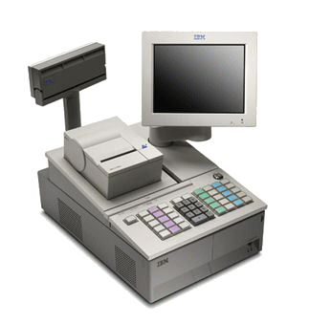
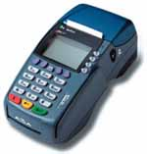
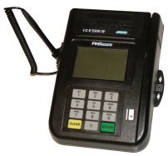
Retail System Alternatives
Integrated Cash Register
Stand-Beside Point-of-Sale
Typical for chain and multi-lane or vendors with cash registers that are eWIC ready, but encouraged for all
Operate like all other tender types
Typically separate equipment not required
Streamlined approach to eWIC
Separate from store cash register system
Double scan with key entered price and discount amounts
Daily totals are reported separately, payment separate from credit and debit
Can work over dial-up, or high speed internet connection

Slide 24
Integrated Systems/Software
IBM SurePOS ACE
IBM 4680-4690 Supermarket Application
LOC Software Store Management Suite (SMS)
Market Master
NCR Advanced Checkout Solution (ACS)
NCR Advanced Checkout Solution / Independent Retailer (ACS/IR)
Retalix StoreLine
Retalix R10
RORC viPOS
StoreNext ISS45 V7
StoreNext ISS45 V8
StoreNext ScanMaster V2
Please note this is not an all inclusive list
Notes:
The list on this slide is a brief listing of the retail systems that have already been integrated for eWIC. This is not an exhaustive list, there may be additional systems that have been integrated that have not been captured here.

Slide 25
eWIC Retail Transactions
Balance Inquiry
Purchase Transaction
Void/Reversal

Slide 26
Purchase Transaction (Part 1)
Card is swiped and cardholder enters their PIN
System validates the card and PIN
Balance obtained from the eWIC system
Each food item that has been scanned is:
Compared to APL maintained locally to determine if it is an allowable WIC item
Compared to cardholder balance to determine if there is sufficient balance to purchase

Slide 27
Purchase Transaction (Part 2)
Retail system captures data including item prices and discounts to send to eWIC system
The household’s balance is reduced by the amounts (qty) of items being purchased
If an item price exceeds the Not To Exceed (NTE) amount, the item is paid up to the NTE and total payment amount adjusted
The eWIC system provides the retail system with approval, paid amount
A receipt showing purchase details, the new food balance, and last date to spend for remaining benefits

Slide 28
Sample Receipts

Slide 29
eWIC Benefits & Challenges

Slide 30
Benefits and Challenges
There are many benefits to implementing eWIC, but there are always challenges when implementing a new system or process
The experiences in other states have shown that the benefits of eWIC outweigh challenges
When asked, the majority of stores would rather stay with eWIC than return to paper

Slide 31
Vendors
Benefits
Challenges
Checkout processes more efficient (no signing, dating, etc)
Transactions are less error prone, do not rely on cashier to validate
Easier and faster to receive payment, vendors are paid within two business days
Vendors experience back office labor savings, no longer necessary to count and deposit or process checks
Issues related to rejected checks are eliminated
Updates to cash register systems
eWIC is different from other tenders, additional training needed
When items are expected to be paid by eWIC are not, troubleshooting is not always straight forward
Stores with stand-beside equipment require double scanning / price entry

Slide 32
Participants
Benefits
Challenges
Less stigma than paper benefits, similar to a debit card transaction
PIN provides security, validates transaction
All benefits in one account/card improves benefit management
Improved shopping experience, participants can buy the quantities they need, rather than having to use the whole check at once
Must keep track of benefit balance
Different store cash register systems have different purchase flows that participants will need to understand
Important to know current balance and purchase correct WIC foods because they may not know an item will not be paid by eWIC until end of transaction
May have bought unauthorized items previously that they think are WIC items

Slide 33
Next Steps

Slide 34
eWIC Planning Project Tasks
Stakeholder engagement planning
Cost analysis
Alternative analysis and recommendations
Federally required implementation plan document
eWIC system contracting activities

Slide 35
WIC Vendor Survey
35
The State will be requesting that vendors complete a survey to capture information used in eWIC planning activities
Your response to the survey is important and will help in accurately developing eWIC implementation plans

Slide 36
Timeline
The planning phase will be completed by Spring 2017
Planning activities will determine the eWIC implementation schedule
After planning is complete, next steps include:
Procure an eWIC service provider
Prepare for implementation
Pilot eWIC followed by statewide rollout

Slide 37
Questions?
37
If you have more questions, please email them to:
Timothy.freeman@doh.hawaii.gov

